Slide 1
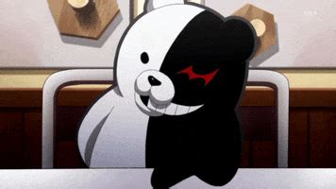
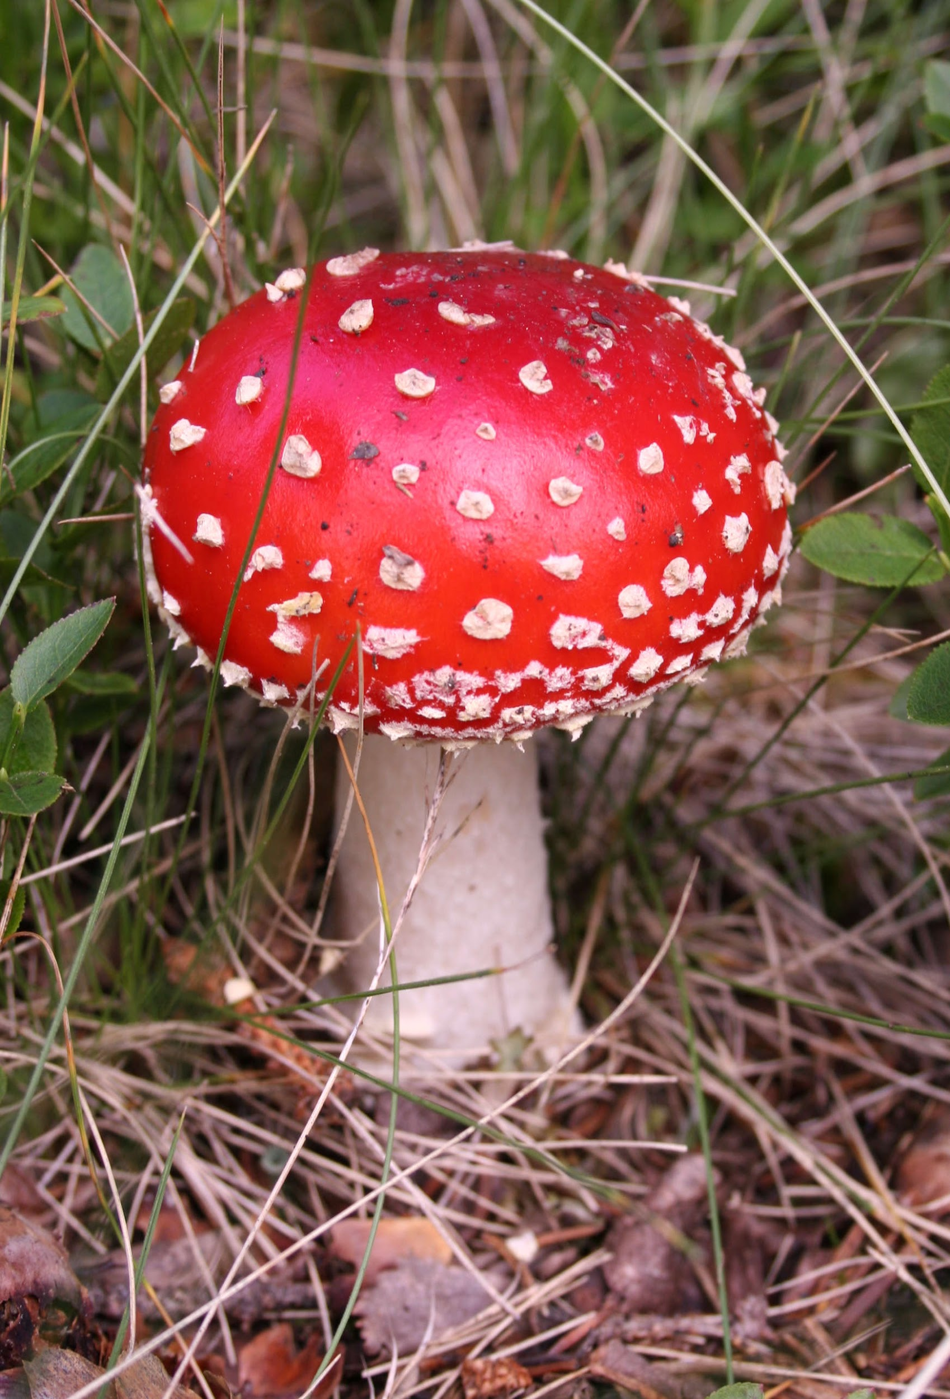
All About Me
By:
Jayna

Slide 2

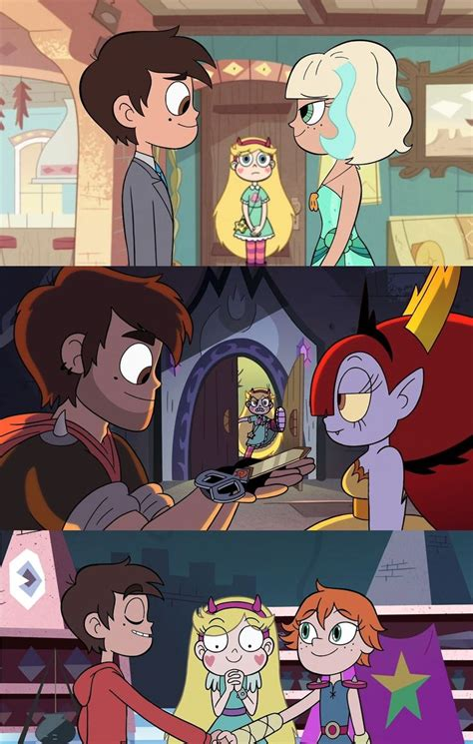
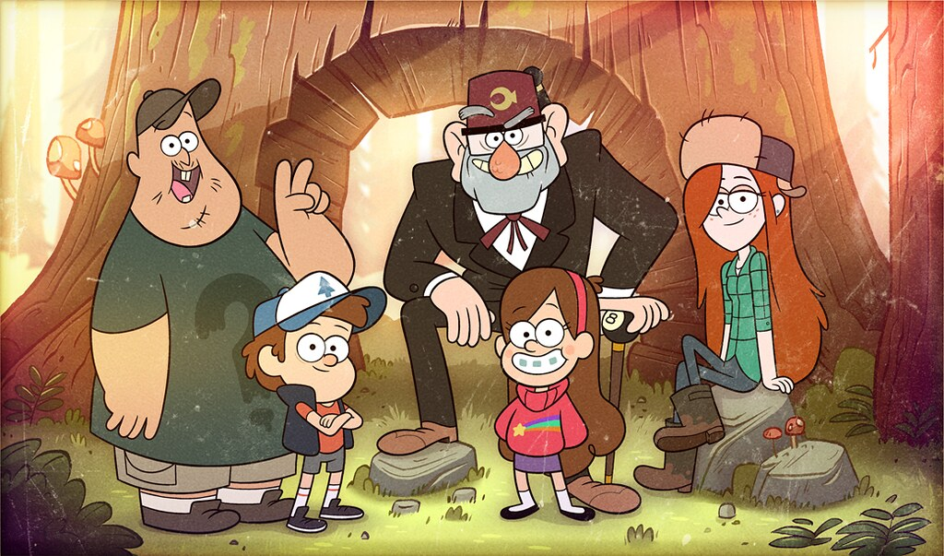
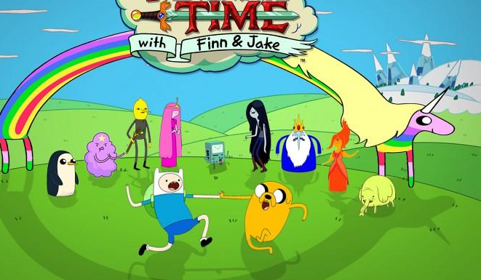
My favorite cartoons
I really like stuff like Star vs the forces of evil, Gravity falls, Adventure Time, and Regular show

Slide 3



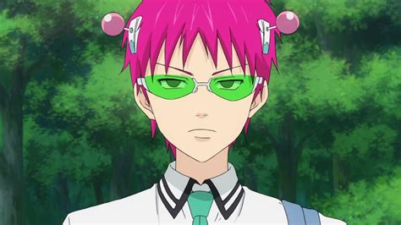
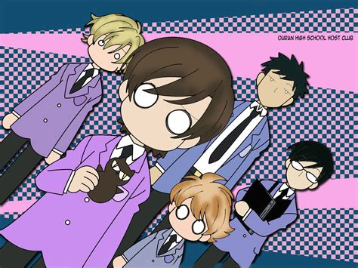
My favorite animes
I don’t watch too many of these I don’t think, but a few of my favorites are Saiki K, Danganronpa, Mha, School-live, Sk8 The Infinity, Ouran Highschool Host Club, A silent voice, demon slayer, and Maid-Sama.

Slide 4
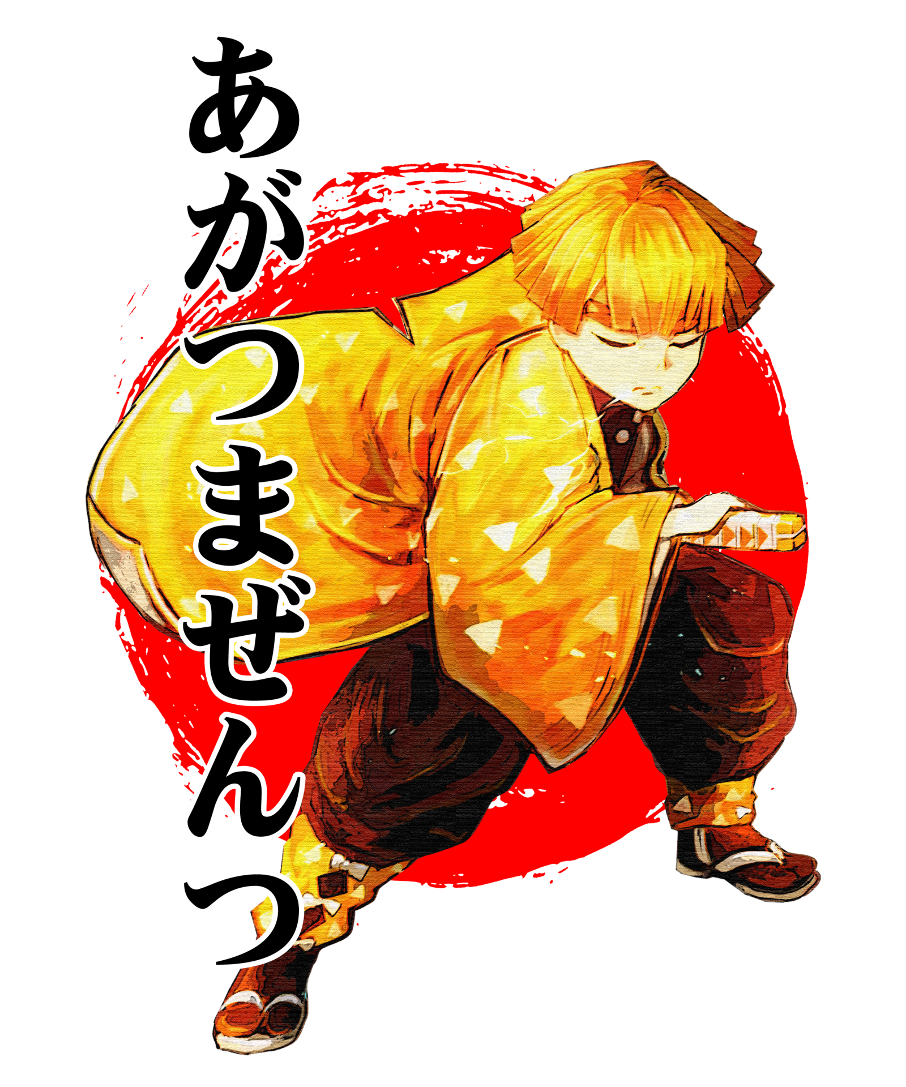
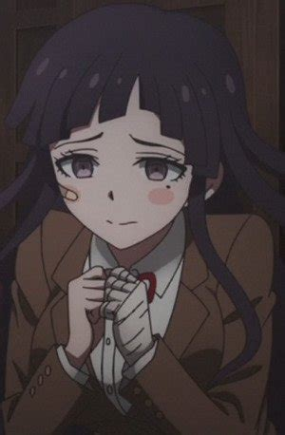
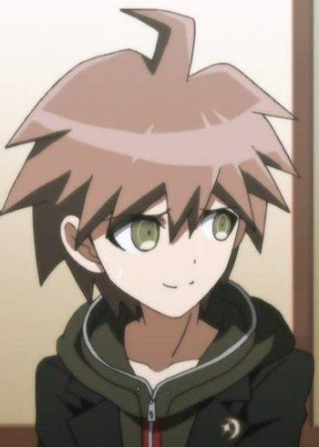
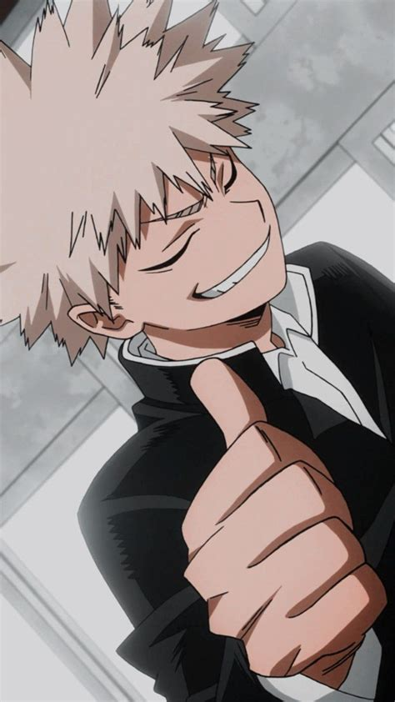
Just more about myself
I use all pronouns
Nicknames
My kin list
My height is 5’7 exactly, though I choose to believe I’m 5’8.
Jay
Tree
Tall kid
Byakuya Togami
Kiyotaka Ishimaru
Mikan Tsumiki
Kazuichi Soda
Nagito Komeada
K1B0
Shuichi Saihara
Toritsuka Reita
Kaidou Shun
Katsuki Bakugo
Tamaki Suo
Tamaki Amajiki
Marceline
Marcos Diaz
Dipper Pines
Shouya Ishima
Zenistu
My favorite anime characters are Makoto Naegi, Ibuki Mioda, Aren Kuboyasu Kokichi Ouma, Ejirou Kirishima, and Rantaro Amami.
My birthday is Nov 23, 2008.
All
Pronouns
Comfort Character

Slide 5

Interests/hobbies
I enjoy drawing and tend to draw mushrooms a lot. I draw people as well. I like making new people out of random and give them personalities and looks. I try to keep it simple a lot due to motivation and art block.
I have a notebook for only drawing as well. It has a lot of random things.

Slide 6
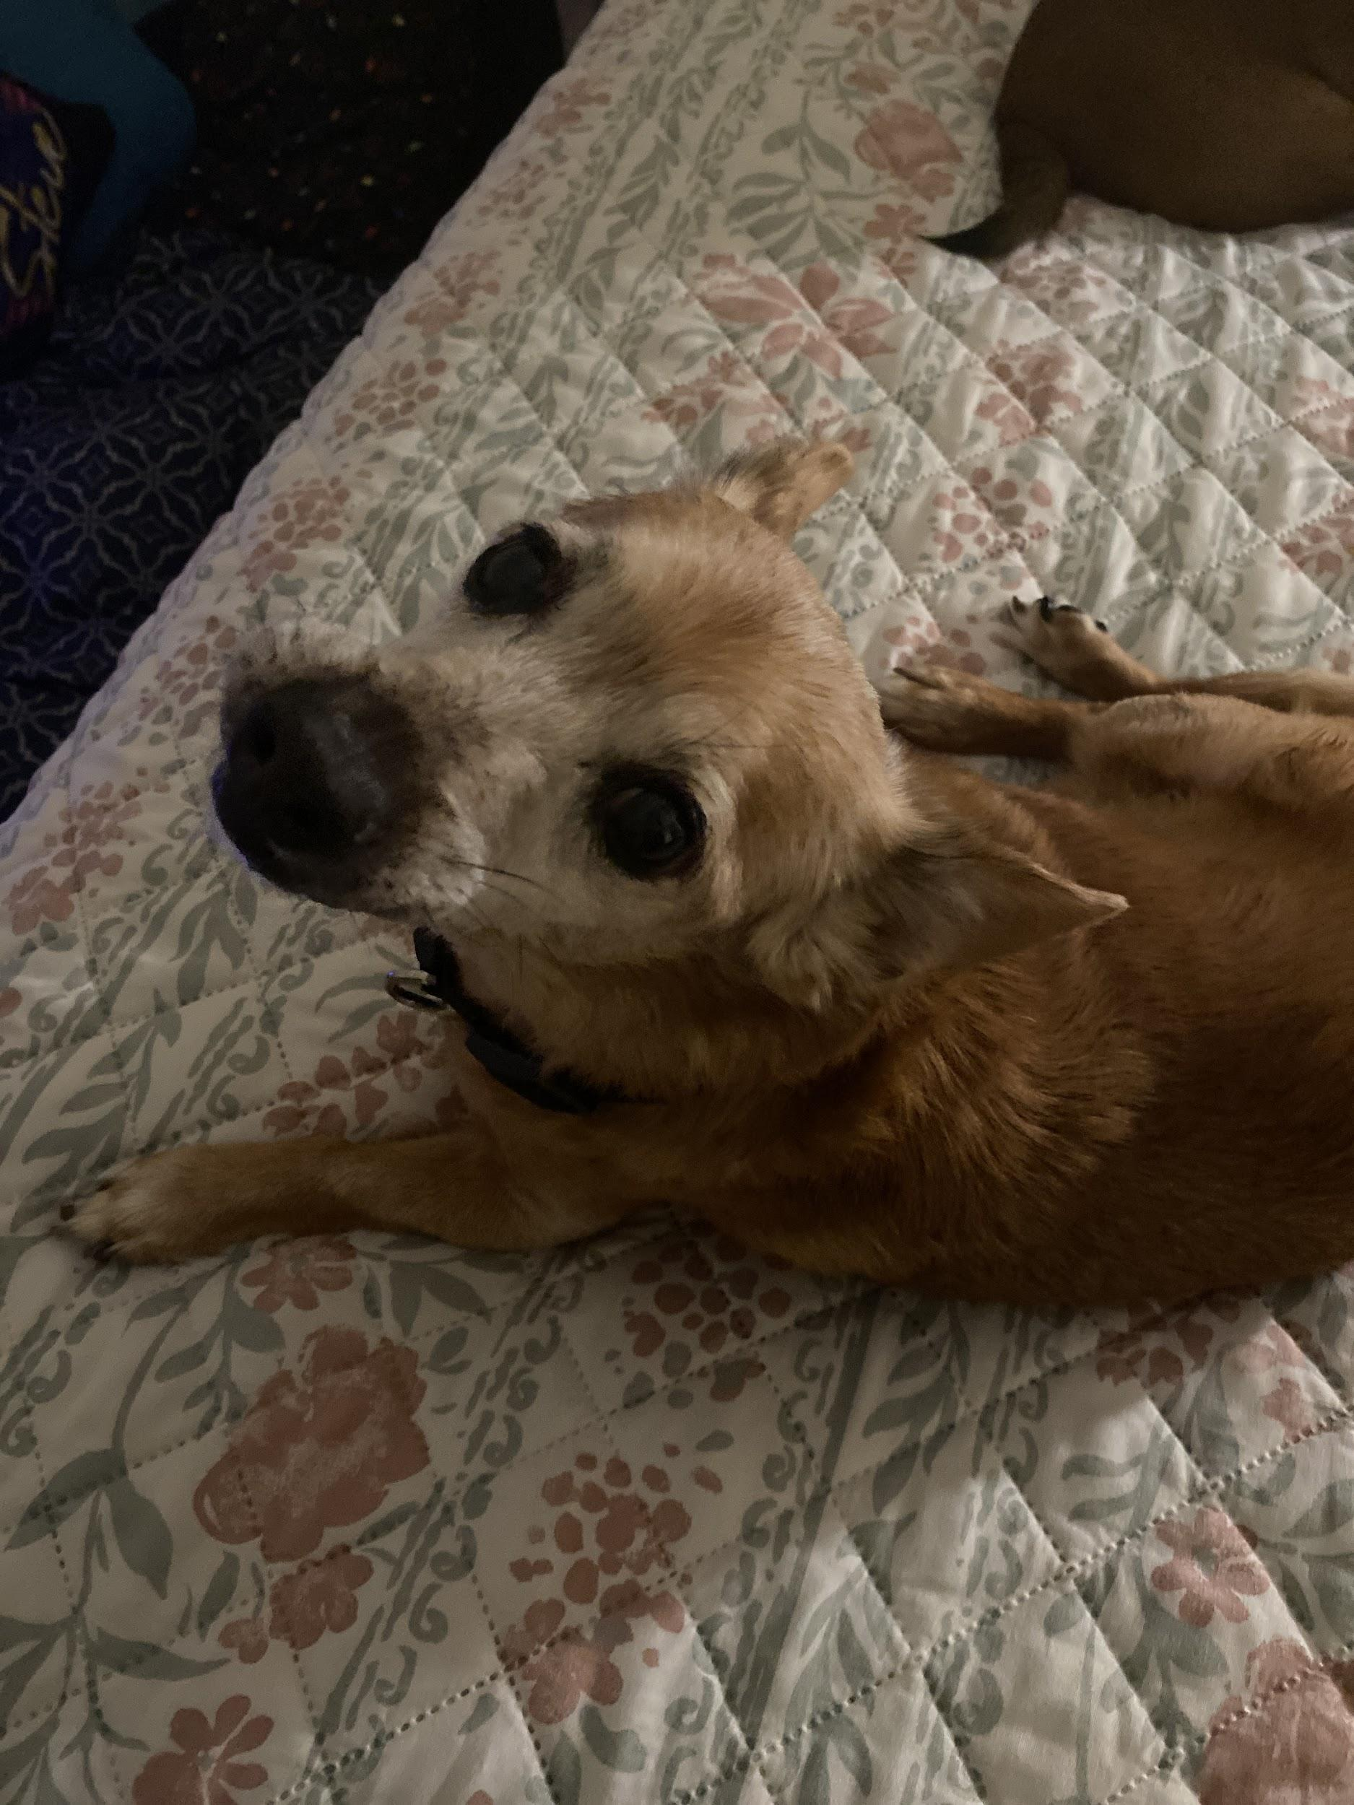
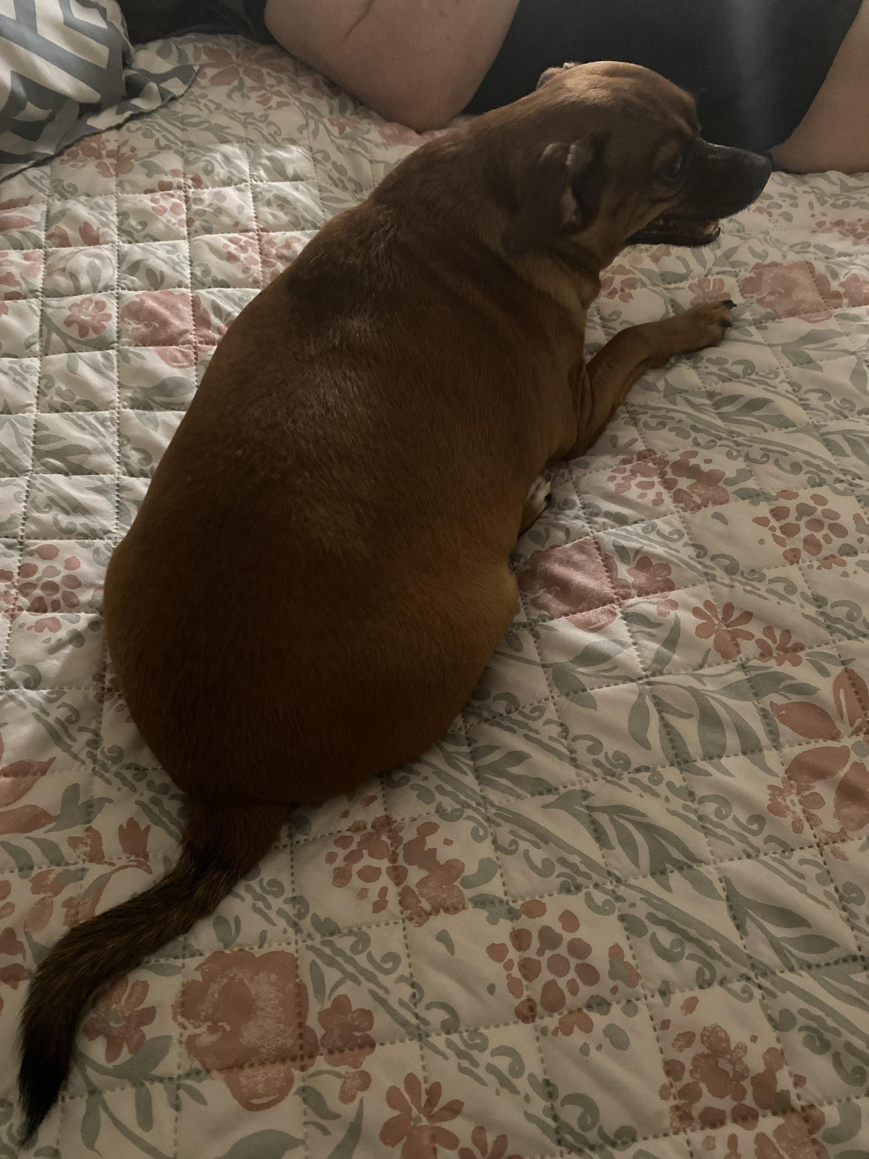
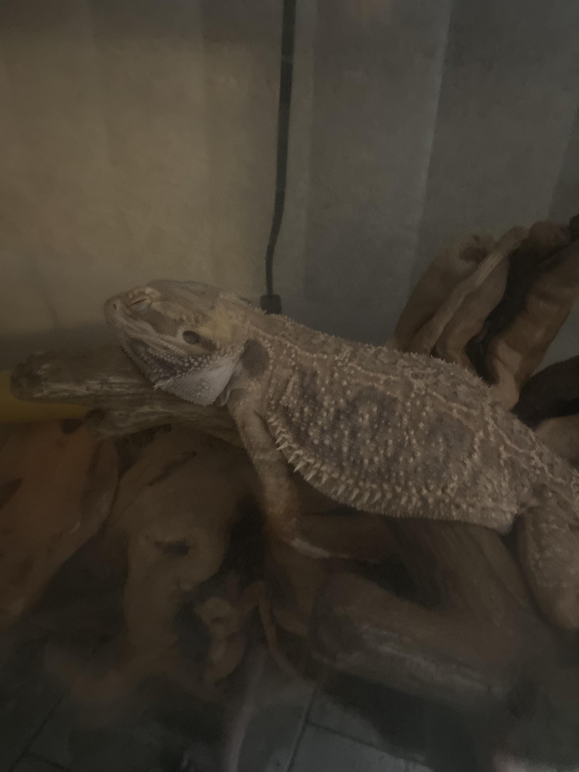
My pets
Snoop
Rufus
Mushu

Slide 7
My family
I have two siblings. I have one brother that is 7, and a sister that is 8. My sister has down syndrome
I have split parents, but that happened about 2 years ago. Now, we visit my dad on weekends and my mom weekdays.
My mother is 31, my father is 35(?)
My mom comes from an asian family, and my dad is portuguese

Slide 8
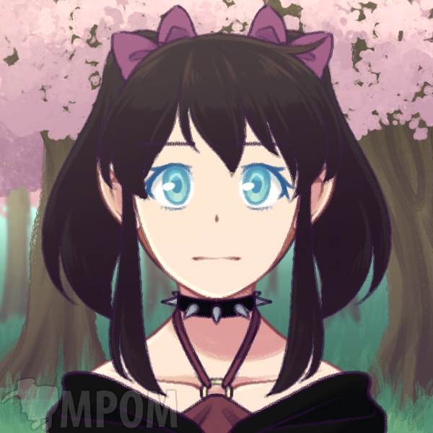
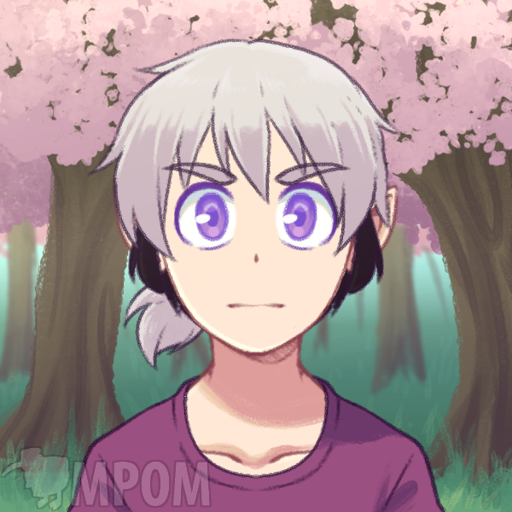
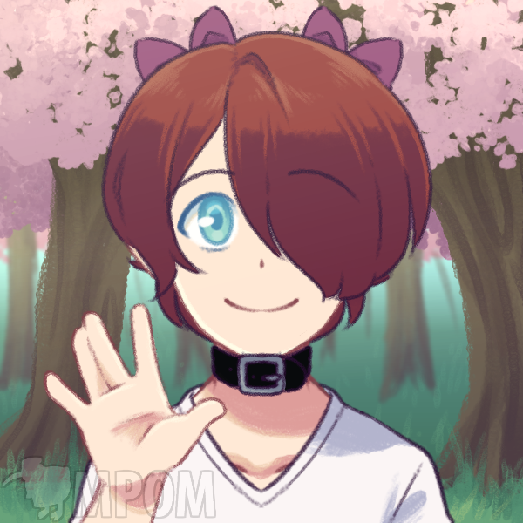
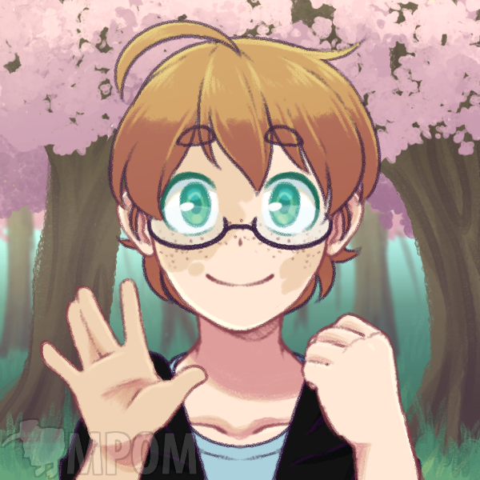
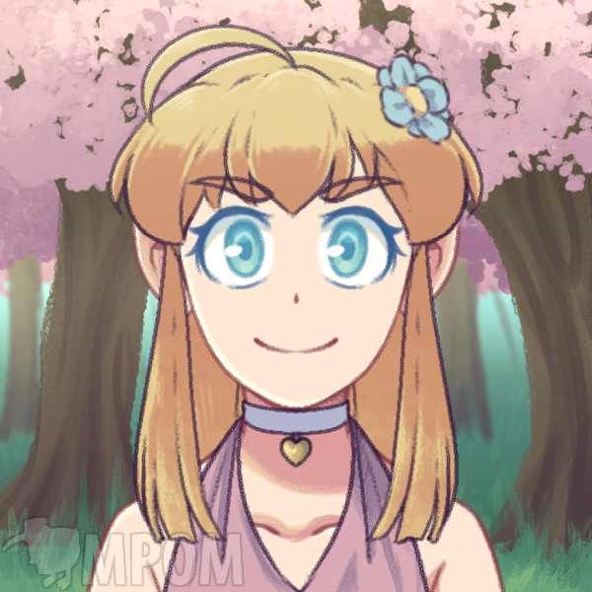
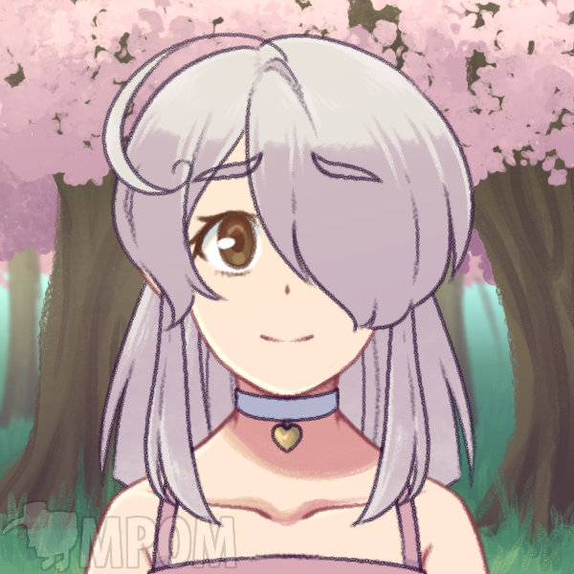
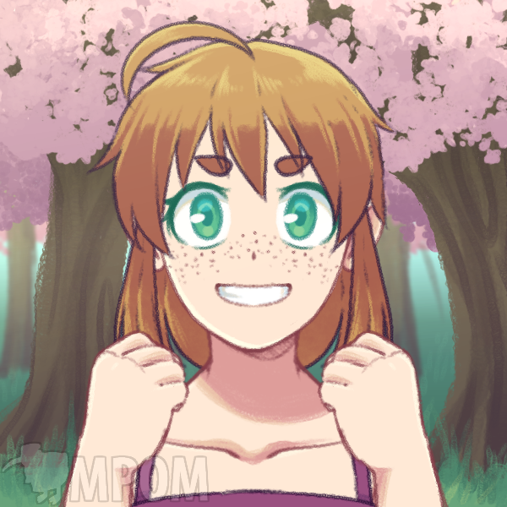
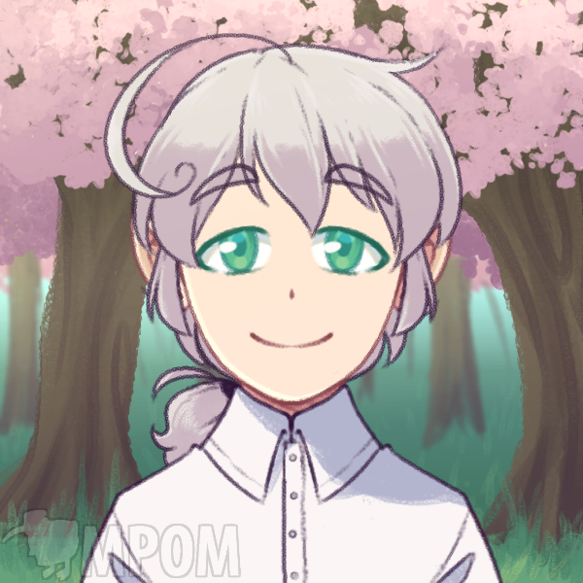
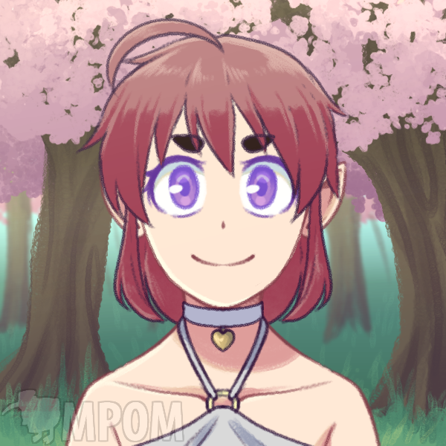
Some characters I’ve made
These are in picrew.me because I didn’t want to draw

Slide 9
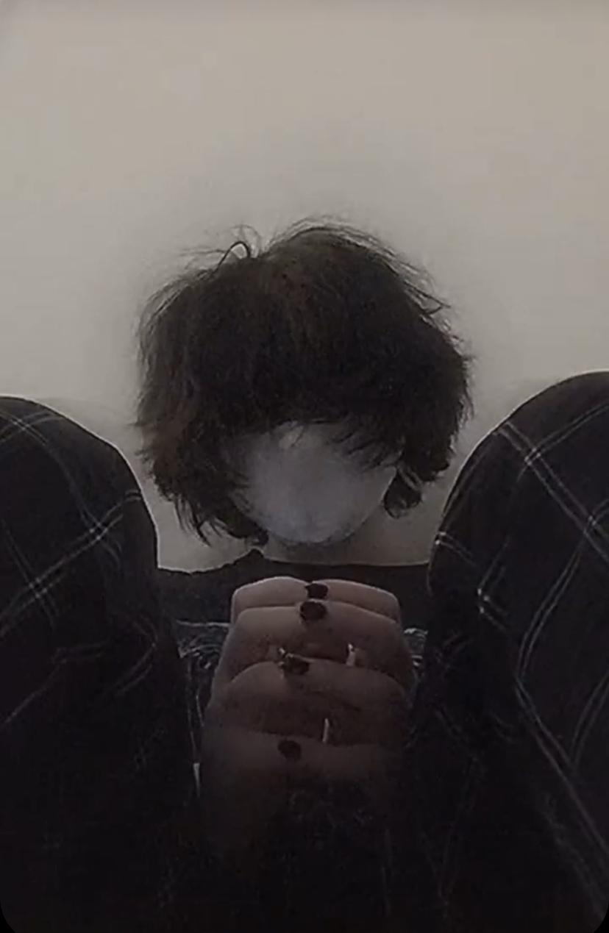
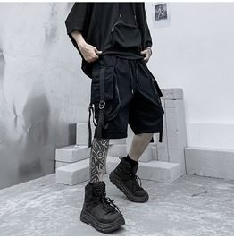
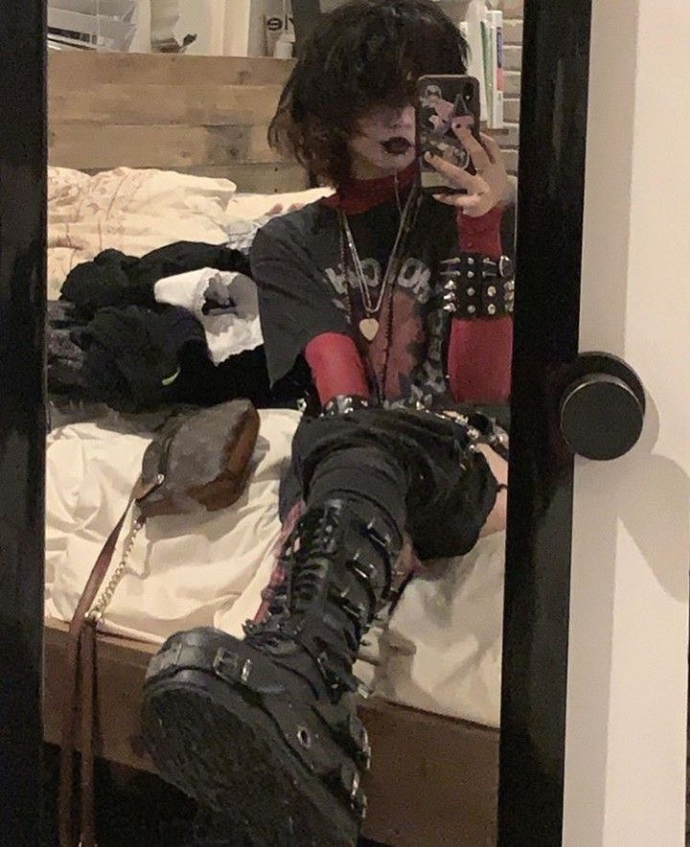
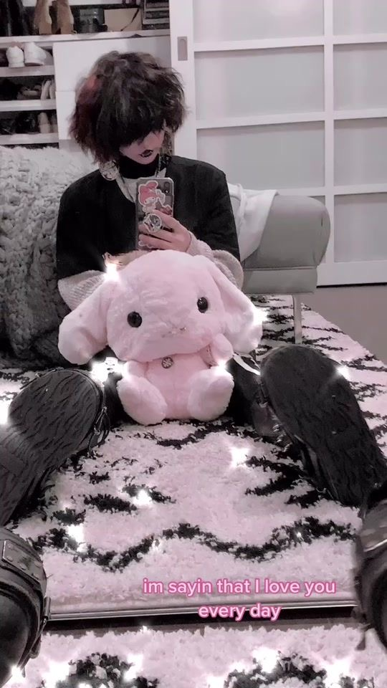
My fashion sense
I enjoy a more alternative style over the normal stye now.

Slide 10
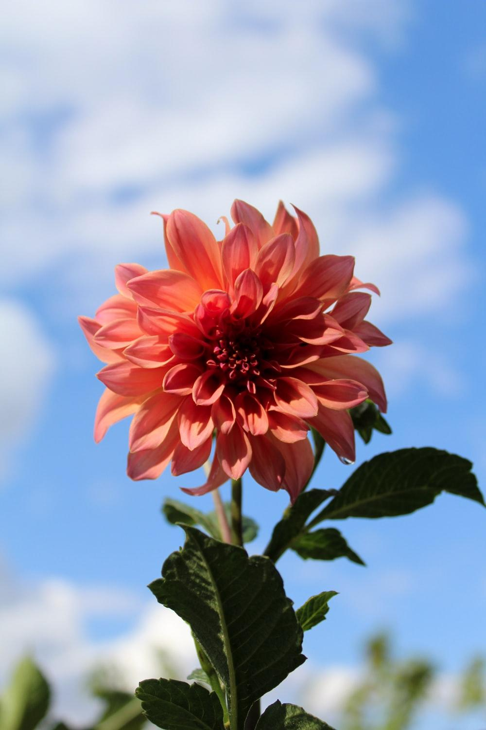
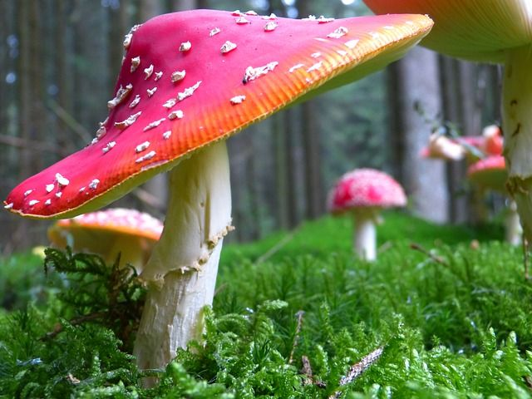
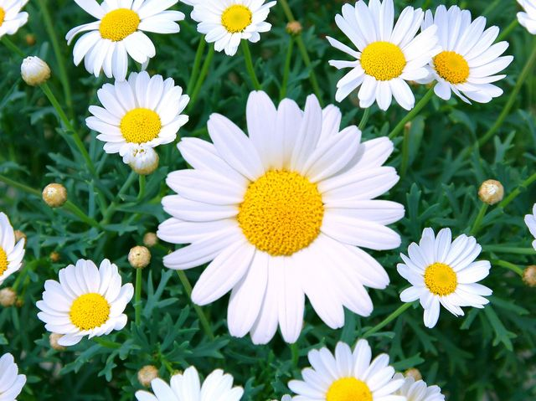
Plants I like
I like Mushrooms, Sprouts, and flowers.

Slide 11
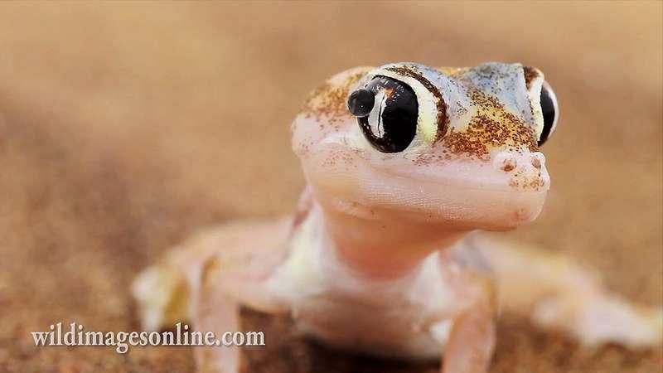
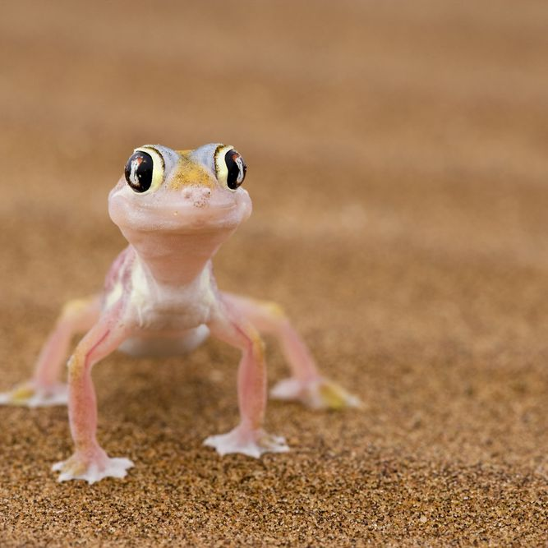
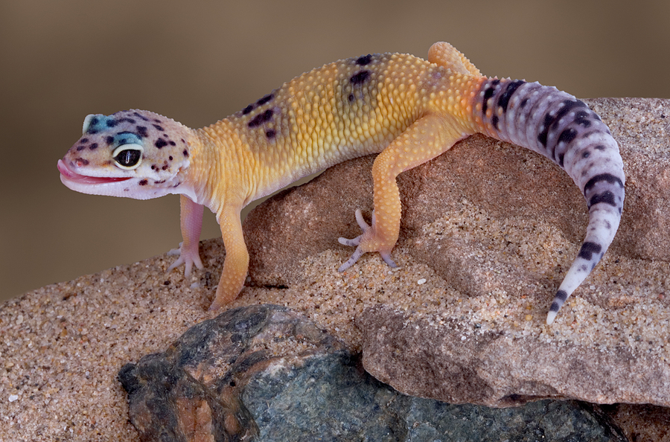
My favorite animal
Geckos are my favorite animal

Slide 12
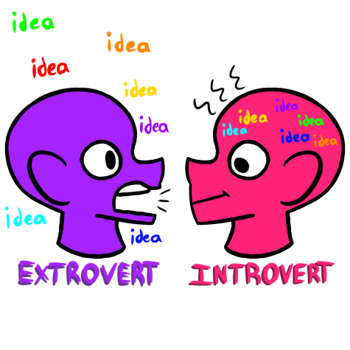
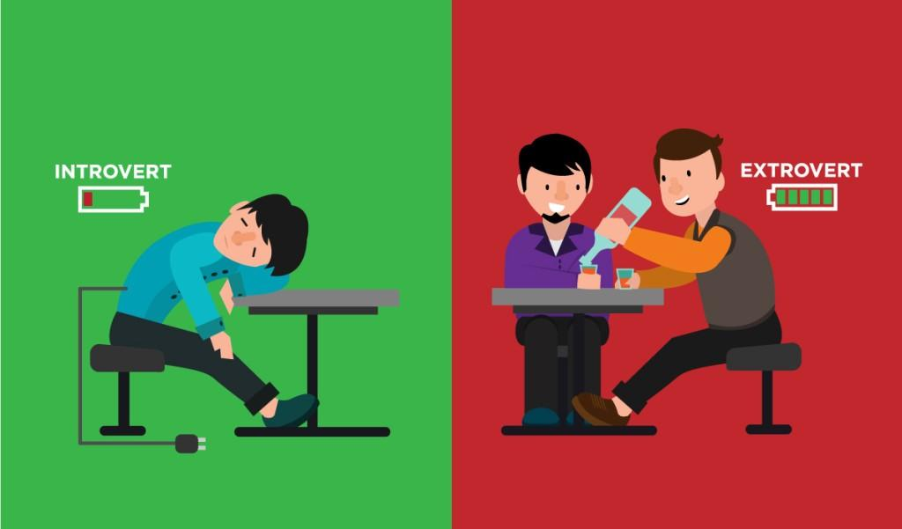
My personality
I try to be social but sometimes I’ll get awkward and don’t know what to say, and I have trouble approaching people. But otherwise, I talk a lot.

Slide 13
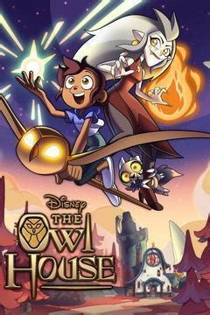


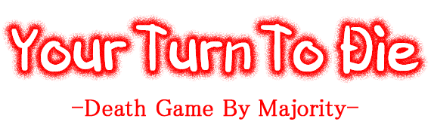
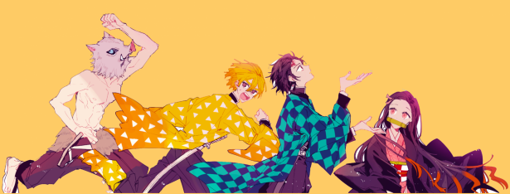
My recommendations
For cartoons I suggest Gravity Falls, Star Vs The Forces of Evil, and The Owl House.
For more action animes, I’d definitely recommend My Hero Academia and Demon Slayer
For comedies, I’d recommend The Disastrous Life Of Saiki K and One Punch Man.
For Gore animes I’d recommend Danganronpa ( All games/animes), School-Live, and YTTD ( Game)
For romance animes I’d suggest A Silent Voice, Ouran Highschool Host Club,

