Slide 1
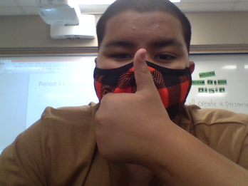

All About Me
By:
D’Macio Acosta

Slide 2
About me
Name-D’Macio Acosta I’m the middle child
Age-13 I do football and wrestling
Birthplace-yuba city
Write-right handed
Favorite colors-blue,red and black
Birthday-3-16-2008

Slide 3
My Family
I have my two brothers the older one is named D'Angelo and the youngest on is named D’Legend
I have my mom Luxeen and my Dad Timo
If you count cousins then I have a big family
My family is a football family all my cousins have done football my older brother he is playing football in his senior year
My Dad and Uncles where fonomal football players

Slide 4
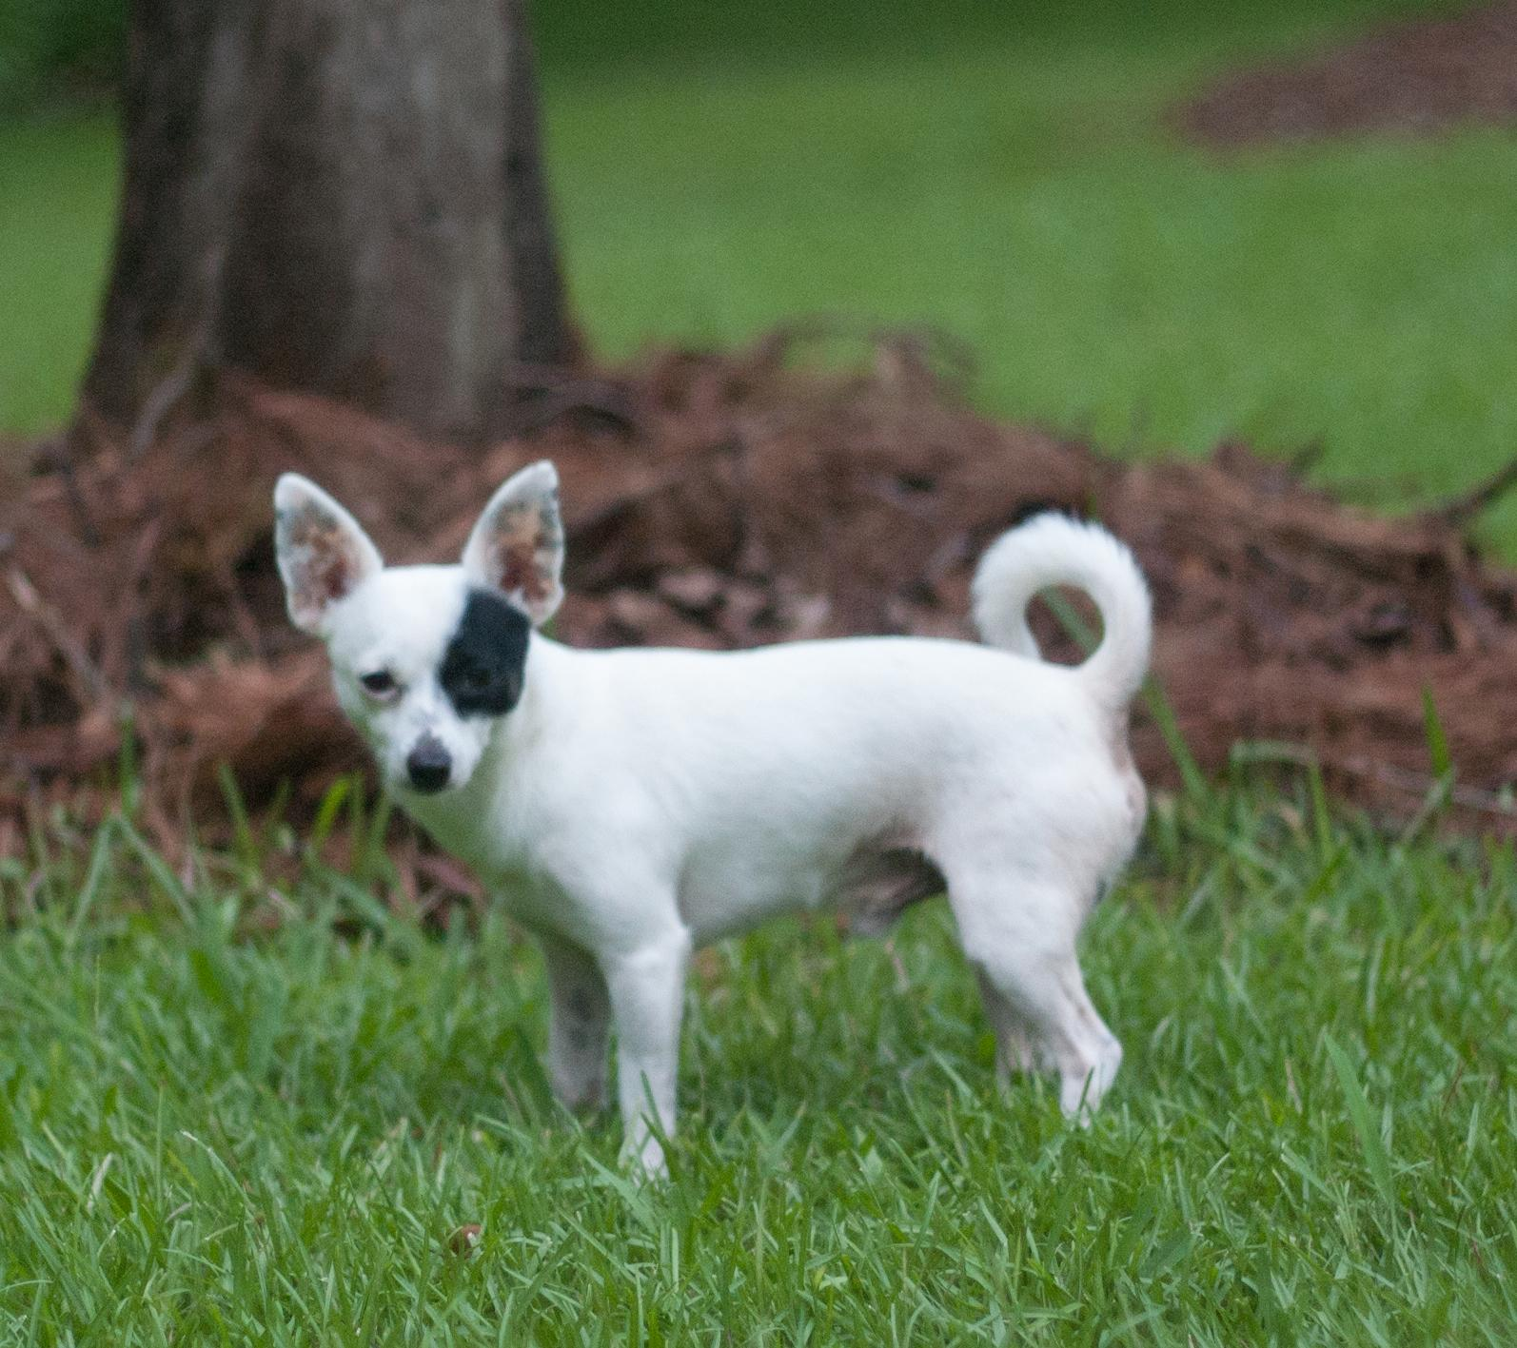
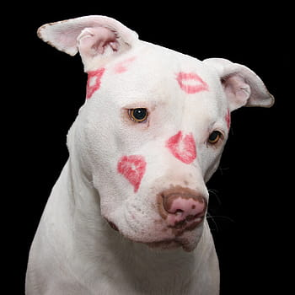
My Pets
I have Two dogs
The first dog is Luna she is my black spotted chiwawa and the second one is Nova she is a pitbull mix

Slide 5



Favorite sports teams
My favorite college football Team is LSU
My favorite NFL football team is The chiefs
My favorite basketball team is the Lakers

Slide 6
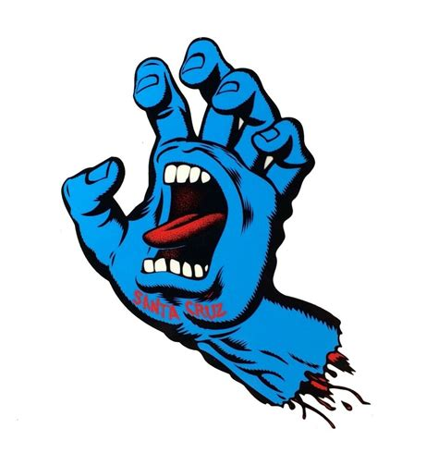
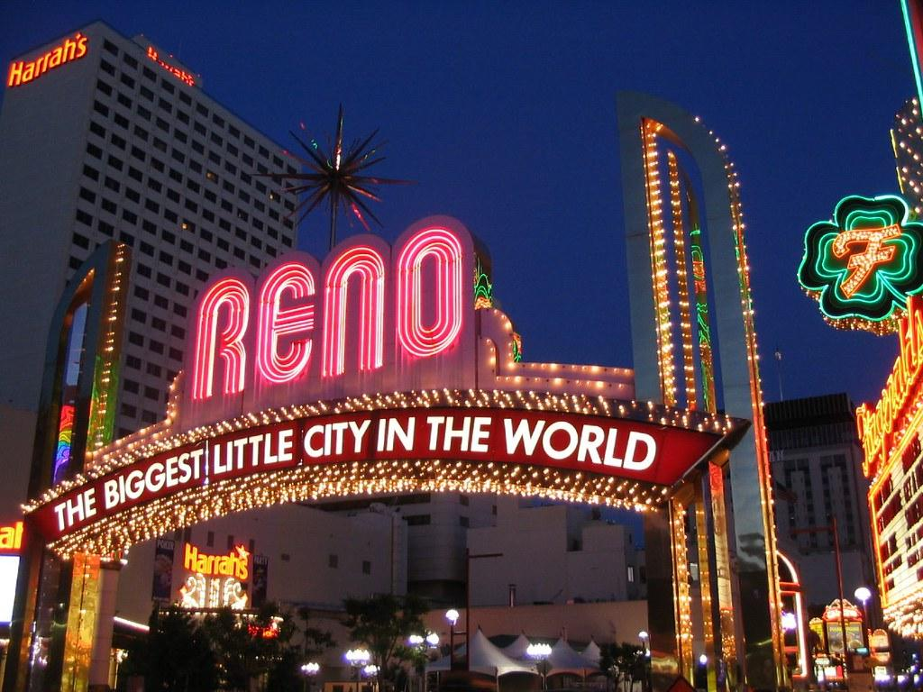
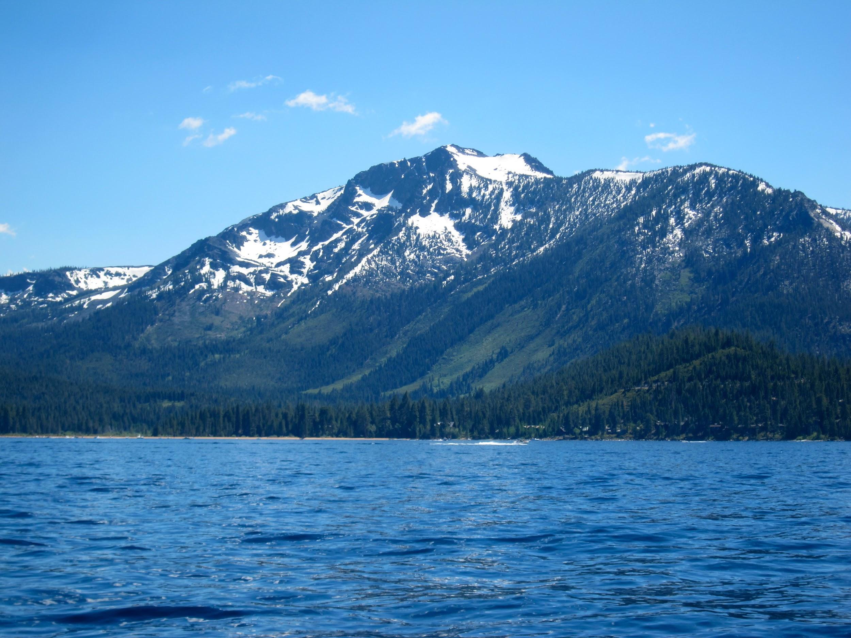
Places I've went to
I have gone to Santa Cruz,Reno
And lake tahoe

Slide 7
About My Job
I am the starting center and detackale on my football team the sutter huskies
My job as the center is to snap the ball to the Quarterback and make sure no one passes me.My jobas a Detackale is to get through the offence of line and either tackle the quarterback or the running back

Slide 8
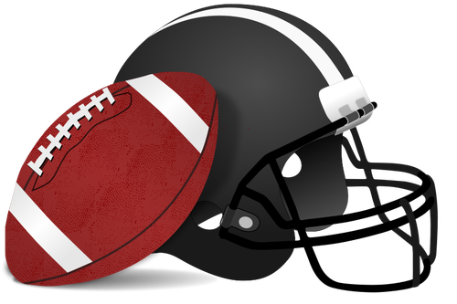
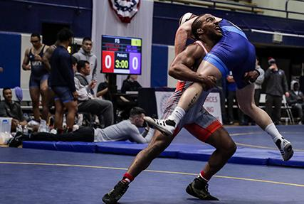



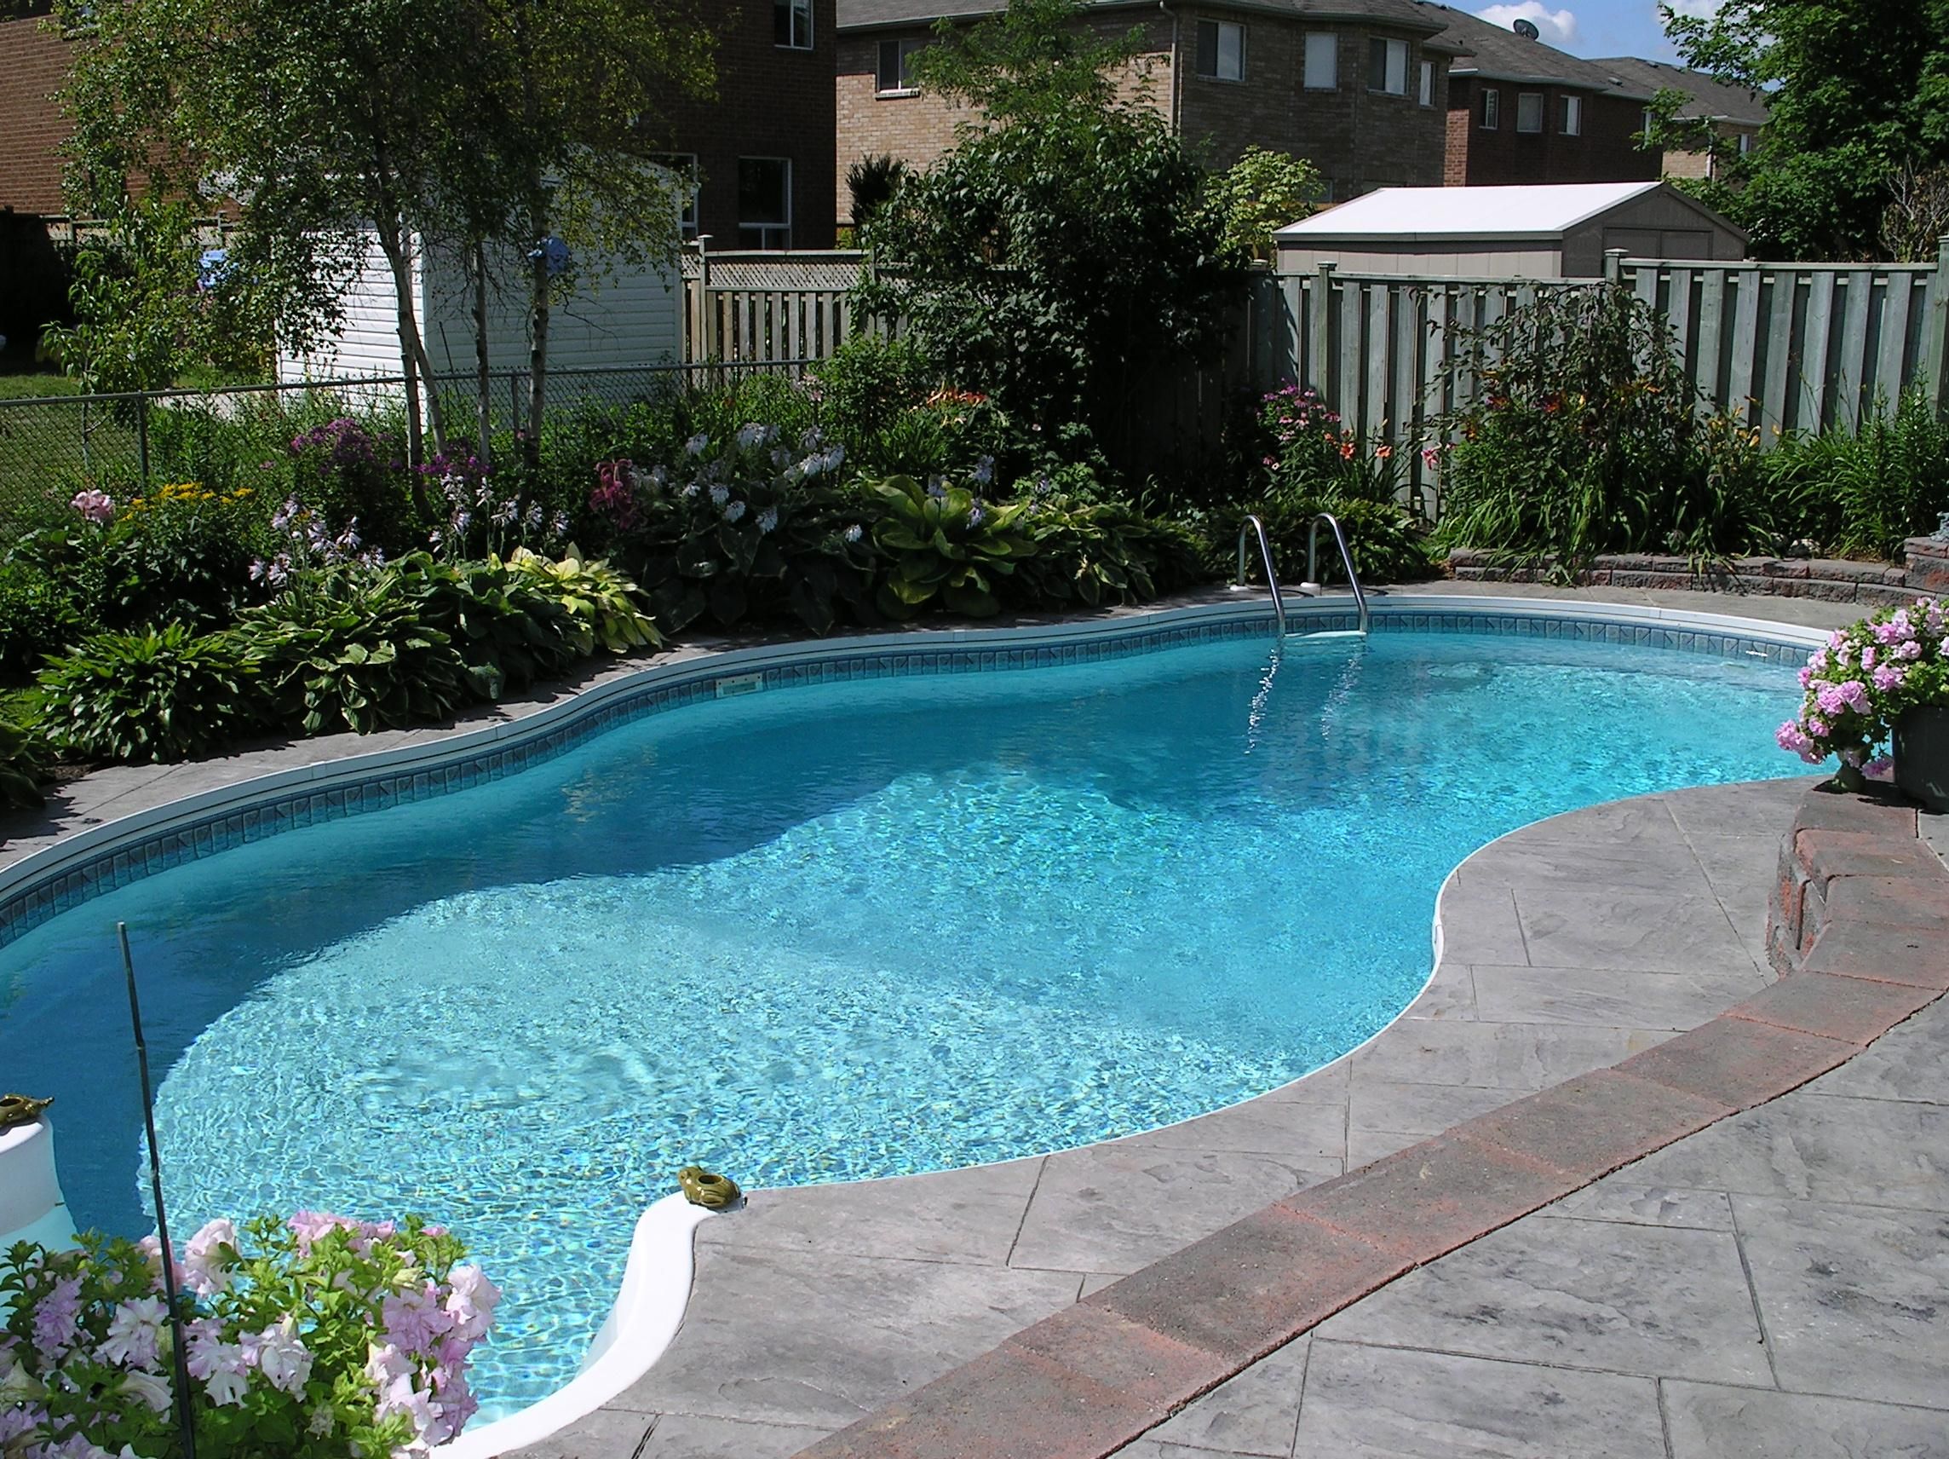
My Hobbies
My hobbies include:
Walking my dogs
Playing sports
Playing video games
Swimming

Slide 9
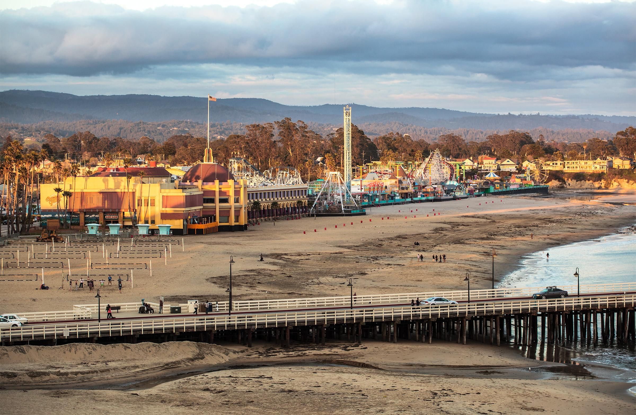
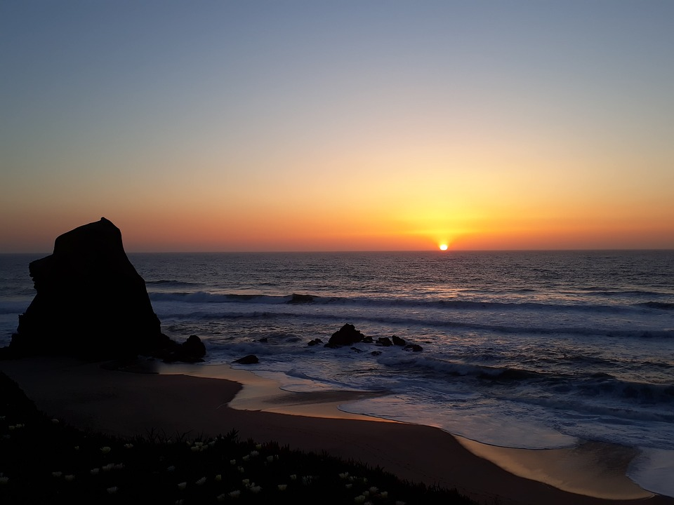
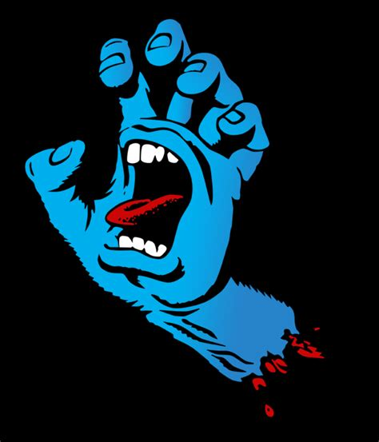
My santa cruz trip
Every year me and my family go to santa cruz
We find a place to stay for about 3 days
We always go to the beach and the Boardwalk

Slide 10
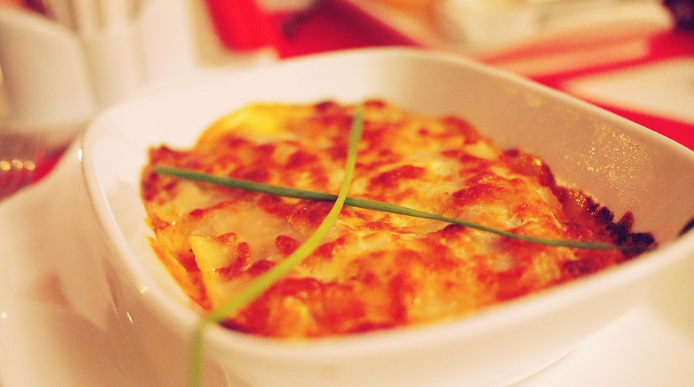
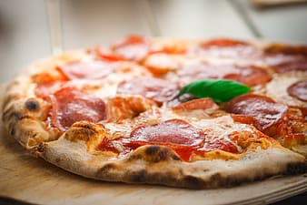
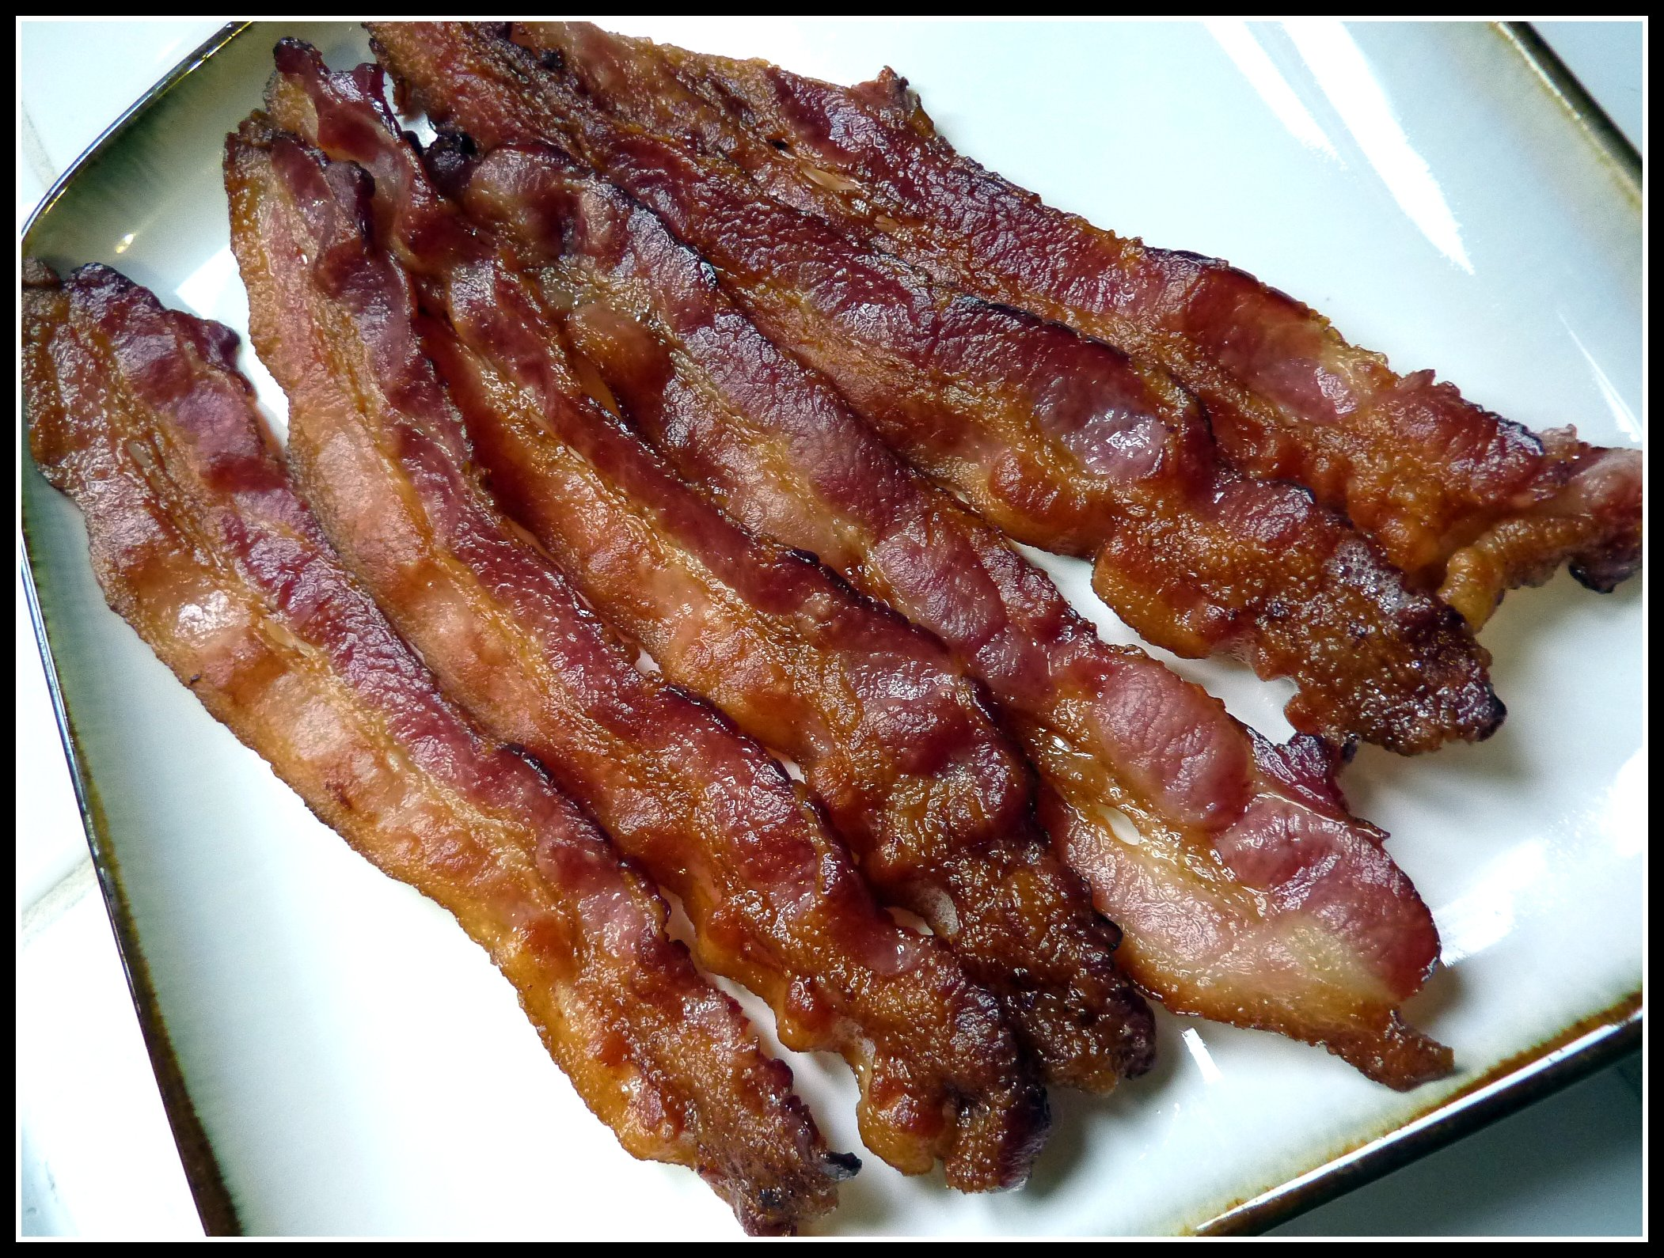
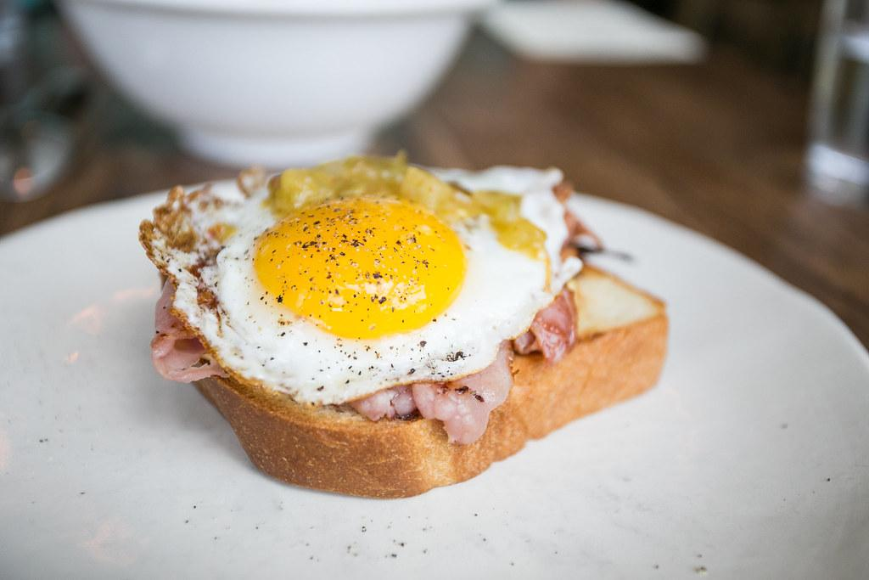
My Favorite Foods
Pizza
Lazanya
Egg sandwich
Bacon

Slide 11
Conclusion Slide
This is me and all the stuff I like to do I hope you enjoyed

