Slide 1
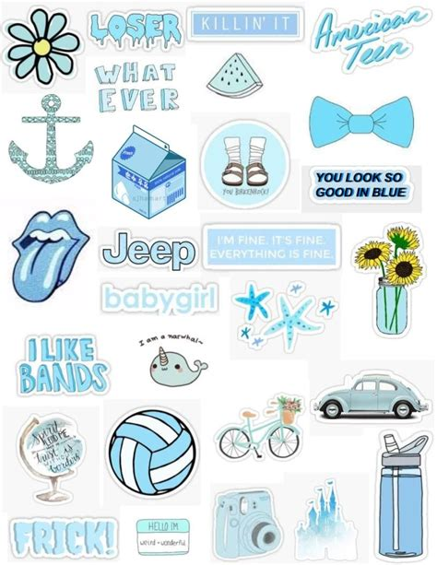
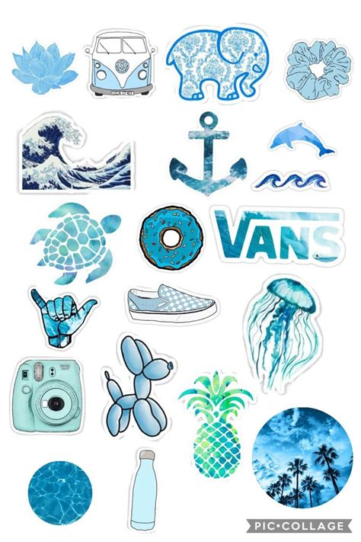
All About Me
By:
Emily verboonen

Slide 2
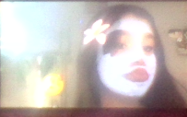
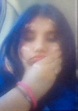
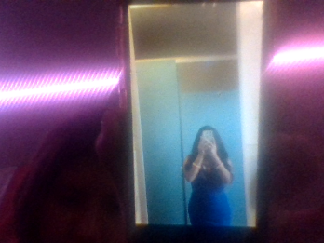
About me
Name: Emily verboonen garcia
Age: 12 years old
Eye color: Brown eyes
Pets: i have 2 dogs
Birthplace: yuba city
Height: 4’10

Slide 3
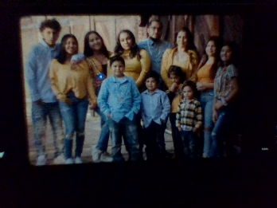
About my Family
I have a amazing family.
I have a great mom and dad.
I have 8 siblings (live in california)
I have 4 step sisters and 5 biological siblings so its is always very hectic in the mornings. Living in a house with 9 people can get very intense

Slide 4



My Horoscope
So my horoscope is taurus fun fact about taurus we get along with every sign whats actually really cool is both of my best friends are both Tauruses mabe that is how we get along nice what makes me a taurus is my birthday lands on April25 at 7:13am

Slide 5
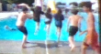
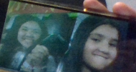
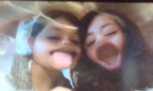
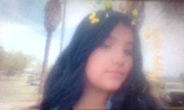
My personality
My personality is really casual I love hanging out with friends and family I love to make people happy whenever they're sad I'm not the best at giving people advice but I sure love to make people laugh I love making people feel like they're special

Slide 6
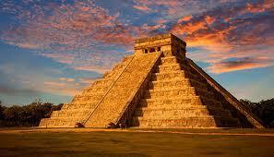
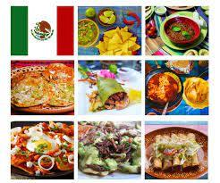
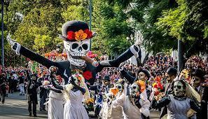
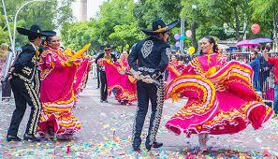
My race
I am mexican-american.
My favorite mexican food to eat is
tamales,tacos,enchiladas, menudo. I love being
mexican in mexico there are carnivals there always people dancing the temples the underwater caves and the music.

Slide 7
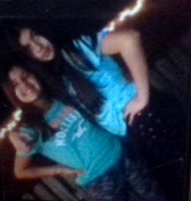
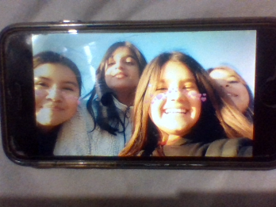
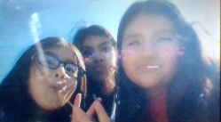
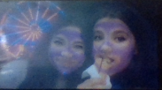
My friends
I have 2 best friends there names are izabella and Alondra and the rest are friends i love hanging out with them they make me so happy i see them as sisters i just love them both so so much

Slide 8
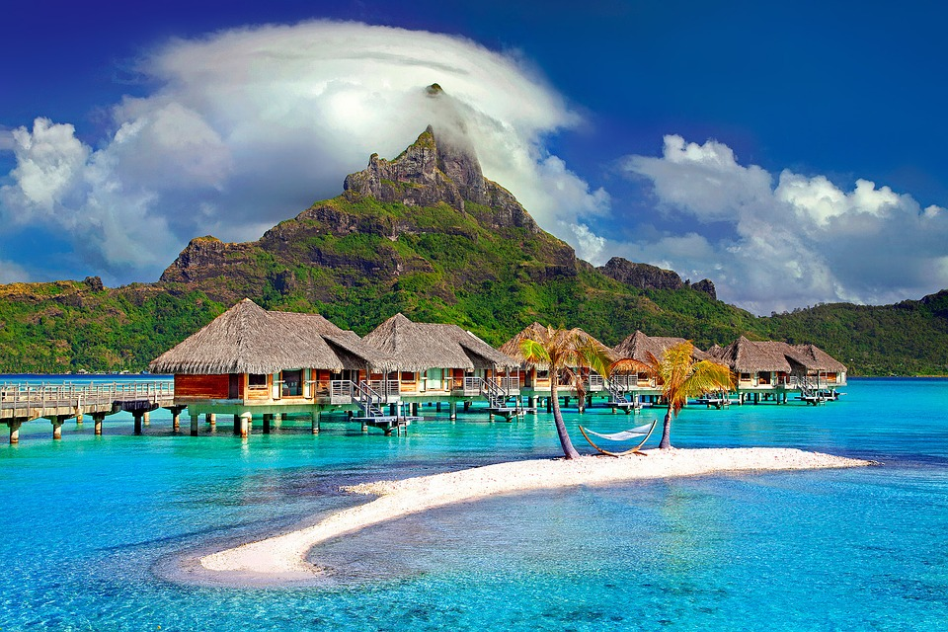
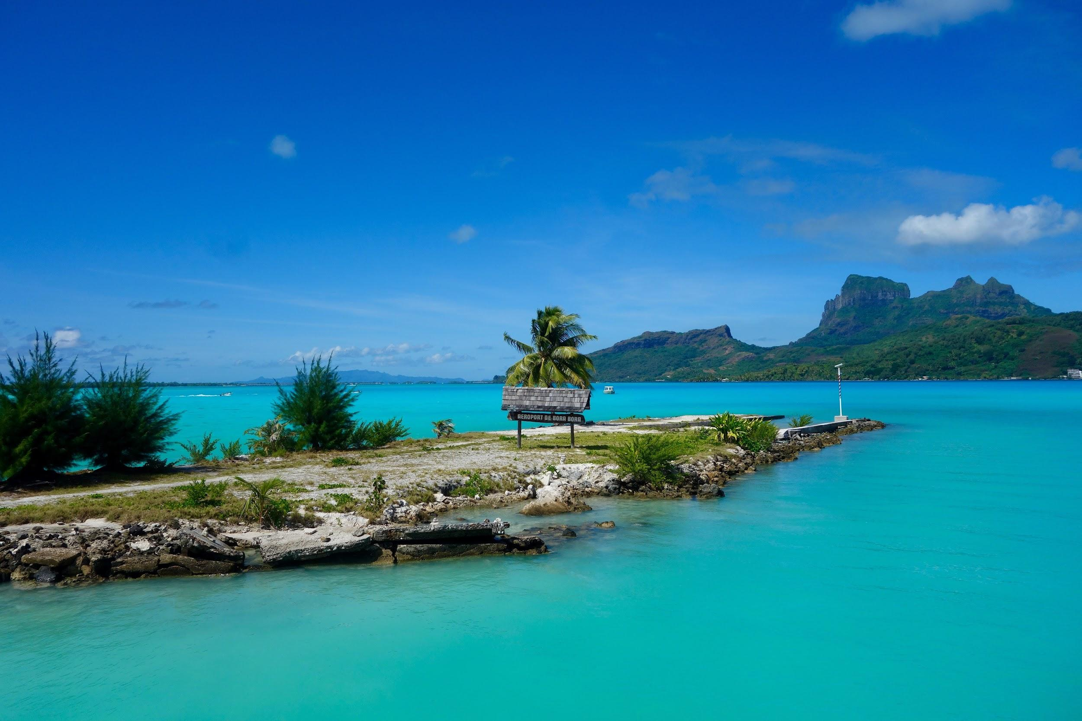
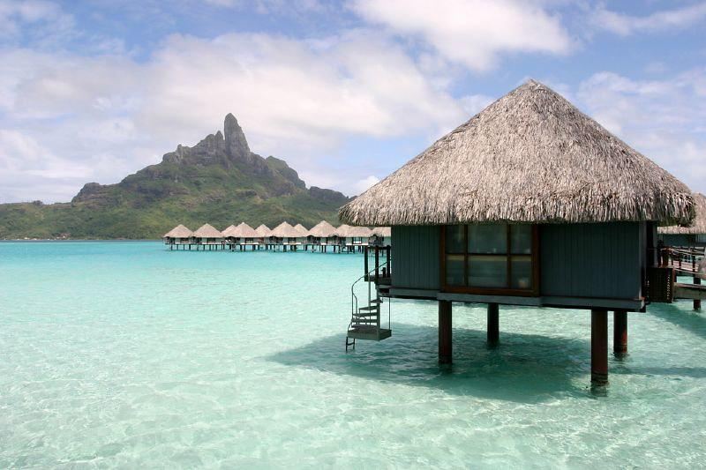
The place i want to visit one day
I really want to visit bora bora i feel like it is really pretty and i feel like i would have a lot of fun there i love the water there it all just looks really pretty.

Slide 9
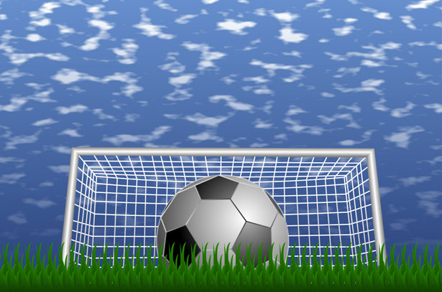
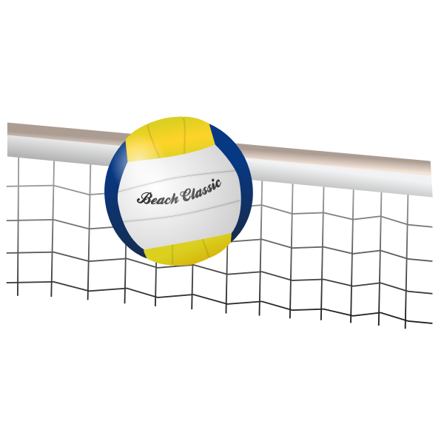
My Favorite sports
I love to play soccer i have been sense i was 5 so i play every year
I also love to play volleyball i might tryout for the school this year

Slide 10
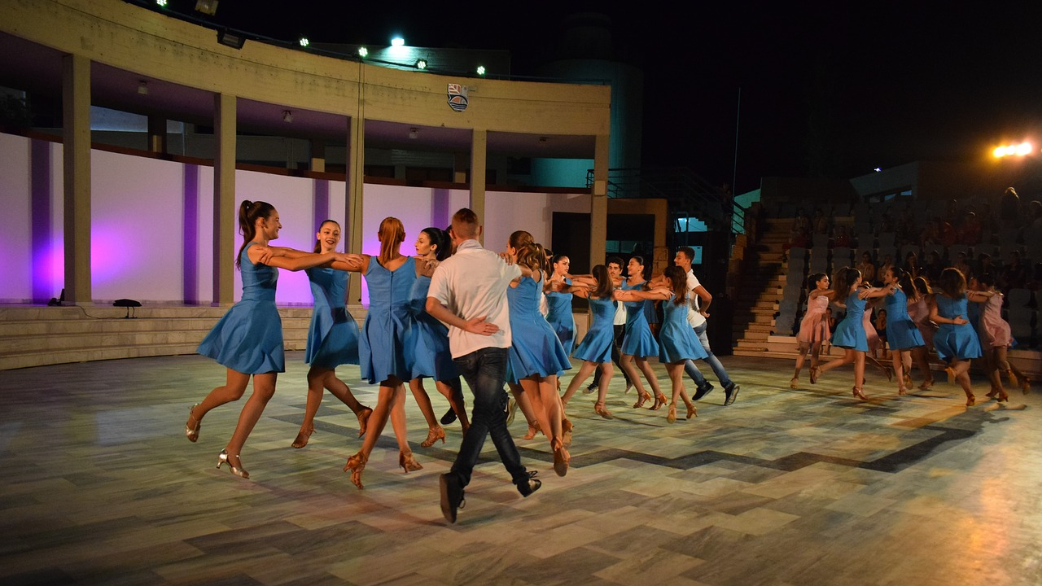
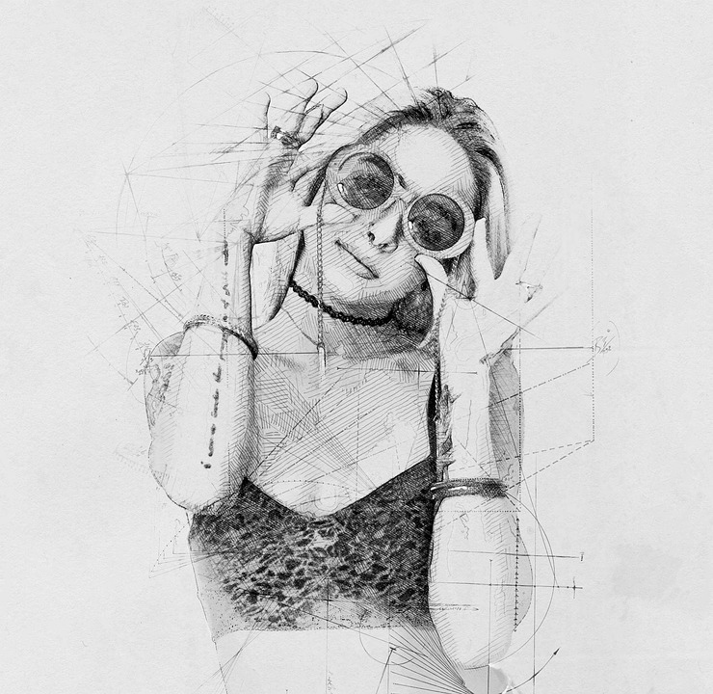
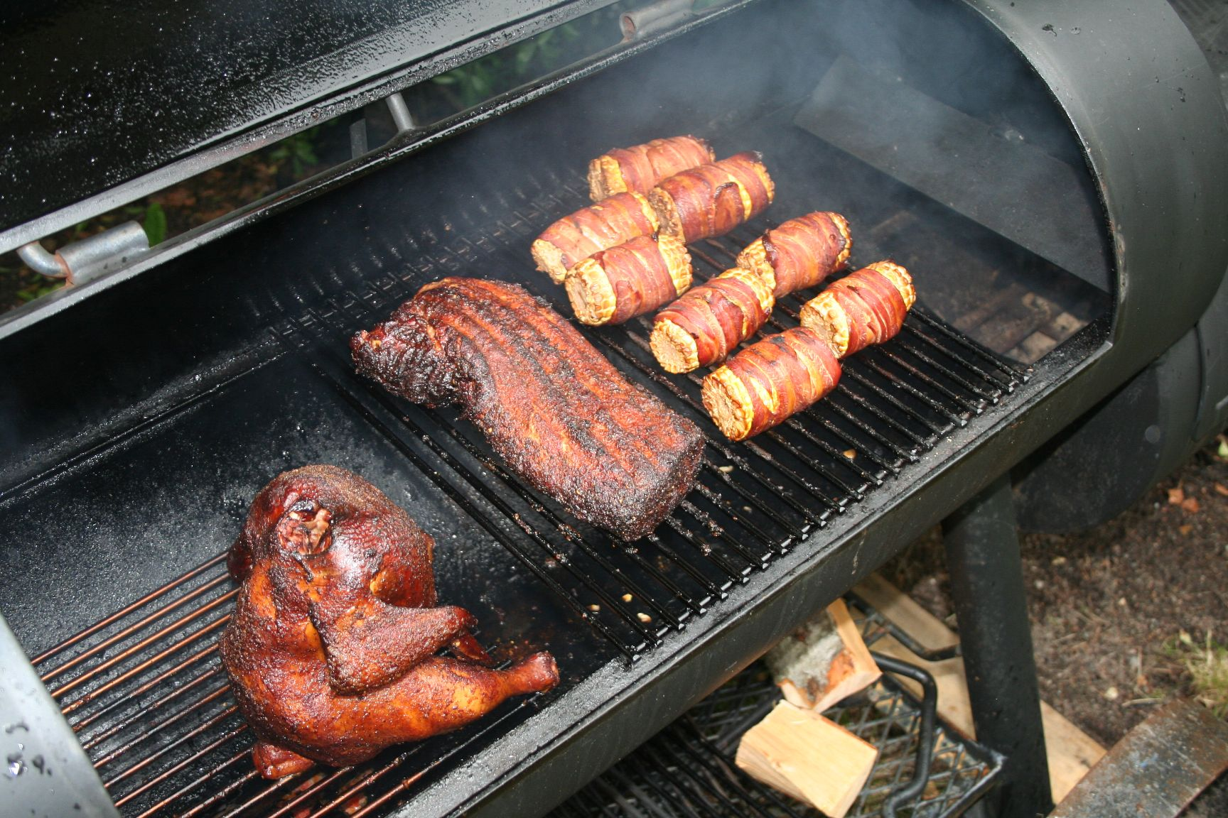
What i do when i and board
I love to dance every time i am dancing i feel like i can do anything i feel really flexible when i start to dance
I love to draw and sketch sometimes when i am in a problem that the person can’t understand things i feel like it is better to draw it out so they can understand
I love to have family gatherings because we all have a great time and normally when we have family gatherings we normally eat bbq so we have a lot of fun

Slide 11
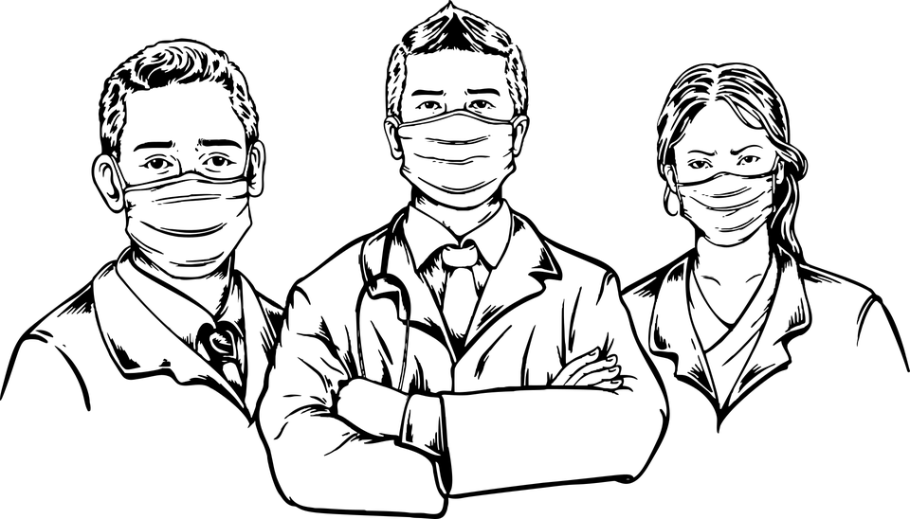



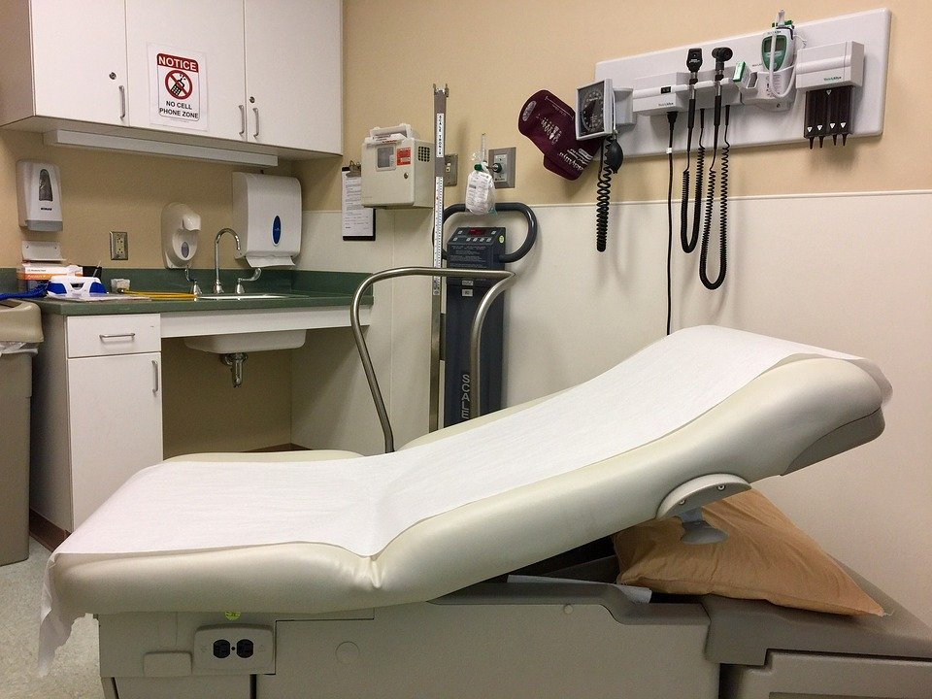
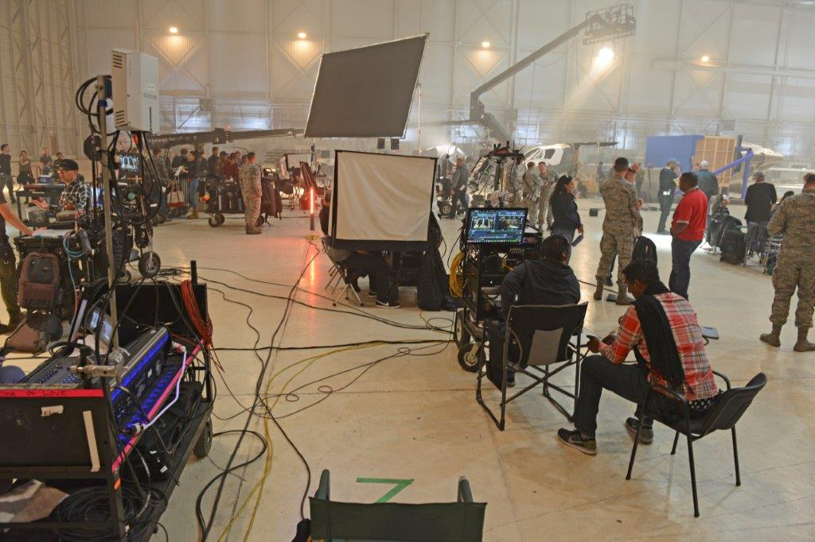
My dream jobs
My dream jobs are i really want to be a actor and if that does not work i am going to be a doctor.the reason why i want to be a actor cause i love acting and i have a lot of emotions so i feel like i can make it work. I also want to be a doctor because every sense i was a little girl i always wanted to help people and like every time one of my family members were sick i would always want to help them.

Slide 12
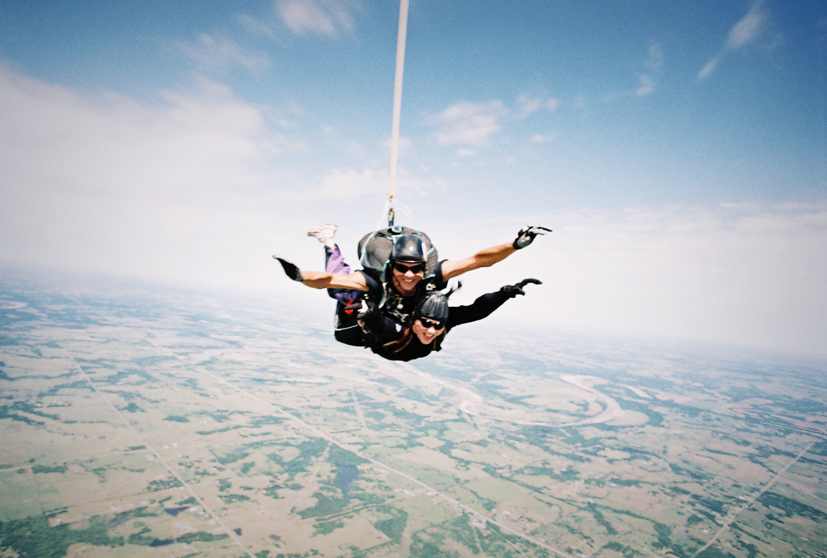
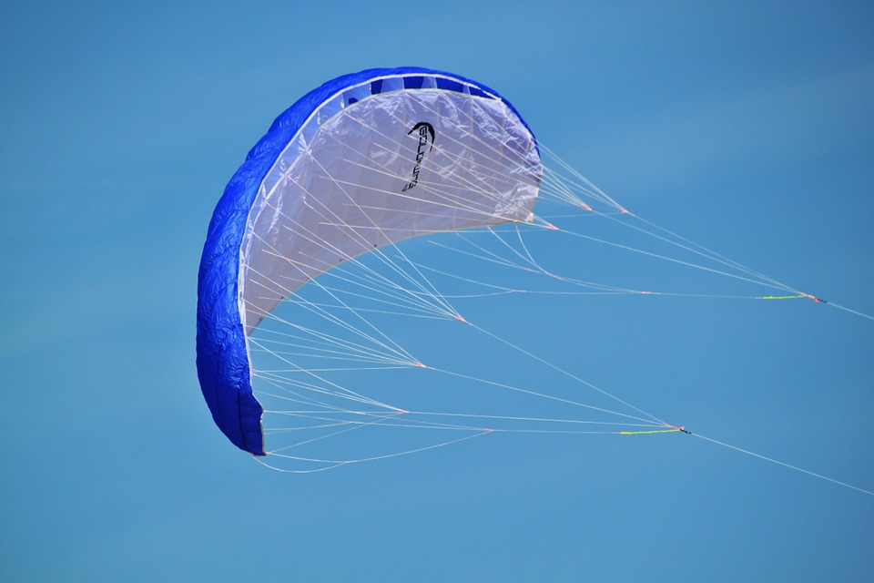
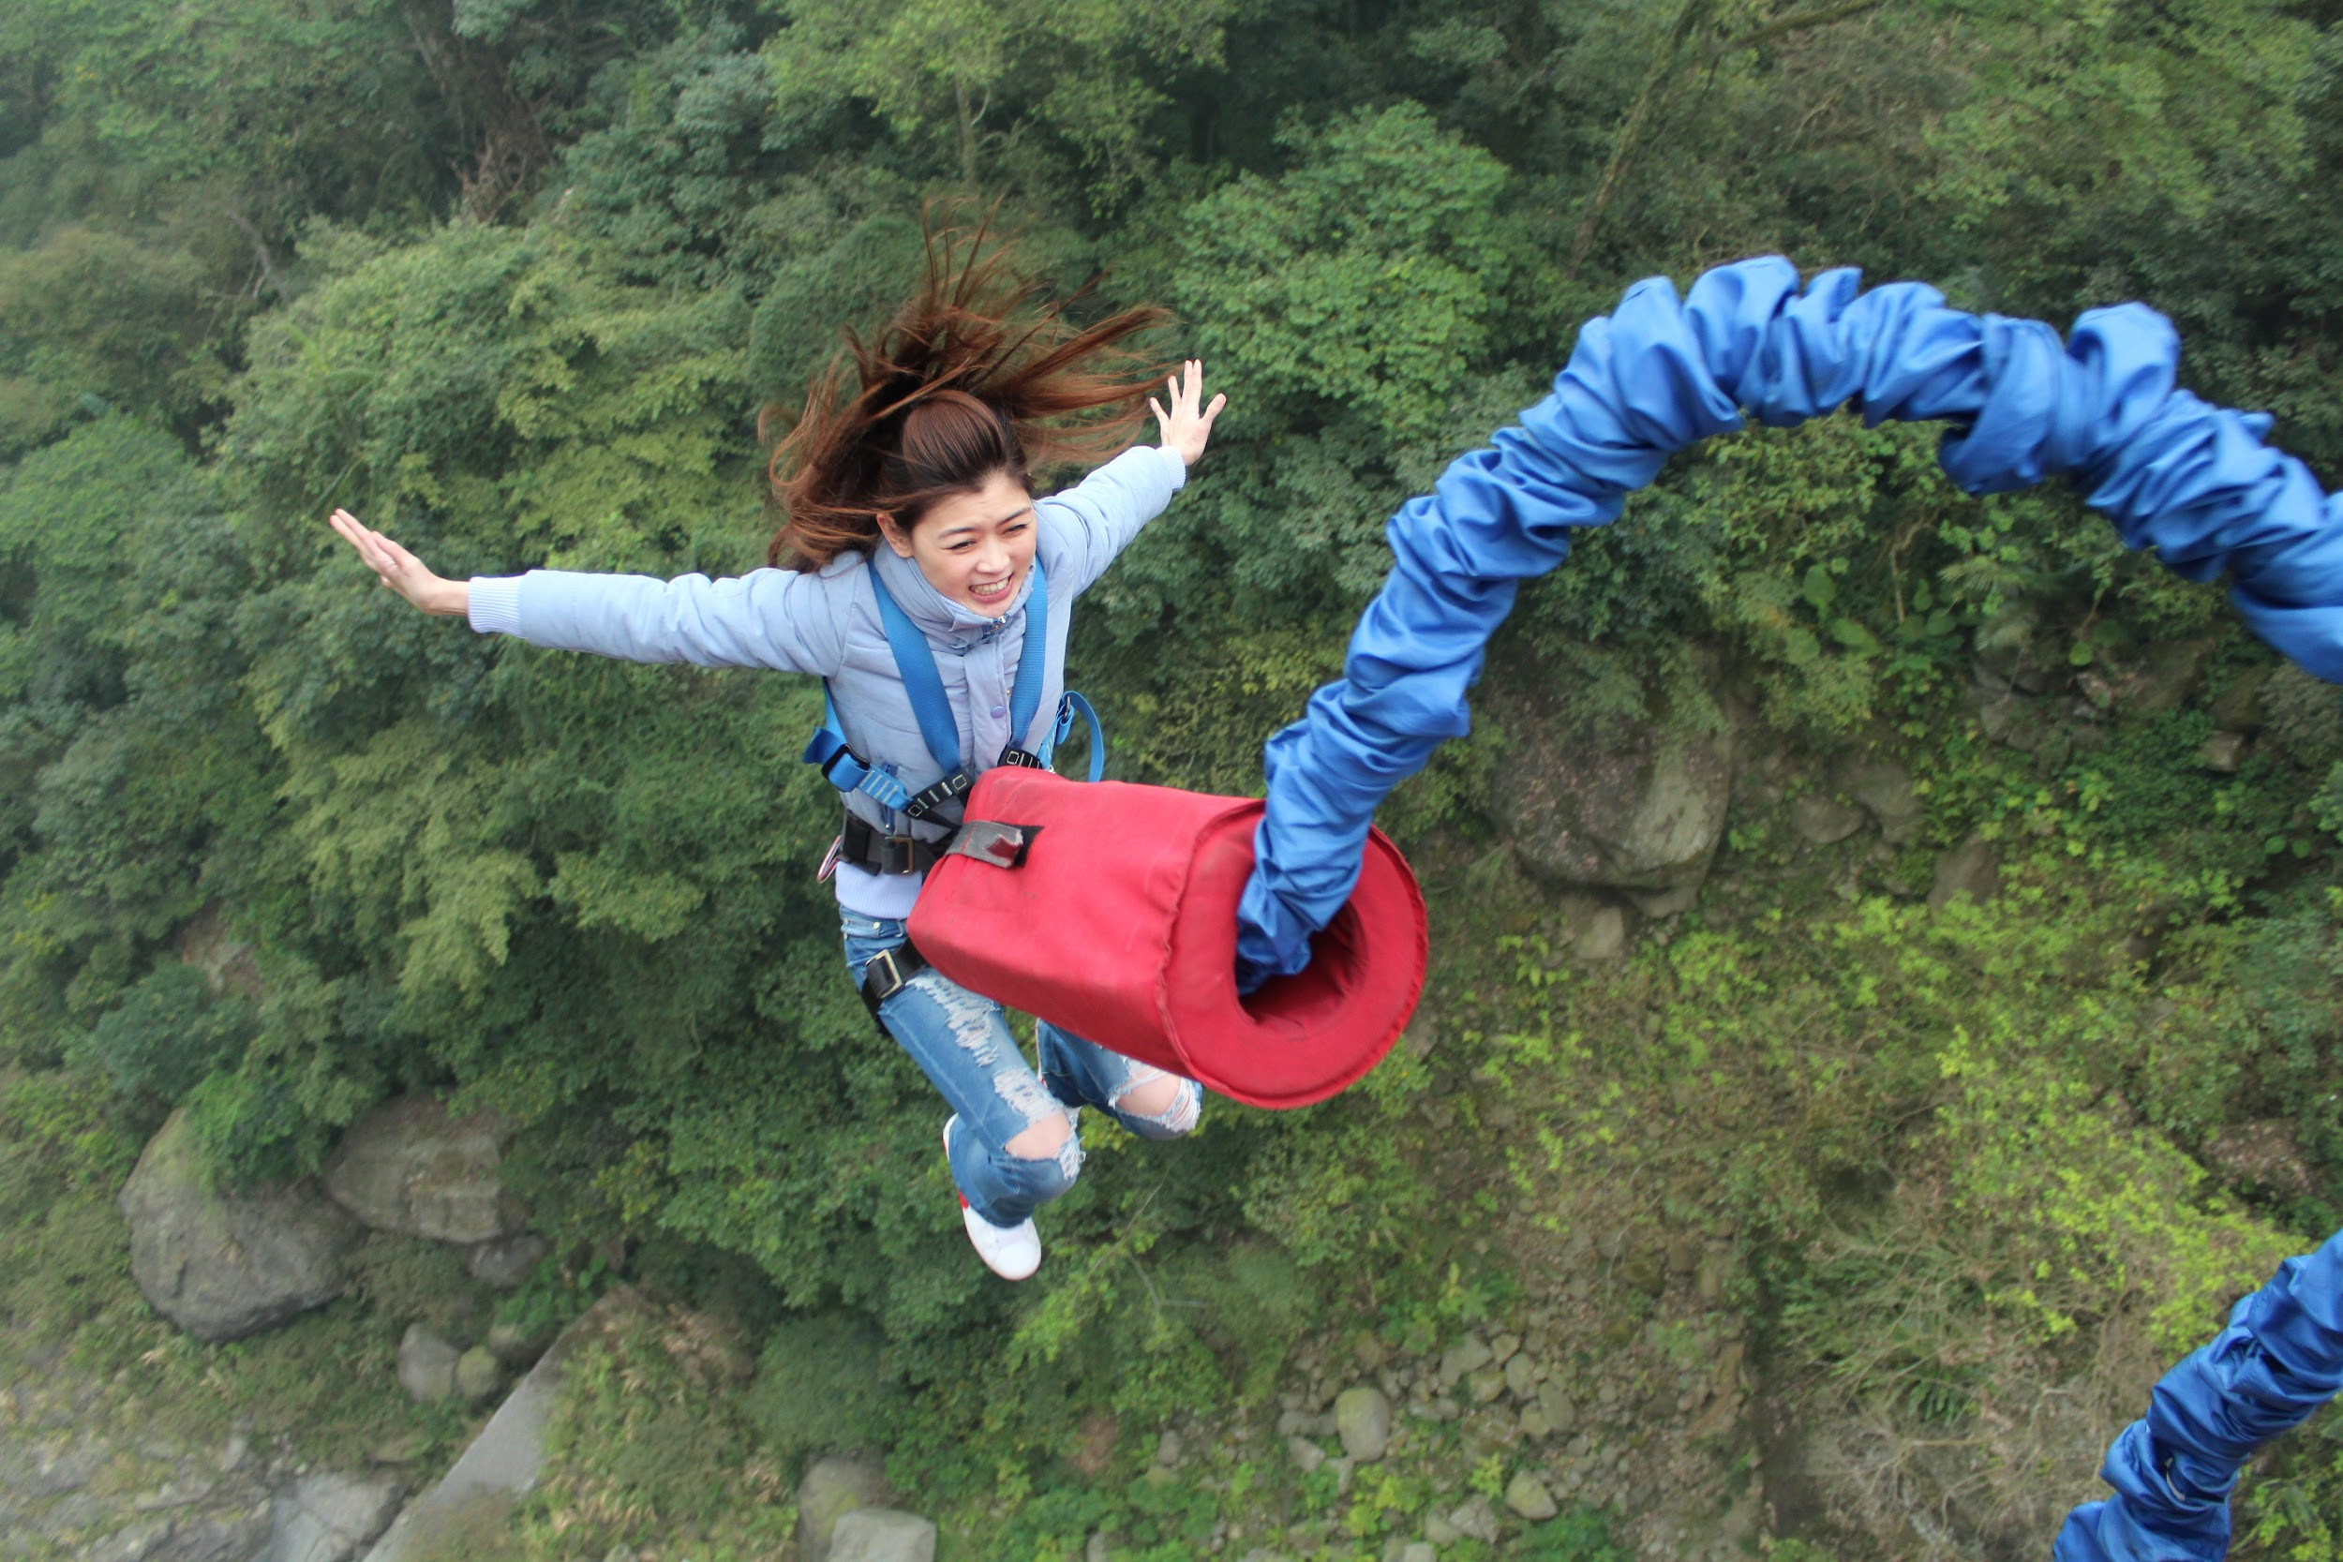
Future plans
I really want to go skydiving
I really want to go paragliding
I really want to go bungee jumping

Slide 13
The end
All About Me
by: Emily verboonen

