Slide 1
All About Me
By: Fernanda Hernandez-Tapia

Slide 2
My name is: Fernanda Hernandez-Tapia
I have 1 brother and 1 sister
I have 2 nieces and one nephew and and a mystery gender (that means there is gonna be a new baby)
Me and my siblings get along really well
I sometimes babysit my nephew or nieces

Slide 3


I’m a very basic person
My favorite colors are:
Black:
Red:
Light blue:
Light pink:

Slide 4
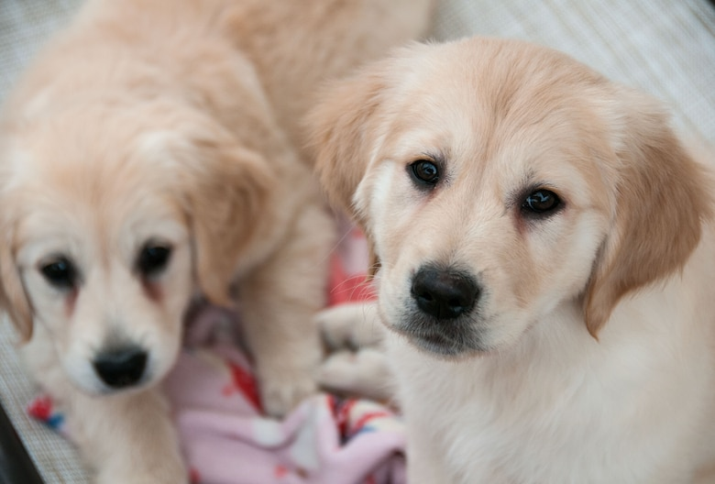

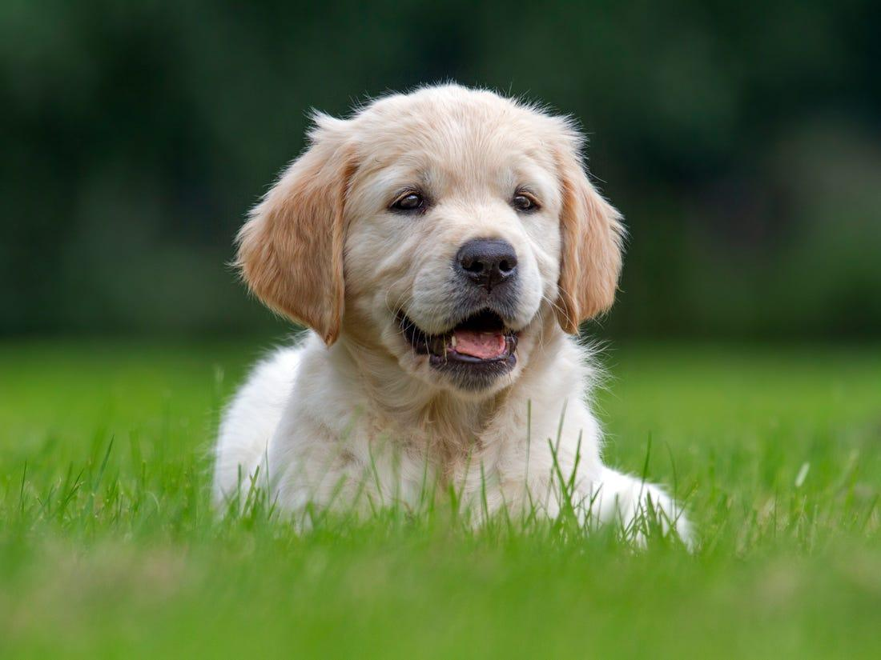
I have 1 dog
His name is paco, It was my aunts dog but when we went to go visit her she said if we can take care of him because she was going to have surgery 3 years pass and she still has not asked for him until she called and said we can keep him so i’m happy about that.

Slide 5
My personality:
I have many personalities : When i’m around family i’m this funny cousin. When im with friends i’m serious and also goof around a lot
When i’m in school im this serious person and i really try to focus on school and do what needs to be done.

Slide 6
My role models:
My role model is my mom,dad,brother,sister,and one of my friends
The reason why they are my role models is because they respect,they know how to listen,and they work hard and make good money.

Slide 7
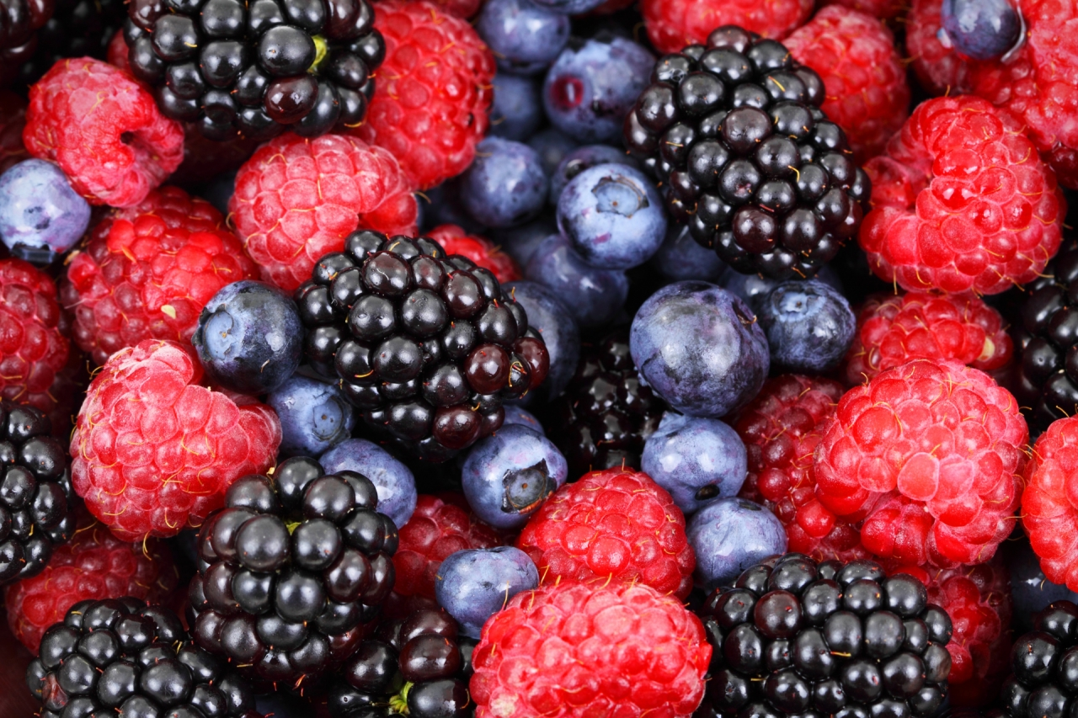
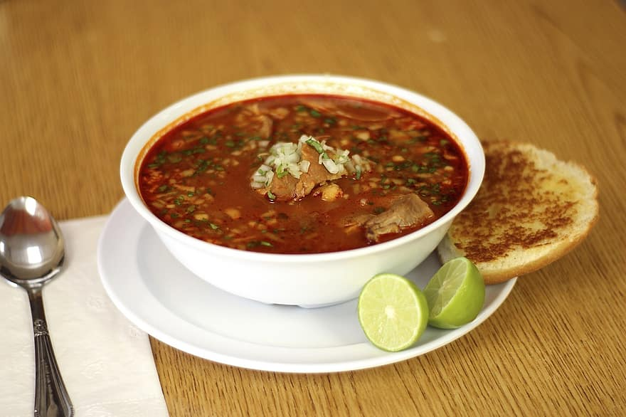
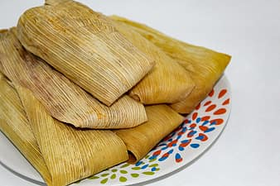
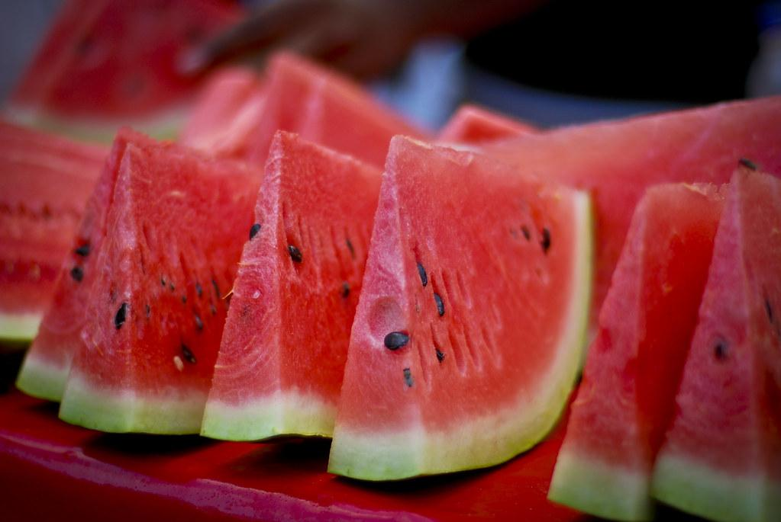
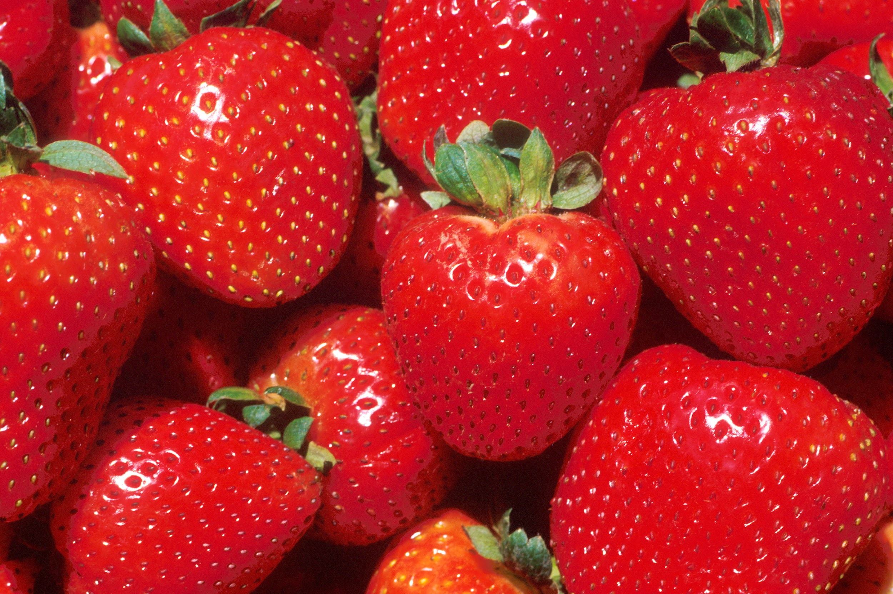
My favorite foods are:
Tamales are my favorite,
My other favorite food is pozole basically everything my mom makes i like My favorite fruits are , Watermelon, strawberries and blueberries,blackberries

Slide 8


My favorite movies/shows:
My favorite movie is “Lilo and stitch,” “Beauty and the Beast”
My favorite shows are “ One day at a time” “never have i ever”
Those are all my favorite movies/shows

Slide 9

My best friends:
I have 5 best friends and 2 friends all my best friends are like family to me i treat them like how treat my siblings.
I don’t have a favorite best friend bc then that will be kinda messed up

Slide 10



My favorite subject in school:
Science!
Math
ELD
Those are my favorite subjects

Slide 11
MY favorite actresses are:
Sadie sink
Kiana Madeira
Maya hawk
Millie bobby brown
Margot robbie
Joey king
Those are my favorite actors

