Slide 1

All About Me
By: Ian Vang
Your name
Ian Vang
https://www.youtube.com/channel/UCZCXxjCETlc-sS6TyNzmM1w SUB TO ME NOW

Slide 2


Boring 101
I like playing games and watching anime. Mostly all the things I do. I do go hiking and camping. I also ski but i'm not that good. I always say i'm bored and I am kinda bored. I have 1 sister only. She bothers me too much lol. I do youtube videos for fun and because i'm bored. I don't use any money so I just use anything I can get for free.

Slide 3
Family
I have a lot of family at my moms and dads side. I don't see them much because of stuff (personal). I always see 2 of my cousins almost every day because they live at my grandparents house and I visit every weekday.

Slide 4
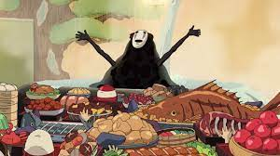
Foods
I like noodles. Like pho (and a lot more I don't know how to spell because it’s in a different language)
Yes I hate vegetables but ill eat them if i need to.
I like meat. A lot of it. I was thinking about being vegan but that ended quickly.

Slide 5

Even more boring extra 101
There's nothing much about me. I don't really do anything except with my family. I'm Kinda quiet not really a socializing person. I stay indoors and i'm just watching anime. (lol) I like to work by myself but if I do work in groups I do my own thing then just combine the answer with the other people. It's still working together because in the end we all combined our answers into one.

Slide 6
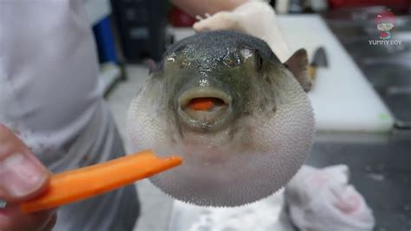
Even more boring extra 102
I get good grades and everything but i'm just like “bleugh” I don't know what to do. For me there's nothing much to do. I don't know what to do. I do go out sometimes. I don't like school but I do it anyway for education. I play too much games but they help me learn. Sometimes they teach me things I didn't know.
Go to youtube and search “pufferfish carrot meme” and “bleugh” will make more sense.

Slide 7



Pets and things
There is not a lot about me I guess. All the pets I've have are either dead or alive and long gone. I do youtube for fun and I started animating but after my tablet broke I kinda gave up. I might start again as a hobby so i'm not so bored.
I like Music and rhythm games. I play a lot of them (mostly roblox) so my fingers are trained I guess. There is also this game called FNF that I like to play.
The only picture I found with the google search on here
Not my picture. Just something for the animating part.

Slide 8
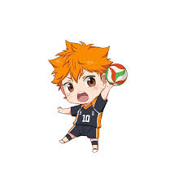

sports
I like to fish. Yep thats all. Nothing much. I don't know how to fish really good but it's just fun. I think i'm starting to run out of ideas. You know playing games could be a sport just like Esports.
I'm not very active but my stamina it pretty good.
The checkmark of health
I don't play volleyball

Slide 9
schools
I've been to 4 schools before I don't know why I transfer so much. I'm kinda bored all the time of you can tell. The only time i'm not bored is when i'm actually doing something I like.

Slide 10
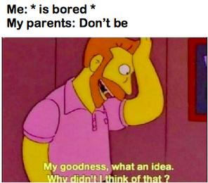
Nothing 2
I don't know what i'm doing. Most of the time i'm just bored. I do a lot of things with my mom and dad but i can just summarize it into a 30 second story. It won't be that great because I don't know how to explain things. Life isn't boring unless you make it boring. I don't make it boring because for some reason when I say i'm bored it's fun. I guess that's one way to do it. When someone asks me to do something I will but I just kinda do it in my own way.

Slide 11
Conclusion Slide
If there's nothing much about me sorry.(not lol)
yes i'm bored.
I don't decorate much. I only do when i'm BORED
I sit in the back because I like it. I don't really mess around unless I have a friend. (haha no)
Welp that's all...

