Slide 1
All About Me
By:
Bella Tinoco

Slide 2
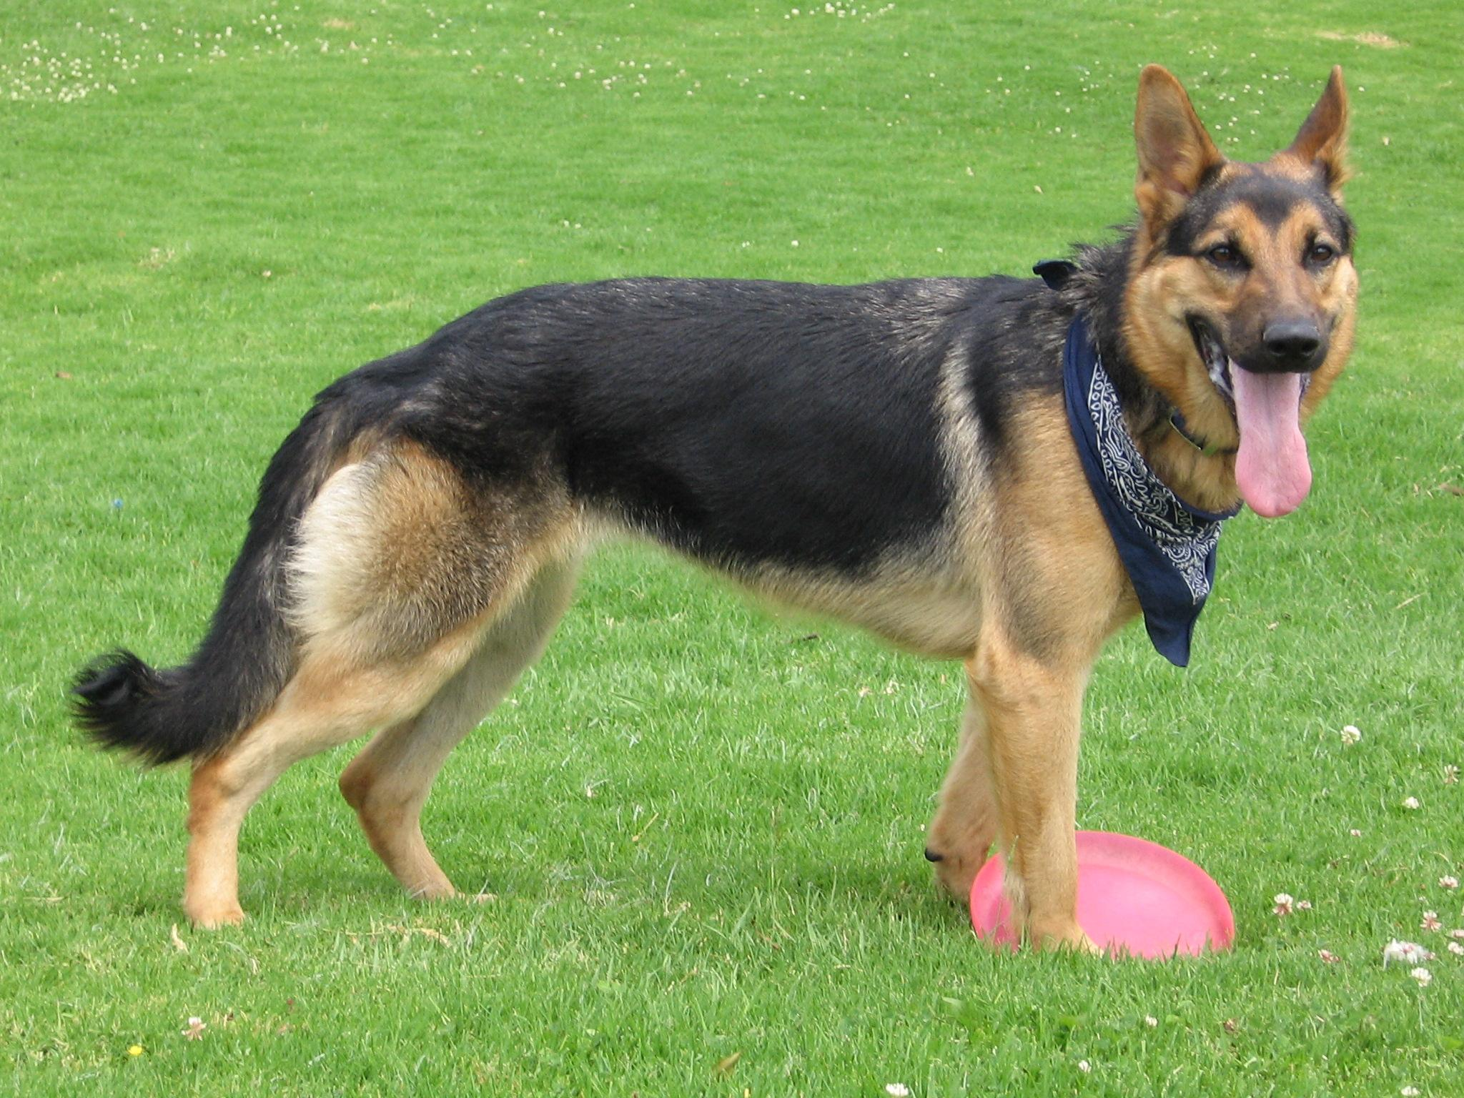
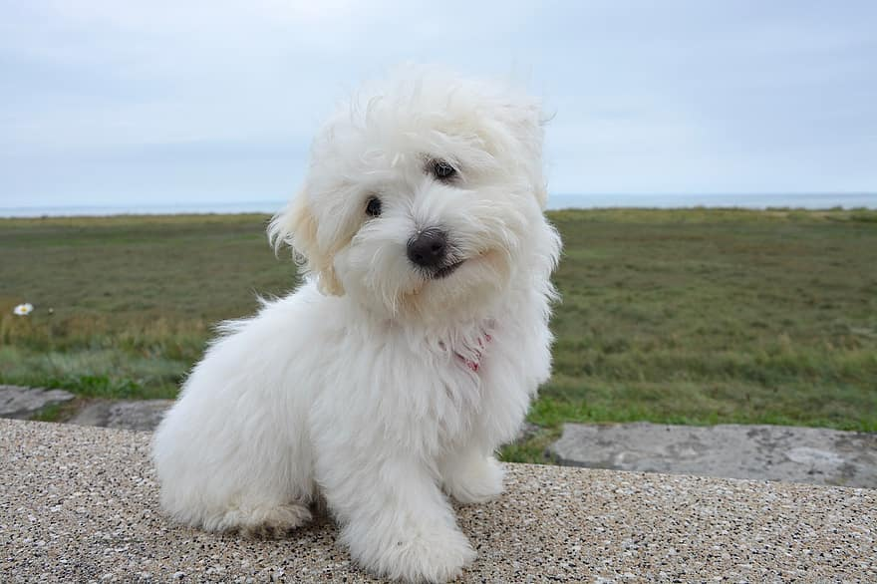
My dogs Cooper and chiquilin
I used to have a dog named Cooper but he unfortunately died at 42 he loved to play with footballs and rocks nothing else and he was the opposite of chiquilin,energetic. .
I also used to have a dog chiquilin but he would always get VERY dirty after a bath so he was white and black and he he was more the opposite of cooper ,lazy.

Slide 3

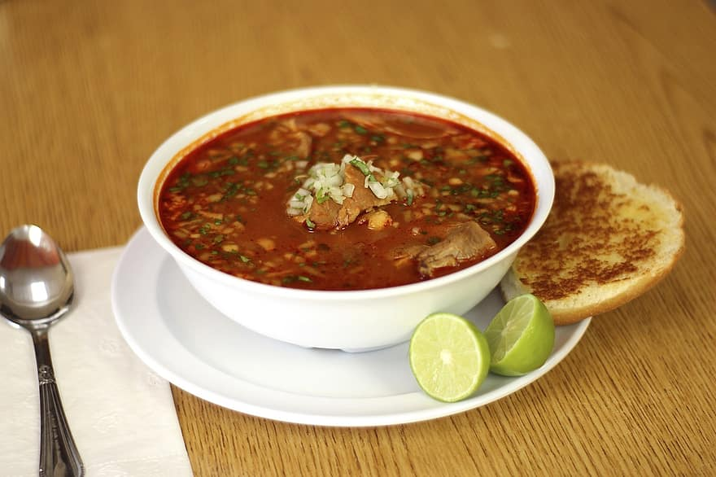
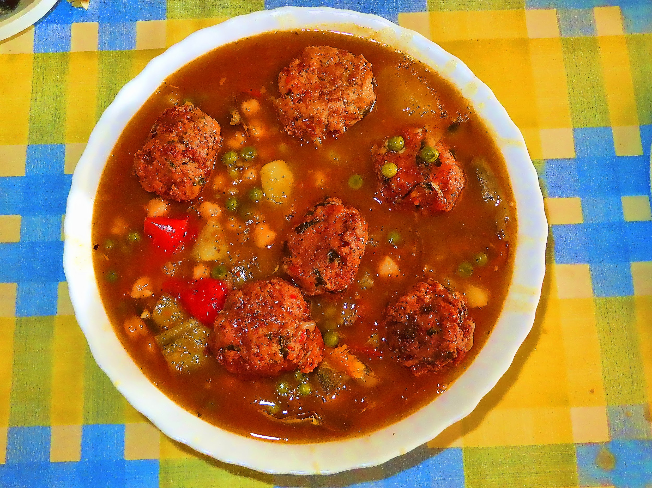
My Favorite foods.
My 2nd favorite food ius Albondigas or in english meatball soup it is very good and contains actual meatballs and veggies like carrots potatoes, cilantro and
My Grandma Makes Pozole for me on my birthdays,christmas and really anyone’s birthday that wants some. There are different types of pozole such as red pozole or green pozole and it is actually very delicious i love it so much i can eat it for up to 5-6 days in a row ask my siblings!

Slide 4

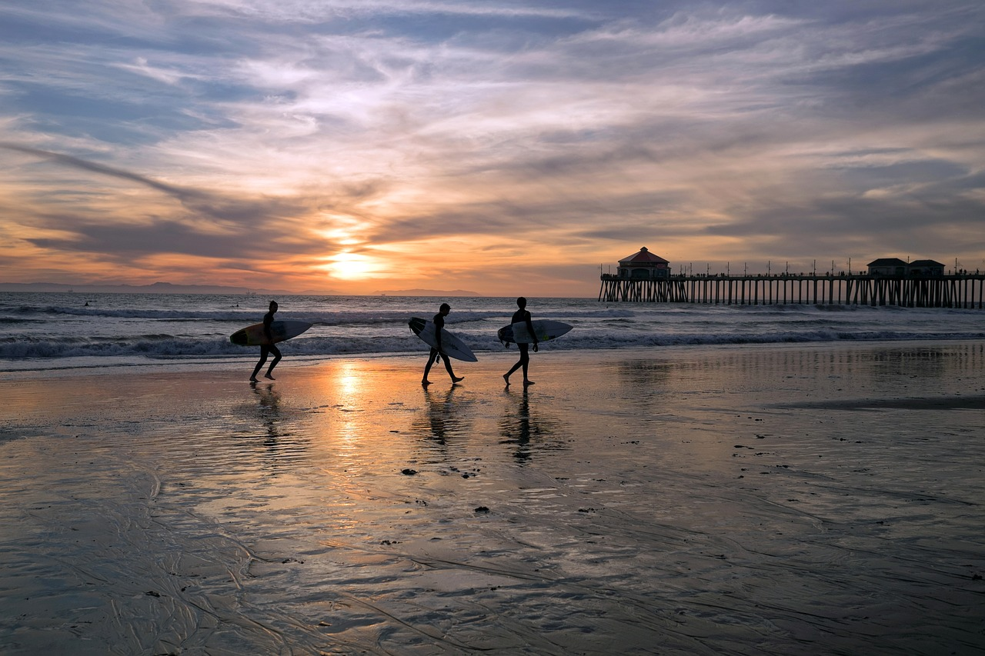

My favorite things to do!

Slide 5





Social Favorites
When i’m not outside i love to watch Youtube, do filters on Snapchat, watch reels on Instagram and watch and make videos on Tiktok

Slide 6

My Friends!
MY Friends are
Kaylee
Vivianna
Rylee
Jesus
People I hang out with at lunch are,
ALL my friends, Josh , Ian and Ramon.

Slide 7

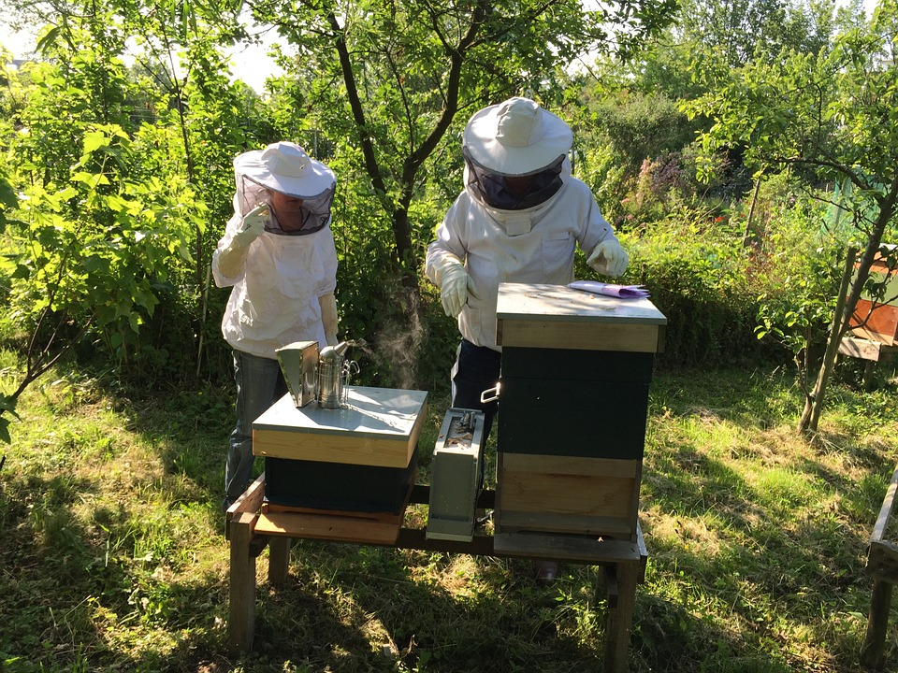
My Family
My Mom Is Rose Tinoco , she’s a single mom
My grandparents are Rocio and leonso Tinoco
My closest cousins that we consider as siblings are
Jose, Eduardo, Eugenio, and Vanessa
Eugenio and Vanessa both came to LOMS also
My Grandparents, Uncles, Aunts and a family friend work in my Grandparents Beekeeping Business (Tinoco Pollination Services)
In total I have 26 Family members and a baby cousin on the way

Slide 8

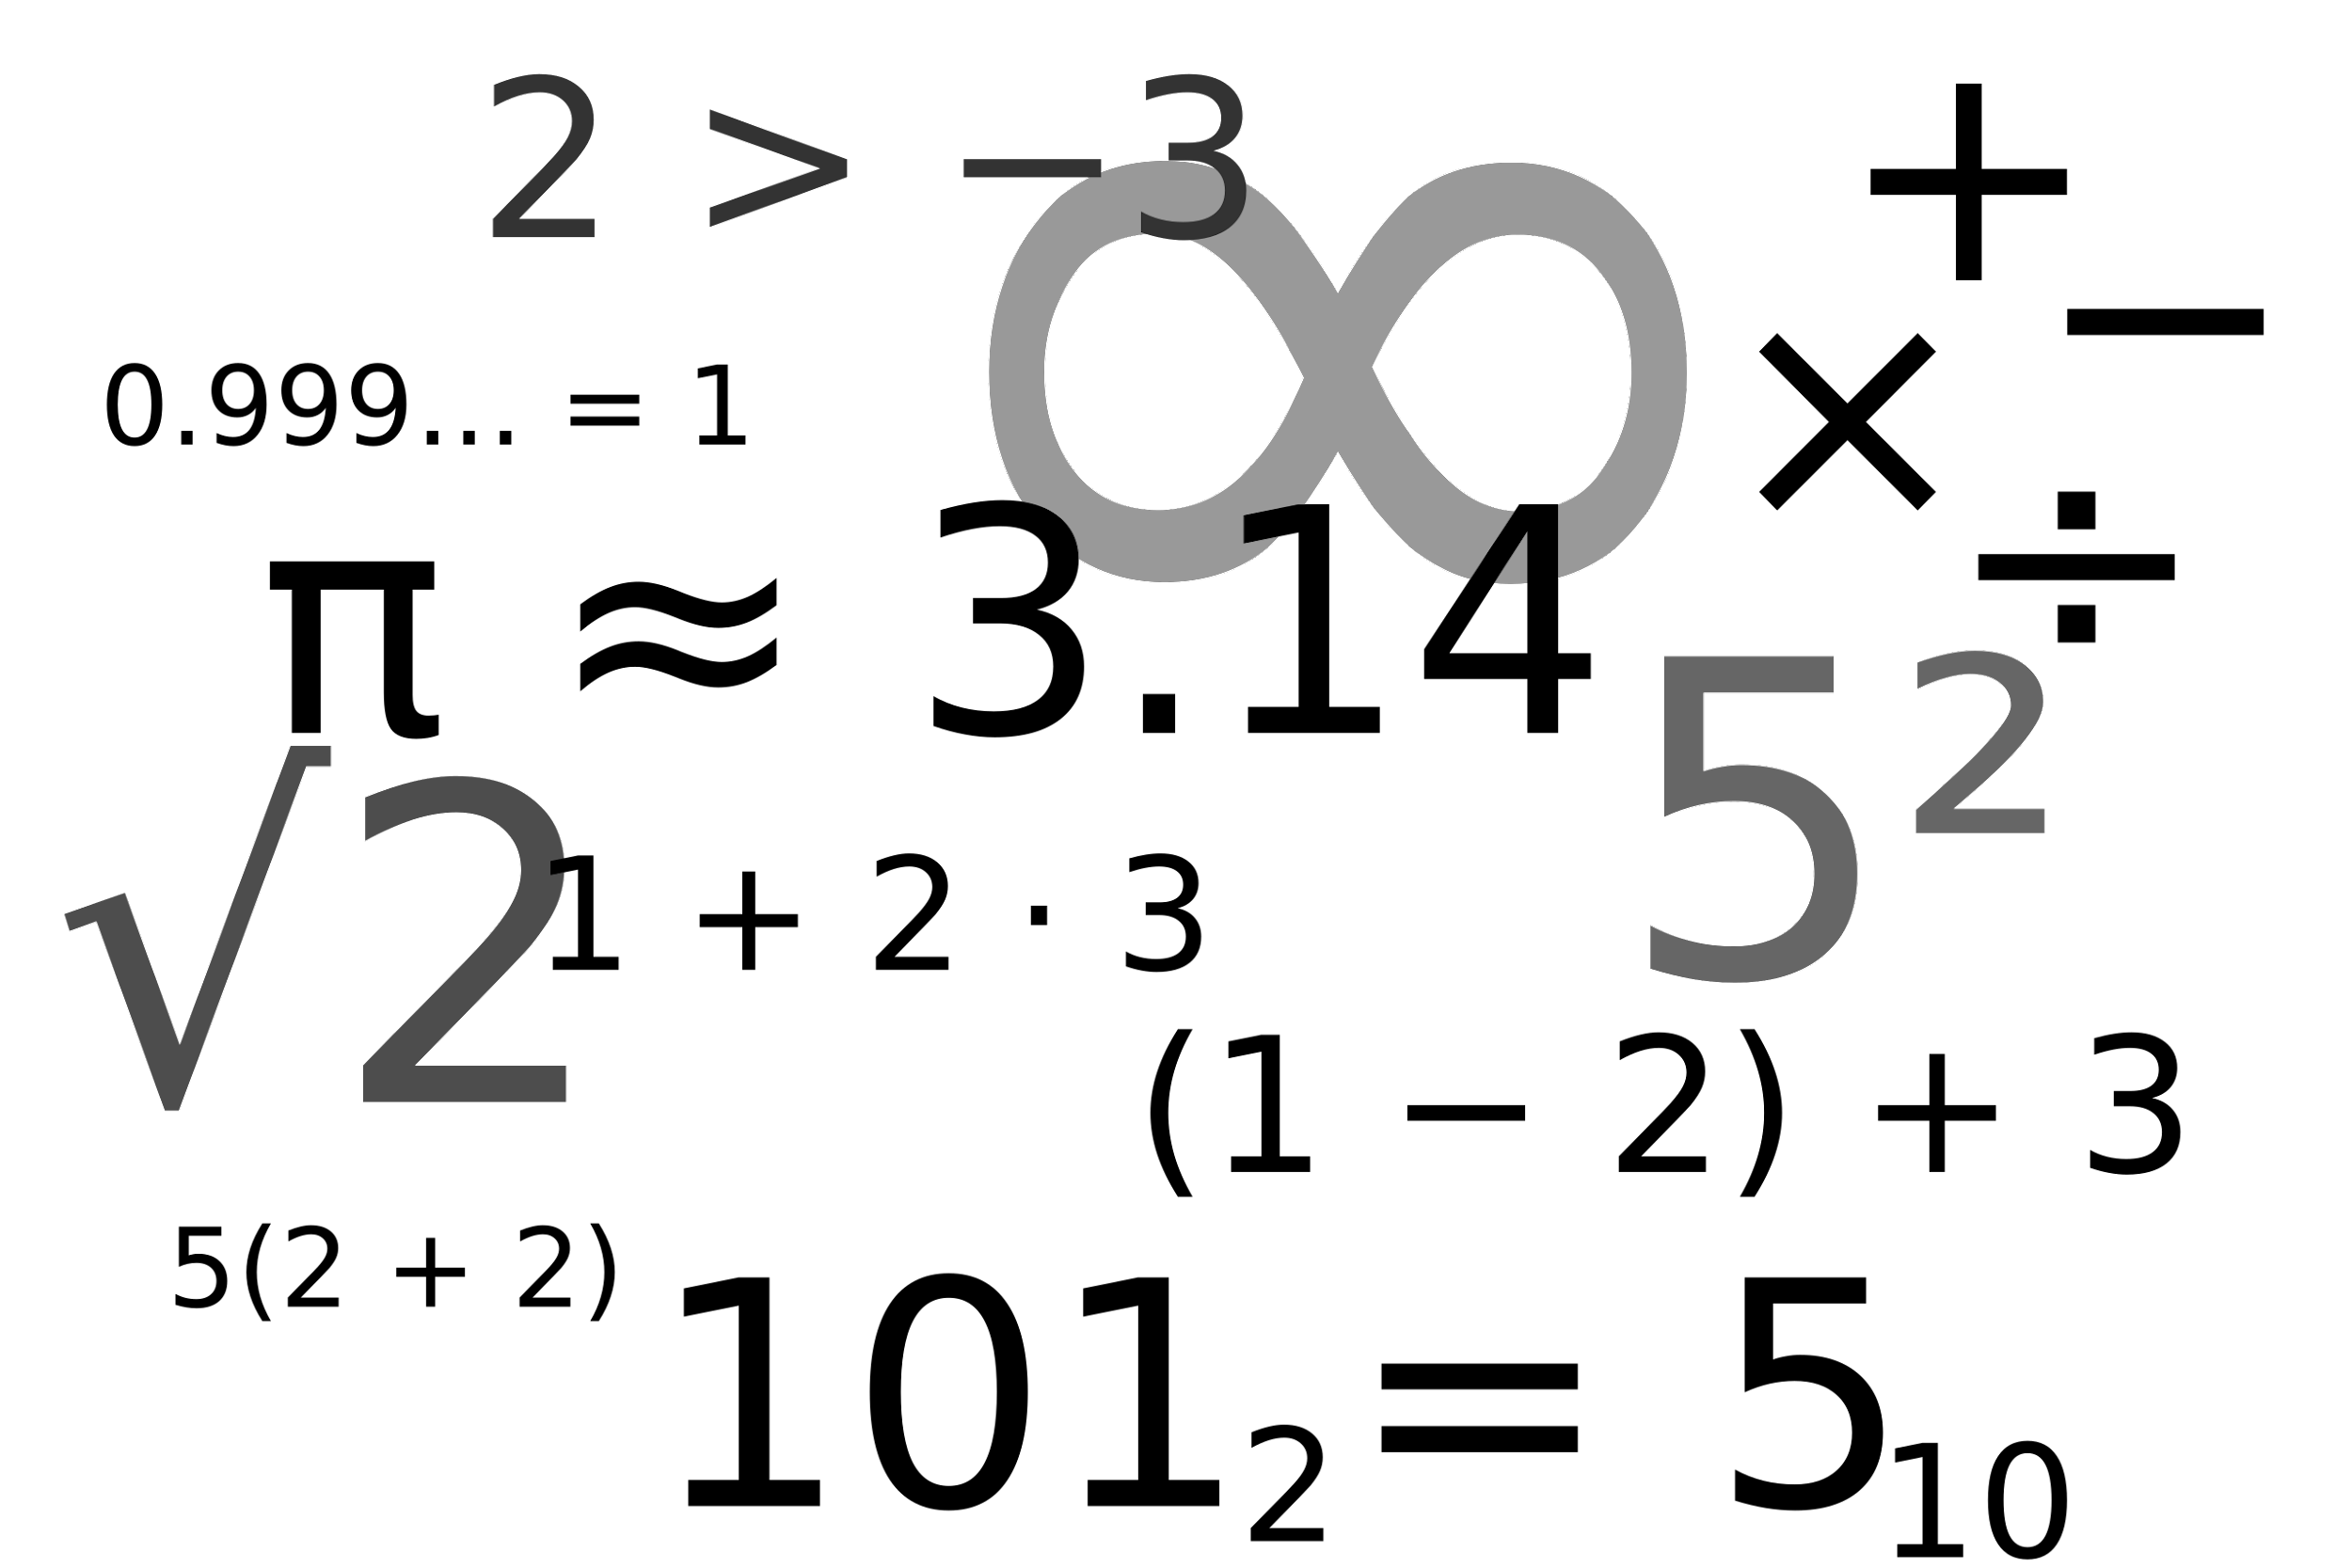
My favorite Subjects
My Favorite Subjects are
Math with Mr.Badovinac and Science with Mr.Perez because I have always liked math I don’t know why even though i’m not the best at it ,and I like science because you get to feel like a real scientist and learn about lots of new things.

Slide 9

My Goals For This year
My Goals for this year are to be more positive even when bad thing are happening , I also would like to study more because I have always had A+ and B+ but because of DL I wasn’t always very focused so my grade went downhill and im trying to make them go back up to the clouds.

Slide 10
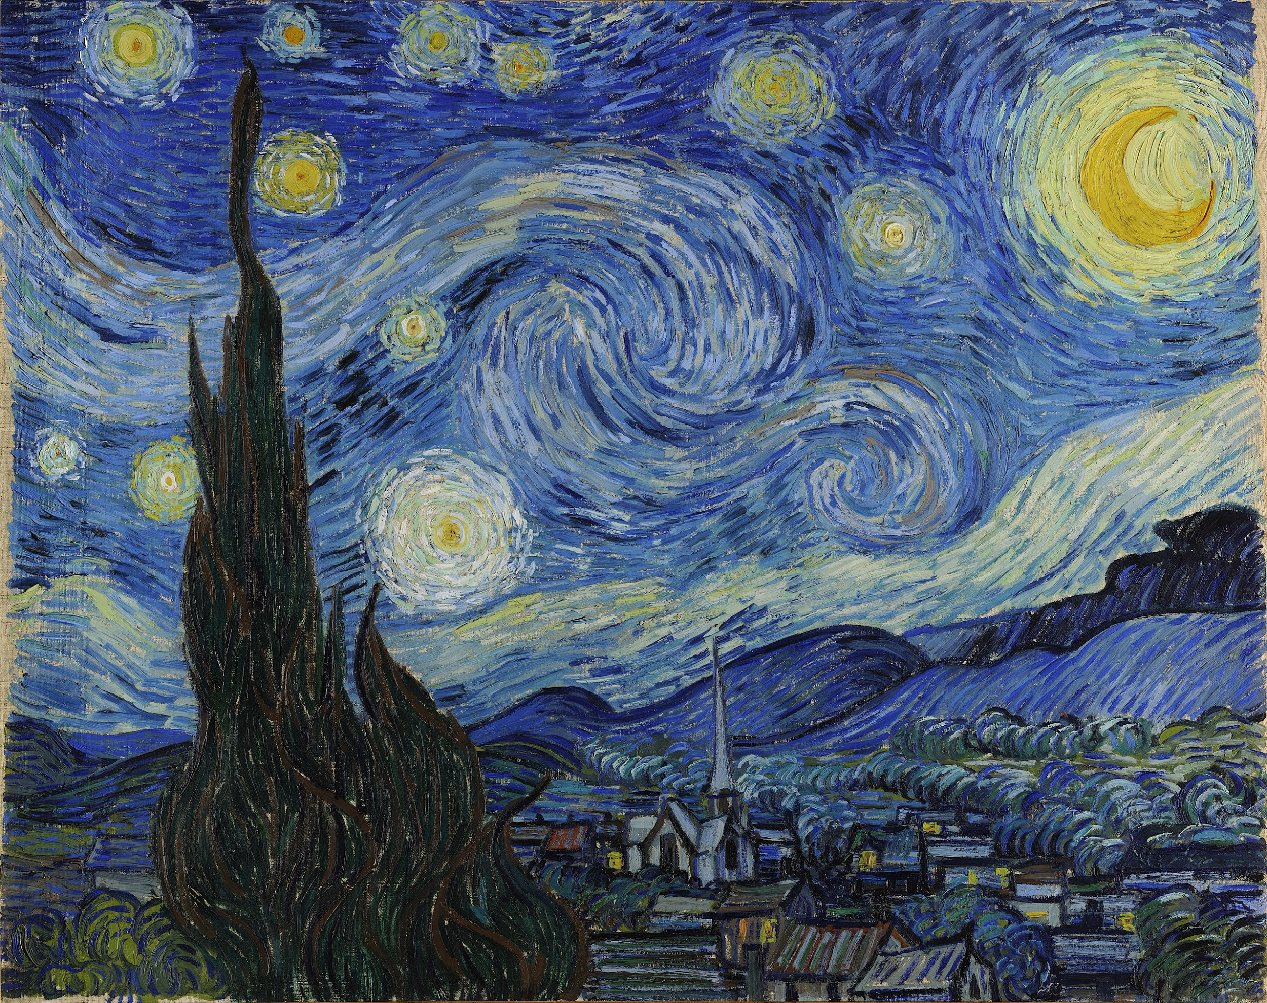
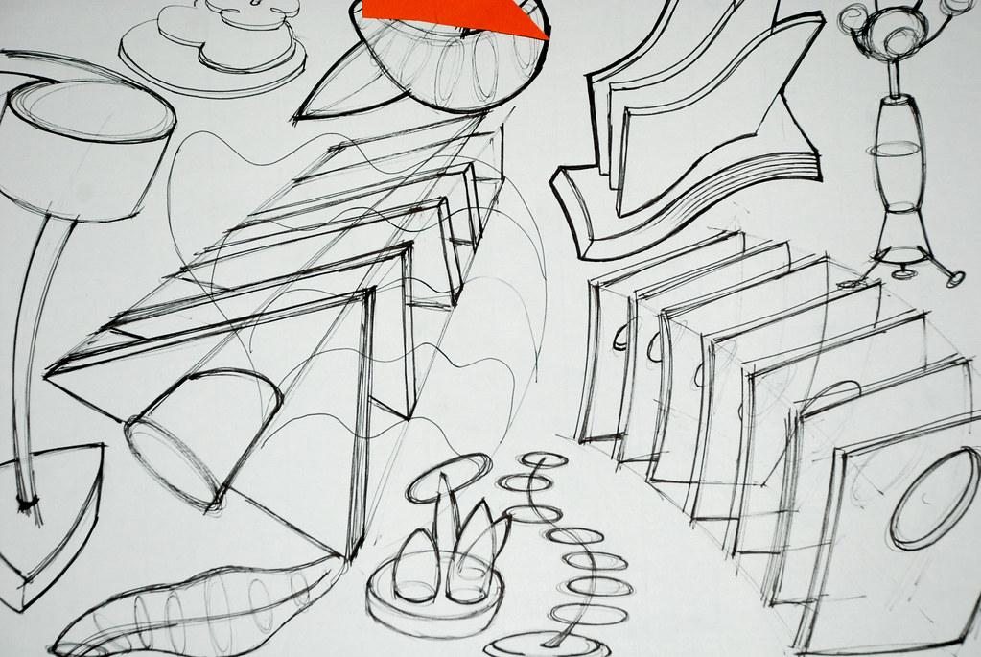
Art
I’ve always loved drawing and to this day I am actually really good at it when i’m mad or sad or happy I like to draw my feelings and I am really good at drawing Flowers, Names in Calligraphy ,and people.

Slide 11

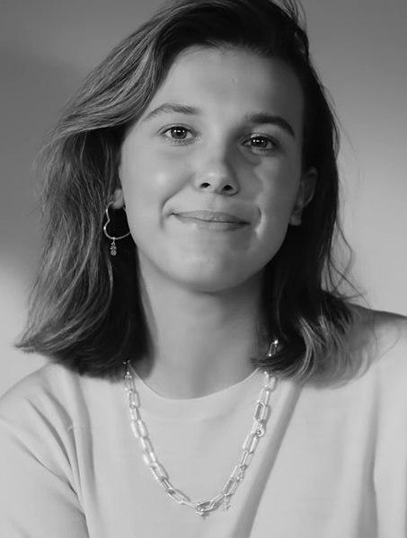


My dreams When Im older!
I would really love to become a big movie star/ Actress like my role model Millie Bobby Brown . My dream College is to go to UCLA, Berkeley and/or Harvard.

Slide 12



Conclusion Slide
I hope you Enjoyed this little presentation about me, and learned something from it and i hope alots of my dreams will come true in the future

