Slide 1

All About Me
Jasmine barrientos

Slide 2
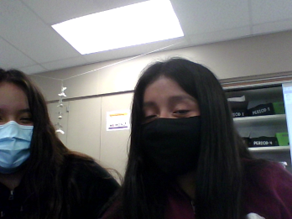
My best friend yuliana:
This is my best friend yulliana,We have been best friends for over 4 years so far she is really fun to talk to most of the time.One thing i like about her is that she always cheers me up when am sad or upset as well she has been an amazing friend so far.

Slide 3
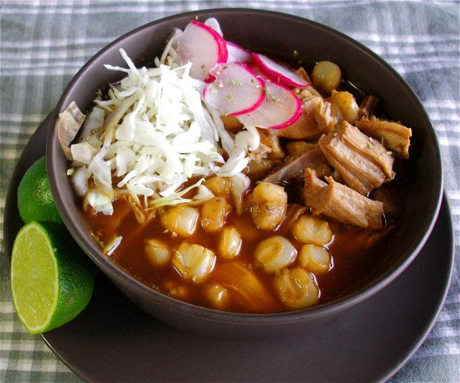
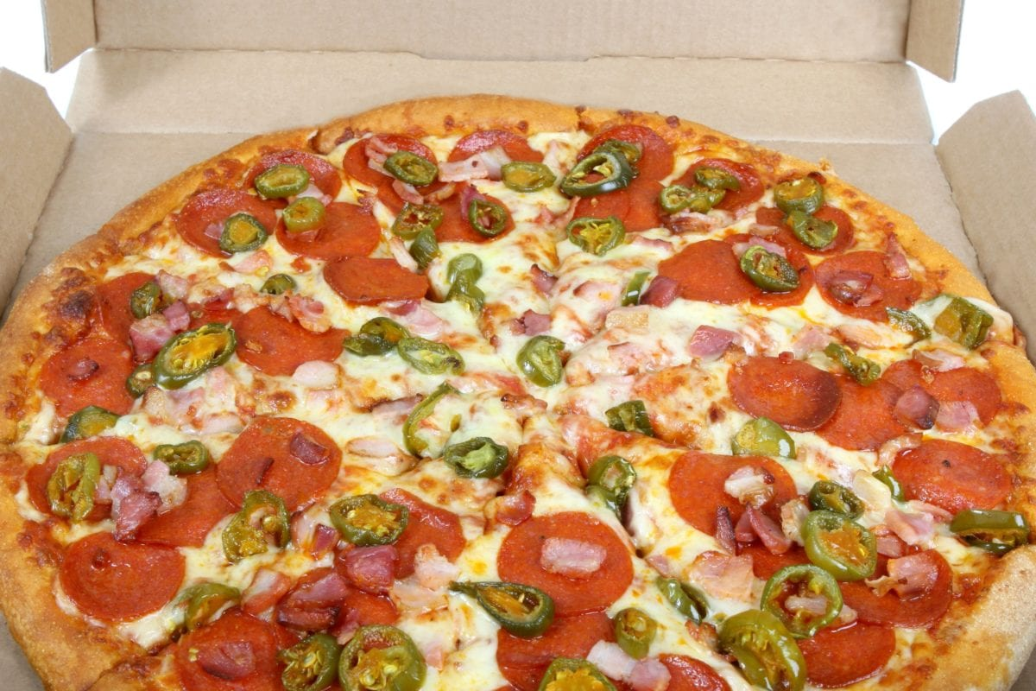
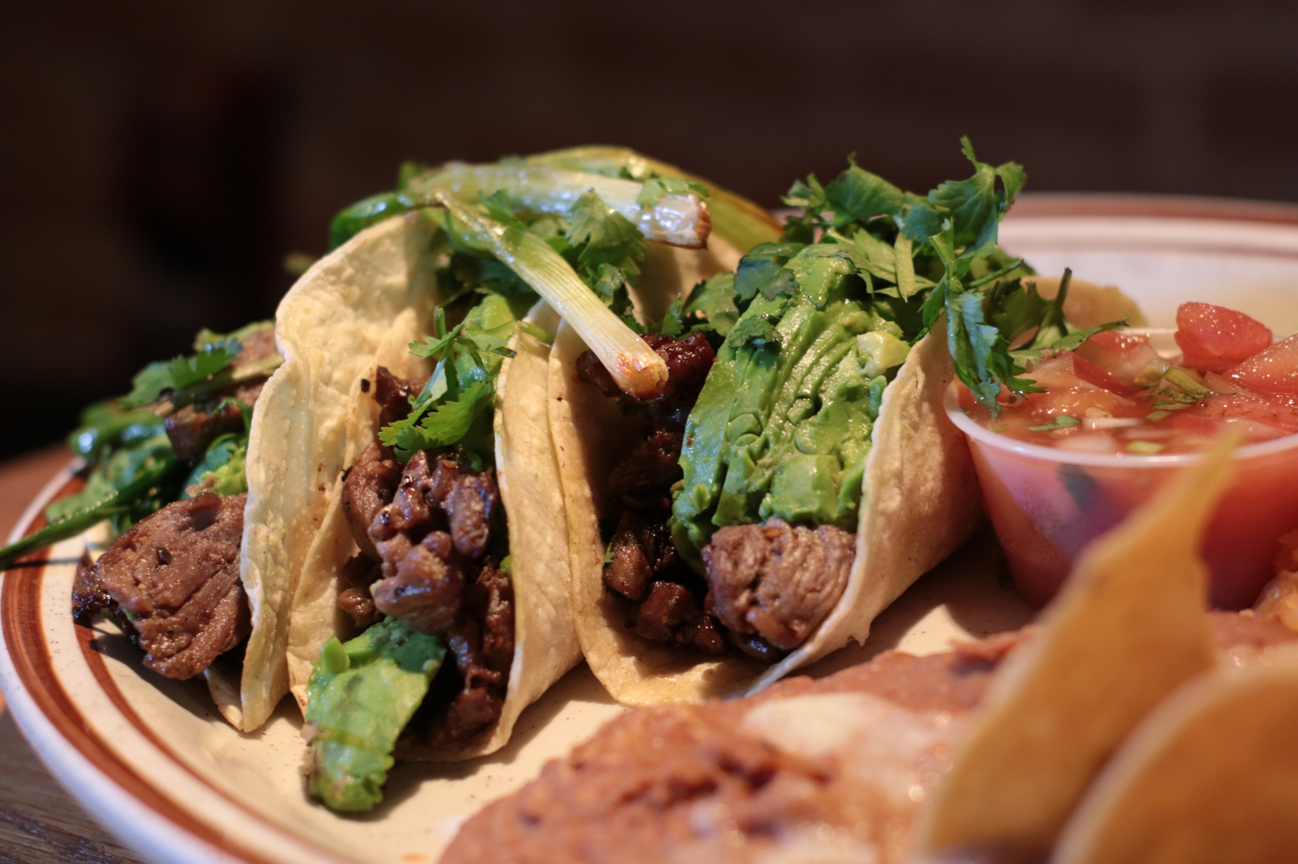
My favorite food:
One of my favorite food is-------->
Pizza: tacos: pozole
I eat this food mostly during a holiday,I love pepperoni pizzas if i have a choice
1 reason why i love tacos is because of the spicy sauce.
I enjoy eating pozole because of the carne with lemon.

Slide 4
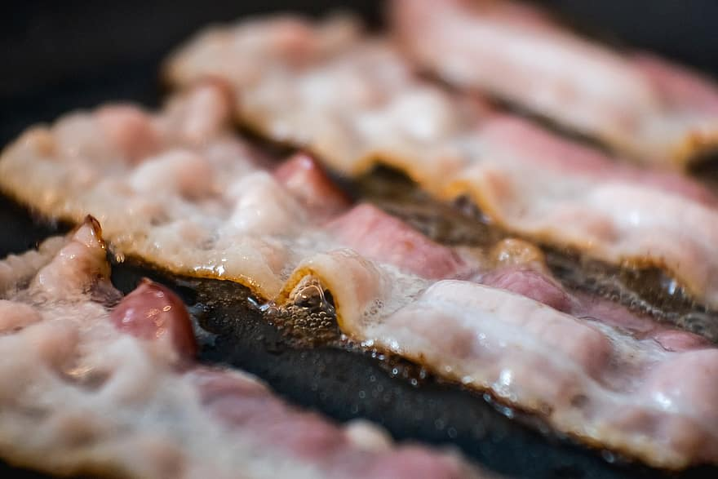
Maggie my dog
I have a dog named maggie she is ¾ years old I have had her since what I remember I was in 3rd grade she is a chihuahua,Sometimes I take her on walks and give her treats her favorite treat is baked bacon,Something cool about her is that she sits down or gives you her paw for a treat she gets very excited when we say the word baken because they are her favorite treat.

Slide 5
My favorite sports and hobby
Volleyball:
I like volleyball because you cant let the ball touch the ground and you have to run to not let the ball fall.
I enjoy dancing to mexican music and singing mexican music most of the time.
Coloring is also something I enjoy doing when I have nothing to do most of the time.

Slide 6
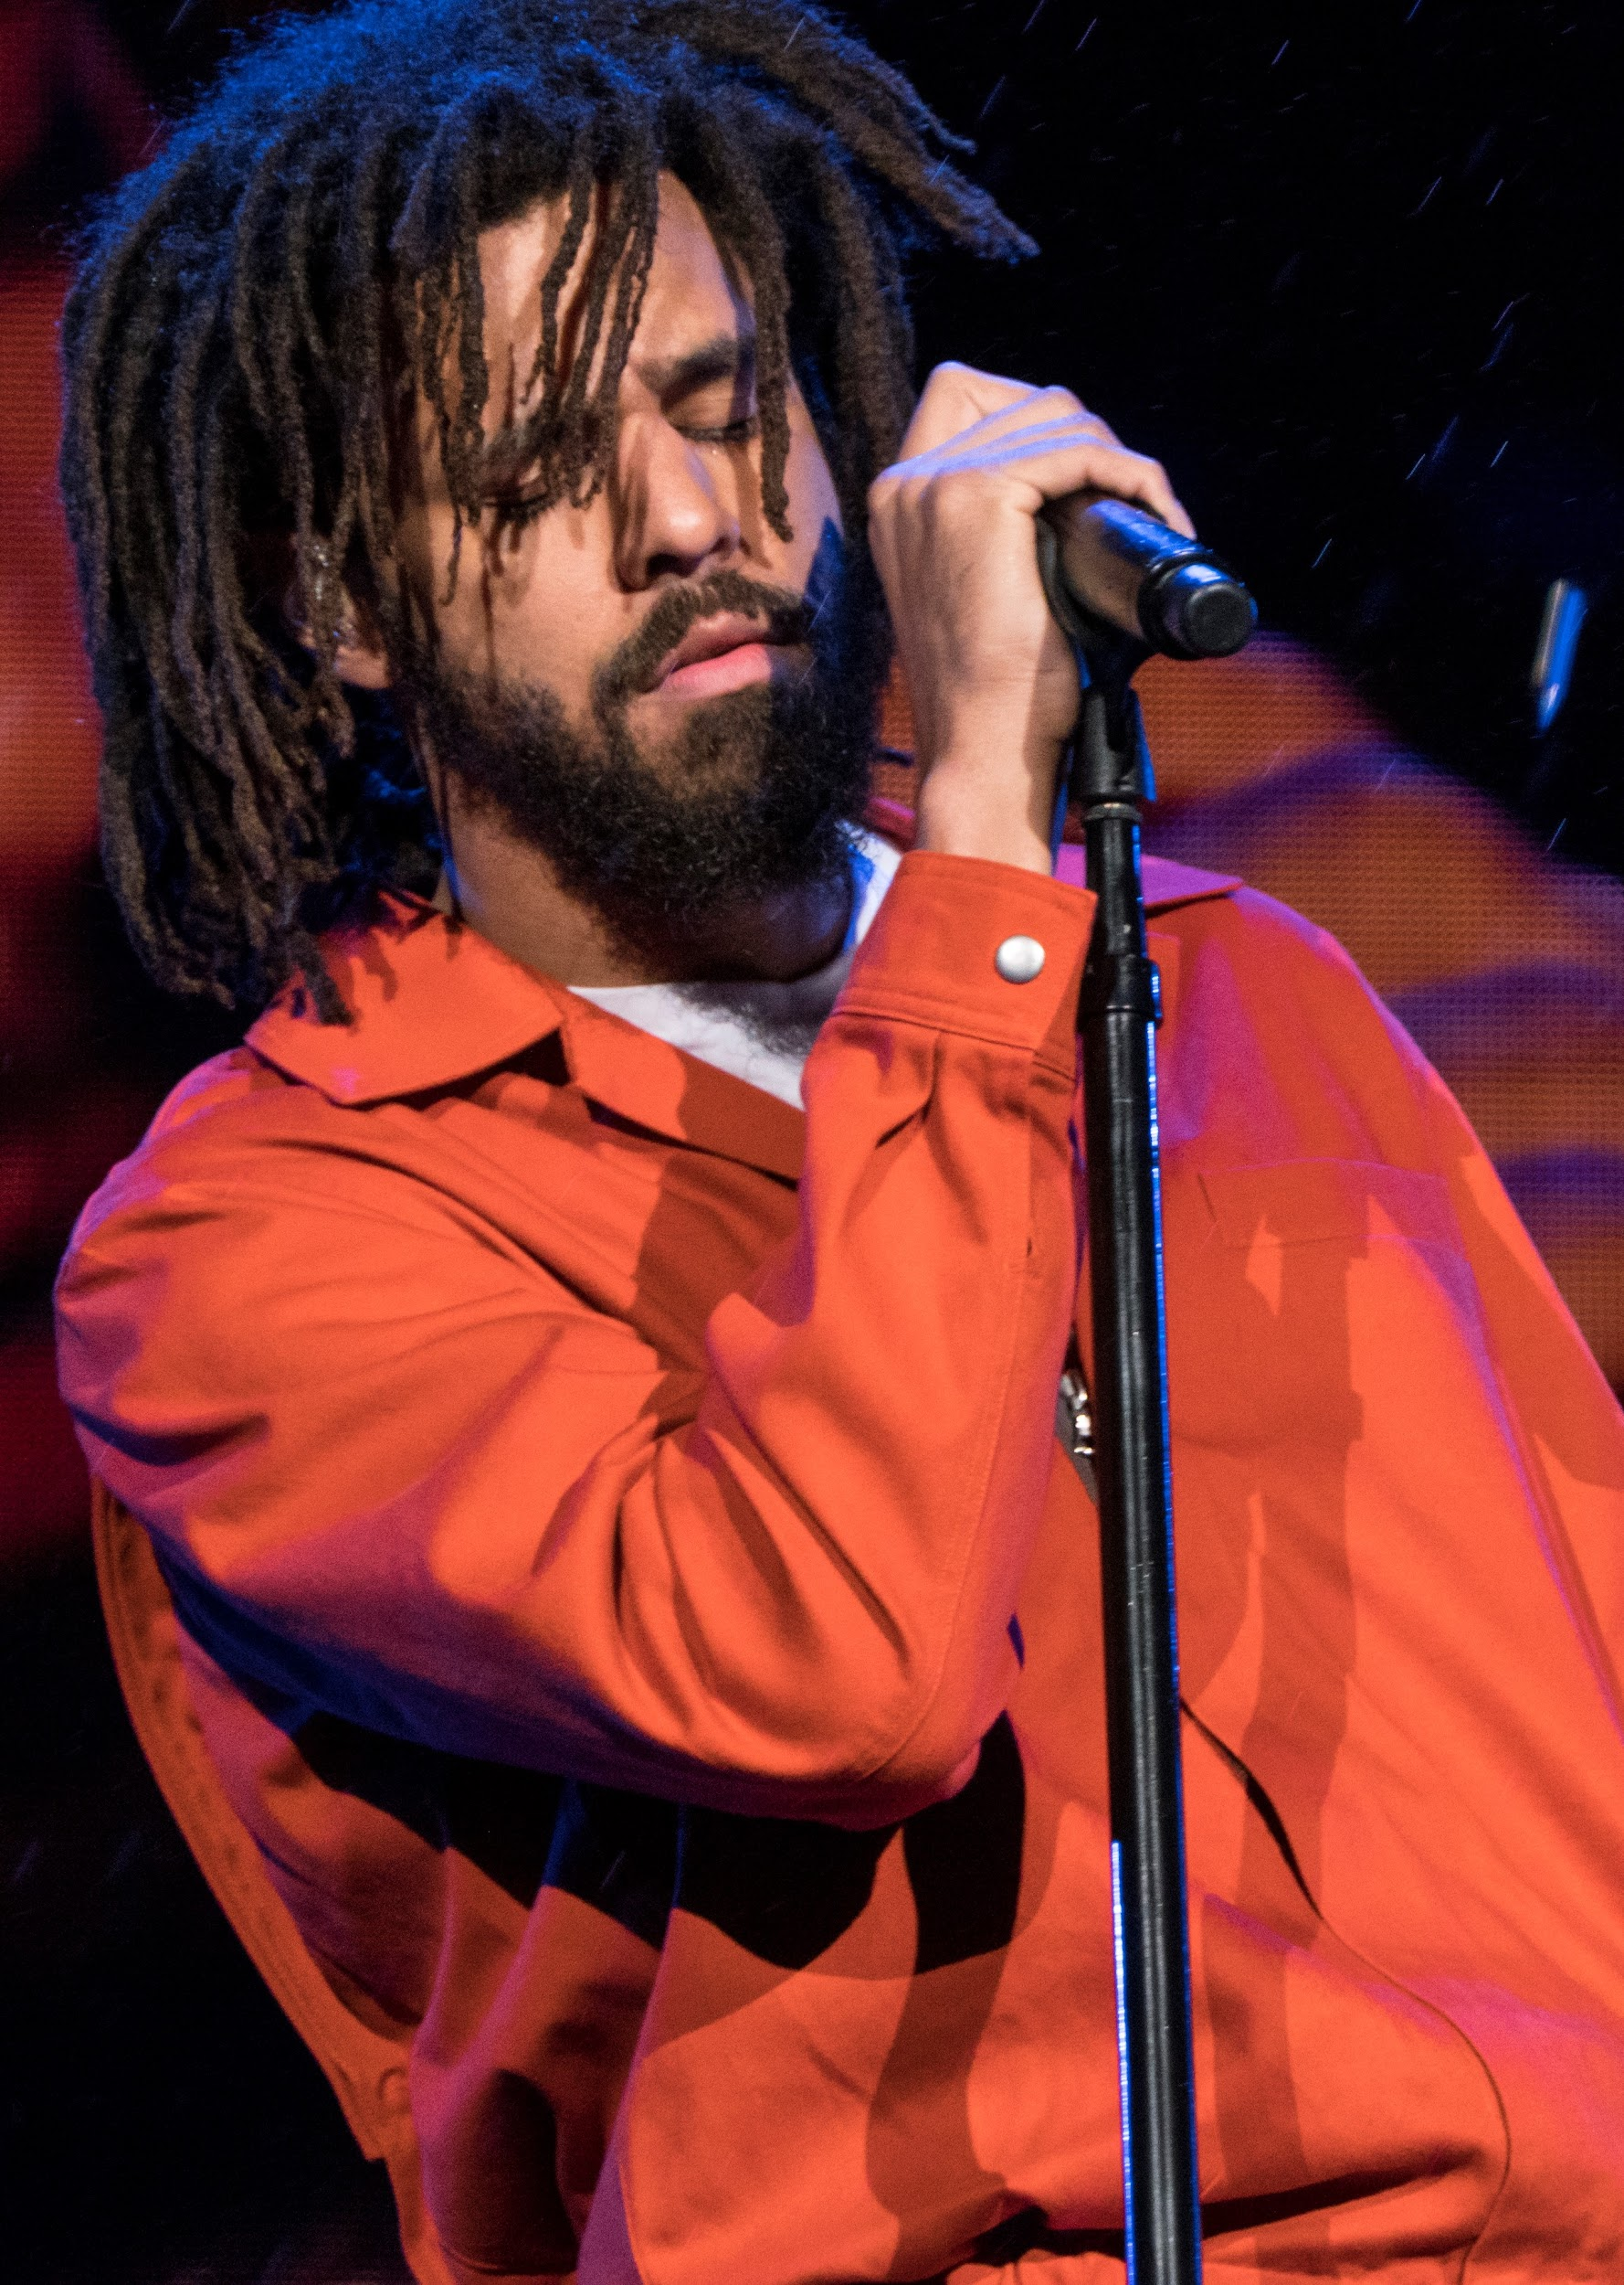
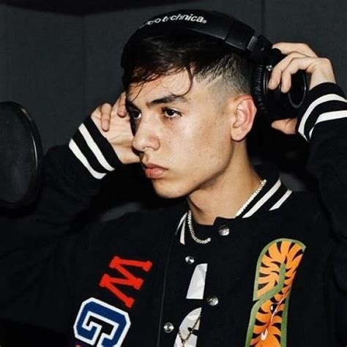
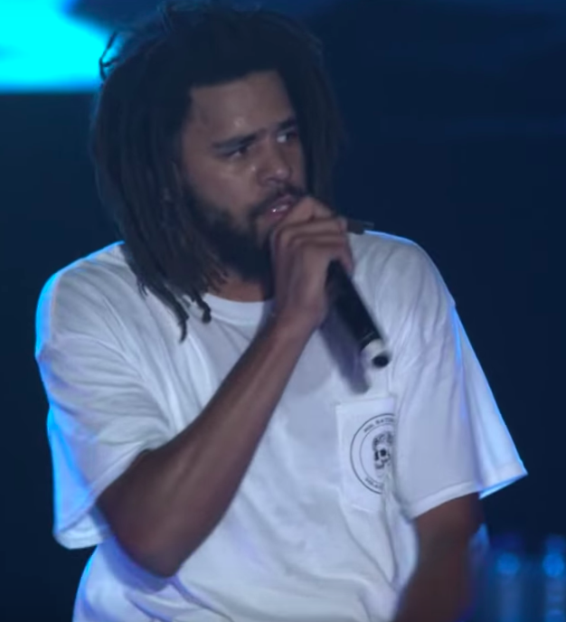
Favorite songs
One of my favorite singer would be J cole he is my favorite singer because i like how his song beats are good to the rhythms in his lyrics.
Also,Natal cano is another of my favorite singer because he is a good corrido singer.
Natal cano J cole

Slide 7
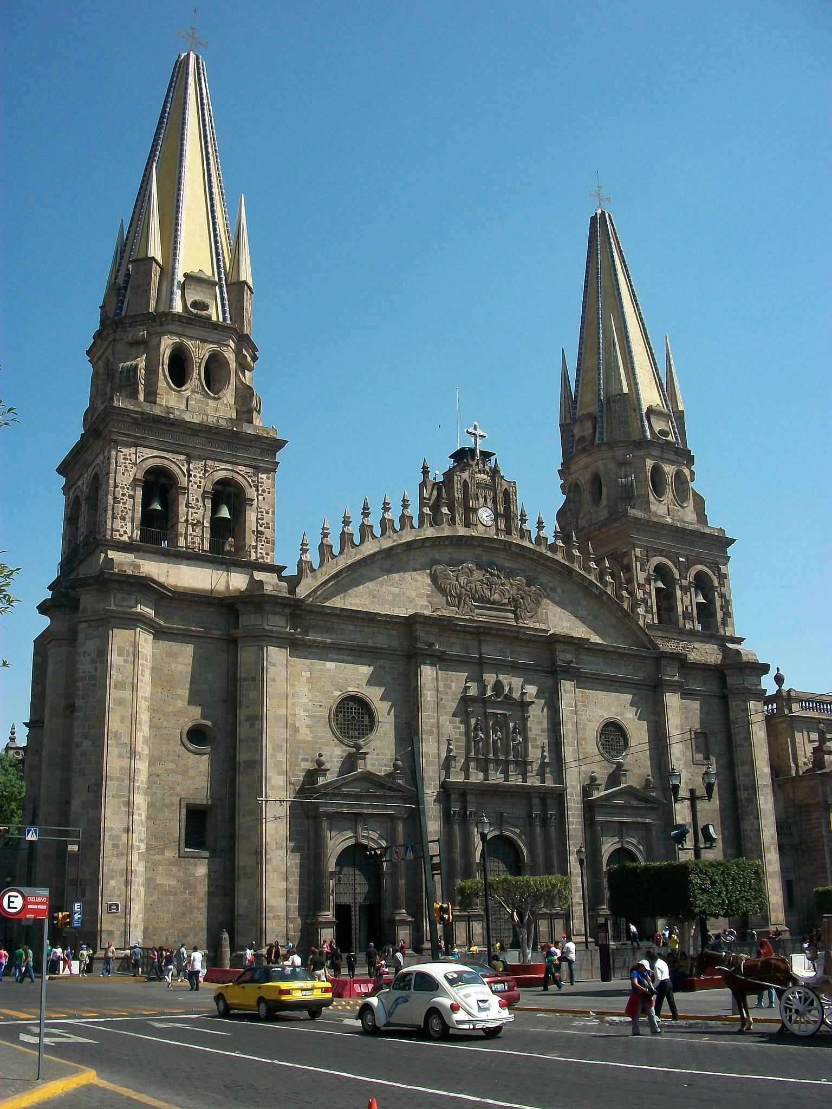
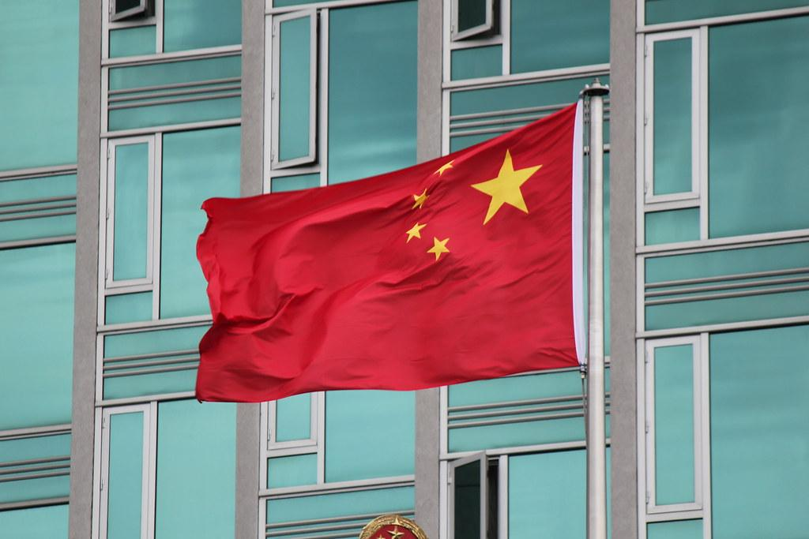
Somewhere I would want to visit.
I would personally want to visit china,One reason why i wanna visit china is because of the food and culture there cool things you can do there,I would also want to understand the language when i grow up or maybe even now thats a place i will visit when am older.
Jalisco,I heard jalisco is one of the most popular or recent place,They also make food taste xxtimes better than the original they have good spicy candy as well that is like my favorite.

Slide 8

How do I feel about covid?
When covid started I never thought it would've came to the part where we couldn't go to school I really missed my friends teachers,I was really upset about it till this day there's been a few more cases about covid I really miss family gatherings we got lucky that I or my mom and dad didn't get covid.

Slide 9
My silly sister!
I have a sister named Griselda she is one of the best sisters she is nice and kind me and griselda argue most of the time but end up laughing at the end my sister is in 10th grade she is very short and shy sometimes she is one of the bravest sister in the whole entire walnut country she is always there for me when am sad or upset!

Slide 10

My family
My family is not so big in my opinion well I only know some of my family members but I love them all,I have a cousin named jazmine and she is very funny when am sad she makes me laugh with her jokes i enjoy being around her were never apart unless we get different classes.My family is hispanic am hispanic too I love being hispnic because of the food and culture!

Slide 11
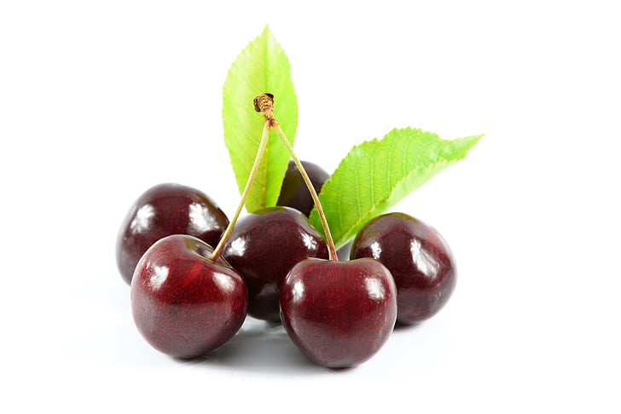
Working
Over the summer I worked picking cherrys in oregon it was really fun I went to an area where you can look at the ocean that separates oregon and another place all the way up a hill.

