Slide 1
All About Me
By:
Jennifer Ramirez

Slide 2
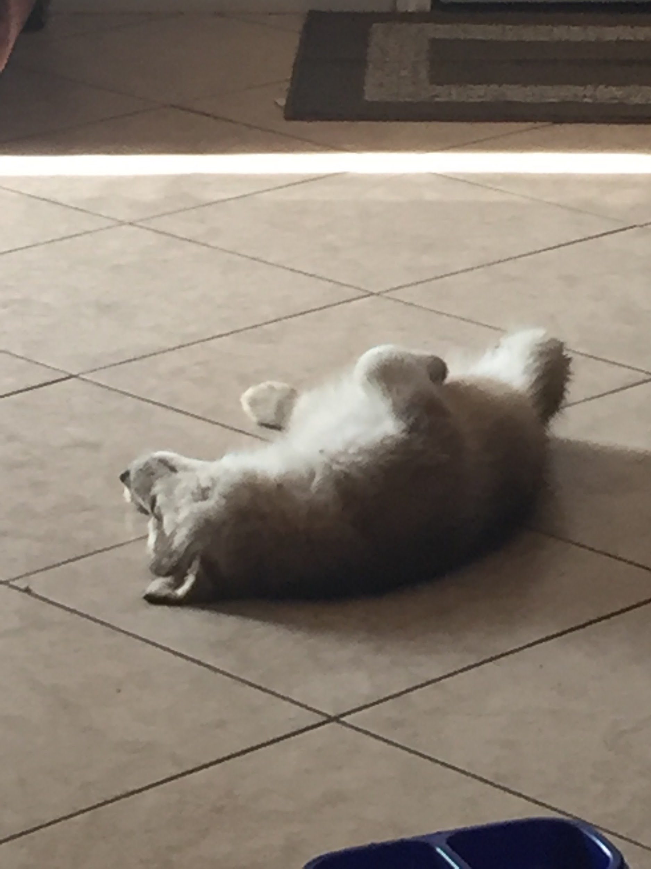
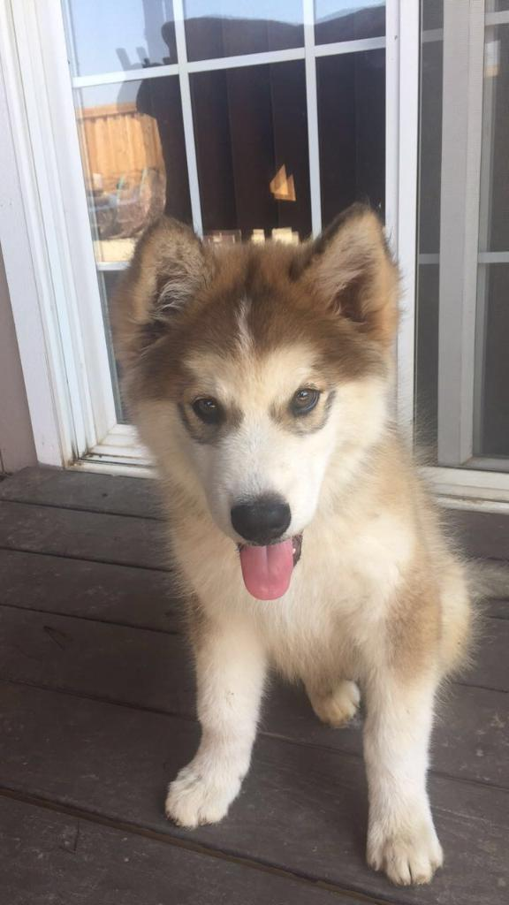


My pet
I have one husky
He is 3 months old
He likes to go on runs and walks
His name is Toby
Toby

Slide 3
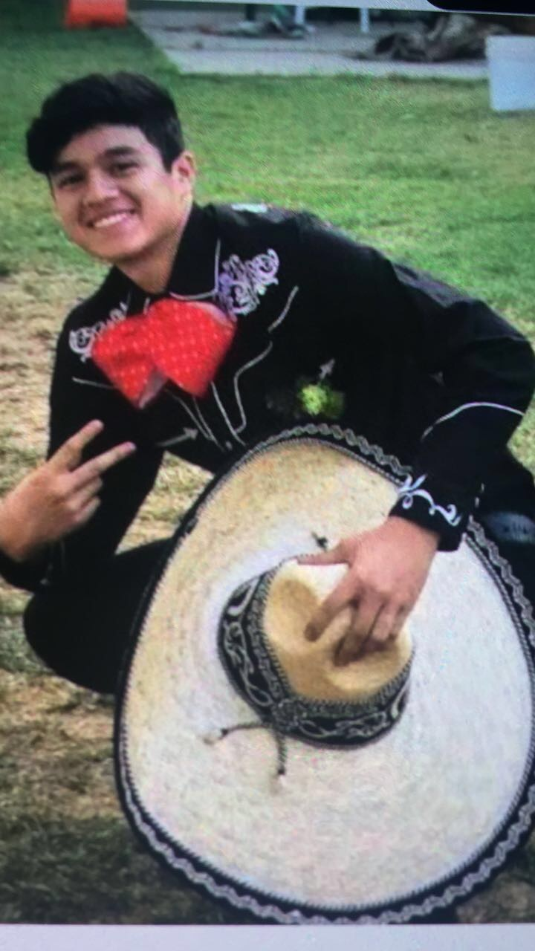
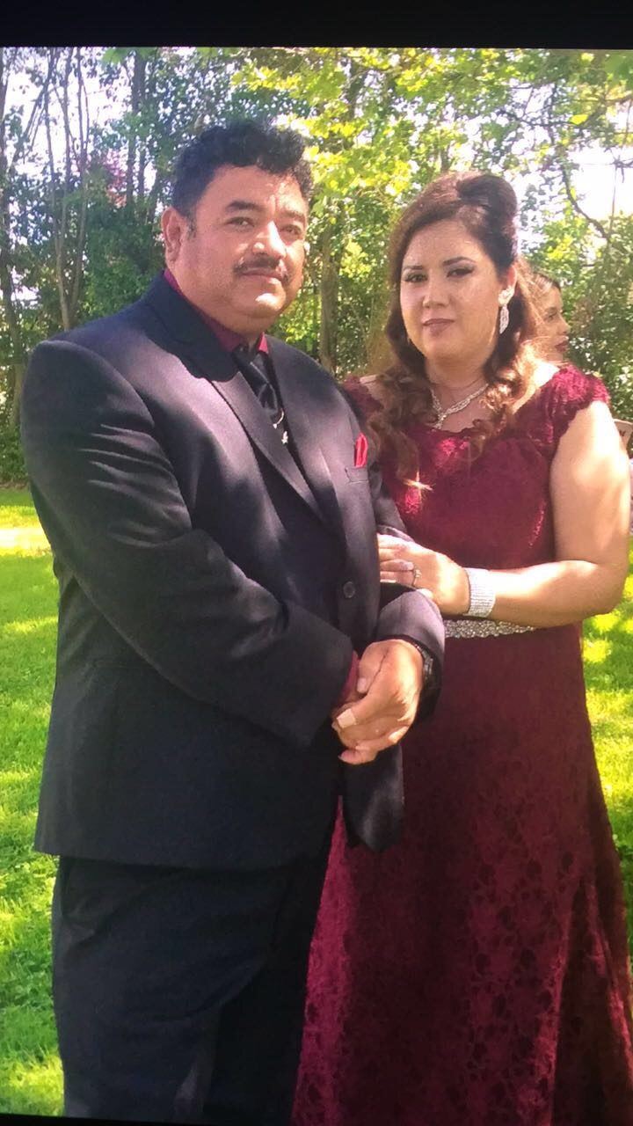
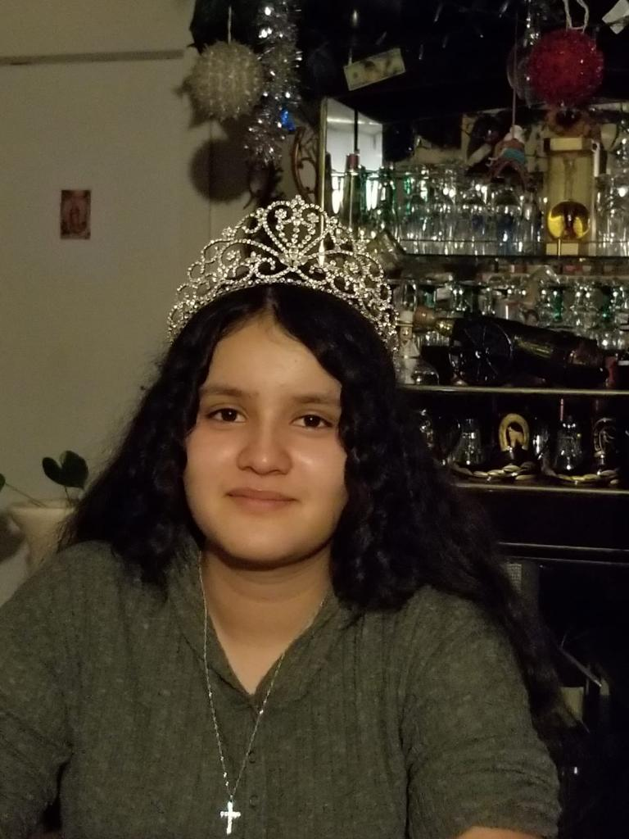
My family
Danny - 20
Dad - 48
I have 2 older siblings
My parents got married at 14
My mom had my brother when she was 18
My mom had my sister when she was 22
My mom had me when she was 27
Mom - 40
Susie - 17

Slide 4
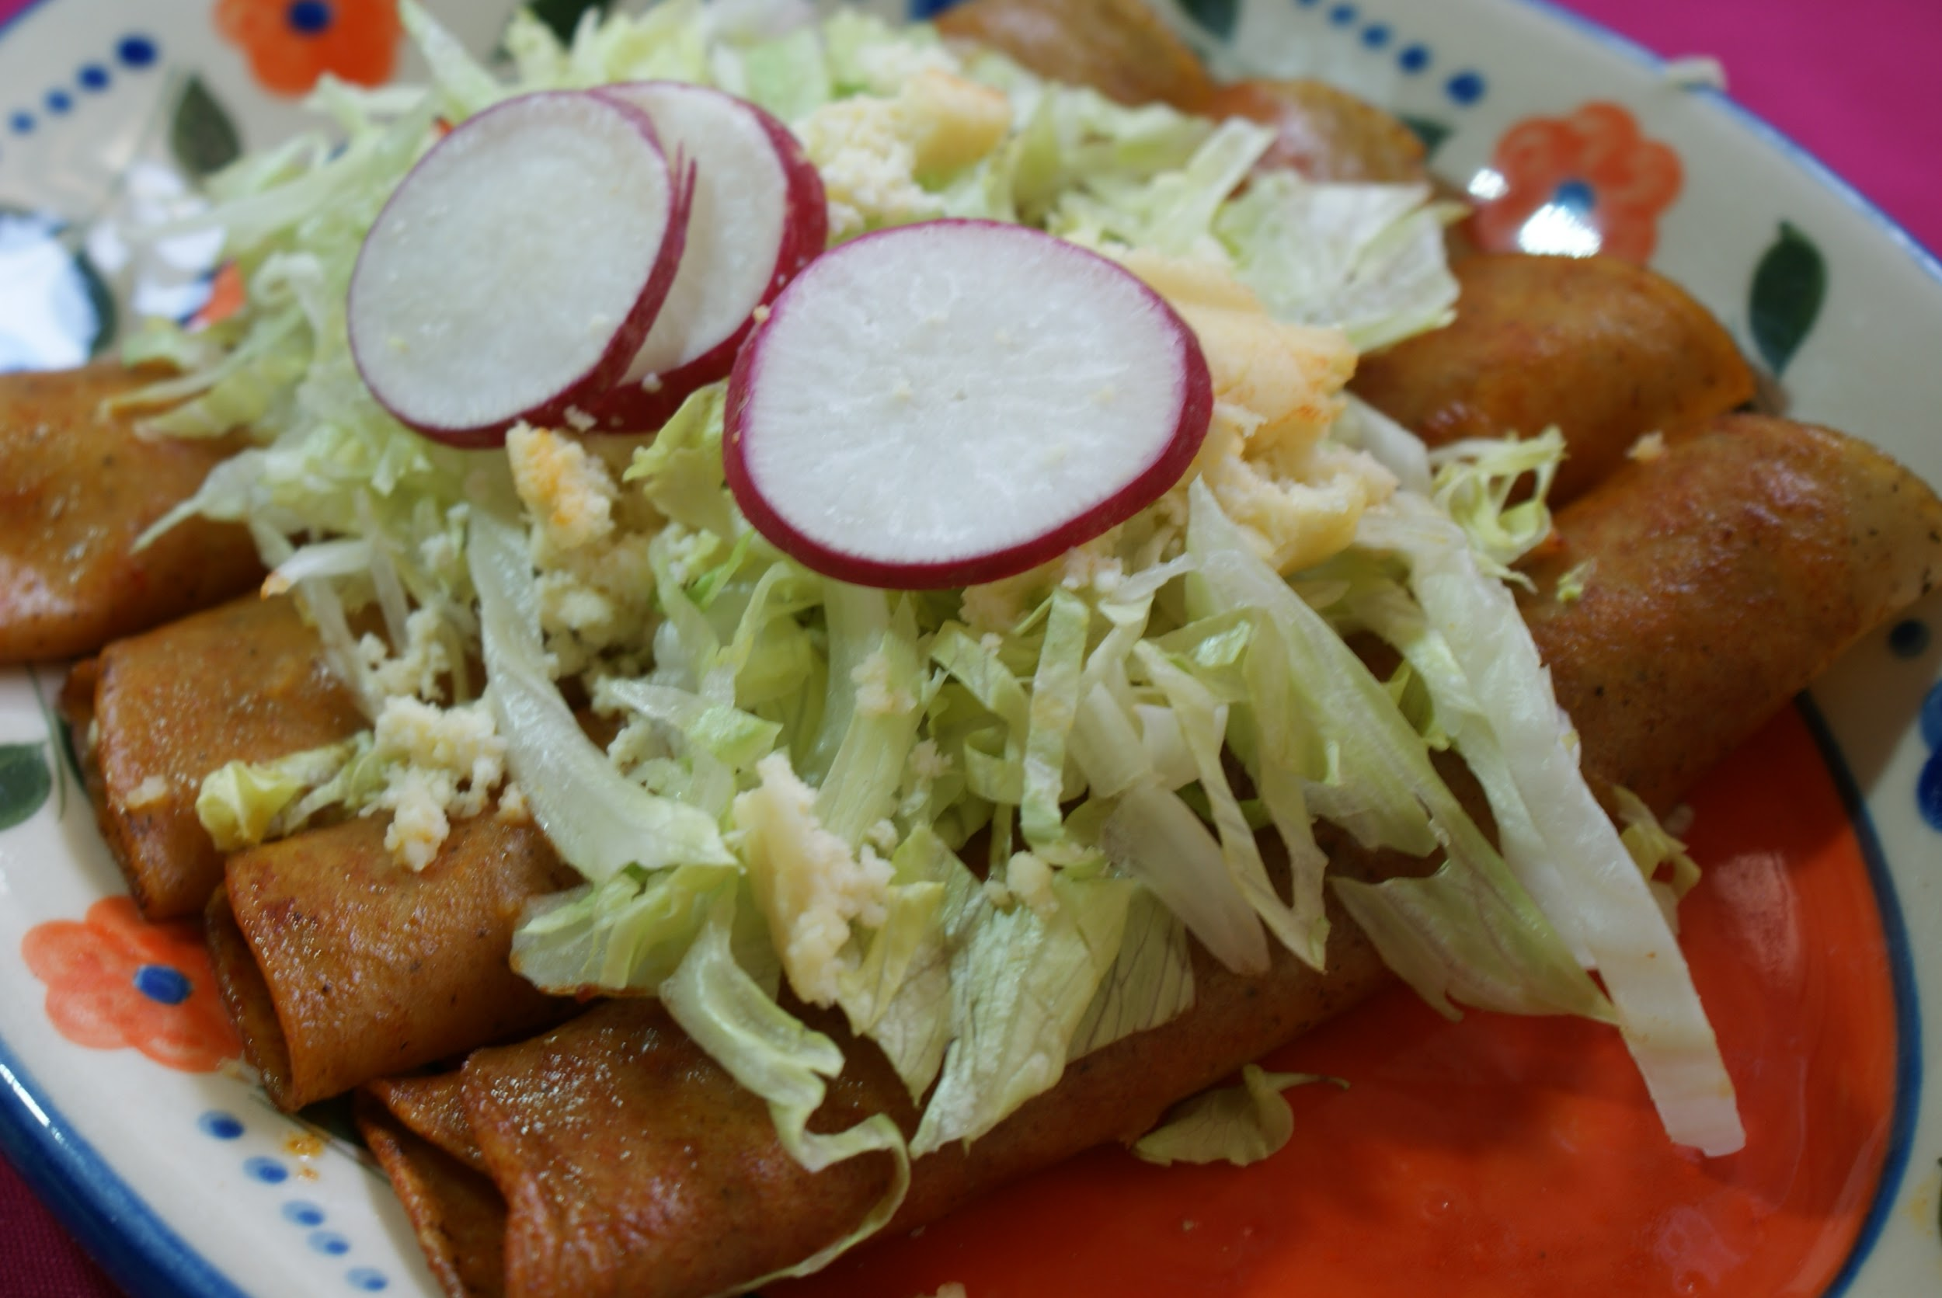
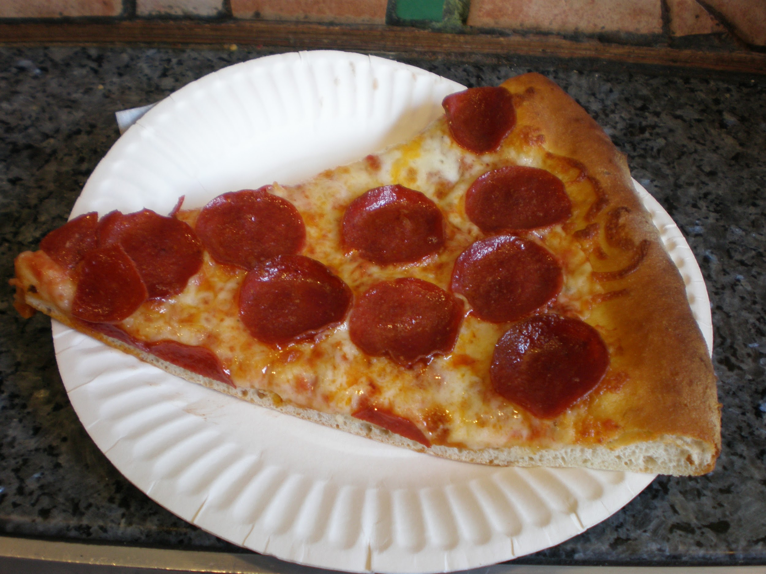
Favorite foods
I don’t have as much favorite foods
Enchiladas
Pizza

Slide 5
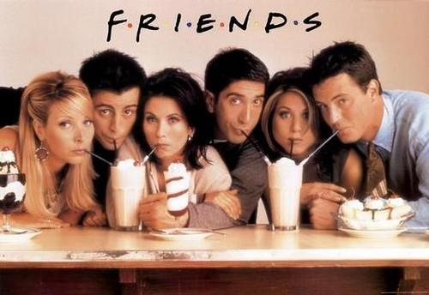
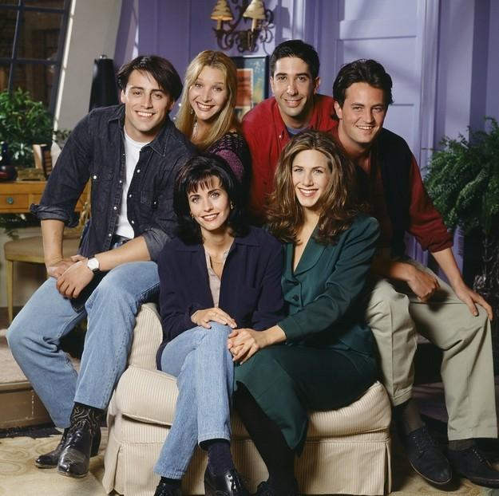
Favorite T.V series
My favorite T.V series is F.R.I.E.N.D.S

Slide 6




My favorite colors
One of my favorite colors are blue/sky blue
Another one of my favorite colors are red/light red
Lastly another of my favorite colors lime

Slide 7
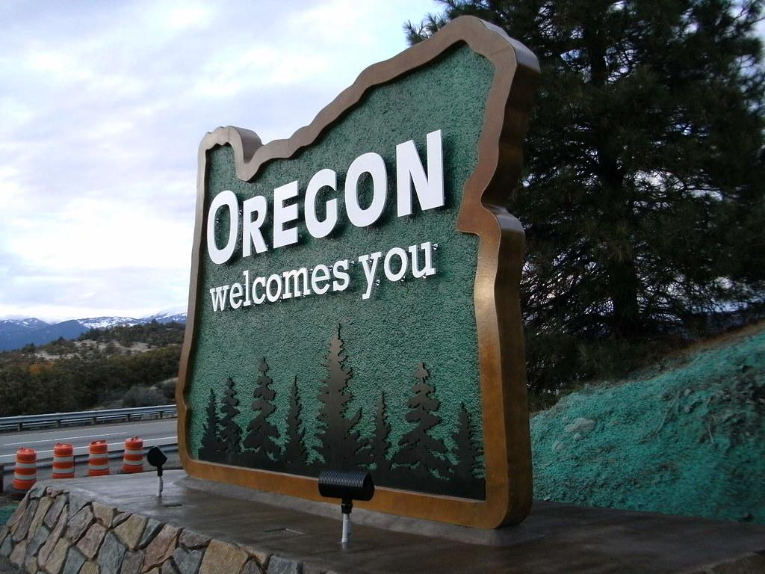
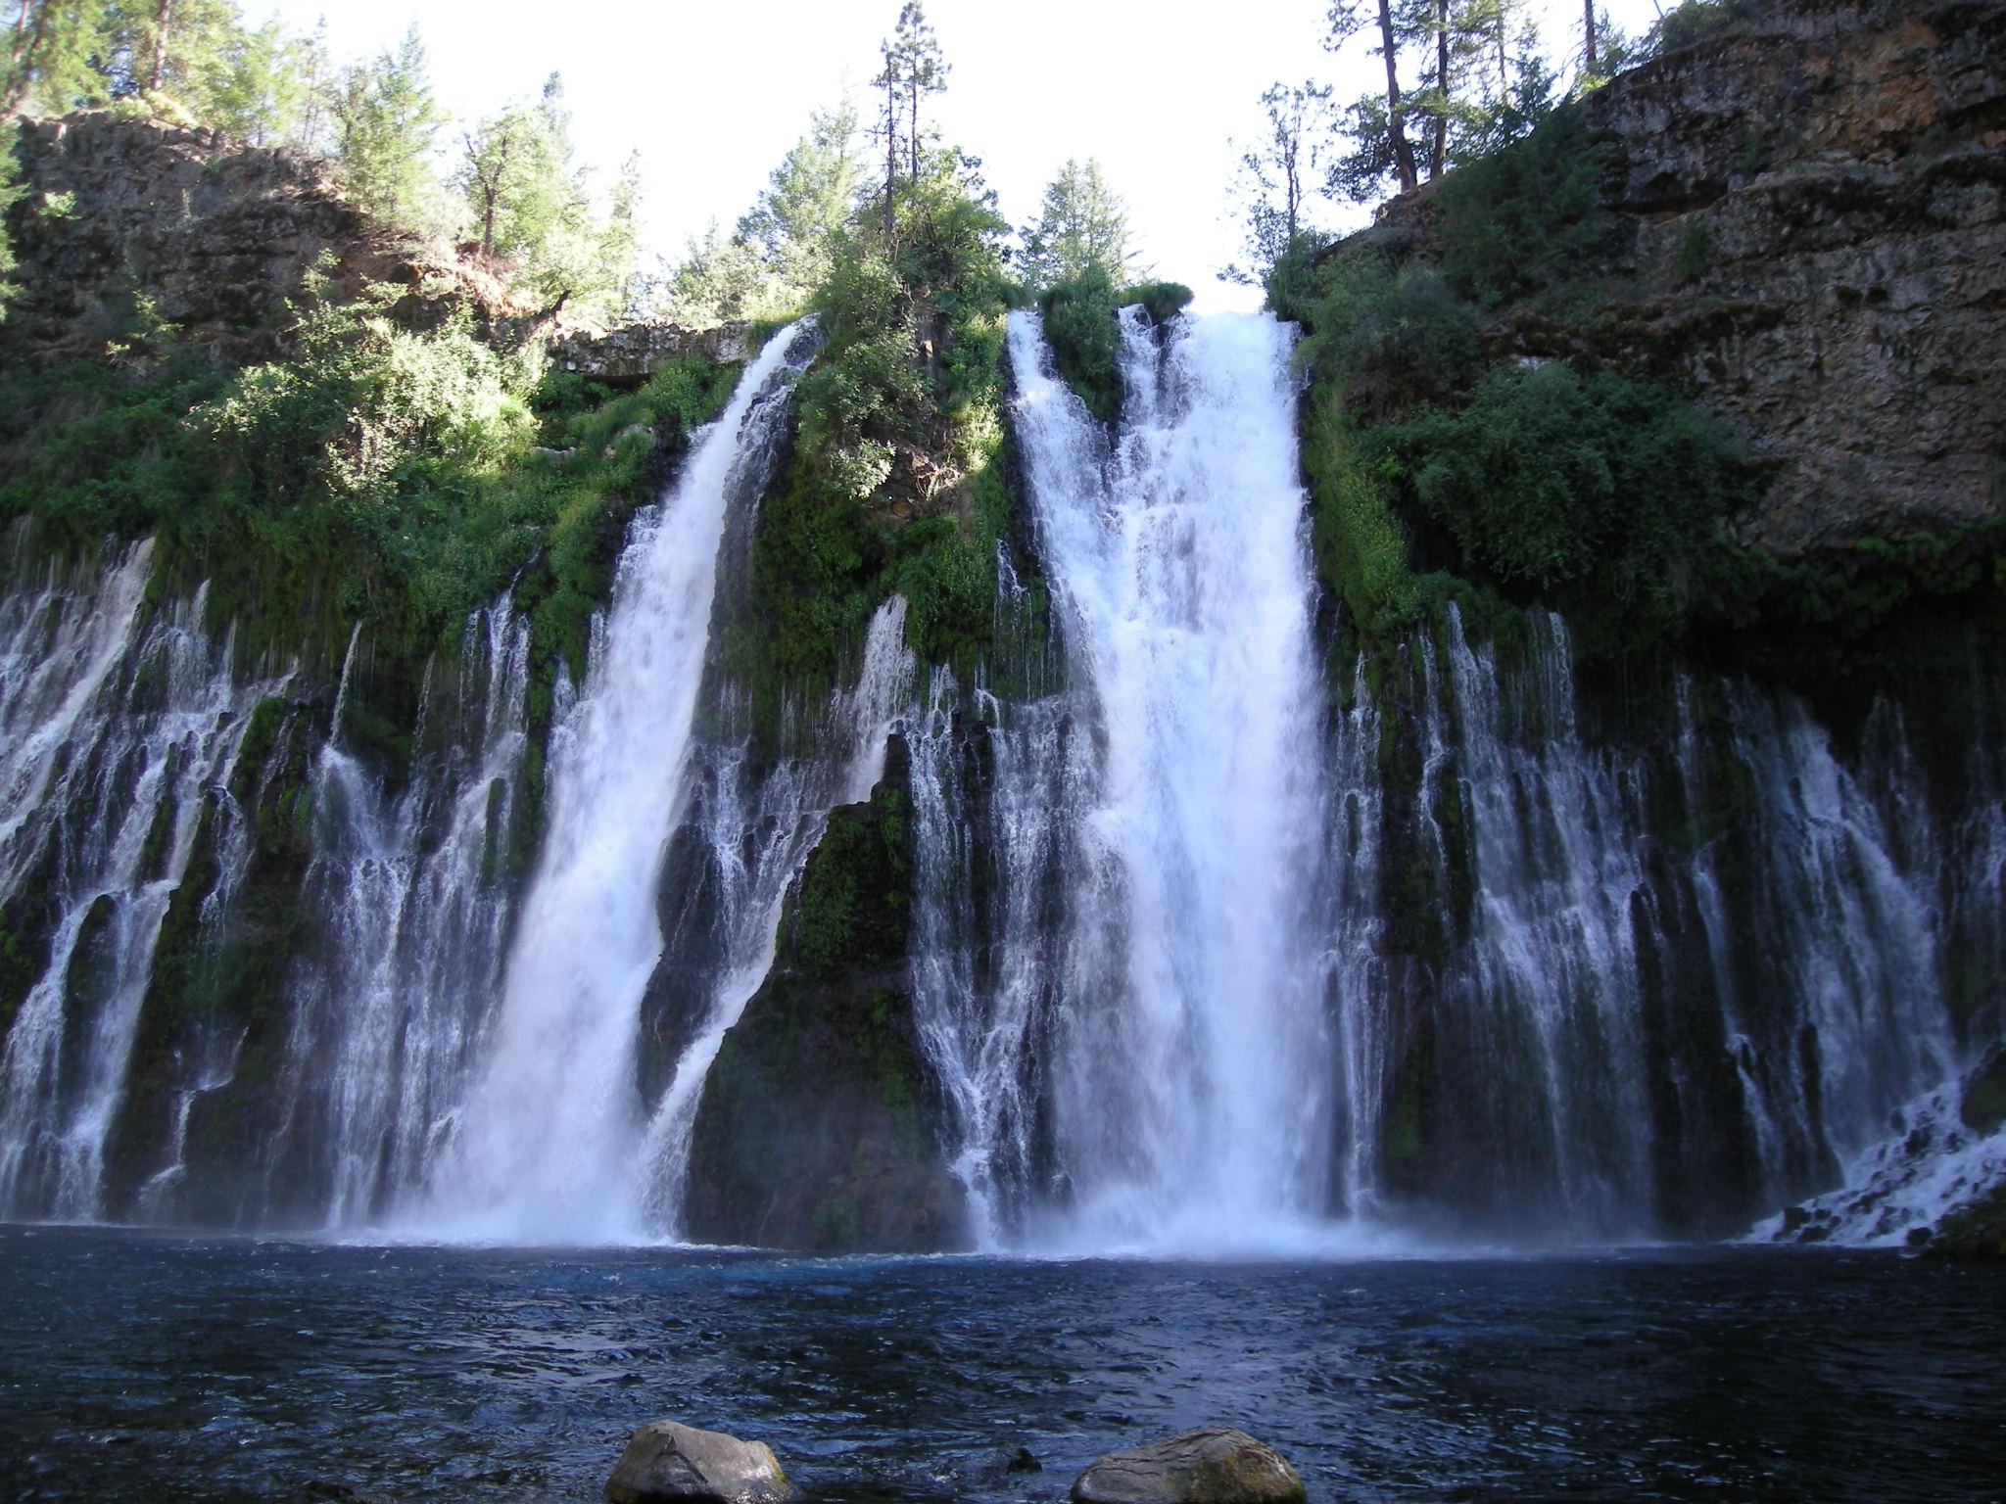
Places I visited
I went to burney falls during summer with my family
I went to oregon with my family last summer break for my mom’s birthday

Slide 8
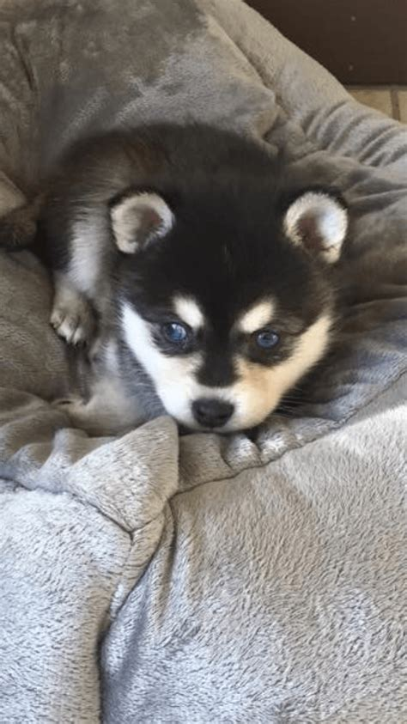
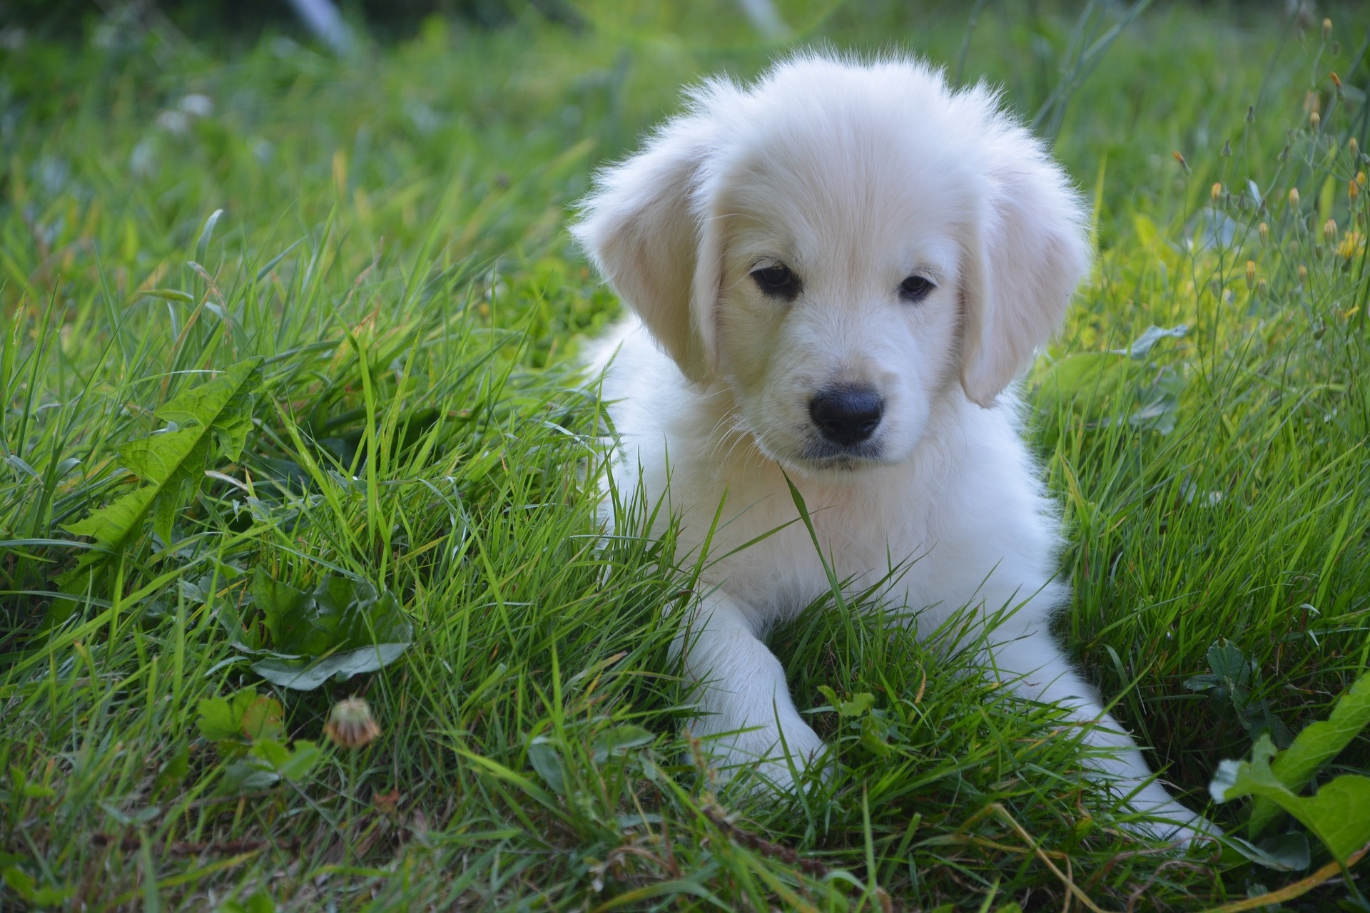
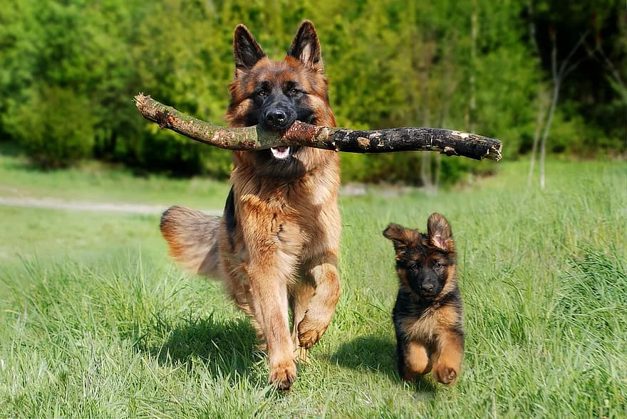
Favorite animals
Husky
German shepherd
Golden retrievers

Slide 9
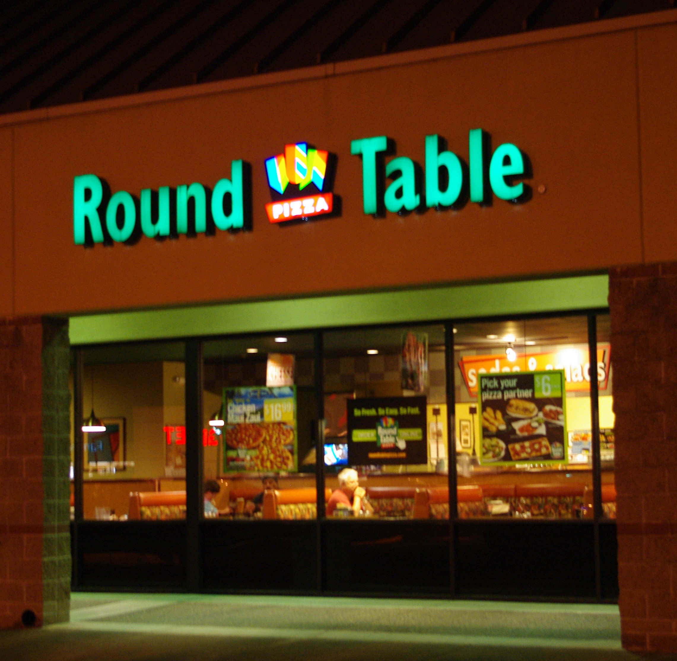
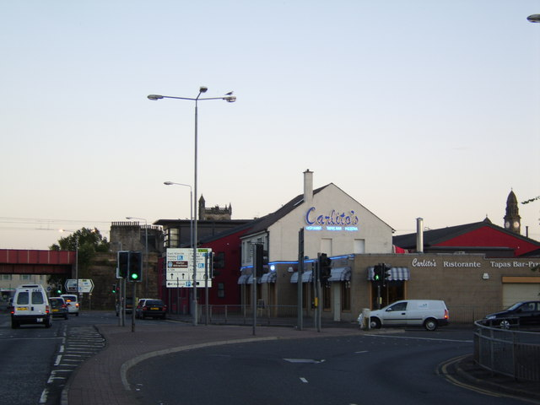
My favorite places to eat
One of my favorite places to eat is round table. (Normally on my birthday)
Another one of my favorite places to eat is at a mexican restaurant named Carlitos
I mostly like fast food places then actually going to a restaurant because its faster and I like burgers.

Slide 10
What I want to accomplish when I finish school
When I finish school I want to start looking for a job later one when I have enough money I would like to get myself a house and give some spare change to parents.

Slide 11
Conclusion Slide
I hoped you like to get to know me and what I do and did over summer break. I hope to get to know all of you including Mr. Perez. I had some struggles trying to figure out stuff but it all worked out at the end.

