Slide 1
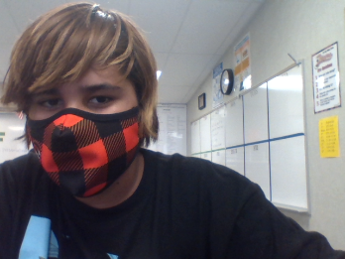
All About Me
By:
Jesus Valdez

Slide 2
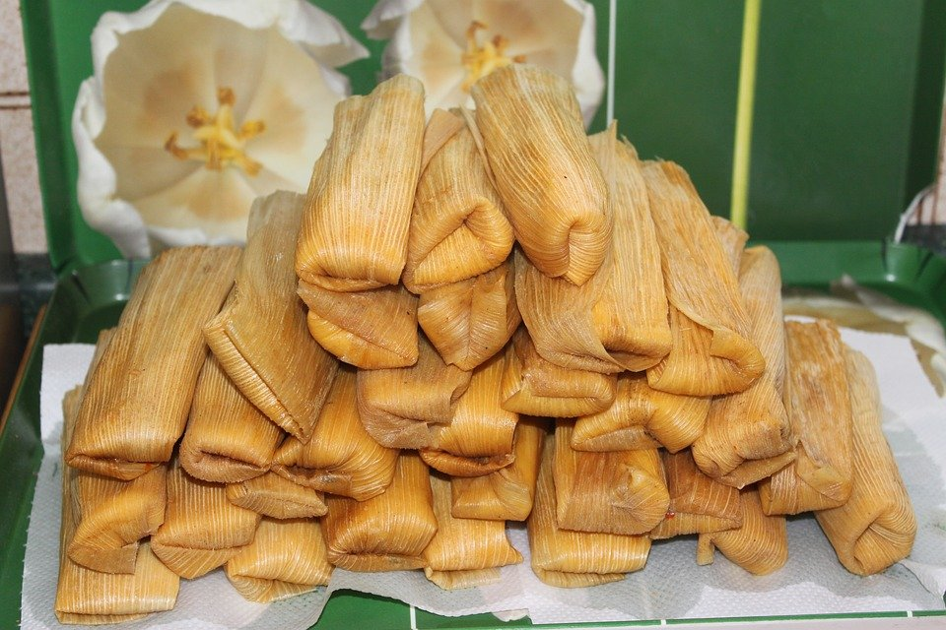
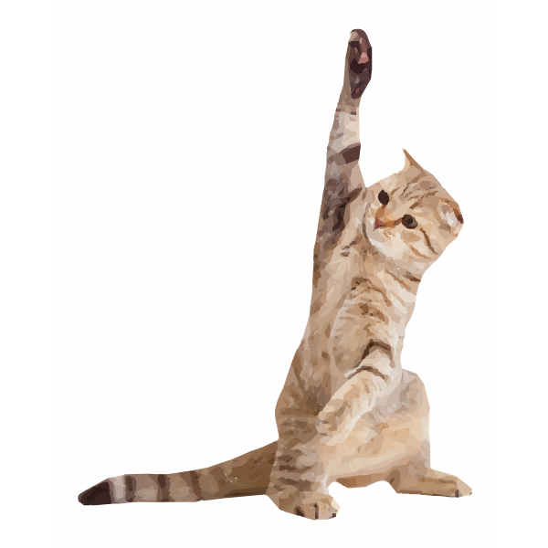
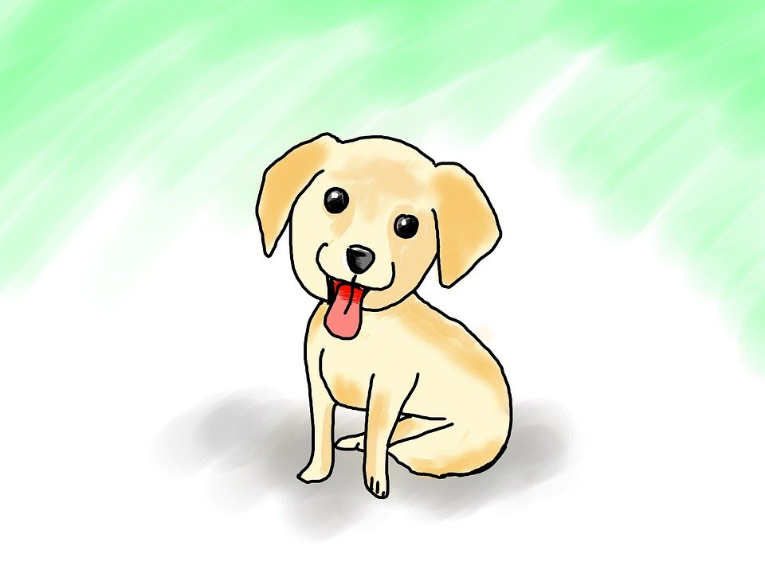
About me
My favorite food is
is Tamales *disclaimer these are not my pets*
I have 1 dog and 1 cat

Slide 3
My Family
I have 3 sister 1 brother also I have my mom and my 2 brother in law and my sister in law
I have no pictures of them

Slide 4
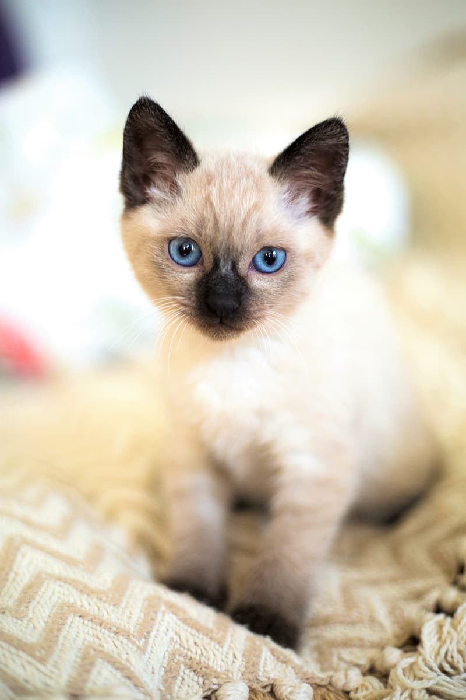
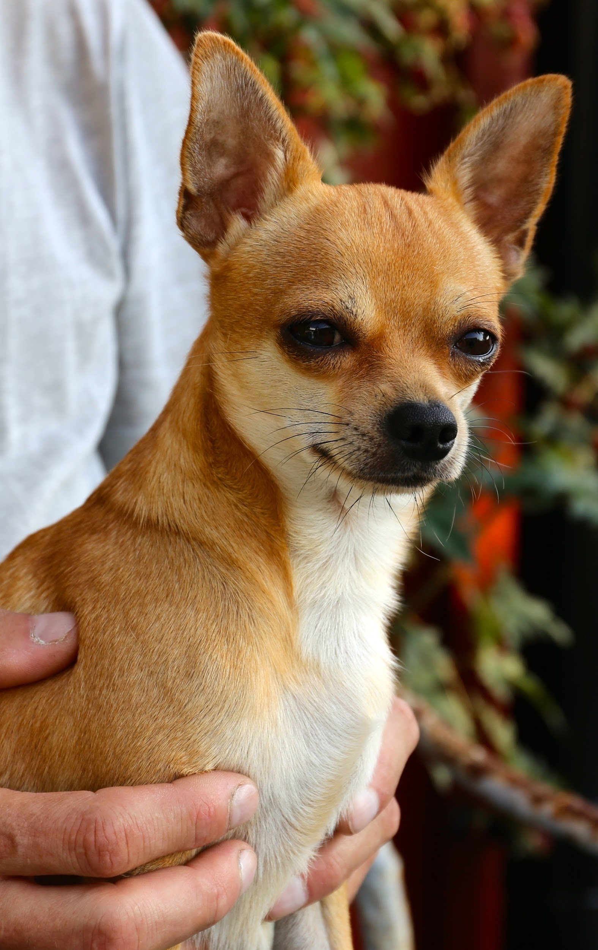
My Pets
I have 1 dog named Scooby and
I have a cat named Rocket Catcoon.

Slide 5


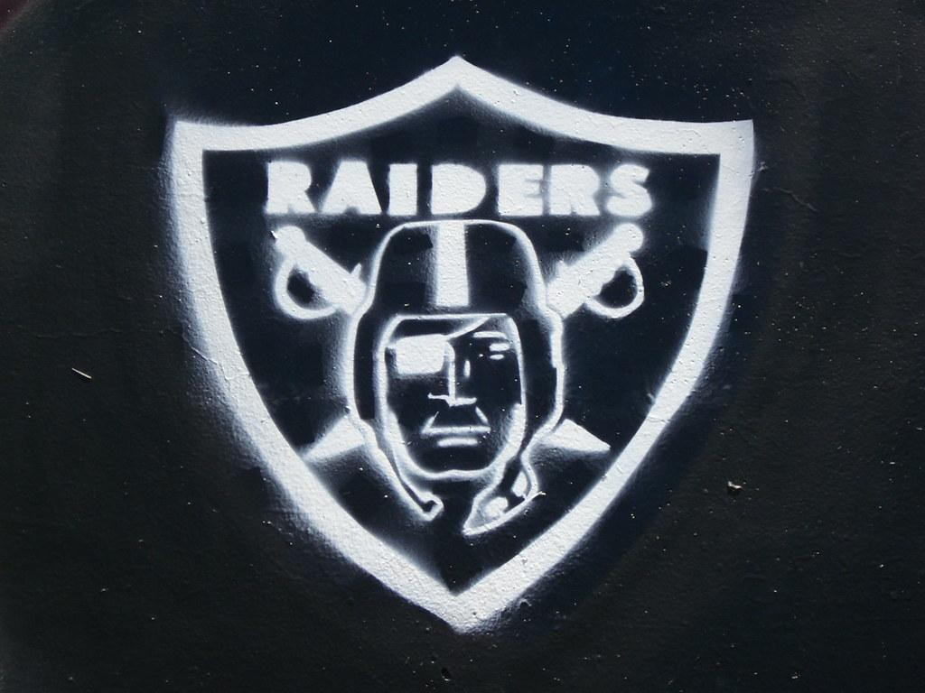

My Favorite Sport Teams
I have a couple sports teams I like they are Chargers,Raiders,Lakers.

Slide 6



My Hobbies
One of my Hobbies are that I like is playing basketball it because fun and it’s I get to run and get to use my arms.

Slide 7


My Favorite Subject
My favorite subject is math my second favorite is science.

Slide 8
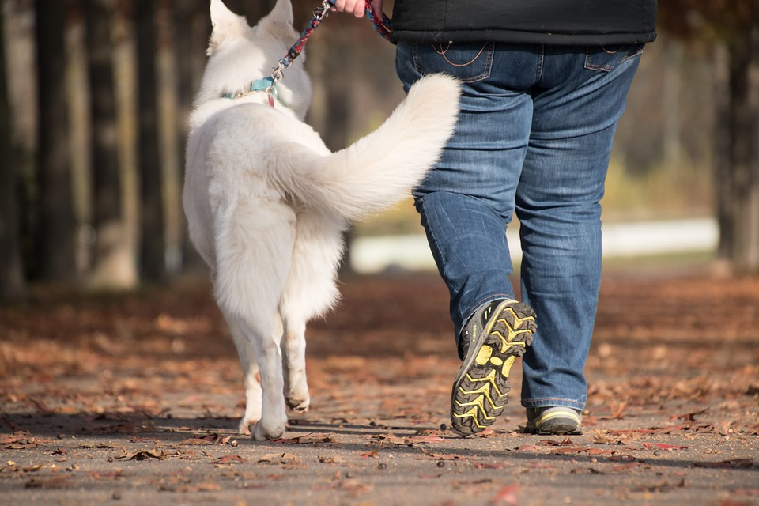
What I do for Fun
I play video games for fun I like to walk my dog

Slide 9
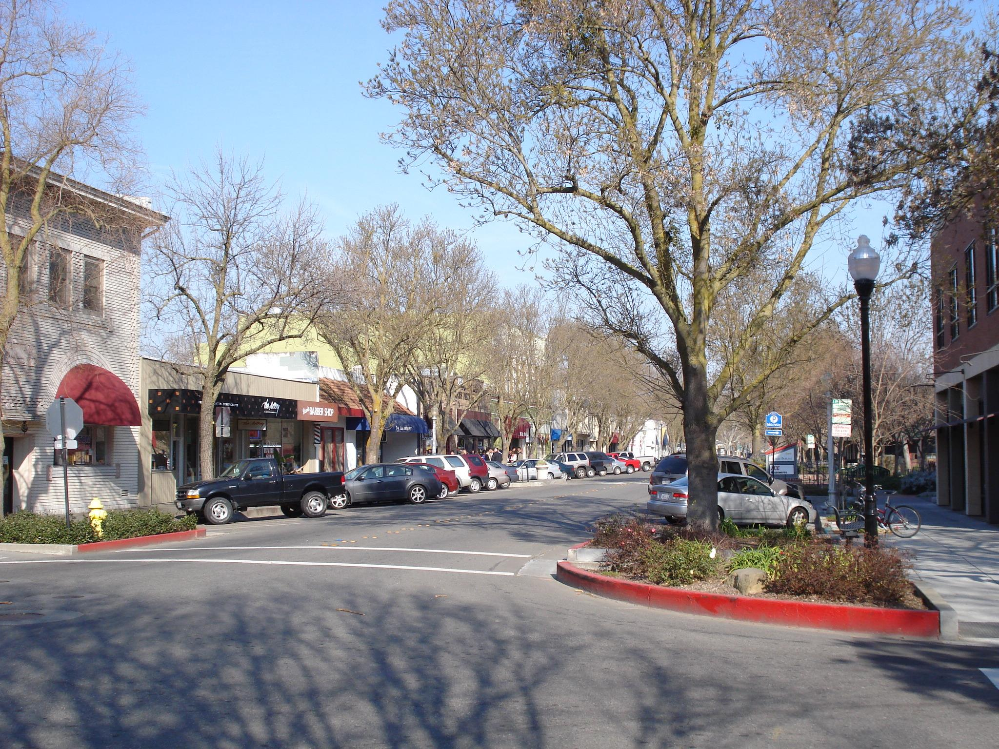
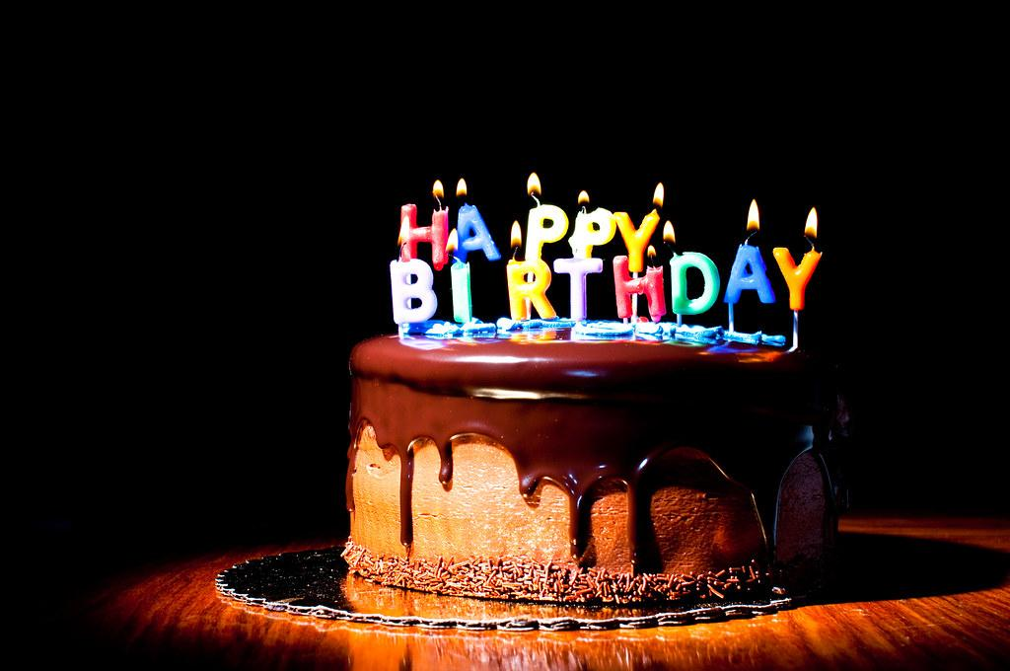
Birthday and where I was born at
My birthday is January 29 2009 at Davis.

Slide 10



Favorite Color
My favorite colors are red purple and blue

Slide 11
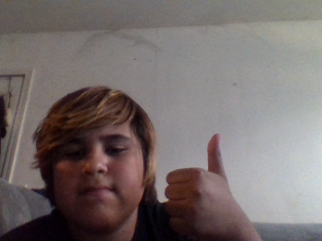
THE END
This slide is All about me this is how you get to know about me

