Slide 1
All About Me
By: jose rodriguez
Jose Rodriguez

Slide 2
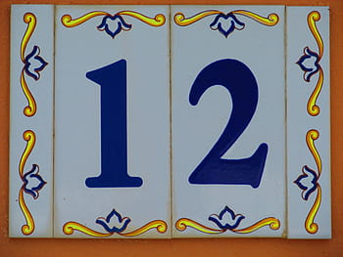
About me
My name is Jose Rodriguez i am 12 years old my birthday is on October 16 2008 my favorite color is blue and gray also places i have visited are coos bay oregon, fallon nevada, pismo beach and los angeles

Slide 3
Family
I have a mom and dad and 1 brother i am the oldest and things i do for fun are run after my brother.

Slide 4
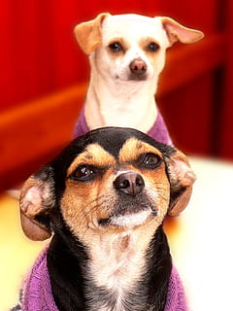
Pets
I have 2 dogs and they are chihuahuas.

Slide 5
Hobbies
I like to play basketball when i am at school and when i am at home i like to play video games.

Slide 6

Goals
My goals for this year are to get good grade in all classes and be a good student

Slide 7

Future
My plans for high school are to get good grade, graduate and go of to collage.

Slide 8
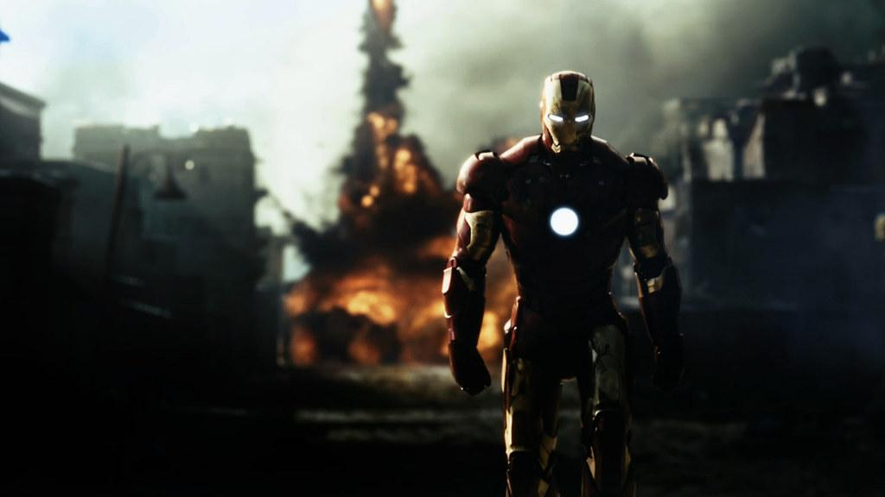
Movies
My favorite type of movies are action because they are cool.

Slide 9
Things i do and don’t like about school
Things i do like about school are the teacher because they are nice and my favorite subjects are math, ela, history. Things i don’t like about school are teachers giving hard tests.

Slide 10
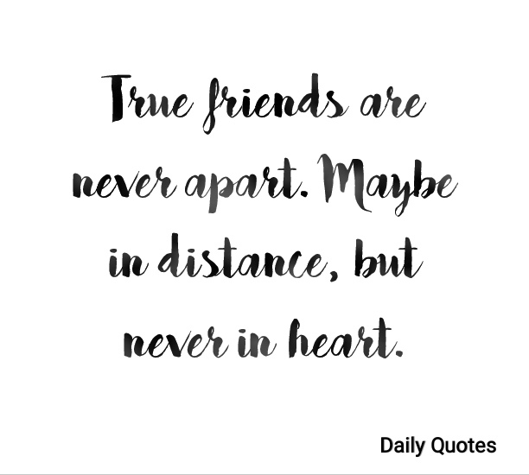

Favorite quotes

Slide 11
Favorite places to eat
My favorite places to eat are boiling crab and chinese places.

