Slide 1
All About Me
By:
Joshua/josh

Slide 2
About me
Hi my name is joshua or you can call me josh.
Some things about me is i like to the sports like basketball or football
Another thing about me is i hate when ever its to hot i always liked the cold
I like to go the pools with my family or friends
Notes:
U \To always go the

Slide 3
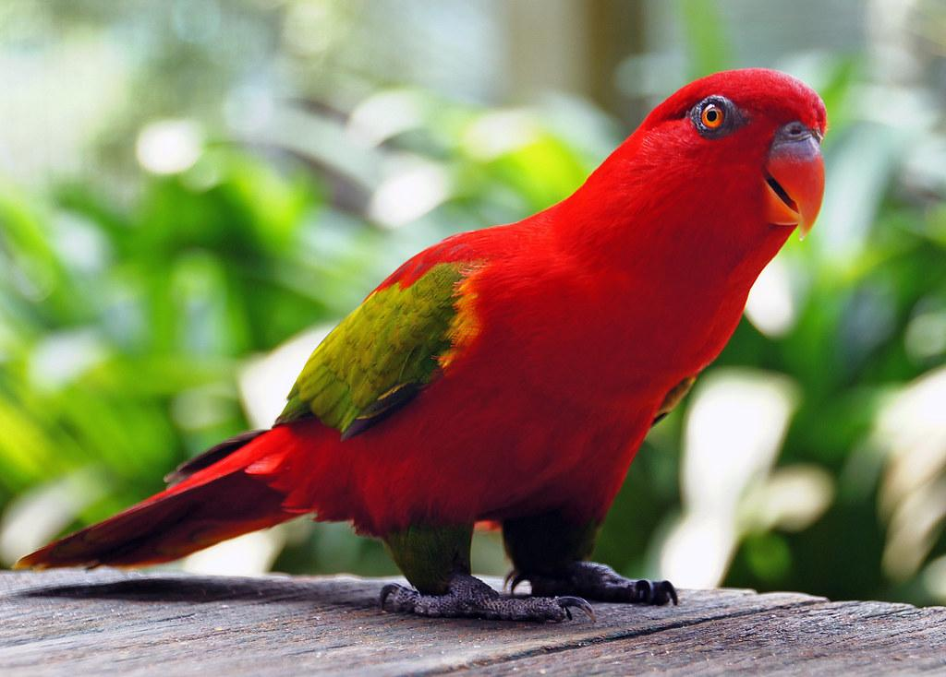
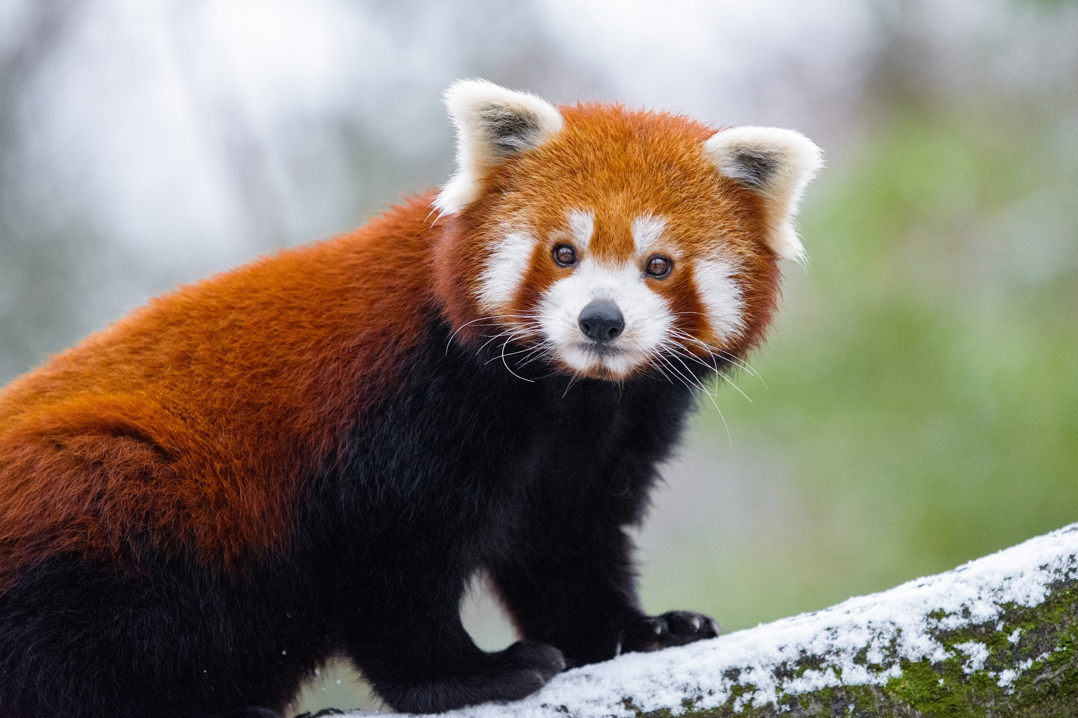
Animals
Ever since i was a kid i always liked to go to the zoo it was my favorite place to go when i was a kid my favorite animal to look at was the red pandas or the parrots the parrots always repeat what i said so it was really fun as a kid

Slide 4
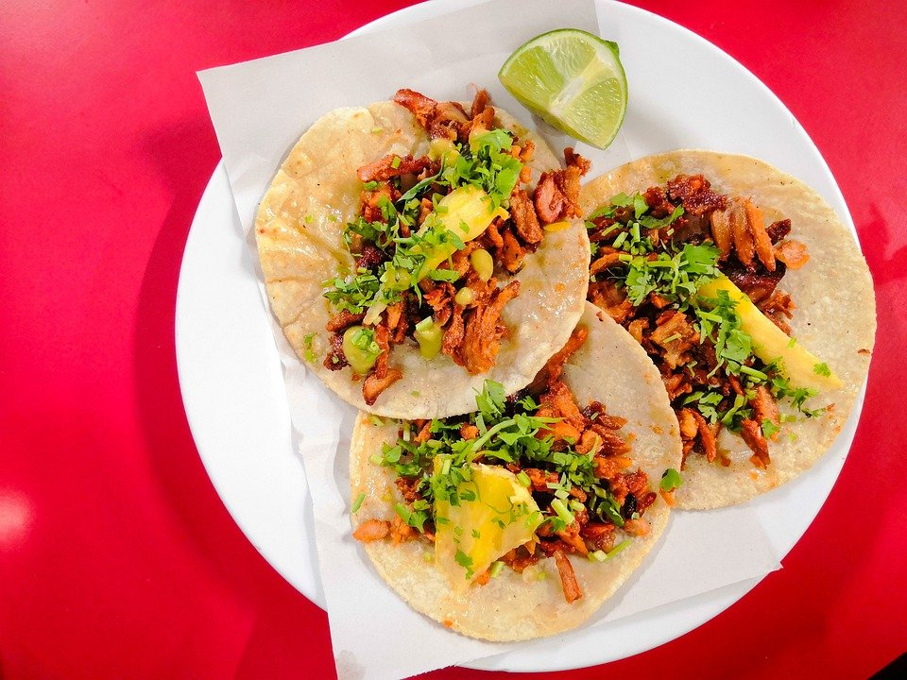
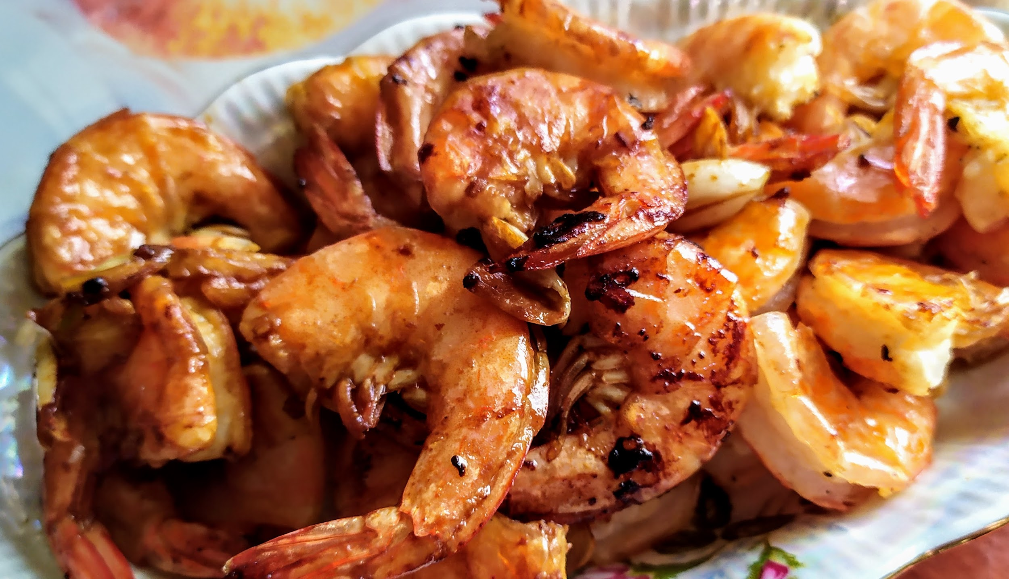
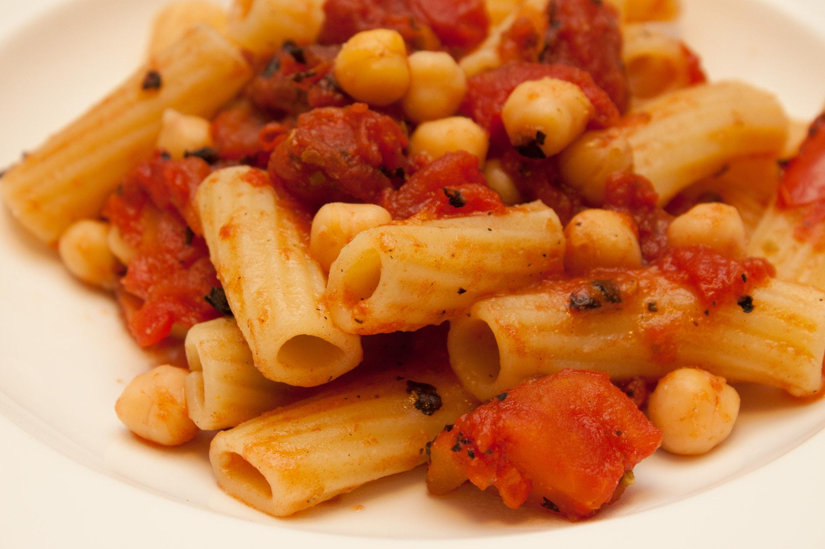
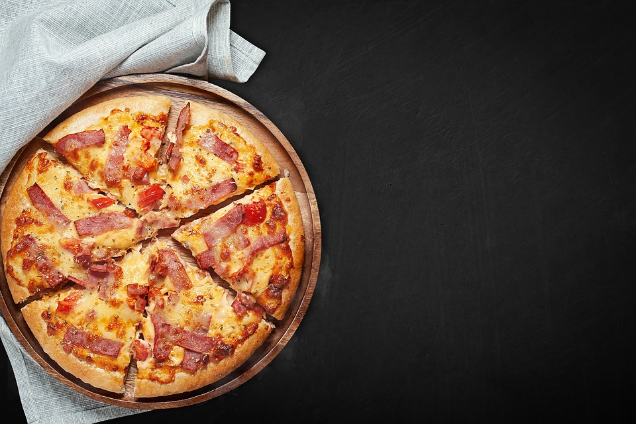
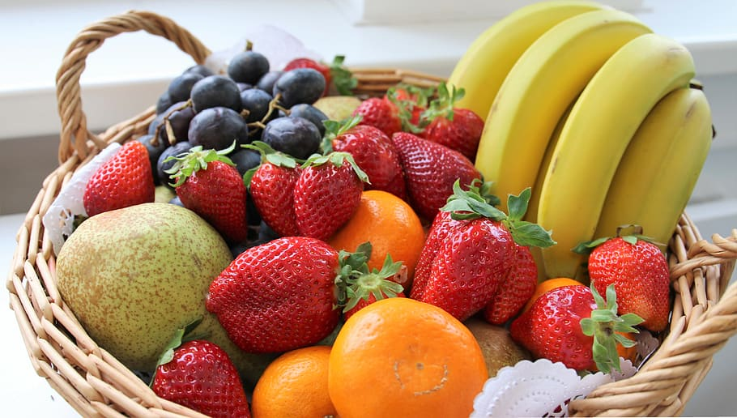
My favorite food
My favorite food was always sea food or fruit.I also like pizza,pasta,tacos, ,those are my favorite food right now

Slide 5
My favorite things in school
One of my favorite things in school is when i get to hang out with my friends and i like history it gets very interesting and fun most of the times.i also like PE and i like all of my teachers they are nice and kind.

Slide 6
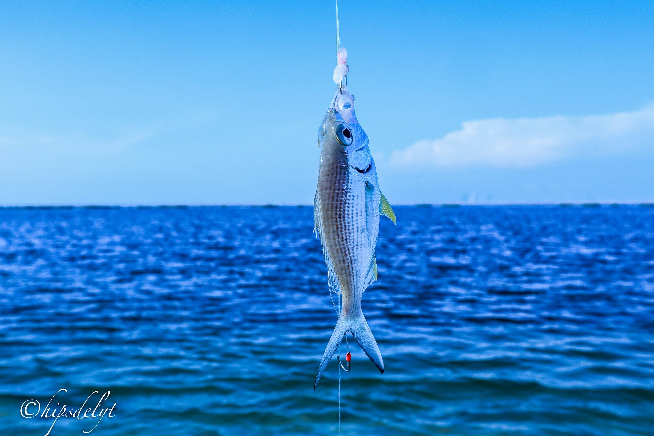
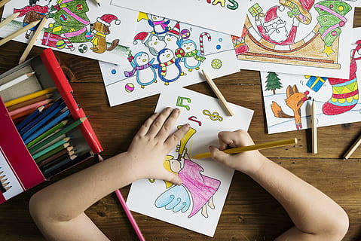
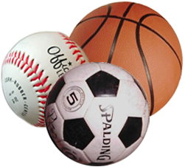
Hobbies
One of my hobbies are that i like going fishing with my dad
Another hobby is playing sports
And my favorite hobby is draw

Slide 7
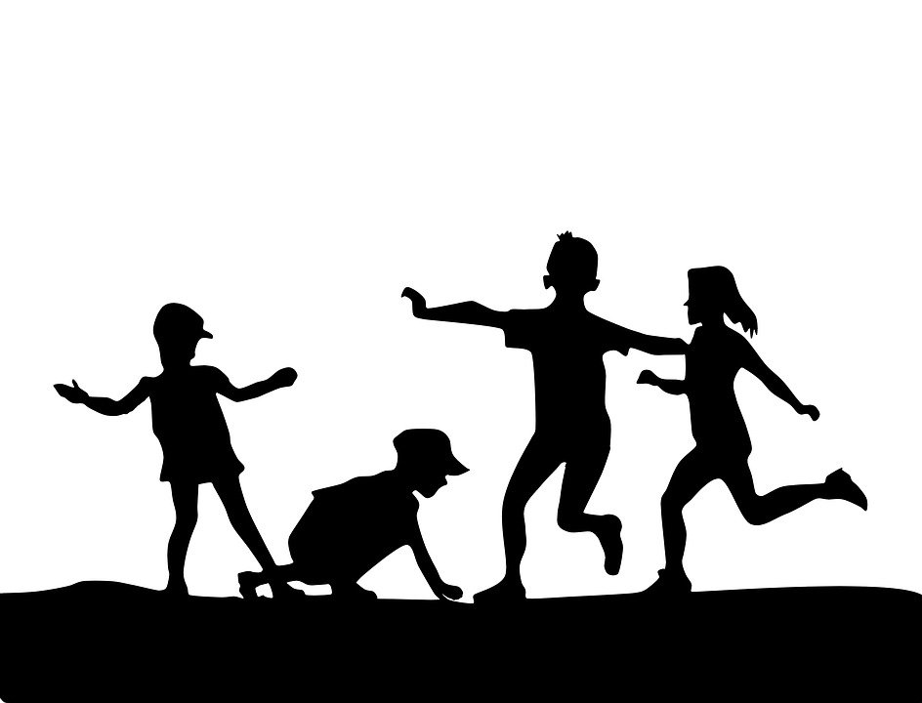
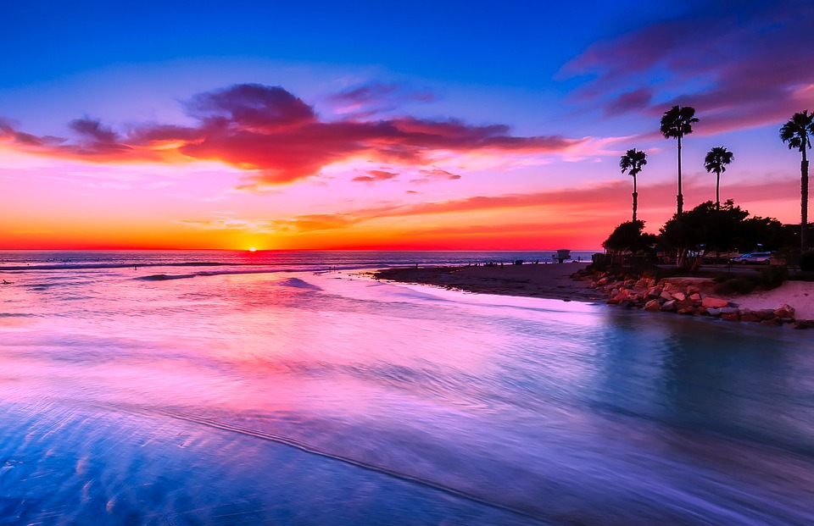
What i do most of the day
The things i do most of the day is helping my mom with things cleaning and playing i also draw,sleep,go outside during the noon,and other things

Slide 8
My favorite shows
My favorite things to watch are anime movies some tv shows i also watch a little bit of youtube and some family guy

Slide 9
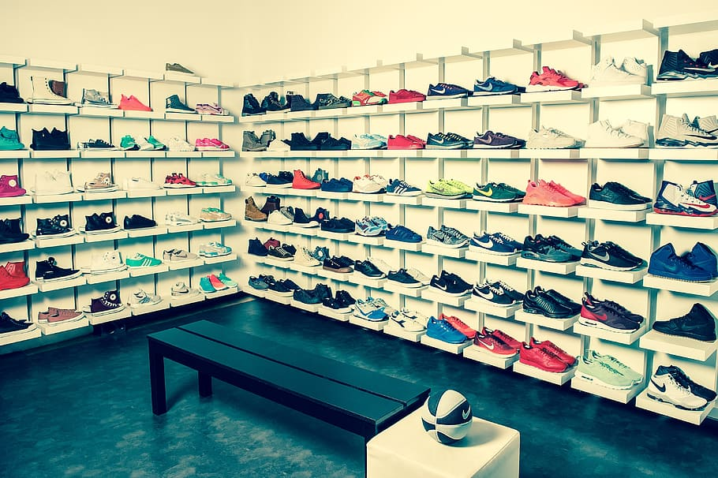
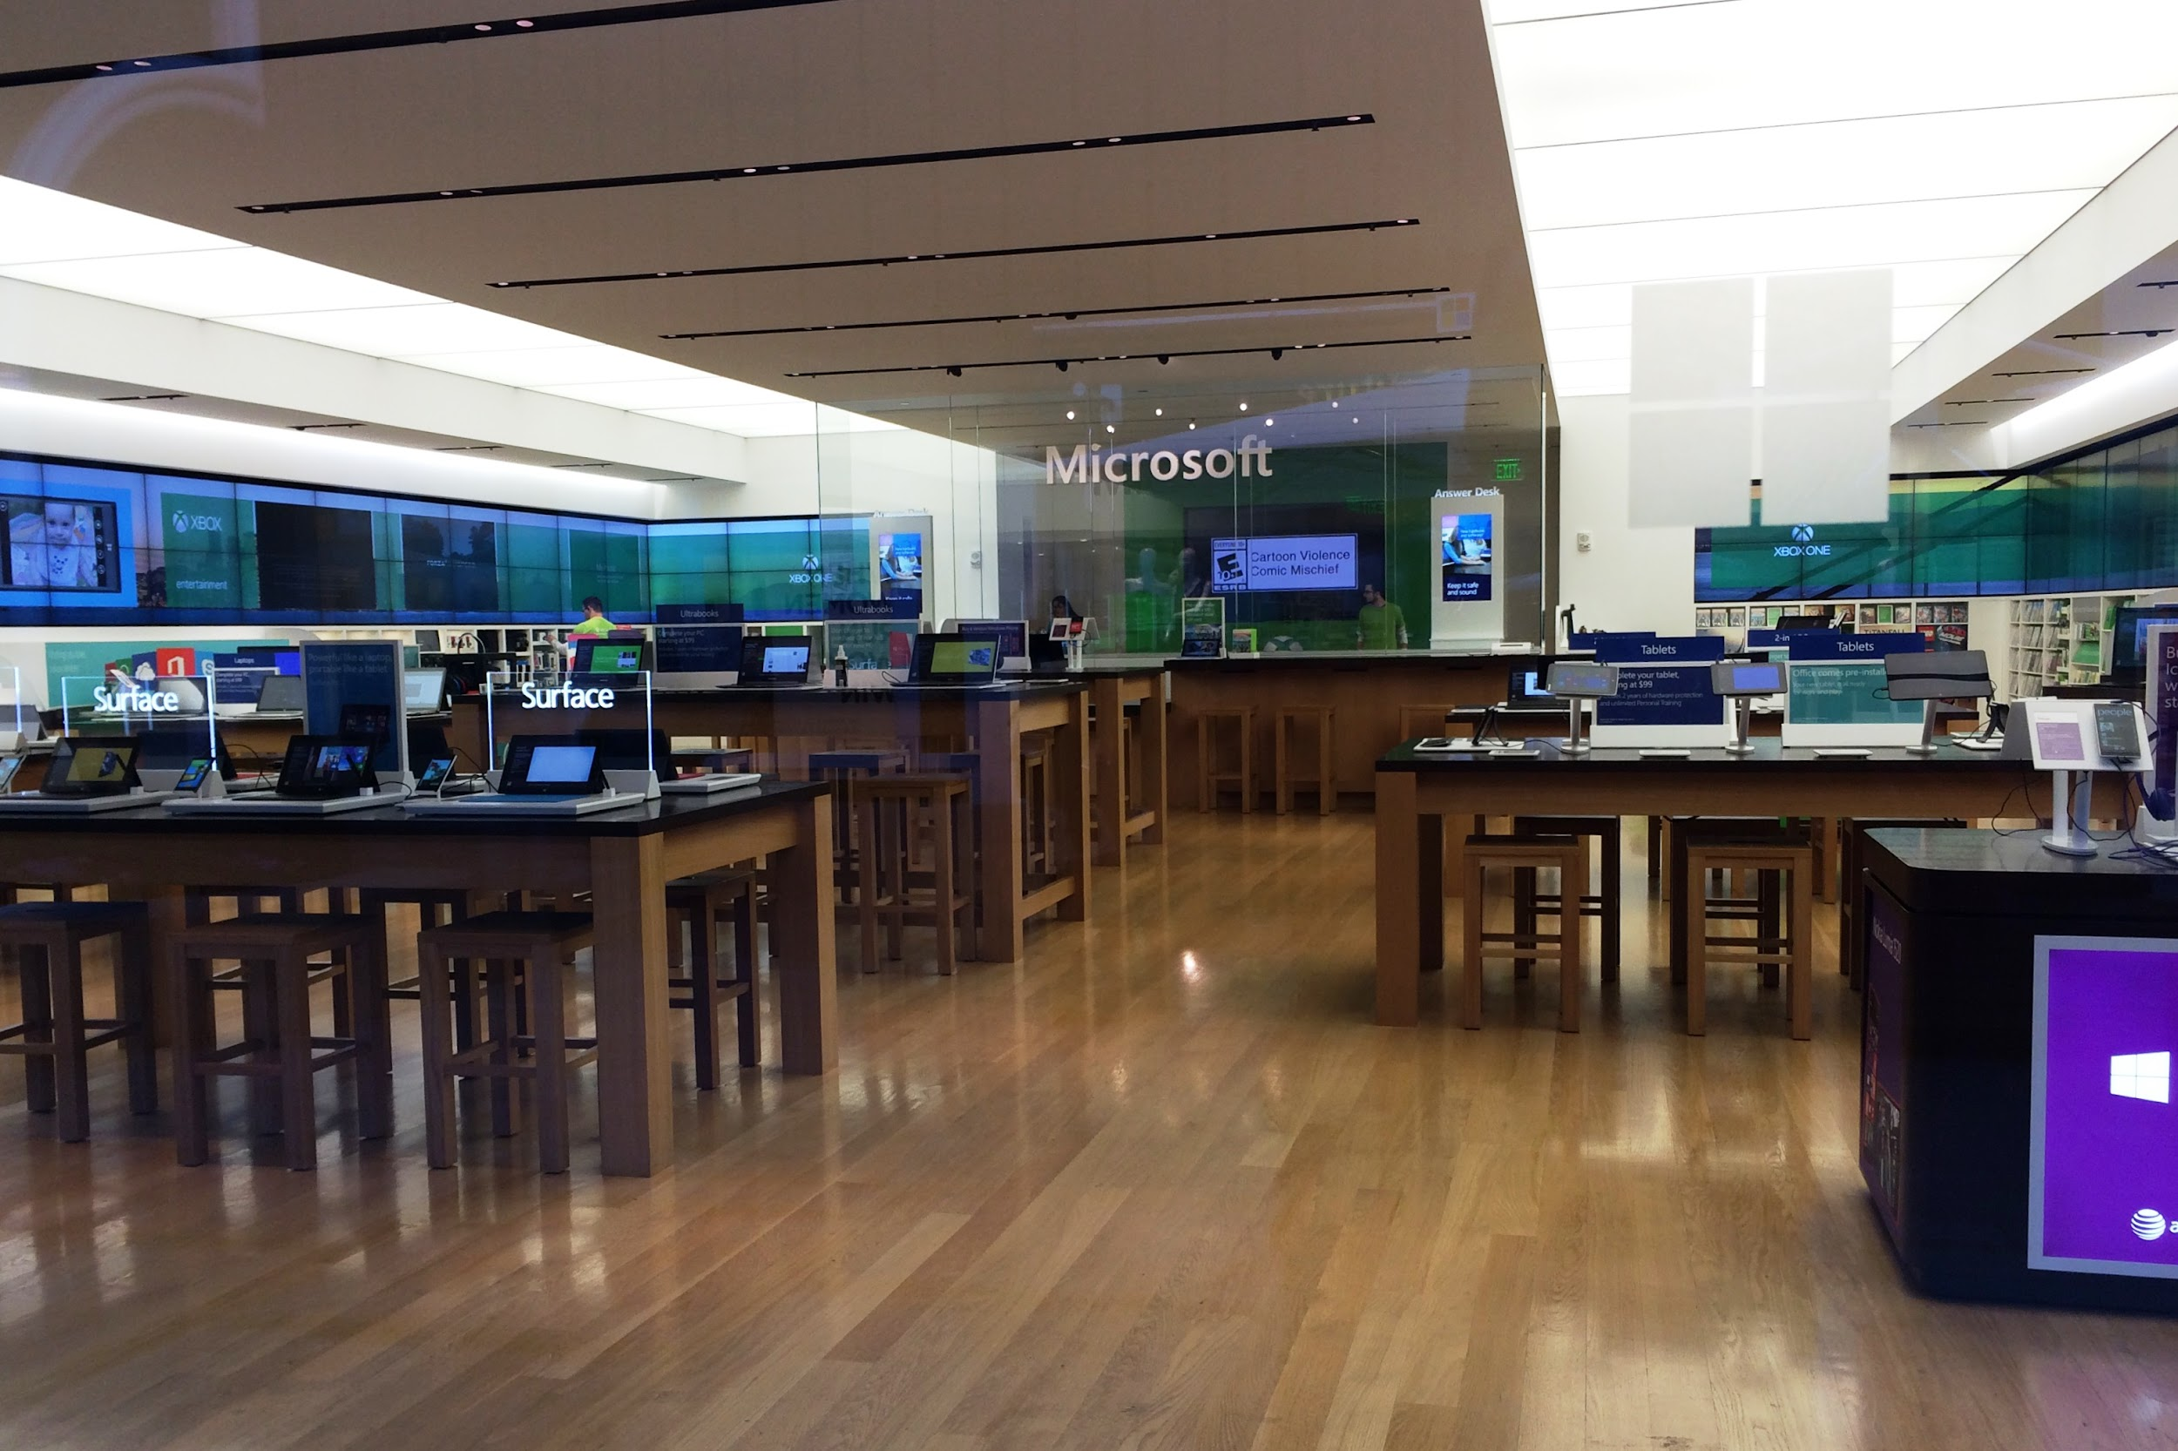
My favorite stores to shop at
I am mostly never picky but i do have some preferences i like to shop just in general but some stores i like to go to are microsoft stores they have a lot of cool things to look at another store is shoes store i have a collection of shoes in my closet

Slide 10
My goals for this year
My goal for this year is to do better then last year i always am always trying to improve that is my goal for this year

Slide 11
Conclusion Slide
In conclusion am a really nice guy i like of lot of things

