Slide 1
All About Me
By: Miley
Miley noria barajas

Slide 2
About me
1. My name is Miley Noria Barajas
2. i am 12 years old
3. my birthday is nov,7,2008 my sign is a scorpion
4. my favorite color is purple
5. i am right handed

Slide 3
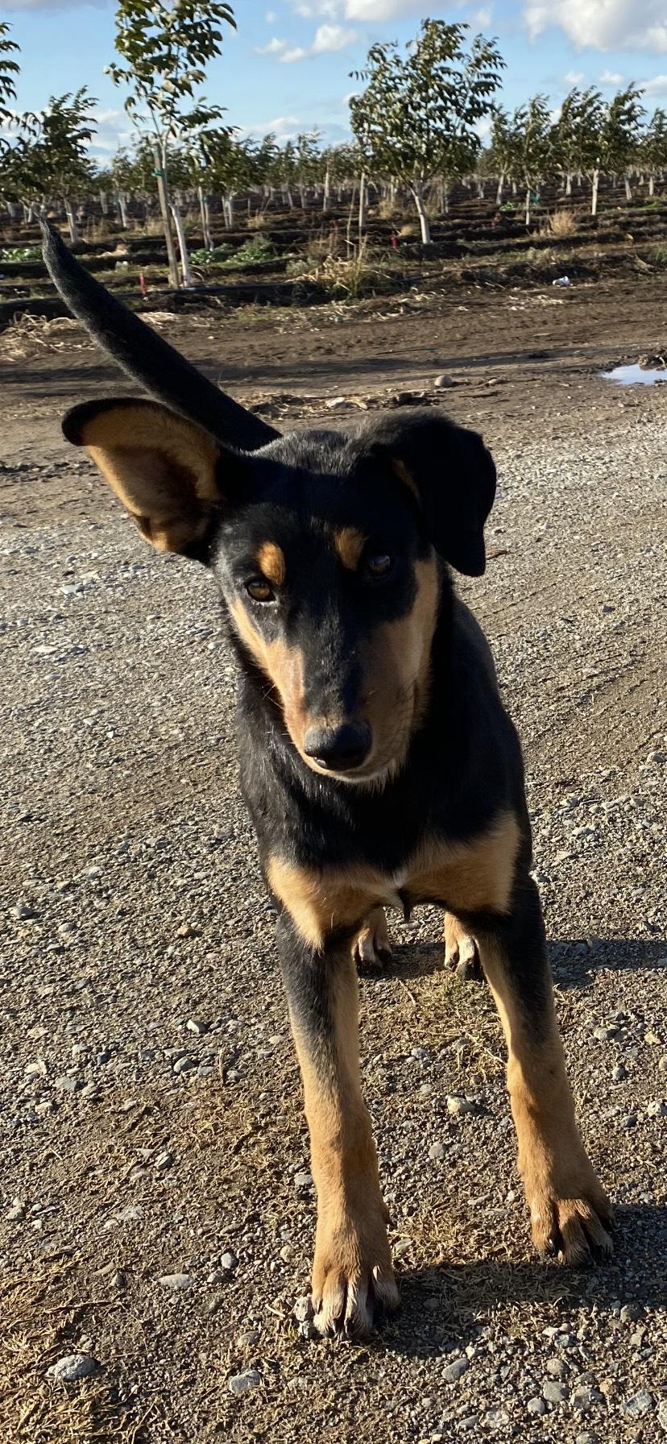
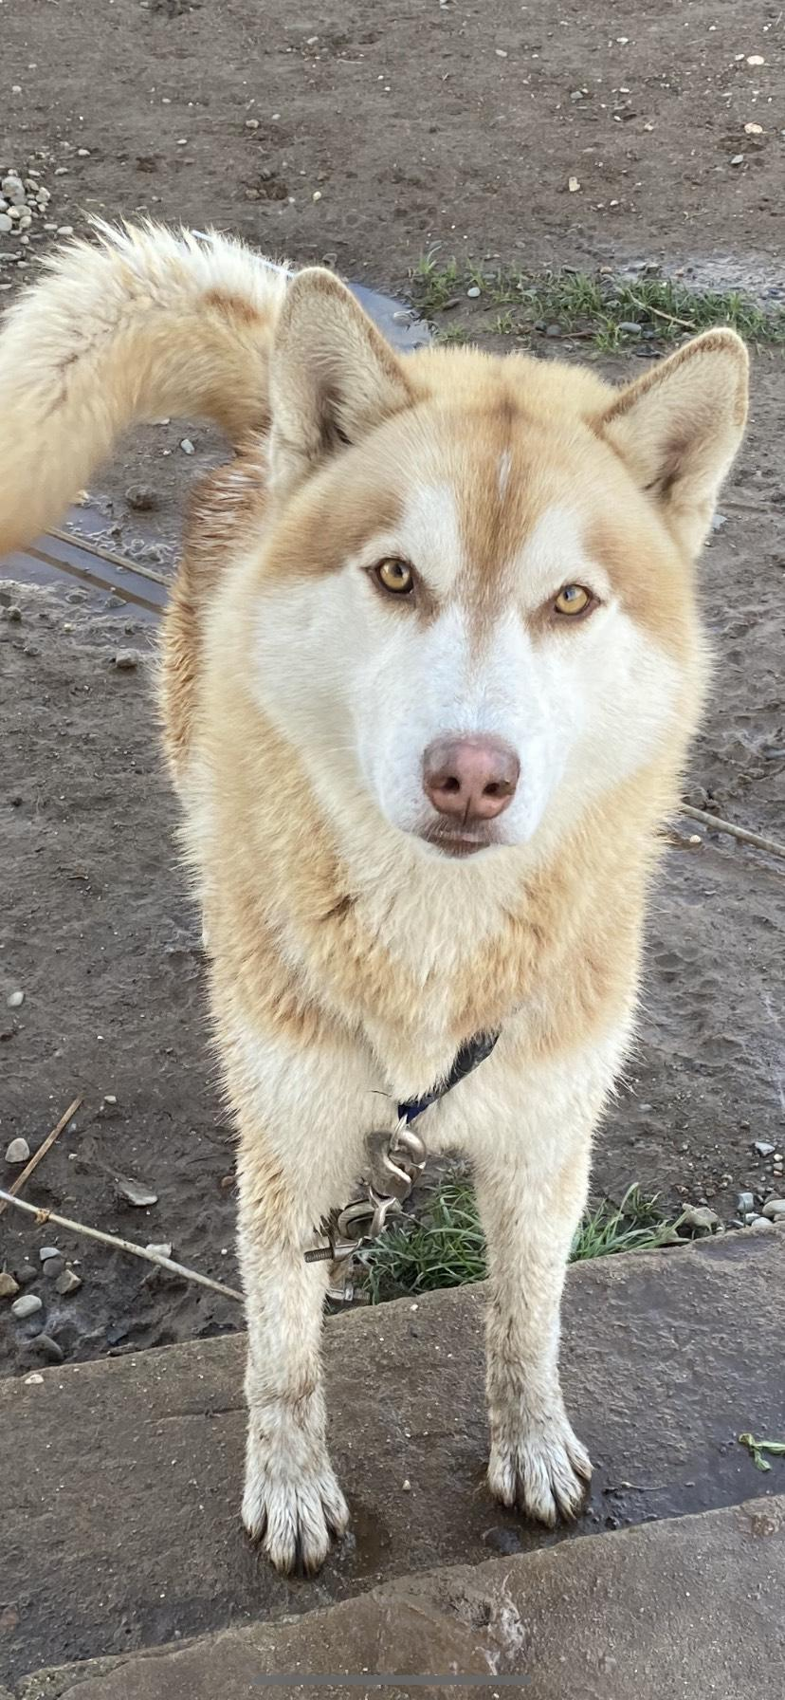
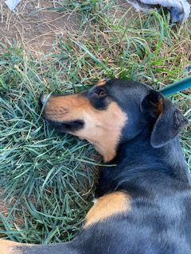
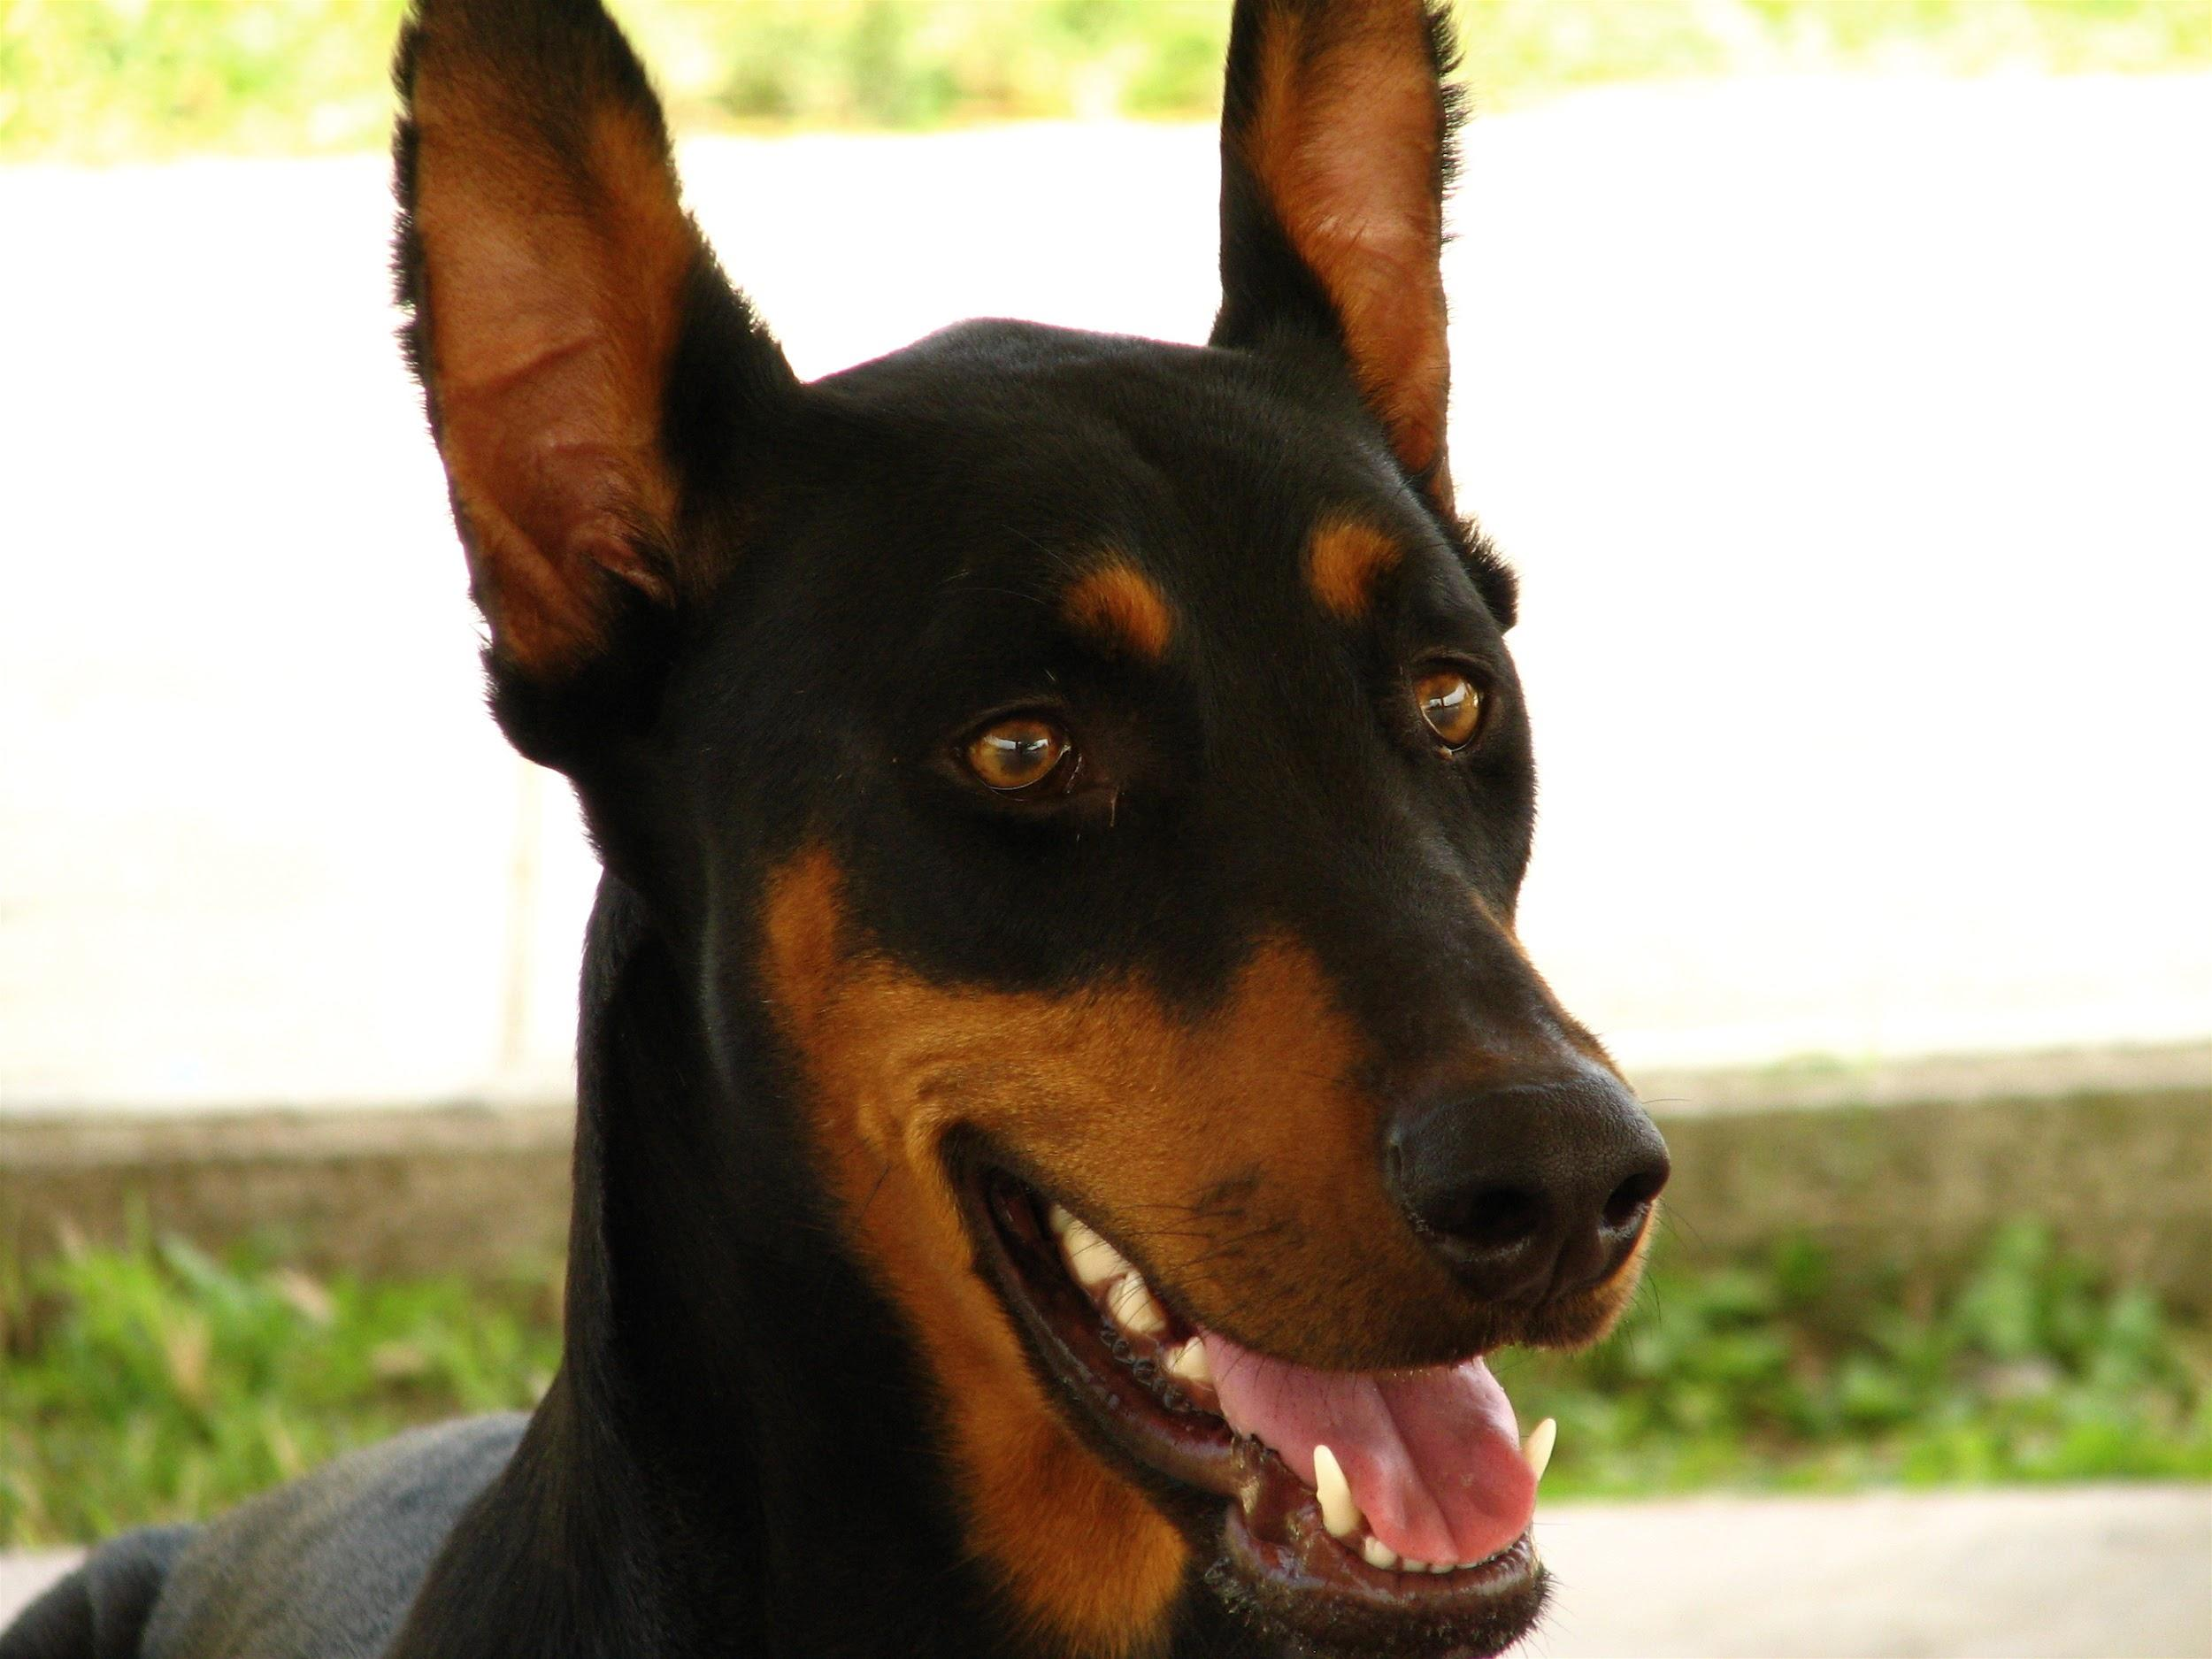
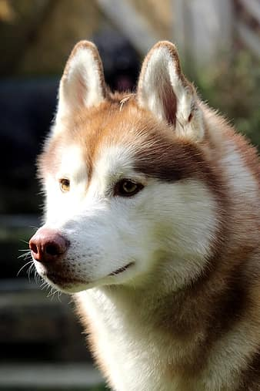
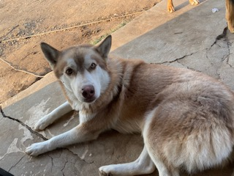
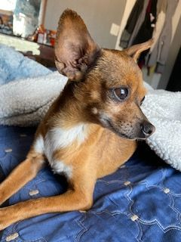
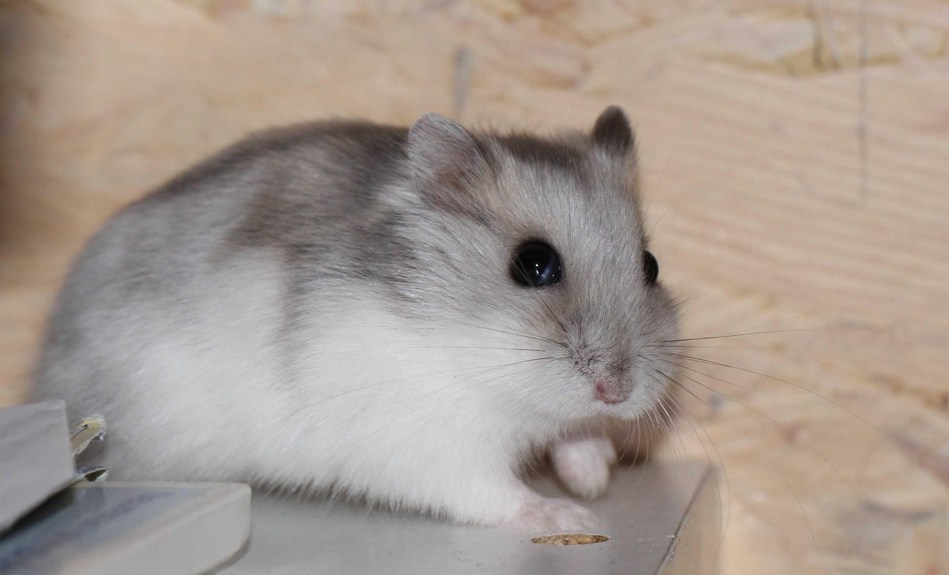
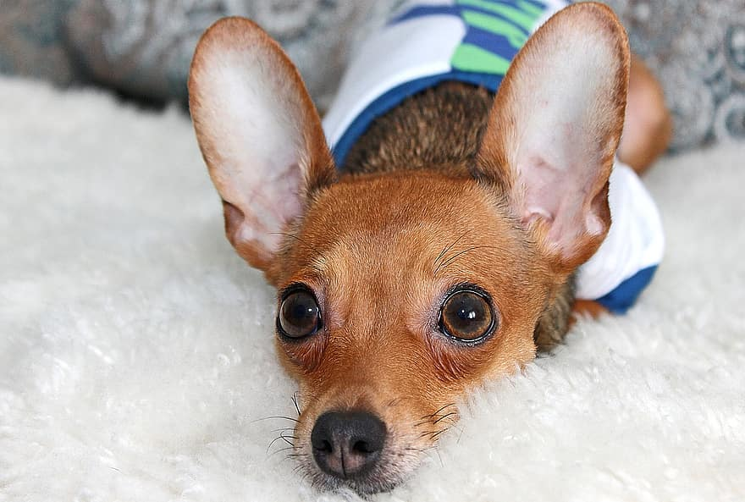
My pet’s
I have 3 dogs and 1 hamster, i have a husky and it’s a boy and his name is buddy and his 2 chihuahua she old we don’t know how old she is we adopted her but when got her when i was 7 her name cinnamon but in spanish so canela and i have a husky slash dobermann and her name is hennessy (sorry) she is 1 and my hamster is girl don’t how old she is. (the hamster pic is not mine)

Slide 4
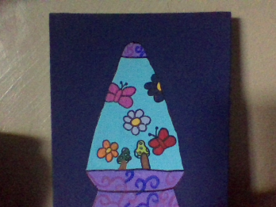
Free time
On my free time i like to paint ,i also like to watch anime and i like to jump on the trampoline with my sister and play with dog and take the walks And also sleep and like to hang out with my family and i like chill. :]

Slide 5
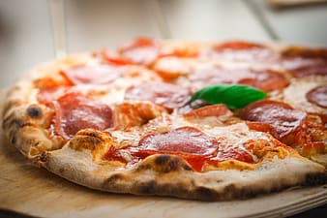
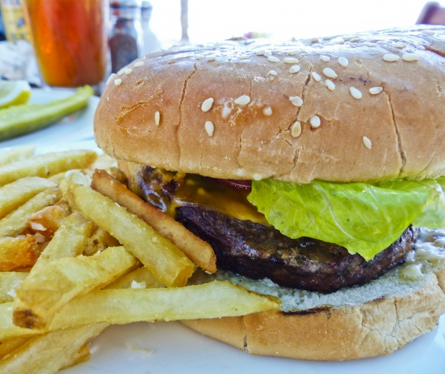
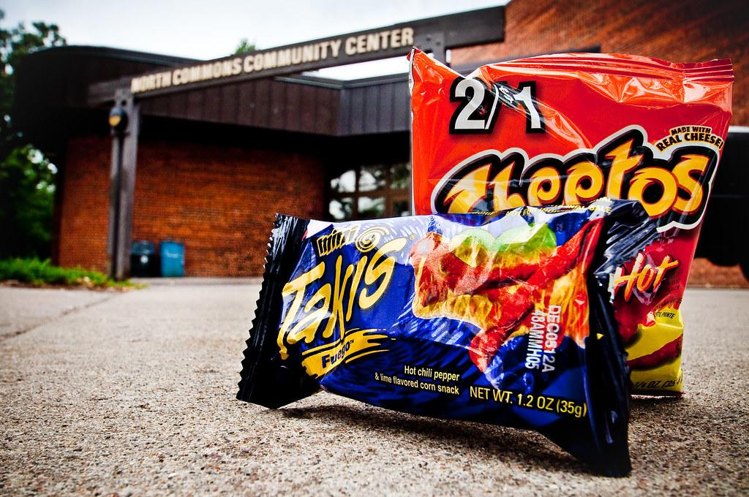
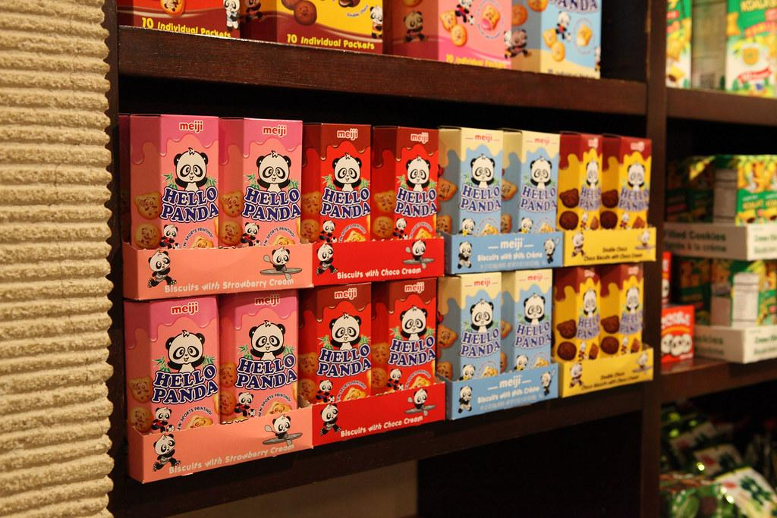
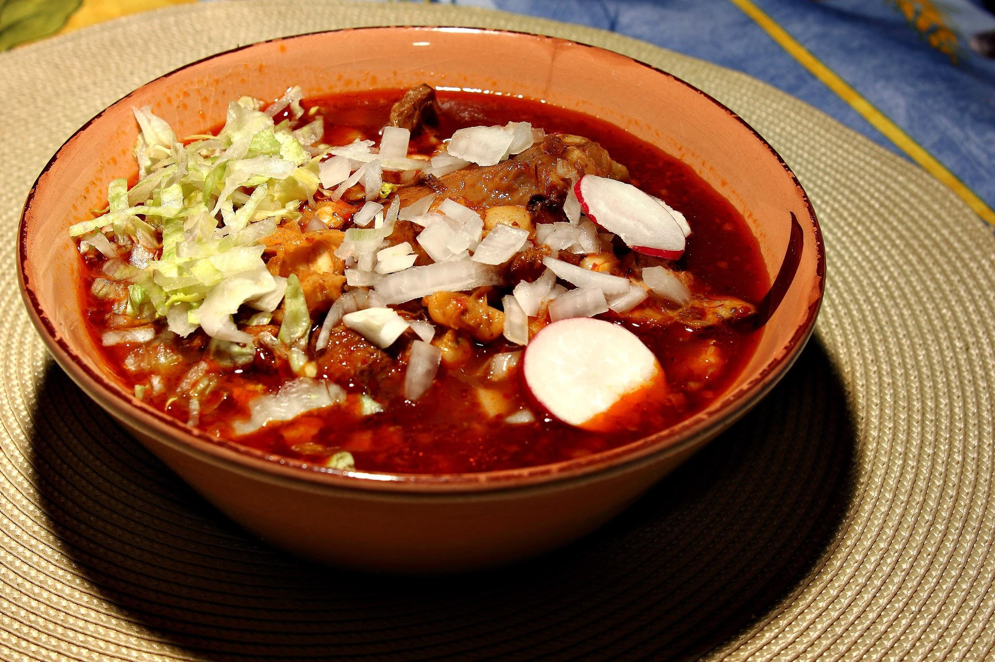
Food
My favorite food are pizza with ranch and ketchup
pozole is mexican dish
hamburgers
my favorite snacks are hello panda, i love spice chips.

Slide 6
My school’s
All the school to, for my kindergarten - 4th i went to woodbridge i enjoy that school but saddle i had to move and for my 5th grade i went to westfield for one year and then i left and came to this school for my 6th grade witch was oline and now this is my 7th grade in persen .

Slide 7
Anime show
My favorite show is ouran high school host club this is my favorite show because the main character is a girl but look like a guy but only reason she look like a guy is because someone put bubble gum in her hair so she had to cut it and the guy on show like her but doesn’t know know he like and he know she is a girl, i also like bubble up like soda pop and i like many more anime.

Slide 8
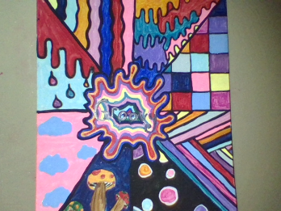
subject
My favorite subject is science and art i like science because i like it try new things and i like art because you can express yourself with the drawing and the color of the paint.

Slide 9
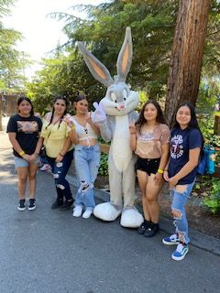
Family
I have two older sisters and a little brother and my mom used to be a single hard working mom but now she found my step dad and everything is easier now, if you look in the pet slide you can see the i have 3 dogs and a chihuahua and she been with me trout a lot she is my sisters dog she got her when she was 13

Slide 10
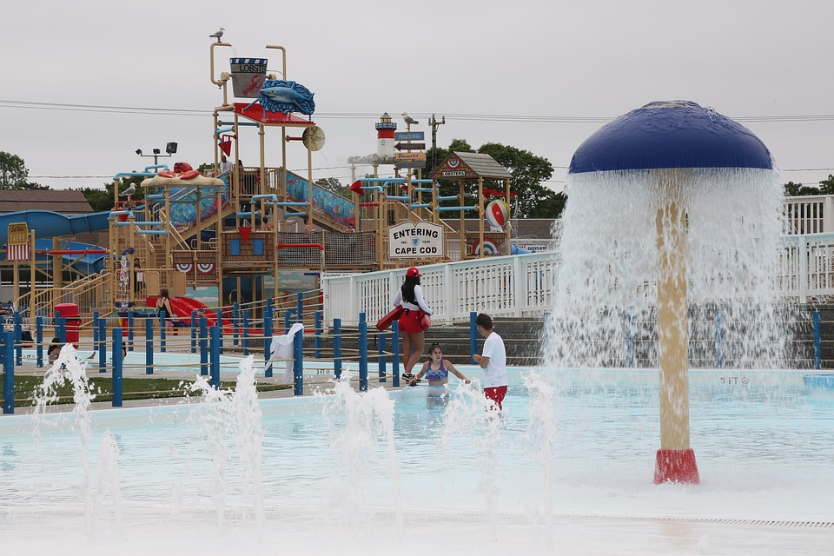
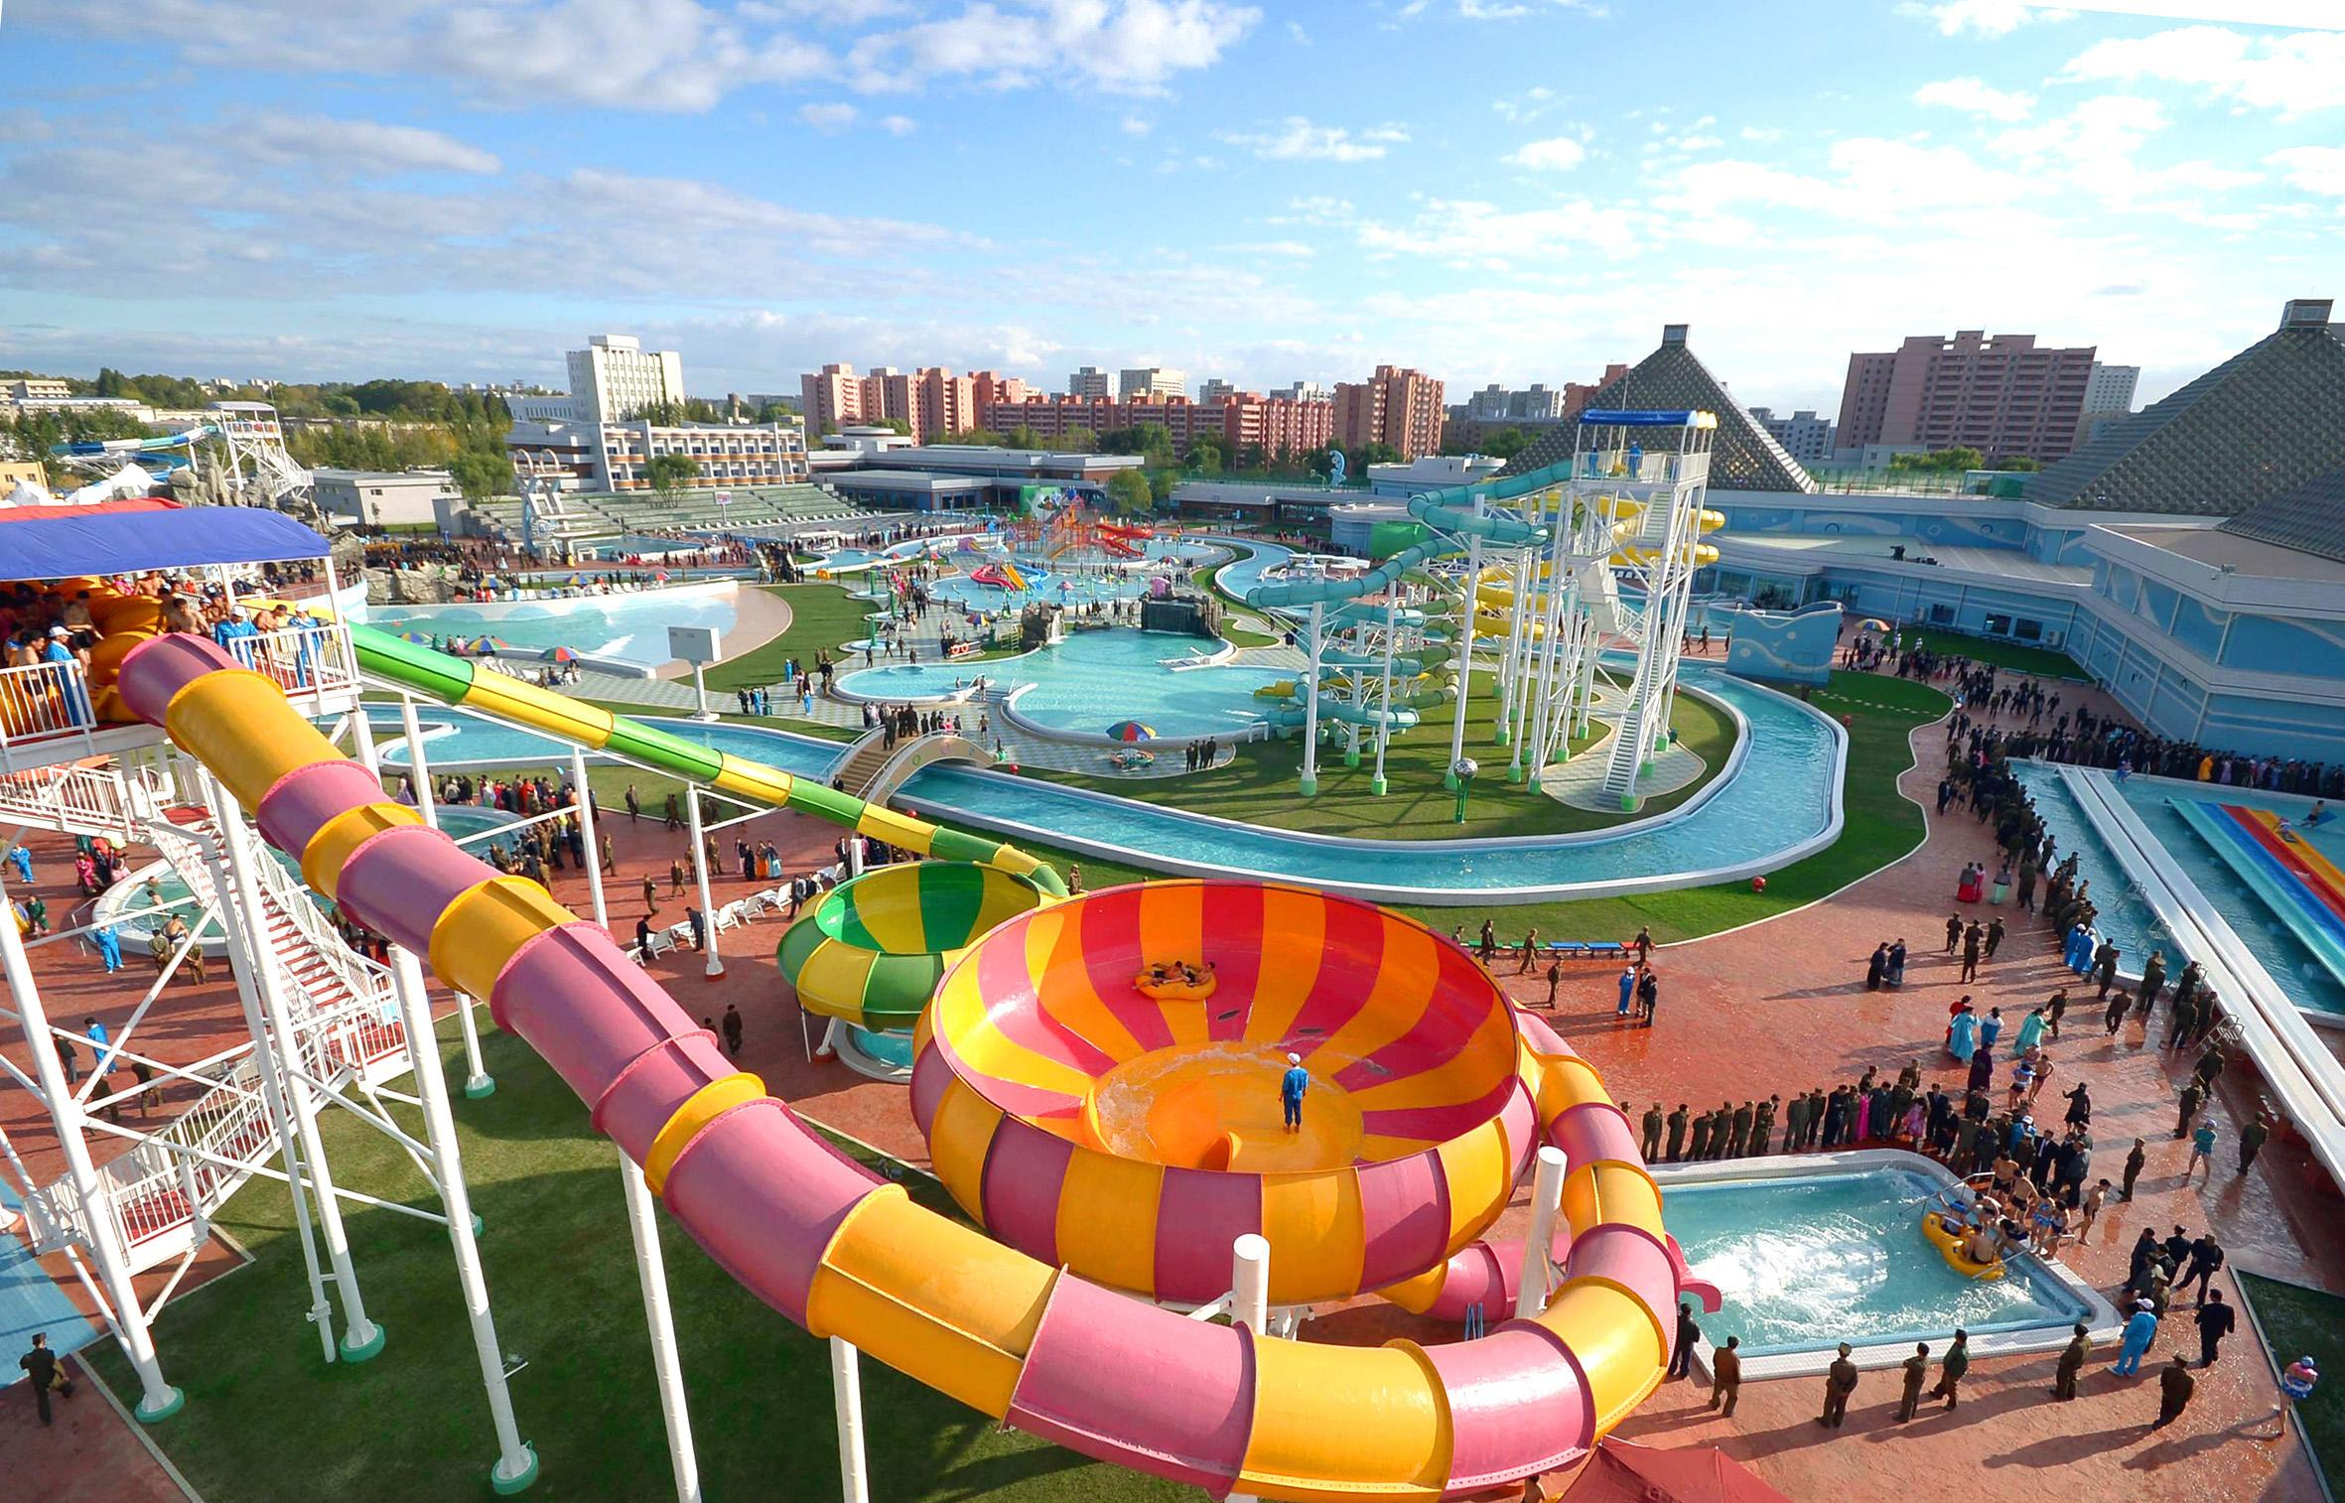
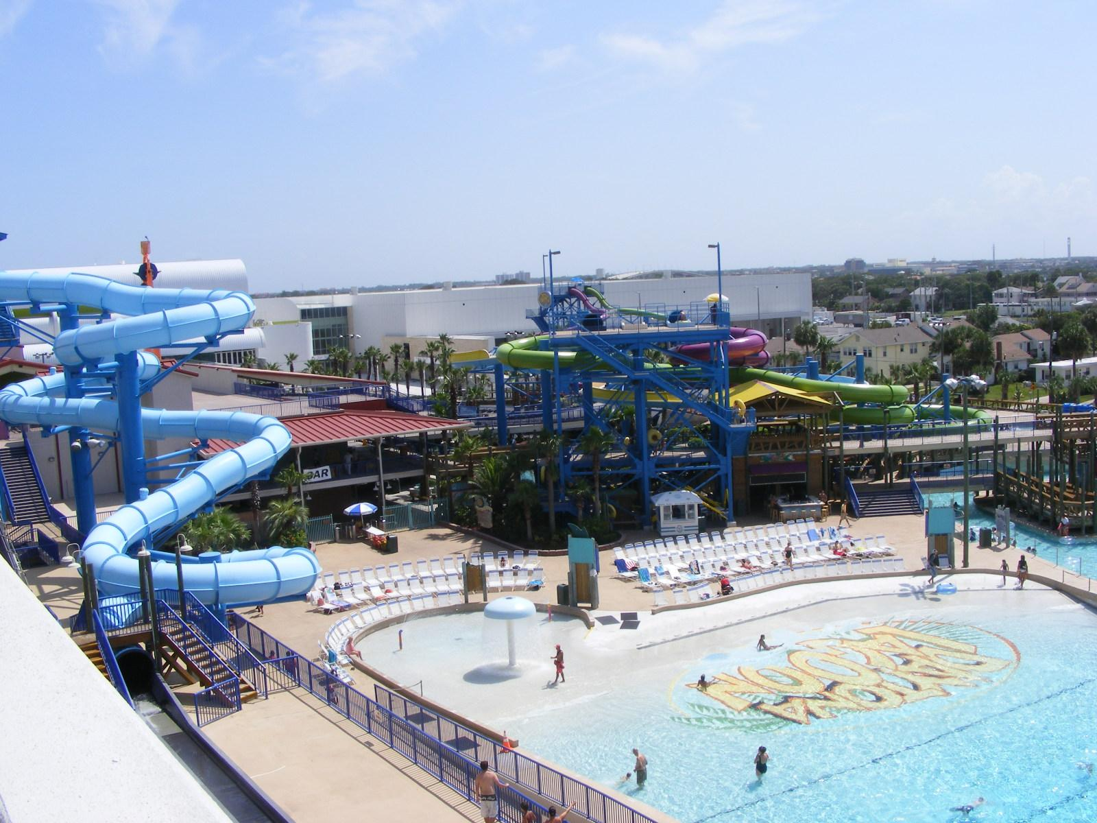
What i did this summer
For summer i figured myself out that i was bisexual i aslo went to six flag for my sister graduation and i also what to sun splash it was really hot and i slept a lot and got addicted to anime

Slide 11
Reslion
I am a proud Mexican i can speak two languages spanish is my first language my family is from nayarit half of my family is in Mexico and half is in the united states i will visit soon me and my little brother have a horse in mexico and her name is oreo and also my grandma own a candy shop.

Slide 12
Conclusion Slide
The End I hope you liked to get to know me i’m a pretty insterng kid and i hope to get to know my classmates better and my teacher

