Slide 1
All About Me
By:
Natalia Yanez

Slide 2
My family
I'm the oldest out of my two siblings
I have a big family on my mom’s side
I have a family of 5

Slide 3

About myself
I am 12 years old
My birthday is on July 11
My favorite movie is midnight sun
My favorite show is called young sheldon

Slide 4
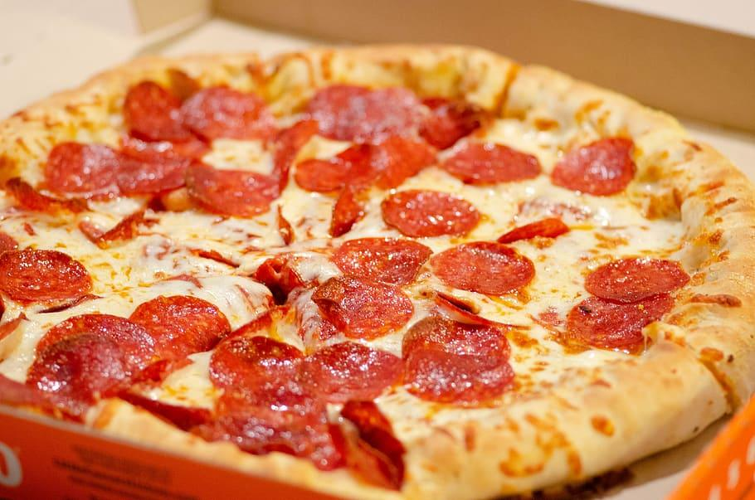
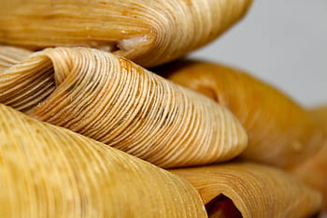
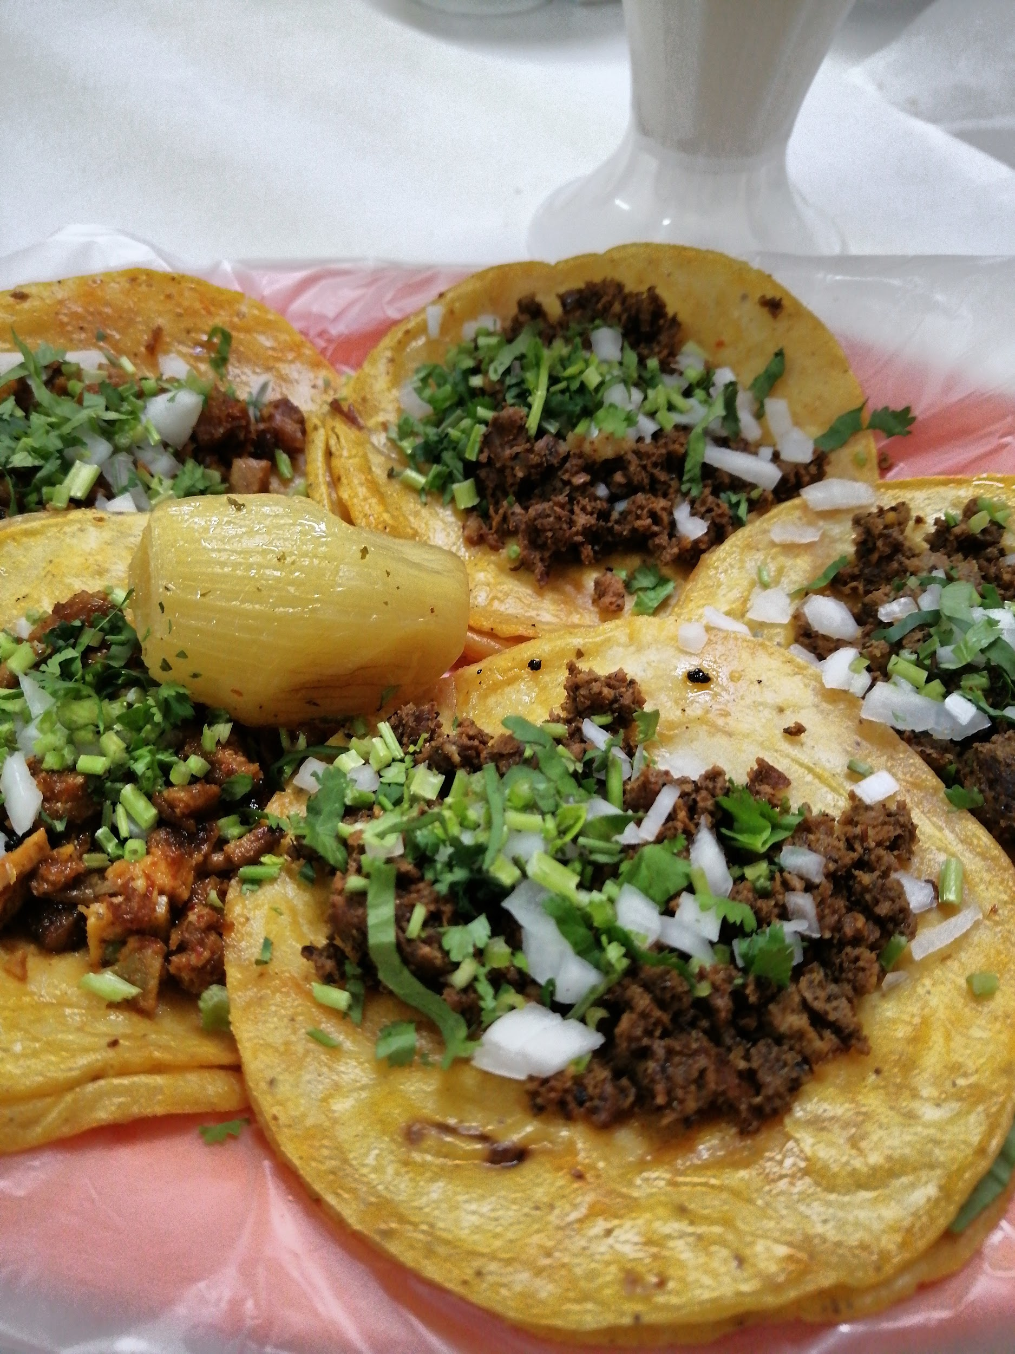
My favorite foods
Pizza
Tamales
Tacos

Slide 5
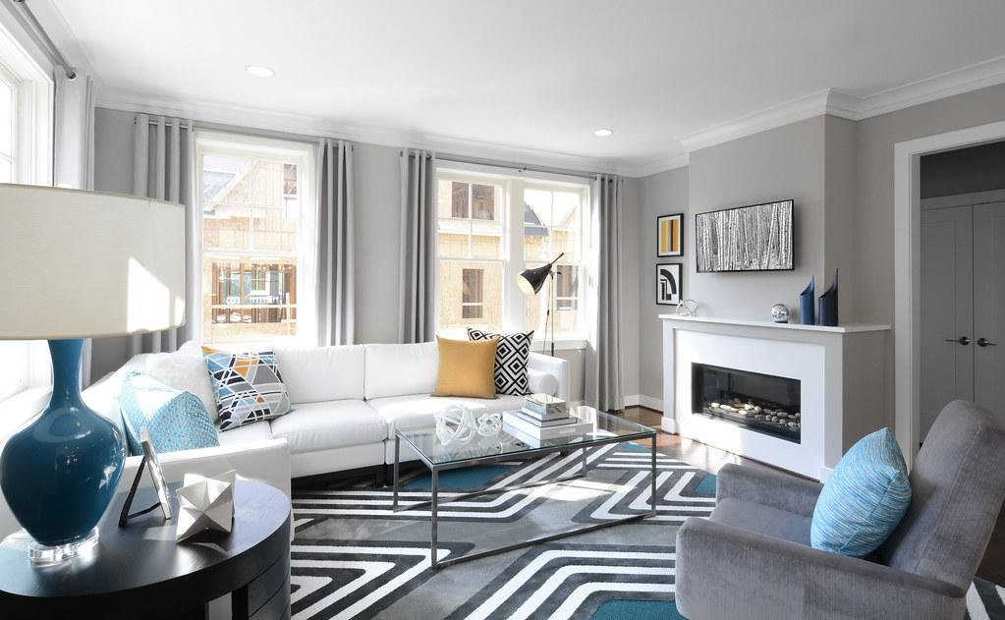
What i would like to do when im older
What I would like to do when im older is to model homes and organize. Why I like that is because it make me feel organized and makes me feel in a nice clean fresh room.

Slide 6
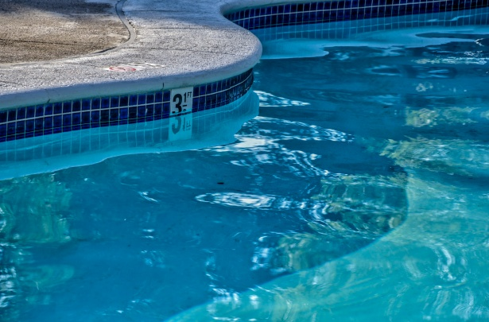
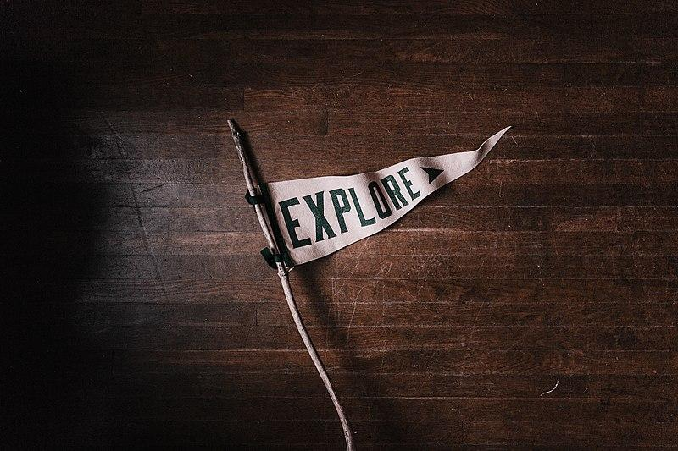
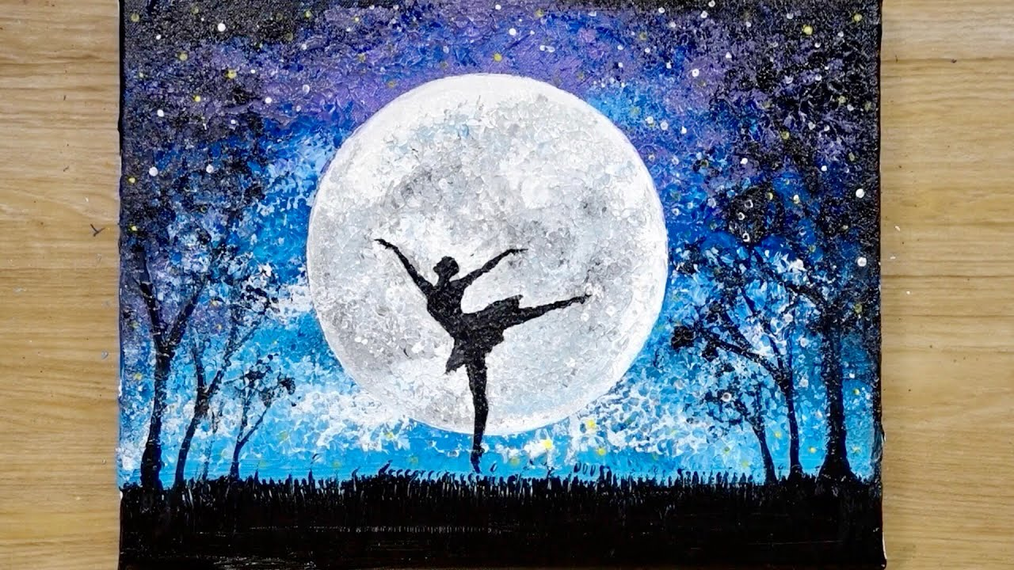
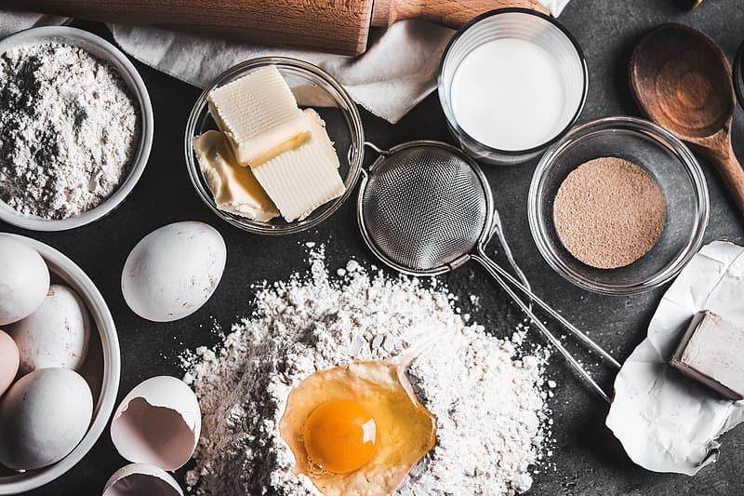
What i like to do
I like to swim with my family
I like to hang out with my cousins from cali and mexico
I like to explore places
I like to paint
I like to bake

Slide 7

Movies i like
I like romance movies
horror movies
Funny movies
Some Action movies

Slide 8
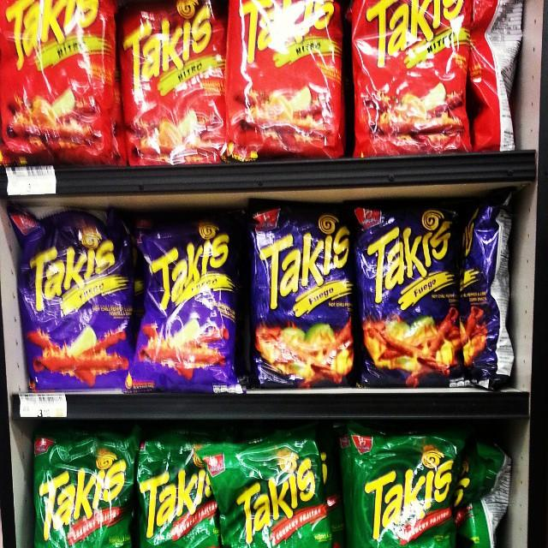
My fav chips
Hot cheetos
Takis
Takis doritos
Turbos
Hot cheetos popcorn

Slide 9
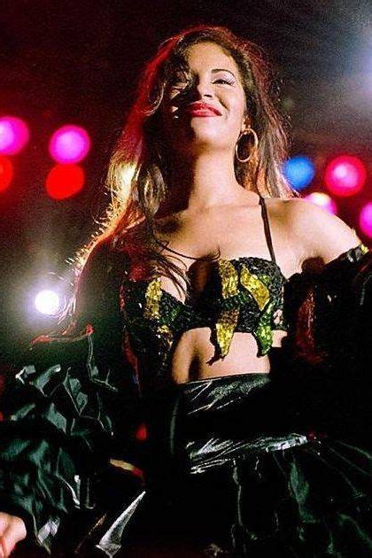
My favorite songs and singers
My Favorite Singer is Selena Quintanilla
I have some other songs that i like that are called Secrets, walk with me and heart attack

Slide 10


Sports i watch
My dad and I watch Los angeles Lakers and Las vegas Raiders

Slide 11
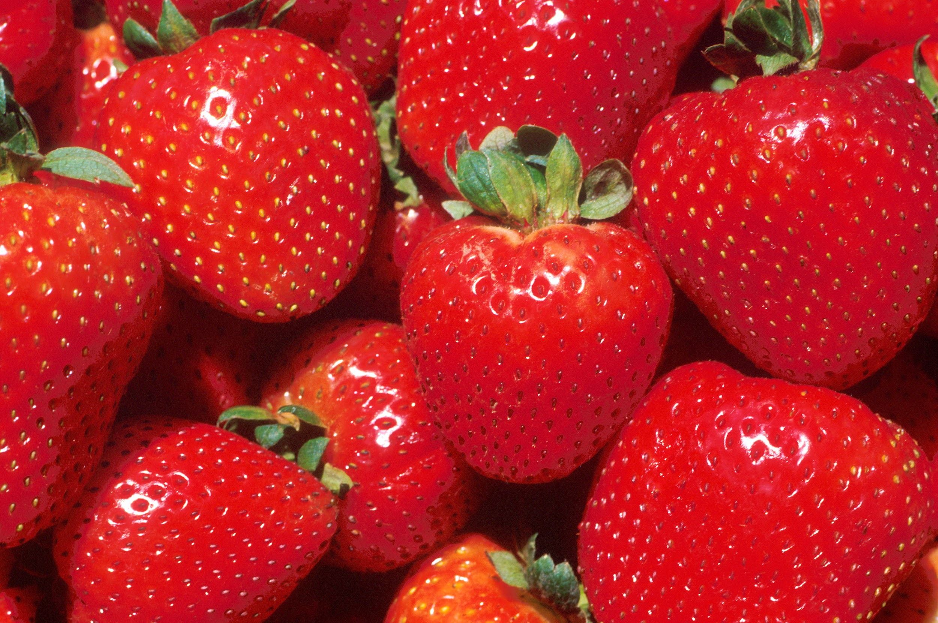
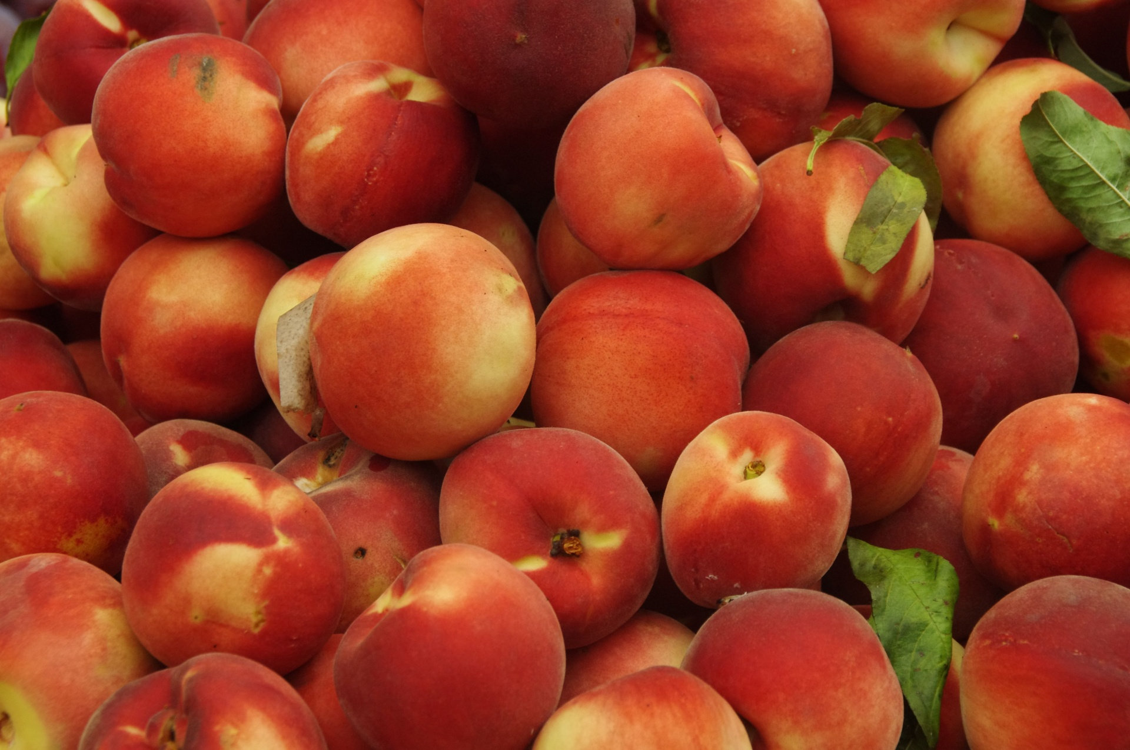
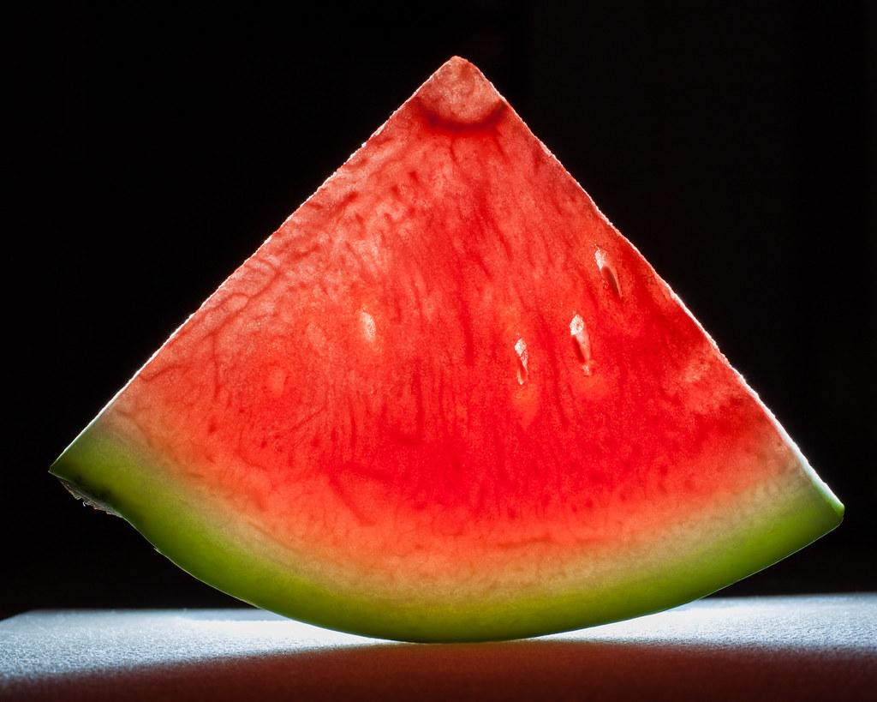
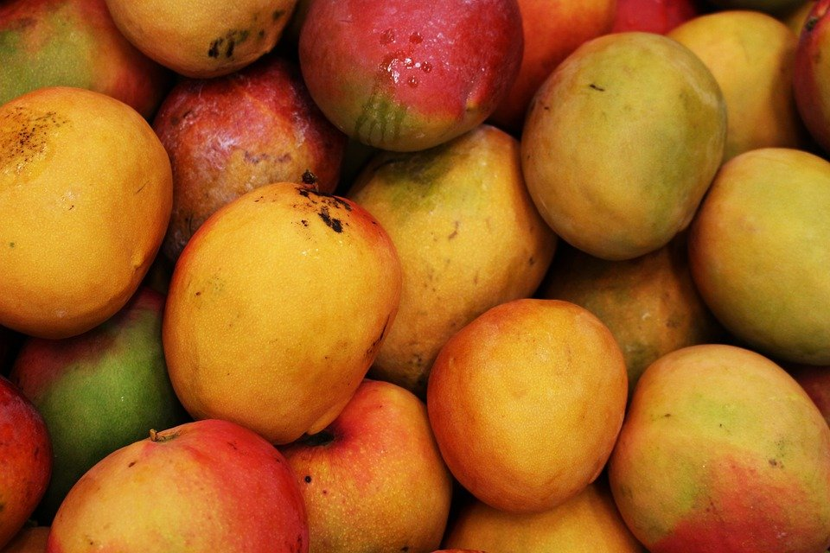
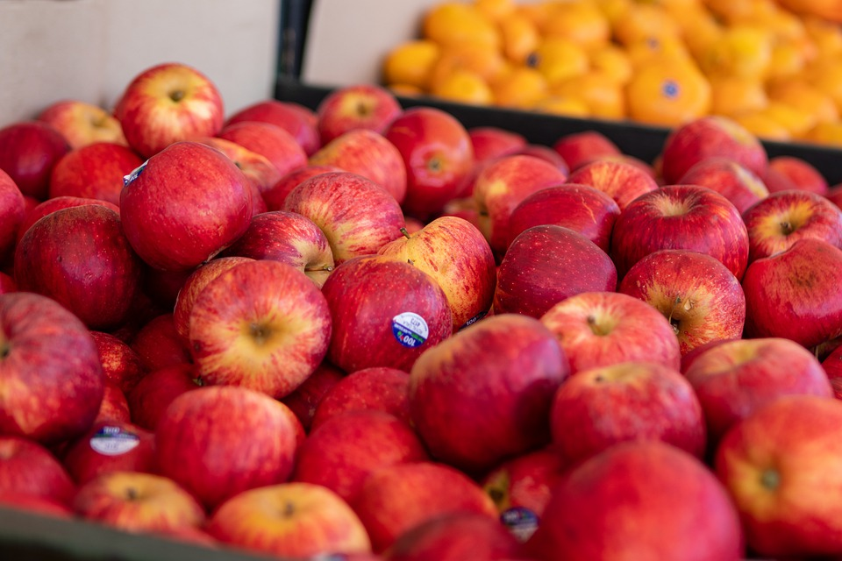
My Favorite fruits
Strawberries
Peaches
Watermelon
Mango
Apples

Slide 12
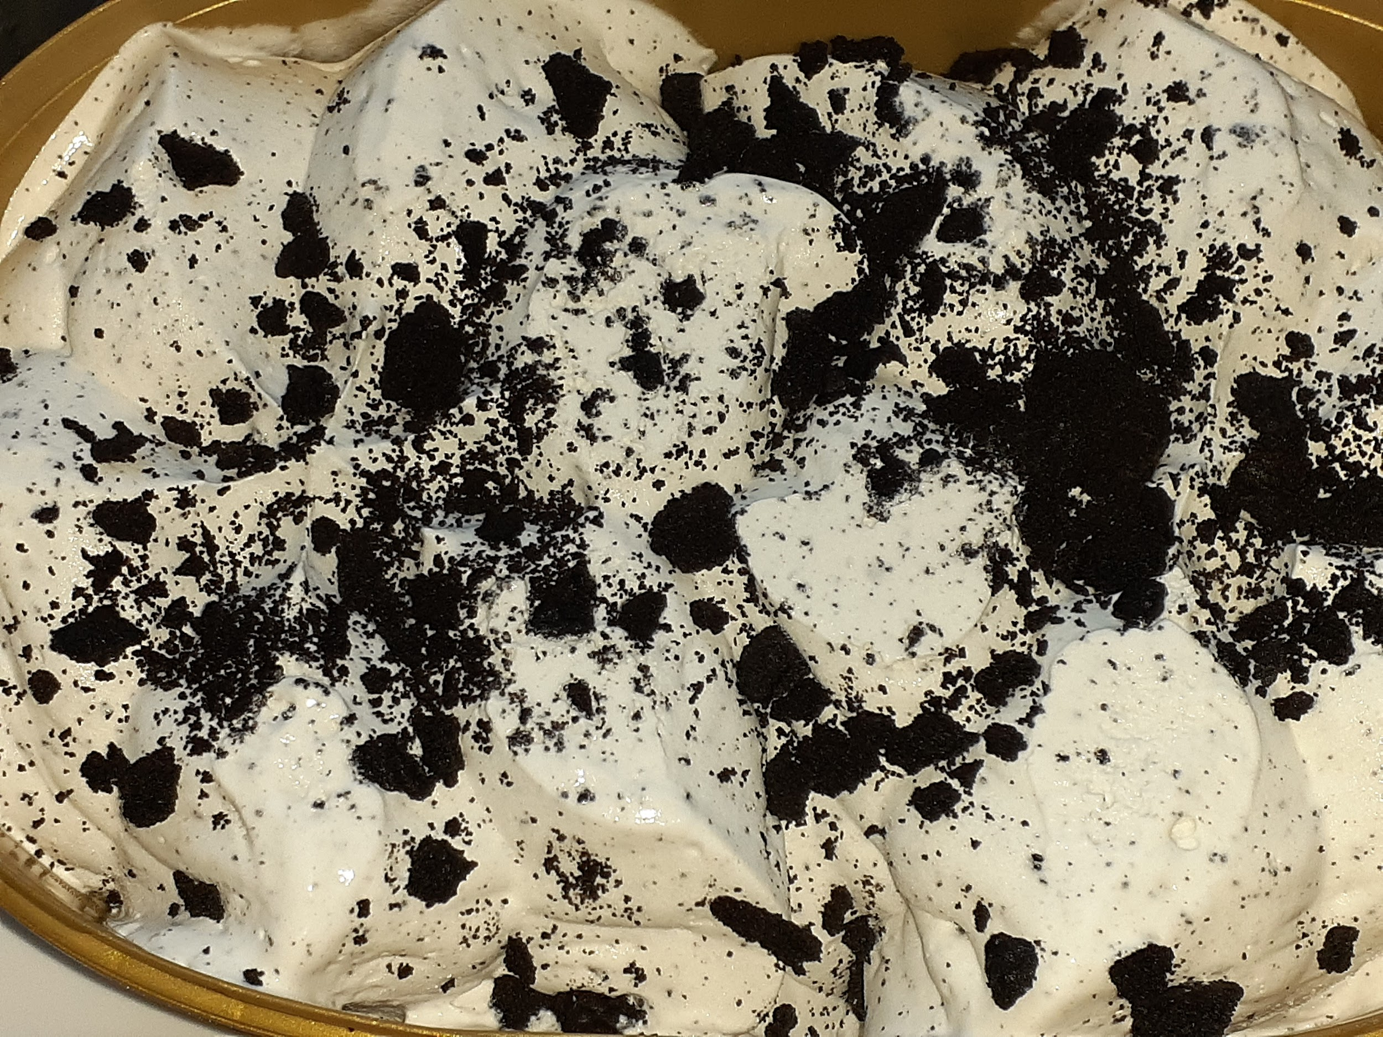
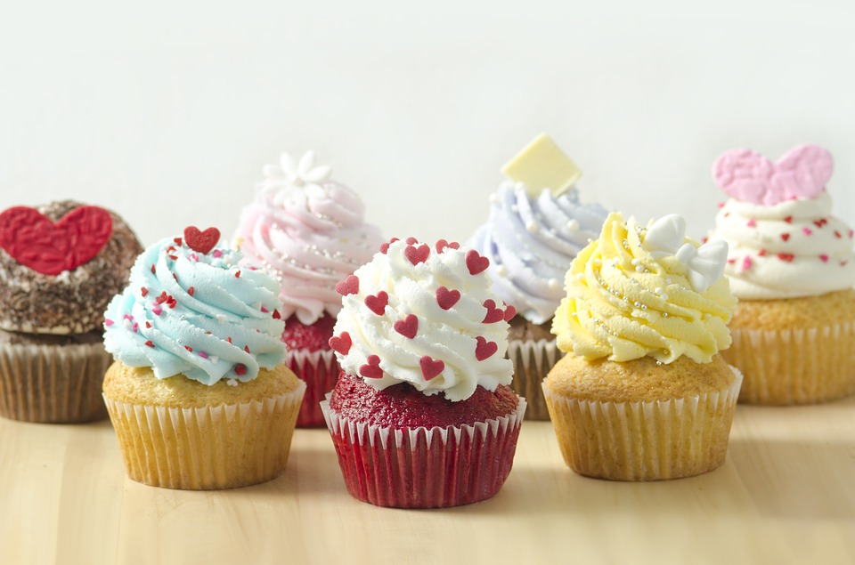
Favorite sweets
Caramel Chocolate
Milk Chocolate
Cookies and cream ice cream
Cupcakes
Cake

Slide 13
The end
This is all about me that I could know.

