Slide 1
All About Me
By:
Nushmia Khan

Slide 2
My name is Nushmia
I’m 12 years old
I was born on January 7, 2009
I was born in Yuba City, California
I’m right handed like most people
I like the colors black, white, lavender, and baby blue
ABOUT ME

Slide 3
MY FAMILY
I have always depended on my mom to help me with anything.
I can always talk to my dad about my problems.
My brothers and I argue alot but were still close to each other.
I had always wanted a baby sister and now I have one. She’s a bit annoying but I love her.
I have a caring mother named Asma
A loving father named Naveed
Two younger brothers named Naqash (6 years old) and Hanzala (9)
And a baby sister named Zunisha (1 ½ years old)

Slide 4
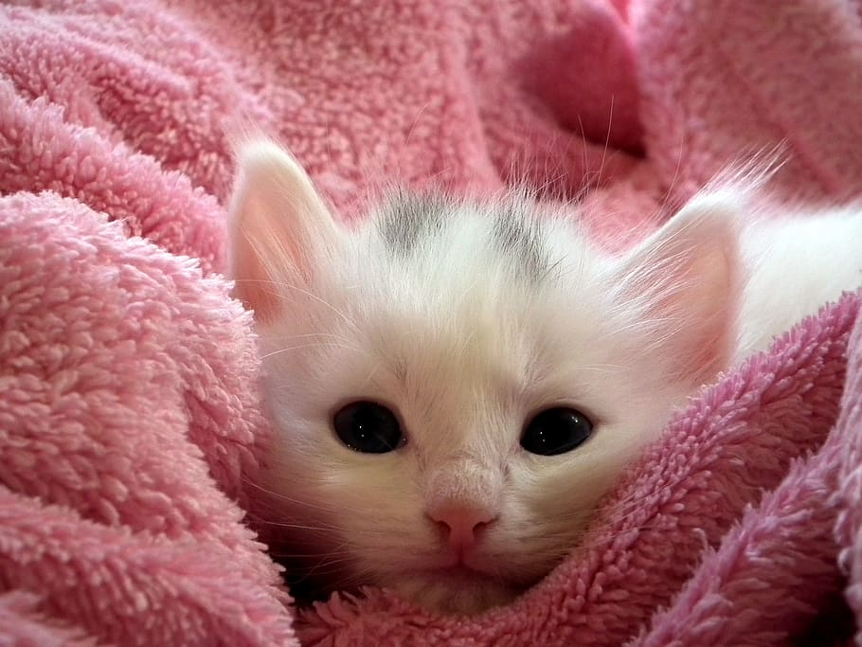
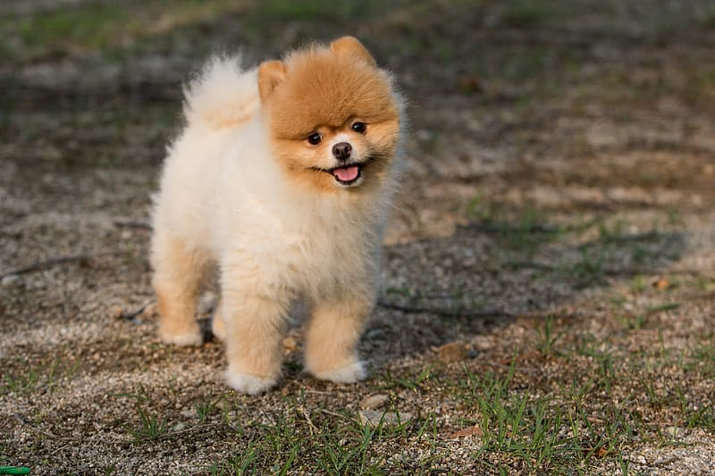
MY PETS
I have a cat named Nala and I have a pomeranian named Simba. Nala is 5 years old and Simba is 6 years old. I got Nala when she was 2 and SImba when he was 3.

Slide 5




My Favorite Sports Teams
Los Angeles LAKERS
Pittsburgh Steelers
Los Angeles Dodgers
Pakistan National Cricket Team

Slide 6
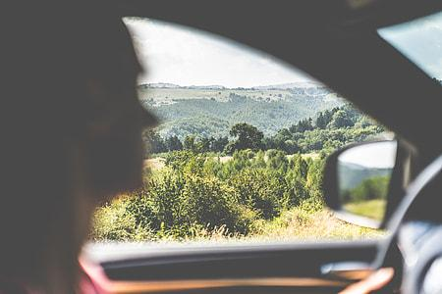
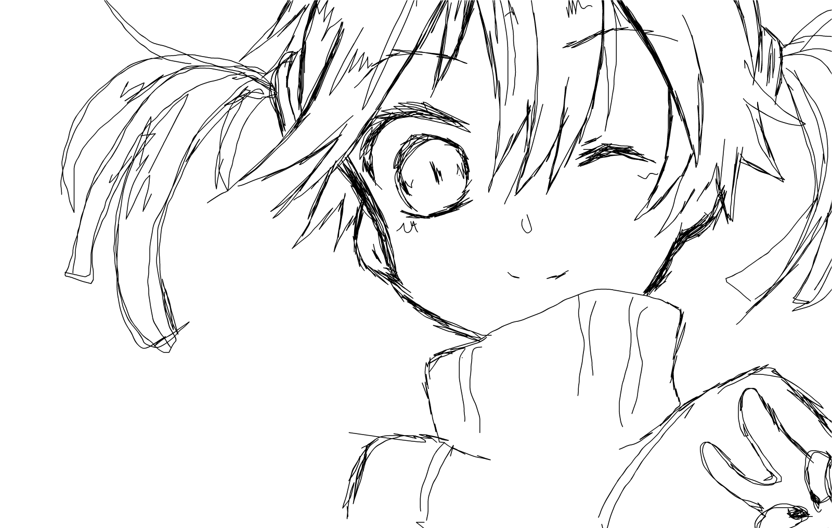
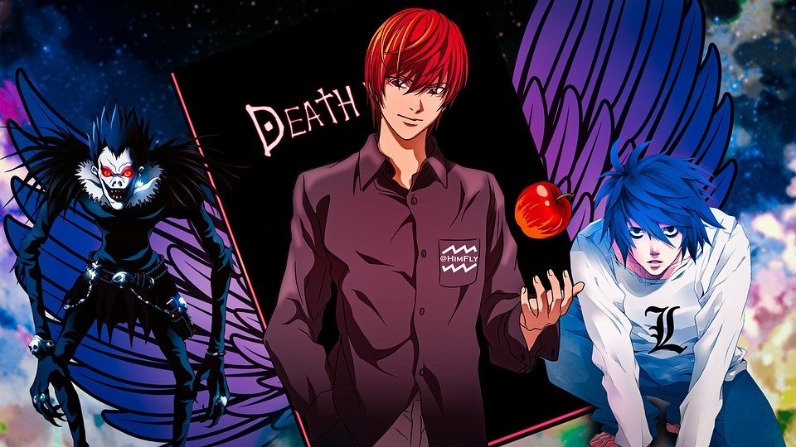
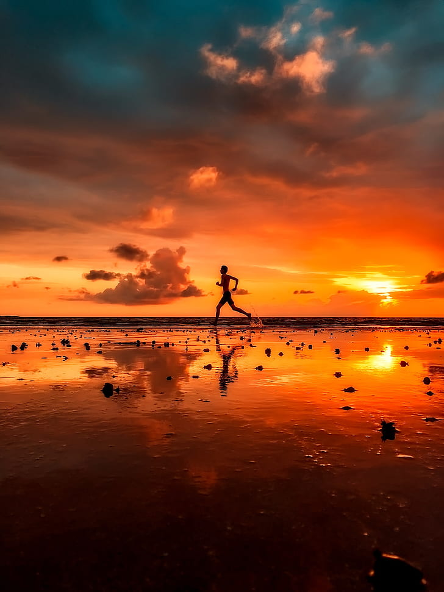
My Hobbies
Drawing
Painting
Watching Anime<3
Going on long drives
Running

Slide 7


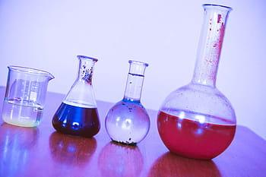
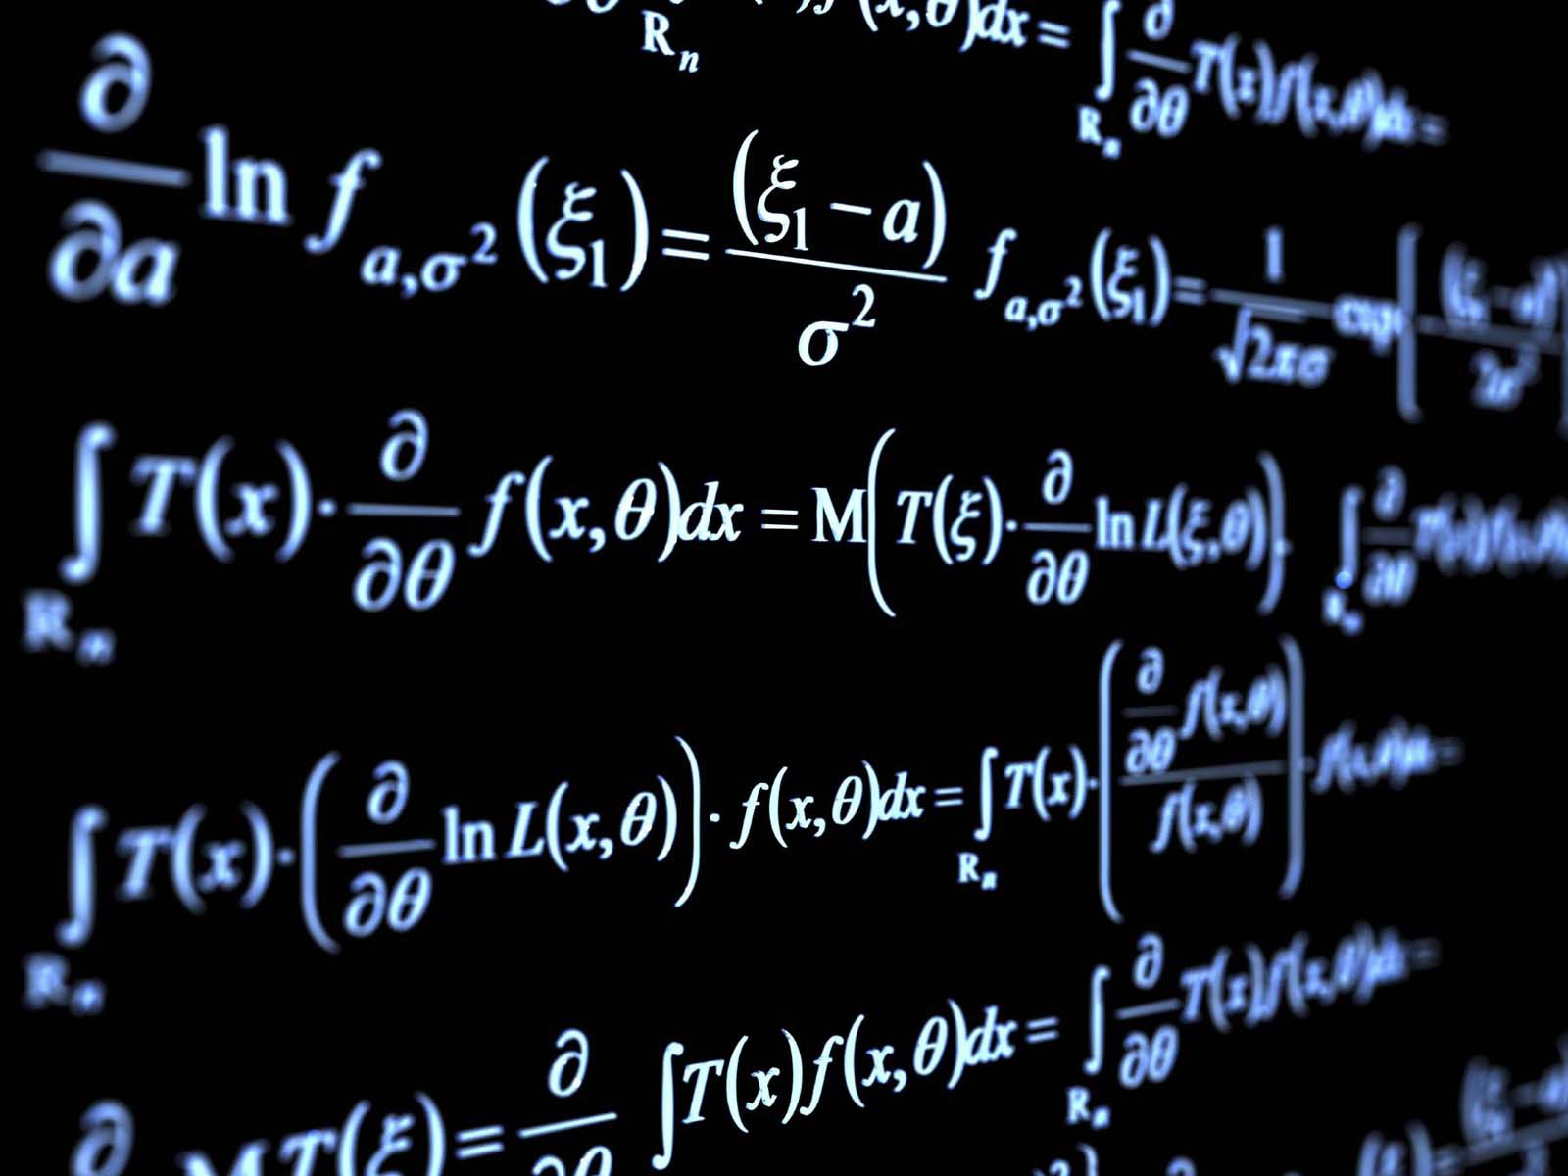
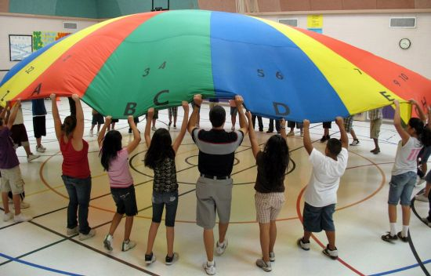
My Favorite Subjects
I like ELA
I love History
Math is okay
Science is fine
PE is awesome
Avid is great
I Guess I Like All Subjects

Slide 8
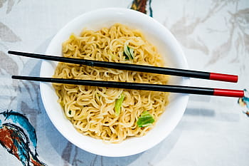
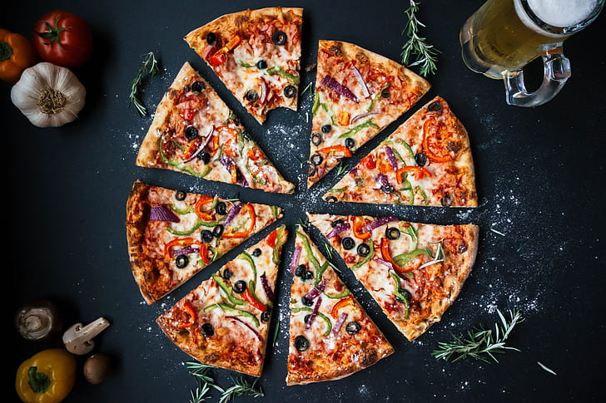
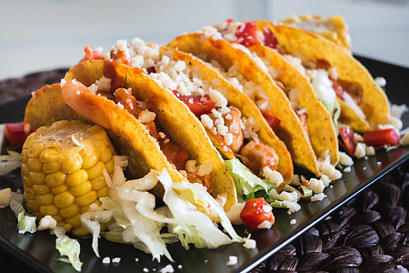
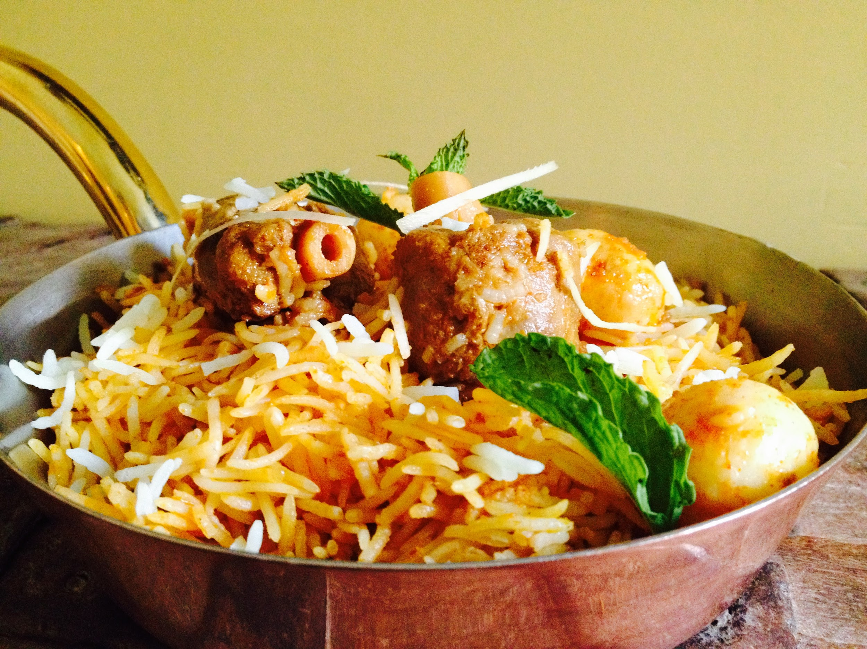
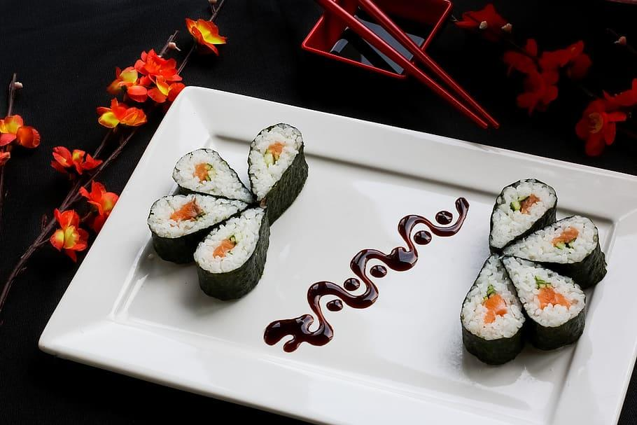
My Favorite Food
Ramen
Biryani
Tacos
Pizza
Sushi

Slide 9
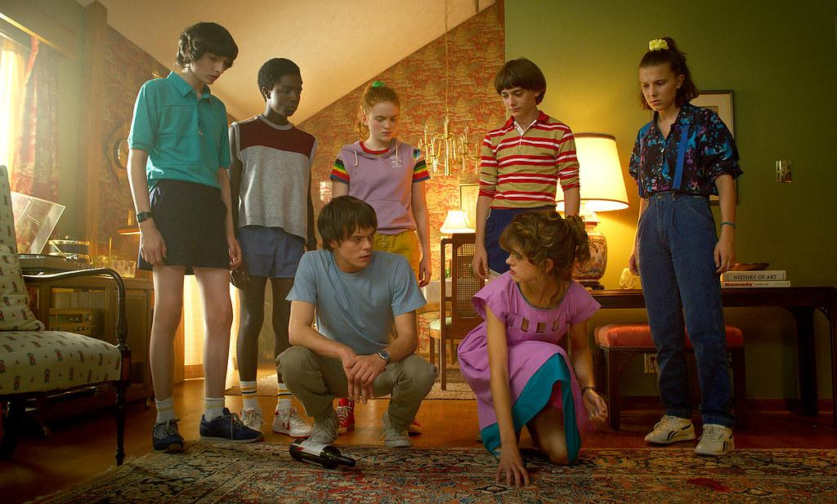
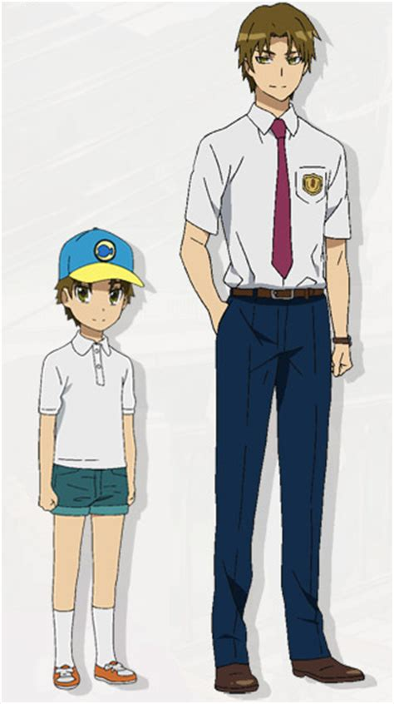
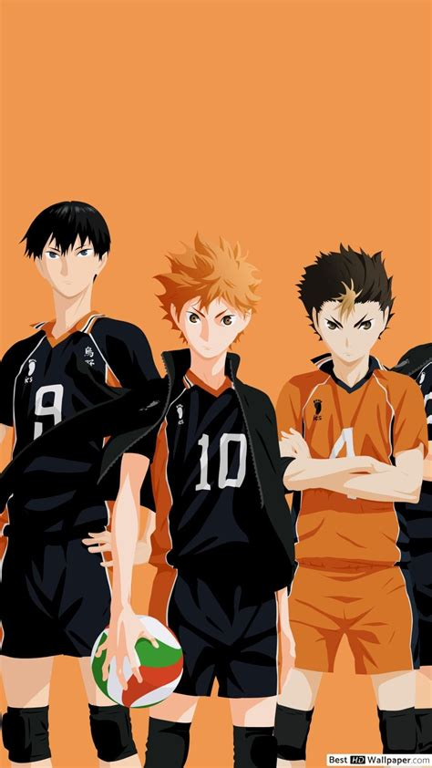

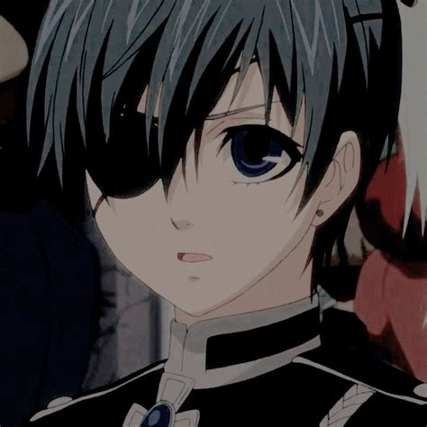
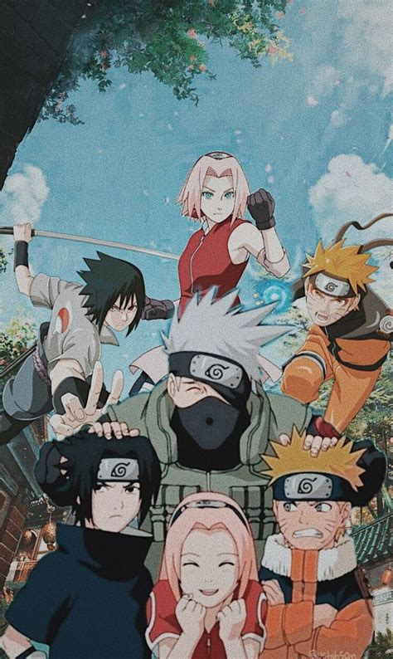
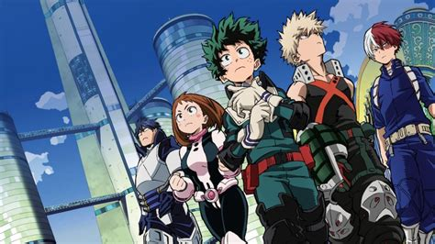

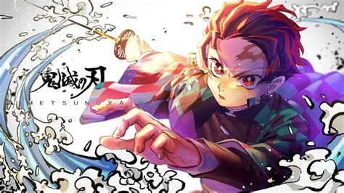
My Favorite Shows
Riverdale
A Series of Unfortunate Events
Stranger Things
MHA/BNHA
Haikyuu!!
Death Note
Demon Slayer
Naruto
Black Butler
Anohana The Flower we Saw That Day

Slide 10

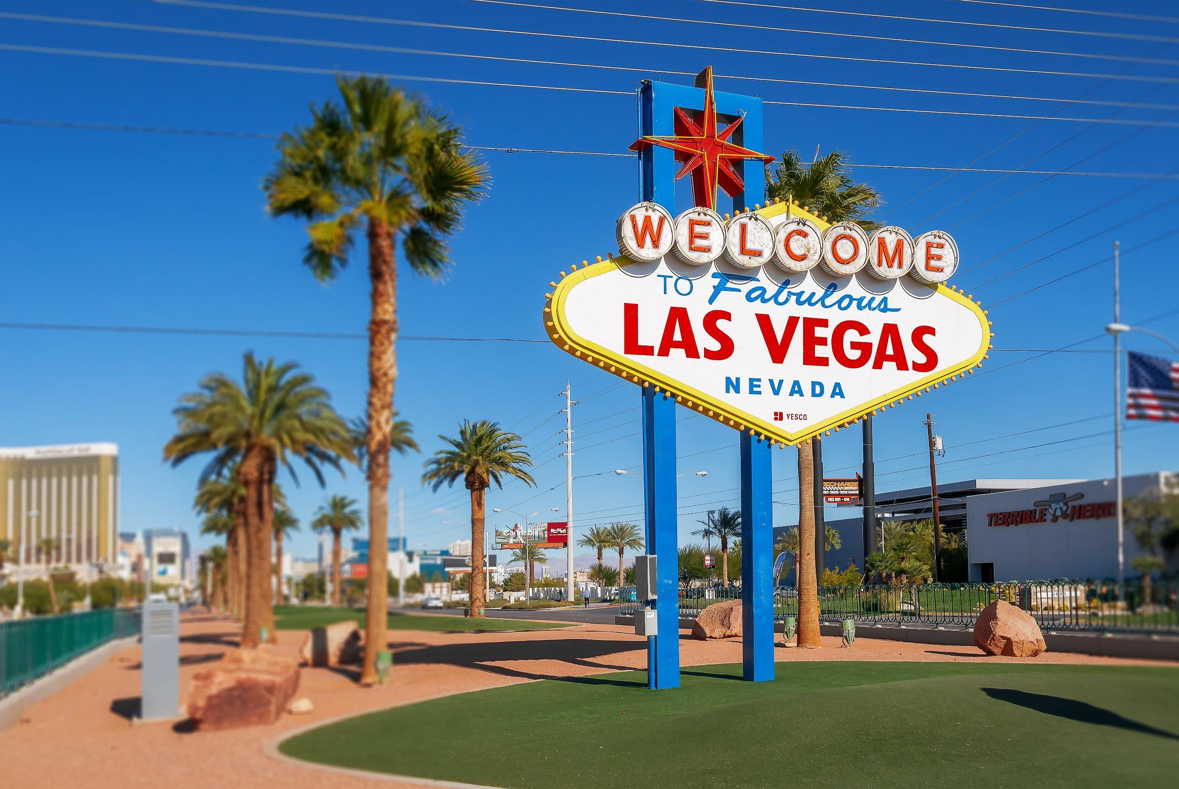
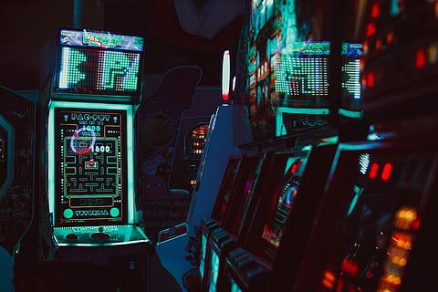
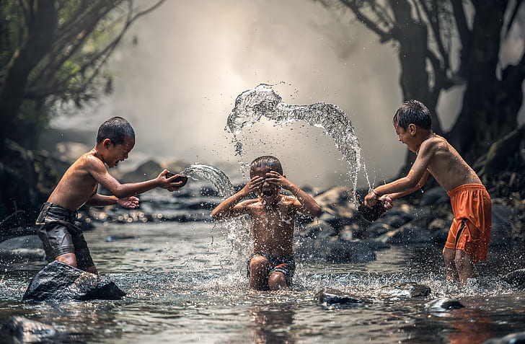
What I Did This Summer
I went to Pakistan for a month
I went Las Vegas for 1 week
My cousins came over
I played video games

Slide 11
The End
Hope you got know me abit better. This was an amazing project to work on, I hope I could get to know you better. <3

