Slide 1

All About Me
By
Samuel Ruiz

Slide 2

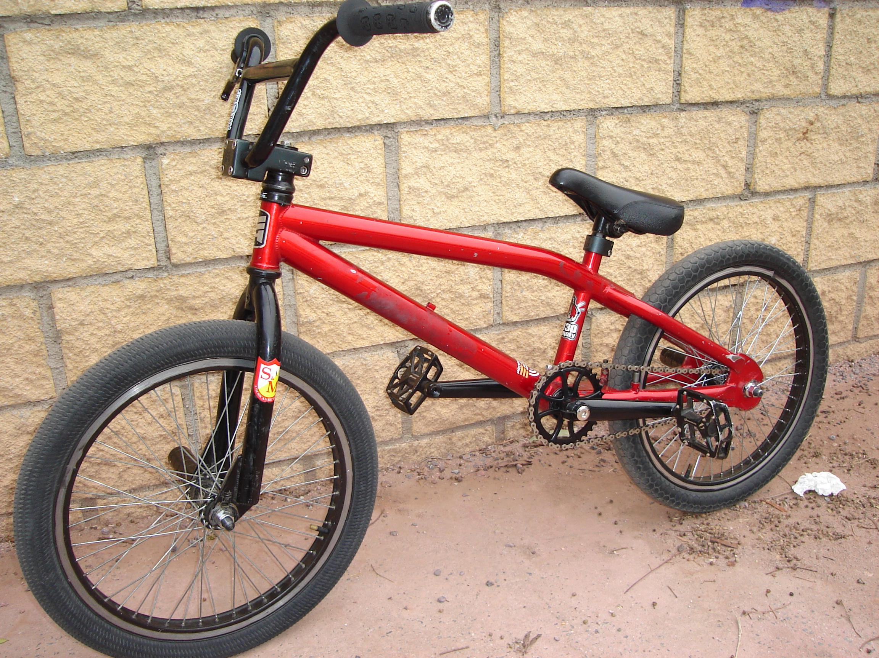
About me
My name is Samuel Frappier im 13 years old and i like to ride my bike on my free time play video games and hangout with friends and go swimming when i'm bored.

Slide 3


Family
I currently have 7 sisters and 3 brothers i’m the middle child
Trust me it isn't fun

Slide 4

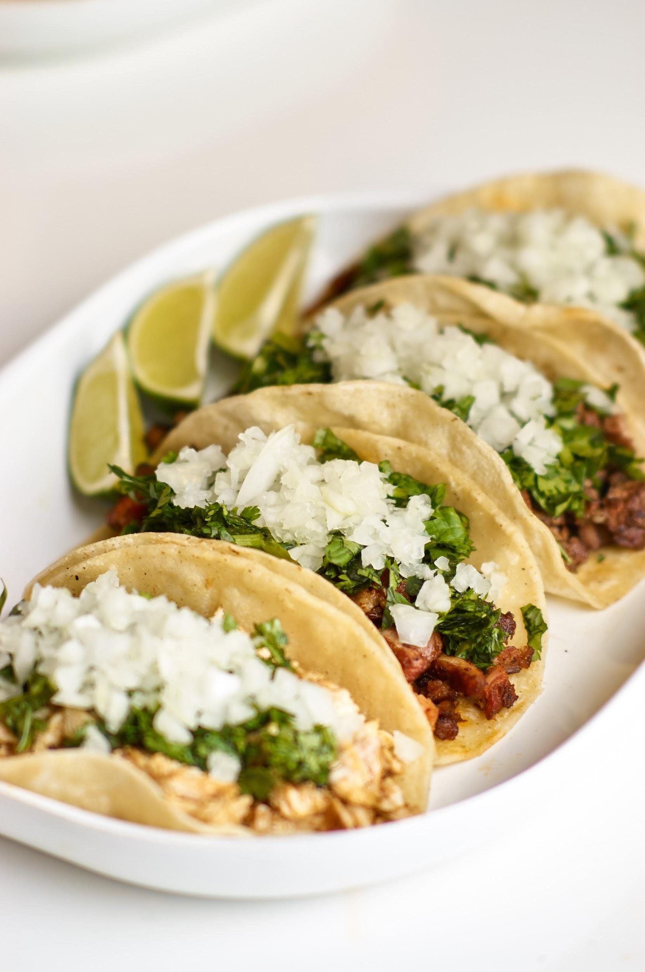
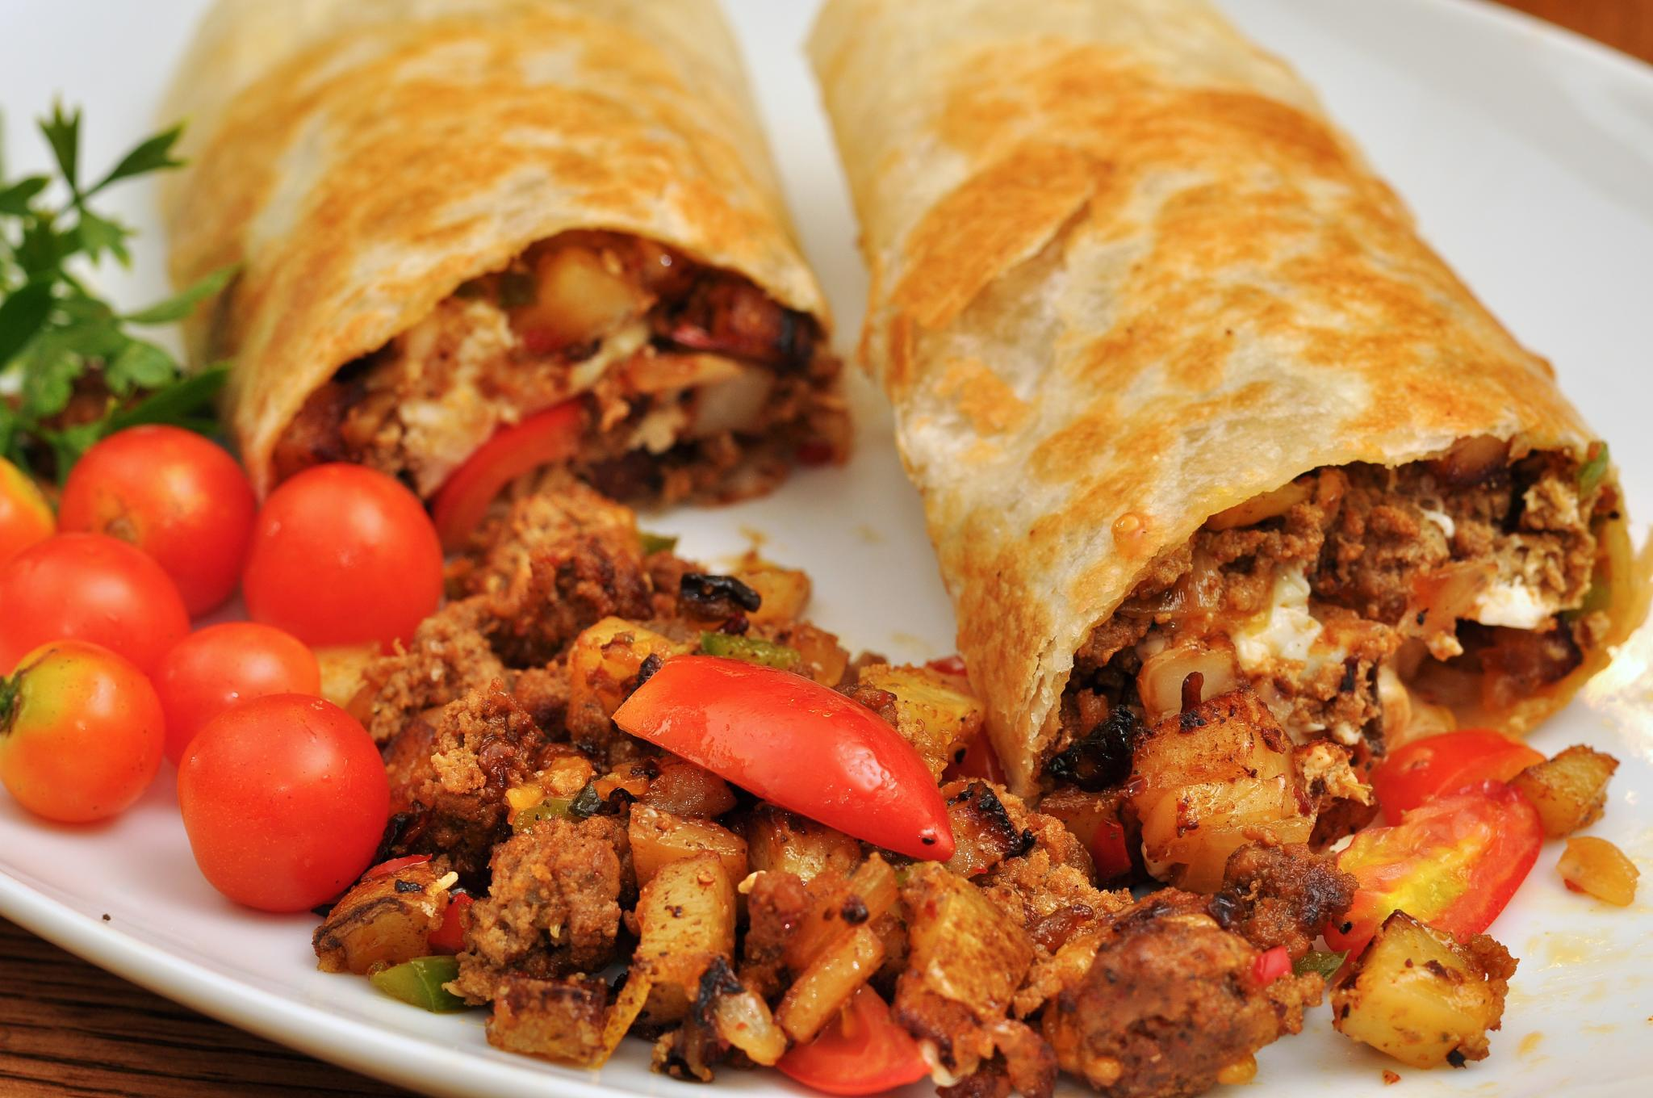
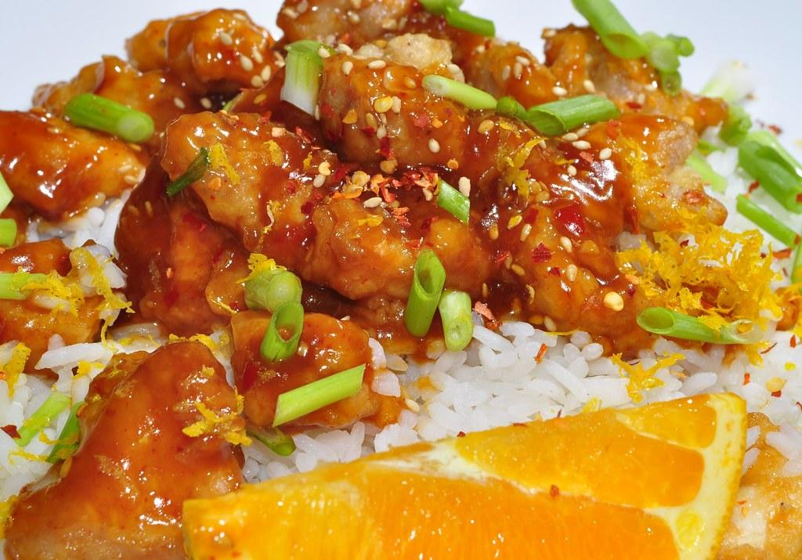
Favorite foods
I'm a big fan of Mexican food i love tacos and burritos i'm also a big fan of chinese but there has to be some orange chicken the best thing about chinese has to be the orange chicken

Slide 5
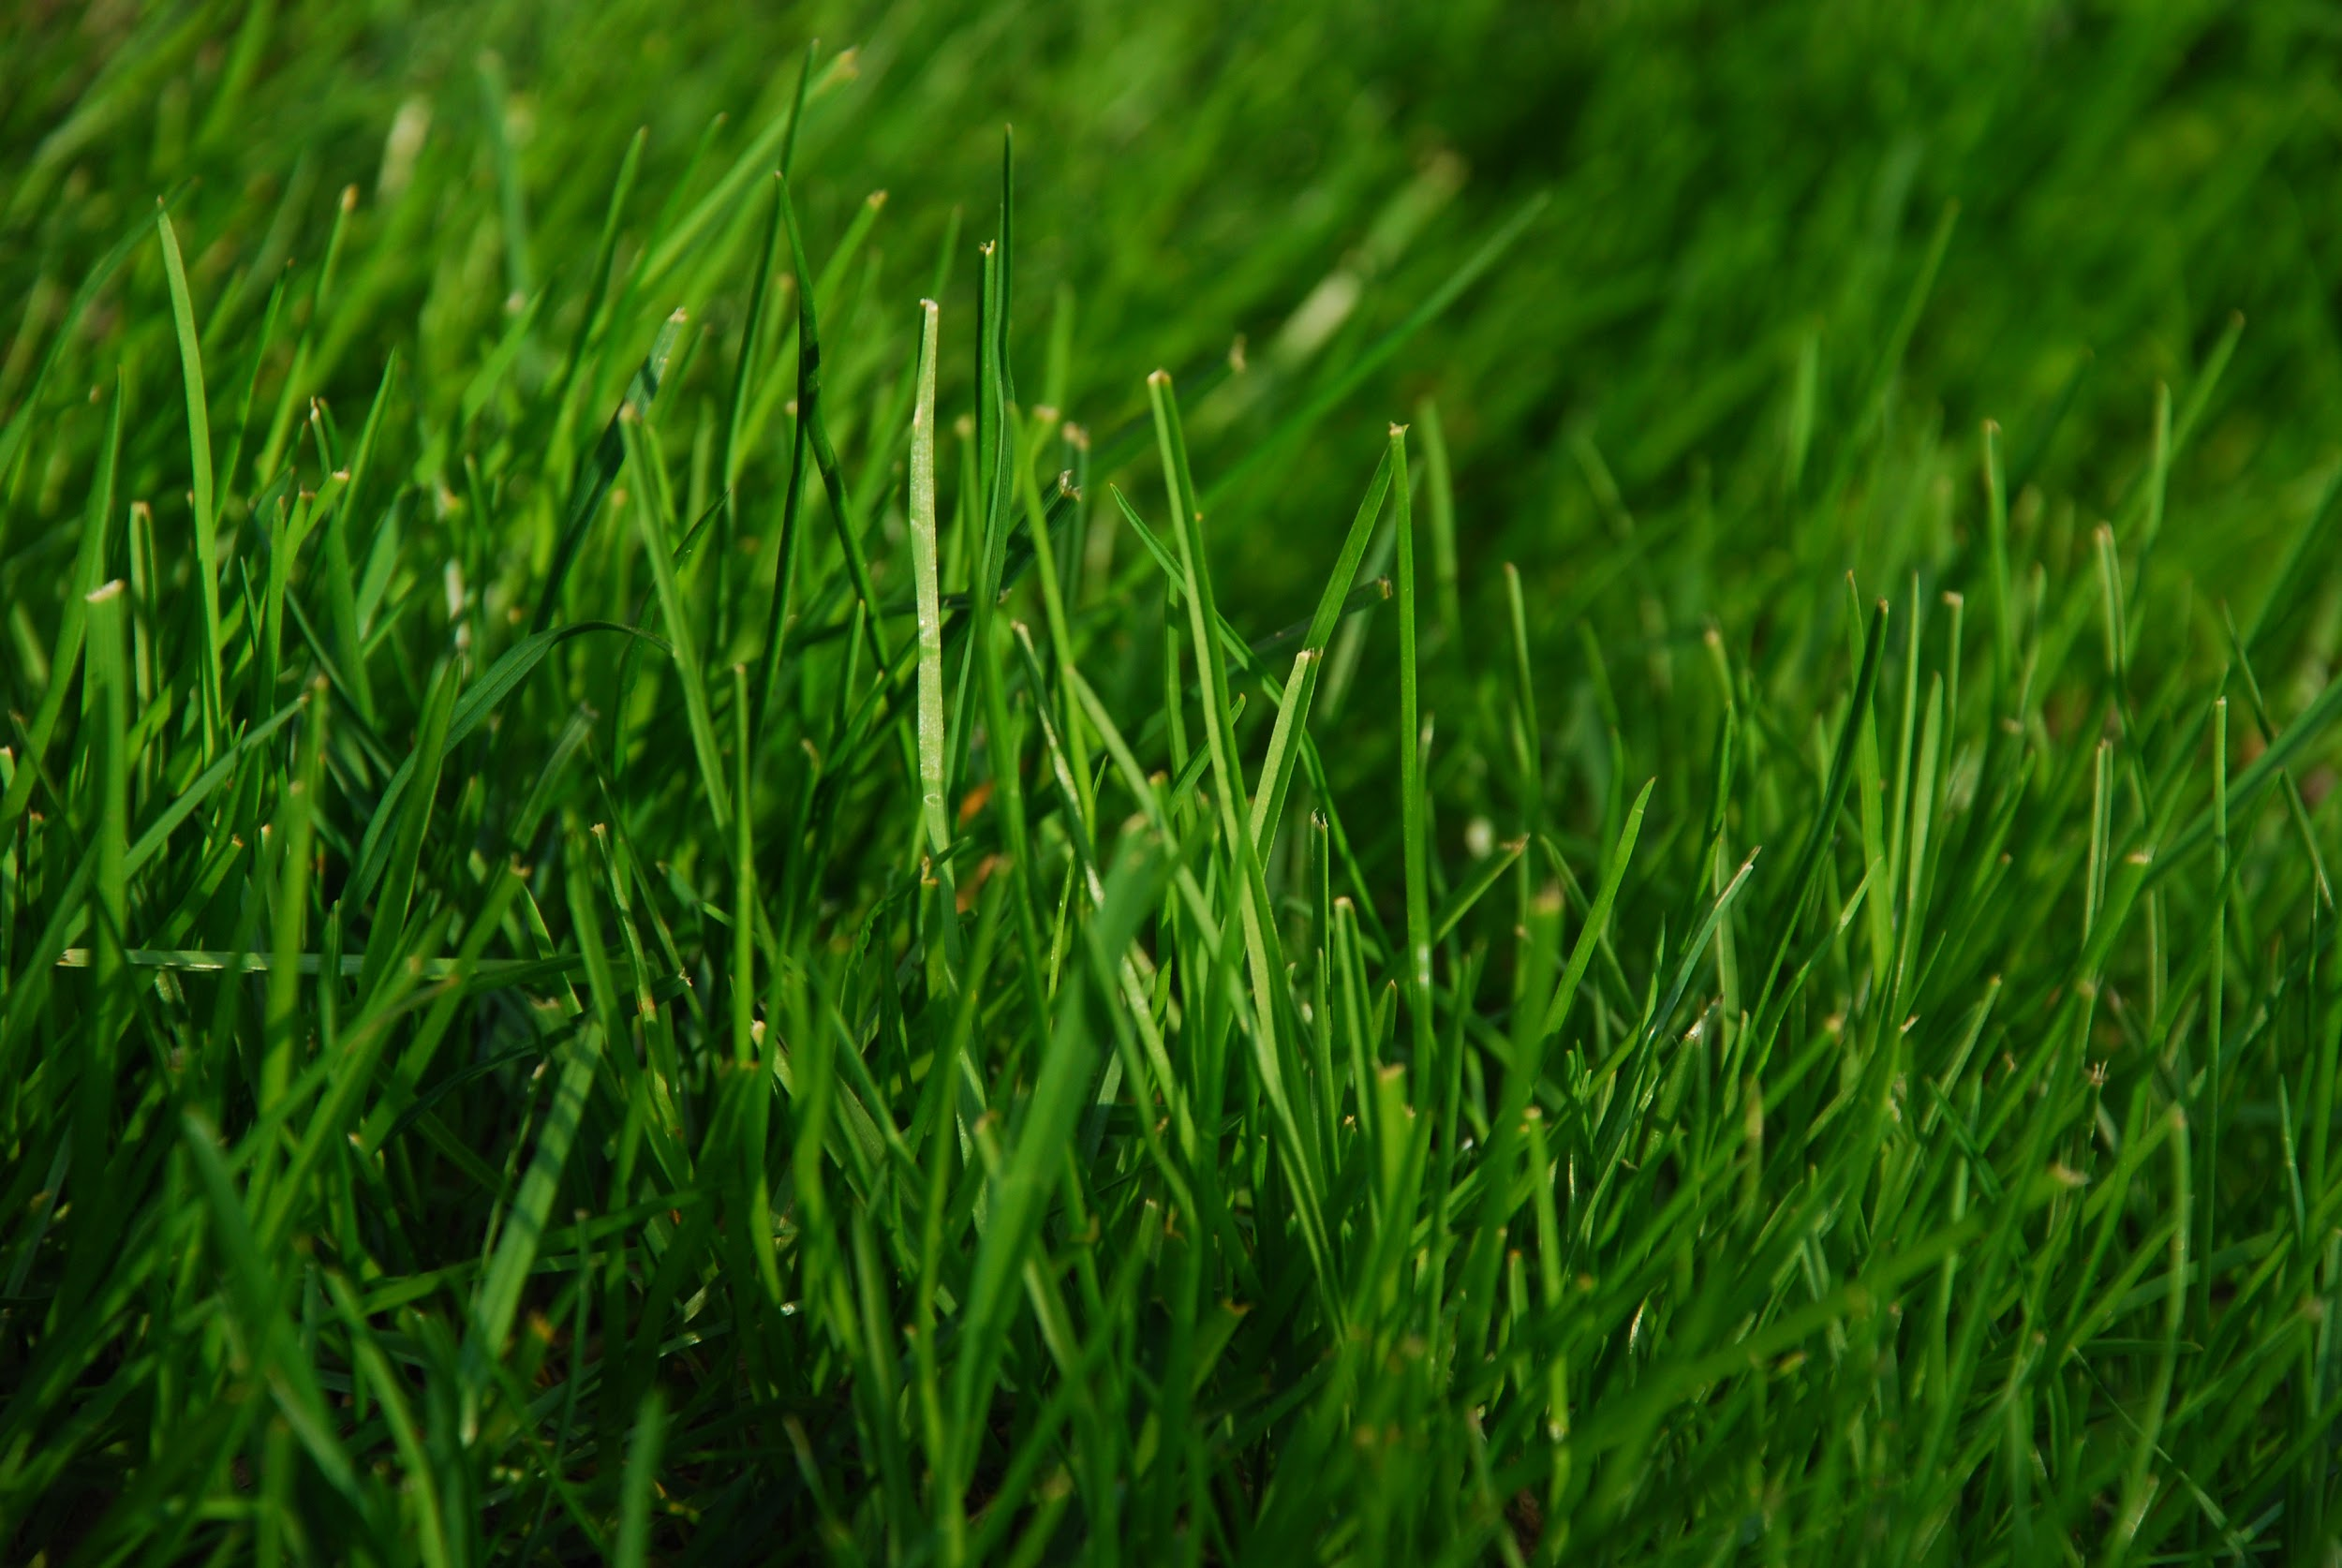


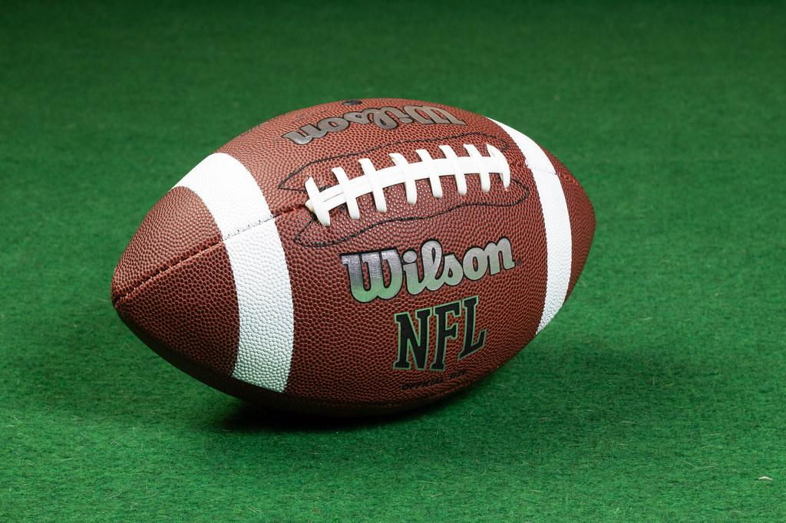
Favorite sports
My favorite sport is easily football i watch and play it and i thoroughly enjoy it if your ever stressed it’s a good way to clear your mind second place is tied for rugby and baseball i used to play baseball for 6 years but i like the concept of rugby more it's pretty much football mixed with baseball because you don't have pads on.

Slide 6

Favorite movies and actors
My favorite kind of movies are comedies i like adam sandler nick jonas clark duke and many more some of my favorite movies are, the grownups movies i like the movie year one both hot tub time machines

Slide 7

Favorite songs
Most of my favorite songs are by lukas Graham and twenty one pilots other than that i listen to a bunch of random stuff just pretty much whatever i can find.

Slide 8

Best friends
I have a few friends most don't currently go to LOMS they have either moved or we stopped talking but i do have 1 best friend and he does go to the school we hangout as much as we can and we always make eachother laugh when we do hangout.

Slide 9
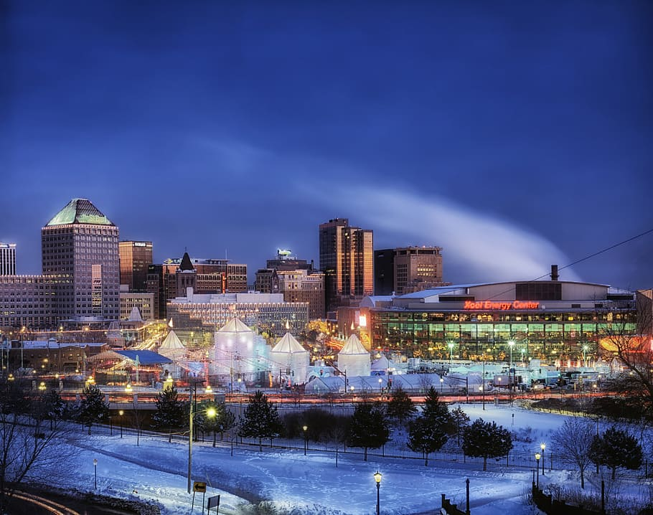
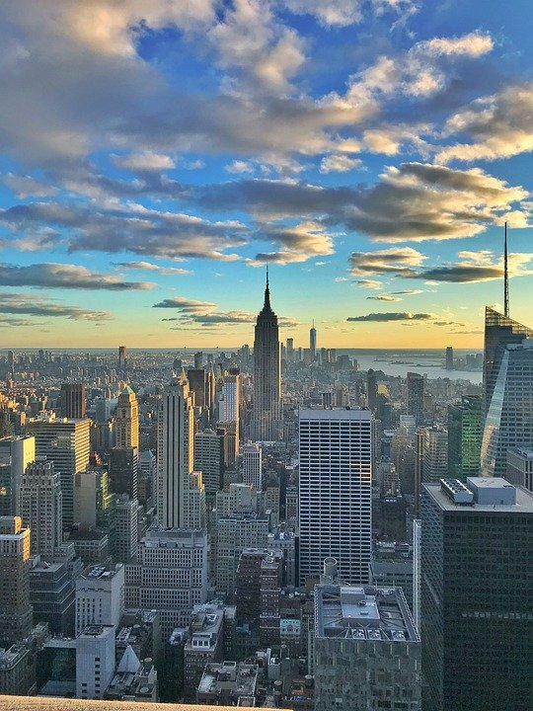
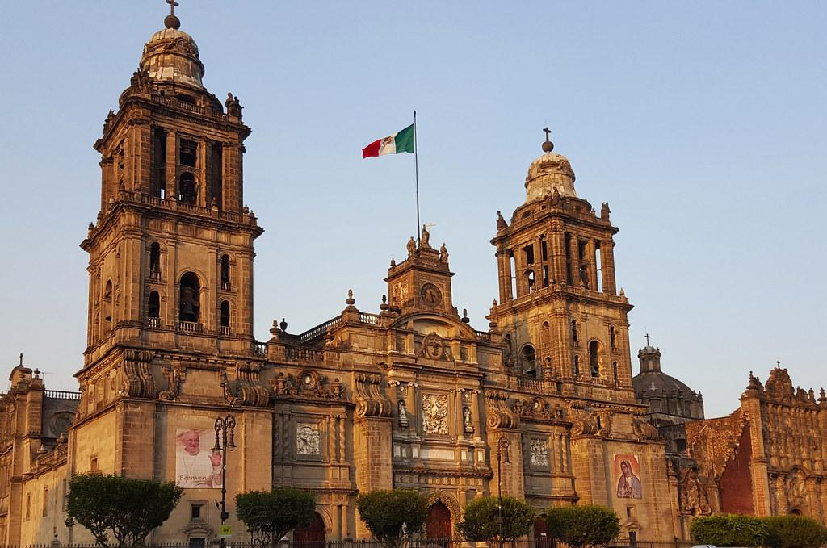
Birthday
My birthday is july 31st 2008 i was born in ashtabula ohio a little town northeast of cleveland i was about 8 months when we moved to california and since then haven't lived anywhere else though i did go to mexico NYC and minnesota.

Slide 11
Conclusion Slide

