Slide 1
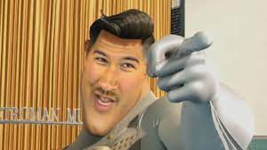
All About Me
By:
Tyler Keck

Slide 2

My name is Tyler James Keck. I am 12 years old.
I was born February 7th, 2009. My favorite color is Black. My favorite mixture of colors is Black and Red.

Slide 3


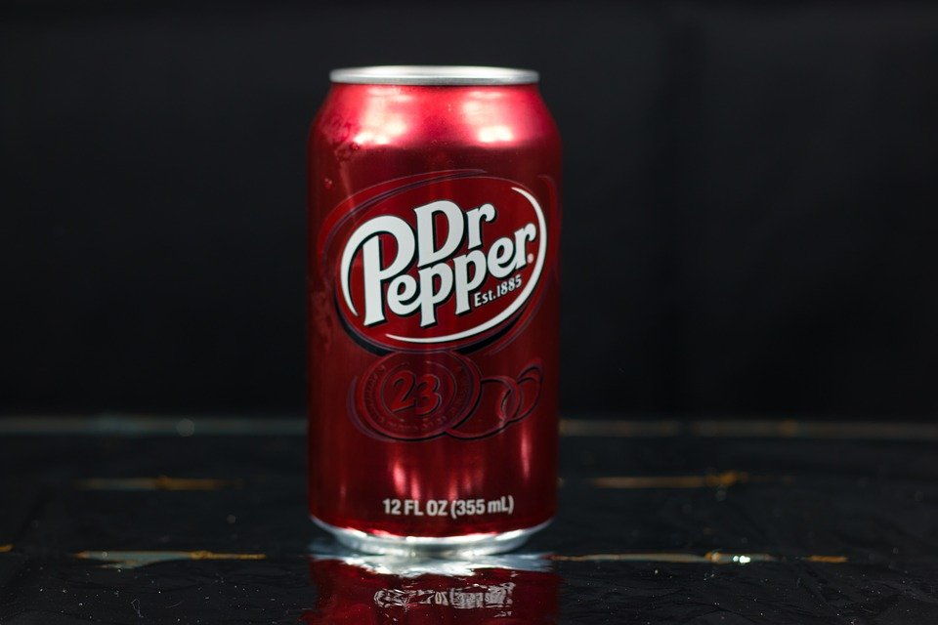
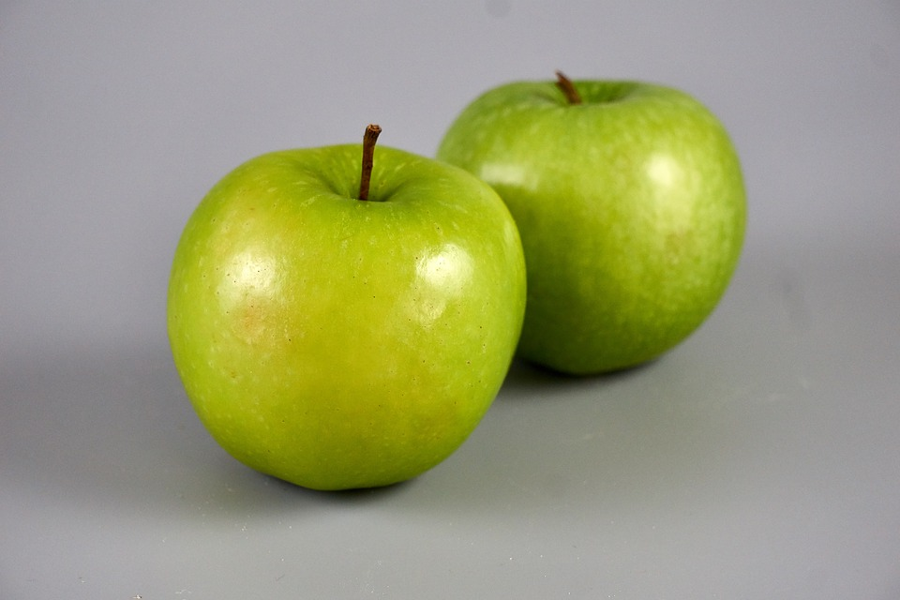
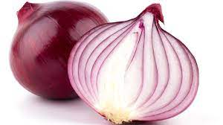
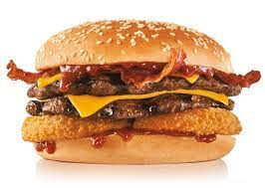

My favorite food is Ramen.
I love eating Ramen and all the different types. My favorite kind of Ramen is Beef. My favorite fruit is a Granny Smith Apple. My favorite vegetable is Onion. My favorite drink is Dr. Pepper, and my favorite fast food is Carl’s Jr. My favorite thing to get at Carl’s Jr. is the Double Western Bacon Cheeseburger.

Slide 4
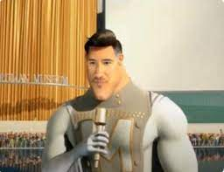

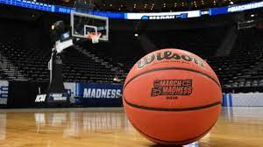


My favorite subject is P.E.
The reason I like P.E. is because I like to move around a lot. My favorite sport is Baseball. I like Basketball, Football, and Soccer.

Slide 5
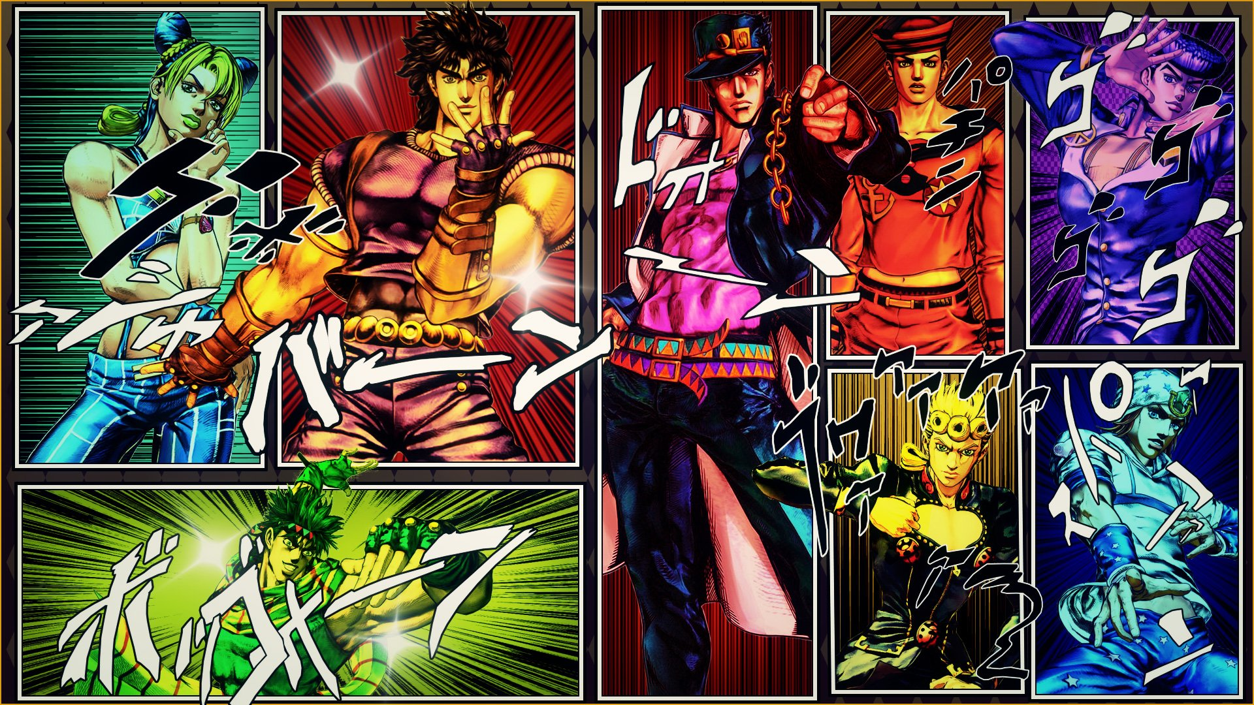

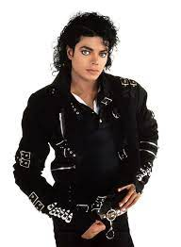



My favorite show is JoJo’s Bizarre Adventure.
My favorite movie is The Suicide Squad. My favorite singer is Michael Jackson. My favorite band is Imagine Dragons. My favorite superhero is Spider-Man. My favorite villain is The Joker.

Slide 6


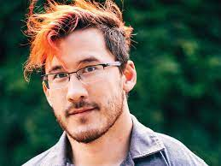
My favorite Video Game is Call of Duty: Warzone.
My favorite Youtube channel is Markiplier. My favorite cartoon is Spongebob Squarepants because the meme content they have in the show.

Slide 7
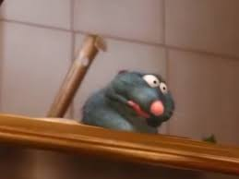
I have a huge family.
I have my Grandmother, Grandfather, Mom, Dad, 4 sisters, 3 brothers, 2 nephews, 4 nieces, uncountable amount of cousins, 5 Aunts, and 3 Uncles.

Slide 8
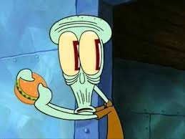
I have a lot of pets.
I have 7 dogs, 6 cats, and 1 lizard. My dogs names are Edee (German Shepherd), Brody (Labradoodle), Chance (Pitbull), Dina (Pitbull), Mya (Chihuahua), Ted E. (Chihuahua), and Archie (Chiweenie). My cats names are Holly, Toothless, Binx, Cheddar, Cheese, and Lucky. The lizard does not have a name.

Slide 9
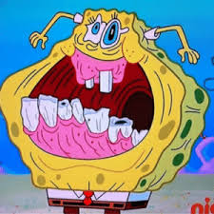
I have multiple hobbies.
I like to collect anything shiny, I like to catch fish, and my favorite (of course) is gaming.

Slide 10
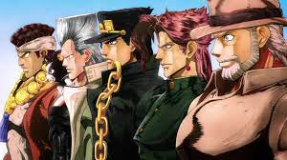
I want to do a lot of things before I pass away.
I have always wanted to skydive, swim with dolphins, surf, see a whale, see a shark, adopt a kid, and play in a movie.

Slide 11
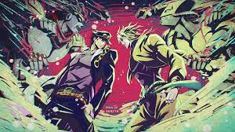
Conclusion Slide
That was all the things about me.
By: Tyler Keck

