Slide 1
All About Me
By: Vicente

Slide 2
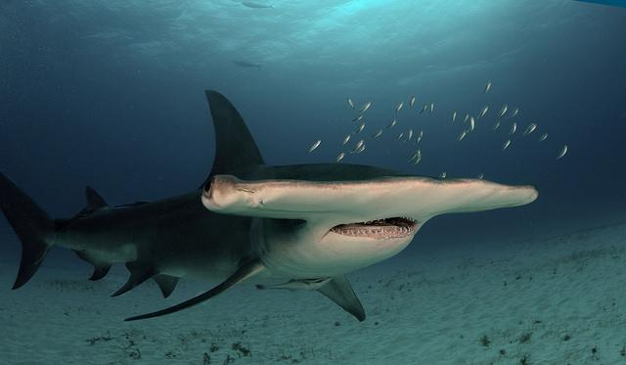

My favorite color, animal, and sport
My favorite color is turquoise
my favorite sport is soccer
and my favorite animal is the great hammerhead shark.

Slide 3
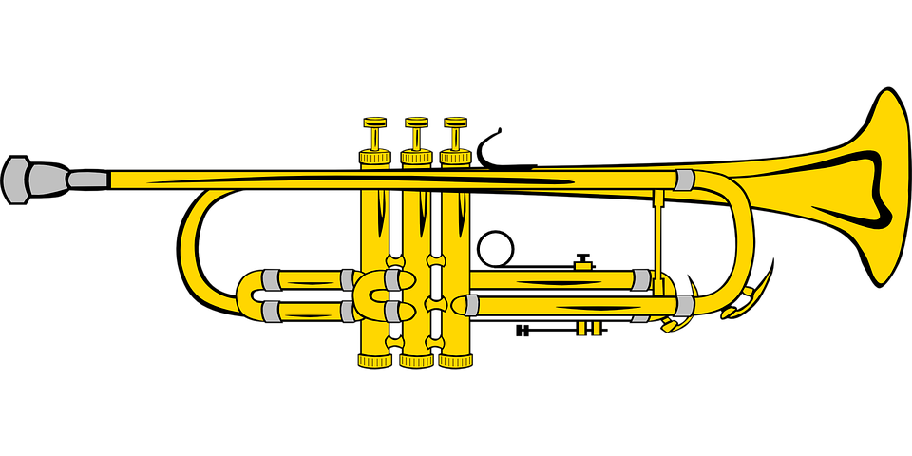
Facts about me
I like playing soccer, I am good at playing the trumpet, I have 2 brothers, I was born in Hayward just like my 1st younger brother and my dad
I visit my bio dad every 1st, 3rd, and 5th weekend of every month.

Slide 4
What I wanna be when I grow up
When I grow up I wanna be a marine biologist because I was really inspired on what they do and it made me wanna be on too.

Slide 5
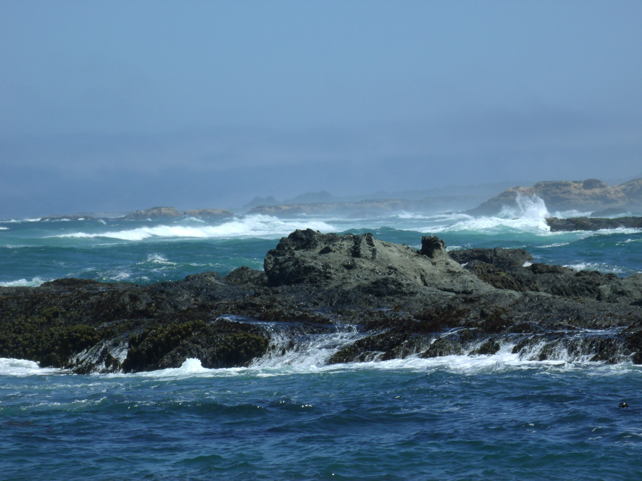
What I did for summer
For the summer I went camping in Fort Bragg and I had so much fun, the cool thing about it is that it was actually very cold and you would have to have a huge blanket all to yourself just to get warm. Also, we found small crabs in the cracks and crevices of the nearby rocks.

Slide 6

What I did for the summer (continued)
I went to my aunts house for 4 days and we stayed up until 2:00 even though we were supposed to go to bed at 12:00. On Thursday it was my uncles birthday because they were twins and when my uncle steven came home he got a 3d printer and they were using it all day. On friday my mom and dad came and we celebrated their birthday and we went back home at 10:00pm.

Slide 7

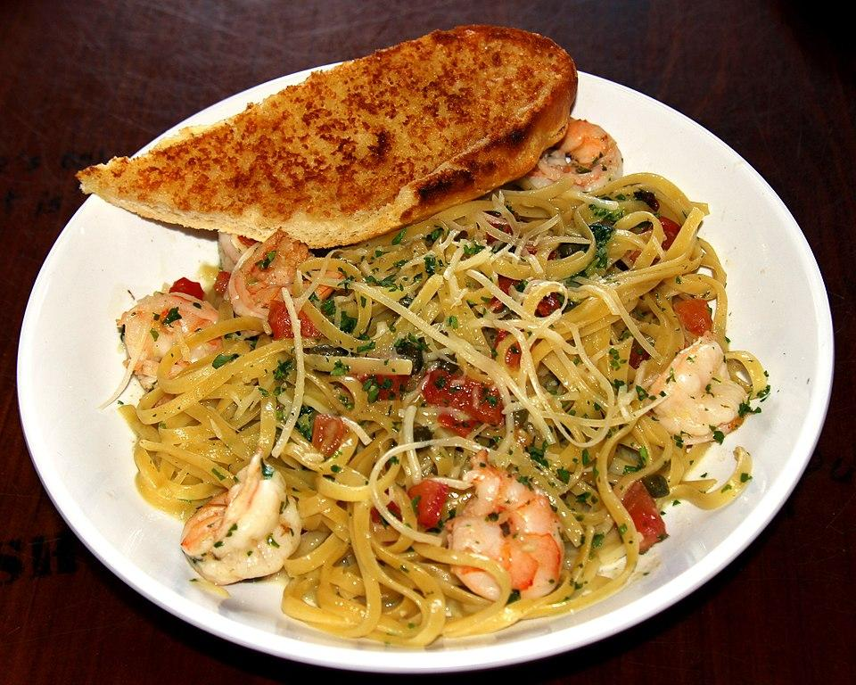
Different Favorites
My favorite food is either my moms shrimp scampi or my dad’s chicken parm. My favorite subject is Math. My favorite anime is My hero academia. My favorite family member is ( I don’t have one ) My favorite music artist is Joyner Lucas.

Slide 8
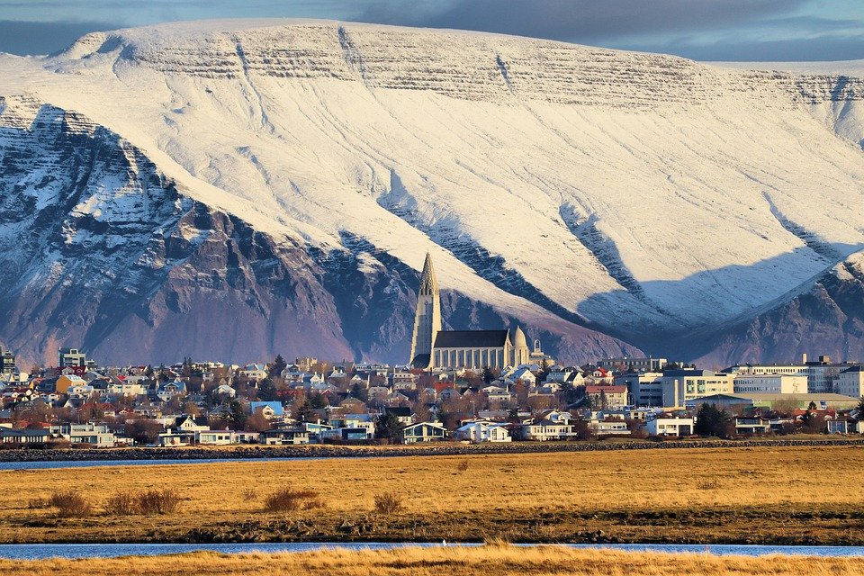
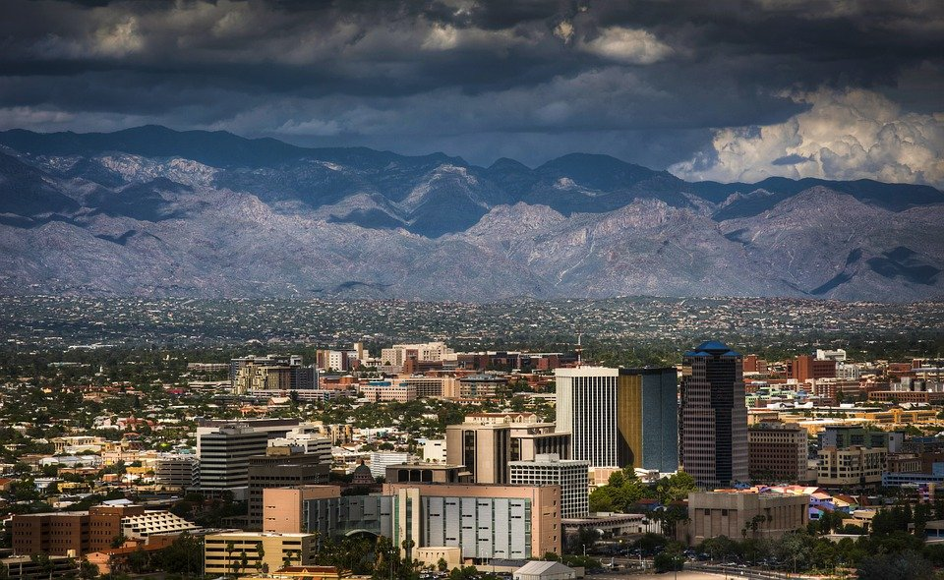
The places I want to visit the most (Some I want to visit again)
Some places I want to visit the most are Japan, China, Mexico, Arizona, and Iceland.

Slide 9
Some of my favorite moments
Easily one of my favorite moments was when my parents got married, we had so much fun after and it was just an amazing moment to witness. Another favorite moment is when I went to Texas for the first time. We had a party and everyone was swimming in the pool and having so much fun. After that we were helping plan for a Quinceanera and when it came the party went on till 3:00am but finished cleaning at 4:30.

Slide 10
My favorite songs
My favorite song is Devil’s work by Joyner Lucas. Then my second favorite song is ADHD also from Joyner Lucas. Isis by Joyner Lucas and Logic. And Gotta Be Next To You by Mike Jones. Believer by Imagine Dragons. Scars by DizzyEight and someone else whom I forgot the name of.

Slide 11
Welcome
I hope that you guys enjoyed this slideshow and got to know more about me and I look forward to seeing yours (Unless I have already seen yours)
To The End

