Slide 1
All About Me
By:
Yasleen Perez

Slide 2
About Me
Name: Yasleen Perez
Age: 12
Birthplace: Yuba City, California
Write: Right Handed
Favorite Color: I like all of the pastel colors
Birthday: June 16, 2009

Slide 3
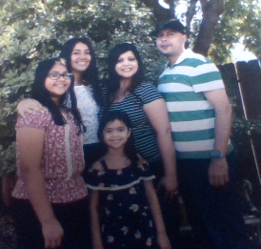
About my Family!
I have 2 sisters. Vanessa Perez and Yaneli Perez. Vanessa is 15. Yaneli is 7. My mom is Cindy Perez and my dad is Francisco Perez.

Slide 4
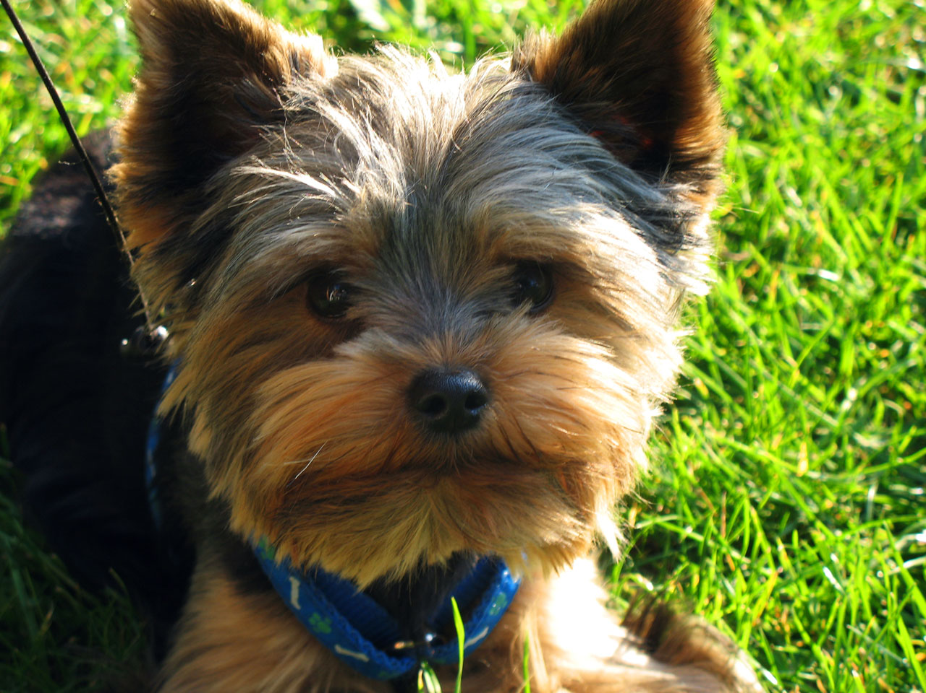
Pets
I sadly have no pets. If I were to get a pet, I would want a yorkie!

Slide 5
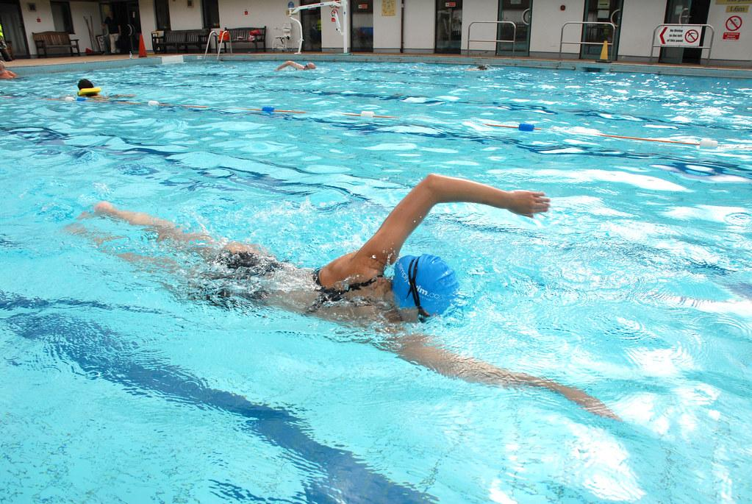
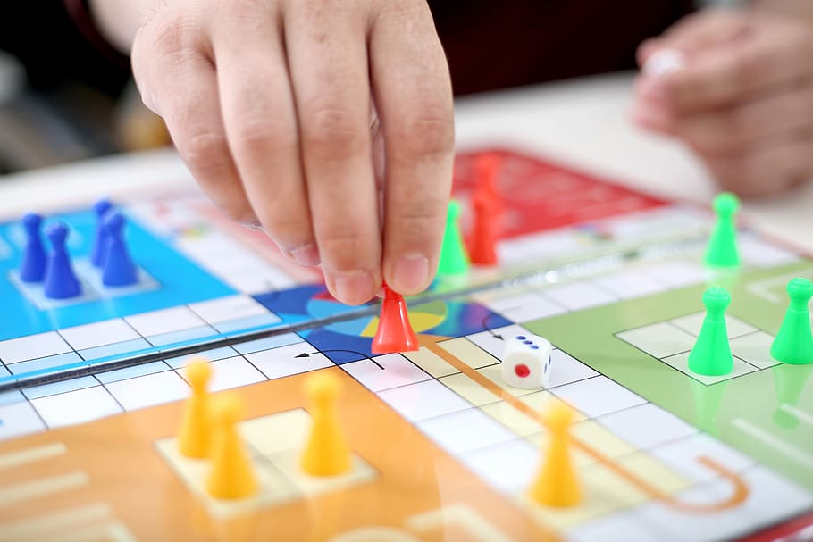
My Hobbies
My hobbies are
Swimming
Hanging out with family and friends
Going to stores
Playing games with friends.
Swimming
Playing games with friends

Slide 6



College
When I get older I would like to attend Chico State or Stanford University!

Slide 7

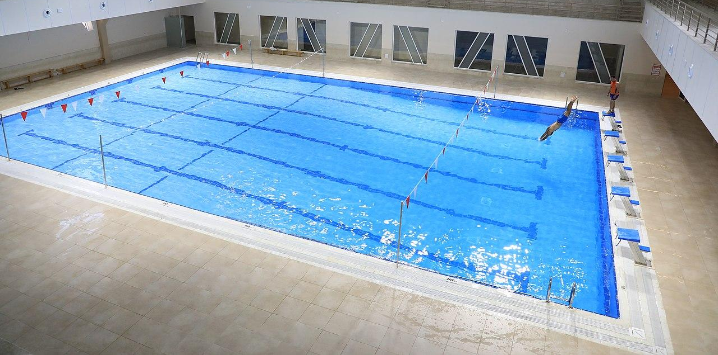
What I did over the Summer!!
Where I went.
Six Flags
Roseville
Went swimming a lot
Had a lot of sleepovers with friends and cousins!
I was going to go to Reno, but the fire stopped us from going.
We were going to got to Lake Almanor as well, but the fire over there also stopped us from going.

Slide 8


Favorite Subjects
I have 2 favorite subjects! The first one is ELA. My second one is Math.

Slide 9
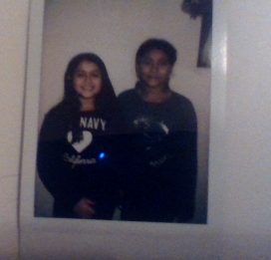
My Best Friend!
My Best friend is Suhei Enriquez! We have been best friends ever since kindergarten!!

Slide 10
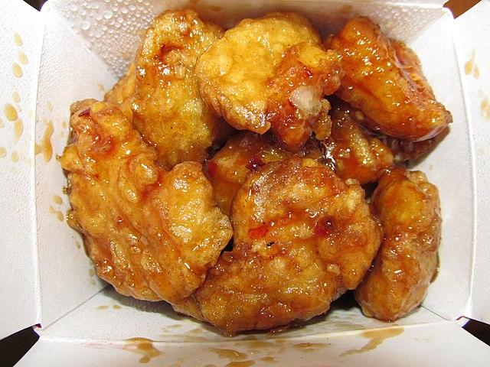
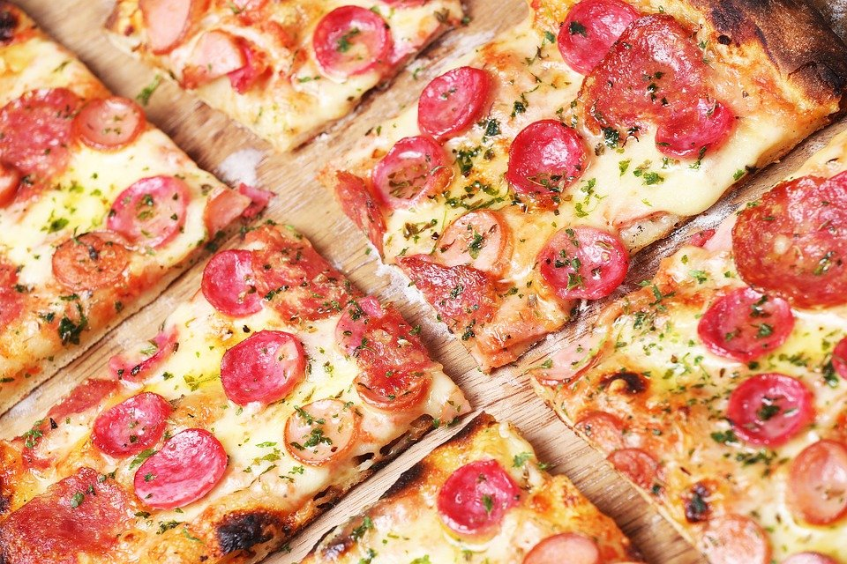
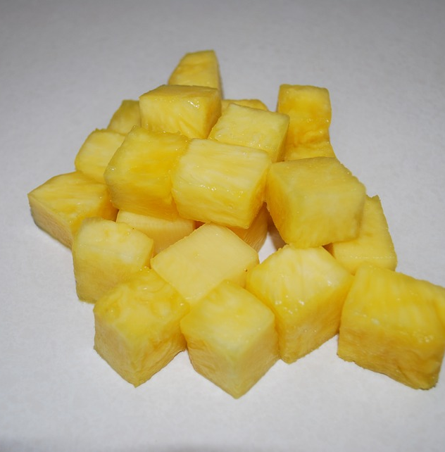
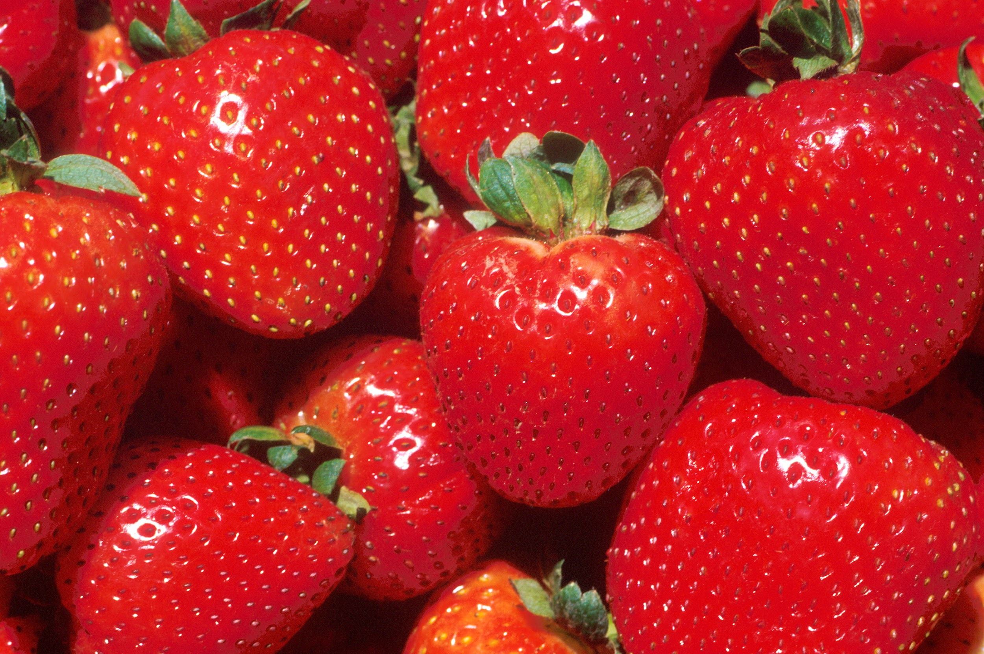
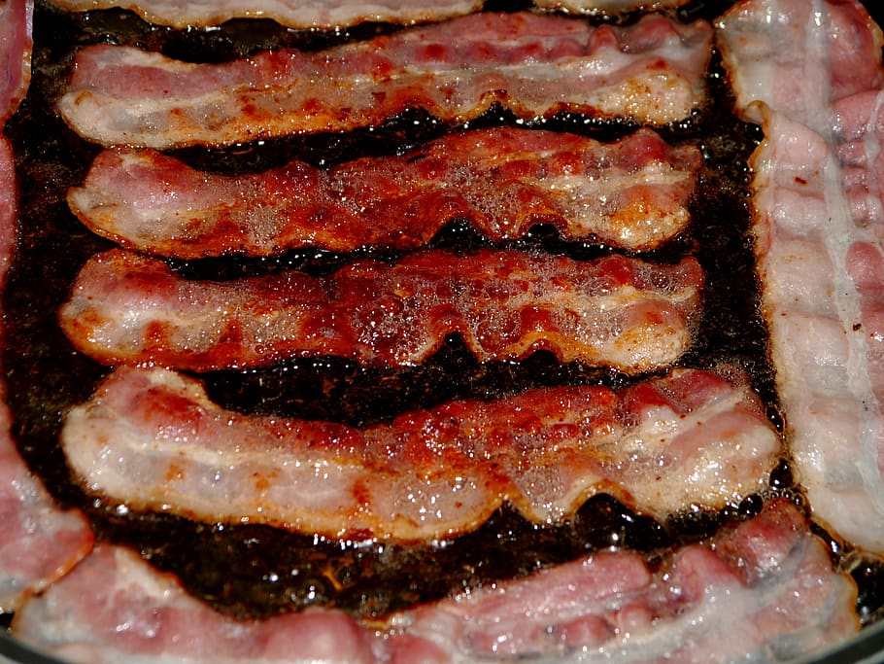
My Favorite foods
My favorite foods are
Orange chicken
Pizza
Pineapple
Strawberries
Bacon

Slide 11
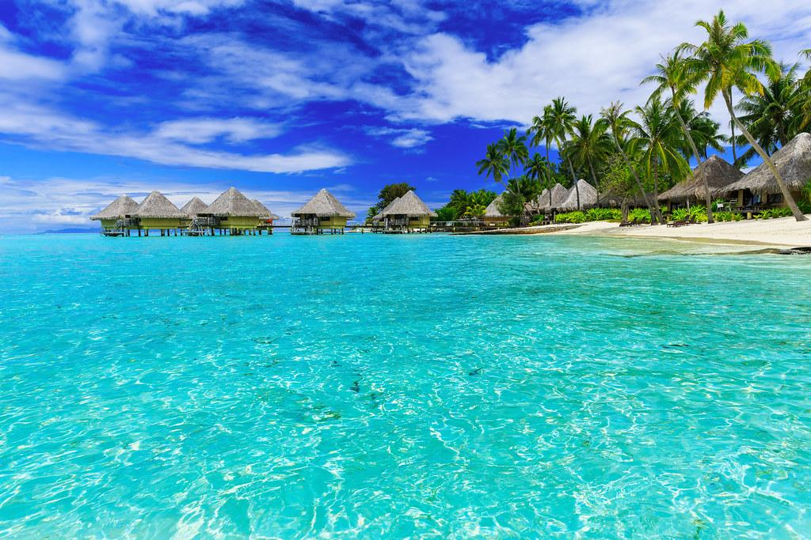

Places I would like to visit
I would like to visit Bora Bora because it looks super pretty and the water is super clear. I would also like to go to Hollywood! I have been there before and I really enjoyed it, so that is why I would love to go again!

Slide 12
The End!
I hope you enjoyed getting to know a bit about myself!

