Slide 1
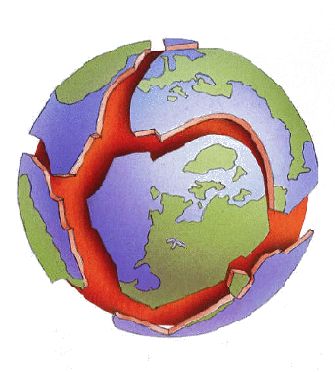
Earth’s Natural Phenomena HyperDoc
Mr. Perez
7th Grade Science

Slide 2


Task One: What do YOU know about Earth?
FIRST...
Skip this edpuzzle.
SECOND...
Answer the question “What do you know about Earth’s history?” in your own words using the Answer Garden to the right. Your answers must be 20 characters or less, so be specific!

Slide 3
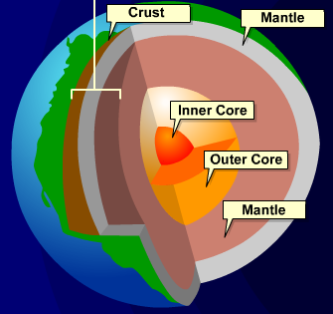
Comparing Earth’s Interior
1. Click on the icon of Earth’s Interior to the right.
2. Then, on the next slide, complete the graphic organizer for each section of Earth’s Interior.

Slide 4

Graphic Organizer
 | Crust | mantle | Outer Core | Inner Core
Thickness (km)
Description
Image

Slide 5
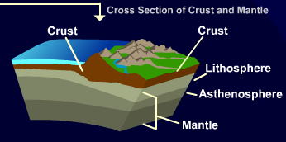
The Crust and Mantle
First, click on the icon to the right.
Then, complete the graphic organizer and matching activities that follow on the next two slides.

Slide 6

 | Crust | Lithosphere | asthenosphere | mantle
Thickness (km)
Description
Image
Graphic Organizer, Part II (Crust and Mantle)

Slide 7
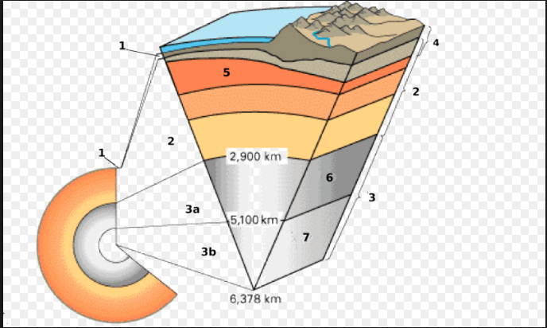
Asthenosphere
Core
1
4
Lithosphere
5
2
Mesosphere
Crust 1
2
1
Liquid
Mantle
6
Match the layers of the Earth on the left with the appropriate number on the diagram.
3
Solid
3a
Outer Core
7
3b
Inner Core
Notes:
https://www.youtube.com/watch?v=3MFr2cC3erk

Slide 8
Task Two: What are Plate Tectonics?
FIRST...
First, create your EdPuzzle account by clicking the icon to the right. Then, watch the assigned video, “Plate Tectonics Explained”, and answer the questions as posed.
SECOND...
Answer the question “What are plate tectonics?” in your own words using the Answer Garden to the right. Your answers must be 20 characters or less, so be specific!

Slide 9
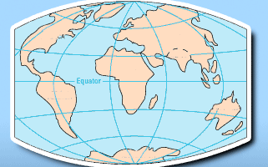
What are Plate Tectonics?
1. Click the icon to the right to view an interactive on Plate Tectonics and Boundaries.
2. Review the information and then complete the games as prompted.
3. Once finished, use the interactive to complete the graphic organizer and questions on the following slides.

Slide 10

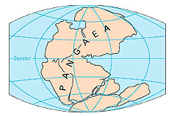
Continents on the Move
200 Million years | 135 million years | 65 million years | 40-50 million years
Using the information from the link provided on the previous slide, fill in the graphic organizer to the left. Provide at least 2 details per time era about Pangea’s breakup.

Slide 11



Types of Plate Boundaries
 | Transform | divergent | convergent
definition
examples
Correct picture
FOr each type of plate boundary, match the appropriate picture, provide a definition, and give at least two examples of each on earth.

Slide 12
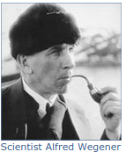
Alfred Wegener
1. Who was Alfred Wegener and what did he discover?
2. What book did Wegener publish, and why was it important? | SKIP
3. What was “Pangea”, and what evidence did Wegener have of its discovery?

Slide 13
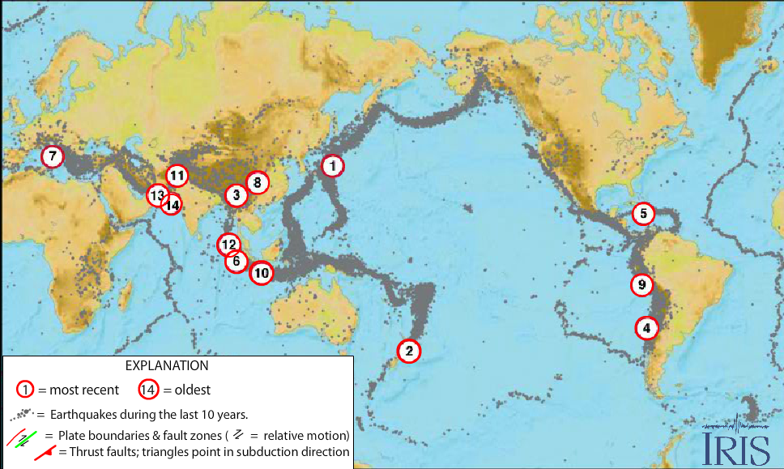
Task THREE...
Earthquake!
Click on the picture to access iris’ interactive guide on earthquakes from 2001-2011. Use the interactive to complete the graphic organizer and questions on the following slides.

Slide 14
Analyzing the Data
1. During which earthquake did the most casualties occur?
2. During which earthquake did the least casualties occur?
3. During which earthquake did the most damage occur?
4. During which earthquake did the least damage occur?
5. Along which boundary did the most earthquakes occur?
6. Along which boundary did the fewest earthquakes occur?
Using the data collected from the earthquake interactive, answer the questions to the left in complete sentences.

