Slide 1
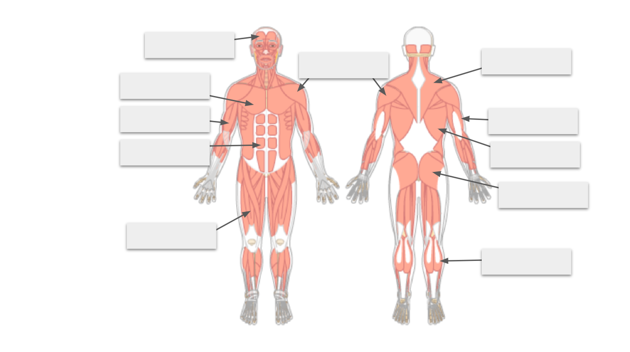
Directions: Drag the options below to the correct location on the diagram.
abdominal muscles
biceps
deltoid
frontalis
gastrocnemius
gluteus maximus
Latissmus dorsi (lats)
pectoralis (major)
quadriceps
trapezius
triceps

