Slide 1
Biotic v Abiotic Review

Slide 2
Directions
For slides 3-11, look at each picture and list all the biotic and abiotics items in each picture. For any organism that you list as biotic, tell me whether they are a producer, consumer or decomposer.
For slide 12, click on the link to play the producer, consumer, decomposer game for review.
For slide 13, click on the link to take the quizziz review game.

Slide 3

Photo #1
Biotic:
Brid
Kangaroo
Fish
Lobster
snail
Abiotic:
Rock
Log
Sun
Lili pads
water

Slide 4
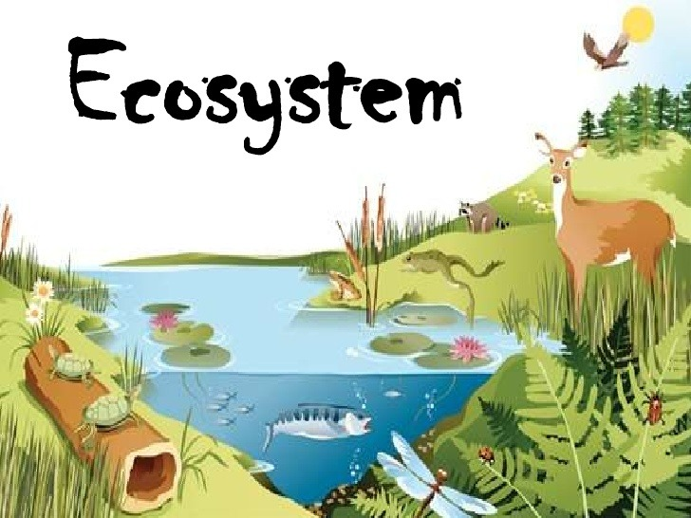
Photo #2
Biotic:
Deer
Frog
Fish
Turtle
raccoon
log
Abiotic:
Lil pads
Sun
Flower
water

Slide 5

Photo #3
Biotic:
Frog
Flies
Fish
Snail
tadpoles
log
Abiotic:
Water seeds
Sun
water
Lil pad

Slide 6

Photo #4
Biotic:
Elephant
Giraffe
Hippo
Tiger
Lion
flamingo
Abiotic:
Sun
Mountain
water

Slide 7

Photo #5
Biotic:
Hippo
Bird
Turtle
Frog
Bacteria
log
Abiotic:
Rock
Sun
Cloud
water

Slide 8

Photo #6
Biotic:
Ducklings
Dragon flie
Fish
Snail
frog
Abiotic:
Pebbles
Sand
water

Slide 9

Photo #7
Biotic:
Wolf
Bunny
beetle
Ducks
Abiotic:
Rocks
Lili pads
water

Slide 10
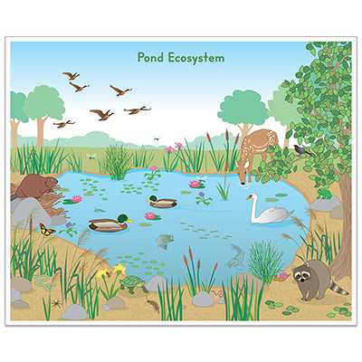
Photo #8
Biotic:
Racoon
Deer
Ducks
Beaver
Butterfly
Turtle
dragonflies
Abiotic: rocks, lili pads, water

Slide 11

Photo #9
Biotic:
Mallard duck
Dragonfly
Fish
Mosquito
snail
Abiotic:
Water
sea weed

Slide 12
Producer, Consumer, Decomposer Game
Click on the link below and play the producer, consumer, decomposer game. If the link tells you to adobe flash players does not work,click on the puzzle piece and click on the allow button to allow the puzzle piece to work.
Producer,Consumer,Decomposer Game

Slide 13
Quizziz Review
Click on the link below to play a quizziz review game on Abiotic v. Biotic.
Quizziz review game

