Slide 1
Biotic v Abiotic Review

Slide 2
Directions
For slides 3-11, look at each picture and list all the biotic and abiotics items in each picture. For any organism that you list as biotic, tell me whether they are a producer, consumer or decomposer.
For slide 12, click on the link to play the producer, consumer, decomposer game for review.
For slide 13, click on the link to take the quizziz review game.

Slide 3

Photo #1
Biotic:
Bird - c
Rotting Log - c , d
Algae - p
Insects - d
Fungi - d
Abiotic:
Sun - p
Water - p
Rocks - p
Cloud - p

Slide 4
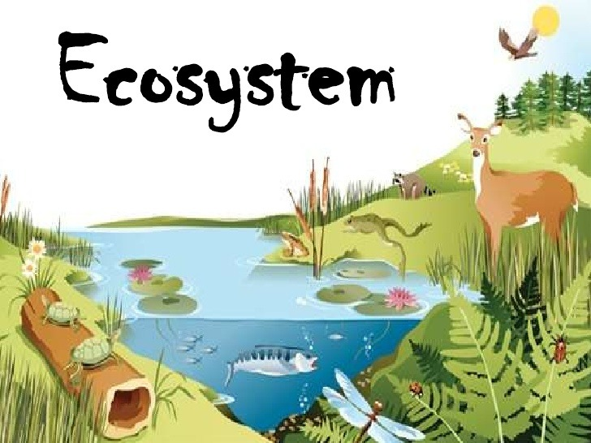
Photo #2
Biotic:
Deer - c
Raccoon - c
Fishs - c
Turtles - c
Abiotic:
Sun
Water
Lily Pads
Flowers
grass

Slide 5

Photo #3
Biotic:
Flies - c
Frog - c
Snail - c
FIsh - c
Abiotic:
Sun
Water
Log
Grass
Lily pad

Slide 6

Photo #4
Biotic:
Giraffe - c
Lion - c
Tree - p
Hippocampus - c
Abiotic:
Water
Clouds
Sun
Mountains
Water weeds

Slide 7

Photo #5
Biotic:
Mushrooms - d
Hippopotamus - c
Turtle - c
Trees - p
Bacteria - c
Abiotic:
Sun
Clouds
Mountains
FLowers

Slide 8

Photo #6
Biotic:
Ducks - c
Fishs - c
Frog - c
Abiotic:
Light
Water
Lily pads
Rocks

Slide 9

Photo #7
Biotic:
Bunny - c
Ducks - c
Fox - c
Trees - p
Bug - c
Abiotic:
Rocks
Clouds
Lily petals
water

Slide 10
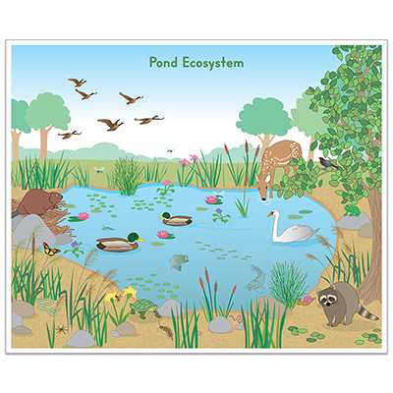
Photo #8
Biotic:
Ducks - c
Swan - c
Birds - c
Trees - c
Fishes - c
Abiotic:
Light
Rocks
Lily pad
grass

Slide 11

Photo #9
Biotic:
Fishes - c
Frogs - c
Earthworms - c
Tadpoles - c
Abiotic:
Water
Water shrew
Dirt

Slide 12
Producer, Consumer, Decomposer Game
Click on the link below and play the producer, consumer, decomposer game. If the link tells you to adobe flash players does not work,click on the puzzle piece and click on the allow button to allow the puzzle piece to work.
Producer,Consumer,Decomposer Game

Slide 13
Quizziz Review
Click on the link below to play a quizziz review game on Abiotic v. Biotic.
Quizziz review game

