Slide 1
Biotic v Abiotic Review

Slide 2
Directions
For slides 3-11, look at each picture and list all the biotic and abiotics items in each picture. For any organism that you list as biotic, tell me whether they are a producer, consumer or decomposer.
For slide 12, click on the link to play the producer, consumer, decomposer game for review.
For slide 13, click on the link to take the quizziz review game.

Slide 3

Photo #1
Biotic:
Kangaroo insects bacteria algae
Plankton bird
Trees rotting log
Abiotic: water termite mounds rocks sea weed fungi

Slide 4

Photo #2
Biotic:
Deer
Frog
Fish
Turtles
Racoon
eagle/bird
Insects
Flies
Trees
Log
Abiotic:water leaves sun grass

Slide 5

Photo #3
Biotic:
Frog
Fish
snail
Fies
Abiotic: log
Water
grass
Sun
Water weeds

Slide 6

Photo #4
Biotic:
Elephant
Hippo
Lion
Girafe
Flamingo
Trees
Crogcadile
Abiotic: sun grass clouds

Slide 7

Photo #5
Biotic: trees
Turtles
Hippos
Bateria
Algae
Birds
frog
Abiotic: water sun clouds dead leaf

Slide 8

Photo #6
Biotic:
Flies
Fish
Birds
Frogs
Snail
Mosquitoes
Abiotic:water grass plants rockets bsuh

Slide 9

Photo #7
Biotic: tree rabbit fox insects duck
Abiotic: water rock grass pebbles

Slide 10
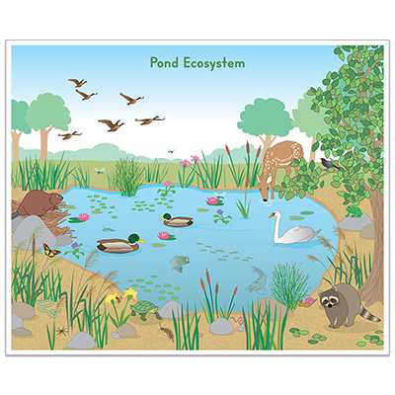
Photo #8
Biotic:
Birds
Ducks
Geese trees logs
Beaver racoon
Fish
Abiotic: water grass rocks leaves plants

Slide 11

Photo #9
Biotic: mosquito
Dragonfly
Duck
Turtle scorpio leech newt
Snail tadpoles water shrew
Earth worm
Abiotic: water

Slide 12
Producer, Consumer, Decomposer Game
Click on the link below and play the producer, consumer, decomposer game. If the link tells you to adobe flash players does not work,click on the puzzle piece and click on the allow button to allow the puzzle piece to work.
Producer,Consumer,Decomposer Game

Slide 13
Quizziz Review
Click on the link below to play a quizziz review game on Abiotic v. Biotic.
Quizziz review game

