Slide 1
Biotic v Abiotic Review

Slide 2
Directions
For slides 3-11, look at each picture and list all the biotic and abiotics items in each picture. For any organism that you list as biotic, tell me whether they are a producer, consumer or decomposer.
For slide 12, click on the link to play the producer, consumer, decomposer game for review.
For slide 13, click on the link to take the quizziz review game.

Slide 3

Photo #1
Biotic:
Trees Producer
Insects Consumers
Bacteria Decomposer
Logs Decoposers
Abiotic:
Water
Rocks
Clouds
Sun

Slide 4
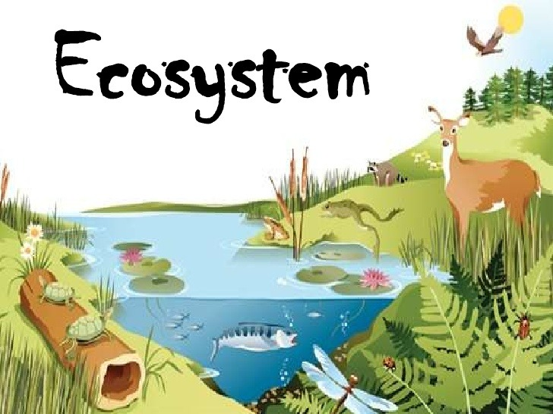
Photo #2
Biotic:
Animals Consumers
Grass Producers
Trees Producers
Logs Decomposer
Abiotic:
Water
Sun

Slide 5

Photo #3
Biotic:
Animals Consumers
Buches Producer
Log Decomposer
Abiotic:
Sun
Water

Slide 6

Photo #4
Biotic:
Trees producer
Animals consumers
Grass producer
Abiotic:
Water
Clouds
Mountains
Sun

Slide 7

Photo #5
Biotic:
Animals/Consumers
Trees/Producer
Bacteria/Decomposers
Logs/Decomposer
Flowers/Producer
Abiotic:
Water
Clouds
Sun

Slide 8

Photo #6
Biotic:
Animals Consumers
Plants Producers
Abiotic:
Water rocks

Slide 9

Photo #7
Biotic:
Animals Consumers
Trees Producer
Insects Consumer
Leaves Producer
Abiotic:
Water
Rocks
Clouds

Slide 10
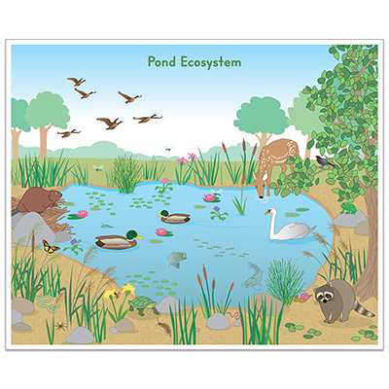
Photo #8
Biotic:
Animals consumers
Trees Producers
Flowers producer
Abiotic:
Water
Rocks

Slide 11

Photo #9
Biotic:
Animal Consumers
Abiotic:
Water

Slide 12
Producer, Consumer, Decomposer Game
Click on the link below and play the producer, consumer, decomposer game. If the link tells you to adobe flash players does not work,click on the puzzle piece and click on the allow button to allow the puzzle piece to work.
Producer,Consumer,Decomposer Game

Slide 13
Quizziz Review
Click on the link below to play a quizziz review game on Abiotic v. Biotic.
Quizziz review game

