Slide 1
Biotic v Abiotic Review

Slide 2
Directions
For slides 3-11, look at each picture and list all the biotic and abiotics items in each picture. For any organism that you list as biotic, tell me whether they are a producer, consumer or decomposer.
For slide 12, click on the link to play the producer, consumer, decomposer game for review.
For slide 13, click on the link to take the quizziz review game.

Slide 3

Photo #1
Biotic:
Bird -C
Kangaroo -C
Trees -P
Plankton -P
Algae -P
Abiotic:
Water
Sun
Clouds
Dirt

Slide 4

Photo #2
Biotic:
Deer -C
Turtle -C
Frog -C
Dragonfly -C
Racoon -C
Abiotic:
Water
Sun
Dirt
Typha

Slide 5

Photo #3
Biotic:
Snail -C D
Water Weeds -P
Flies -C
Tadpoles -C
Frog -C
Abiotic:
Sun
Water
Shell of a snail

Slide 6

Photo #4
Biotic:
Crocodile -C
Elephants -C
Flamingos -C
Lion -C
Giraffes -C
Abiotic:
Water
Sun
Clouds
Snow

Slide 7

Photo #5
Biotic:
Hippo -C
Turtle -C
Frog -C
Mushrooms -D
Flower -P
Abiotic:
Rocks
Sun
Clouds
Typha
Dirt

Slide 8

Photo #6
Biotic:
Ducks -C
Frog -C
Fish -C
Snail -D
Flies -C
Abiotic:
Rocks
Water
Dirt
Empty Snail shell

Slide 9

Photo #7
Biotic:
Fox -C
Ducks -C
Rabbit -C
Insect -D
Lily Pad -P
Abiotic:
Rock
Water
Clouds
Typha

Slide 10
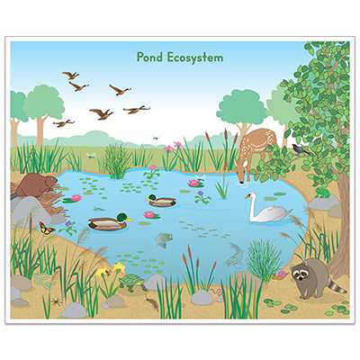
Photo #8
Biotic:
Spider -C
Otter -C
Racoon -C
Swan -C
Deer -C
Abiotic:
Rocks
Dirt
Clouds

Slide 11

Photo #9
Biotic:
Newt -C
Water Scorpion -C
Pond Skater -C
Leech -C
Tadpoles -C
Abiotic:
Water
Dirt
Clouds

Slide 12
Producer, Consumer, Decomposer Game
Click on the link below and play the producer, consumer, decomposer game. If the link tells you to adobe flash players does not work,click on the puzzle piece and click on the allow button to allow the puzzle piece to work.
Producer,Consumer,Decomposer Game

Slide 13
Quizziz Review
Click on the link below to play a quizziz review game on Abiotic v. Biotic.
Quizziz review game

