Slide 1
Biotic v Abiotic Review

Slide 2
Directions
For slides 3-11, look at each picture and list all the biotic and abiotics items in each picture. For any organism that you list as biotic, tell me whether they are a producer, consumer or decomposer.
For slide 12, click on the link to play the producer, consumer, decomposer game for review.
For slide 13, click on the link to take the quizziz review game.

Slide 3

Photo #1
Biotic:
Bird-c
Kangro-c
Trees-p
Insects-c
Frog-c
Abiotic:
Sun
Water

Slide 4
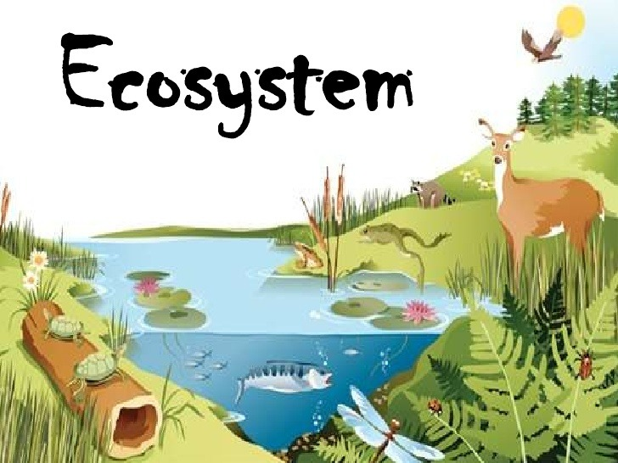
Photo #2
Biotic:
Turtle-c
Deer-c
Grass-p
Bird-c
Fish-c
Abiotic:
Water
Sky
Mountain

Slide 5

Photo #3
Biotic:
Frog-c
Fish-c
Snail-c
Water seeds-p
Flies-d
Abiotic:
Sun
Water

Slide 6

Photo #4
Biotic:
Elephant-c
Alligator-c
Grass-p
Giraffe-c
Flamingo-c
Abiotic:
Clouds
Sun
Water

Slide 7

Photo #5
Biotic:
Trees-p
Hippo-c
Log-d
Turtle-c
Flowers-p
Abiotic:
Sun
Clouds
Water
Mountain

Slide 8

Photo #6
Biotic:
Fish-c
Frog-c
Duck-c
Grass-p
Snail-c
Abiotic:
Water
Rocks

Slide 9

Photo #7
Biotic:
Rabbit-c
Trees-p
Ducks-c
Cockroach-c
flowers-p
Abiotic:
Water
Rocks
Clouds
Sky

Slide 10
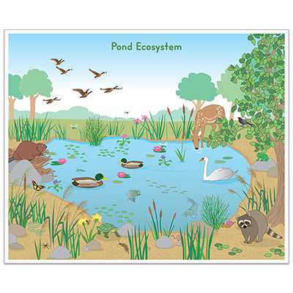
Photo #8
Biotic:
Duck-c
Butterfly-p
Deer-c
Flowers-p
Birds-c
Abiotic:
Water
Rocks
Sky

Slide 11

Photo #9
Biotic:
Mosquito-d
Dragonfly-c
Duck-c
Tadpoles-c
Water scorpion-p
Abiotic:
Water
Sky

Slide 12
Producer, Consumer, Decomposer Game
Click on the link below and play the producer, consumer, decomposer game. If the link tells you to adobe flash players does not work,click on the puzzle piece and click on the allow button to allow the puzzle piece to work.
Producer,Consumer,Decomposer Game

Slide 13
Quizziz Review
Click on the link below to play a quizziz review game on Abiotic v. Biotic.
Quizziz review game

