Slide 1
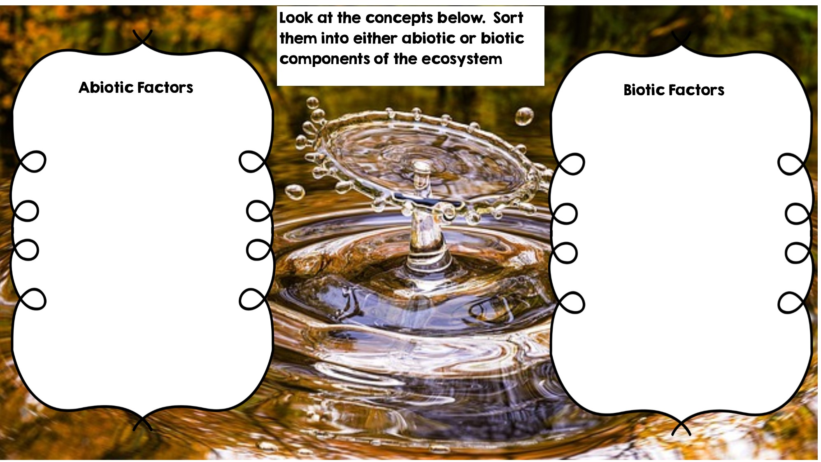
Temperature
Dead Animal
Rocks
Frog
Water
Fox
Sunlight
Rotting Log
Grass
Deer
Flowers

Slide 2
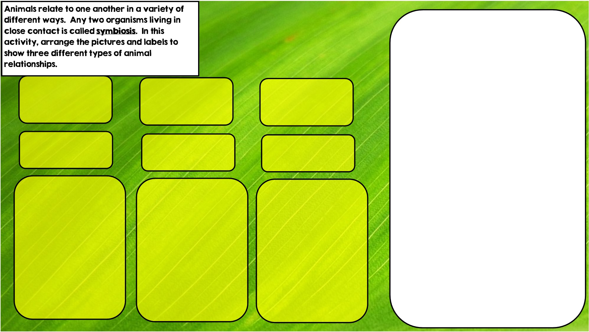

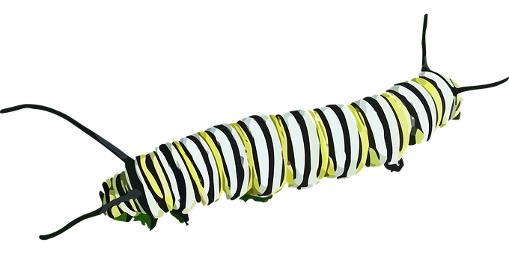

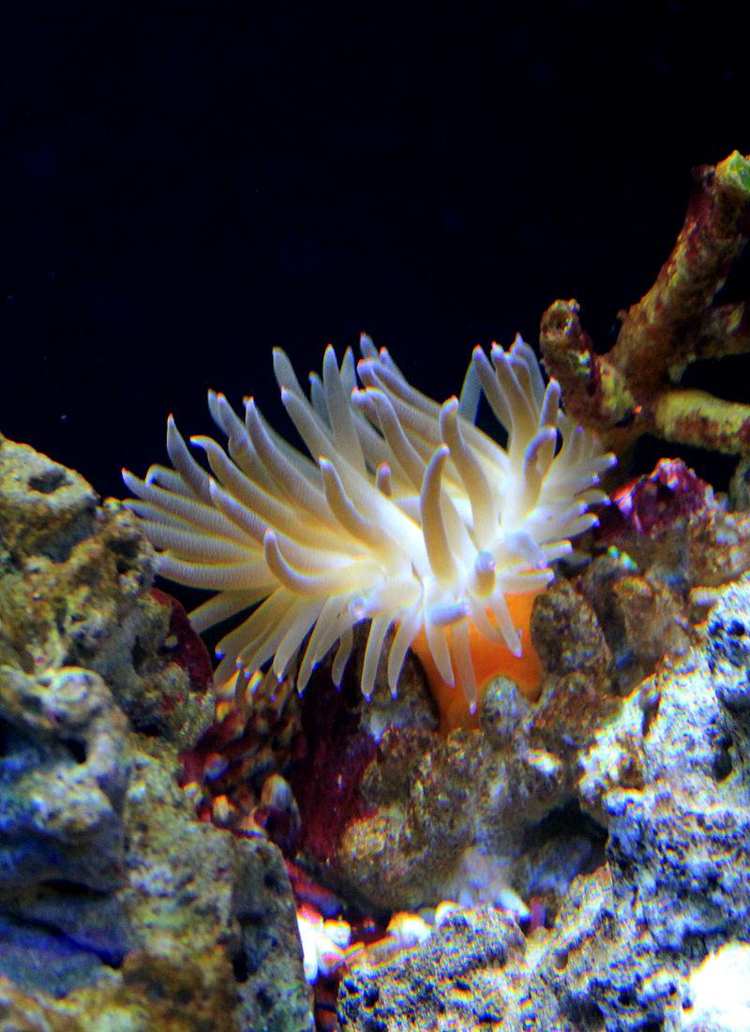

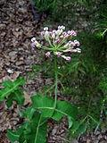
Hint: I live in stingers
Hint: I live in intestines
Hint: I eat toxic leaves
Parasitism is where one organisms benefits and the other is hurt
Commensalism is where one organism benefits and doesn’t hurt the other.
Mutualism is where both organisms benefit

Slide 3
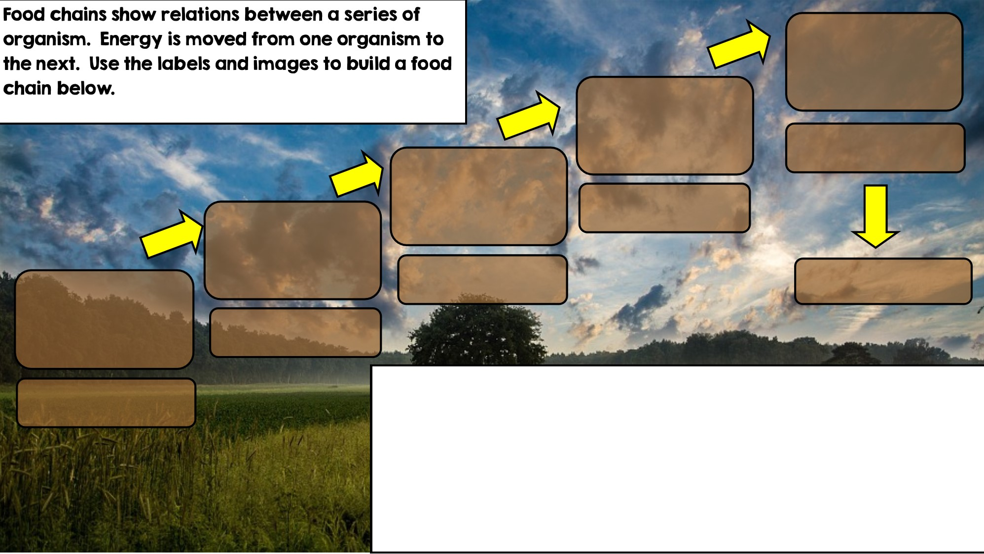

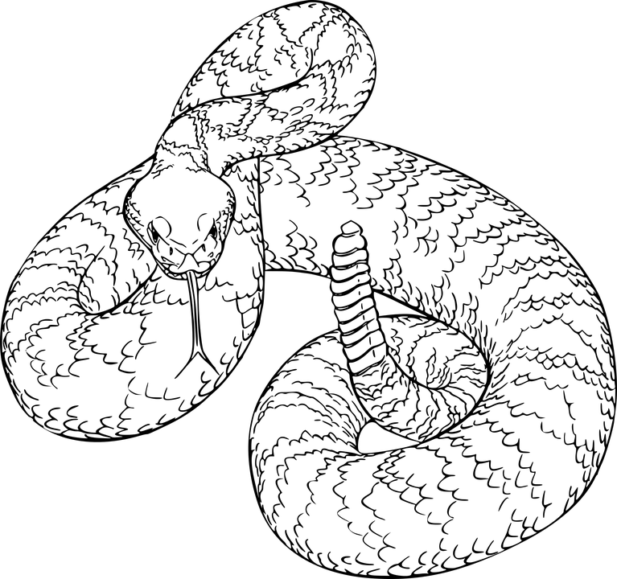
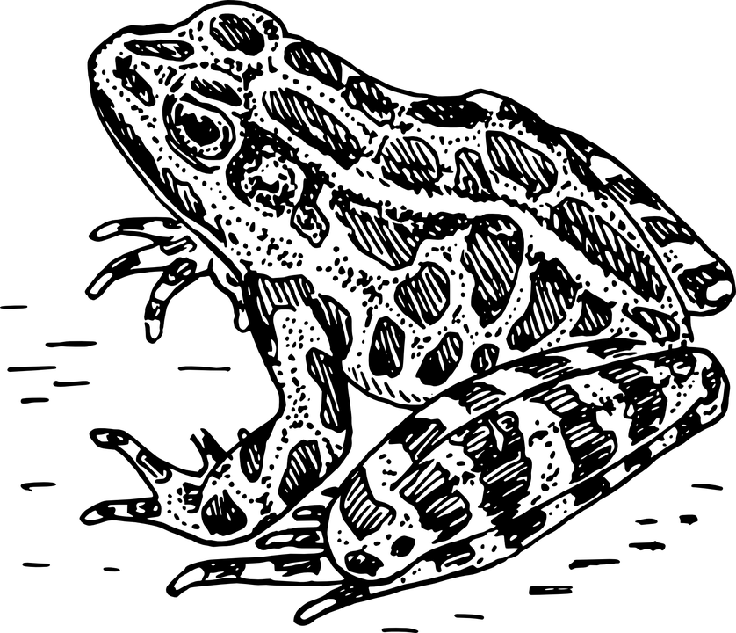
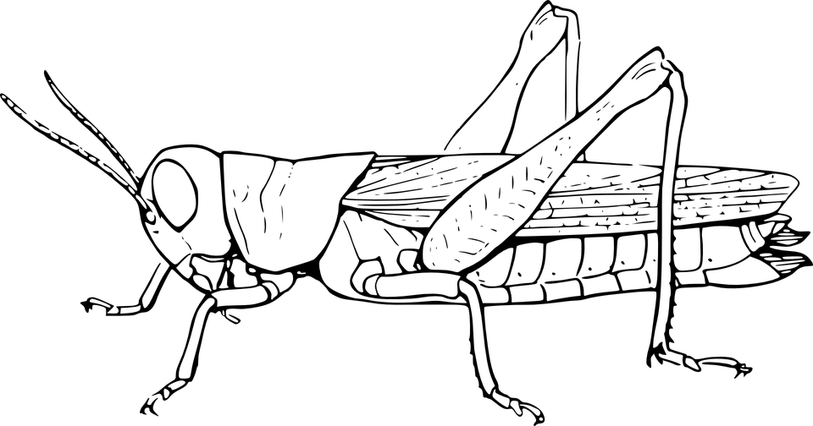

Apex Predator
Tertiary Consumer
Secondary Consumer
Decomposer
Primary Consumer: Heterotroph
Producer: Autotroph

Slide 4
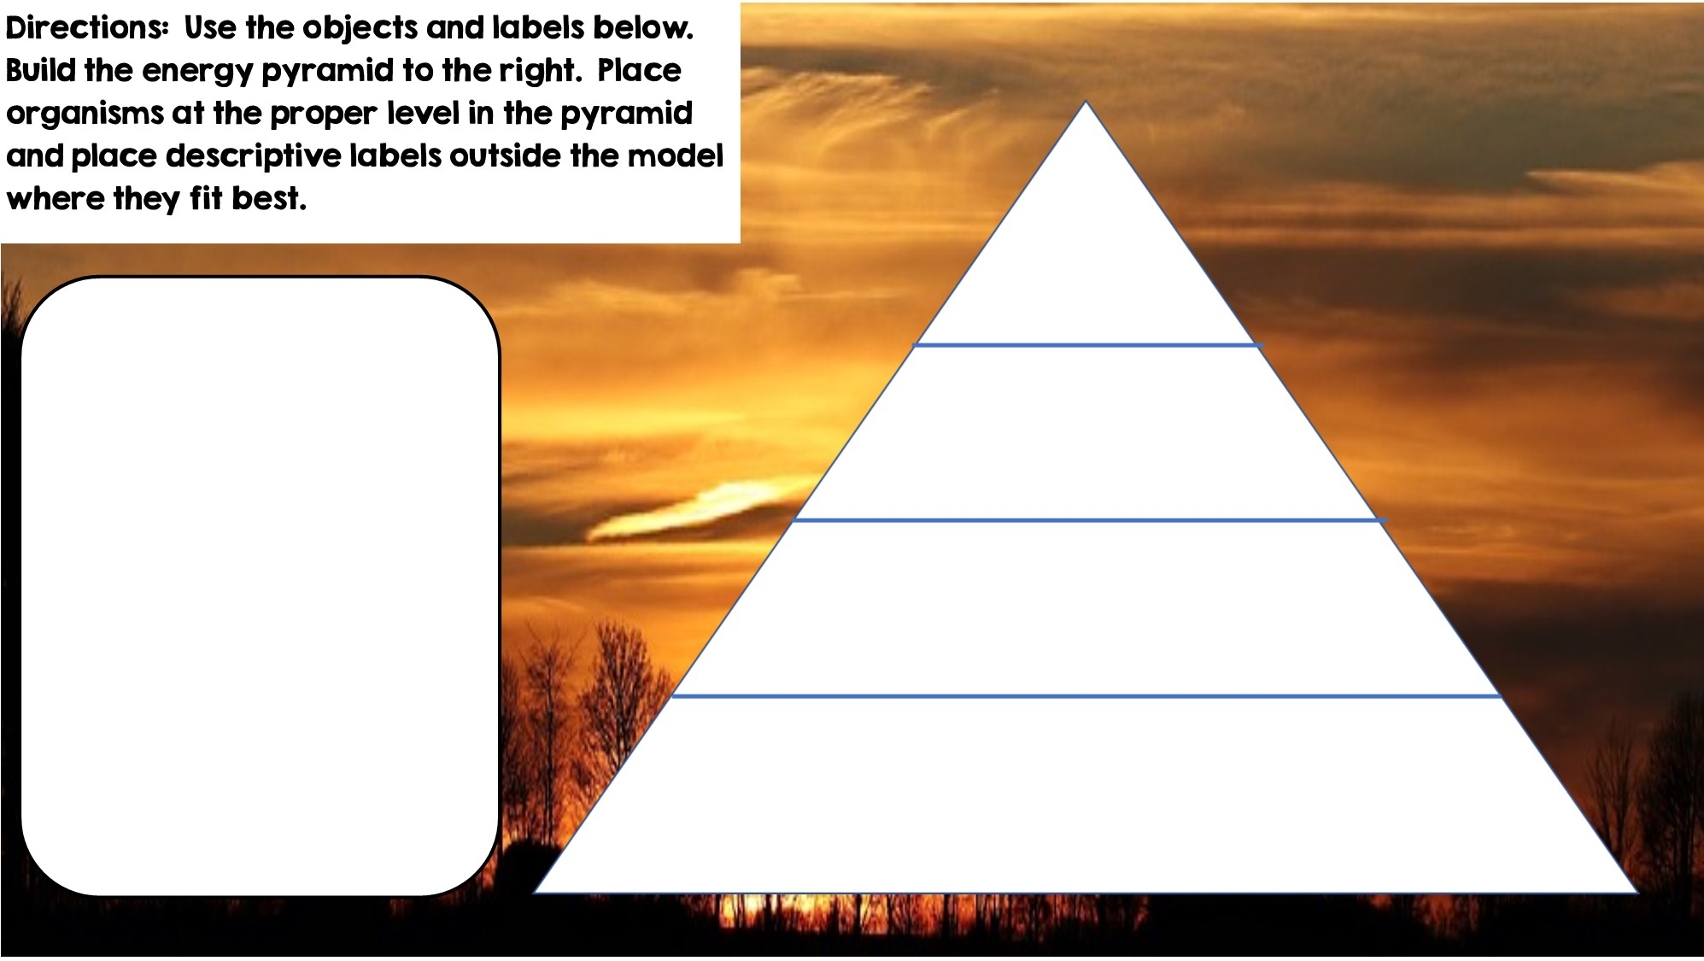

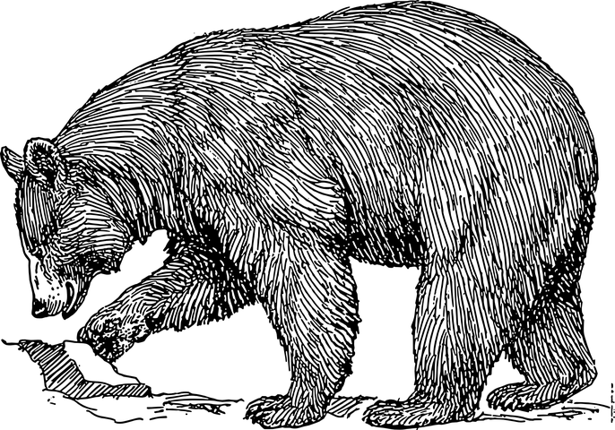

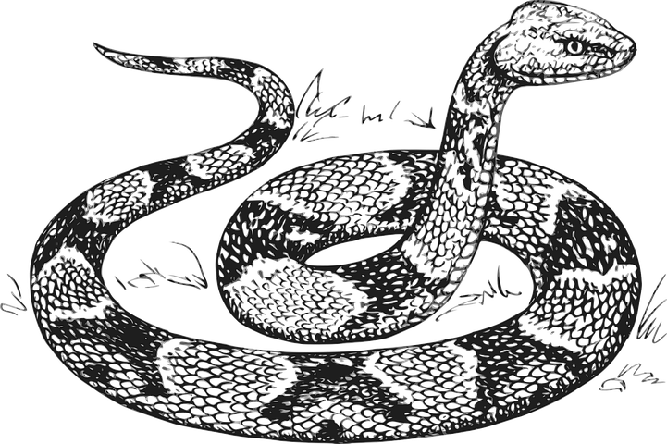
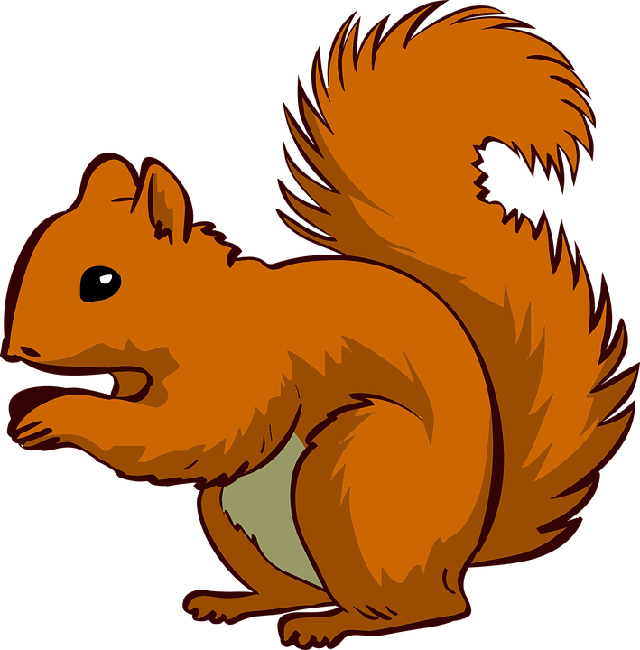






Only 10% of the energy from each tropic level is transferred
Heterotrophs
Tertiary Consumers
Secondary Consumers
Heterotrophs
Primary Consumers
Heterotrophs
Autotrophs
Producers

Slide 5
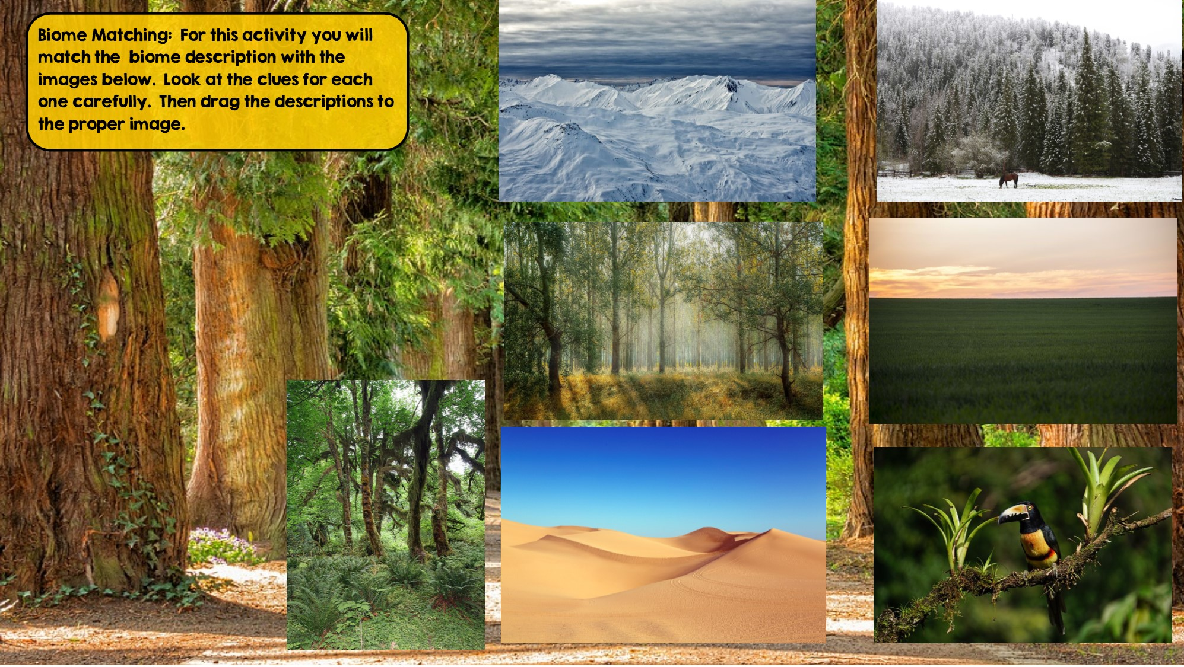
Taiga
Hint: Snowy Forest
Grassland
Hint: Very few trees grow
Tundra
Hint: Cold Desert
Tropical Rainforest:
Hint: Found near equator
Temperate Deciduous Forest Hint: Four distinct seasons
Desert
Hint: little to no water
Temperate Rainforest
Hint: Cool rainforest

Slide 6
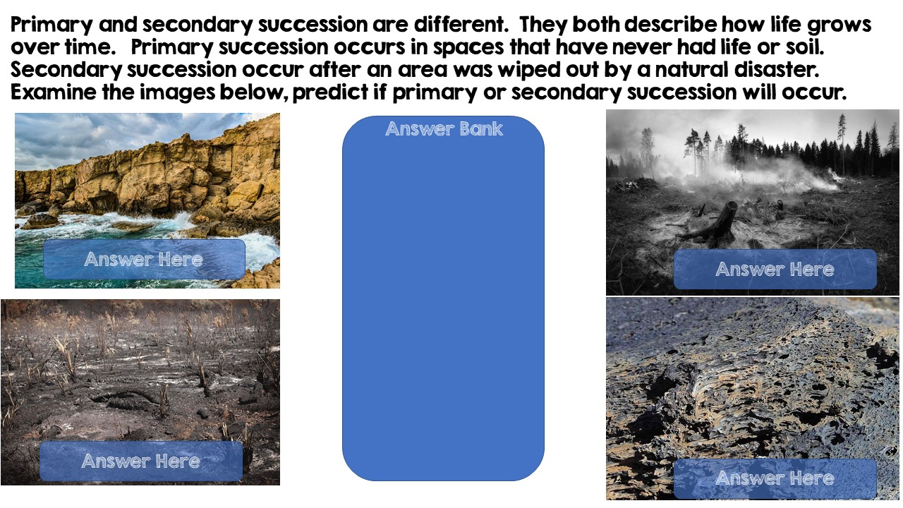
Primary Succession
Primary Succession
Secondary Succession
Secondary Succession

Slide 7
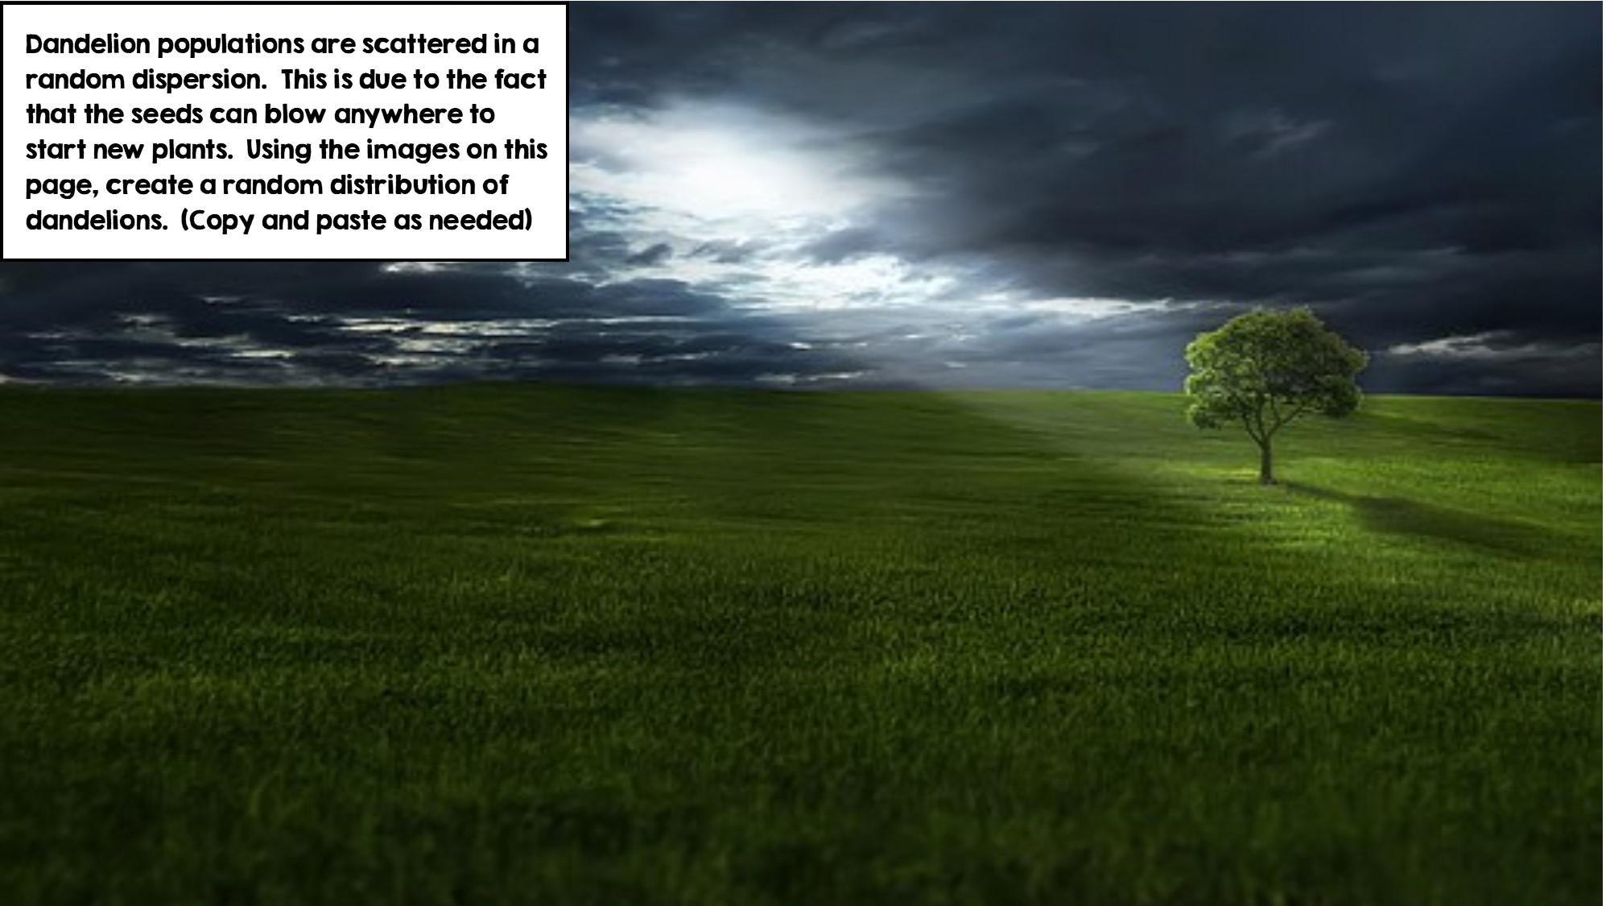
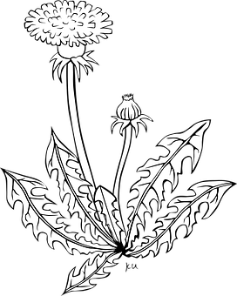

Slide 8
