Slide 1
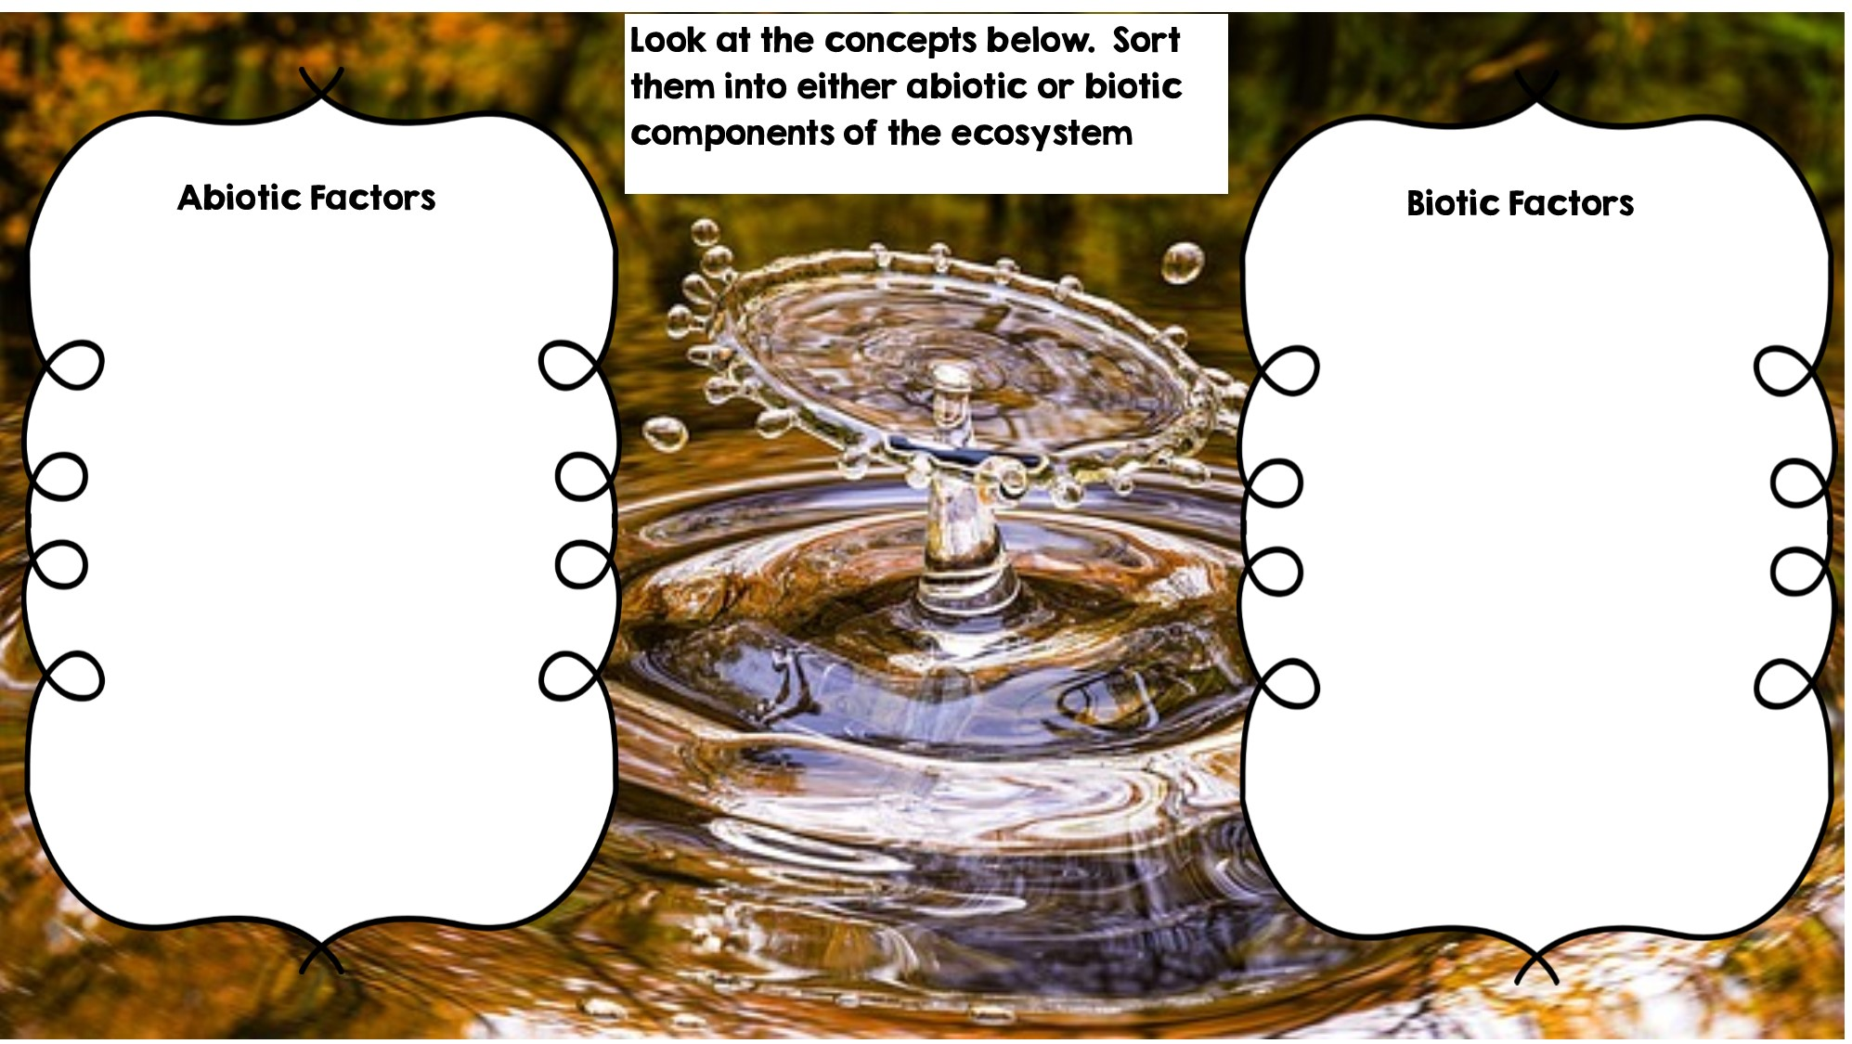
Frog
Rocks
Fox
Water
Rotting Log
Temperature
Dead Animal
Deer
Sunlight
Grass
Flowers

Slide 2
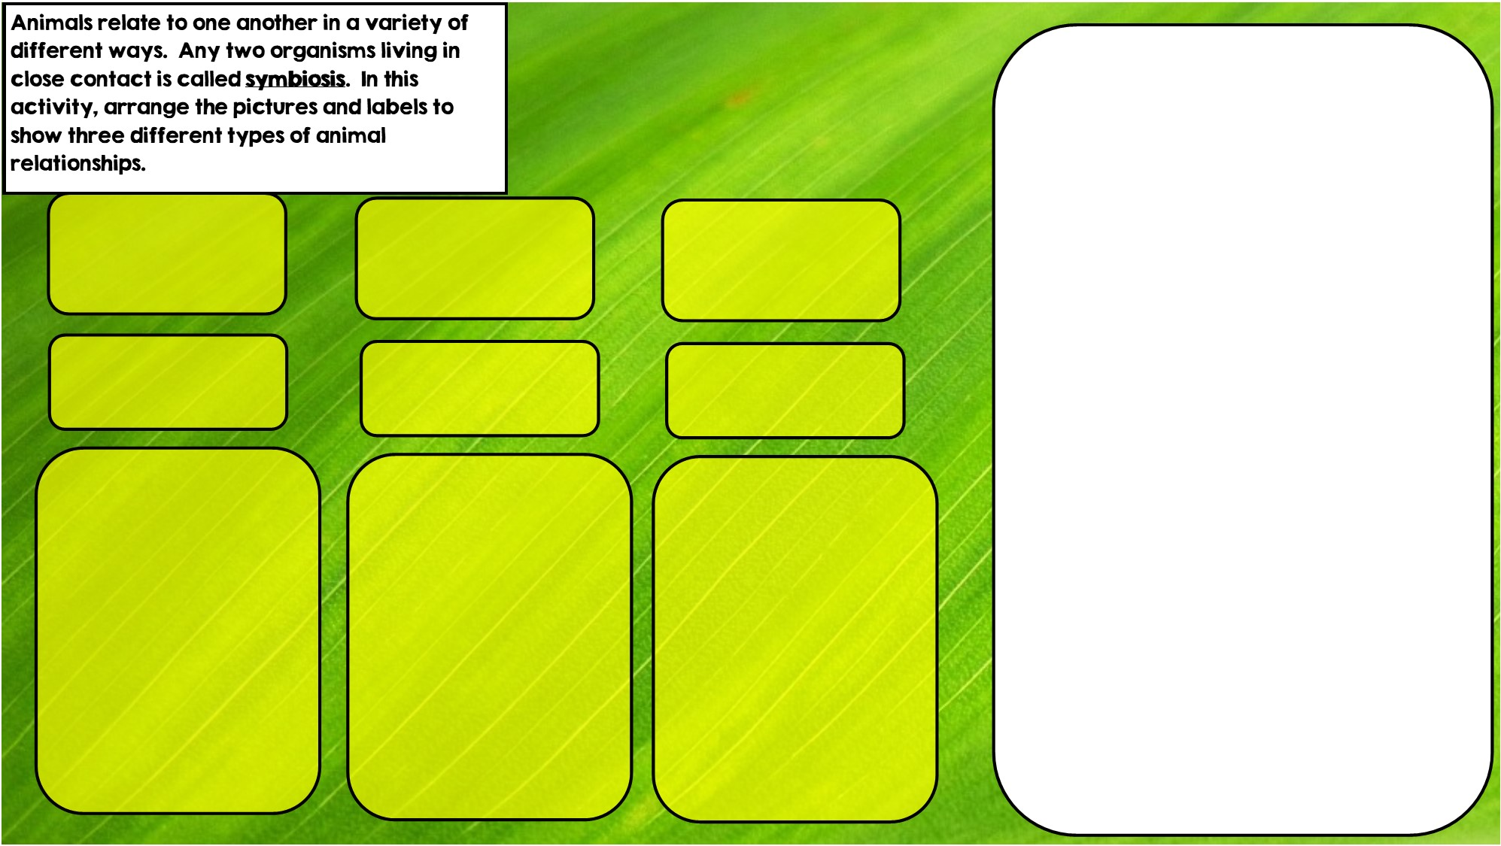

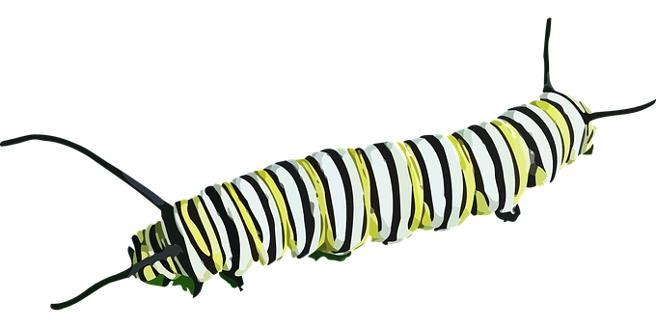

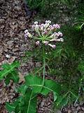
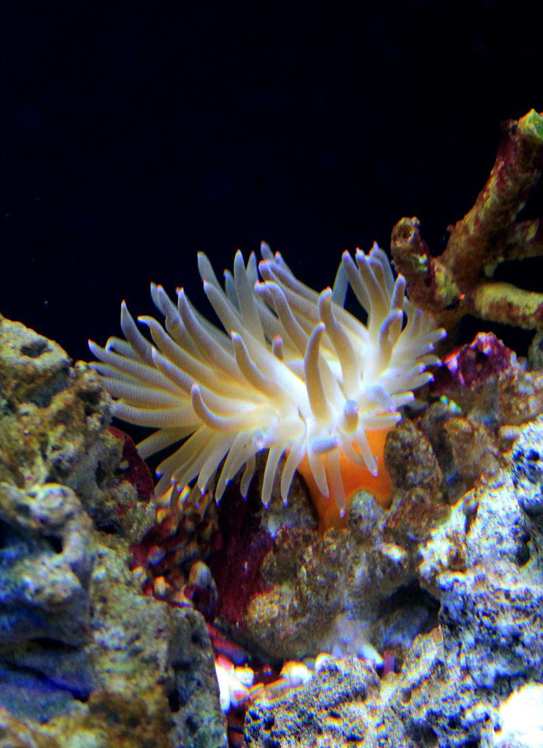

Hint: I eat toxic leaves
Commensalism is where one organism benefits and doesn’t hurt the other.
Parasitism is where one organisms benefits and the other is hurt
Mutualism is where both organisms benefit
Hint: I live in intestines
Hint: I live in stingers

Slide 3
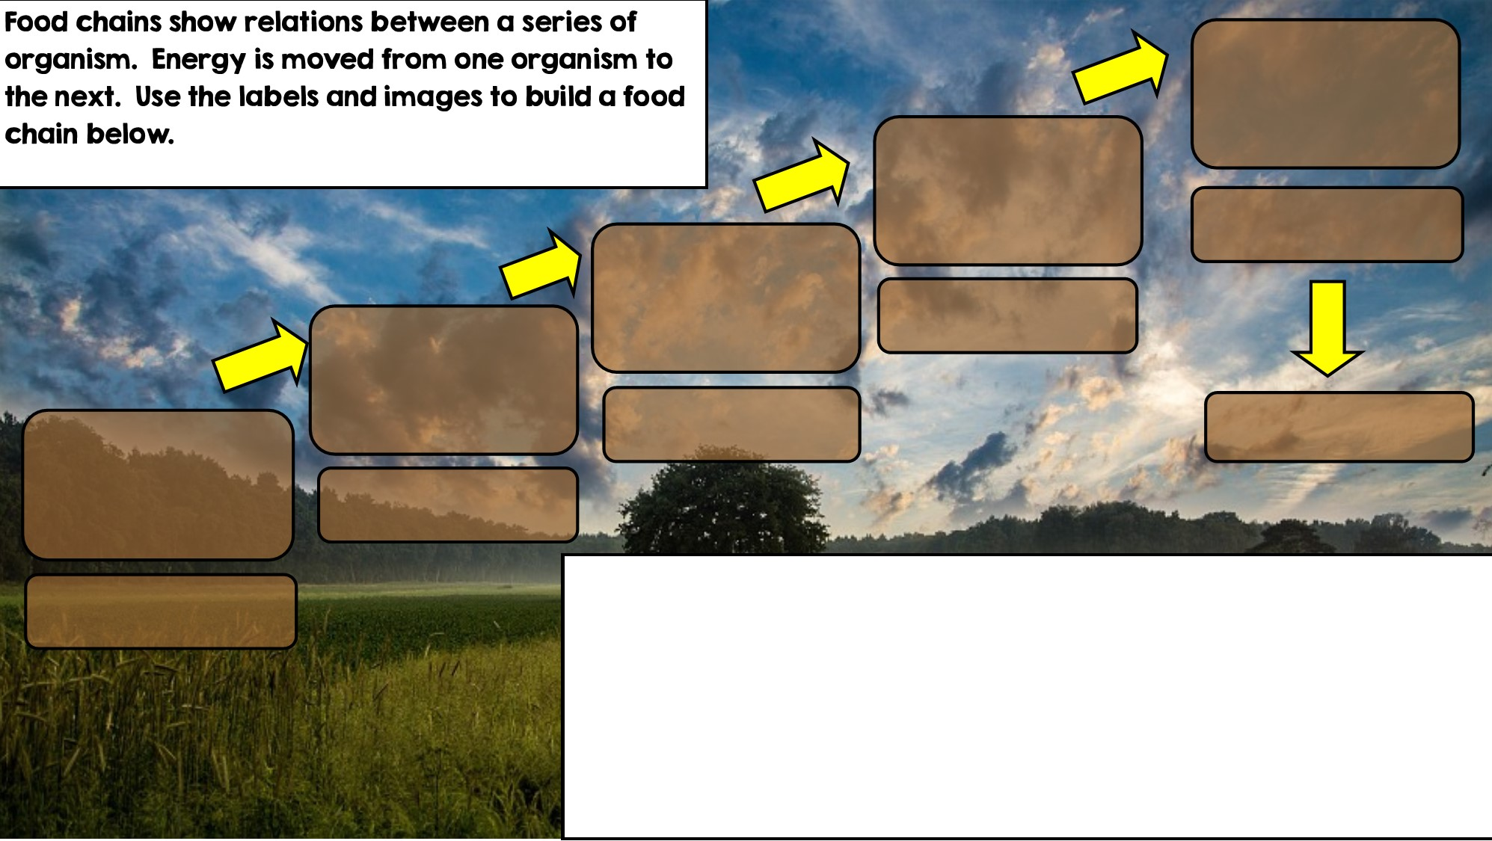

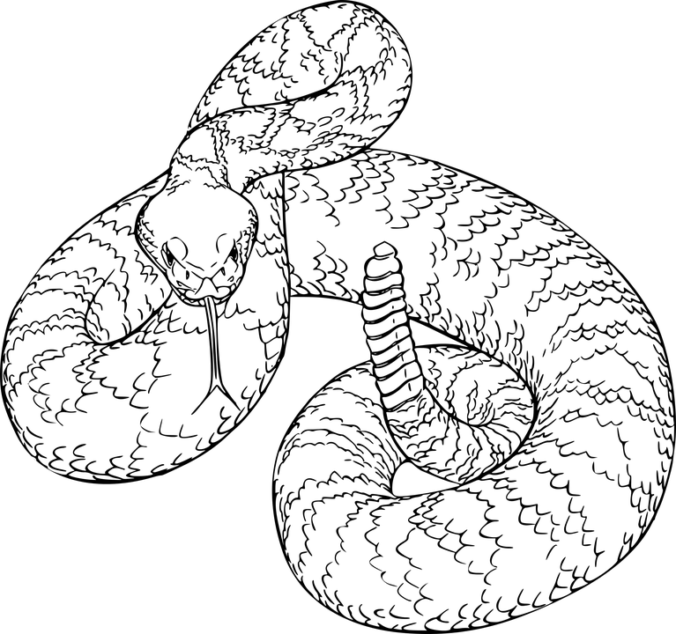
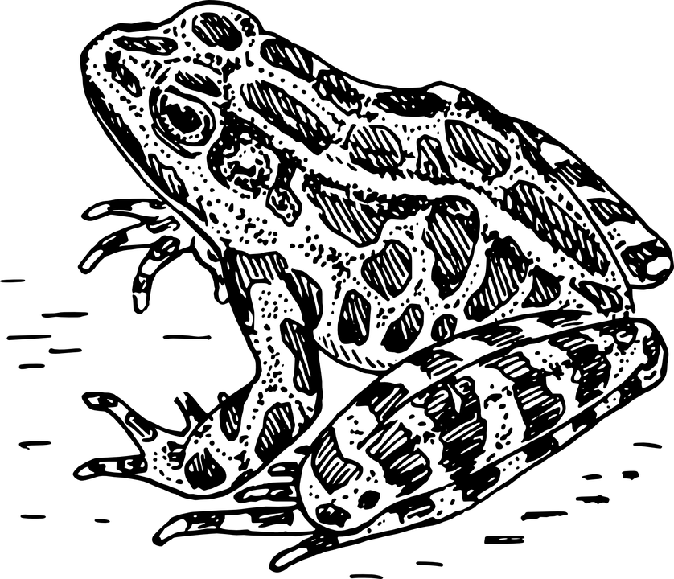
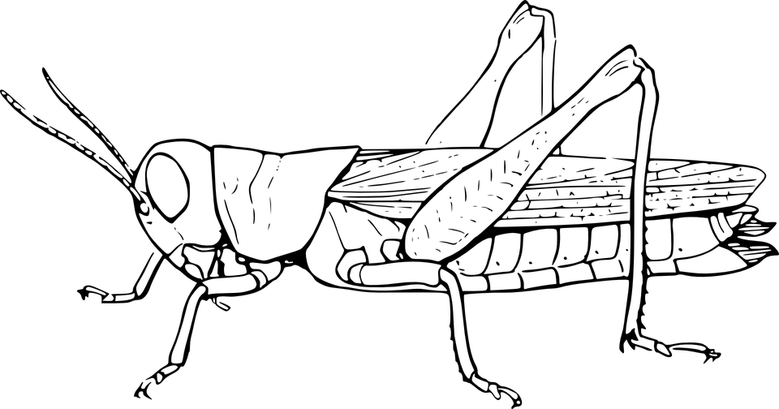

Apex Predator
Tertiary Consumer
Secondary Consumer
Decomposer
Primary Consumer: Heterotroph
Producer: Autotroph

Slide 4
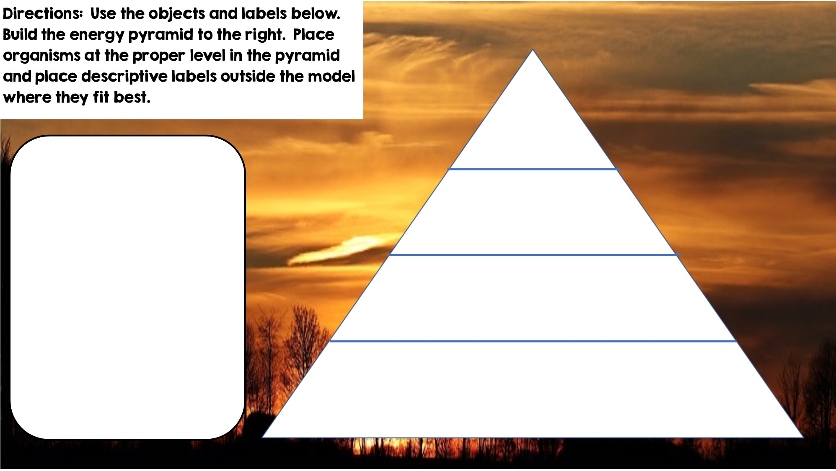



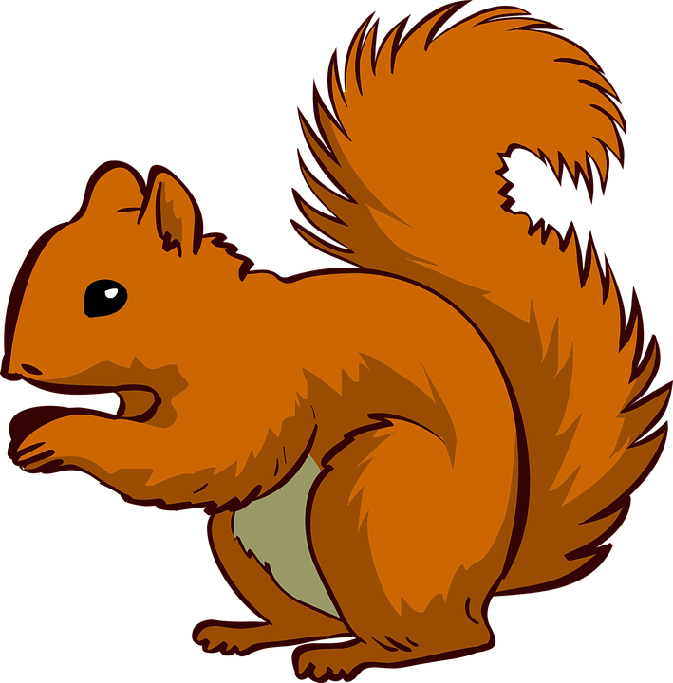


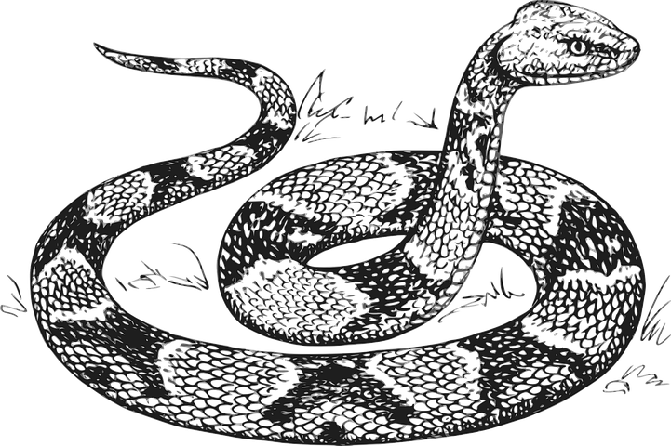


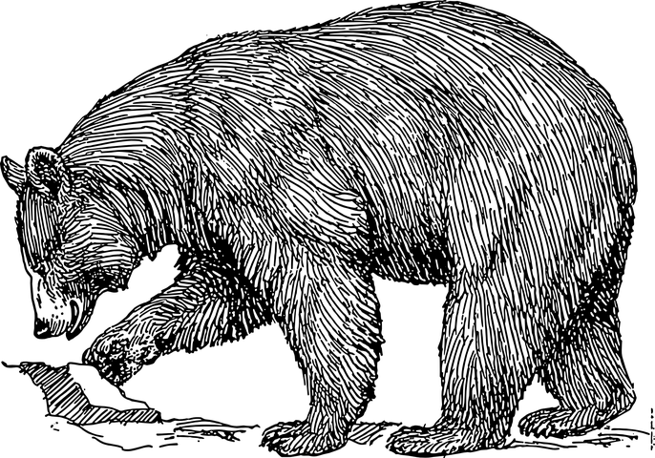

Only 10% of the energy from each tropic level is transferred
Tertiary Consumers
Producers
Secondary Consumers
Primary Consumers
Heterotrophs
Heterotrophs
Autotrophs
Heterotrophs

Slide 5
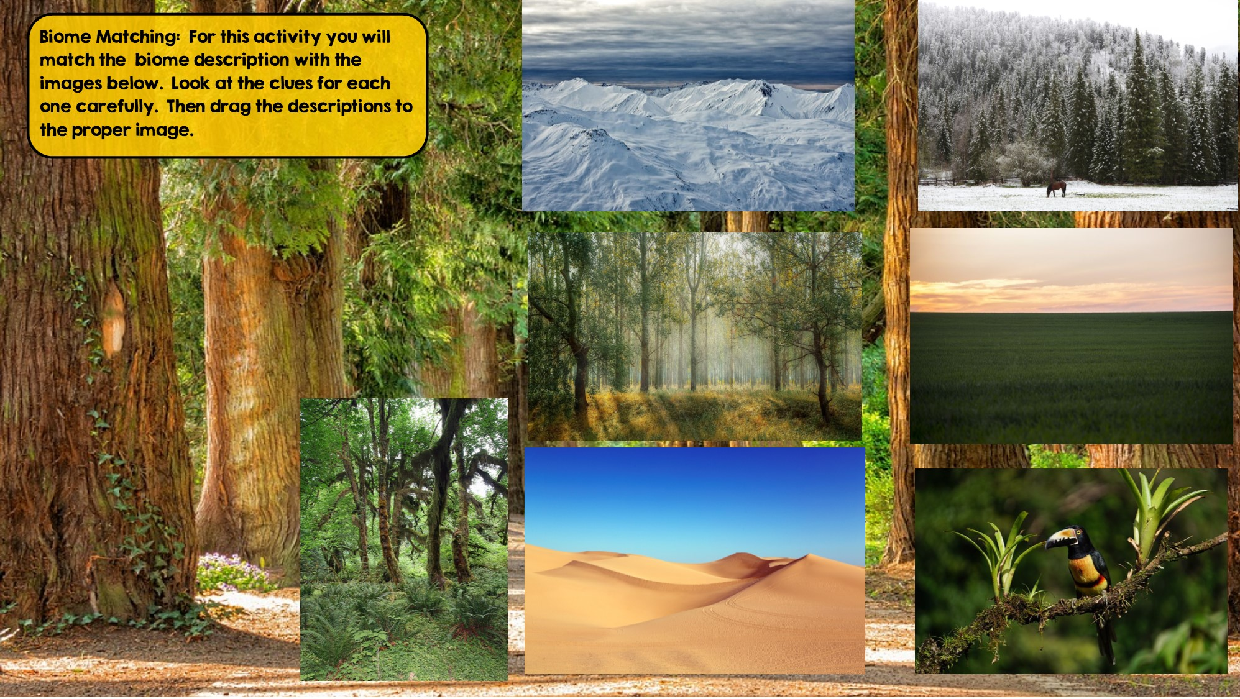
Tundra
Hint: Cold Desert
Taiga
Hint: Snowy Forest
Tropical Rainforest:
Hint: Found near equator
Grassland
Hint: Very few trees grow
Temperate Deciduous Forest Hint: Four distinct seasons
Desert
Hint: little to no water
Temperate Rainforest
Hint: Cool rainforest

Slide 6
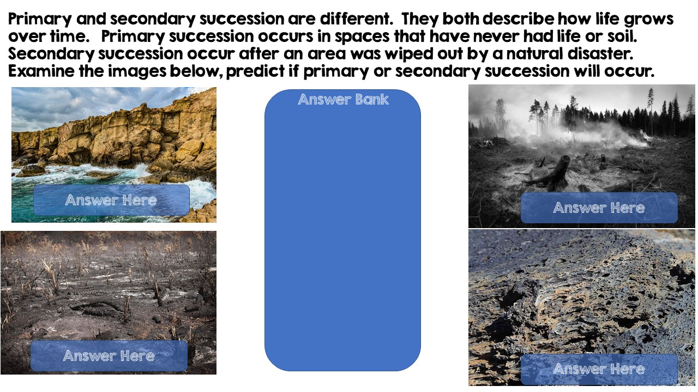
Secondary Succession
Secondary Succession
Primary Succession
Primary Succession

Slide 7
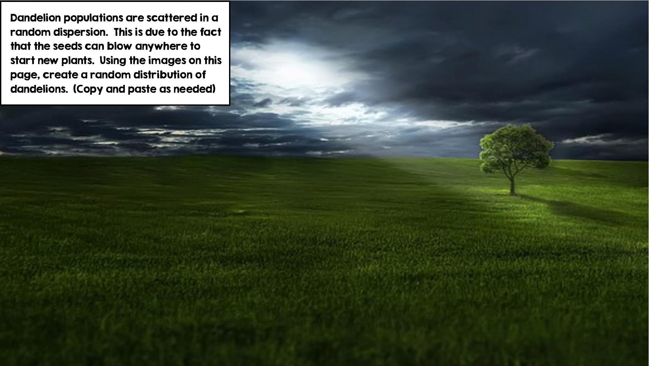
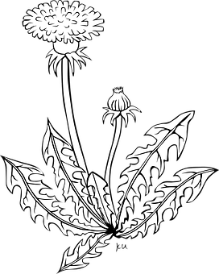

Slide 8
