Slide 1
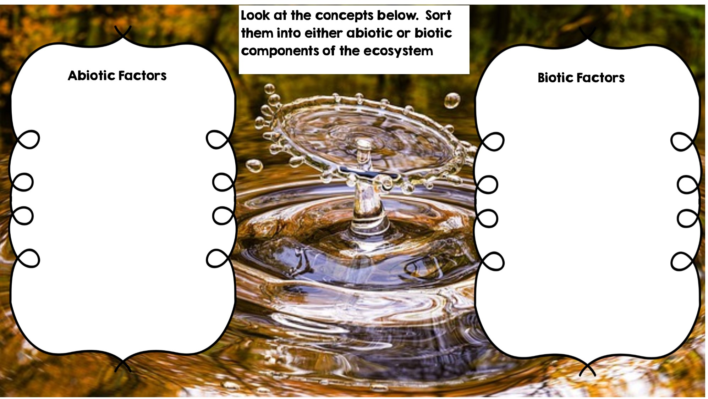
Fox
Rocks
Rotting Log
Temperature
Frog
Water
Flowers
Sunlight
Deer
Grass
Dead Animal

Slide 2
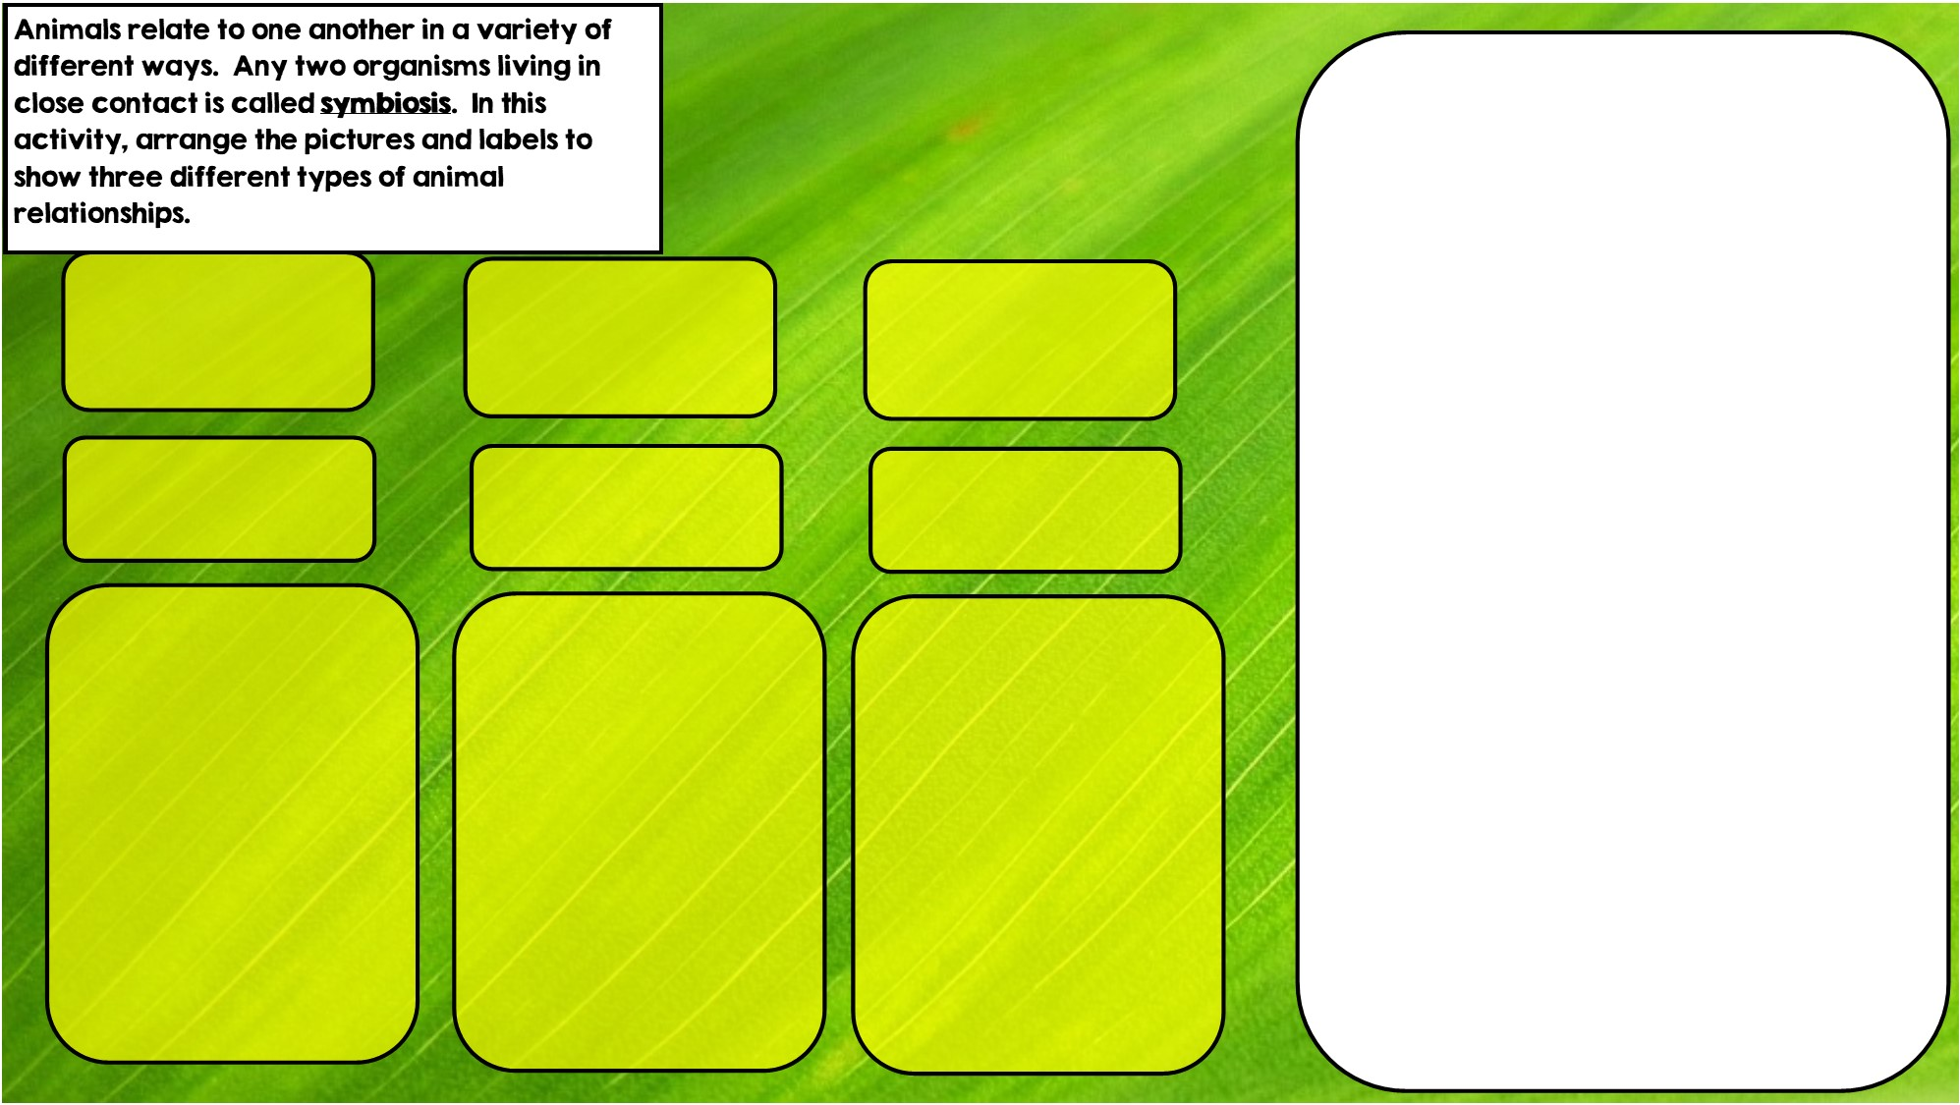
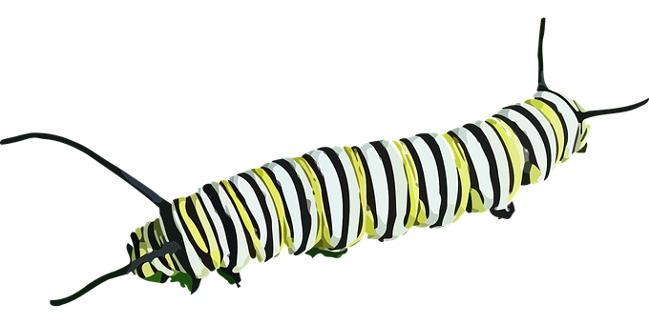


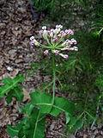
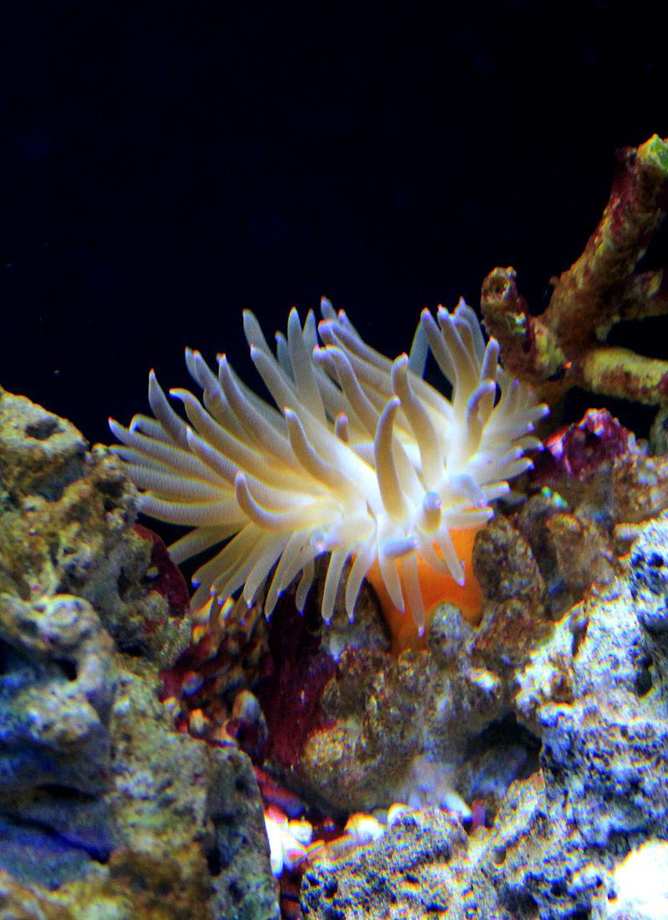

Commensalism is where one organism benefits and doesn’t hurt the other.
Hint: I live in intestines
Hint: I live in stingers
Hint: I eat toxic leaves
Mutualism is where both organisms benefit
Parasitism is where one organisms benefits and the other is hurt

Slide 3
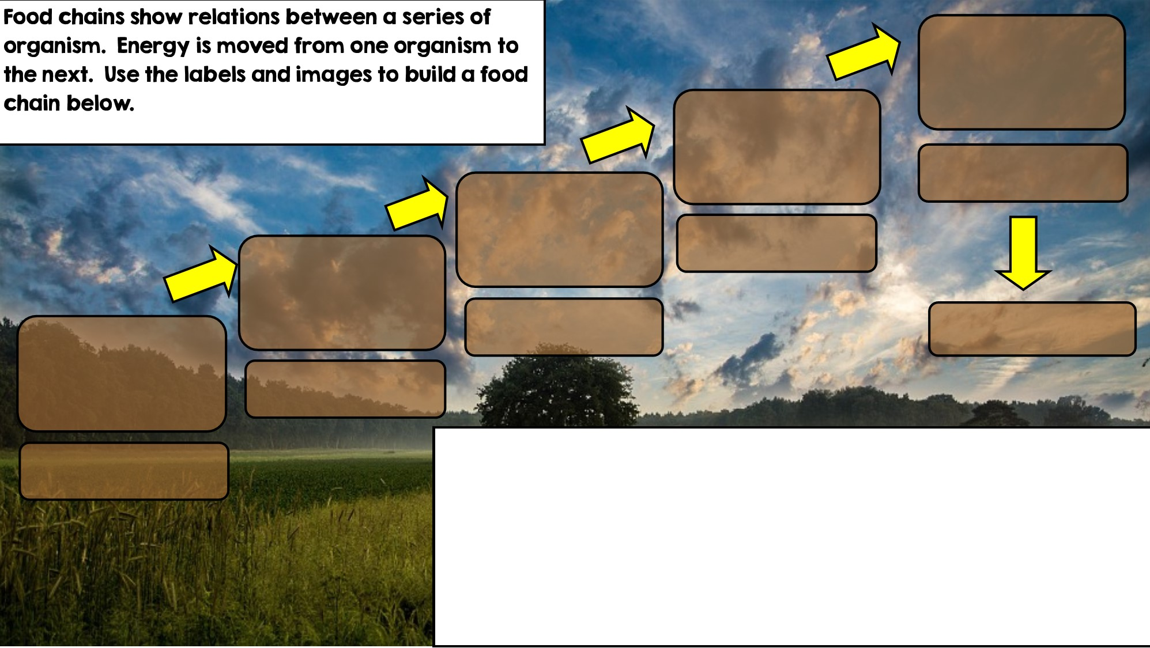

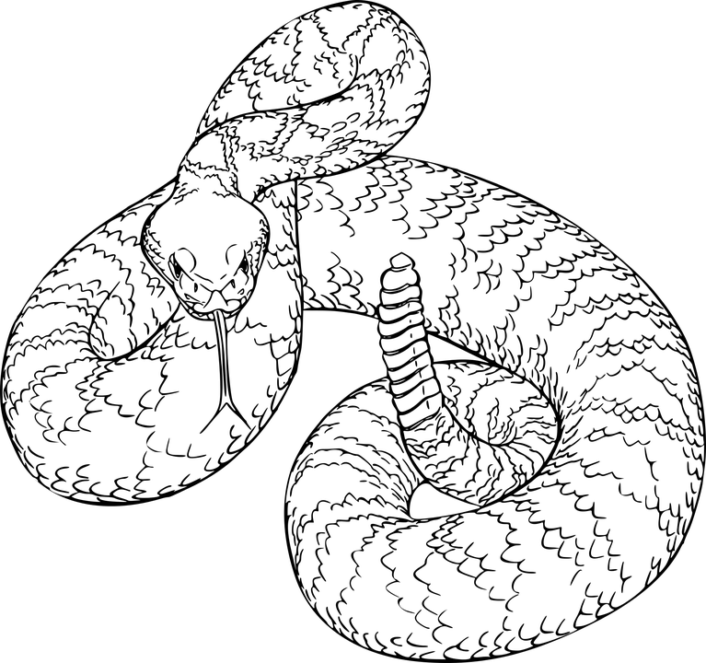
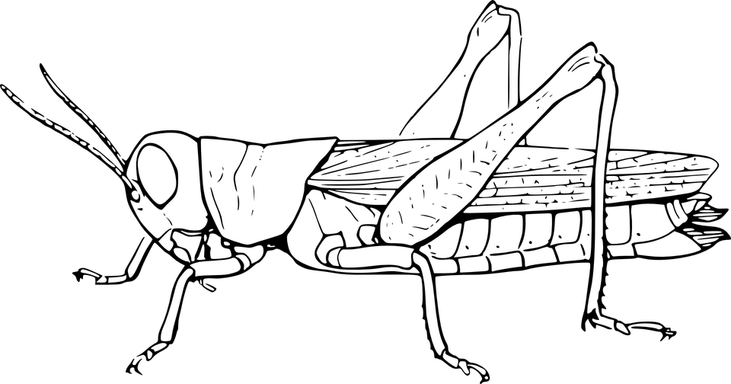

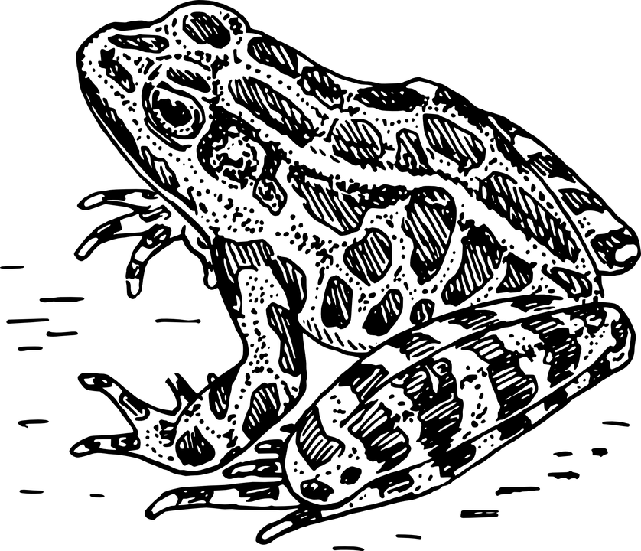
Producer: Autotroph
Secondary Consumer
Primary Consumer: Heterotroph
Decomposer
Tertiary Consumer
Apex Predator

Slide 4
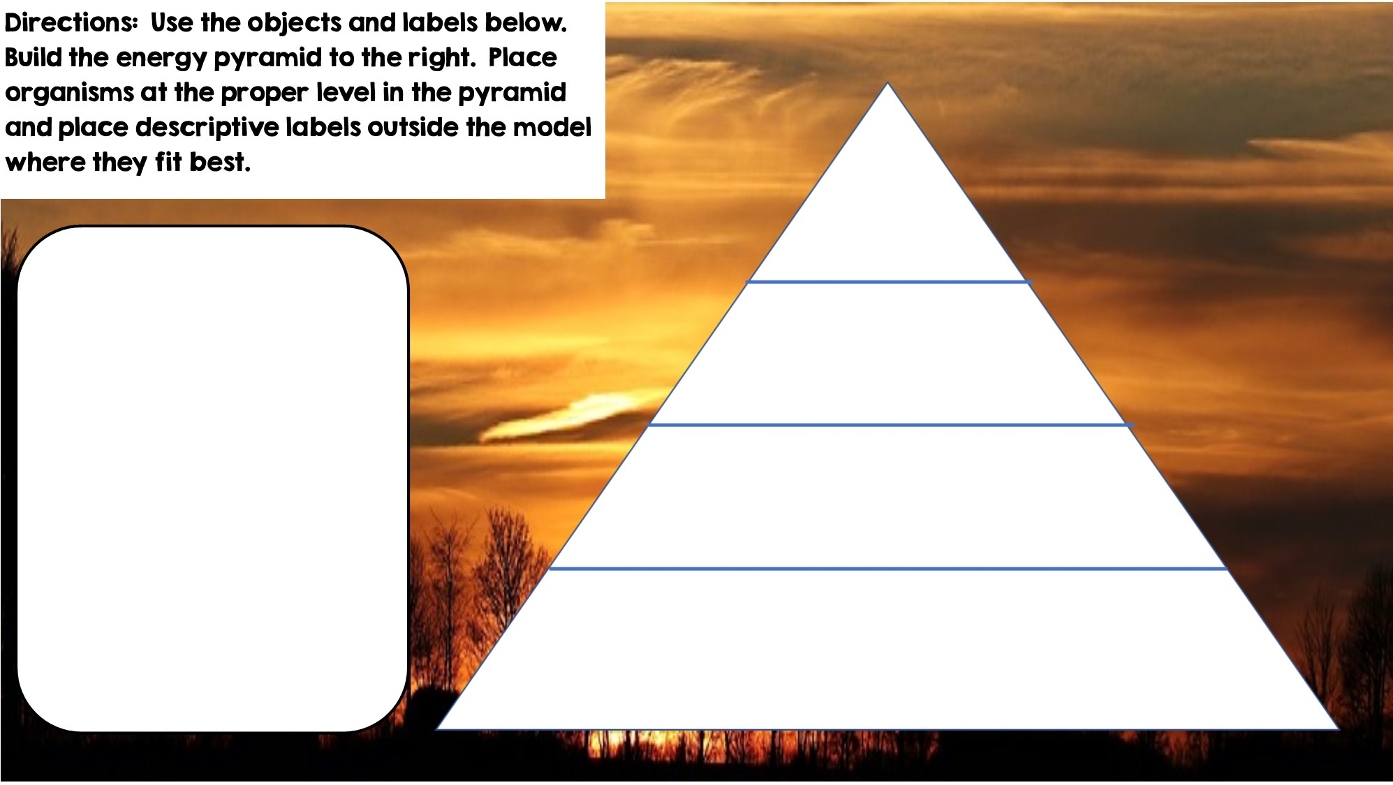



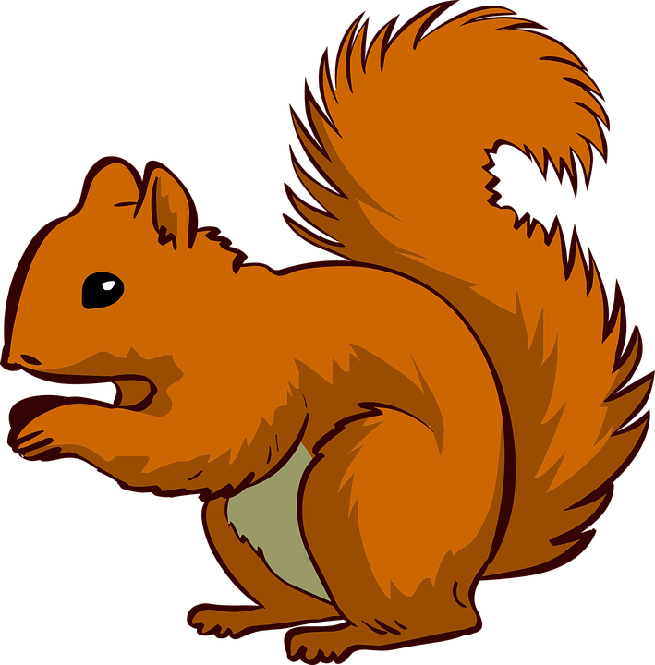


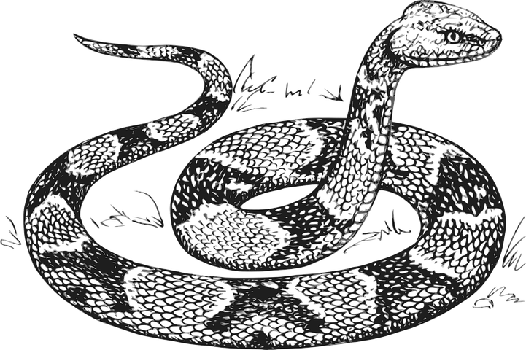


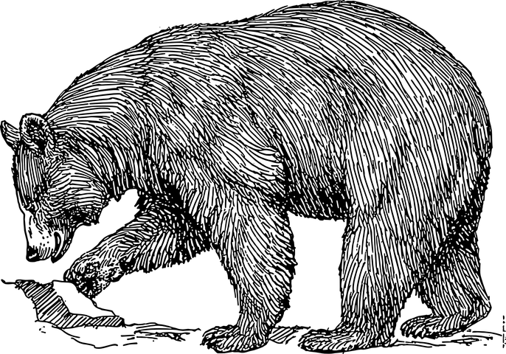

Only 10% of the energy from each tropic level is transferred
Tertiary Consumers
Producers
Secondary Consumers
Primary Consumers
Heterotrophs
Heterotrophs
Autotrophs
Heterotrophs

Slide 5
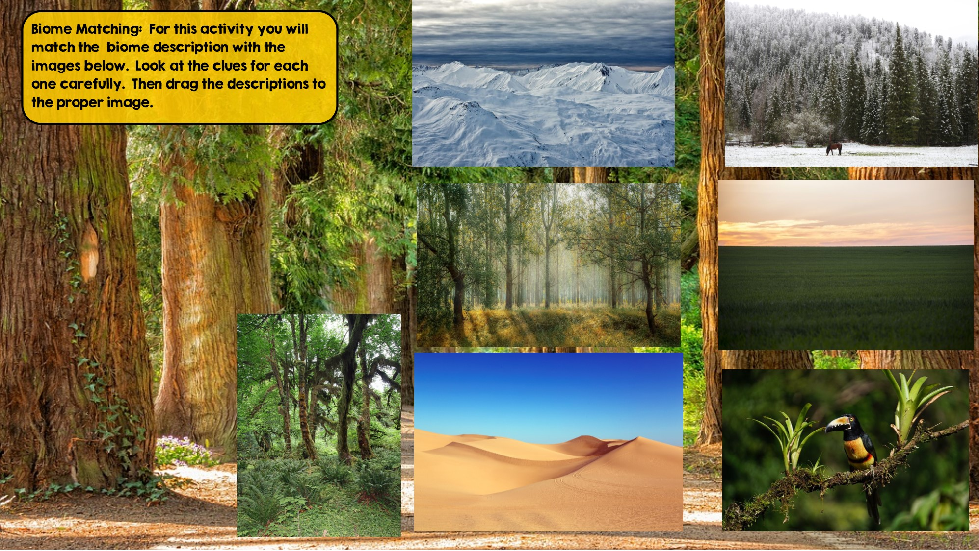
Tundra
Hint: Cold Desert
Taiga
Hint: Snowy Forest
Temperate Deciduous Forest Hint: Four distinct seasons
Temperate Rainforest
Hint: Cool rainforest
Grassland
Hint: Very few trees grow
Desert
Hint: little to no water
Tropical Rainforest:
Hint: Found near equator

Slide 6
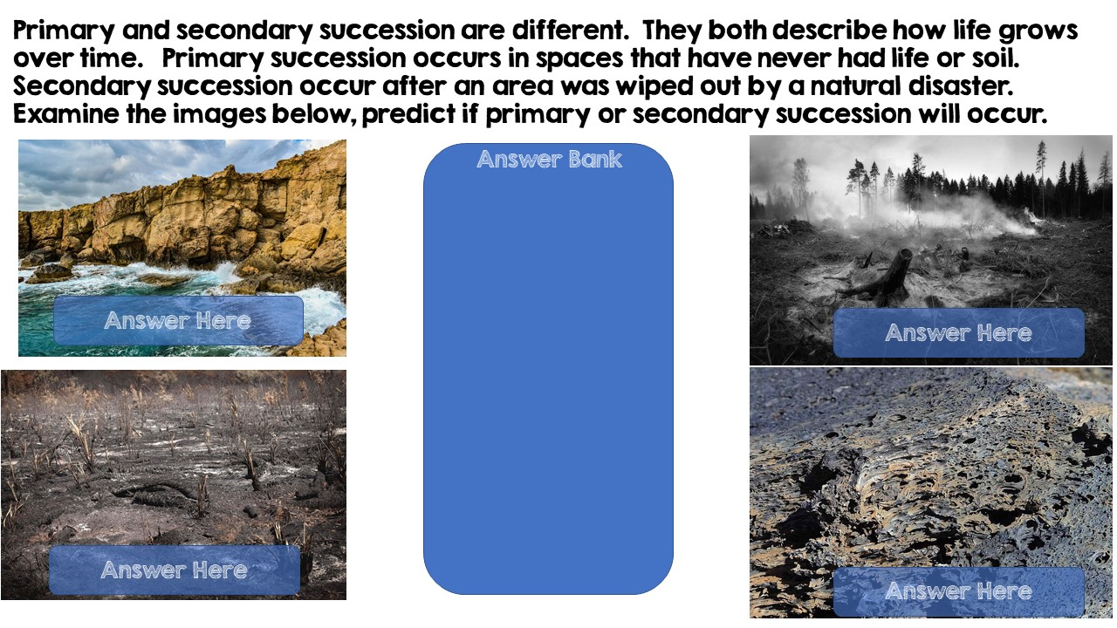
Primary Succession
Primary Succession
Secondary Succession
Secondary Succession

Slide 7
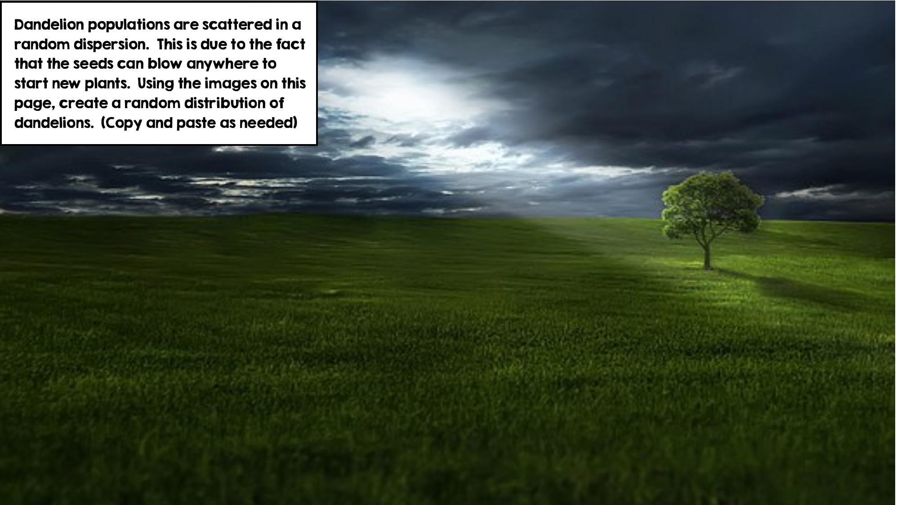
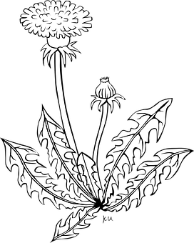

Slide 8
