Slide 1
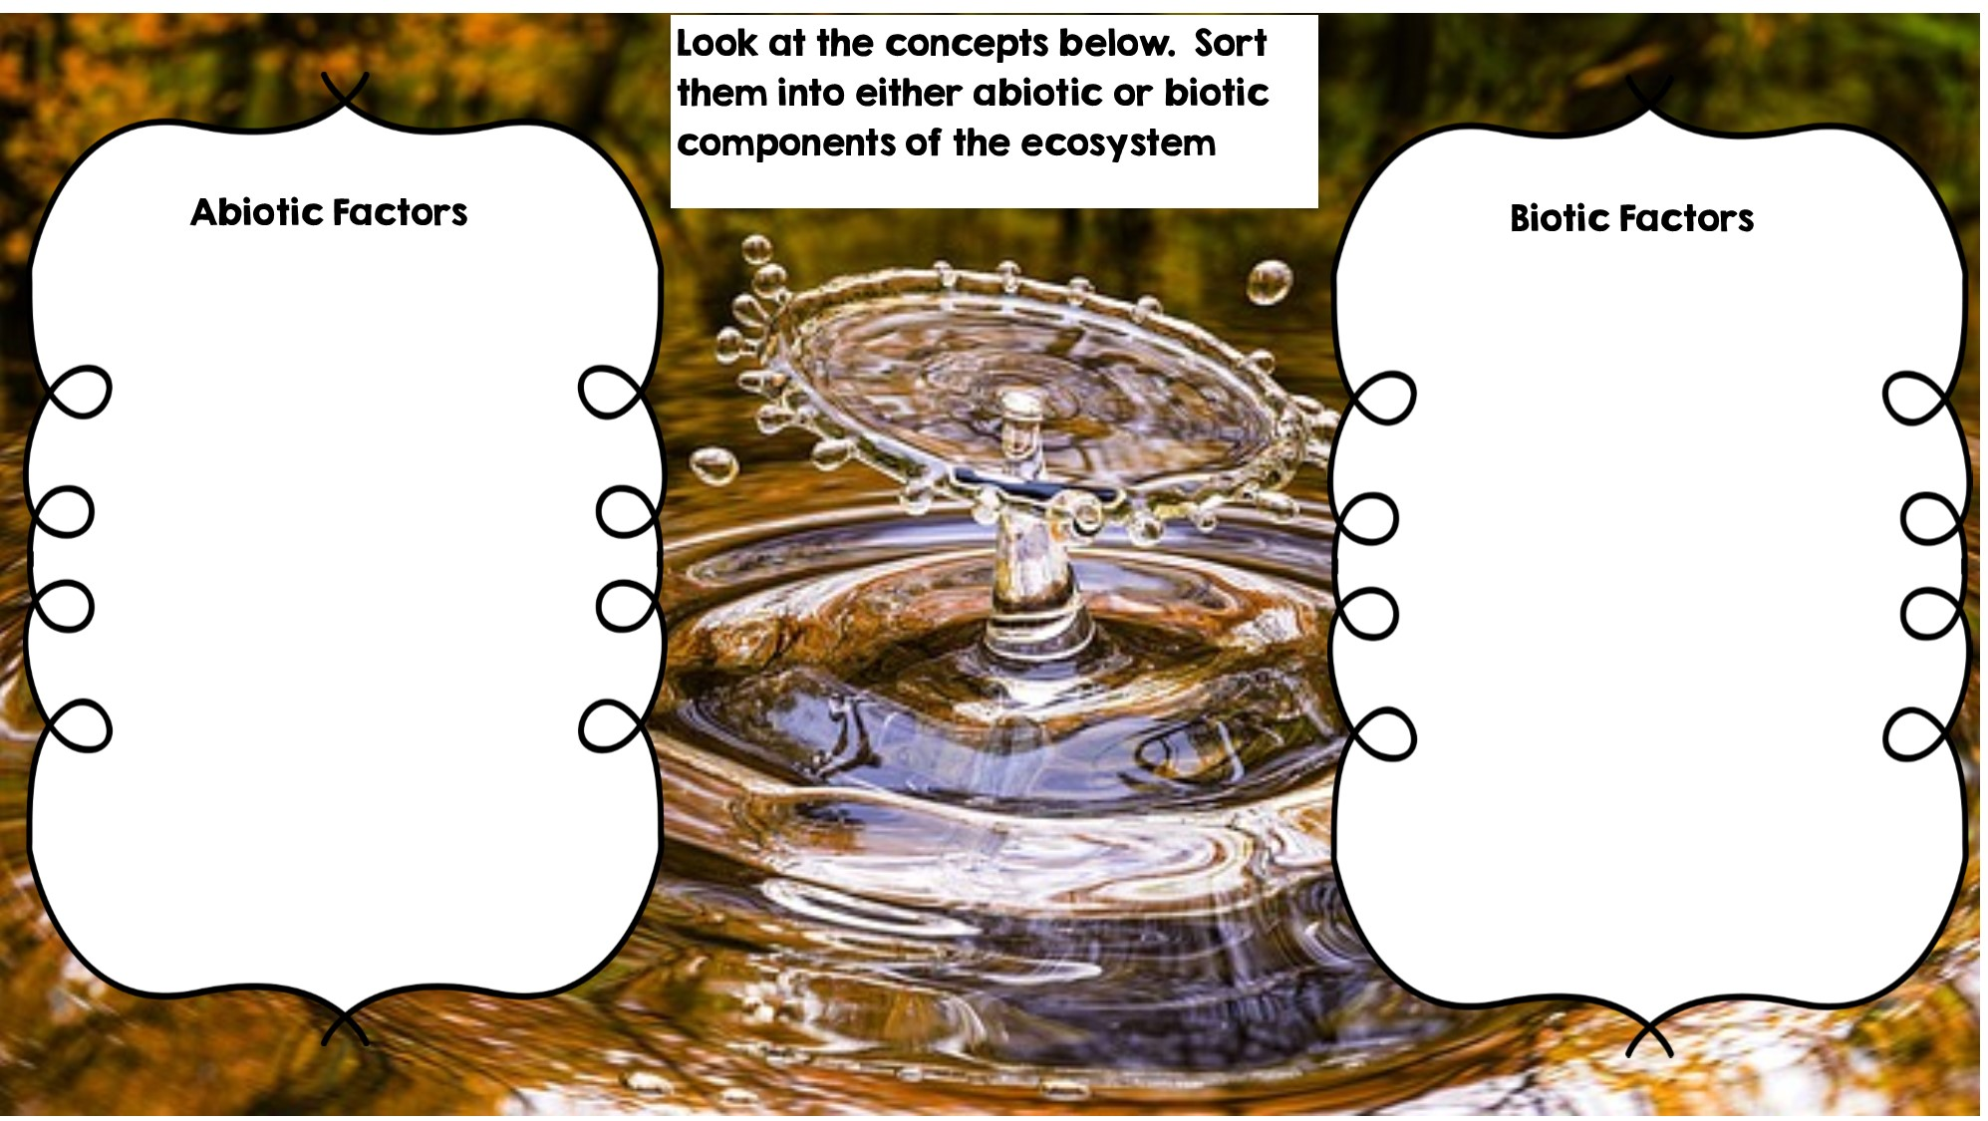
Rocks
Frog
Temperature
Fox
Flowers
Water
Rotting Log
Grass
Sunlight
Dead Animal
Deer

Slide 2
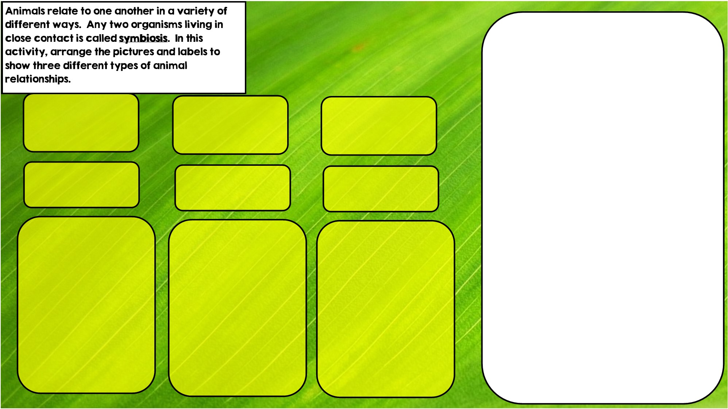
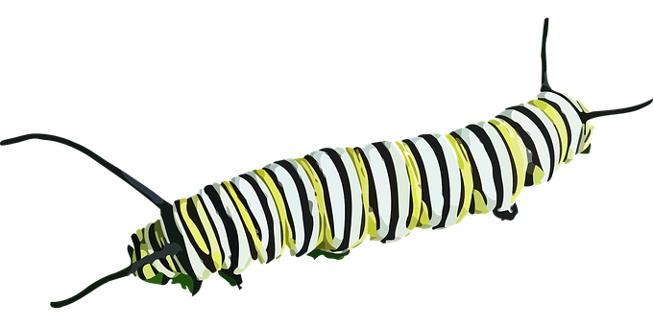


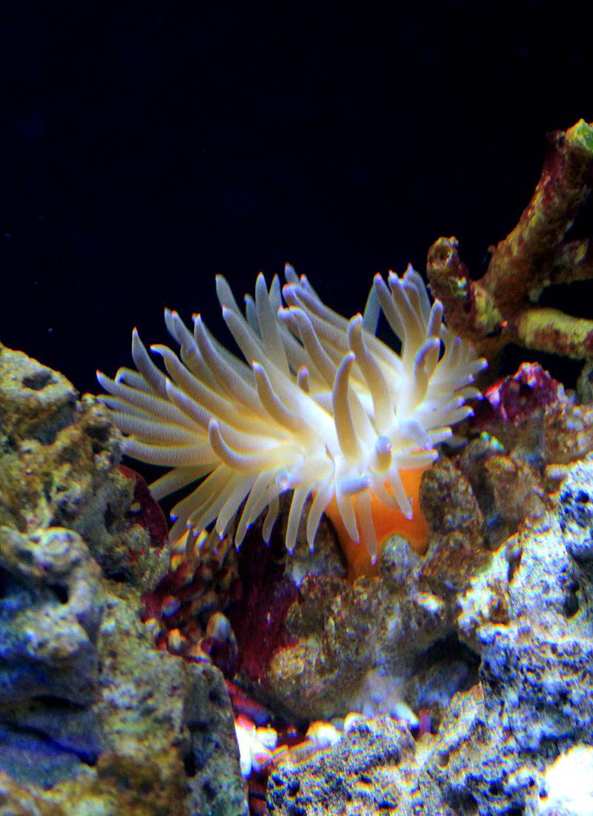
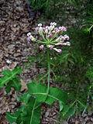

Commensalism is where one organism benefits and doesn’t hurt the other.
Parasitism is where one organisms benefits and the other is hurt
Mutualism is where both organisms benefit
Hint: I eat toxic leaves
Hint: I live in stingers
Hint: I live in intestines

Slide 3
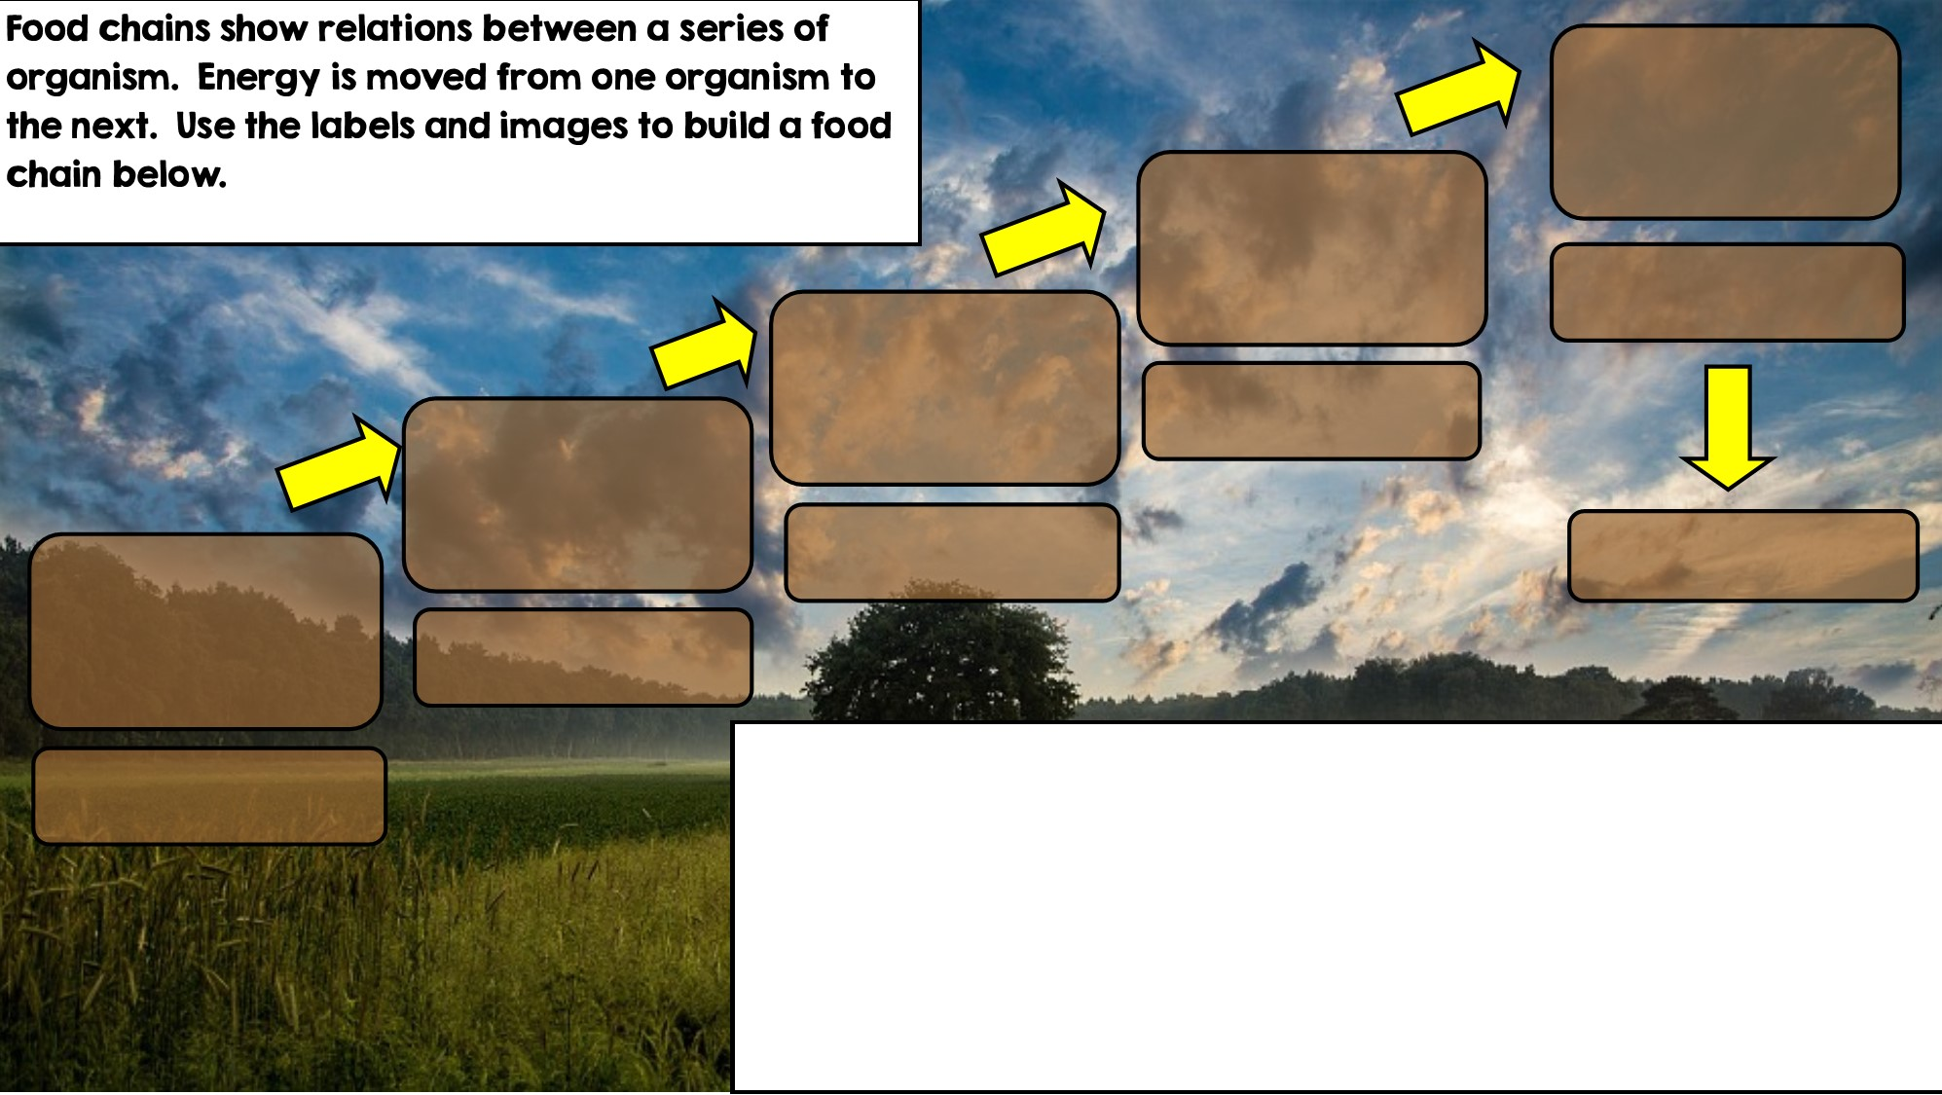

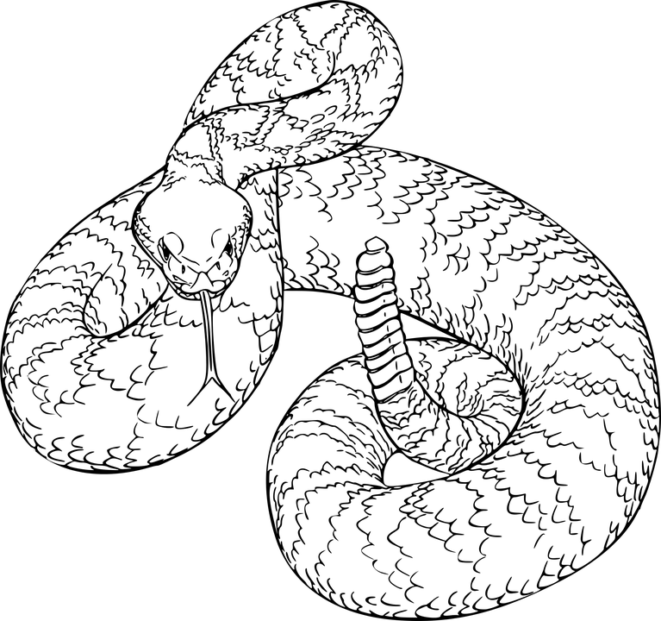
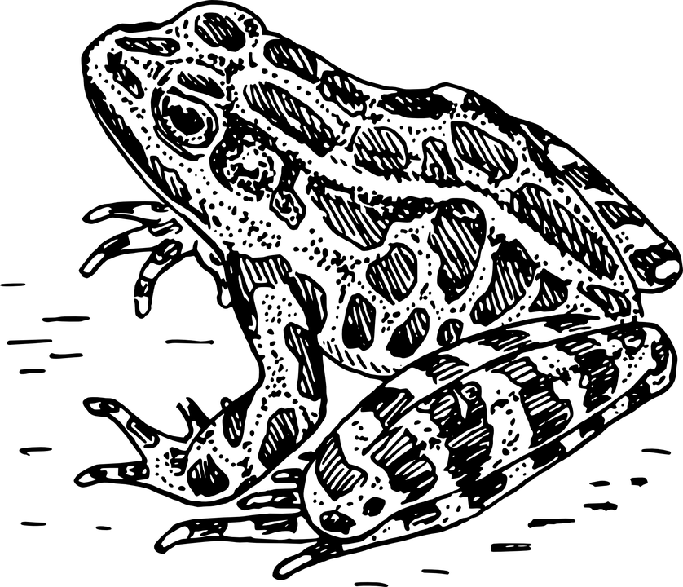
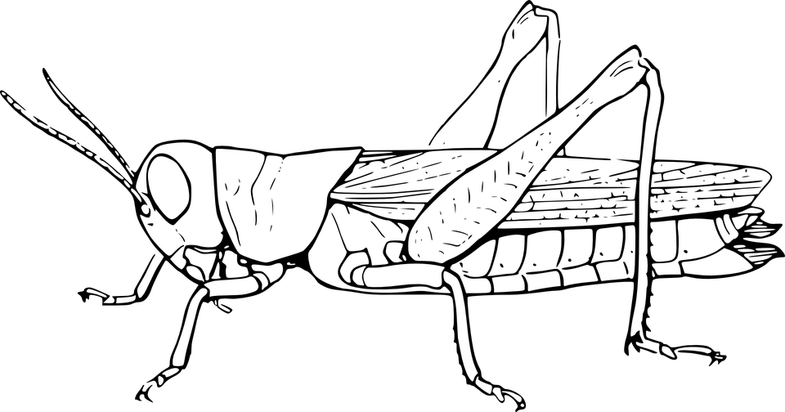

Apex Predator
Tertiary Consumer
Secondary Consumer
Decomposer
Primary Consumer: Heterotroph
Producer: Autotroph

Slide 4
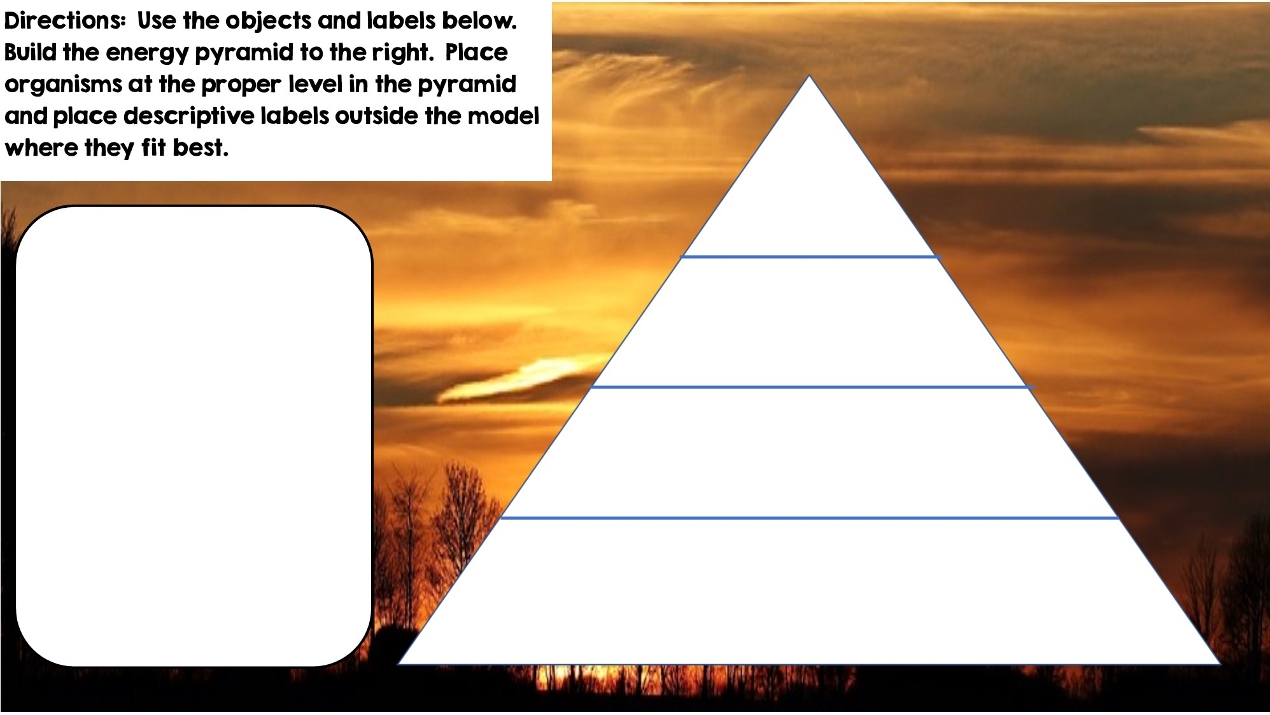


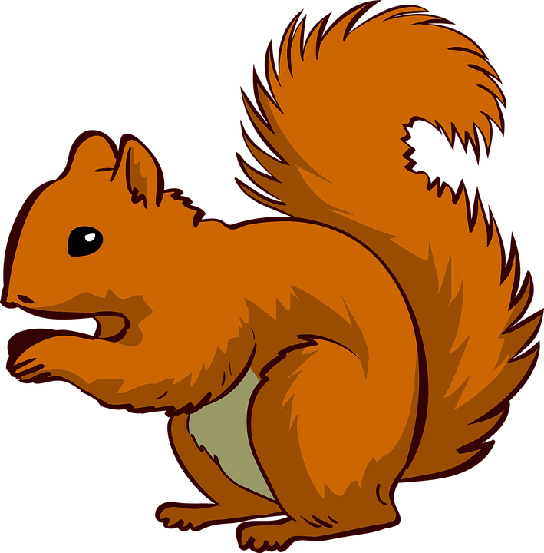


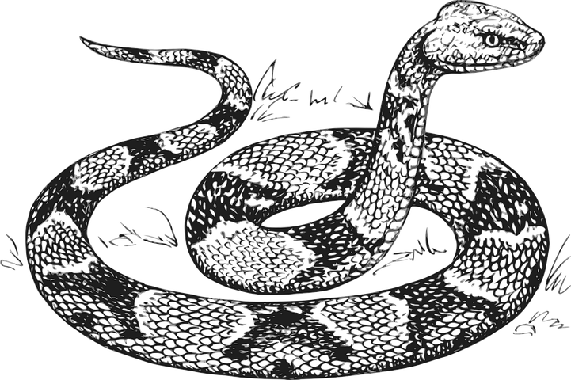

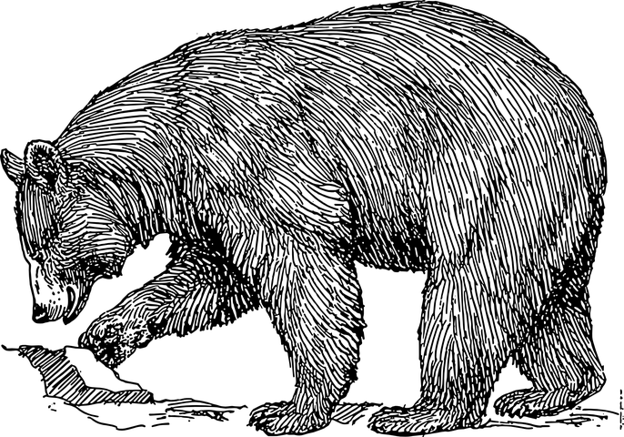



Only 10% of the energy from each tropic level is transferred
Tertiary Consumers
Secondary Consumers
Heterotrophs
Heterotrophs
Heterotrophs
Primary Consumers
Producers
Autotrophs

Slide 5
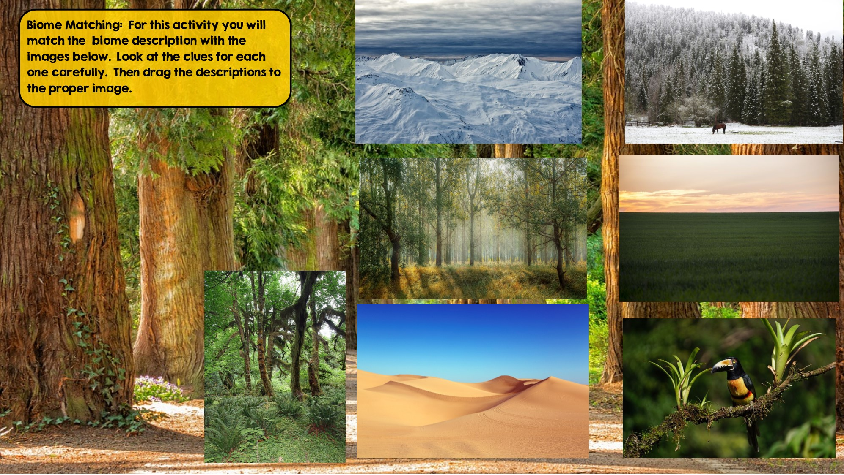
Taiga
Hint: Snowy Forest
Grassland
Hint: Very few trees grow
Tundra
Hint: Cold Desert
Tropical Rainforest:
Hint: Found near equator
Temperate Deciduous Forest Hint: Four distinct seasons
Desert
Hint: little to no water
Temperate Rainforest
Hint: Cool rainforest

Slide 6
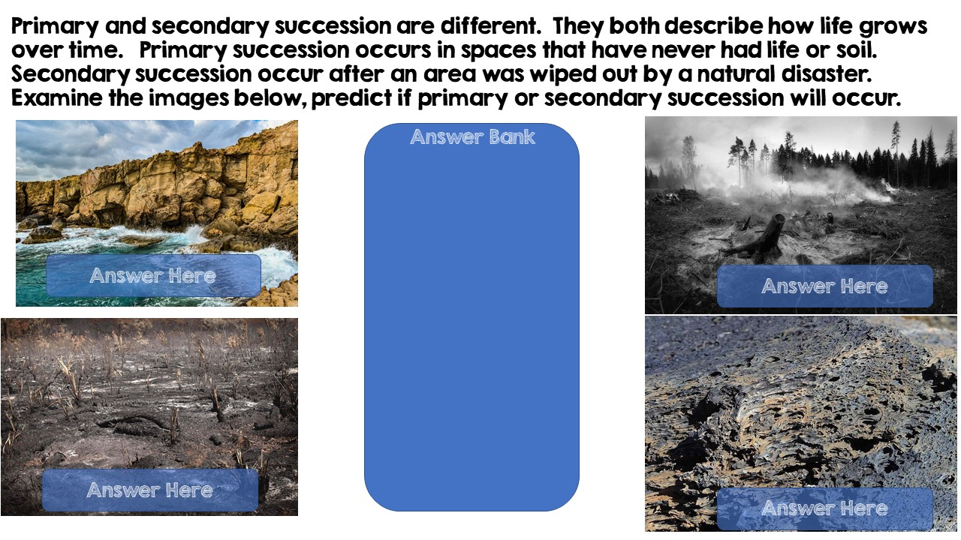
Primary Succession
Primary Succession
Secondary Succession
Secondary Succession

Slide 7
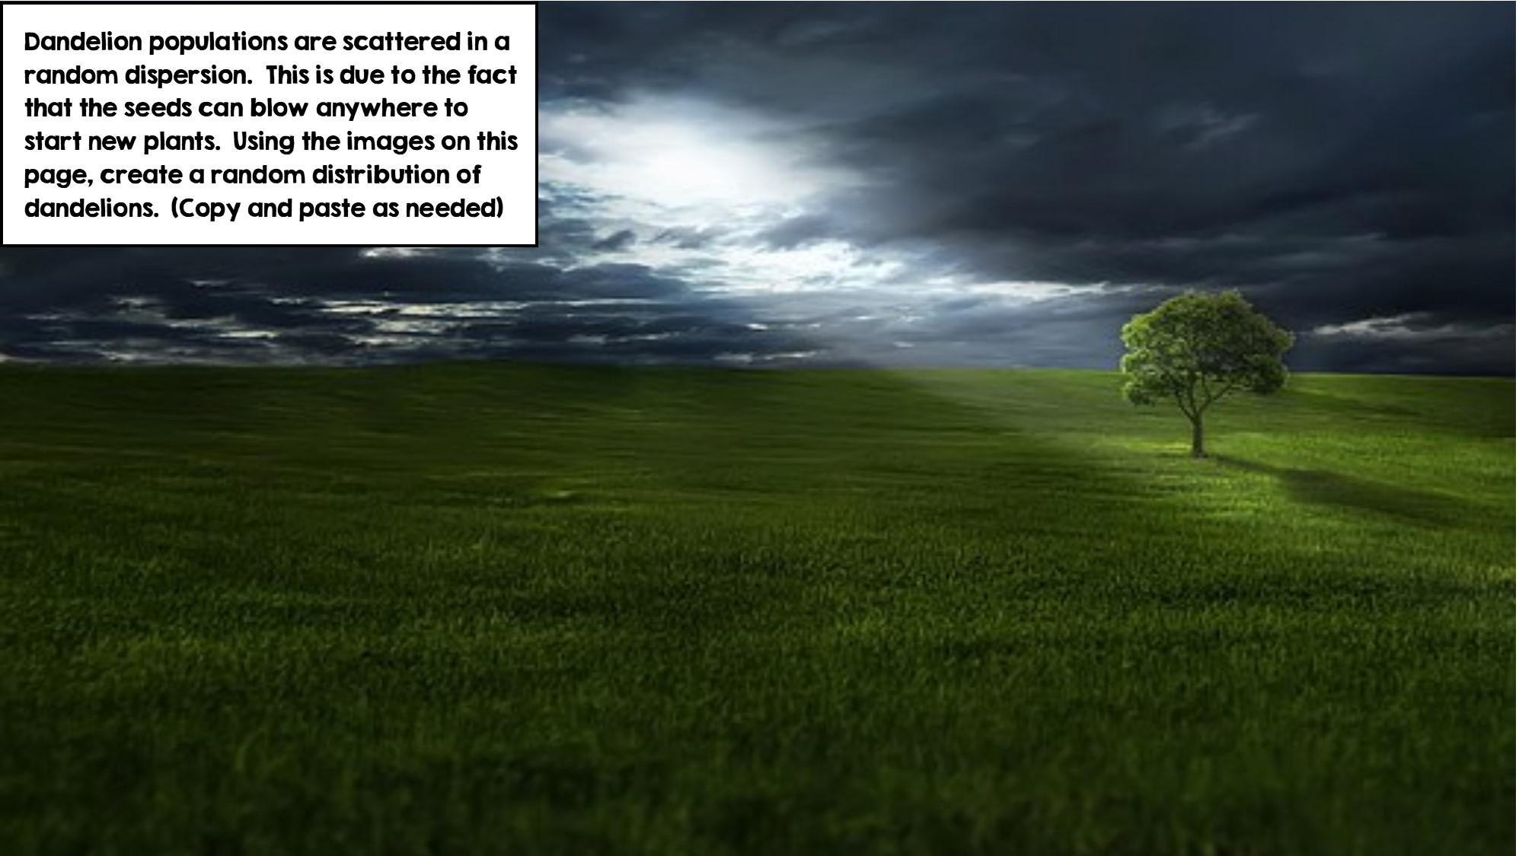
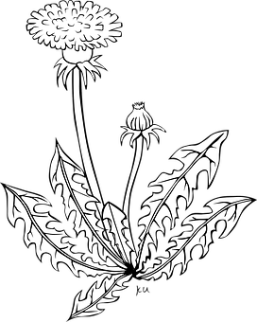

Slide 8
