Slide 1
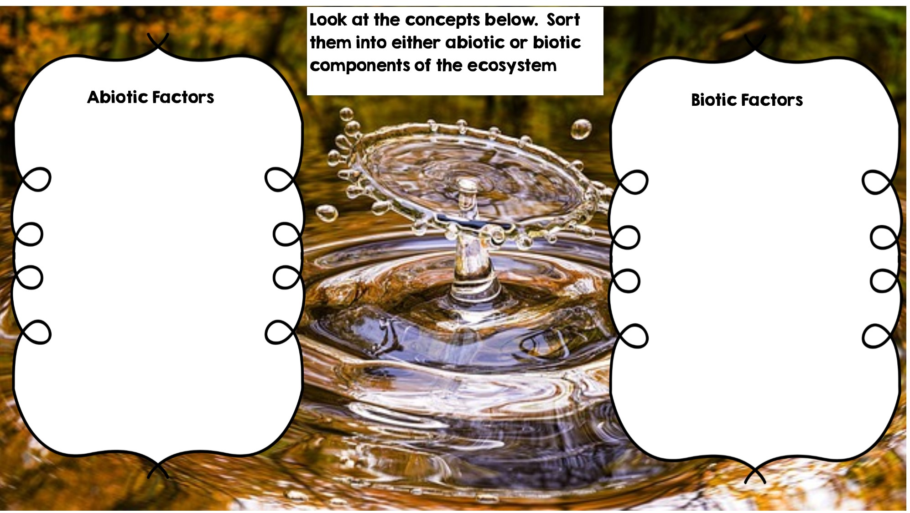
Temperature
Frog
Rocks
Fox
Flowers
Water
Rotting Log
Sunlight
Dead Animal
Grass
Deer

Slide 2
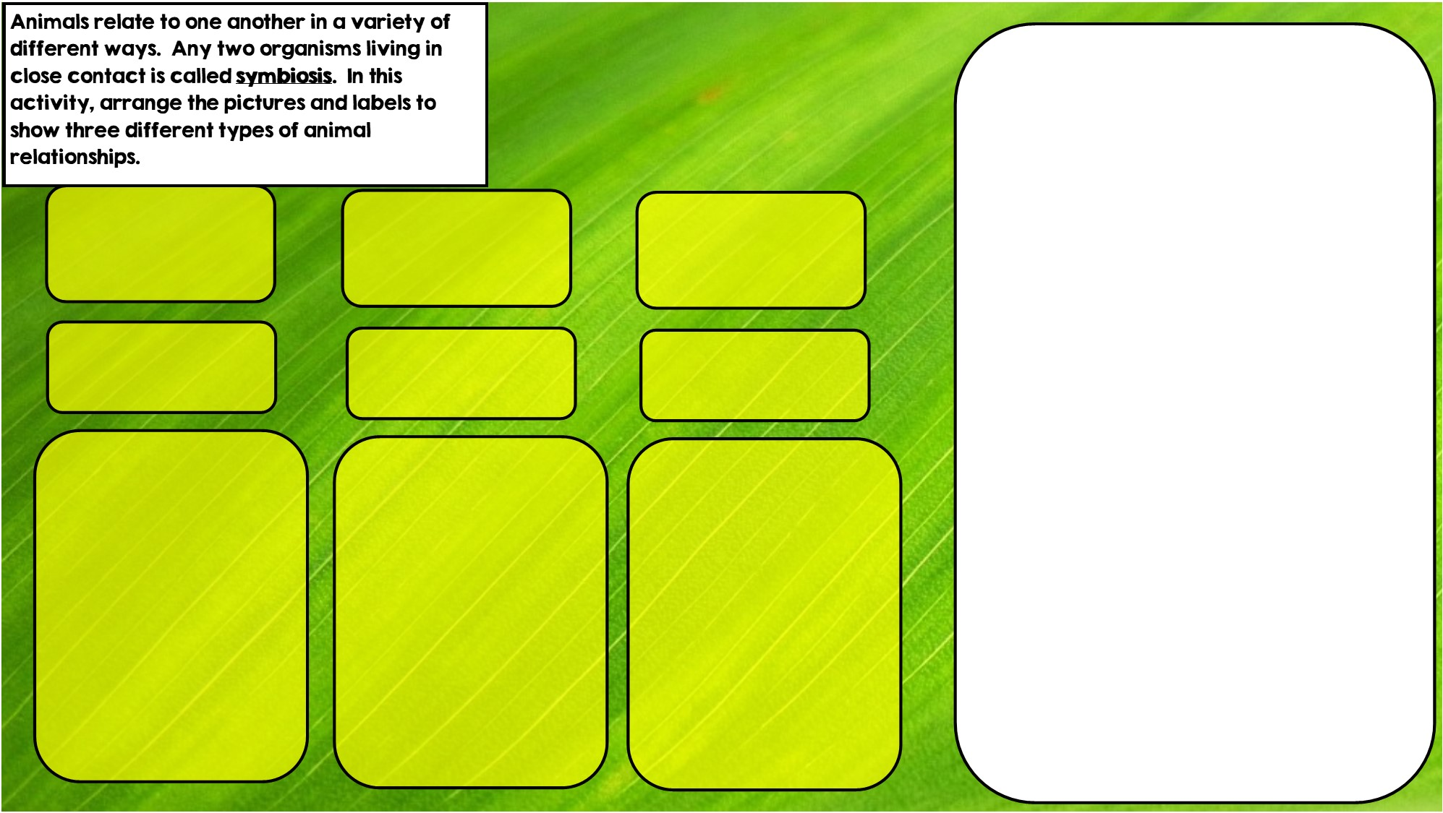

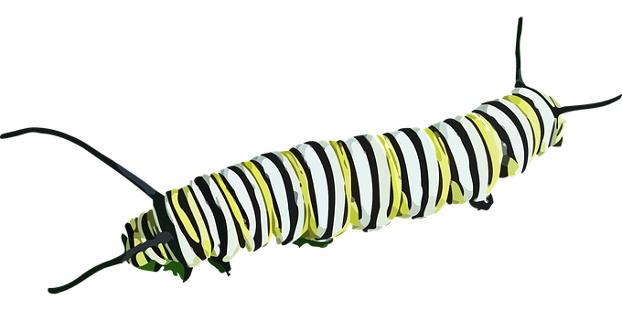


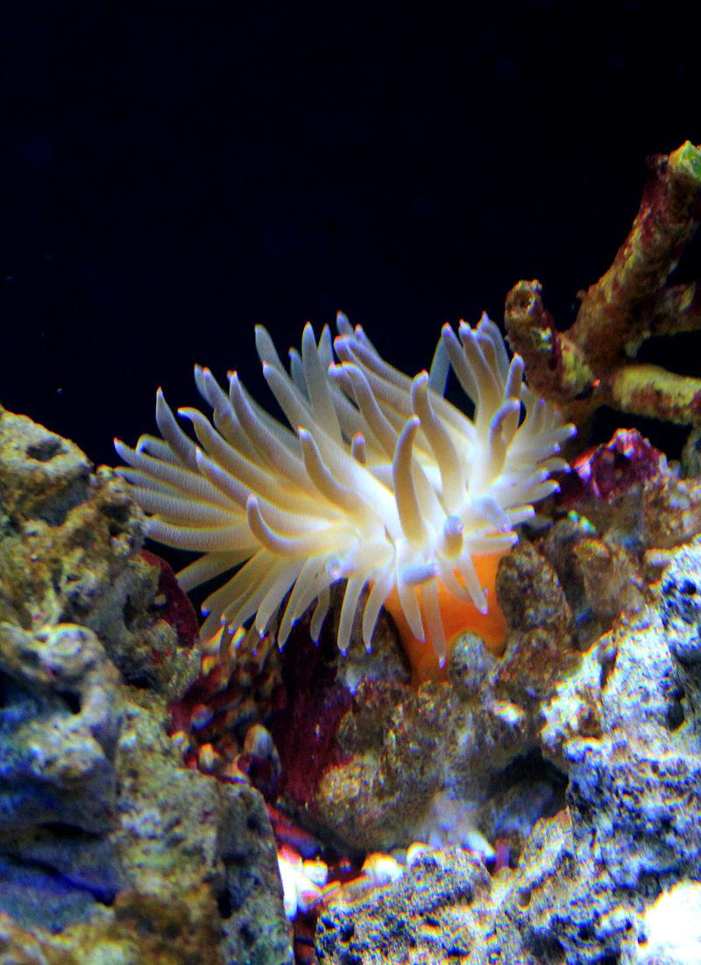
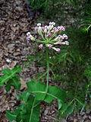
Hint: I eat toxic leaves
Commensalism is where one organism benefits and doesn’t hurt the other.
Parasitism is where one organisms benefits and the other is hurt
Mutualism is where both organisms benefit
Hint: I live in stingers
Hint: I live in intestines

Slide 3
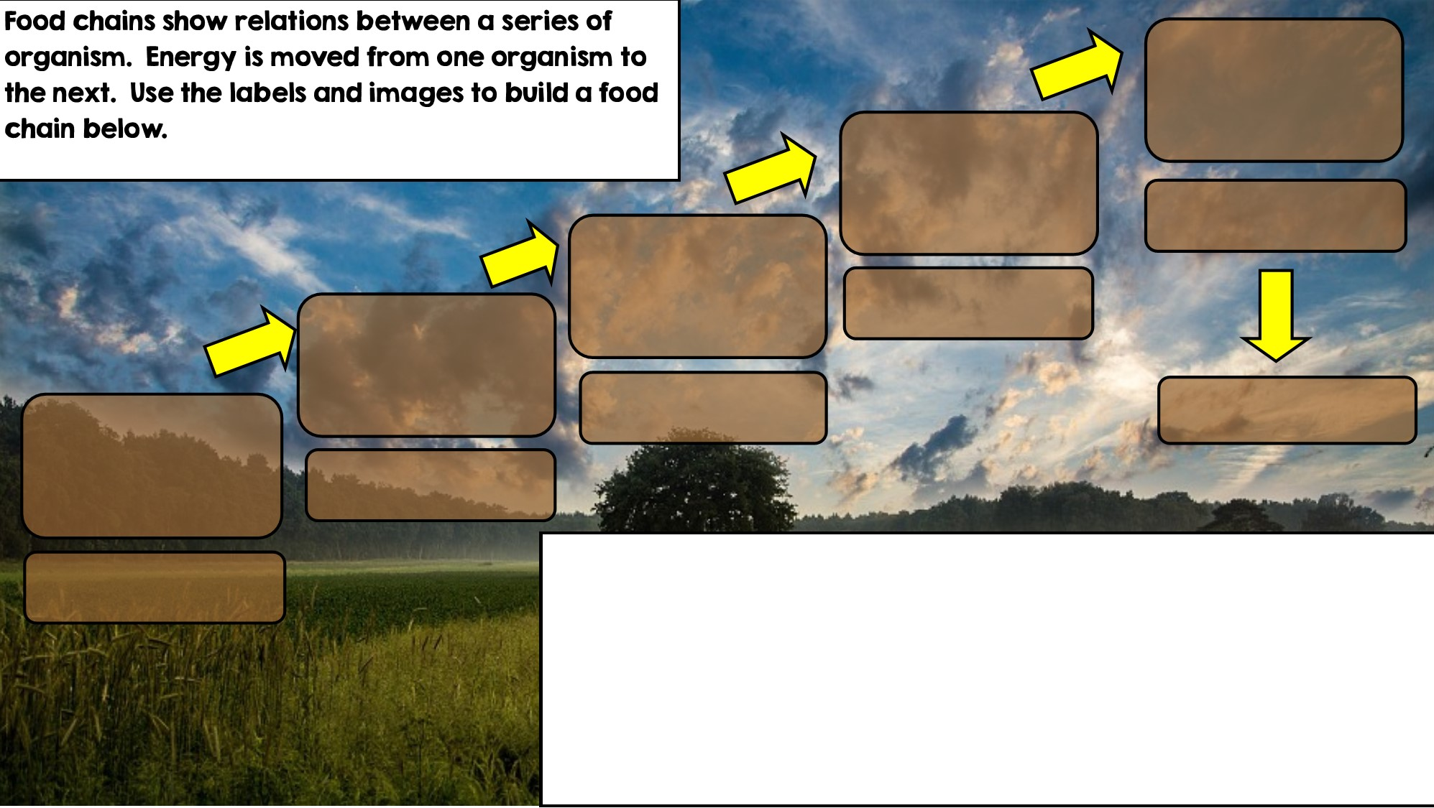

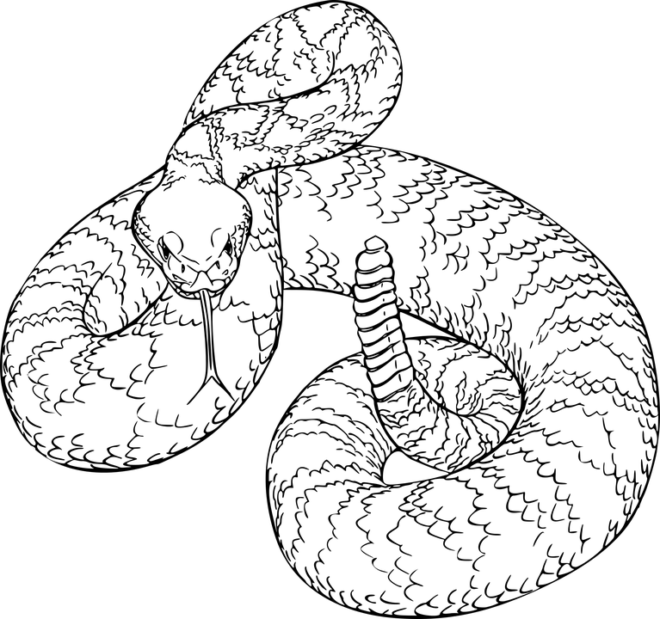
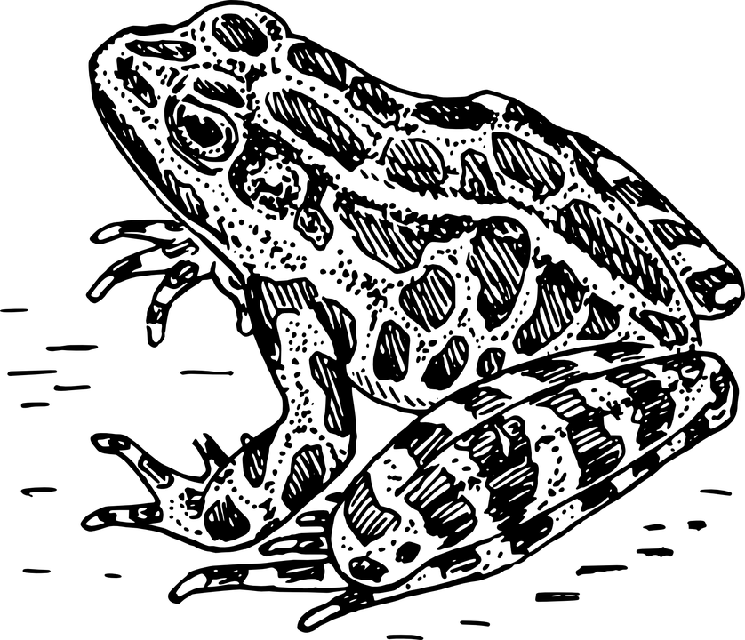
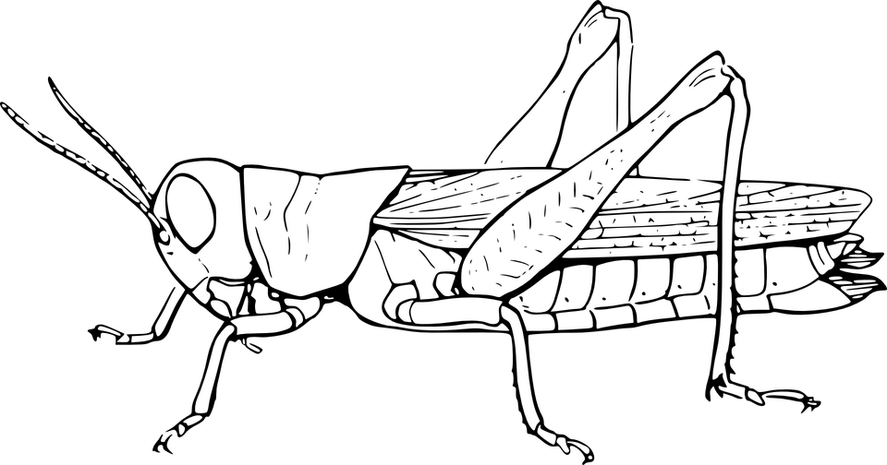

Apex Predator
Tertiary Consumer
Secondary Consumer
Decomposer
Primary Consumer: Heterotroph
Producer: Autotroph

Slide 4
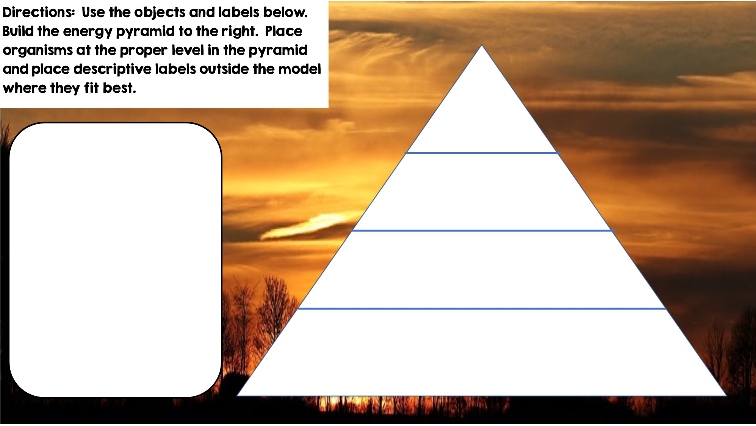

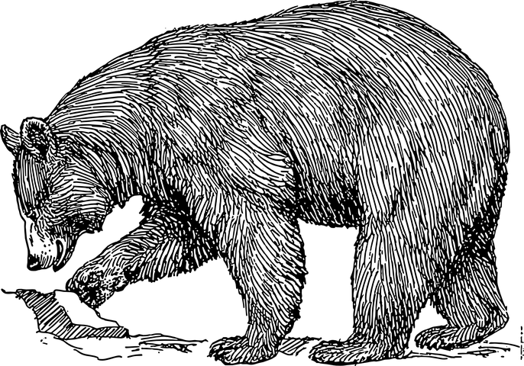


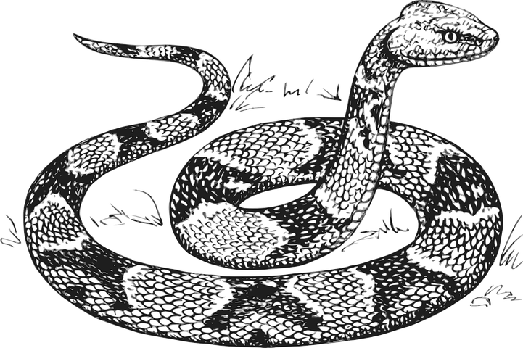

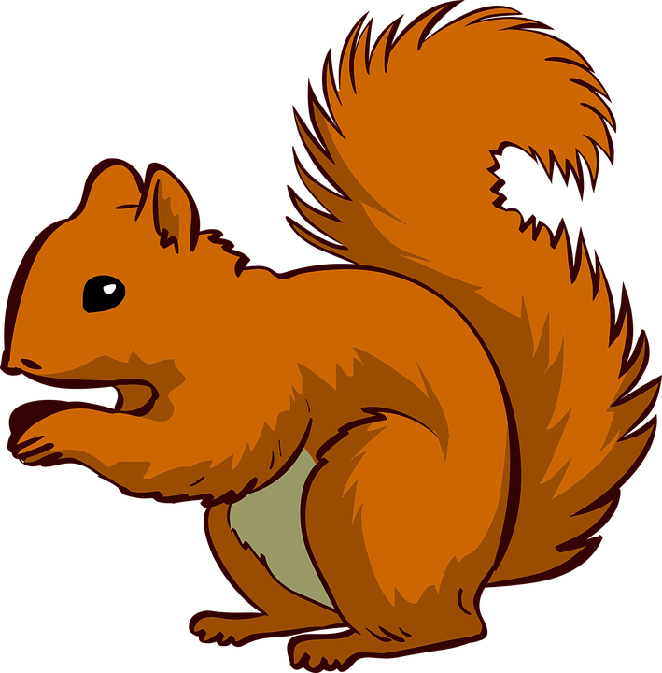




Only 10% of the energy from each tropic level is transferred
Tertiary Consumers
Heterotrophs
Secondary Consumers
Heterotrophs
Primary Consumers
Heterotrophs
Autotrophs
Producers

Slide 5
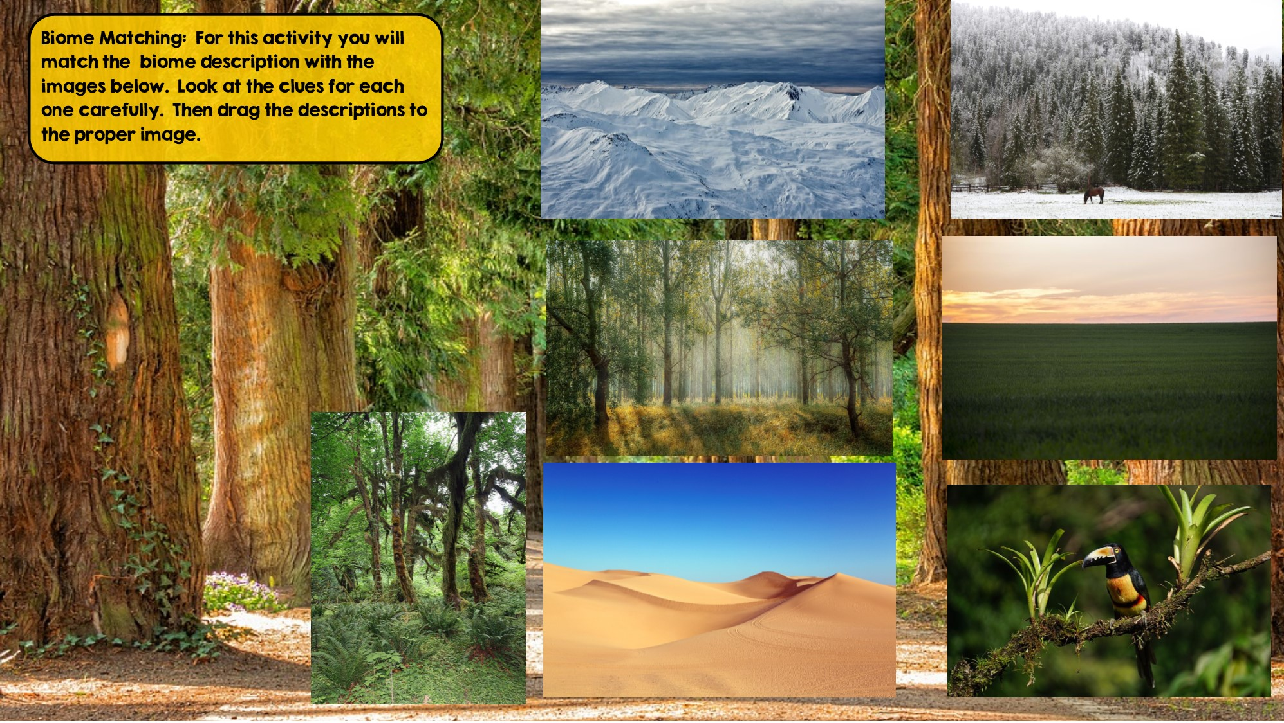
Tundra
Hint: Cold Desert
Taiga
Hint: Snowy Forest
Grassland
Hint: Very few trees grow
Temperate Deciduous Forest Hint: Four distinct seasons
Desert
Hint: little to no water
Temperate Rainforest
Hint: Cool rainforest
Tropical Rainforest:
Hint: Found near equator

Slide 6
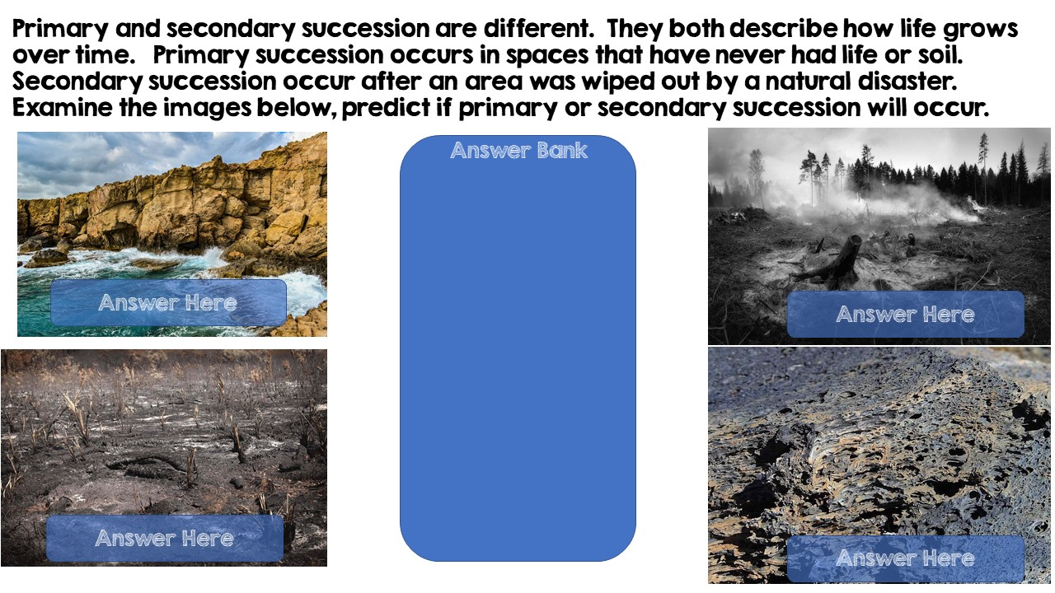
Primary Succession
Primary Succession
Secondary Succession
Secondary Succession

Slide 7
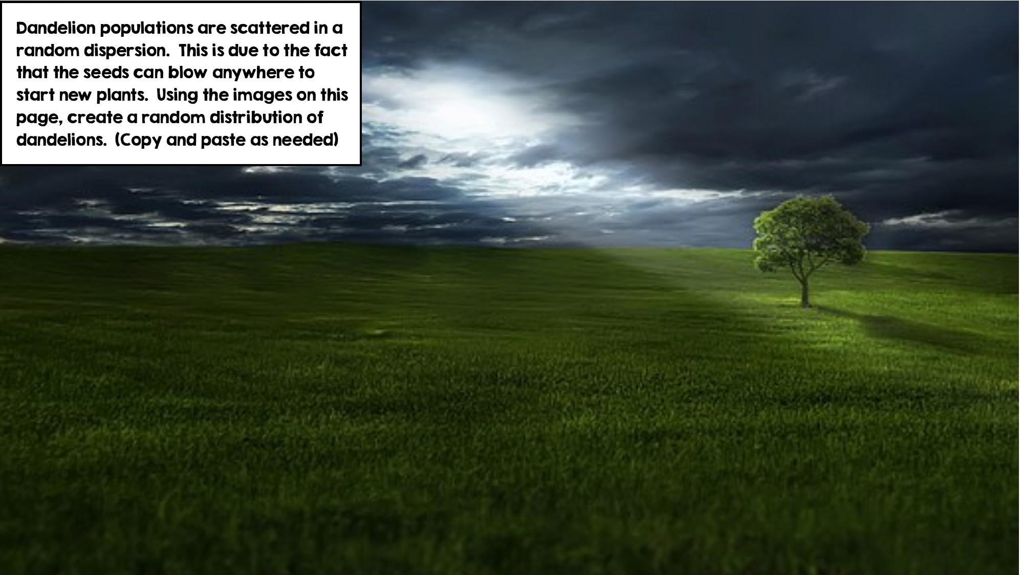
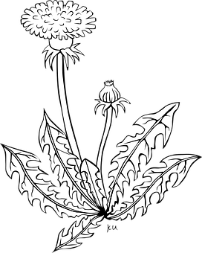

Slide 8
