Slide 1
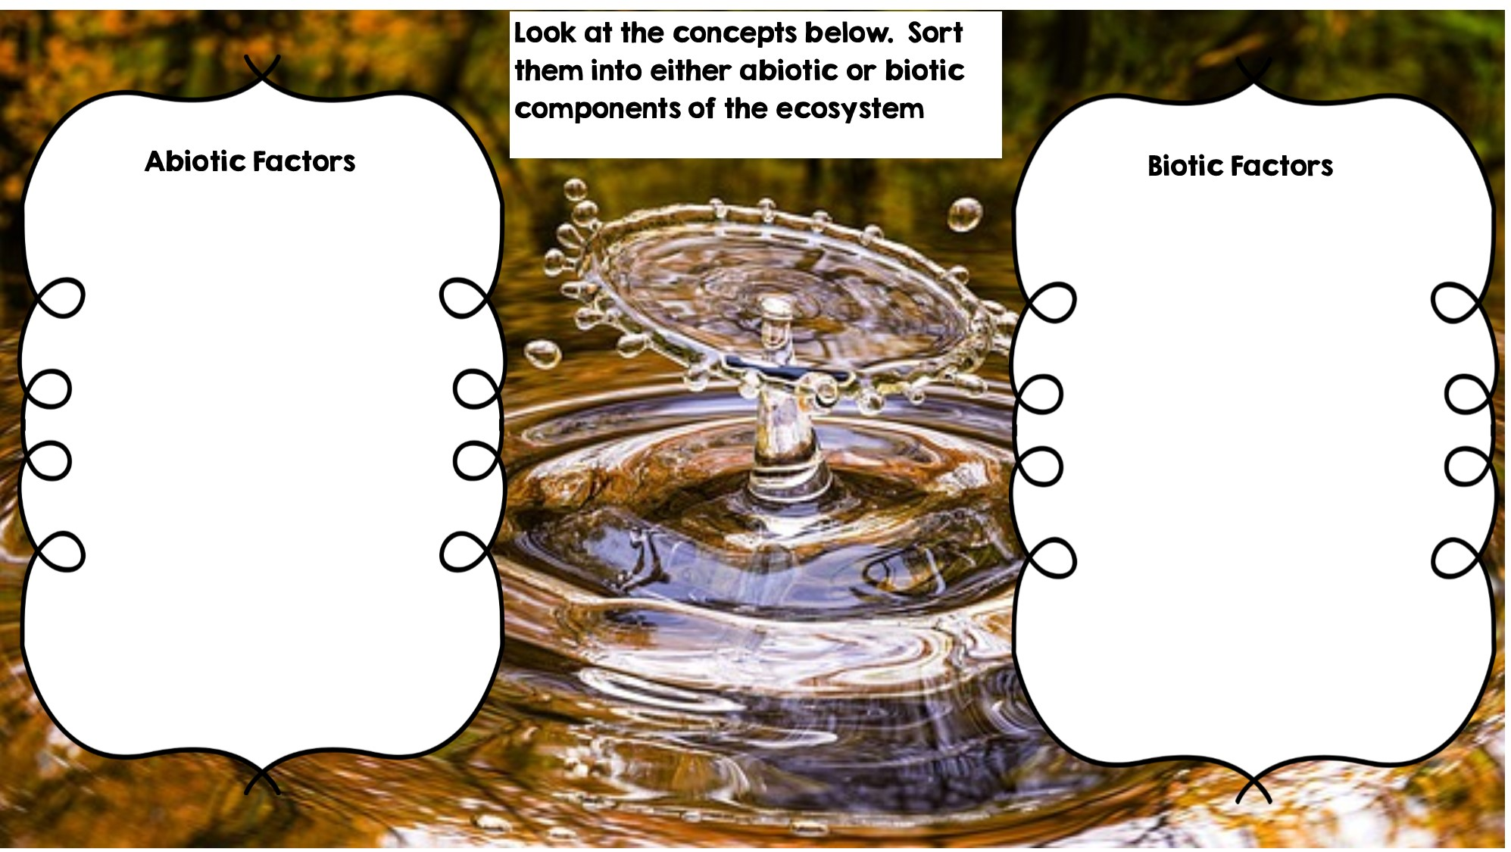
Rocks
Frog
Temperature
Fox
Water
Rotting Log
Sunlight
Deer
Flowers
Dead Animal
Grass

Slide 2
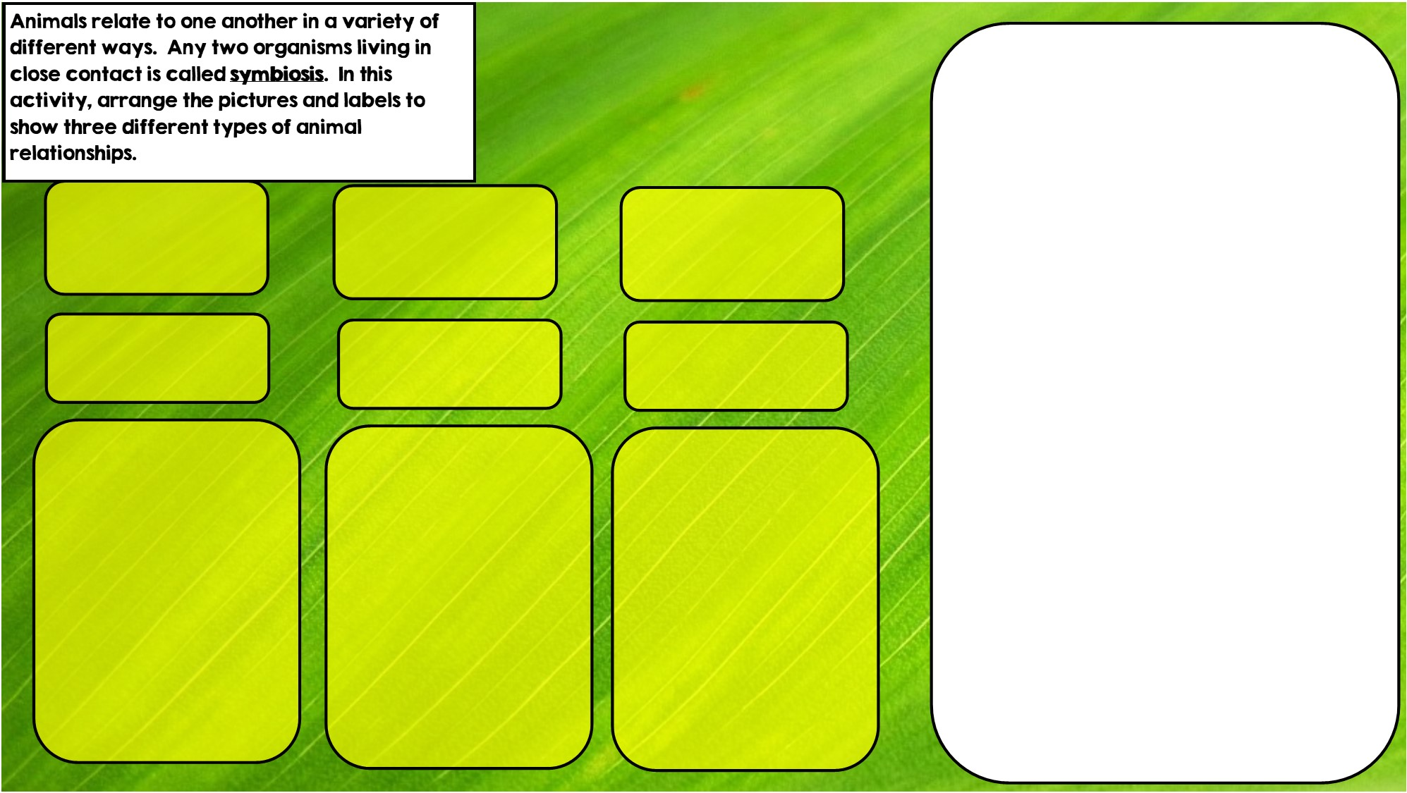
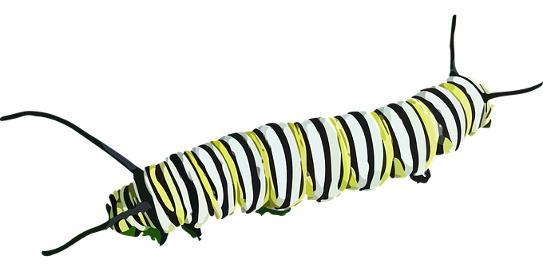


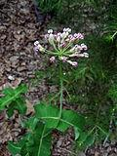
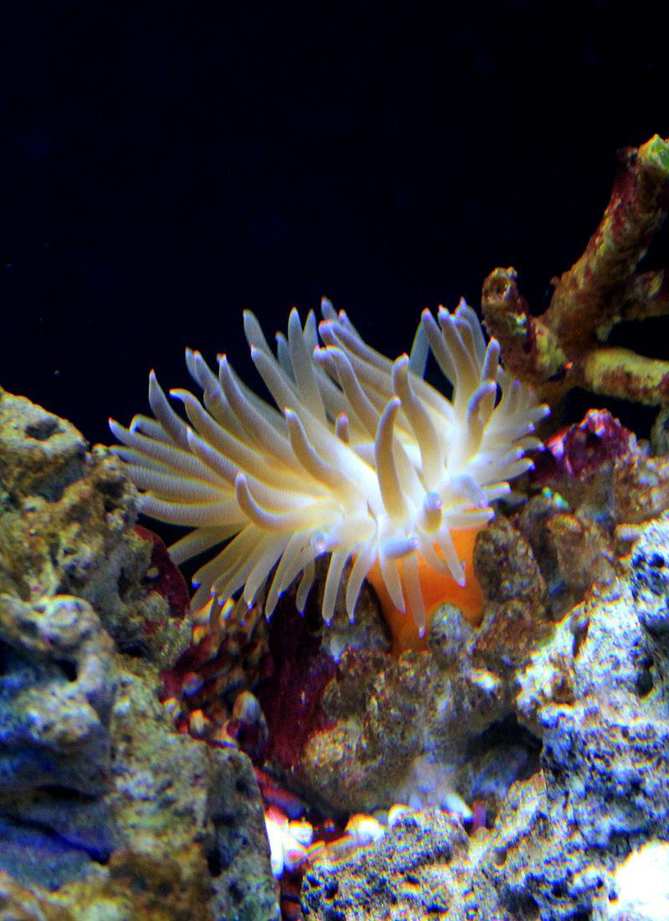

Commensalism is where one organism benefits and doesn’t hurt the other.
Parasitism is where one organisms benefits and the other is hurt
Mutualism is where both organisms benefit
Hint: I eat toxic leaves
Hint: I live in stingers
Hint: I live in intestines

Slide 3
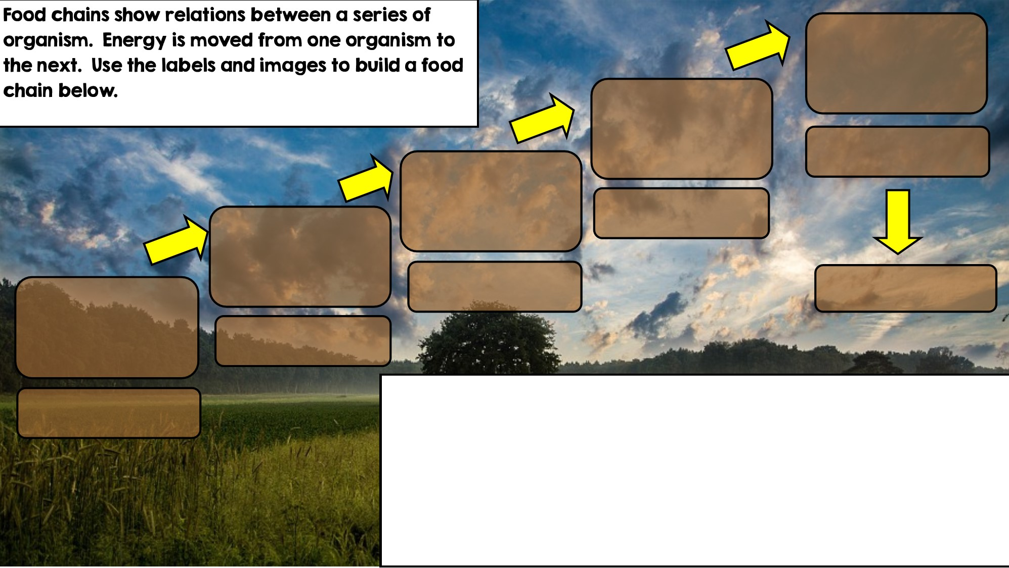

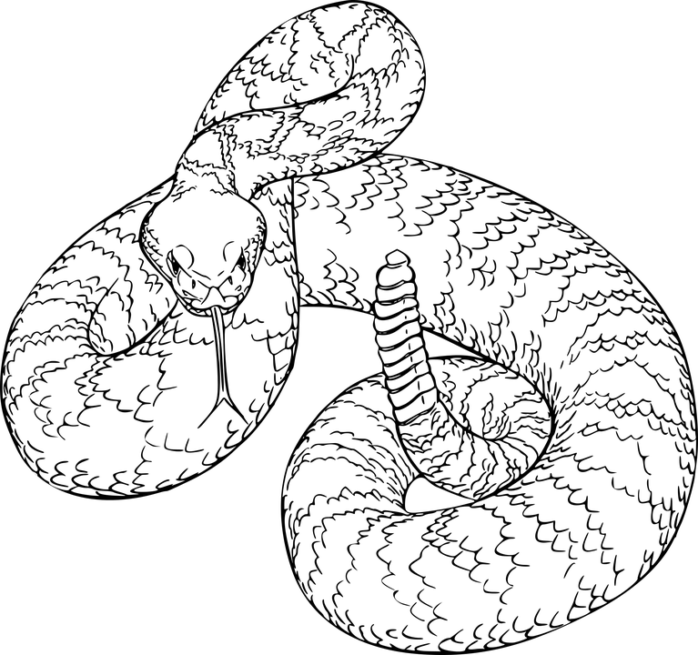
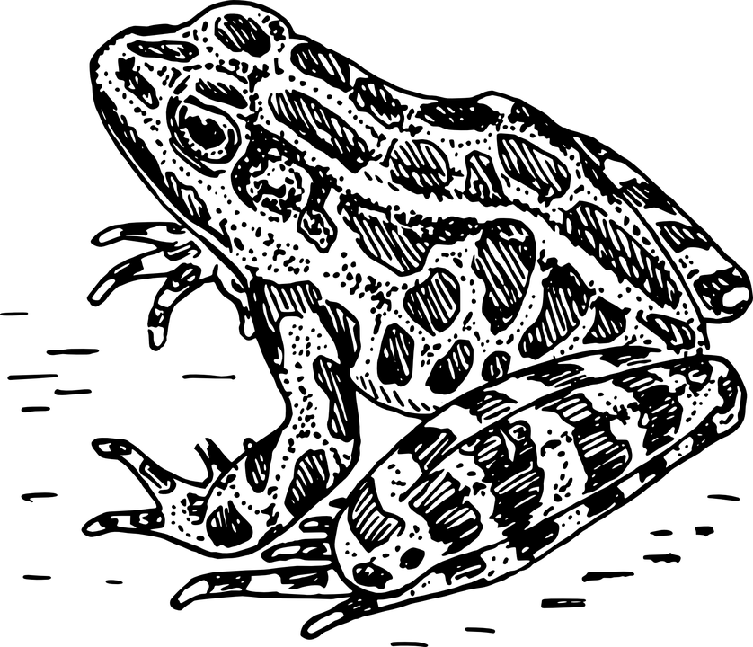
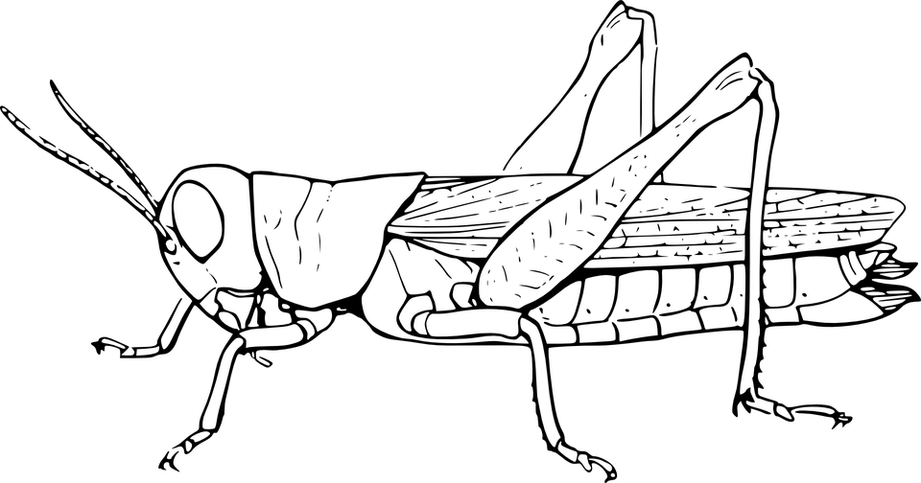

Decomposer
Tertiary Consumer
Secondary Consumer
Apex Predator
Primary Consumer: Heterotroph
Producer: Autotroph

Slide 4
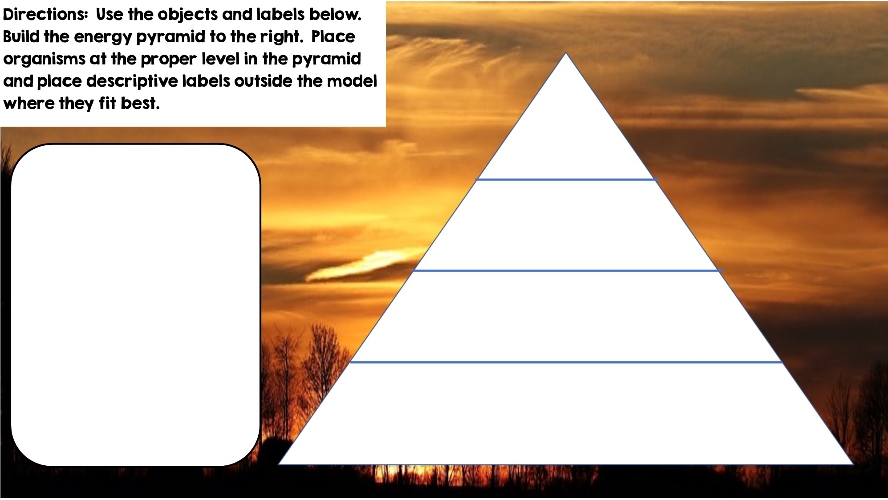
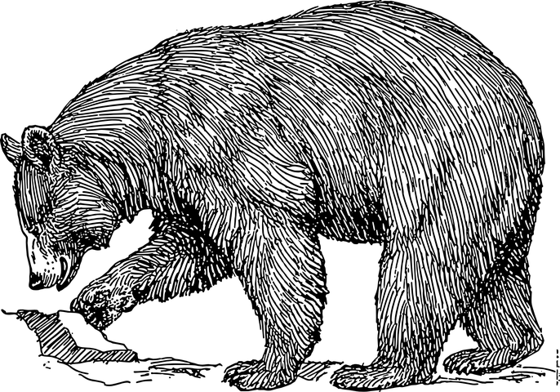
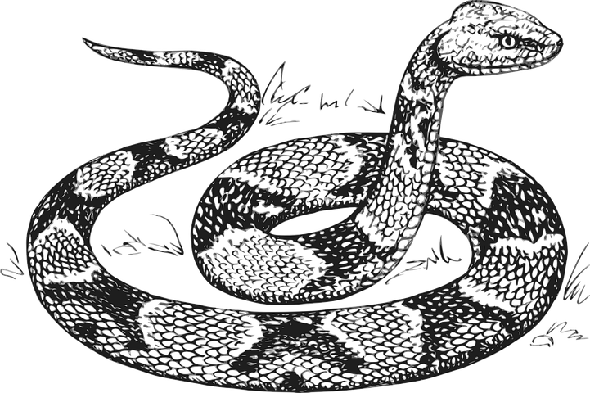


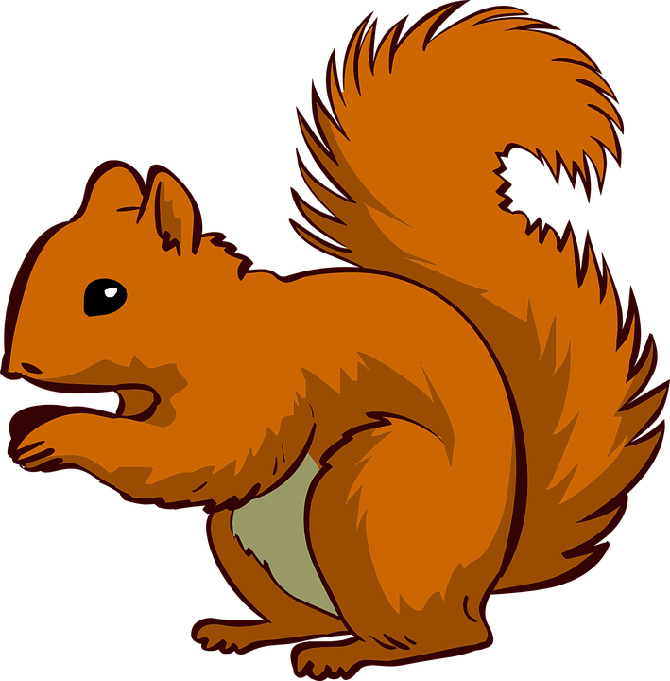






Only 10% of the energy from each tropic level is transferred
Tertiary Consumers
Heterotrophs
Secondary Consumers
Heterotrophs
Primary Consumers
Heterotrophs
Producers
Autotrophs

Slide 5
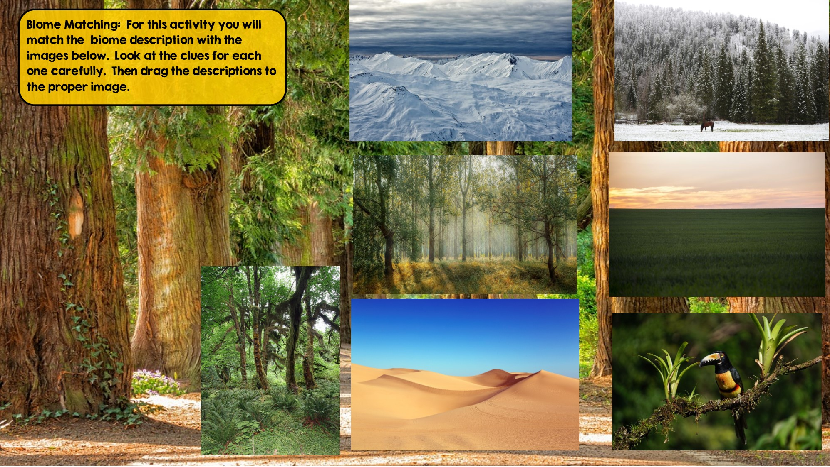
Tundra
Hint: Cold Desert
Taiga
Hint: Snowy Forest
Temperate Deciduous Forest Hint: Four distinct seasons
Grassland
Hint: Very few trees grow
Temperate Rainforest
Hint: Cool rainforest
Tropical Rainforest:
Hint: Found near equator
Desert
Hint: little to no water

Slide 6
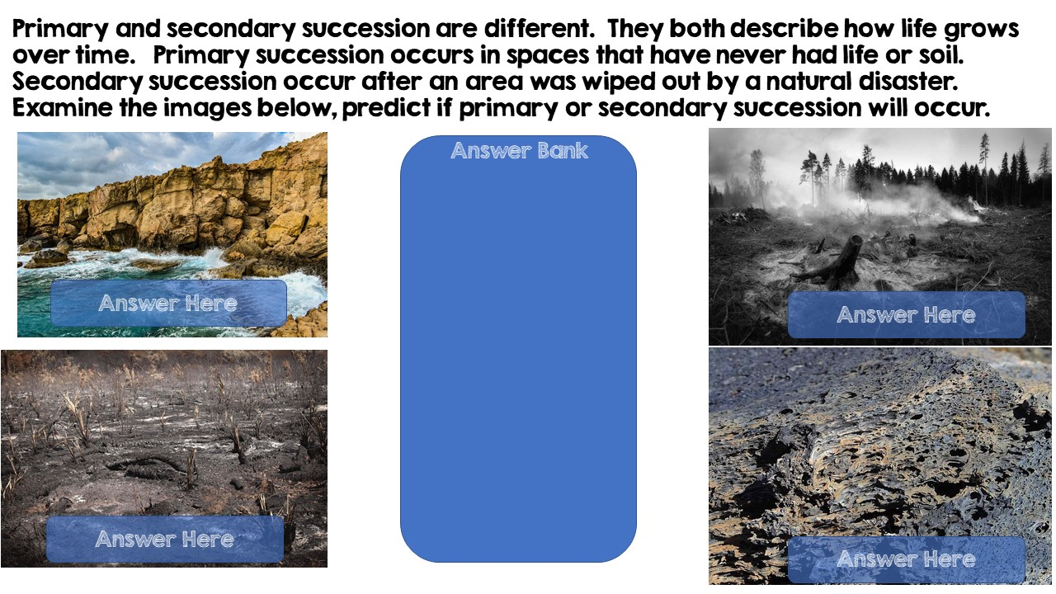
Primary Succession
Secondary Succession
Secondary Succession
Primary Succession

Slide 7
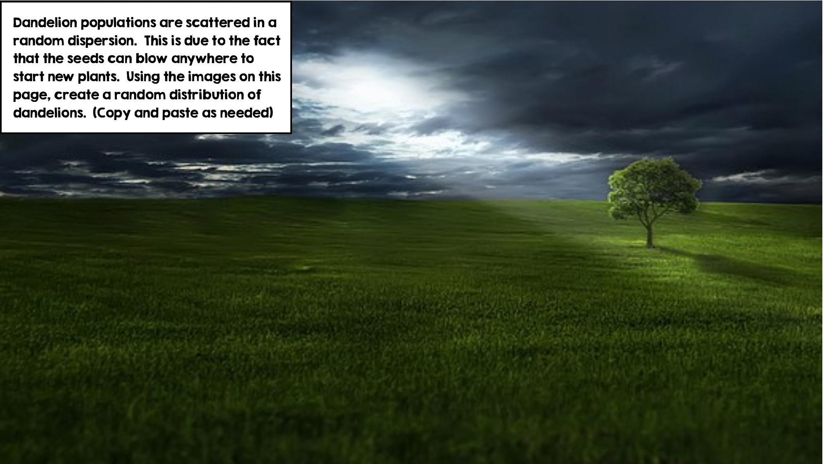
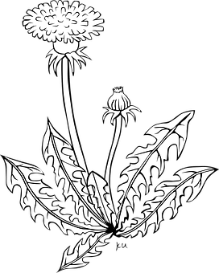

Slide 8
