Slide 1
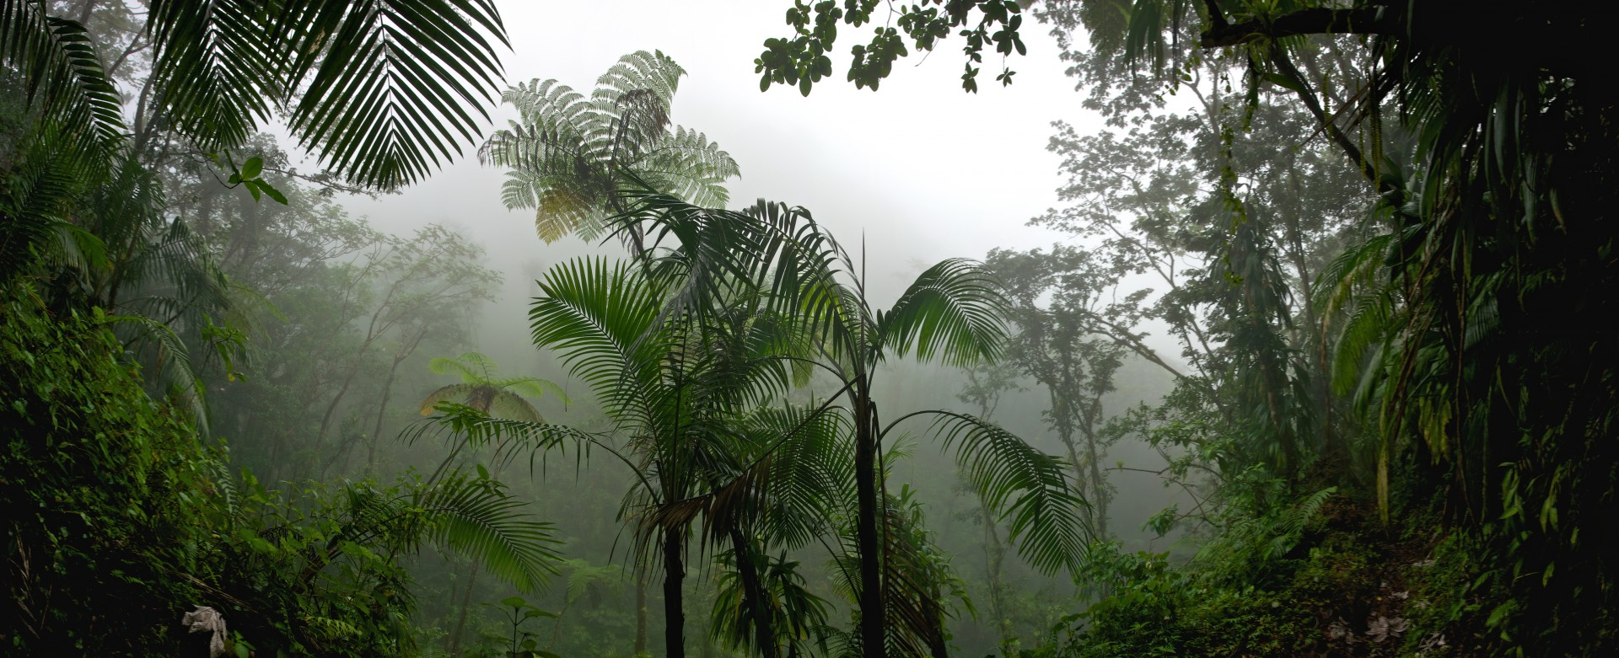
The
Tropical Rainforest
Notes:
1-Each slide have a different background
1-Each slide have pictures
1-Each slide have transitions (information slides in, rotates, etc.)
This slide needs a transition.

Slide 2
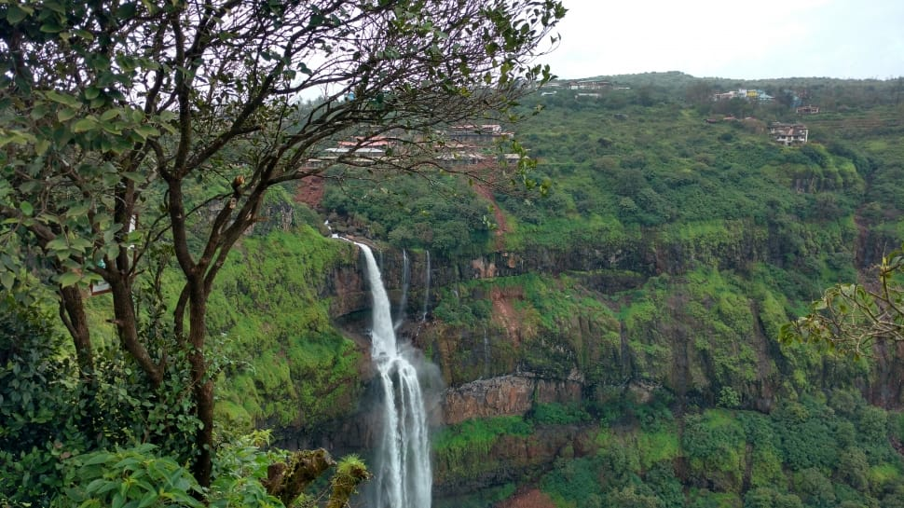
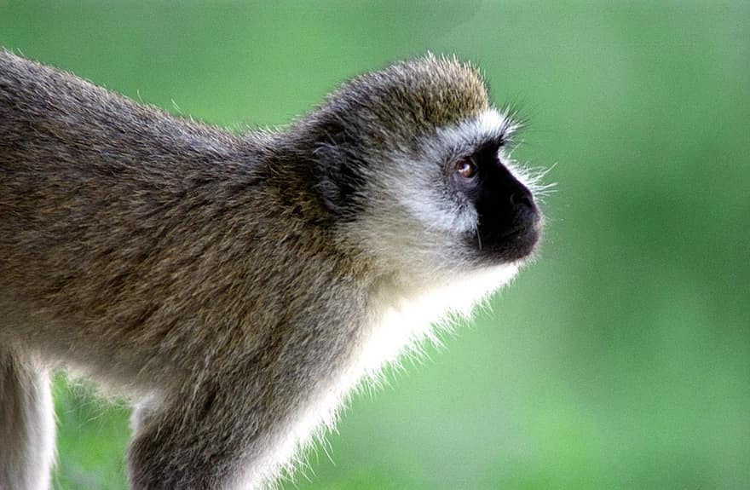
What is The Tropical Rainforest like?
Tropical Rainforests are closed canopy forests growing 28 degrees north or south of the equator. They are very wet places, temperatures are uniformly high -between 20c and 35c.
Notes:
1-Each slide have a different background
1-Each slide have pictures
1-Each slide have transitions (information slides in, rotates, etc.)
This slide needs a transition.

Slide 3
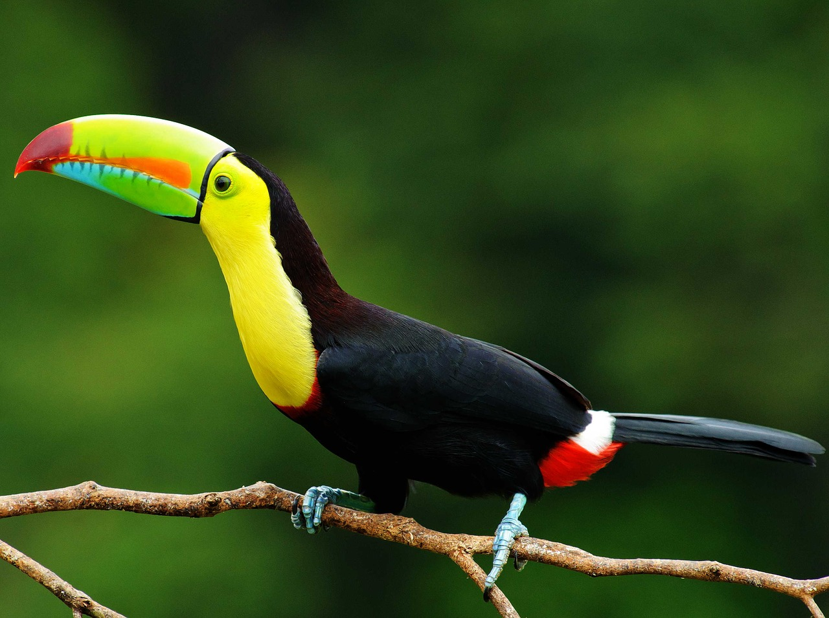
Apaptions for creatures in the Tropical Forest
Many animals have adapted to the unique conditions of the tropical rainforests. The sloth use camouflage and moves very slowly to make it difficult for predators to spot.
Notes:
1-Each slide have a different background
1-Each slide have pictures
1-Each slide have transitions (information slides in, rotates, etc.)
This slide needs a transition. Adaptations is mispelled in the title. Either make the title a sentence with punctuation. Ot capitalize every word.

Slide 4
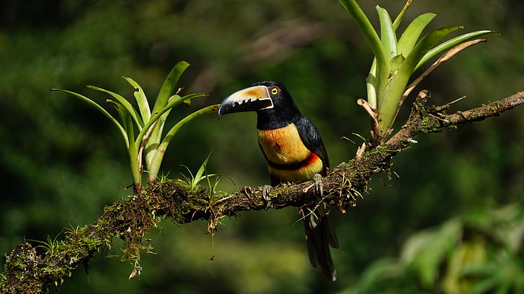
Examples of the Tropical Rainforest Producers
The producers in the Tropical rainforest is Trees, vines, mosses, grasses, tropical fruit trees.
Notes:
1-Each slide have a different background
1-Each slide have pictures
1-Each slide have transitions (information slides in, rotates, etc.)
This slide needs a transition.

Slide 5
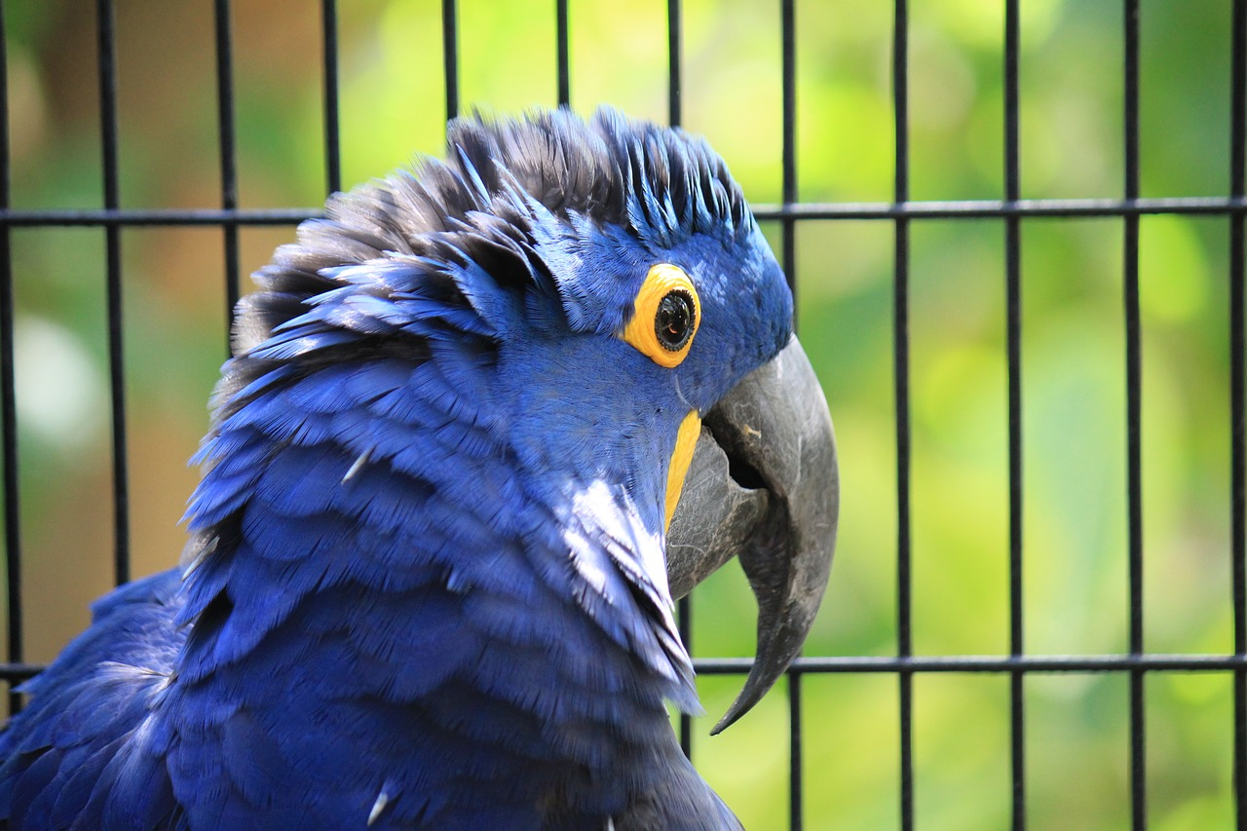
Examples Of Secondary Consumers in The Tropical Rainforest
Secondary consumers in the Tropical rainforest are Tree frogs, the Jaguar, and giant spiders.
Notes:
1-Each slide have a different background
1-Each slide have pictures
1-Each slide have transitions (information slides in, rotates, etc.)
This slide needs a transition.

Slide 6
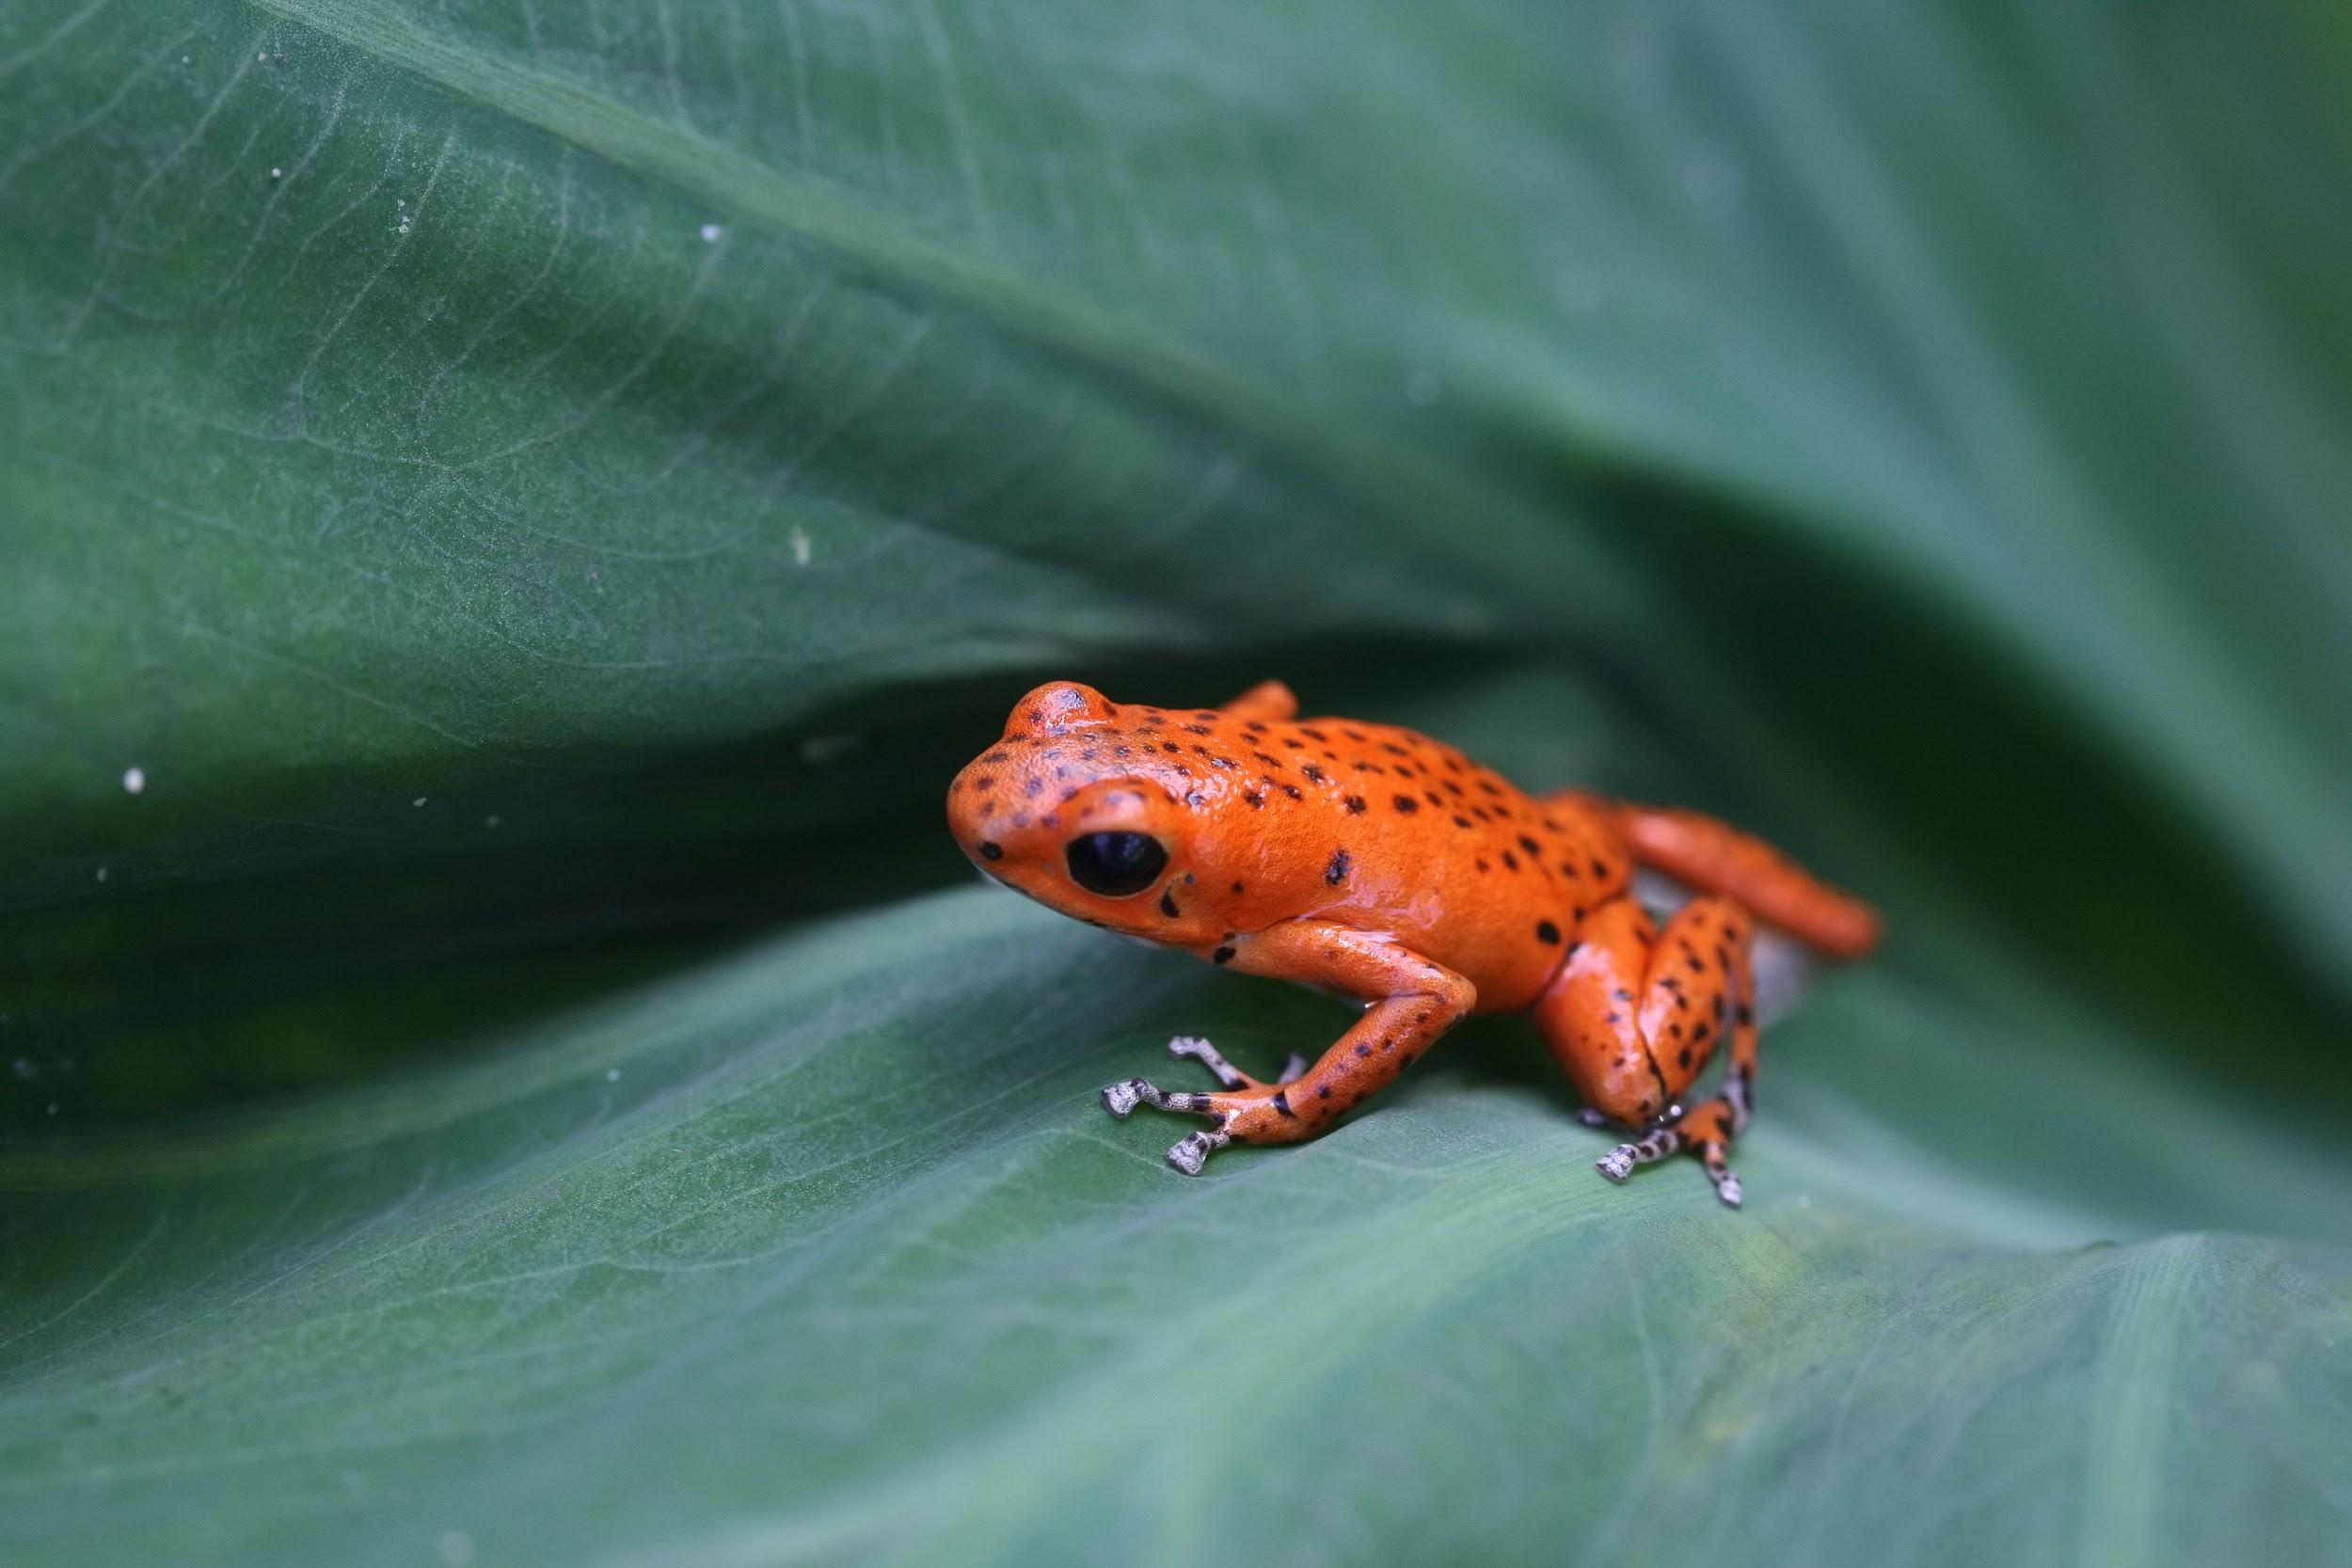
Examples Of Tertiary Consumers
Tertiary consumers in the Tropical rainforest are pumas, crocodiles and dart frogs.
Notes:
1-Each slide have a different background
1-Each slide have pictures
1-Each slide have transitions (information slides in, rotates, etc.)
This slide needs a transition.

Slide 7
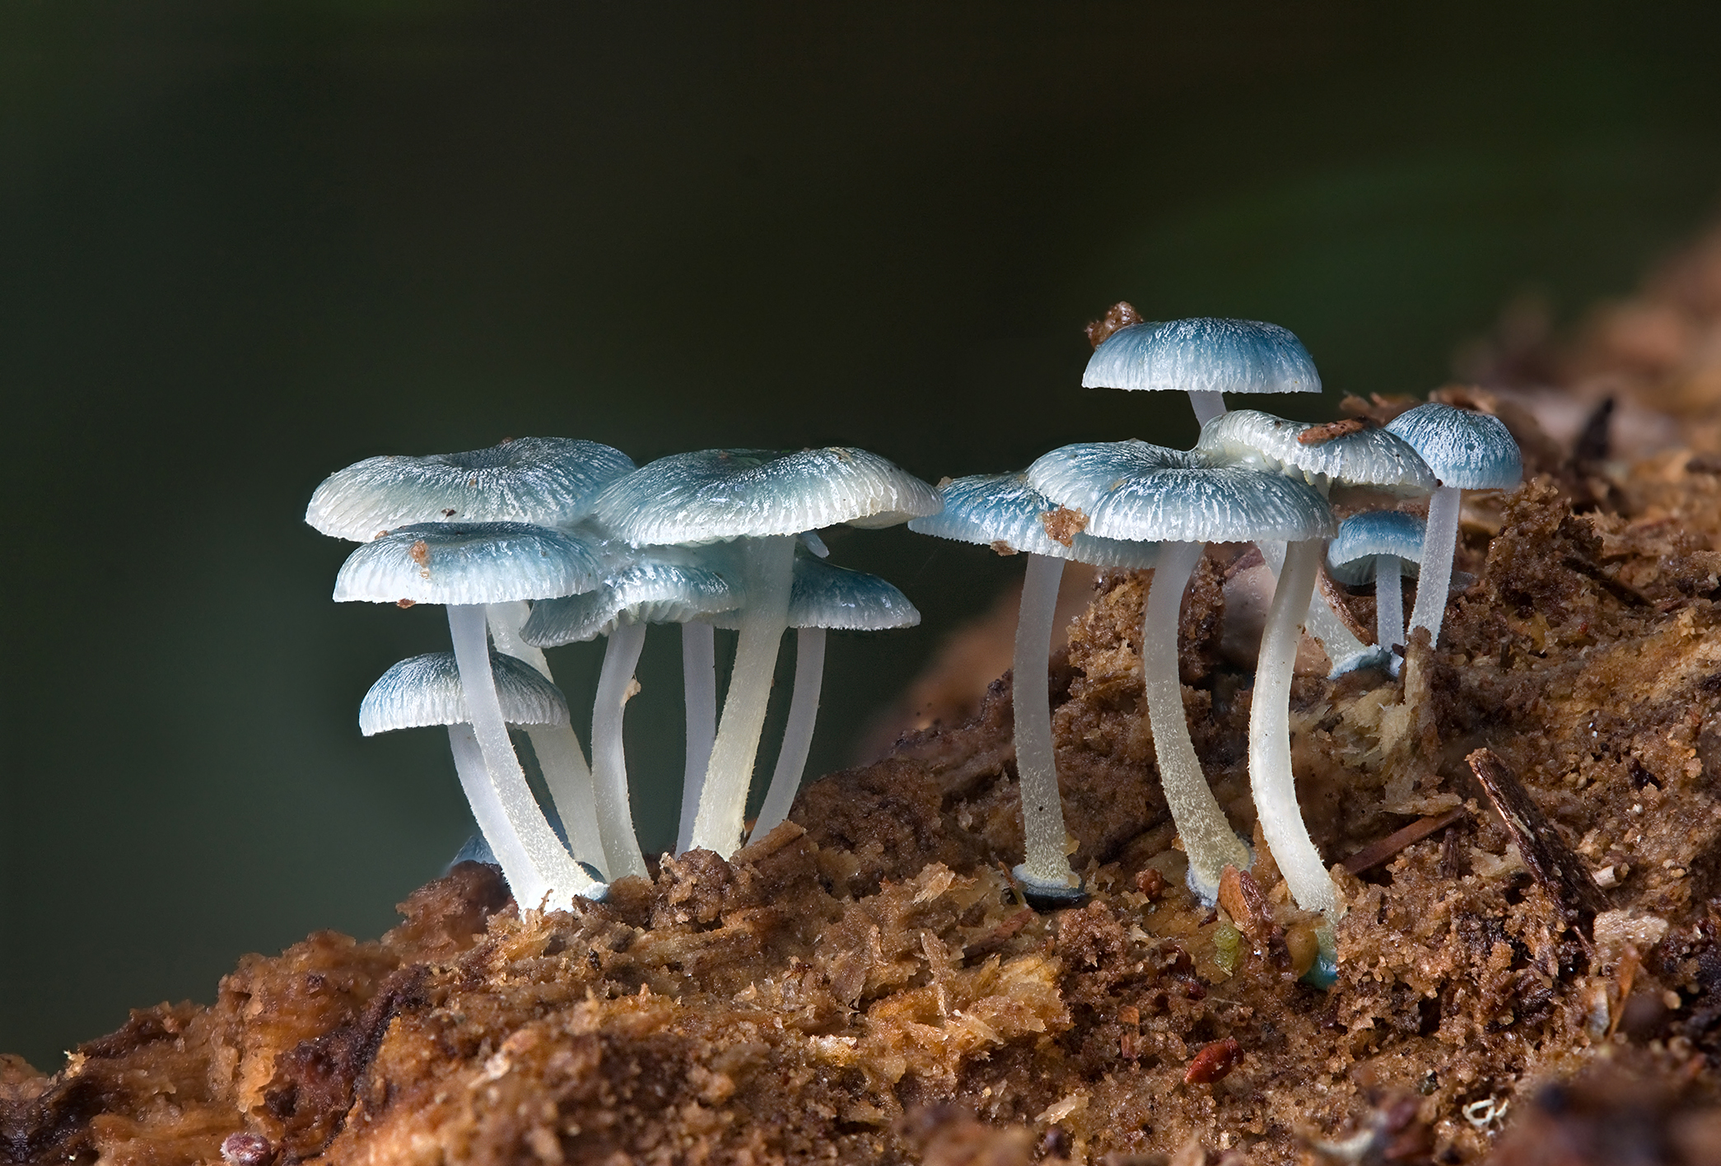
Examples of Decomposers
Decomposers in the Tropical forest are termites, slugs, scorpions, worms, and fungi.
Notes:
1-Each slide have a different background
1-Each slide have pictures
1-Each slide have transitions (information slides in, rotates, etc.)
This slide needs a transition.

Slide 8
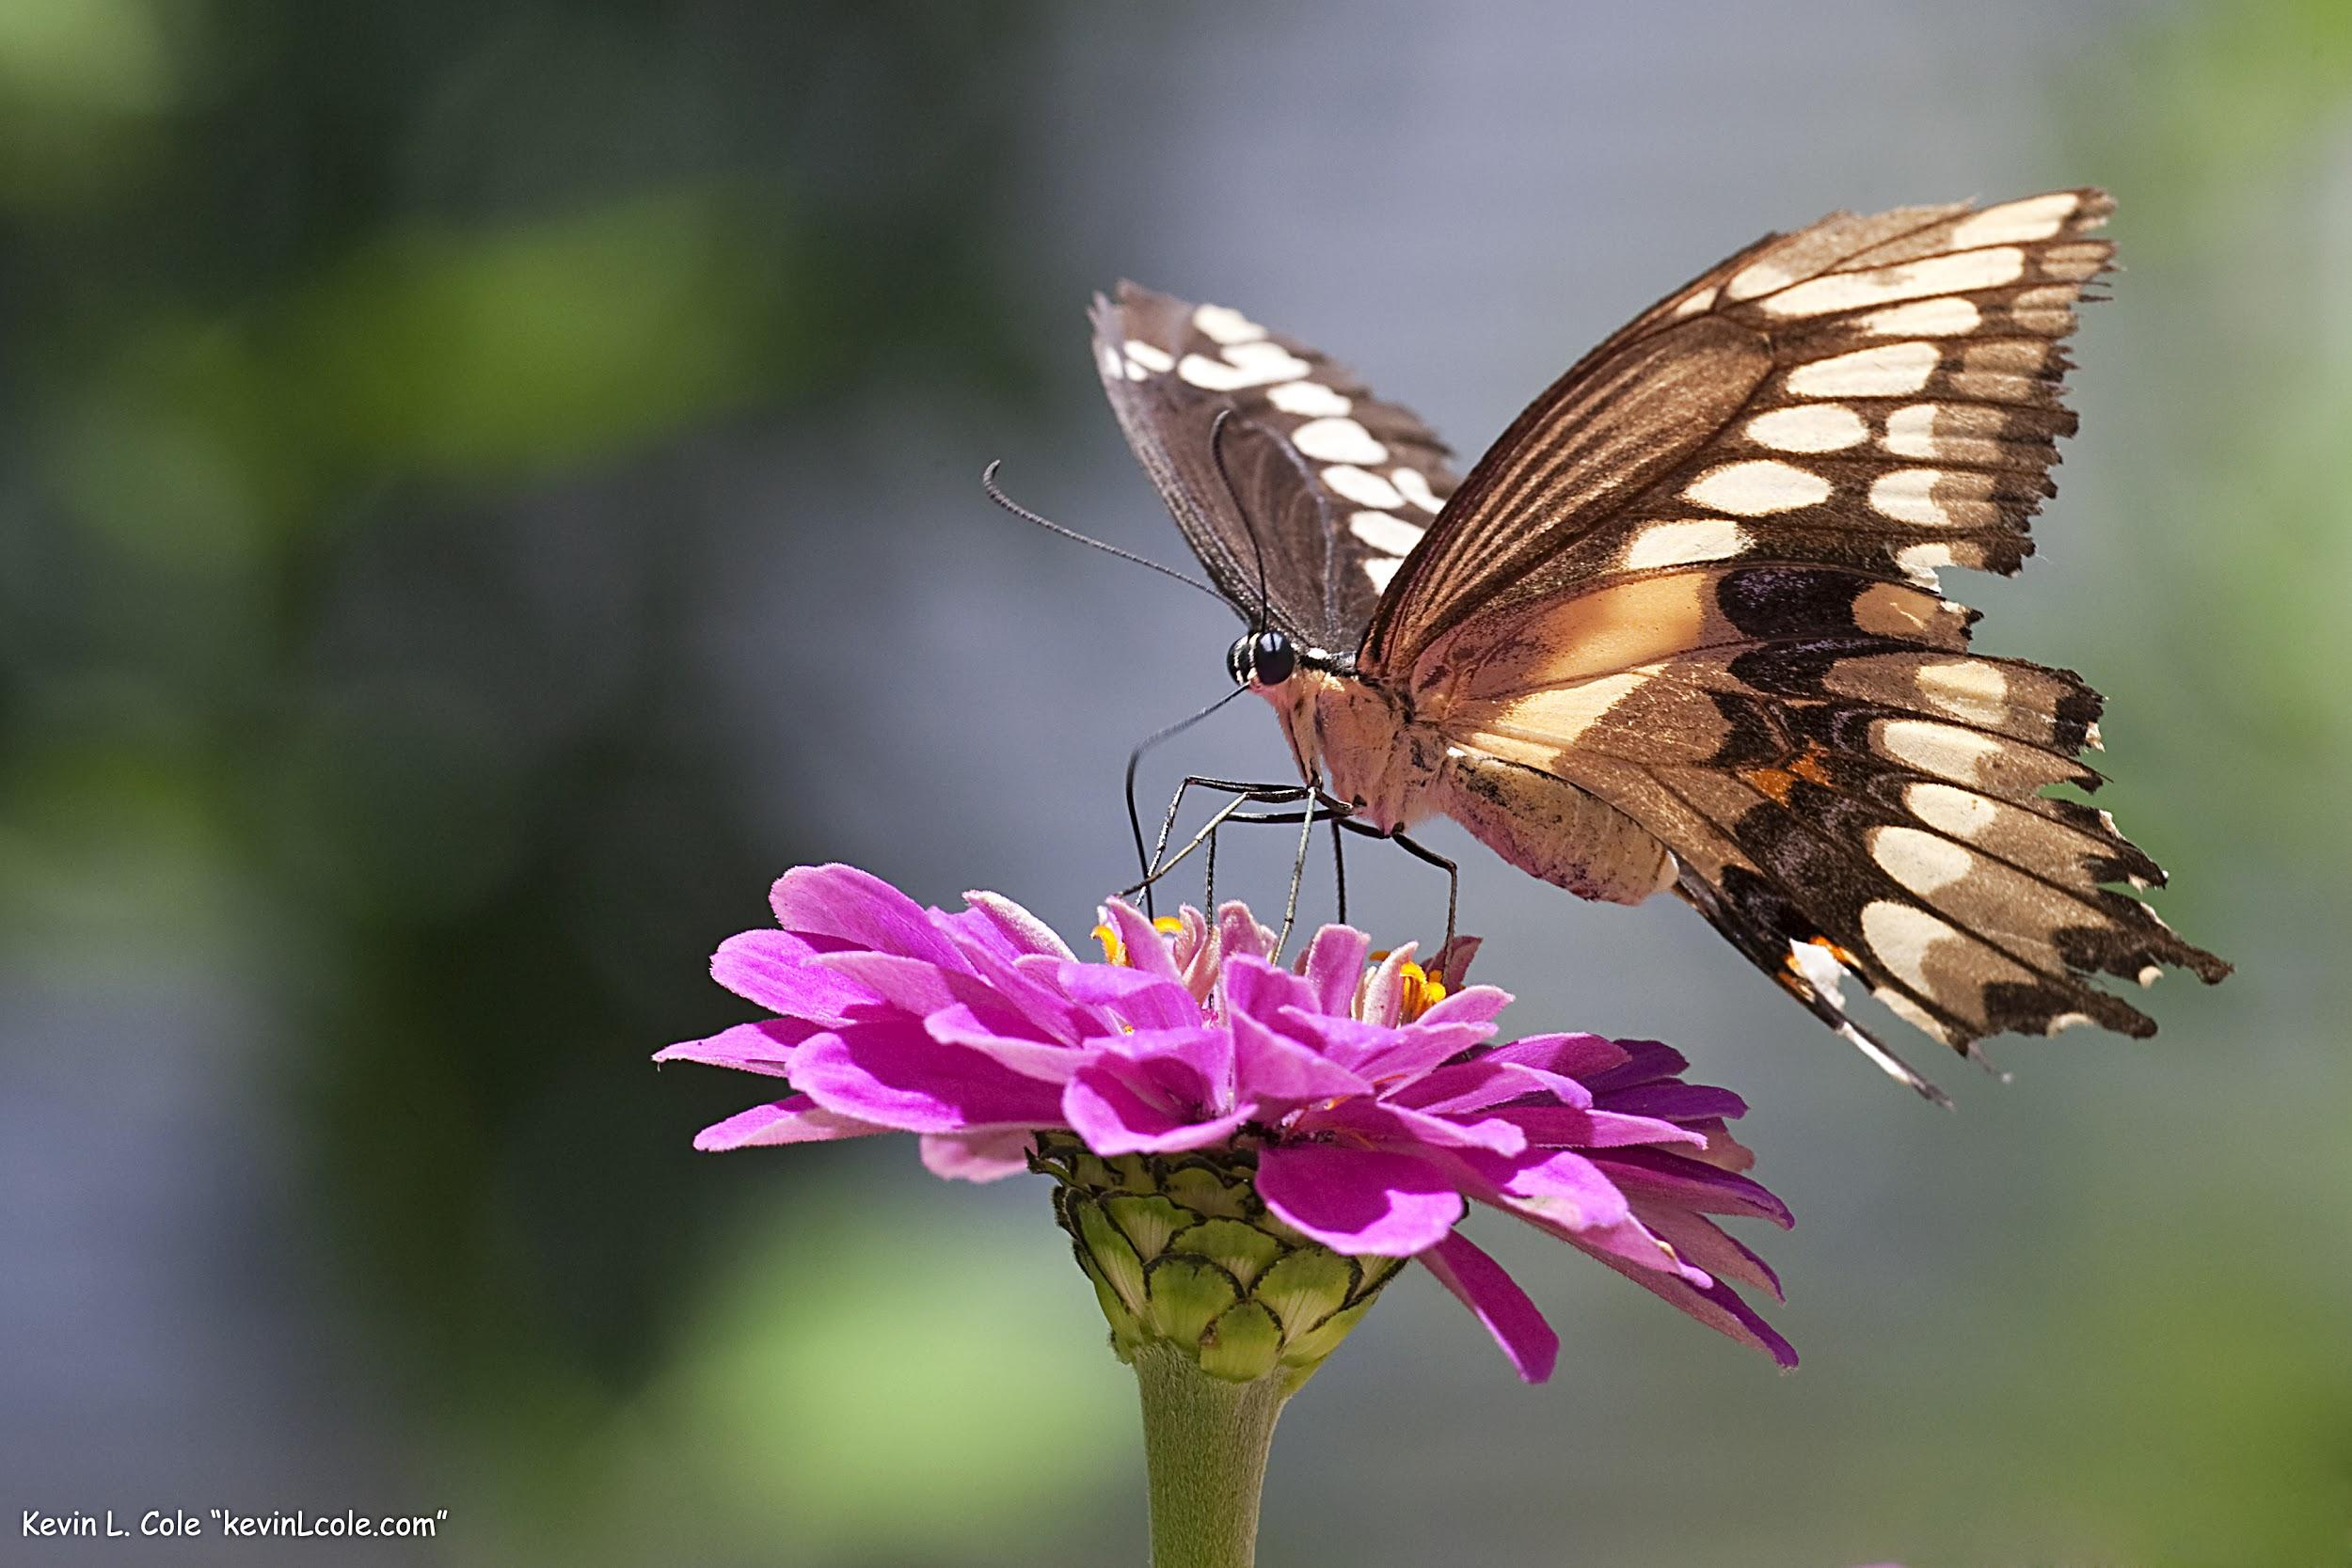
Examples of Mutualism
An example of A mutualism in the Tropical forest is the Monarch butterflies travel in large groups to stay safe.
Notes:
1-Each slide have a different background
1-Each slide have pictures
1-Each slide have transitions (information slides in, rotates, etc.)
This slide needs a transition. The title is hard to read against the background.

Slide 9
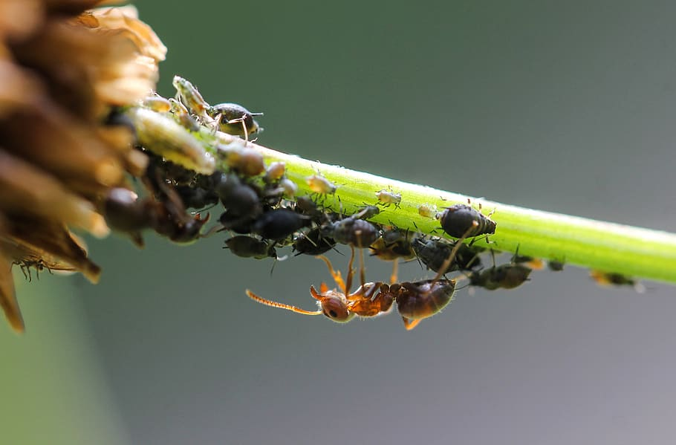
Examples of Commensalism
Bugs actually live on and inside sloth's fur and benefits by getting shelter, and also benefit by eating algae that grows on the sloths fur.
Notes:
1-Each slide have a different background
1-Each slide have pictures
1-Each slide have transitions (information slides in, rotates, etc.)
This slide needs a transition.

Slide 10
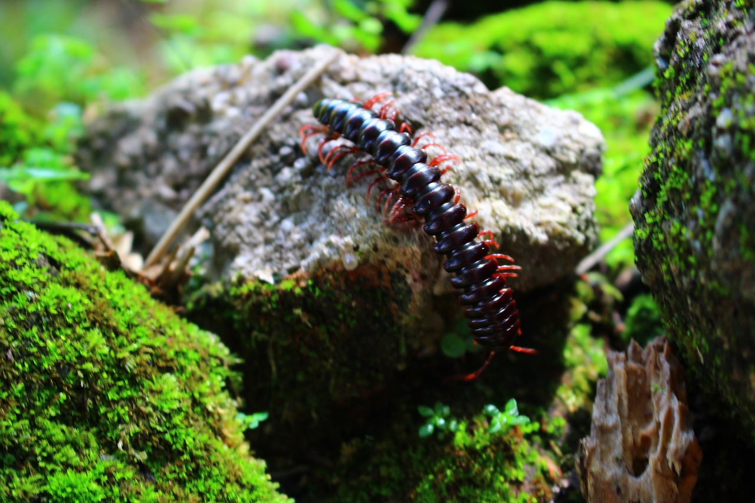
Examples of Parasitism
A Parasitism in the Tropical forest is the roundworms, some of these are notoriously parasitic such as those who live their lives in the animal’s intestinal tract.
Notes:
1-Each slide have a different background
1-Each slide have pictures
1-Each slide have transitions (information slides in, rotates, etc.)
This slide needs a transition.

Slide 11
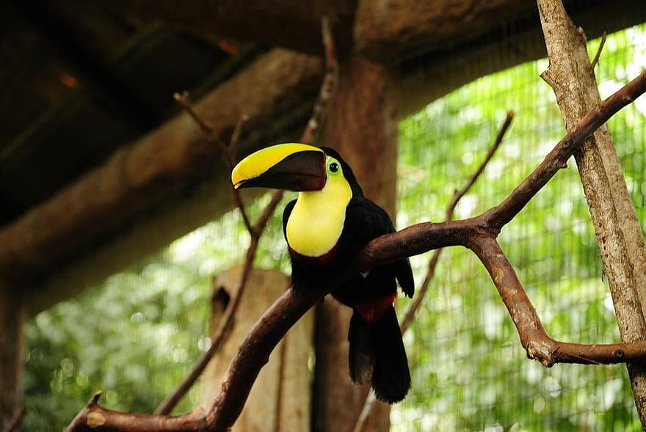
Food Web
A toucan at the bottom consumes the fruit produced by the tree, a primary producer such as a ficus tree, which produces leaves that monkeys eats, and then the monkey is eaten by the harpy eagle.
Notes:
1-Each slide have a different background
1-Each slide have pictures
1-Each slide have transitions (information slides in, rotates, etc.)
This slide needs a transition.

Slide 12
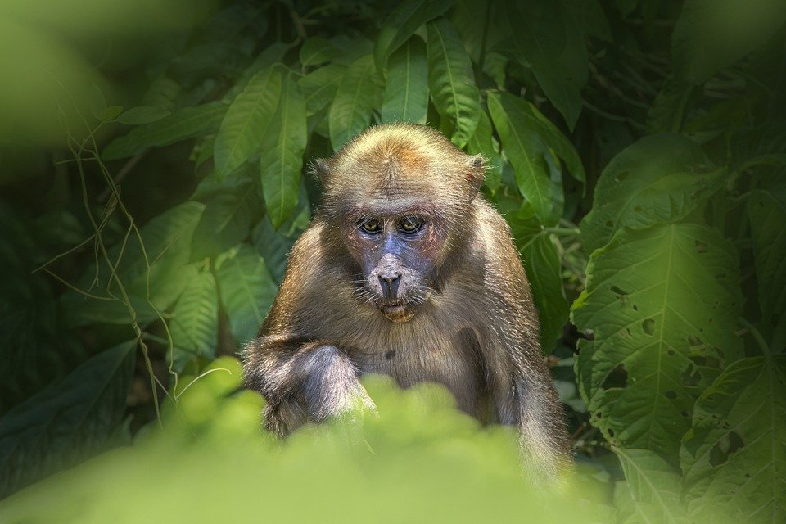
Websites that I used
https://earthobservatory.nasa.gov/biome/biorainforest.php#:~:text=The%20tropical%20rainforest%20is%20a,that%20form%20three%20different%20layers.&text=They%20climb%20trees%20in%20the,trees%2C%20ferns%2C%20and%20palms.
https://www.bioexplorer.net/tropical-rainforest-animal-adaptations.html/
https://www.nationalgeographic.org/encyclopedia/rain-forest/#:~:text=Decomposers%2C%20such%20as%20termites%2C%20slugs,of%20predators%20consume%20the%20decomposers!
https://www.edtechlens.com/blog/rainforest-kids-science-me-ill-you-working-rainforest#:~:text=In%20the%20rainforest%2C%20there%20are,hunt%20together%20to%20find%20food.
Notes:
1-Each slide have a different background
1-Each slide have pictures
1-Each slide have transitions (information slides in, rotates, etc.)
This slide needs a transition.

