Slide 1
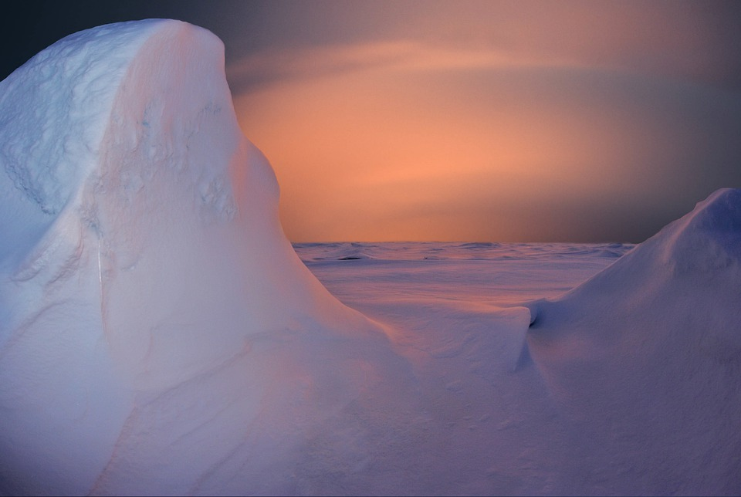
Polar Region
By America Estrada
Notes:
1-Each slide have a different background
1-Each slide have pictures
1-Each slide have transitions (information slides in, rotates, etc.)
Some of the text is hard to read with this background.

Slide 2
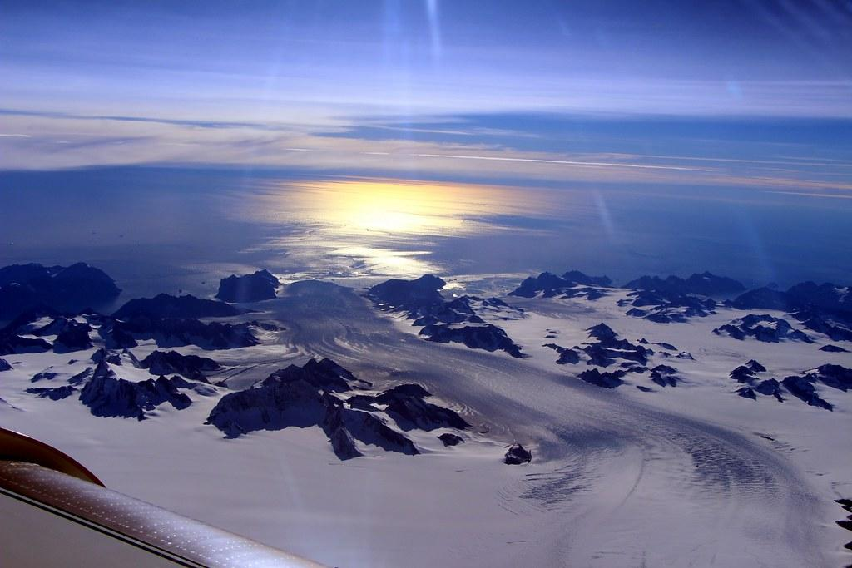
What is your Biome like?
The Polar Regions average temperature is 10 C/50 F. The climate is lacks of warm summers, it hardly ever rains and the only seasons are winter and summer.
Notes:
1-Each slide have a different background
1-Each slide have pictures
1-Each slide have transitions (information slides in, rotates, etc.)
Some of the text is hard to read with this background.

Slide 3
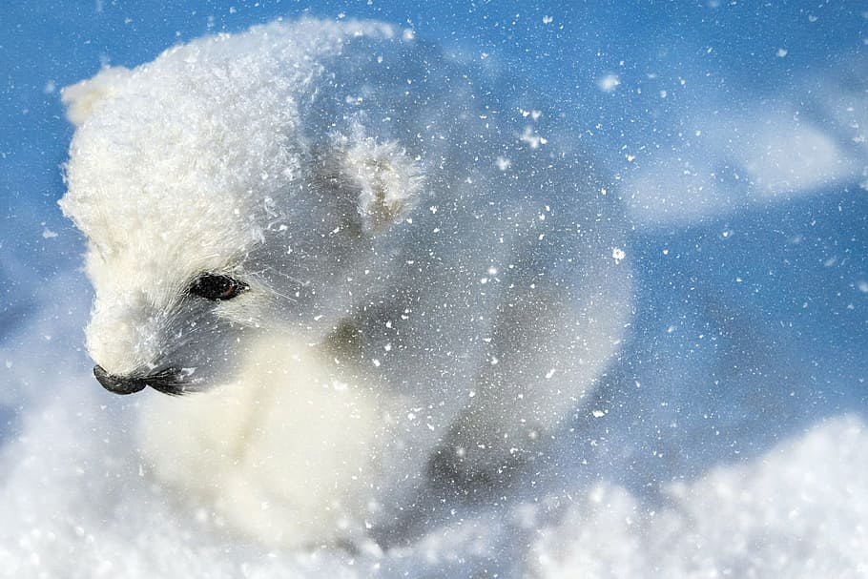
Adaptations creatures need to survive.
The adaptations the creatures need to survive in the polar region are “layers of fat and oily skin to stay warm. Also a white appearance and a small area to reduce heat.”
Notes:
1-Each slide have a different background
1-Each slide have pictures
1-Each slide have transitions (information slides in, rotates, etc.)

Slide 4
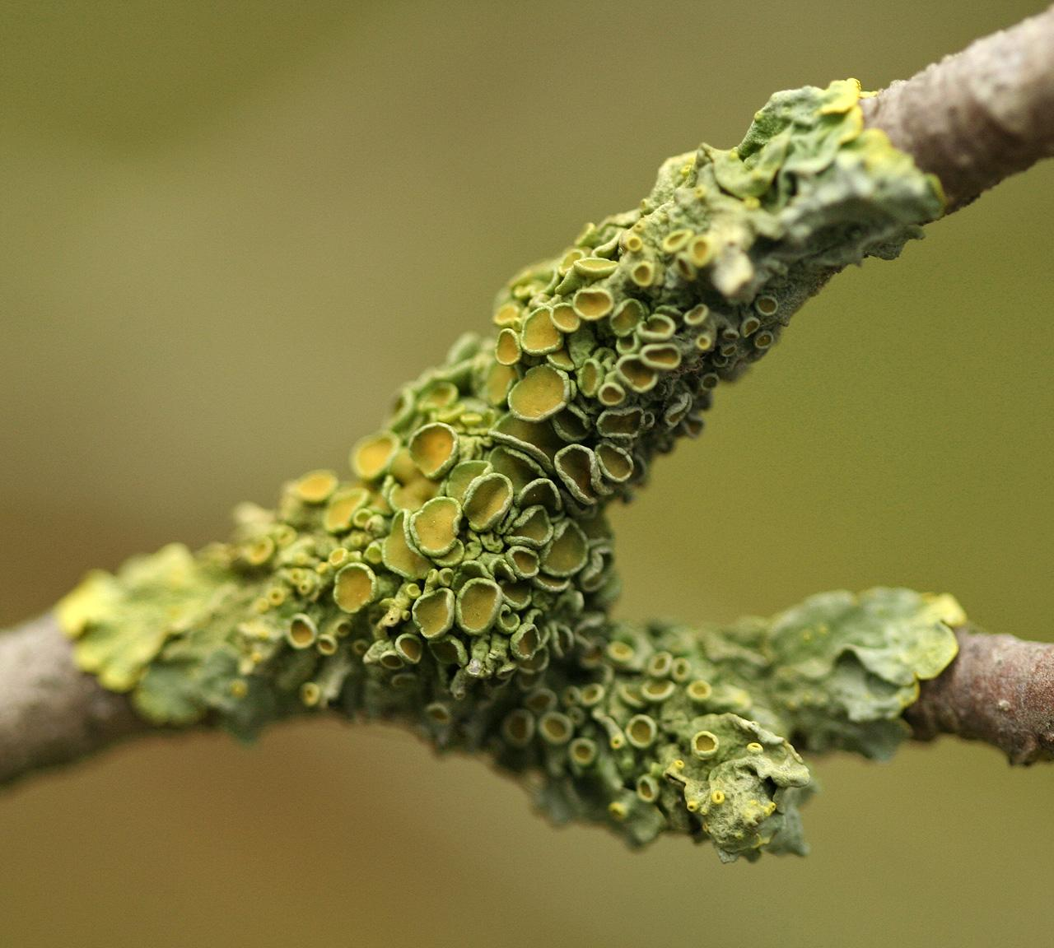
What are the producers in the Polar Region?
Lichen is the only producer in the Polar Region.
Notes:
1-Each slide have a different background
1-Each slide have pictures
1-Each slide have transitions (information slides in, rotates, etc.)
Some of the text is hard to read with this background.

Slide 5
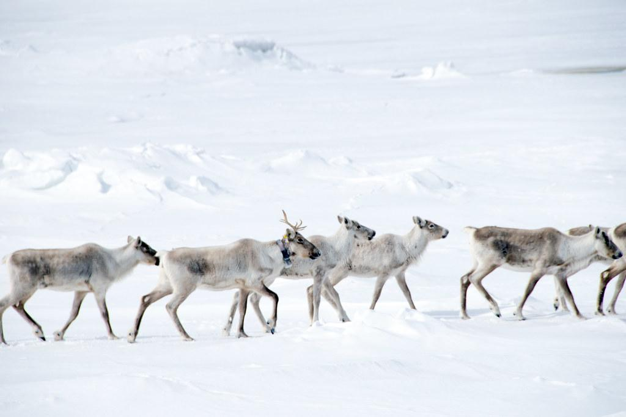
What are the primary consumers in the Polar Region?
The Primary Consumers in the polar region are the Caribou and other grazing (grass eaters) animals.
Notes:
1-Each slide have a different background
1-Each slide have pictures
1-Each slide have transitions (information slides in, rotates, etc.)

Slide 6
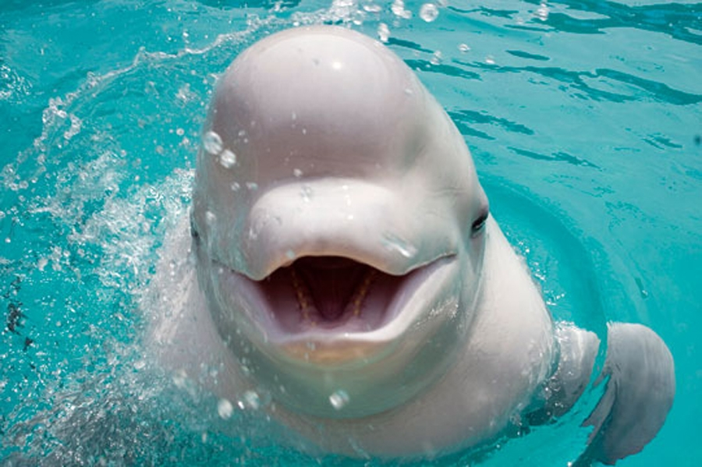
What are the Secondary Consumers in the Polar Region?
The Secondary Consumers in the polar region are beluga whales and seals.
Notes:
1-Each slide have a different background
1-Each slide have pictures
1-Each slide have transitions (information slides in, rotates, etc.)
Some of the text is hard to read with this background.

Slide 7
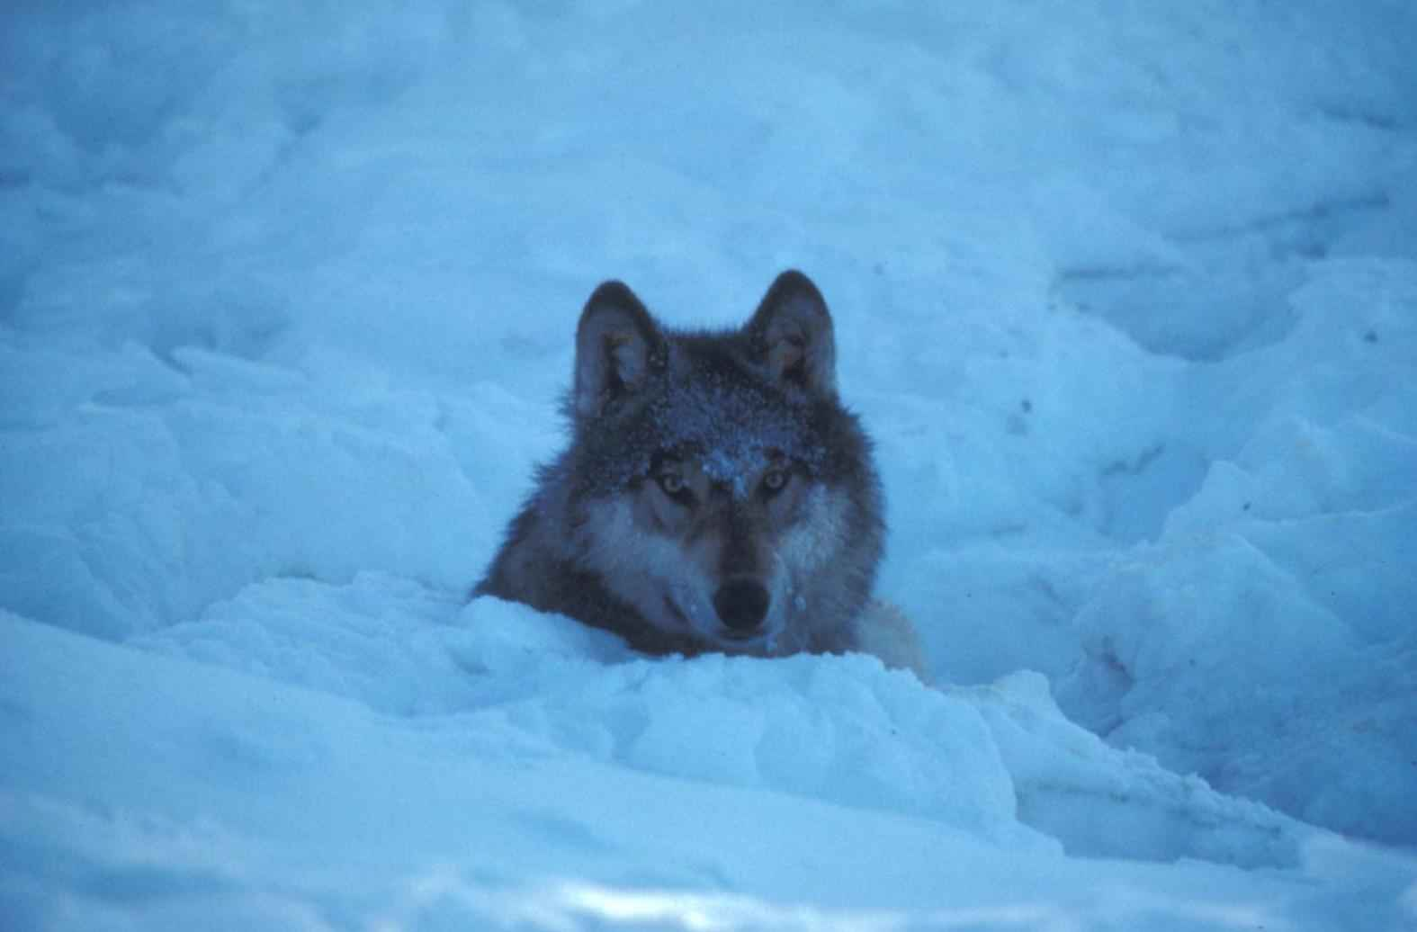
What are the Tertiary Consumers in the Polar Region?
The Tertiary Consumers are polar bears, eagles, and wolves.
Notes:
1-Each slide have a different background
1-Each slide have pictures
1-Each slide have transitions (information slides in, rotates, etc.)

Slide 8
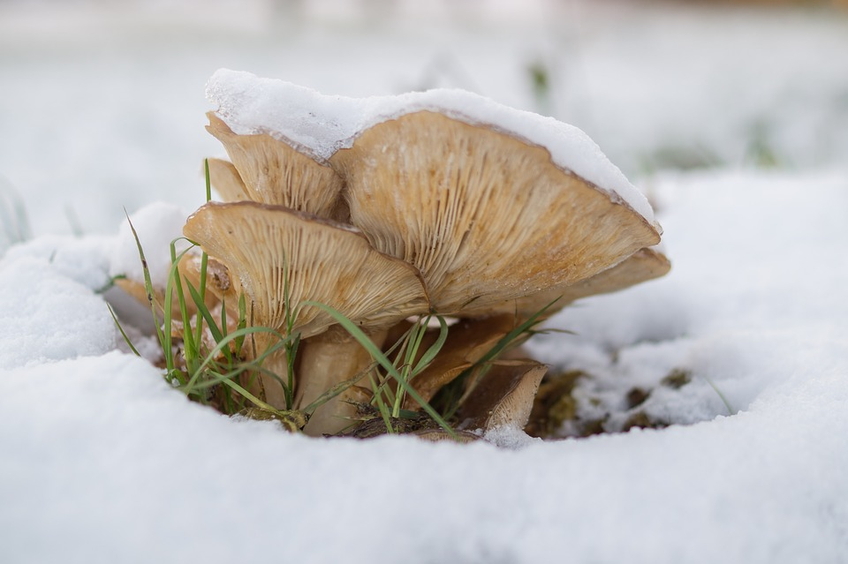
What are the Decomposers?
The Decomposers are Bacteria and Fungi.
Notes:
1-Each slide have a different background
1-Each slide have pictures
1-Each slide have transitions (information slides in, rotates, etc.)

Slide 9
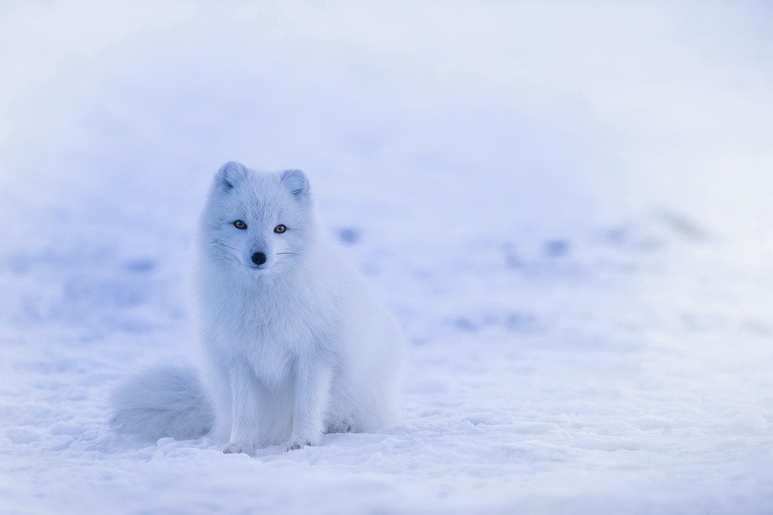
What are the Mutualism Relationship?
One Mutualism Relationship is the Caribou and Arctic fox. The Caribou gets its food being safe from the fox while the fox also gets food at the same time with help with Caribou.
Notes:
1-Each slide have a different background
1-Each slide have pictures
1-Each slide have transitions (information slides in, rotates, etc.)

Slide 10
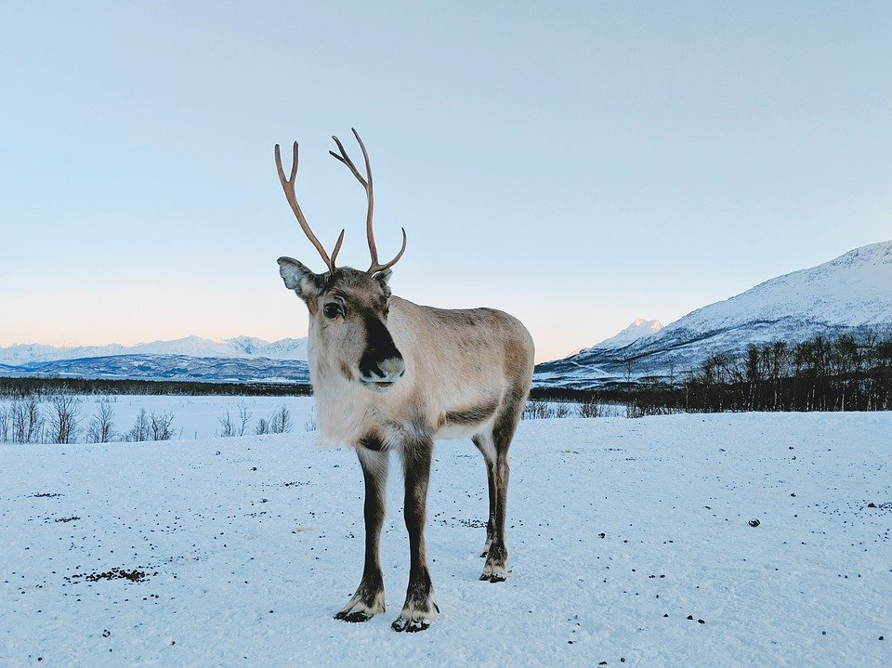
What are the Commensalism Relationship?
A Commensalism Relationship is the Arctic fox, Caribou, and Reindeer. When the Caribou and Reindeer are eating the lichens and looking for food, and the fox starts to follow them and eats the leftovers.
Notes:
1-Each slide have a different background
1-Each slide have pictures
1-Each slide have transitions (information slides in, rotates, etc.)

Slide 11
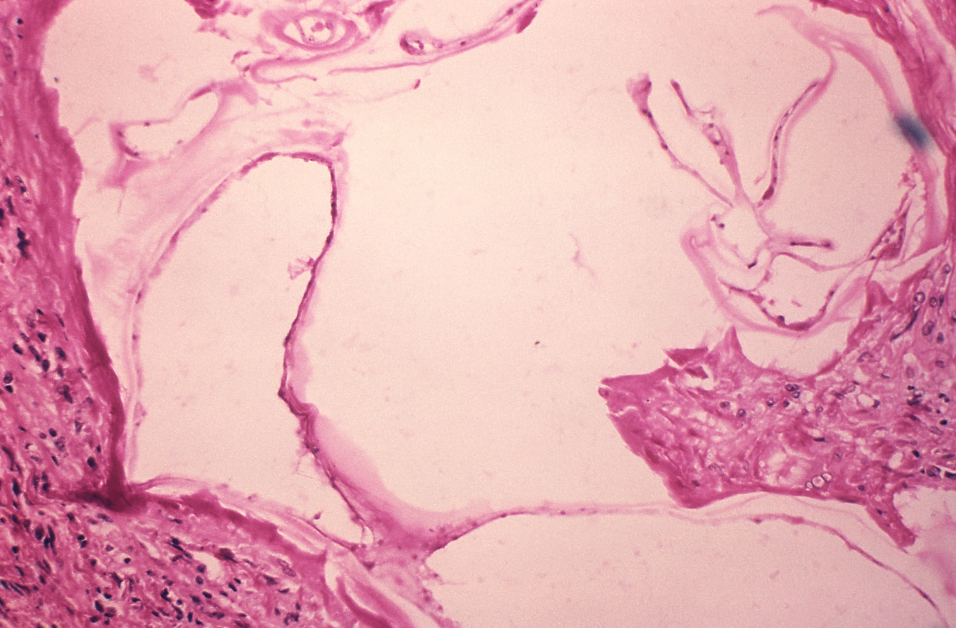
What are the the Parasitism Relationships?
A polar region Parasitism Relationship is between the liver tapeworm cysts and wolves, caribou, polar bears, and moose. The tapeworm feeds on the animals and as a result the animals get malnourished. (lack of nutrients)
Notes:
1-Each slide have a different background
1-Each slide have pictures
1-Each slide have transitions (information slides in, rotates, etc.)
Some of the text is hard to read with this background.

Slide 12
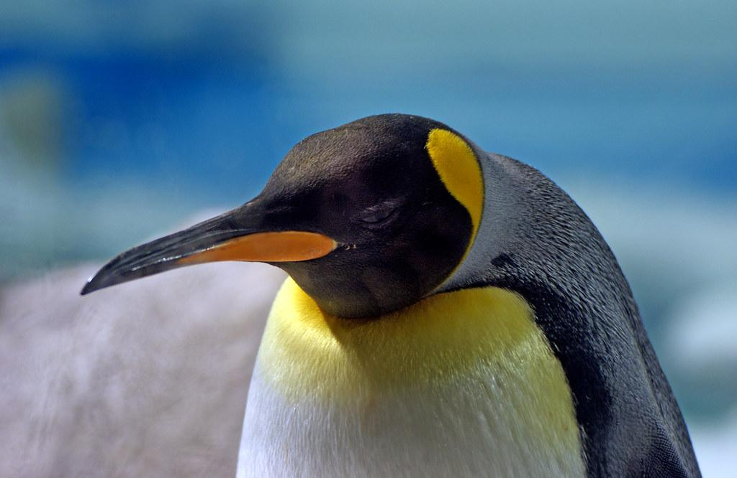
Resources
https://en.wikipedia.org https://divediscover.whoi.edu https://www.bbc.co.uk https://wonderopolis.org https://study.com https://articpolarecosystems2012.weebly.com
https://ab554.wordpress.com
Notes:
1-Each slide have a different background
1-Each slide have pictures
1-Each slide have transitions (information slides in, rotates, etc.)
Some of the text is hard to read with this background.

Slide 13
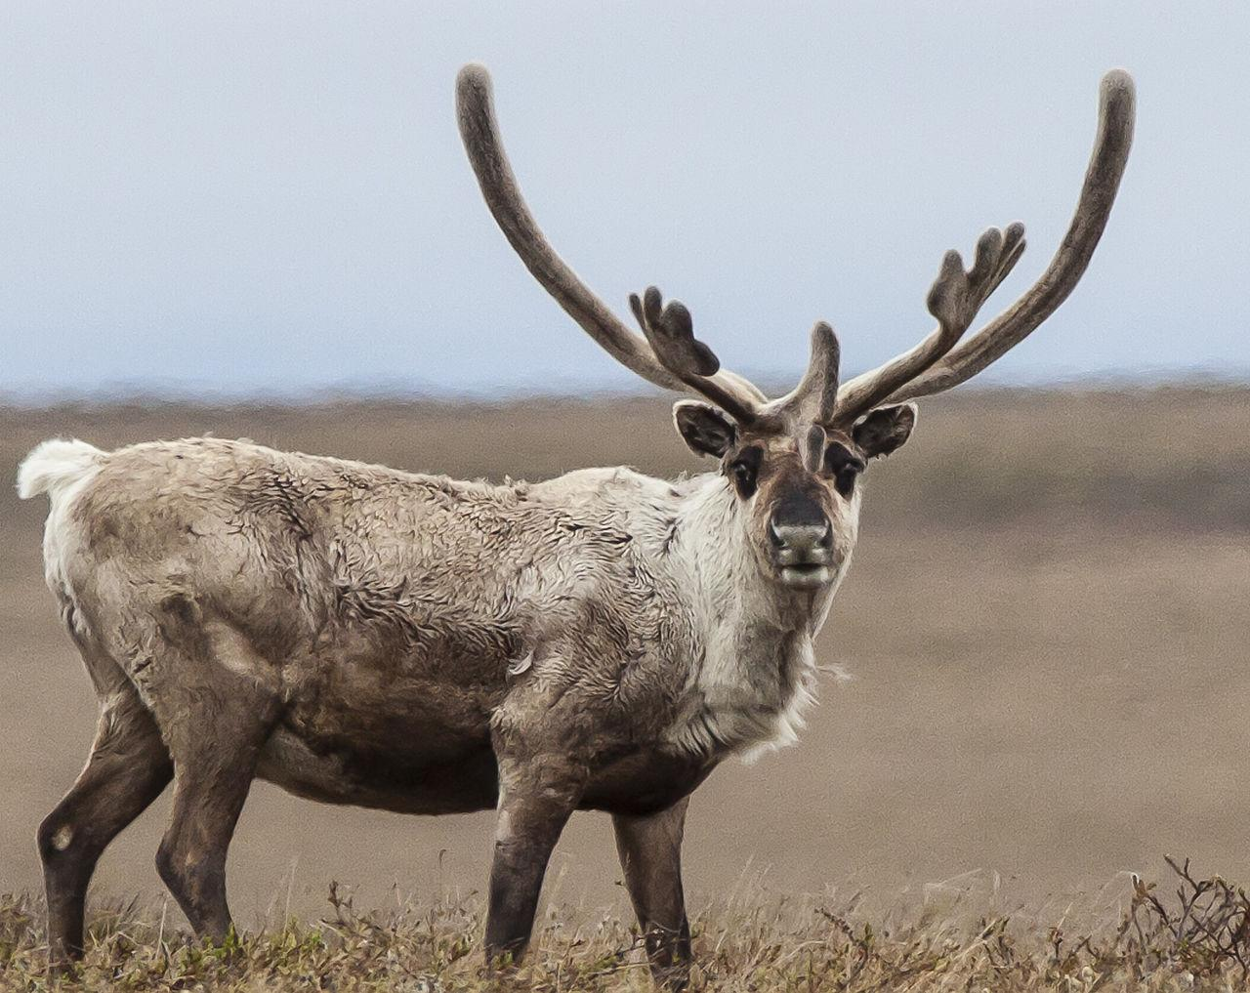
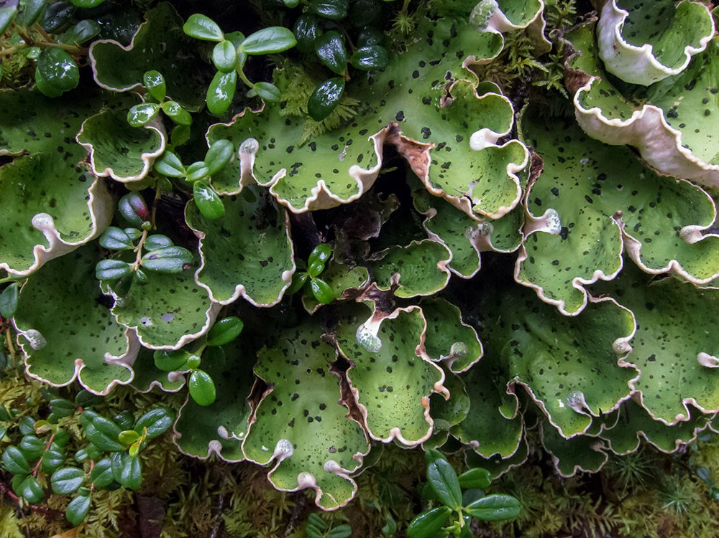
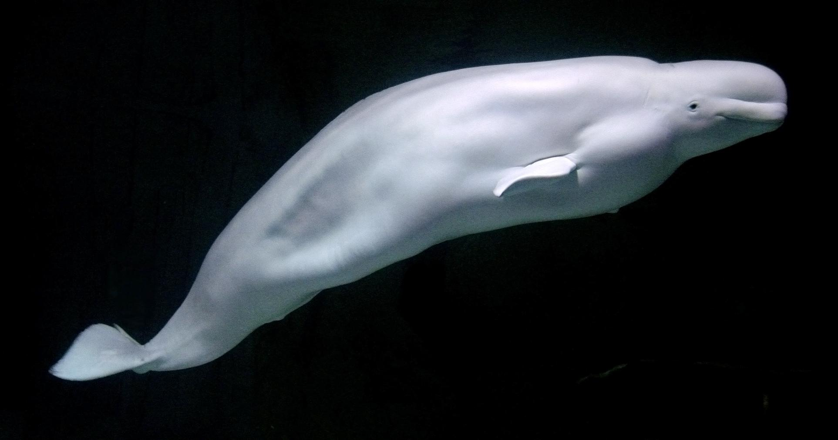
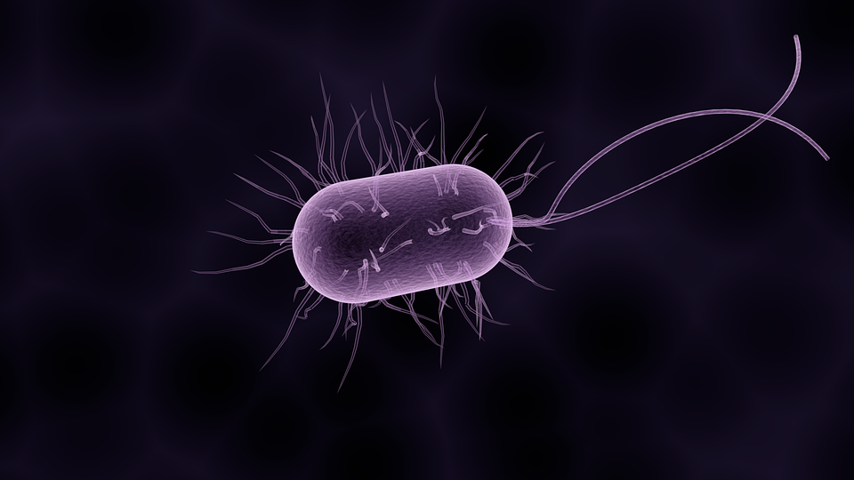
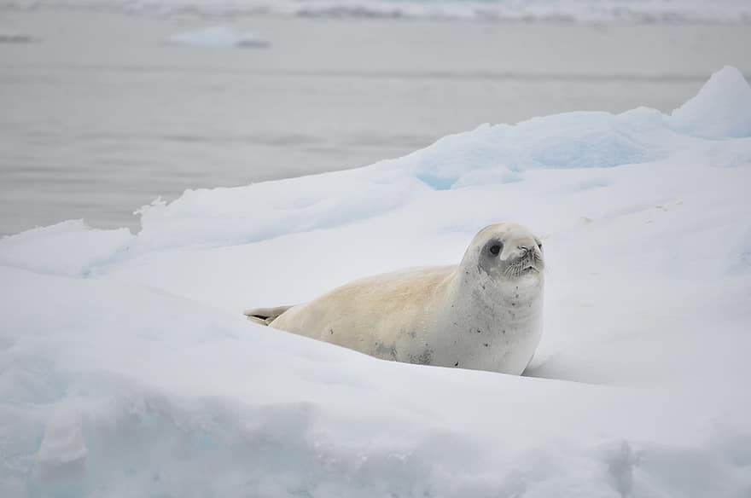
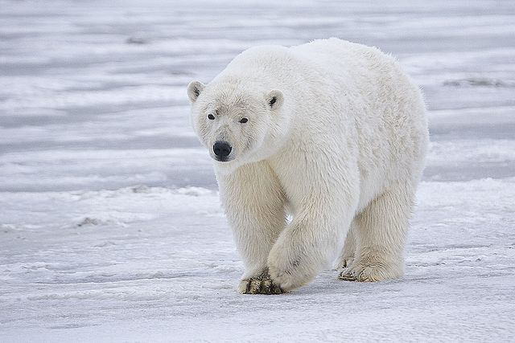
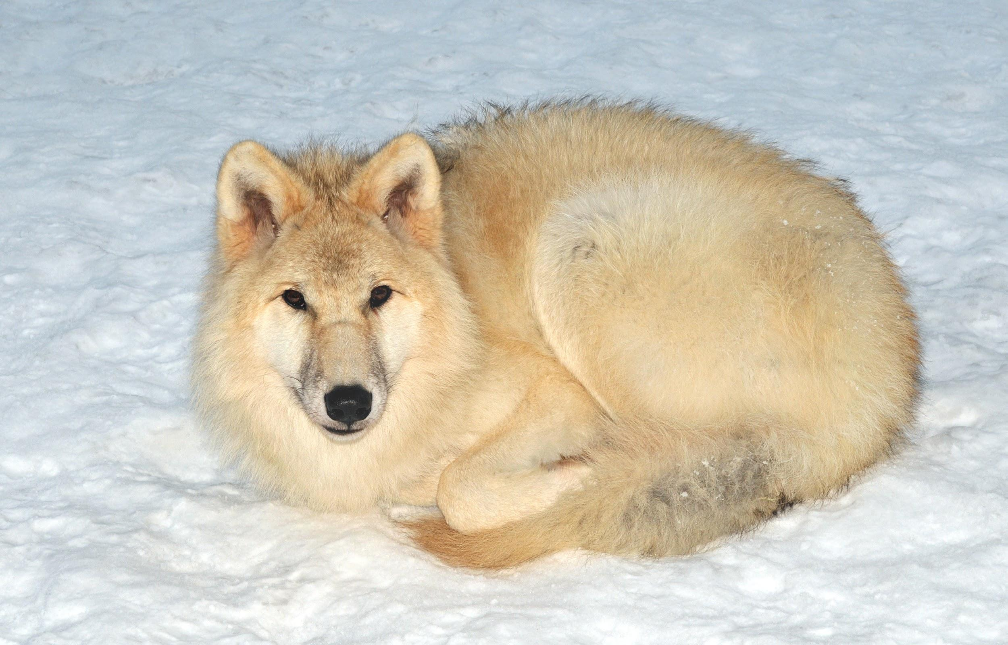
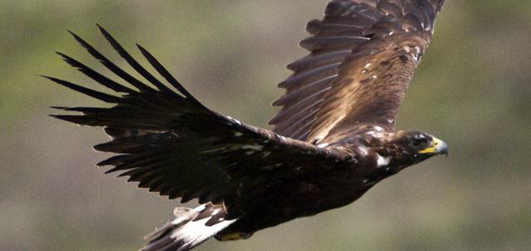
Food web
Lichen (producer)
Caribou (1st consumer)
beluga whales and seals (2nd consumer)
Bacteria, and Fungi (Decomposers)
polar bears, wolves, and eagles ( Tertiary consumer)

Slide 14
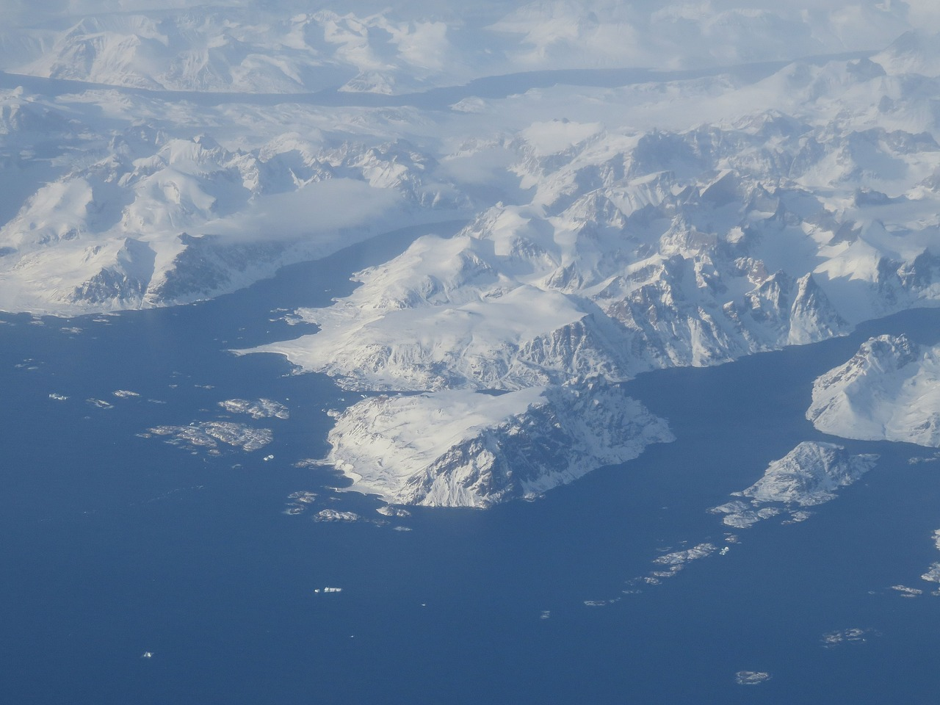
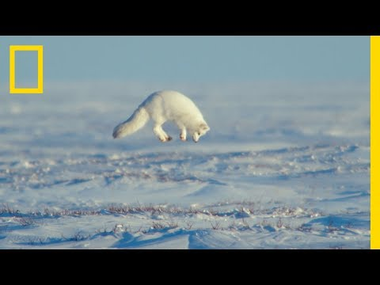
Youtube video
https://www.youtube.com/watch?v=r2Ou58p_D7k

