Slide 1
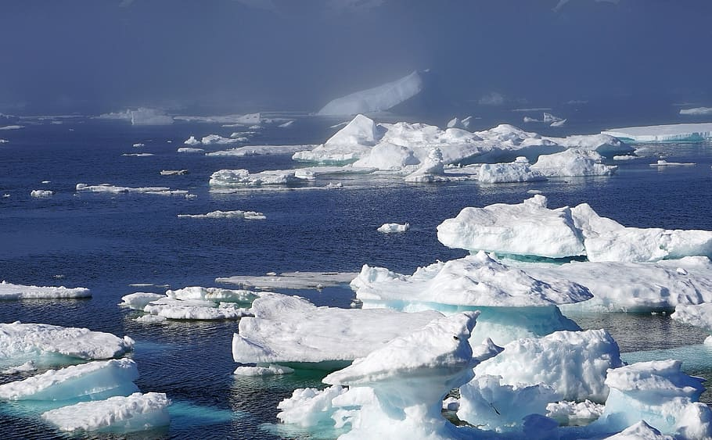
Polar Region:
By: Dayanna Rivera
Notes:
1-Each slide have a different background
1-Each slide have pictures
1-Each slide have transitions (information slides in, rotates, etc.)

Slide 2
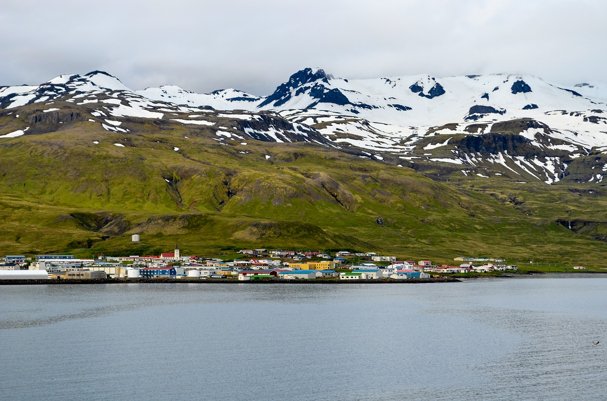
What is the climate like in the Polar Region?
The Polar Region climate has an average temperature every month of less than 10 C ( 50 F). The polar climate consists of cool summers and very cold winters, so when it's summer, there is a lack of warmth.
Notes:
1-Each slide have a different background
1-Each slide have pictures
1-Each slide have transitions (information slides in, rotates, etc.)

Slide 3
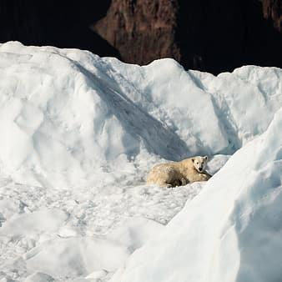
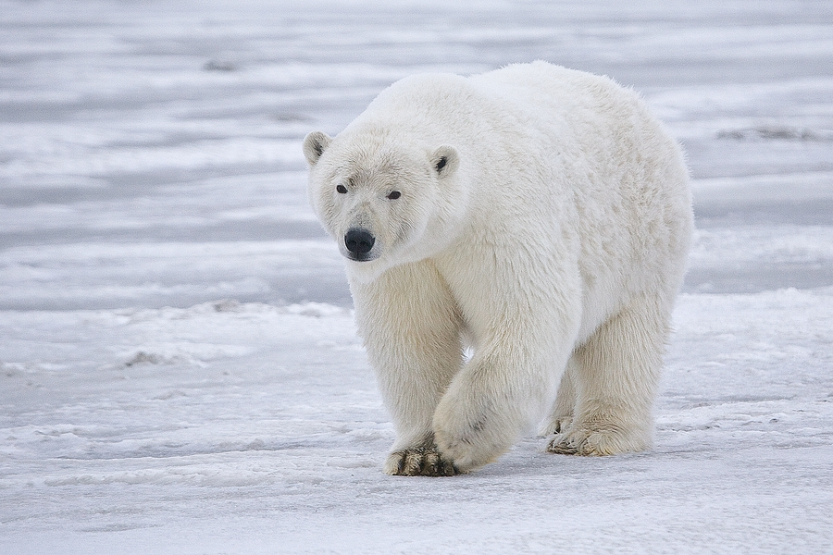
What adaptations do animals need to survive in your biome?
An example of an animal that has adaptations to survive in the polar region is the Polar Bear. Some adaptations that they have are that they have hair that's translucent which makes it seem white because it reflects the snow and they also have layers of thick fur and fat which help them keep warm.
Notes:
1-Each slide have a different background
1-Each slide have pictures
1-Each slide have transitions (information slides in, rotates, etc.)

Slide 4
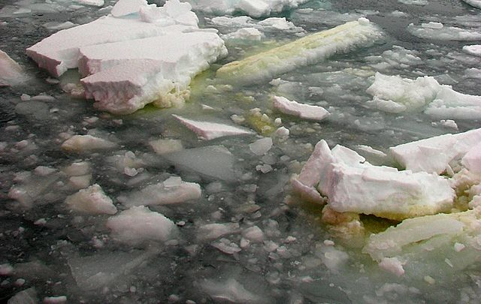
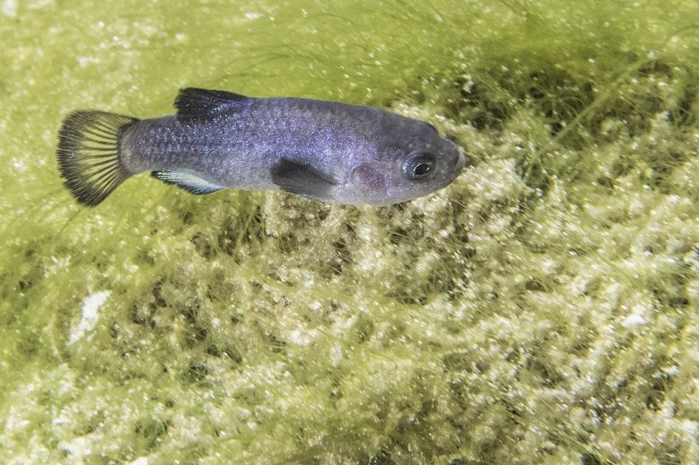
Example of producers:
An example of a producer is algae living in the sea ice (ice algae). It is autotrophic single-celled algae.
Notes:
1-Each slide have a different background
1-Each slide have pictures
1-Each slide have transitions (information slides in, rotates, etc.)

Slide 5
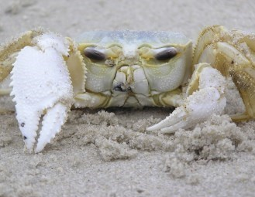
Examples of Primary Consumers:
A couple of examples of primary consumers in my biome are phytoplanktons and crustaceans that consume the zoo plankton.
Notes:
1-Each slide have a different background
1-Each slide have pictures
1-Each slide have transitions (information slides in, rotates, etc.)

Slide 6
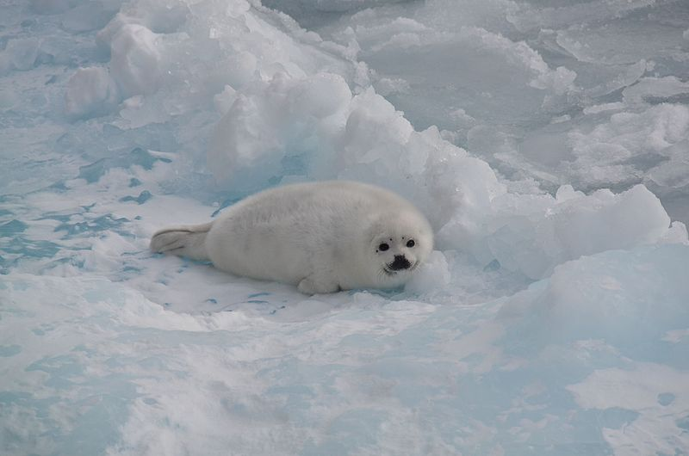
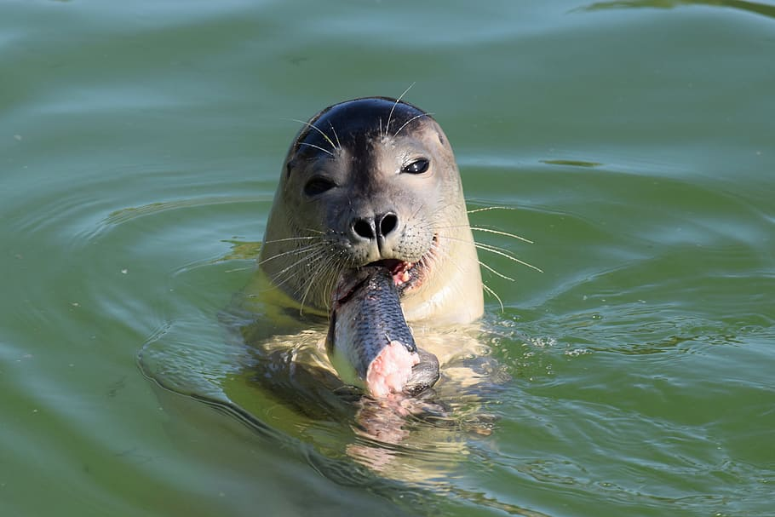
Examples of Secondary Consumers:
Harp Seals are examples of secondary consumers in the Polar Region biome because they mainly eat fish.
Notes:
1-Each slide have a different background
1-Each slide have pictures
1-Each slide have transitions (information slides in, rotates, etc.)

Slide 7
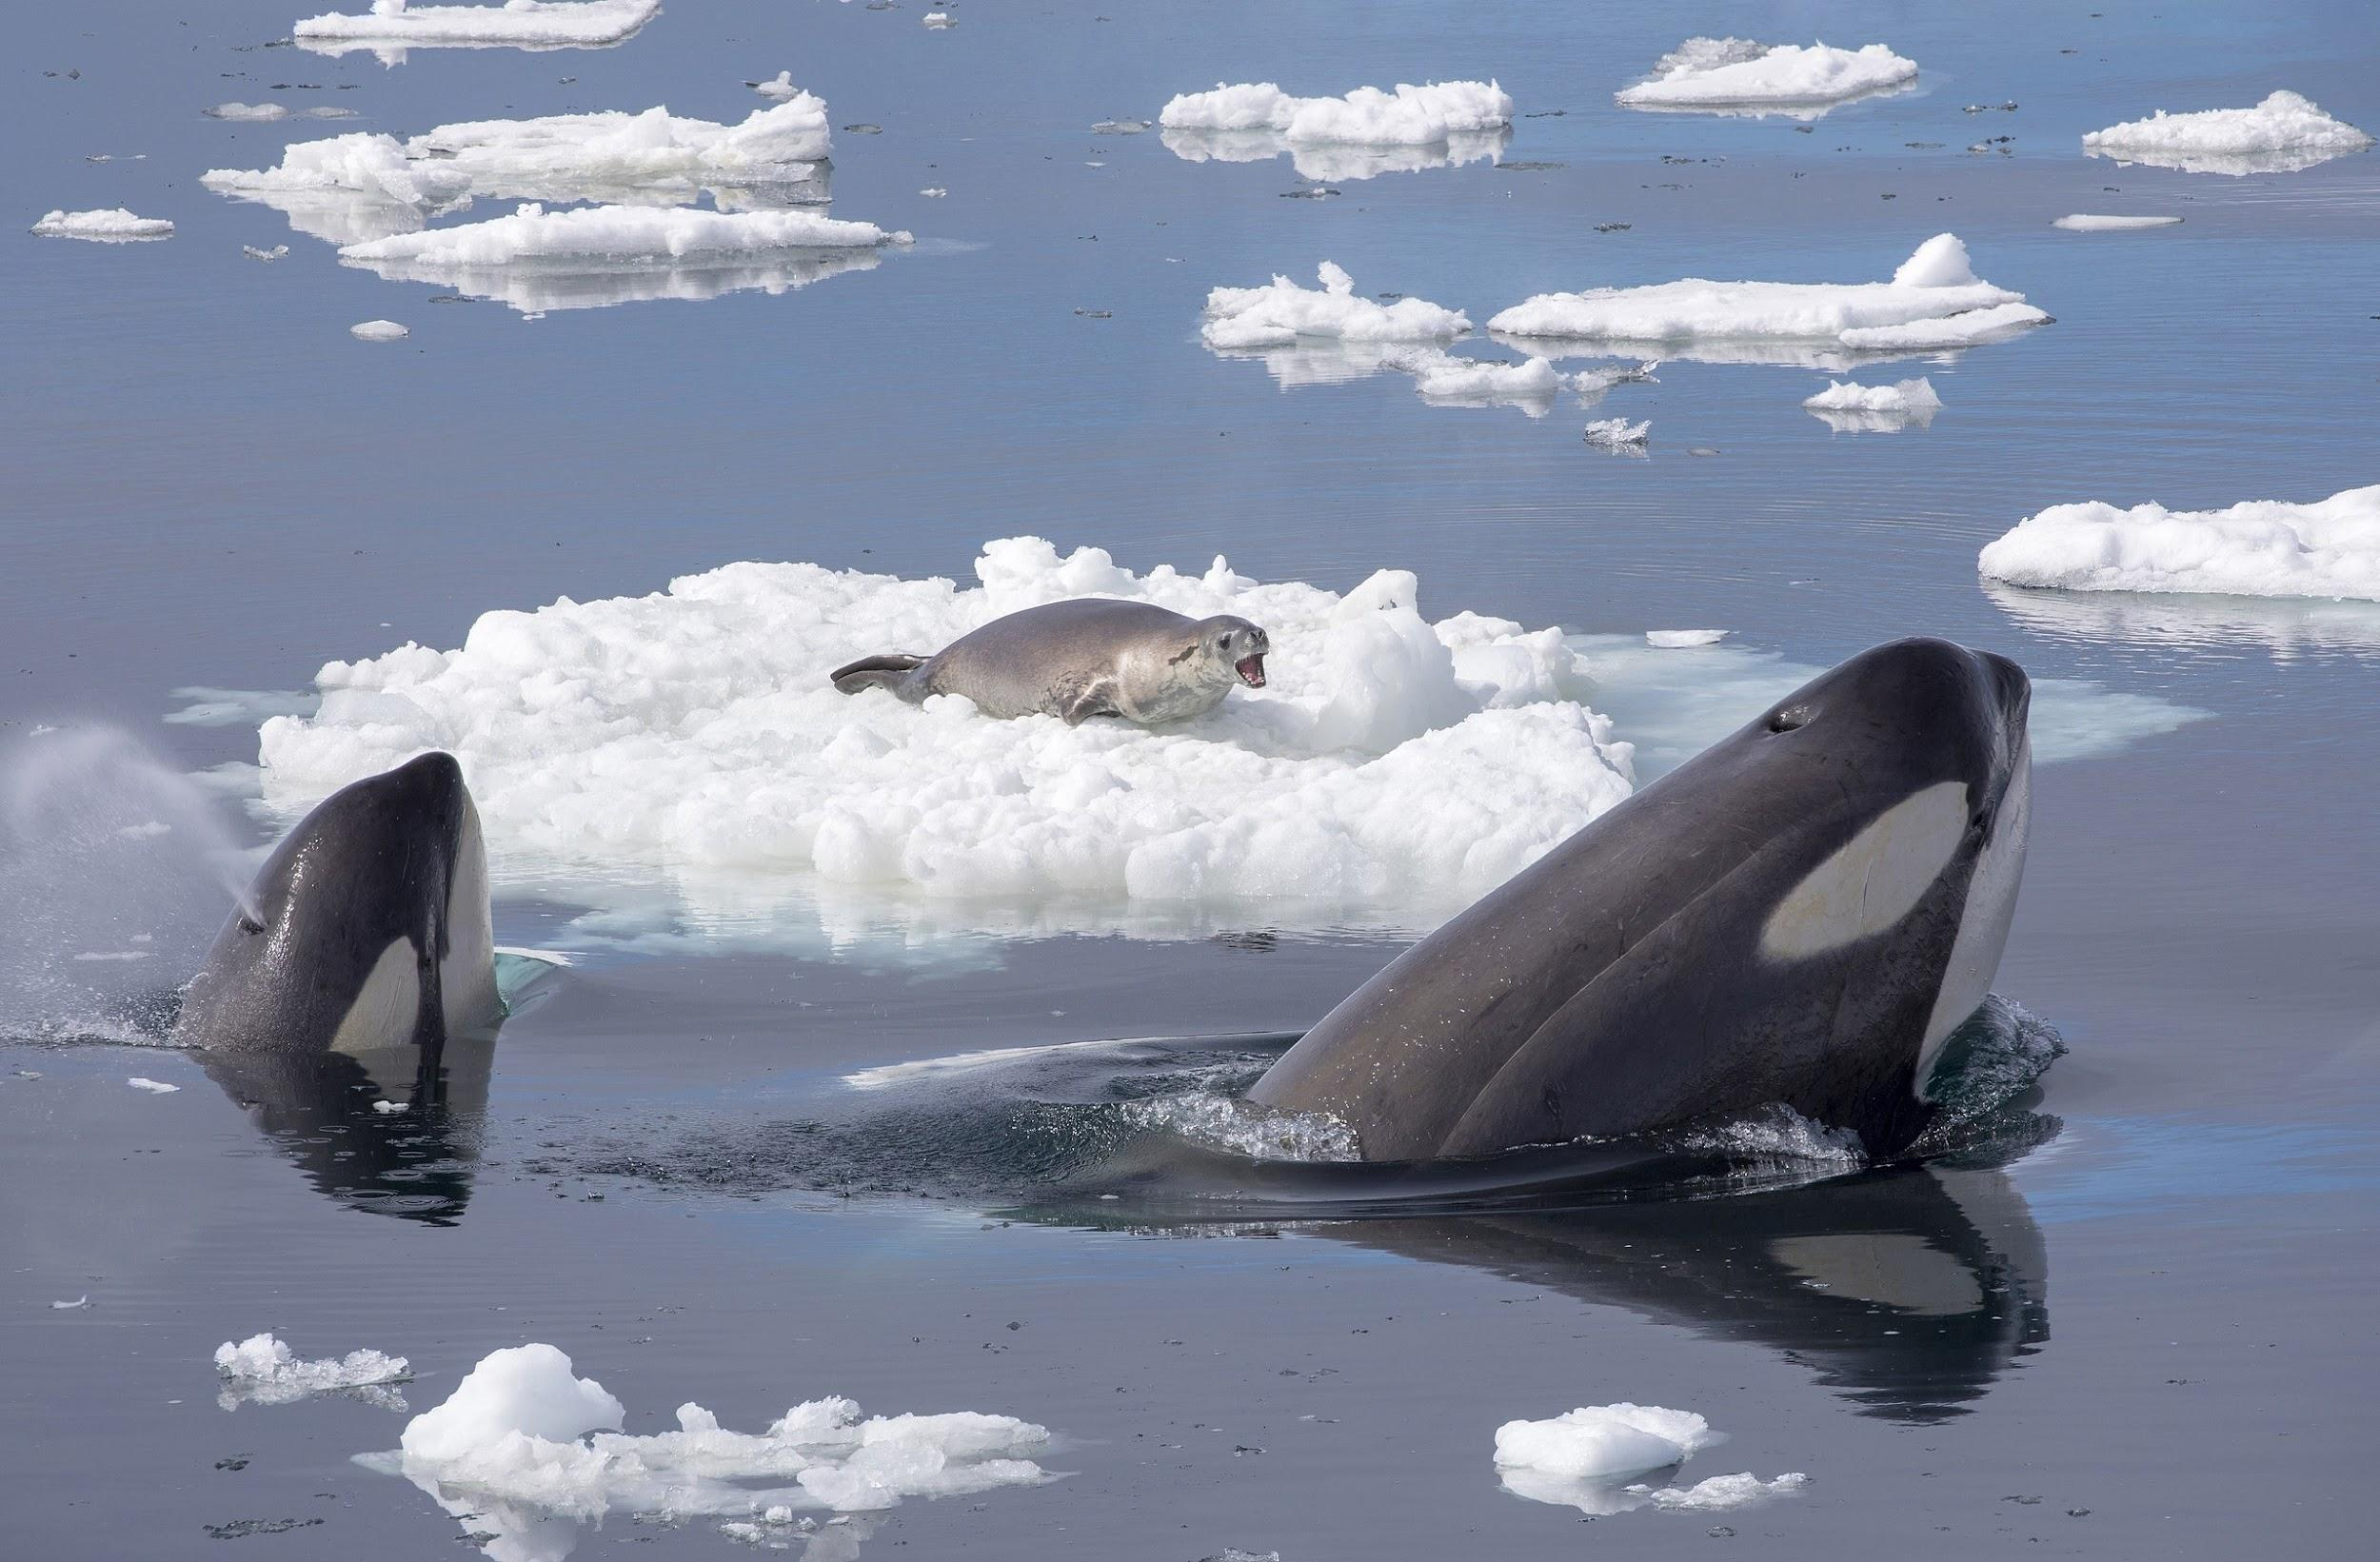
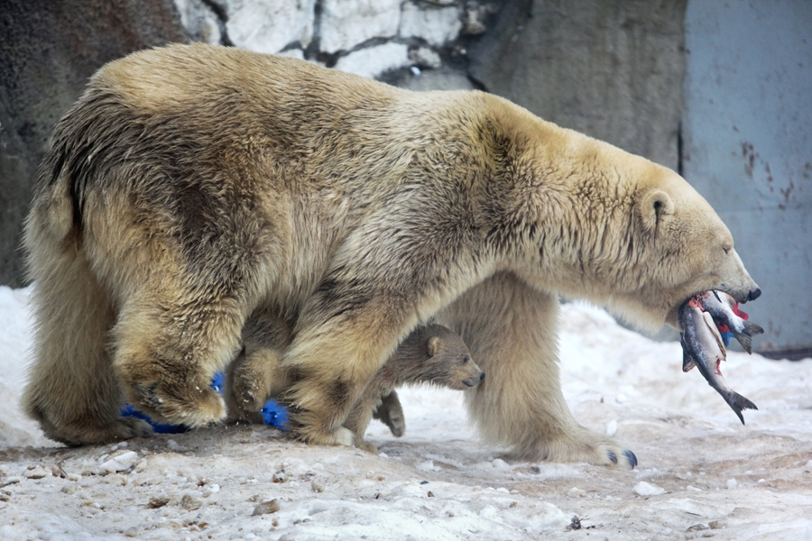
Examples of Tertiary Consumers:
Tertiary consumers consist of polar bears,orca whales, wolves, and eagles.
Notes:
1-Each slide have a different background
1-Each slide have pictures
1-Each slide have transitions (information slides in, rotates, etc.)

Slide 8
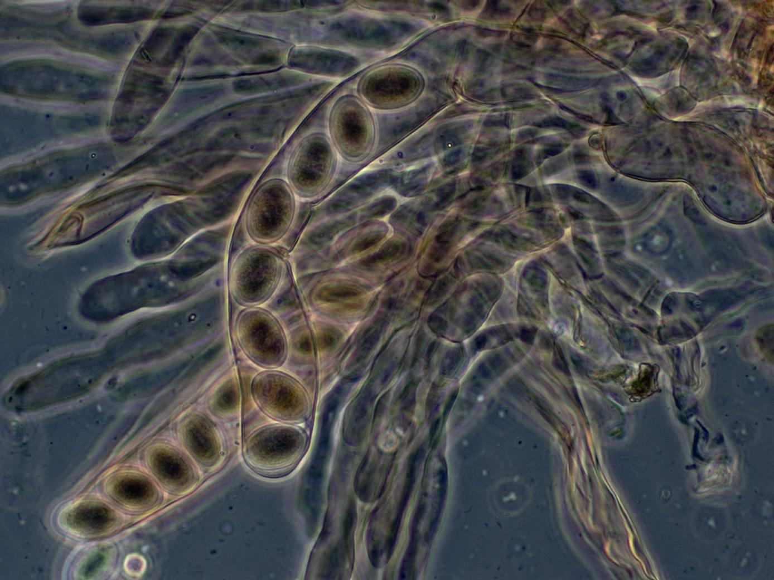
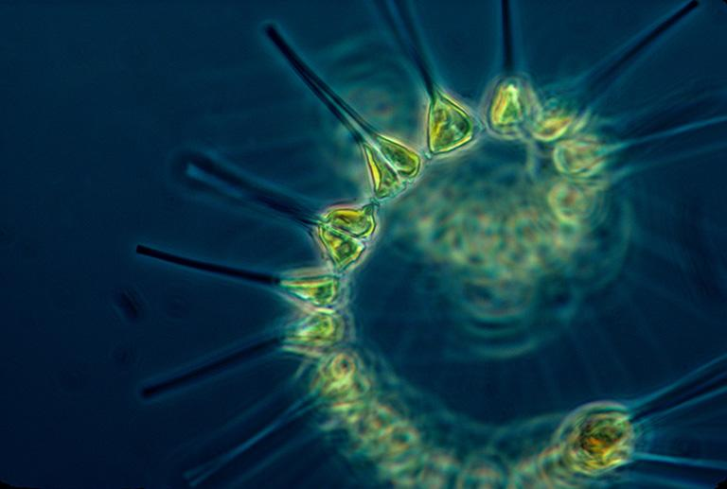
Examples of decomposers:
Some decomposers found in the Polar Region are bacteria, such as microorganisms and fungi. They work together to break down dead and decaying matter, digesting and absorbing the nutrients in the process.
Notes:
1-Each slide have a different background
1-Each slide have pictures
1-Each slide have transitions (information slides in, rotates, etc.)

Slide 9
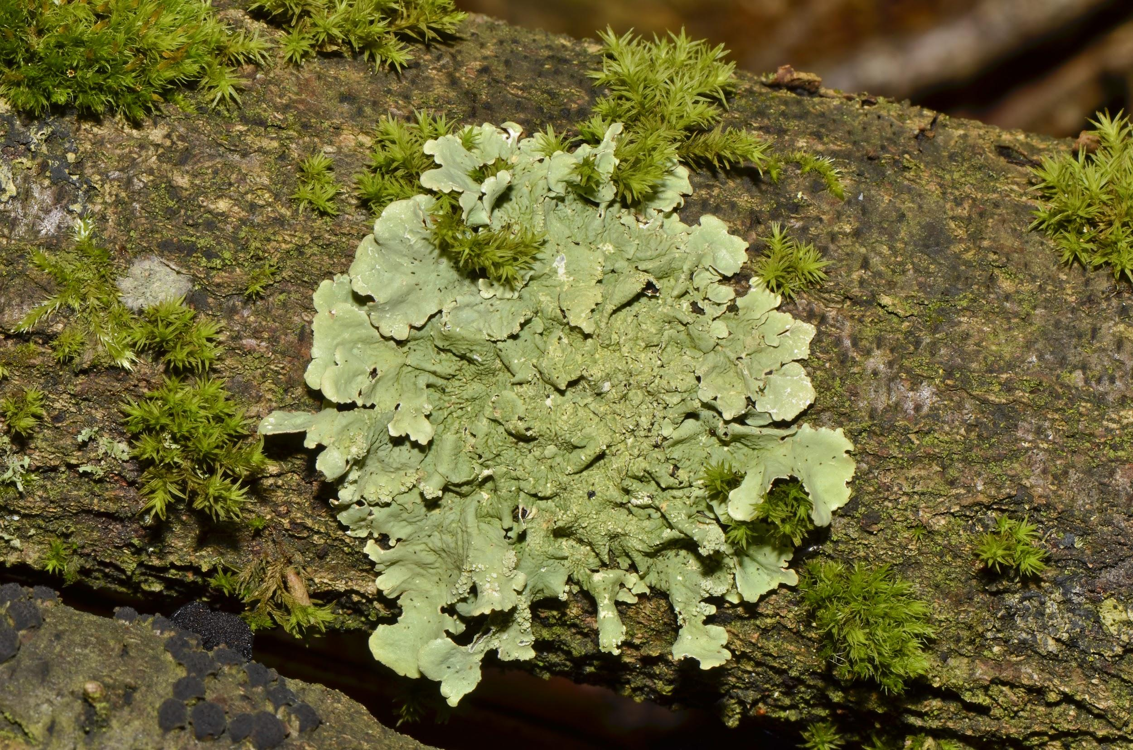
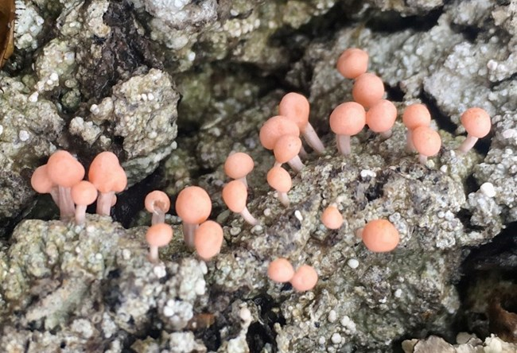
Example of a mutualism relationship:
An example of mutualism in the polar region is, since lichen consists of green alga and fungus, the alga is naturally photosynthetic so they are able to transform carbon dioxide into sugar that fungus feeds on. Meanwhile, the fungus counterpart helps protect the alga by getting minerals substrate and retaining water.
Notes:
1-Each slide have a different background
1-Each slide have pictures
1-Each slide have transitions (information slides in, rotates, etc.)

Slide 10
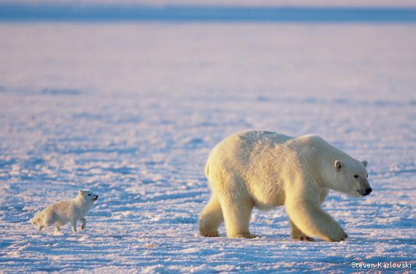
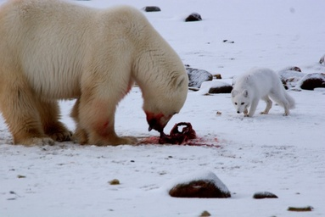
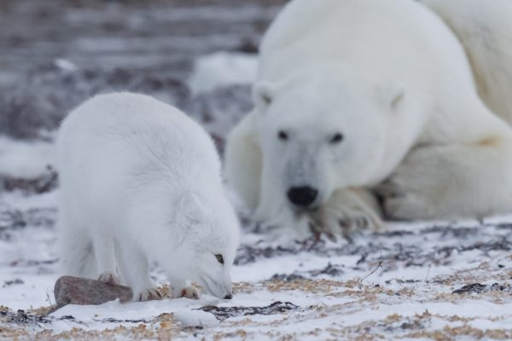
Example of a commensalism relationship:
An example of commensalism in this biome is when the arctic fox follows behind the polar bear and scavenges on scraps of food, the polar bear isn't affected and the fox benefits from the food.
Notes:
1-Each slide have a different background
1-Each slide have pictures
1-Each slide have transitions (information slides in, rotates, etc.)

Slide 11
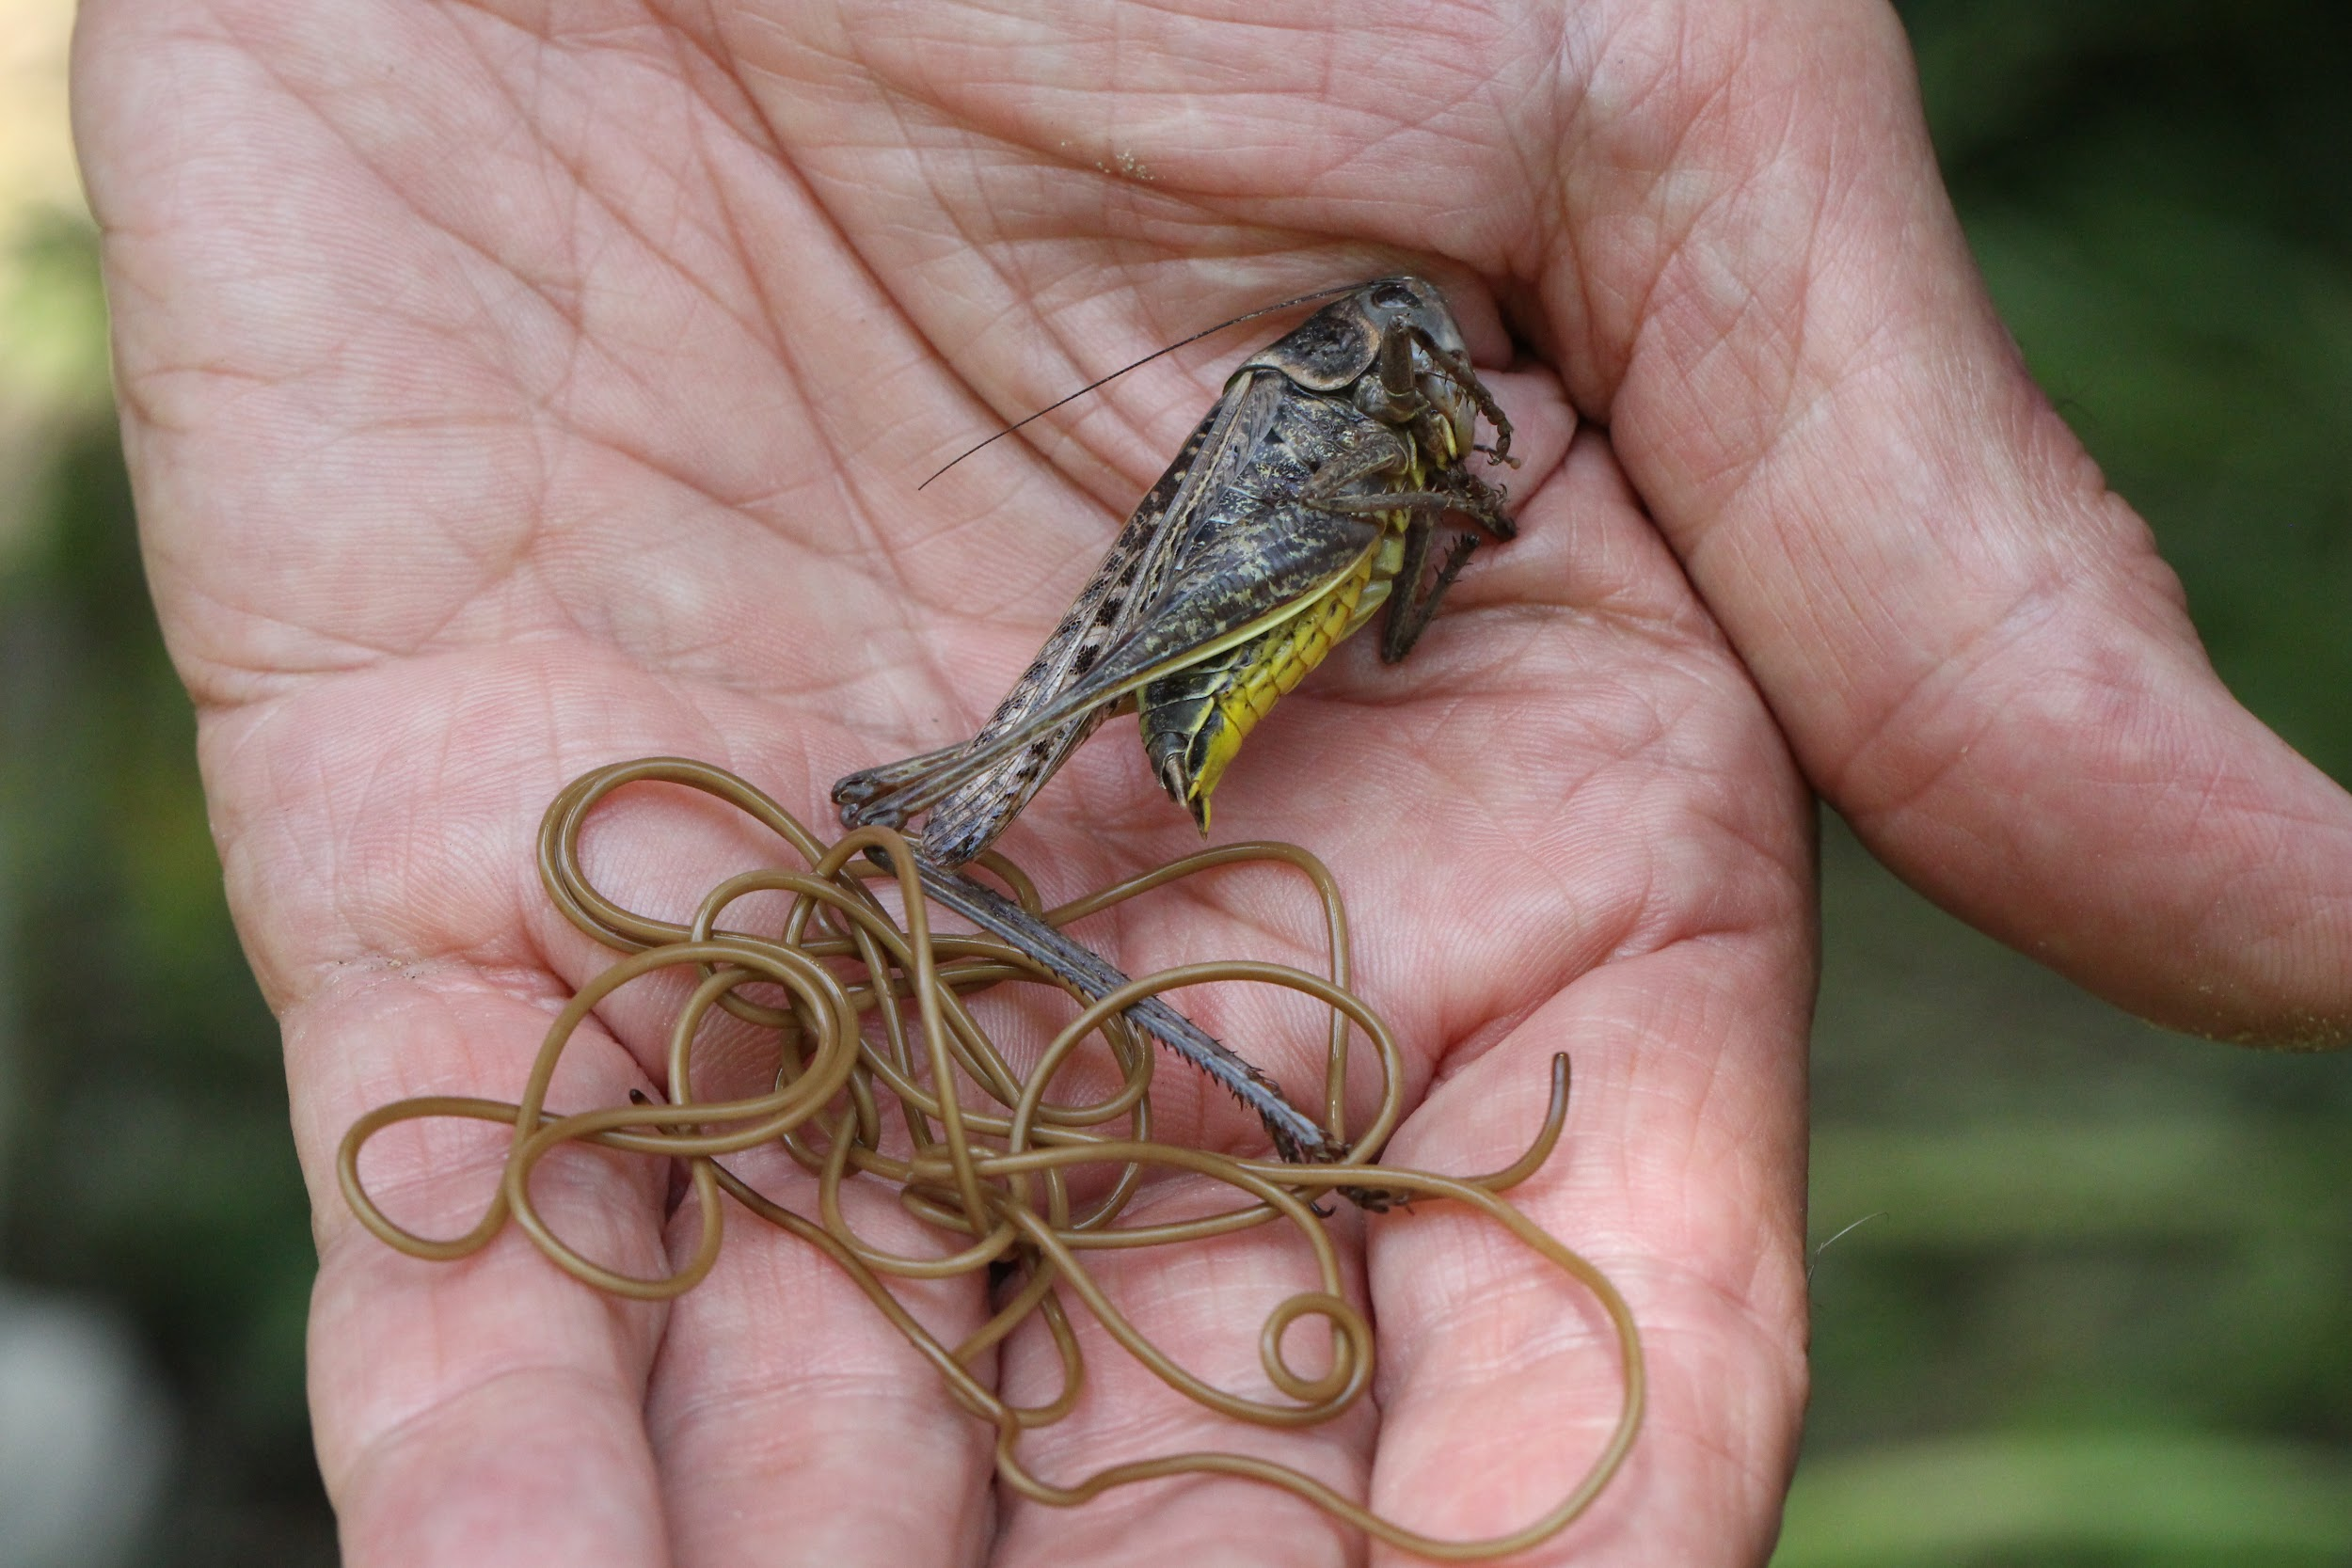
Example of parasitism:
Liver Tapeworm cyst is an example of parasitism because they are prone to live in animal bodies such as wolves, caribou, polar bears and moose; they feed on the food that the animals eat which leads to the animal getting malnutrition.
Notes:
1-Each slide have a different background
1-Each slide have pictures
1-Each slide have transitions (information slides in, rotates, etc.)

Slide 12
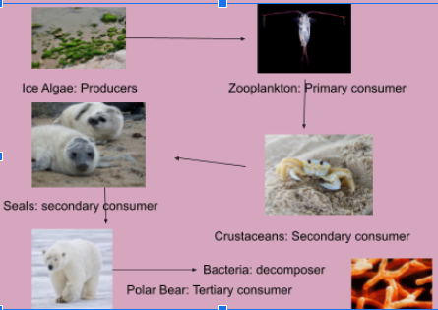
Food Web:

Slide 13
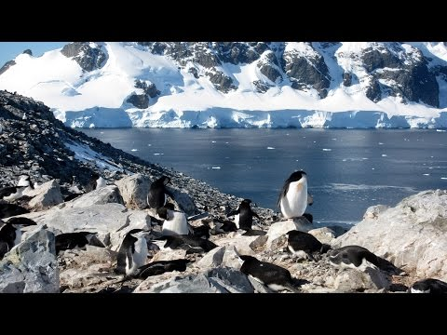
Video of the Polar Region:
https://youtu.be/pTp8Viivdx4
- I picked this video because it shows you how the polar regions looks like like and some animals that live there.
Notes:
1-Each slide have a different background
1-Each slide have pictures
1-Each slide have transitions (information slides in, rotates, etc.)

Slide 14
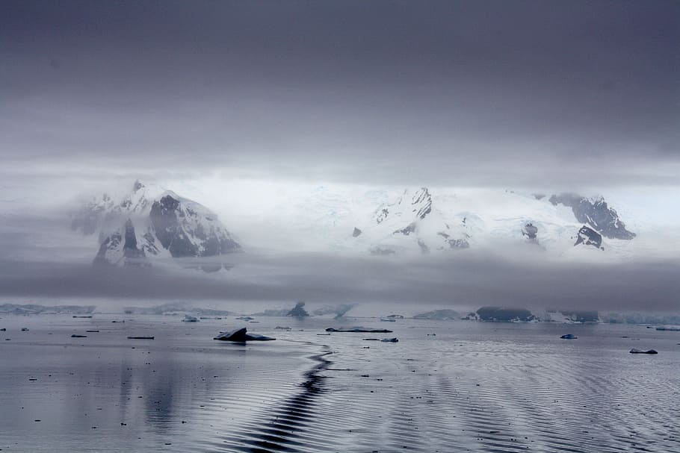
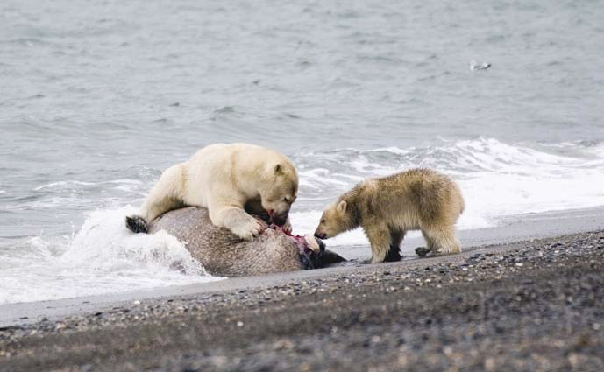
Would i want to live in the Polar Region?
If i am being honest, i don't think i would like to live in the Polar Region, one reason is of course it's way to cold, its freezing, another is because of the animals that live there, like the polar bear, it would kill you in an instant so no thank you, i wouldn't want to live there.
Notes:
1-Each slide have a different background
1-Each slide have pictures
1-Each slide have transitions (information slides in, rotates, etc.)
Extra credit

Slide 15
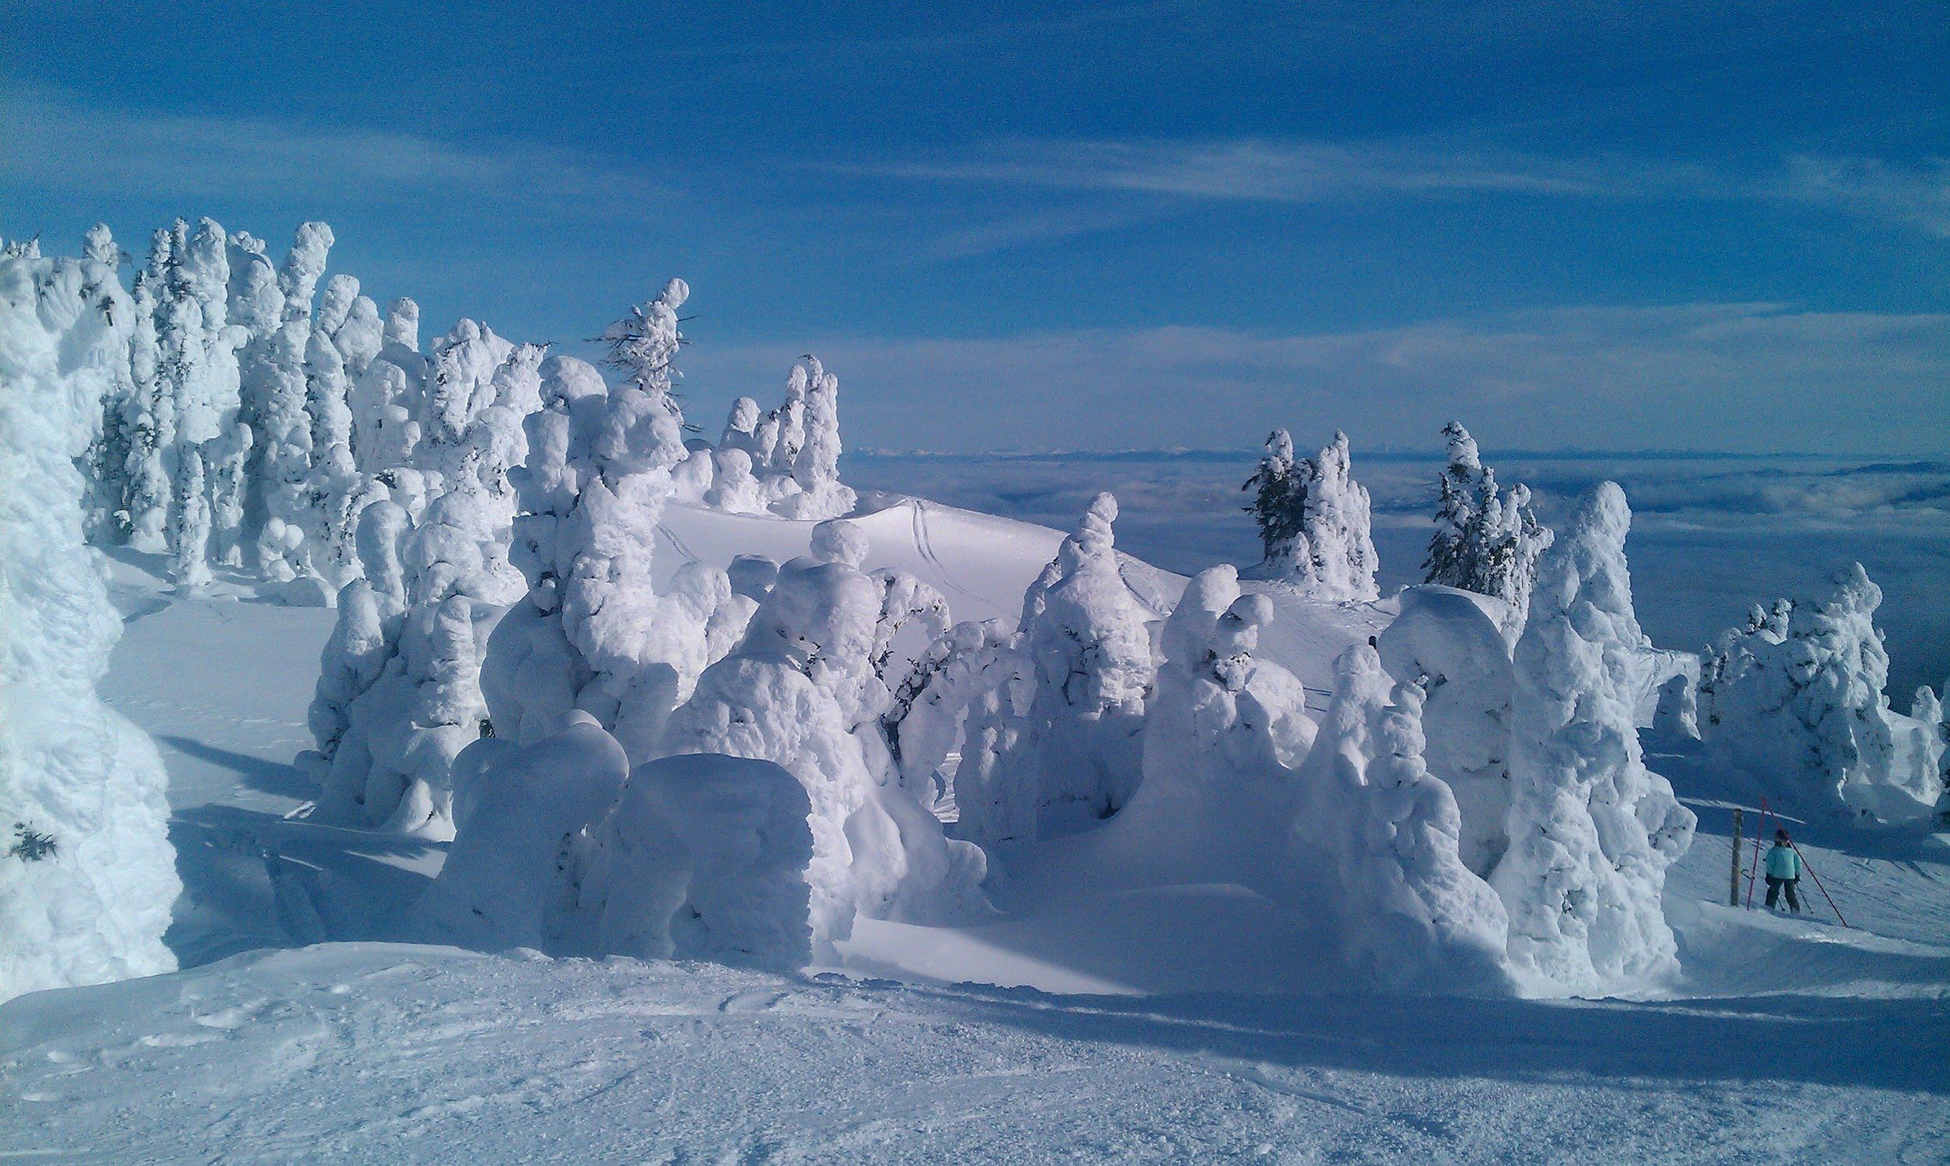
What countries are the Polar Regions found in?
Polar Regions are found in, Canada, Greenland, Ice land, Norway, Sweden, Finland, Russia and the United States.
Notes:
1-Each slide have a different background
1-Each slide have pictures
1-Each slide have transitions (information slides in, rotates, etc.)
Extra credit.

Slide 16
Websites I used:
https://lisbdnet.com
https://www.bioexplorer.net
https://sciencing.com
https://kids.frontiersin.org
https://study.com
https://www.sps186.org
https://sites.google.com
https://www.sunnysports.com

