Slide 1
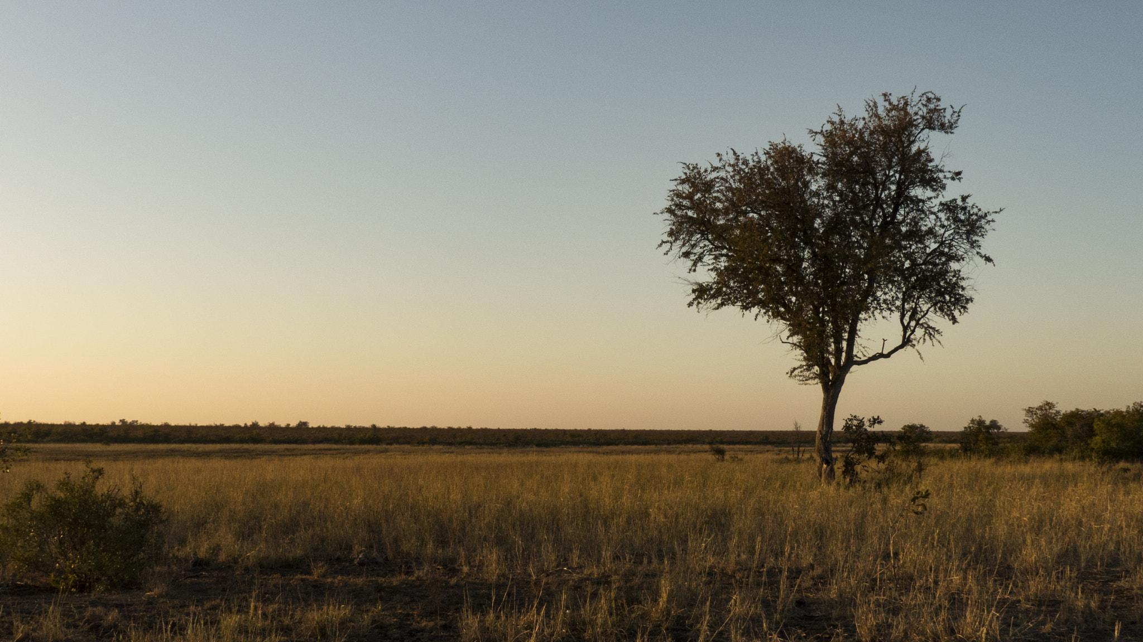
The Savanna Biome
By D’Macio Acosta
Notes:
Each slide have a different background
Each slide have pictures
Each slide have transitions (information slides in, rotates, etc.)

Slide 2
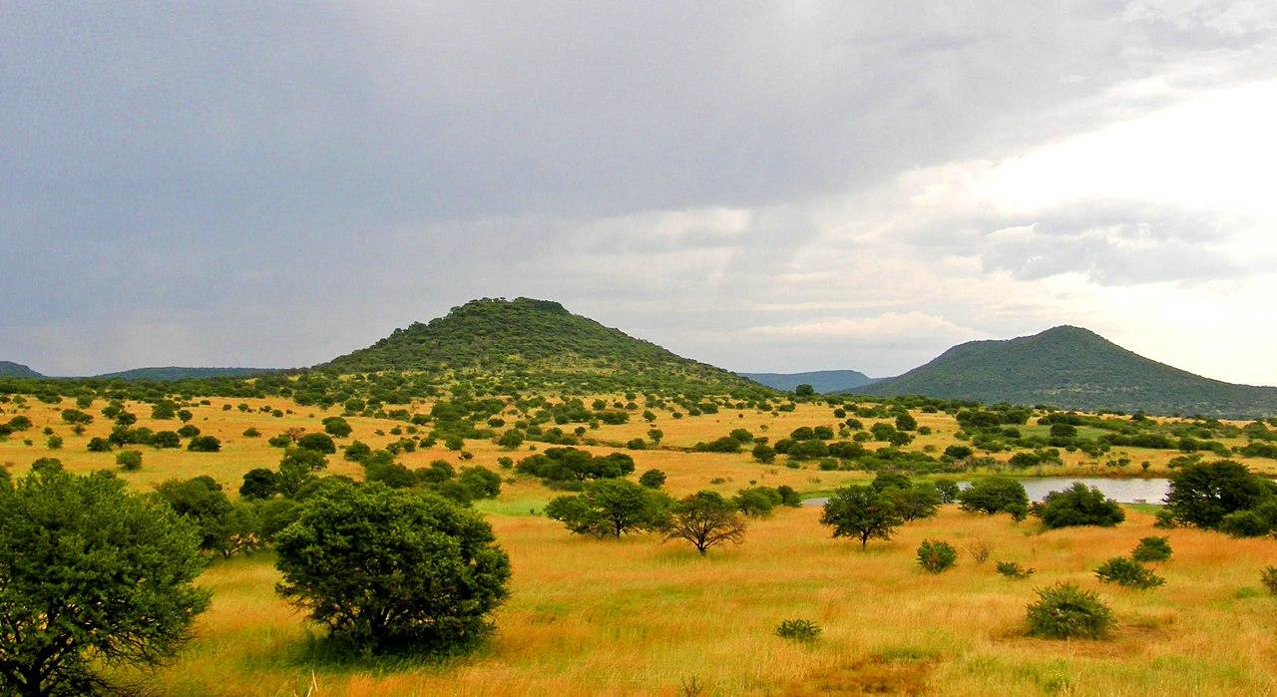
What is the Temperature like in the Savanna
The temperature in the Savanna can range up to 68* to 86* F in the winter it is 68* to 78* F
Notes:
Each slide have a different background
Each slide have pictures
Each slide have transitions (information slides in, rotates, etc.)

Slide 3
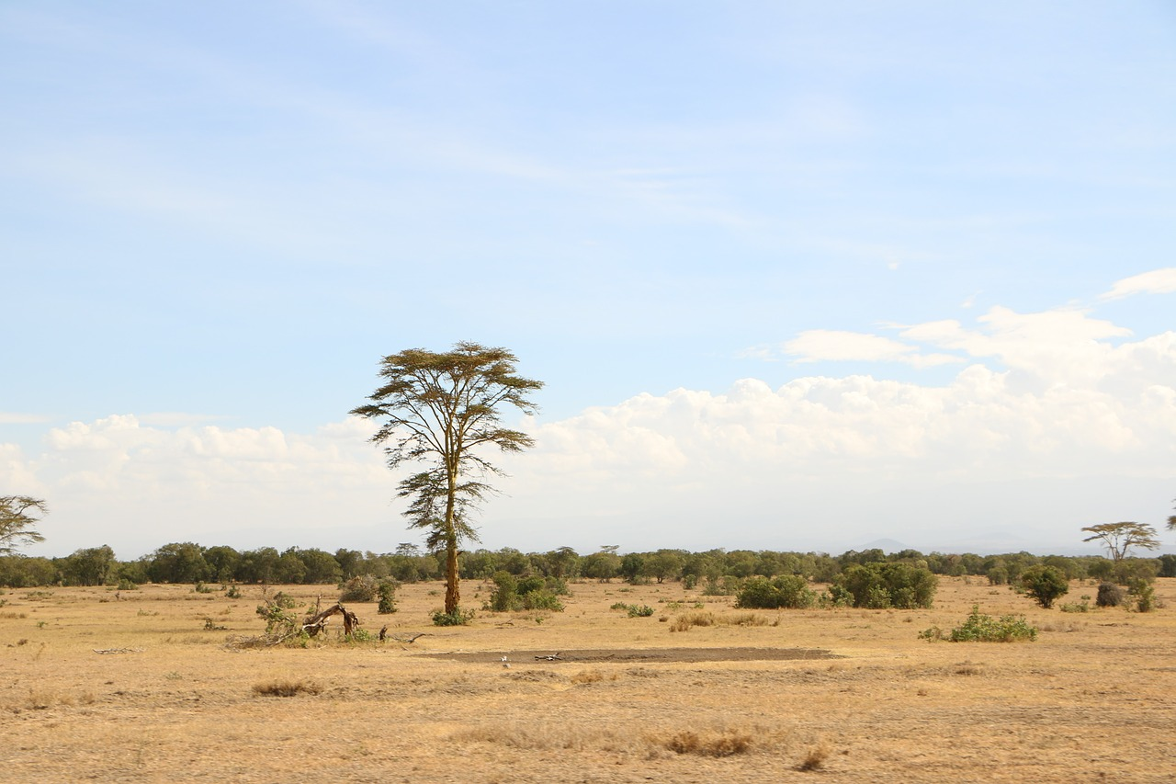
Are there any adaptations creatures need to survive in the savanna?
The animals in the Savanna adapt to the shortage of water and food through various ways to survive the shortage of food and water
Notes:
Each slide have a different background
Each slide have pictures
Each slide have transitions (information slides in, rotates, etc.)

Slide 4
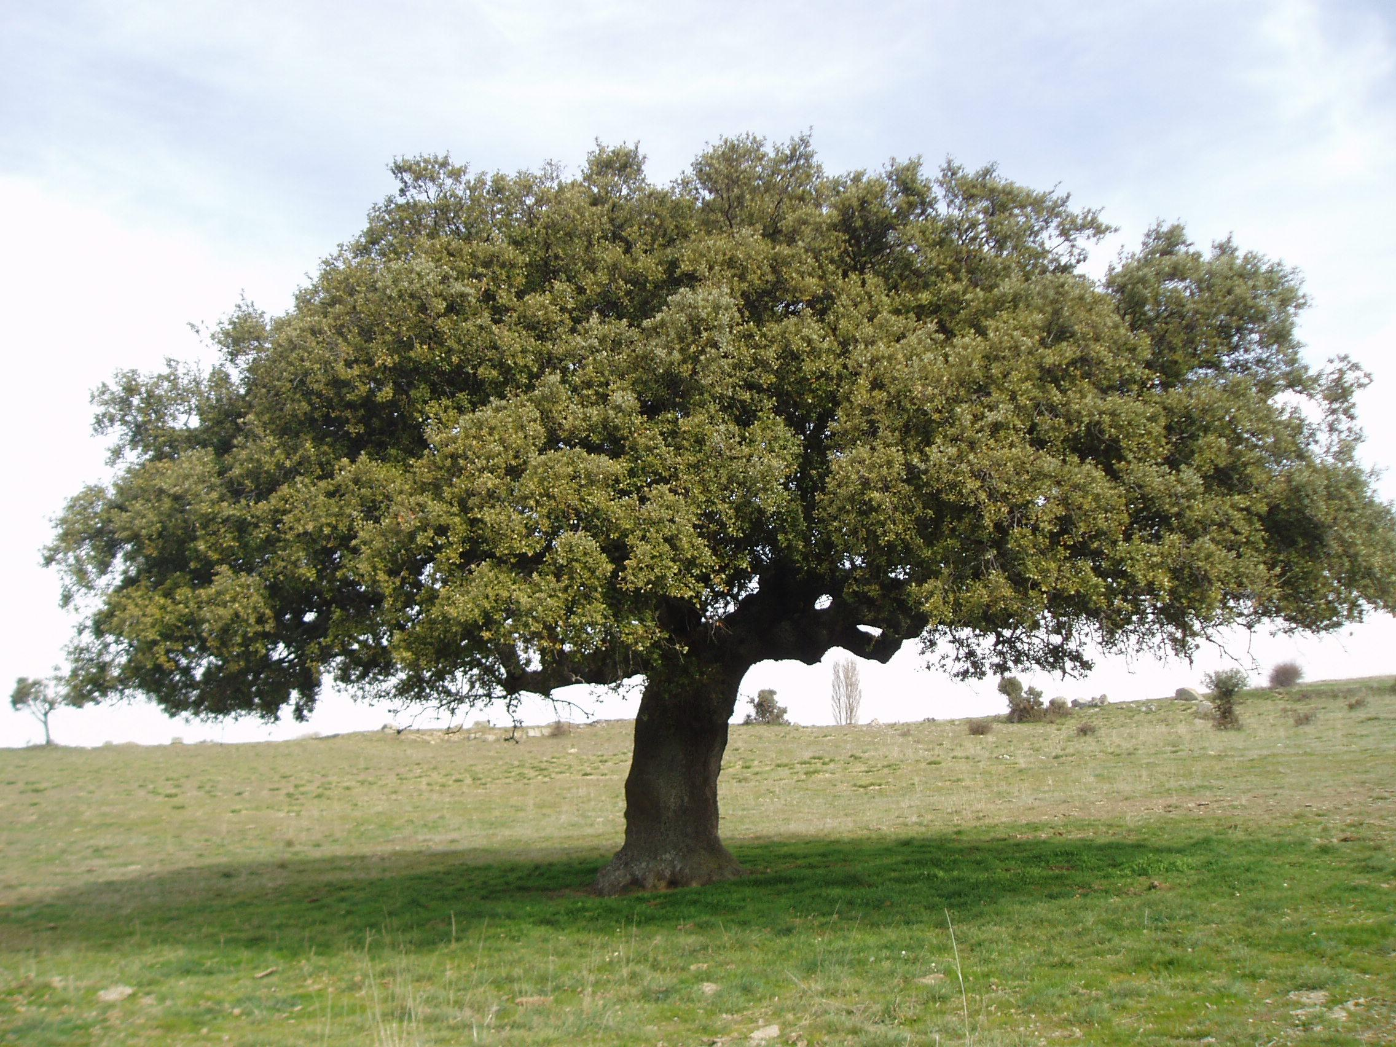
Producers in the Savanna
There are many producers in the savanna such as star grass, lemon grass, acacia trees, red oat grass and jackalberry trees
Notes:
Each slide have a different background
Each slide have pictures
Each slide have transitions (information slides in, rotates, etc.)

Slide 5
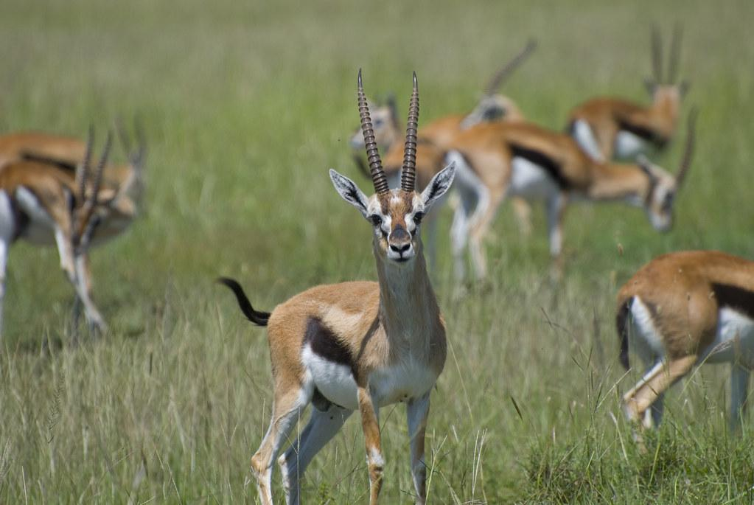
Primary Consumers in the Savanna
There are a high number of primary consumers in the savanna such as the Gazelles, giraffes, elephants, antelope, wildebeest, and zebras
Notes:
Each slide have a different background
Each slide have pictures
Each slide have transitions (information slides in, rotates, etc.)

Slide 6
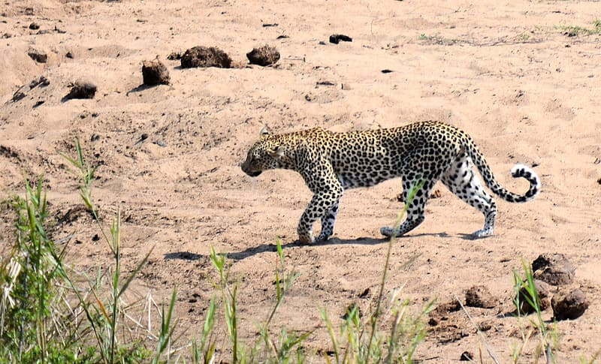
Secondary Consumers in the Savanna
Many of the examples of secondary consumers in the savanna are lions, leopards, cheetahs, hyenas, jackals, wild dogs, snakes, lizards and birds of prey
Notes:
Each slide have a different background
Each slide have pictures
Each slide have transitions (information slides in, rotates, etc.)

Slide 7
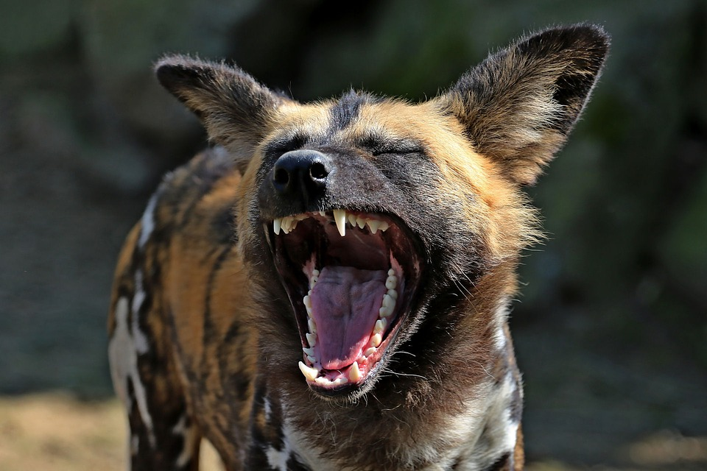
Tertiary Consumers
Examples of tertiary consumers are hyena,the african wild dog and the jackal.
Notes:
Each slide have a different background
Each slide have pictures
Each slide have transitions (information slides in, rotates, etc.)

Slide 8
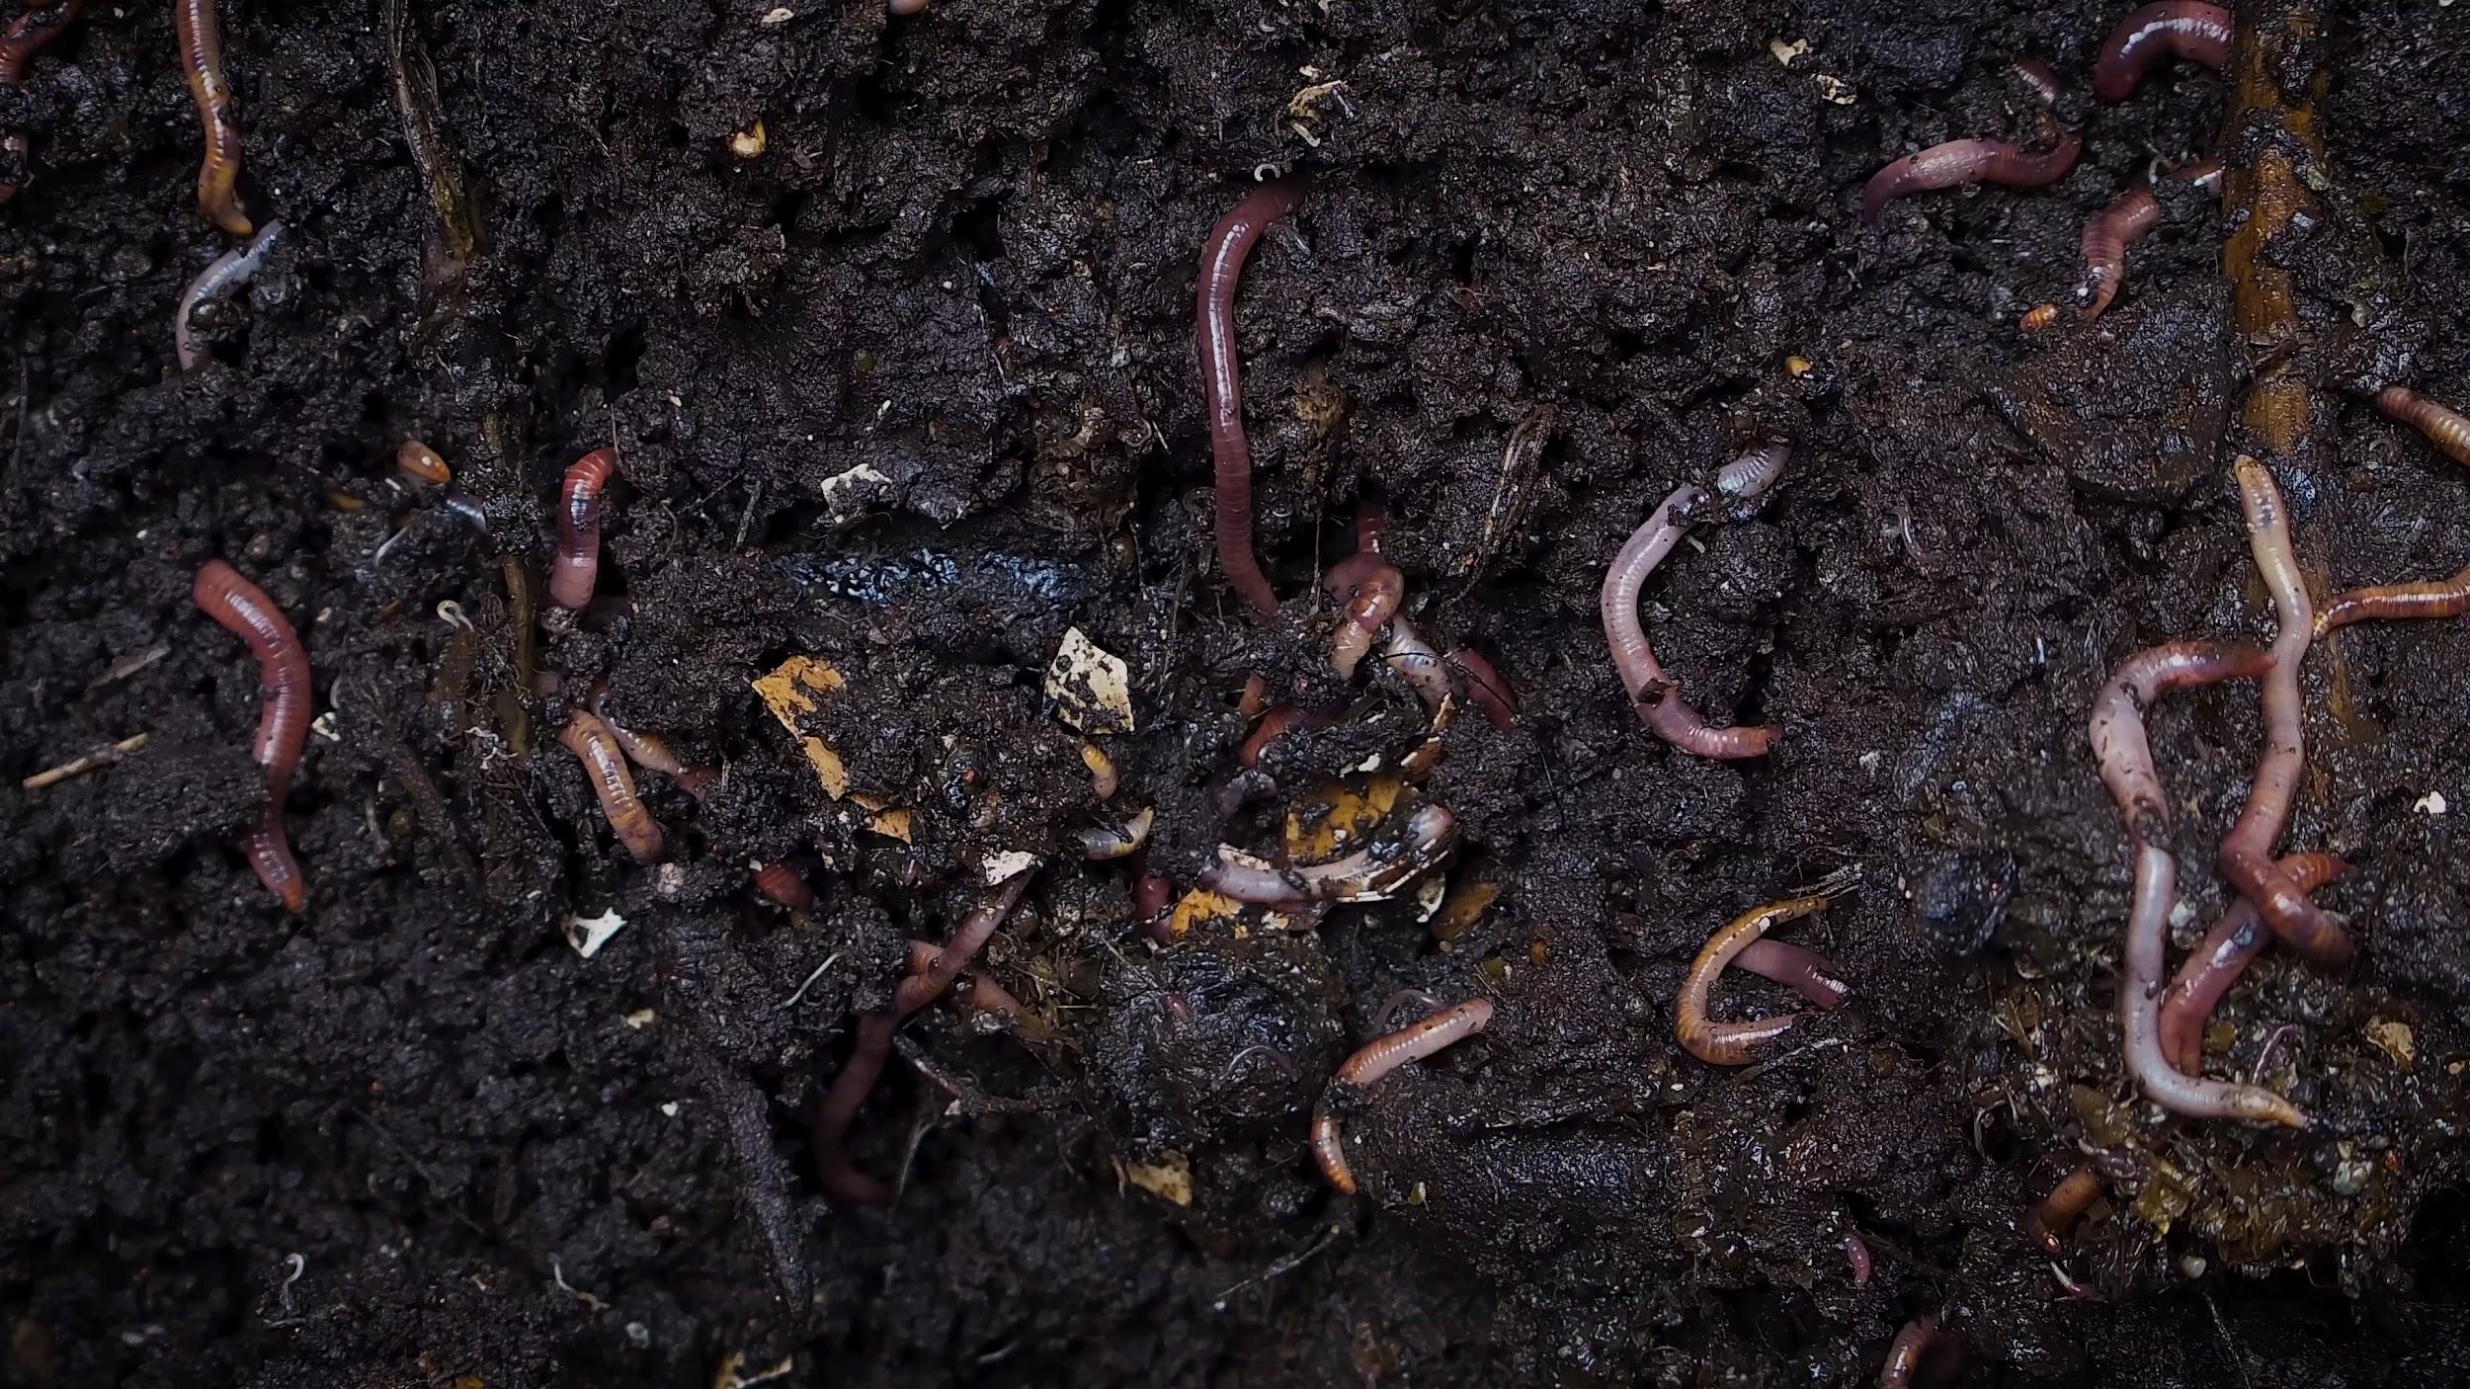
Decomposers in the Savanna
Examples of decomposers in the savanna are bacteria, fungi, earthworms and insects
Notes:
Each slide have a different background
Each slide have pictures
Each slide have transitions (information slides in, rotates, etc.)

Slide 9
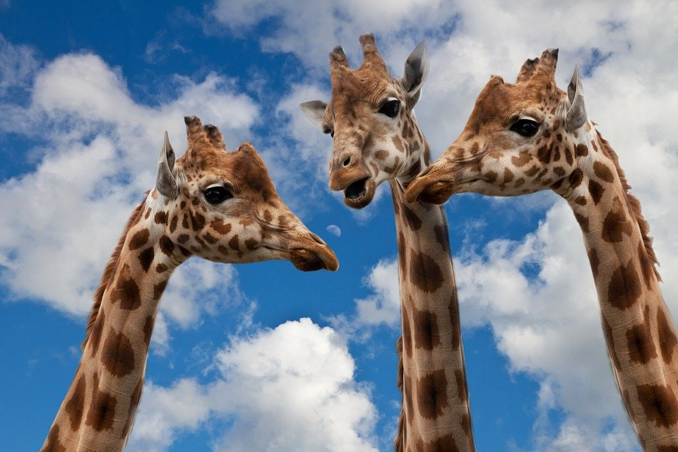
Mutualism in the Savanna
One of the examples of mutualism is the whistling-thorn Acacia tree, large herbivores such as giraffes, and ant communities that live on the trees Whistling-thorn Acacias reward ants that defend the trees from browsing herbivores.
Notes:
Each slide have a different background
Each slide have pictures
Each slide have transitions (information slides in, rotates, etc.)

Slide 10
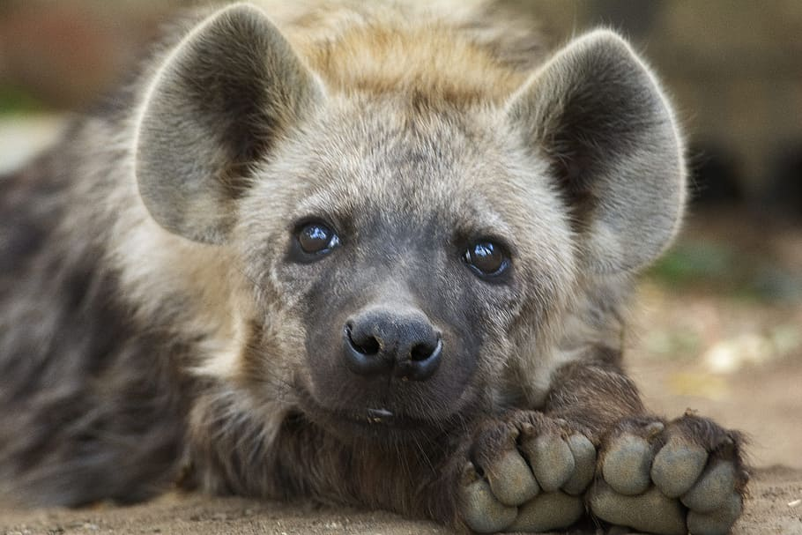
Commensalism in The Savanna
Examples of Commensalism in the savanna is the relationship between lions and hyenas: lions kill and consume certain animals, then hyenas feed on the remains
Notes:
Each slide have a different background
Each slide have pictures
Each slide have transitions (information slides in, rotates, etc.)

Slide 11
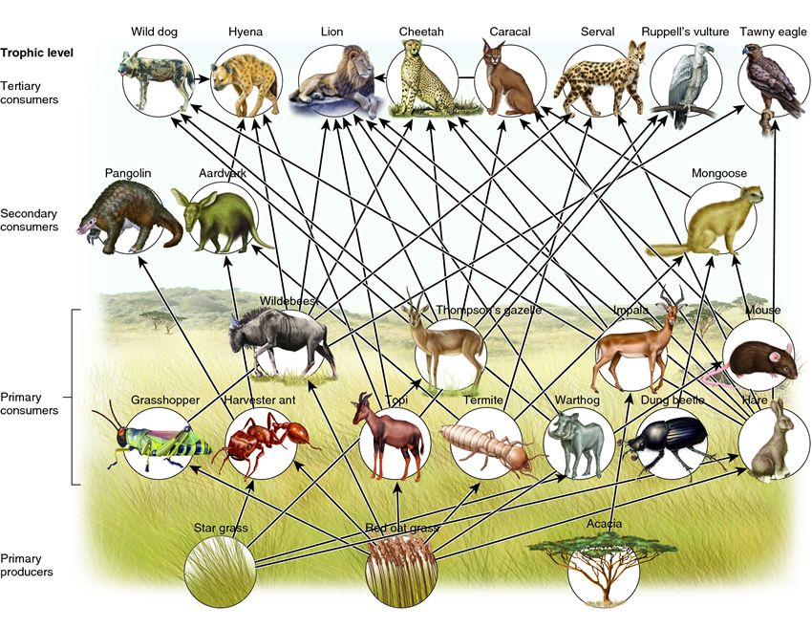
Food chains in the Savanna
Notes:
Each slide have a different background
Each slide have pictures
Each slide have transitions (information slides in, rotates, etc.)

