Slide 1
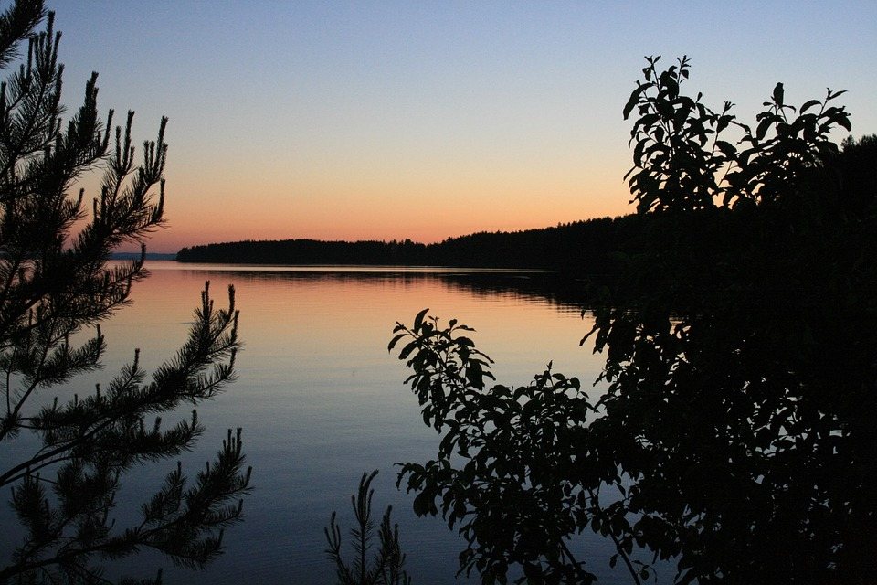
Taiga
Emily Verboonen Garcia
Notes:
Each slide have a different background
Each slide have pictures
Each slide have transitions (information slides in, rotates, etc.)

Slide 2
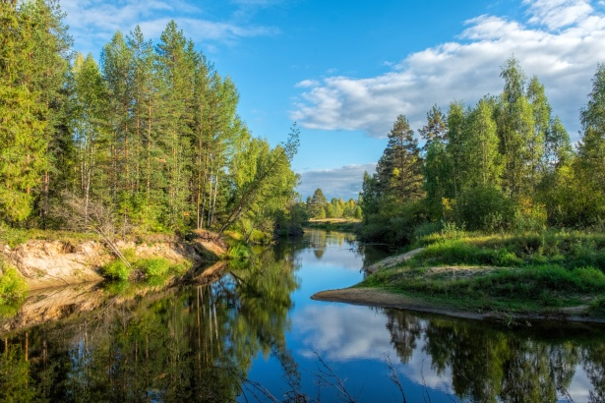
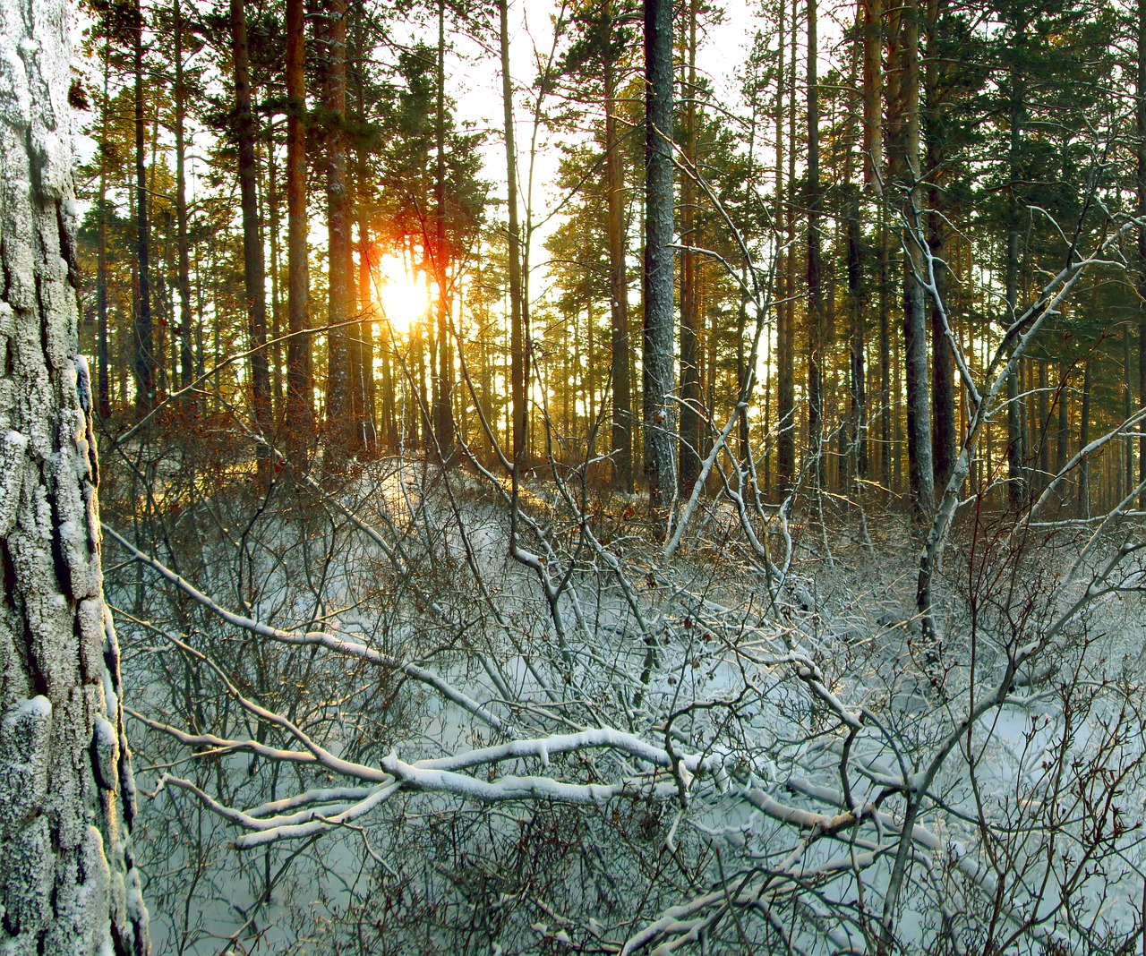
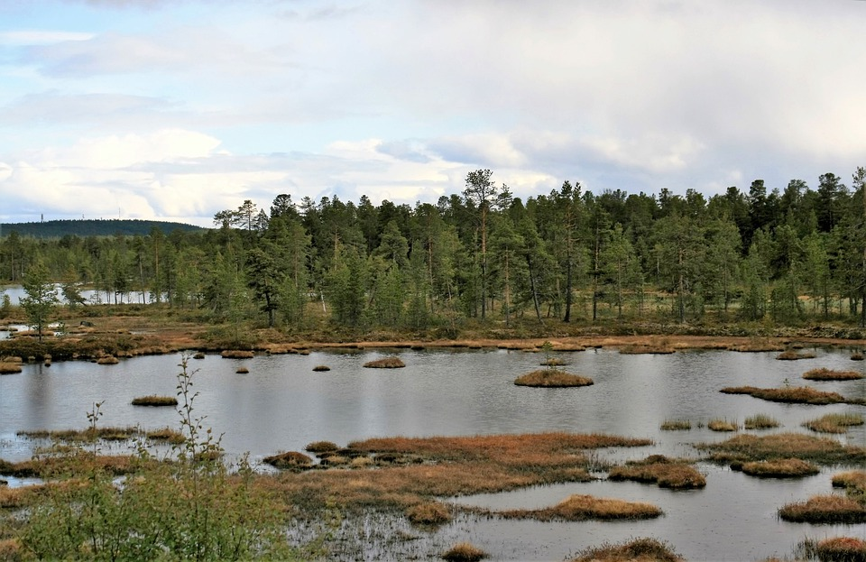
Taiga:
The taiga biome is the largest terrestrial biome. It can also get up to −10 °C (14 °F) or more.
Notes:
Each slide have a different background
Each slide have pictures
Each slide have transitions (information slides in, rotates, etc.)

Slide 3
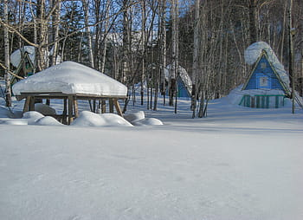
Adaptations:
Animals in taiga need a layer of insulating feathers or fur to protect them from the cold. Most animals migrate to warmer climates once the cold weather begins.
Notes:
Each slide have a different background
Each slide have pictures
Each slide have transitions (information slides in, rotates, etc.)

Slide 4
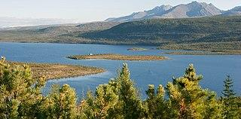
Producers:
Some examples of producers in taiga biome are trees,conifers, small shrubs, moss and grass.
Notes:
Each slide have a different background
Each slide have pictures
Each slide have transitions (information slides in, rotates, etc.)

Slide 5
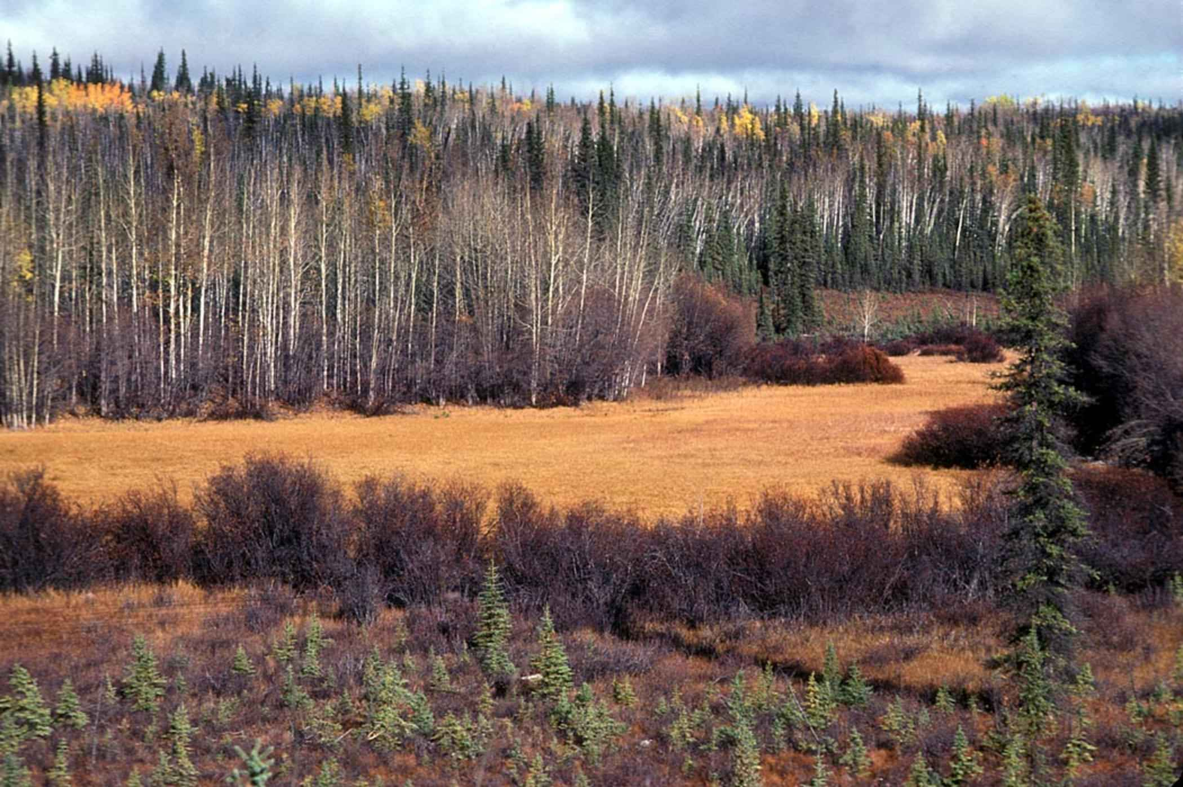
Primary Consumers:
Some examples of primary consumers in the taiga biome are rabbits, voles, mice, shrews.
Notes:
Each slide have a different background
Each slide have pictures
Each slide have transitions (information slides in, rotates, etc.)

Slide 6
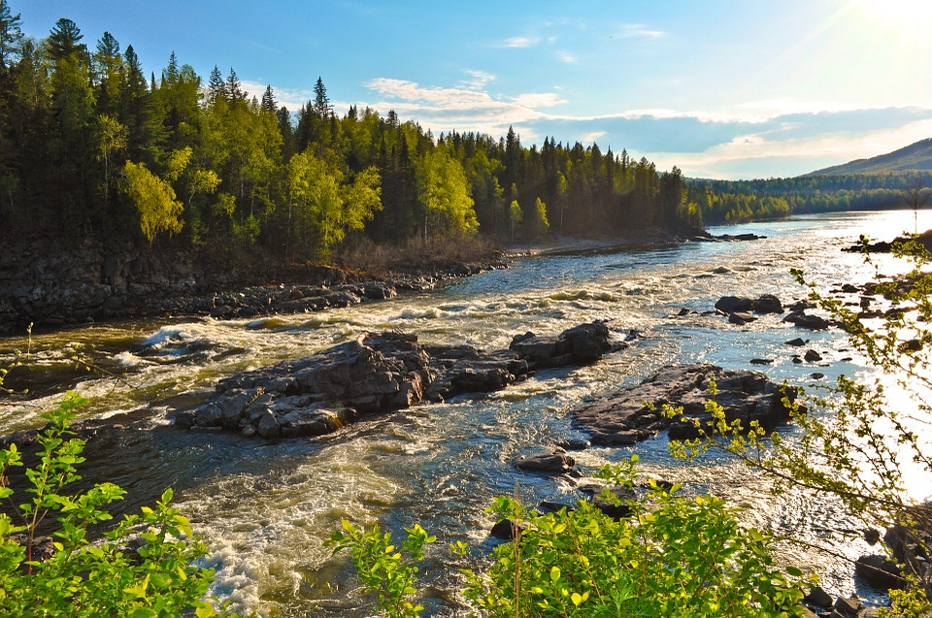
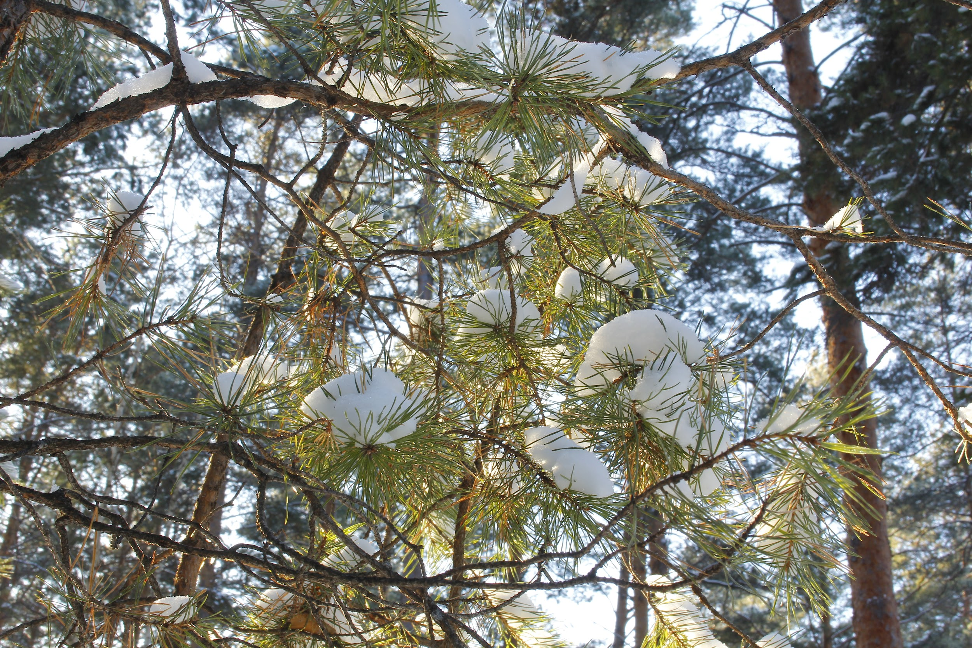
Secondary Consumers:
Examples of secondary consumers in the taiga biome are shellfish,snails,beetles, crustaceans.
Notes:
Each slide have a different background
Each slide have pictures
Each slide have transitions (information slides in, rotates, etc.)

Slide 7
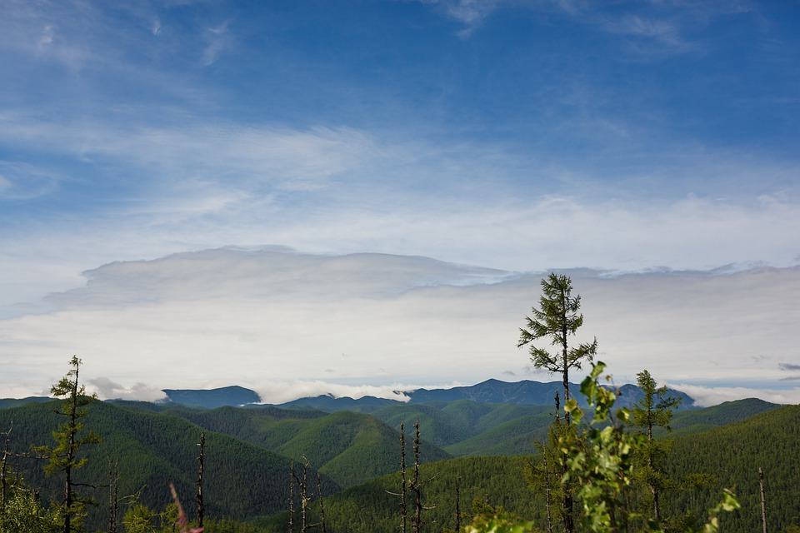
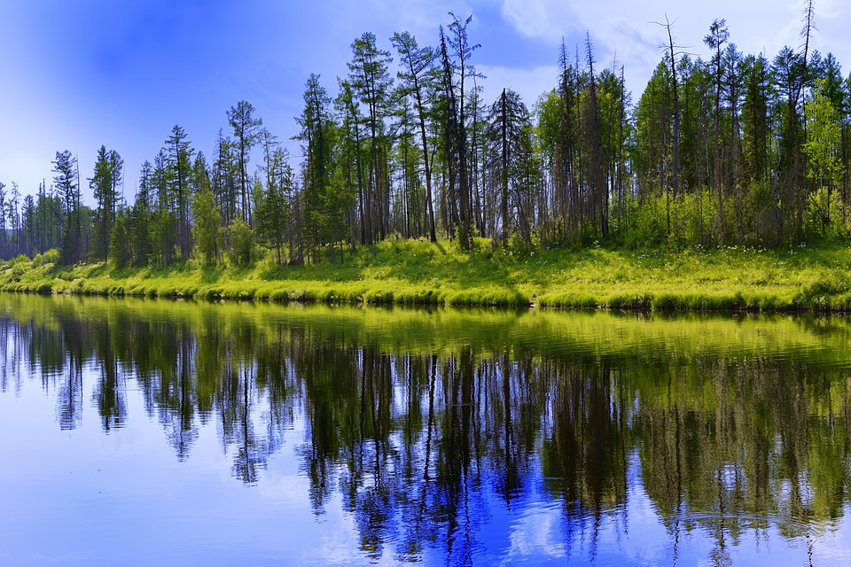
Tertiary Consumers:
Some examples of tertiary consumers in taiga are bears,owls,and eagles.
Notes:
Each slide have a different background
Each slide have pictures
Each slide have transitions (information slides in, rotates, etc.)

Slide 8
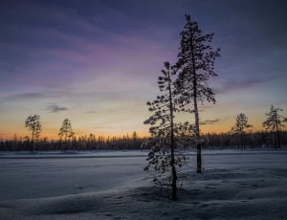
Decomposers:
A few examples of decomposers in the taiga biome are snails,flies,slugs,fungi,bacteria,earthworms and more.
Notes:
Each slide have a different background
Each slide have pictures
Each slide have transitions (information slides in, rotates, etc.)

Slide 9
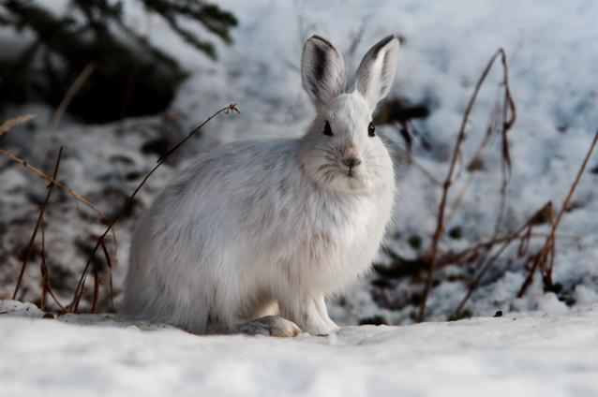
Mutualism:
An example of mutualism in the taiga biome is when bees fly plant to plant.
Notes:
Each slide have a different background
Each slide have pictures
Each slide have transitions (information slides in, rotates, etc.)

Slide 10
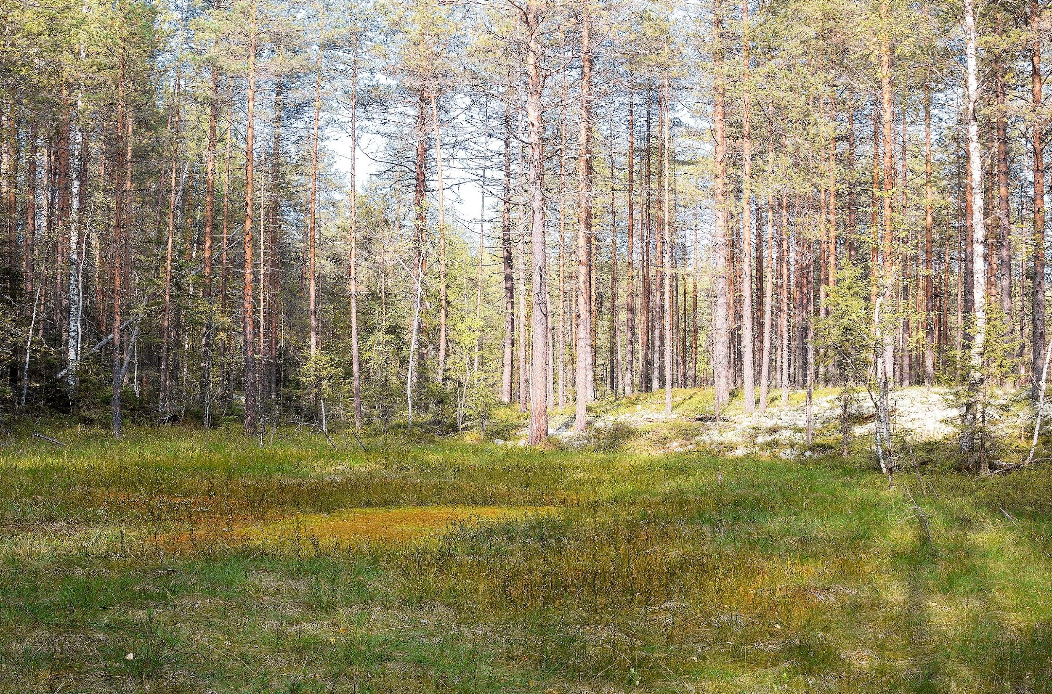
Commensalism:
An example of commensalism in the taiga biome is when moss starts growing on trees.
Notes:
Each slide have a different background
Each slide have pictures
Each slide have transitions (information slides in, rotates, etc.)

Slide 11
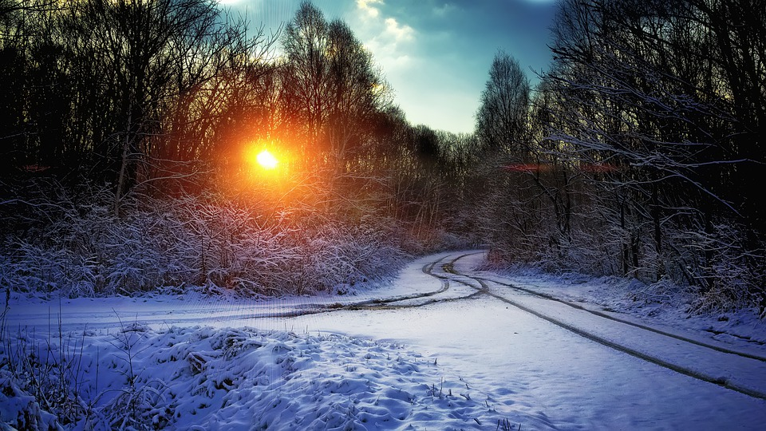
Parasitism:
An parasitism example in taiga is when a winter tick hitchhikes on a moose's back.
Notes:
Each slide have a different background
Each slide have pictures
Each slide have transitions (information slides in, rotates, etc.)

Slide 12
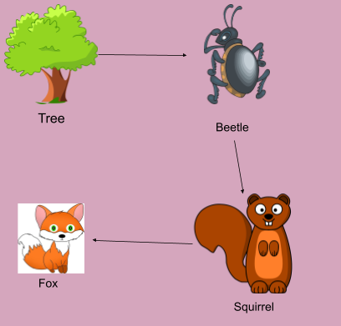
Food Web:
Notes:
Each slide have a different background
Each slide have pictures
Each slide have transitions (information slides in, rotates, etc.)
:)

Slide 13
Resources
Taiga - Wikipedia
Environmental conditions - taiga - Encyclopedia Britannica
Taiga Facts - MBGnet
Taiga Biome (Boreal Forest) - Earth Eclipse
Weather and Climate - Boreal Forest and Taiga

