Slide 1
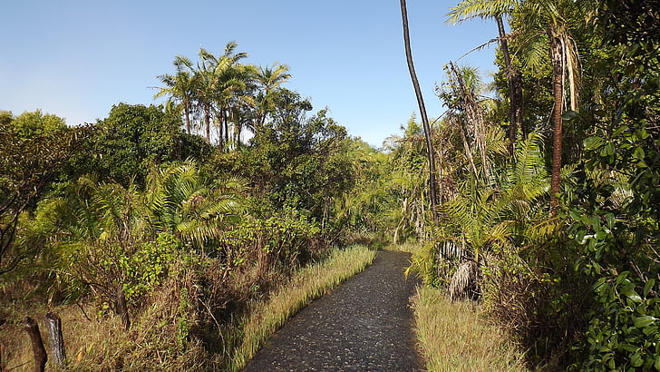
Tropical Rainforest

