Slide 1


Biome Project
The Biome!!
Savanna
Notes:
Each slide have a different background
Each slide have pictures
Each slide have transitions (information slides in, rotates, etc.)

Slide 2
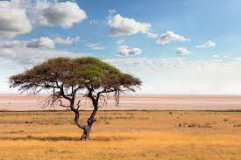

Seasons, Climate, etc.
The temperature is on average 68-86 degrees fahrenheit. The seasons are only dry and wet seasons!! It rains average 30-40 inches.
Notes:
Each slide have a different background
Each slide have pictures
Each slide have transitions (information slides in, rotates, etc.)

Slide 3
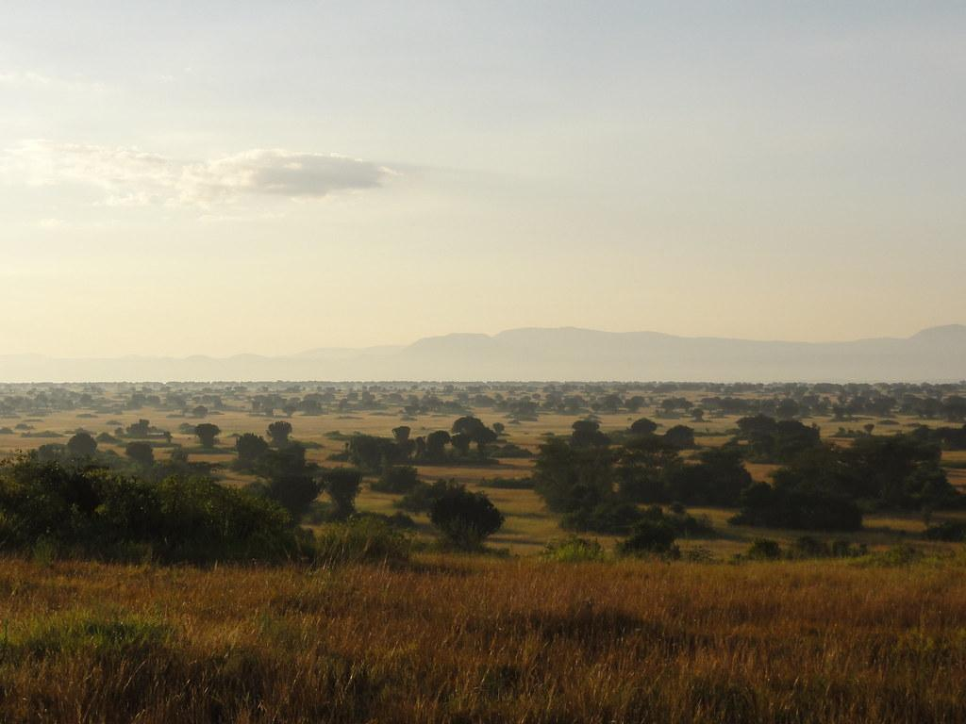
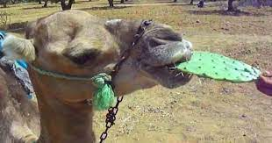

Animal Adaptations
Animals must adapt to little water and food in their home, and therefore they have to find other ways to get food
Notes:
Each slide have a different background
Each slide have pictures
Each slide have transitions (information slides in, rotates, etc.)

Slide 4
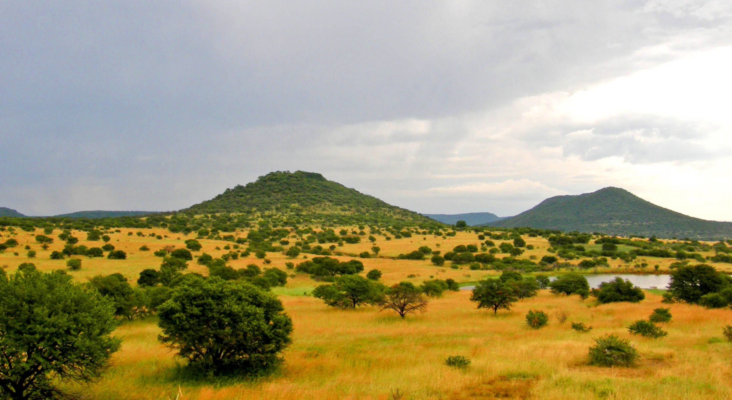
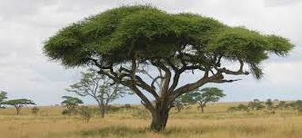

Producers in my Biome:
Some producers in the Savanna are Jackalberry Trees, Star grass, Lemongrass, and Jarrah trees.
Notes:
Each slide have a different background
Each slide have pictures
Each slide have transitions (information slides in, rotates, etc.)

Slide 5
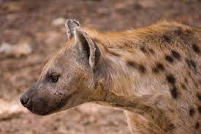

Primary Consumers in my Biome:
The consumers in my biome are Gazelles Giraffe, Antelope, Zebras, Elephants, lizards, bugs, insects
Notes:
Each slide have a different background
Each slide have pictures
Each slide have transitions (information slides in, rotates, etc.)

Slide 6
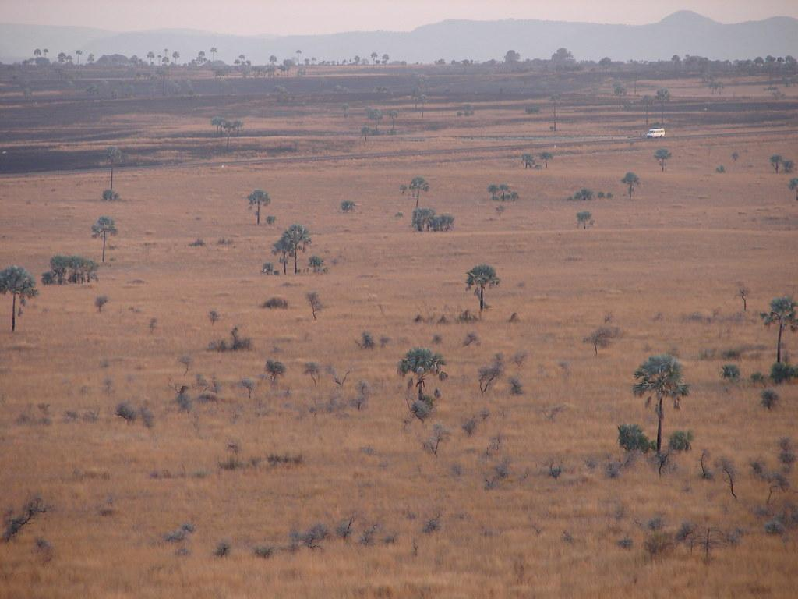

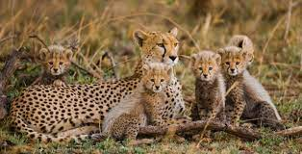
Secondary Consumers in my Biome:
The secondary consumers in my biome are wild dogs, hyenas, birds, lizards.
Notes:
Each slide have a different background
Each slide have pictures
Each slide have transitions (information slides in, rotates, etc.)

Slide 7
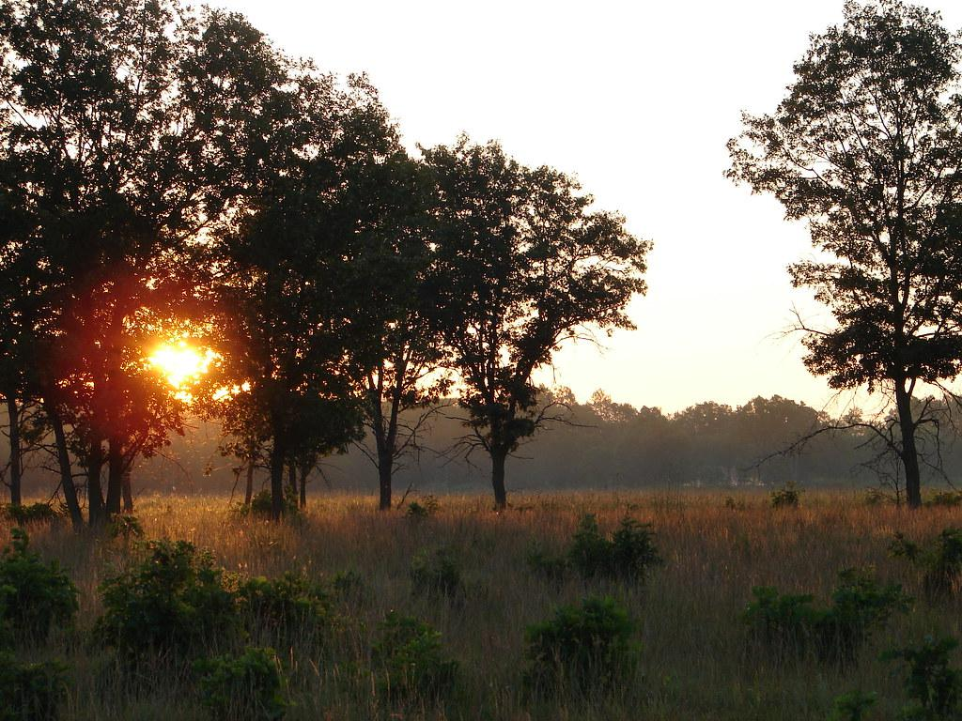

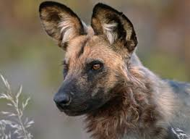
Tertiary Consumers in the Savanna
Tertiary consumers in the Savanna are Lions, leopards, cheetah, jackals, snakes
Notes:
Each slide have a different background
Each slide have pictures
Each slide have transitions (information slides in, rotates, etc.)
The title is hard to read against this background.

Slide 8
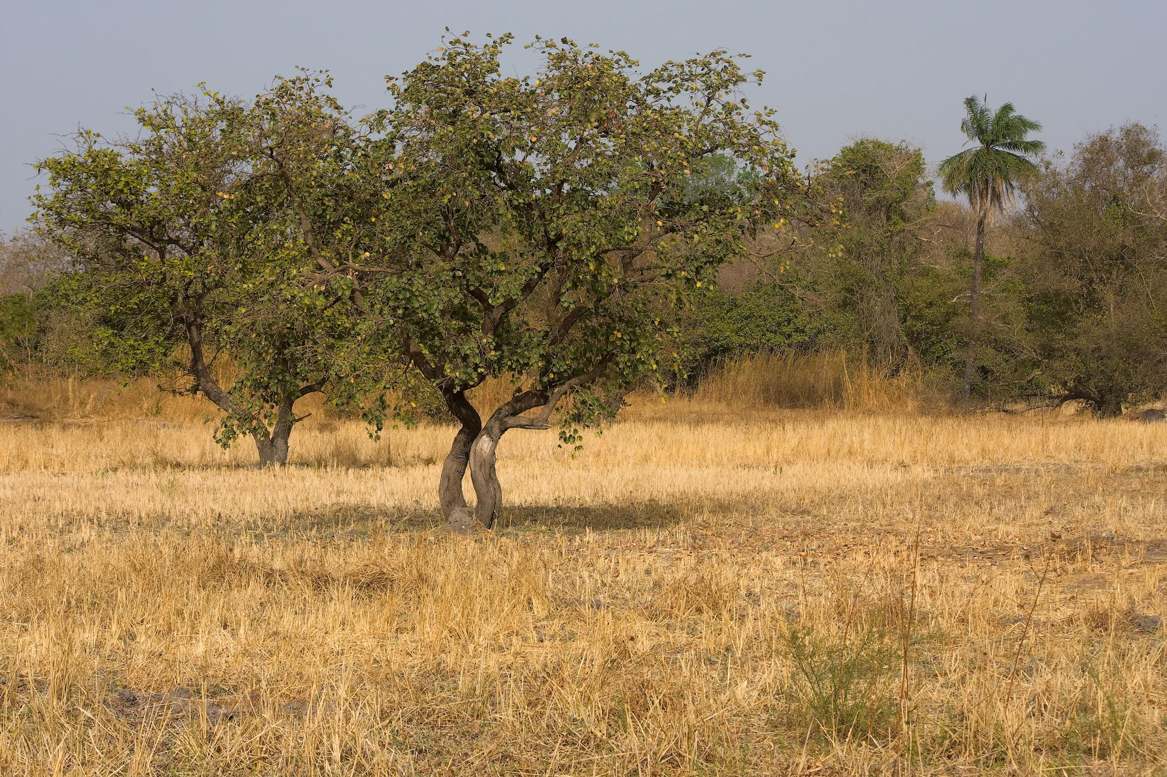
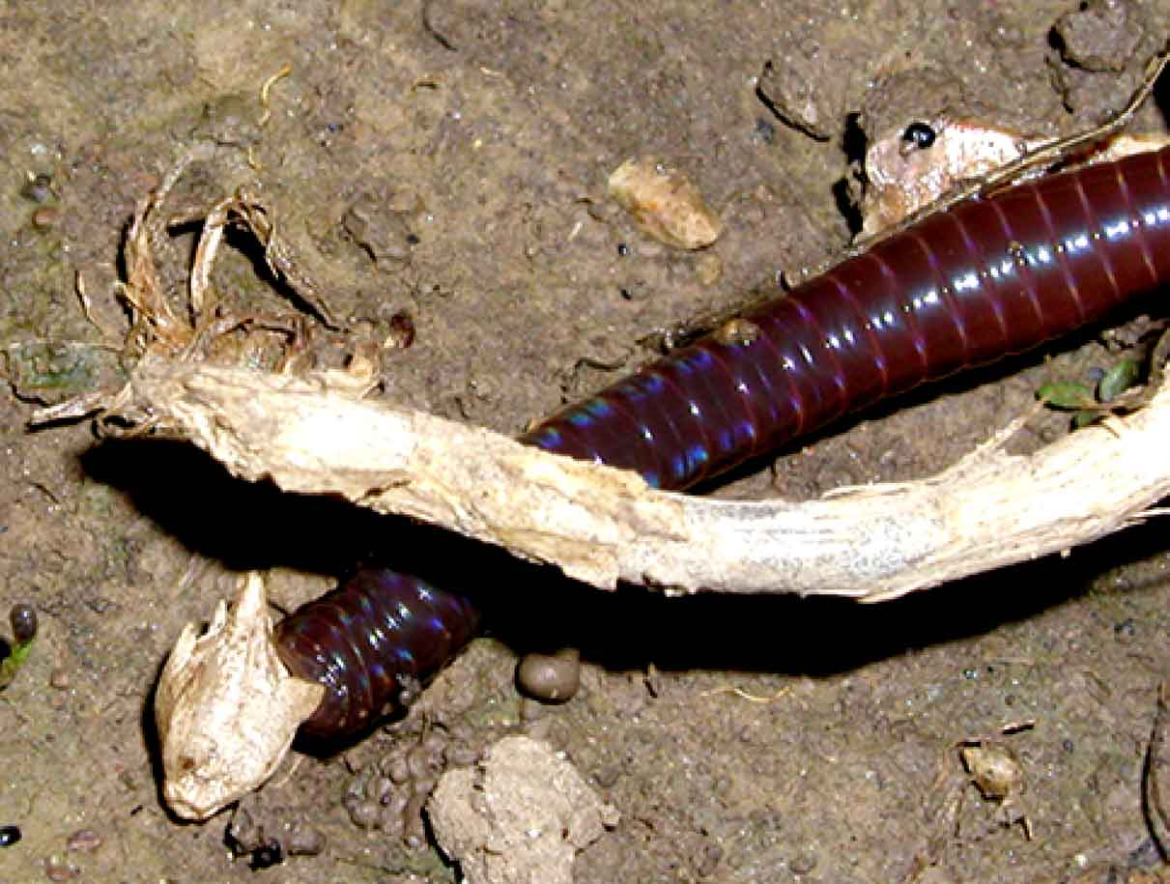

Decomposers in the Savanna
Insects, bacteria, fungi worms.
Notes:
Each slide have a different background
Each slide have pictures
Each slide have transitions (information slides in, rotates, etc.)

Slide 9
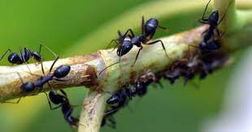
An example of mutualism in my biome.
Ants and trees, the ants would get food, and protect the tree, while the tree gets protection.
Notes:
Each slide have a different background
Each slide have pictures
Each slide have transitions (information slides in, rotates, etc.)

Slide 10

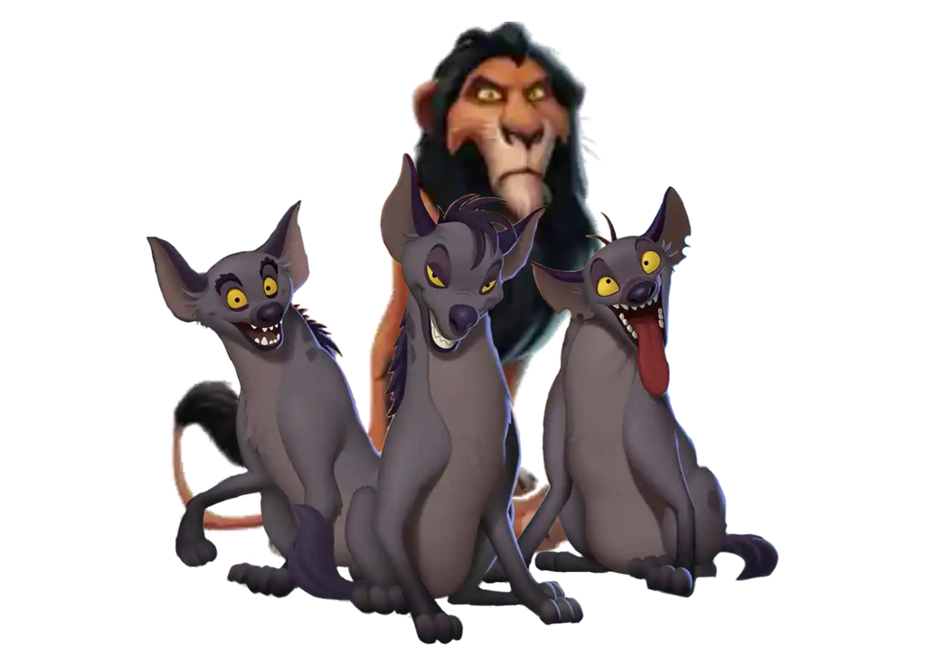
The Commensalism in my Biome:
The lions will hunt and eat, and the hyenas get the leftovers.
Notes:
Each slide have a different background
Each slide have pictures
Each slide have transitions (information slides in, rotates, etc.)

Slide 11
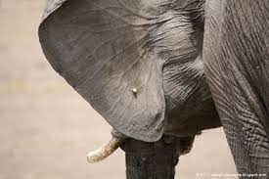

Parasitism in my Biome
An example of parasitism is an elephant and tic. The tic gets the blood from the elephant and that leaves a bad effect on it.
Notes:
Each slide have a different background
Each slide have pictures
Each slide have transitions (information slides in, rotates, etc.)

Slide 12
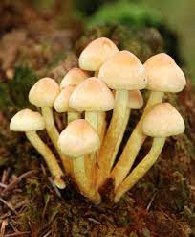
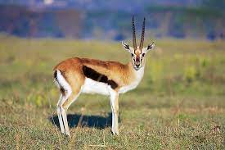
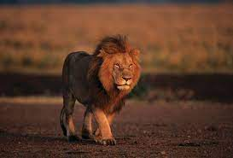
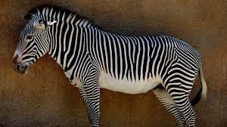
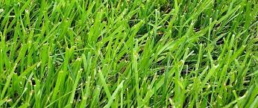
Food web of my Biome

Slide 13

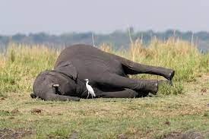
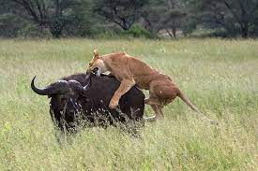
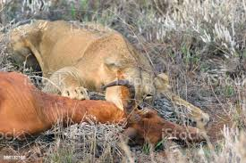
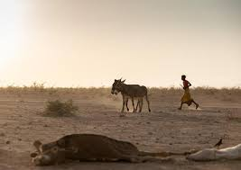
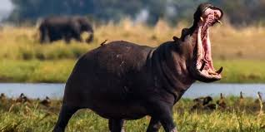
Would I want to live here?
No.
Notes:
Extra Credit Slide
Each slide have a different background
Each slide have pictures
Each slide have transitions (information slides in, rotates, etc.)

