Slide 1
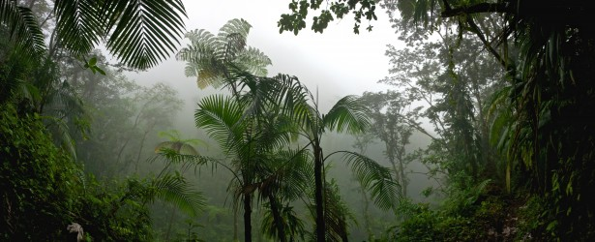
Tropical Rainforest
by : Jennifer Ramirez
Notes:
1-Each slide have a different background
1-Each slide have pictures
1-Each slide have transitions (information slides in, rotates, etc.)

Slide 2
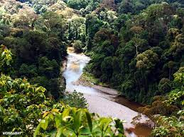
What is the Tropical Rainforest like?
The tropical Rainforest is like a hot, moist biome when it rains and its average temperature is suppose to be from 20°C (68°F) to 25°C (77°F).
Notes:
1-Each slide have a different background
1-Each slide have pictures
1-Each slide have transitions (information slides in, rotates, etc.)

Slide 3
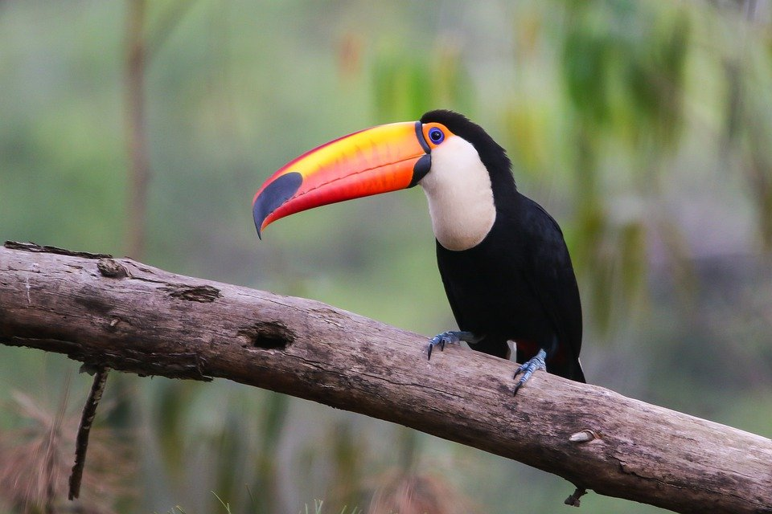
What do toucans adaptations need to be in the Tropical Rainforest?
The toucans adaptations is their beak which provides it for defending itself against smaller predators.
Notes:
1-Each slide have a different background
1-Each slide have pictures
1-Each slide have transitions (information slides in, rotates, etc.)

Slide 4
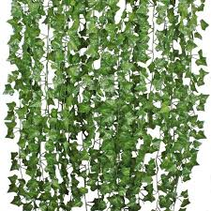
What are some examples of producers in the tropical Rainforest?
One example of a producer that is in the Tropical Rainforest is vines.
Notes:
1-Each slide have a different background
1-Each slide have pictures
1-Each slide have transitions (information slides in, rotates, etc.)

Slide 5
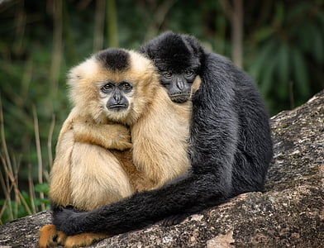
What is an example of a primary consumer in the Tropical Rainforest?
A monkey is an example of a primary consumer in the Tropical Rainforest.
Notes:
1-Each slide have a different background
1-Each slide have pictures
1-Each slide have transitions (information slides in, rotates, etc.)
The title needs to be larger font than the paragraph.

Slide 6
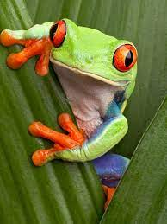
What is an example of a secondary consumer in the Tropical Rainforest?
An example of a secondary consumer in the tropical rainforest is a tree frog.
Notes:
1-Each slide have a different background
1-Each slide have pictures
1-Each slide have transitions (information slides in, rotates, etc.)
The title needs to be larger font than the paragraph.

Slide 7
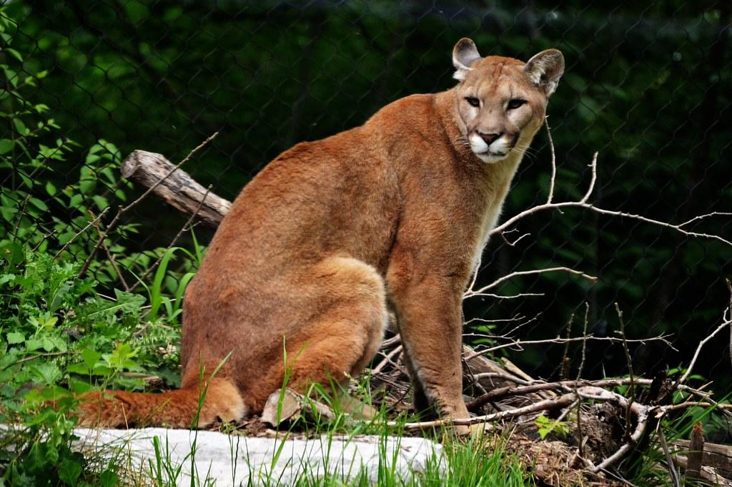
What is an example of a tertiary consumer in the Tropical Rainforest?
Pumas are examples of tertiary consumers that live in the tropical Rainforest.
Notes:
1-Each slide have a different background
1-Each slide have pictures
1-Each slide have transitions (information slides in, rotates, etc.)
The title needs to be larger font than the paragraph.

Slide 8
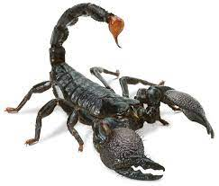
What are some examples of decomposers in the Tropical Rainforest?
Scorpions are an example of decomposers that live in the Tropical Rainforest.
Notes:
1-Each slide have a different background
1-Each slide have pictures
1-Each slide have transitions (information slides in, rotates, etc.)
The title needs to be larger font than the paragraph.

Slide 9
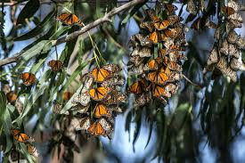
What is an example of Mutualism in the Tropical Rainforest?
An example of mutualism in the tropical rainforest is a monarch butterfly because they travel in large groups to stay safe.
Notes:
1-Each slide have a different background
1-Each slide have pictures
1-Each slide have transitions (information slides in, rotates, etc.)
The title needs to be larger font than the paragraph.

Slide 10
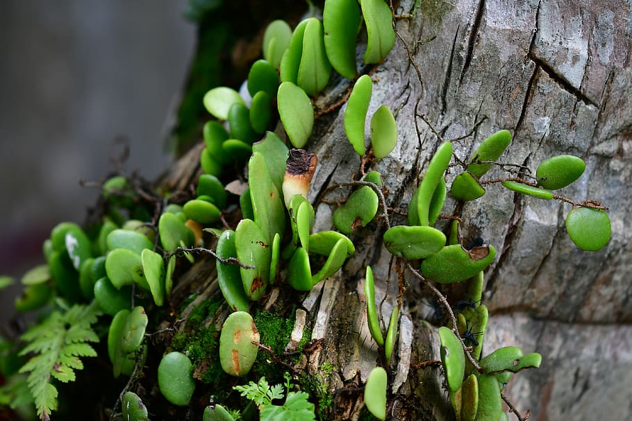
What is an example of Commensalism in the Tropical Rainforest?
An example of Commensalism in the Tropical Rainforest are epiphyte plants.
Notes:
1-Each slide have a different background
1-Each slide have pictures
1-Each slide have transitions (information slides in, rotates, etc.)
The title needs to be larger font than the paragraph.

Slide 11
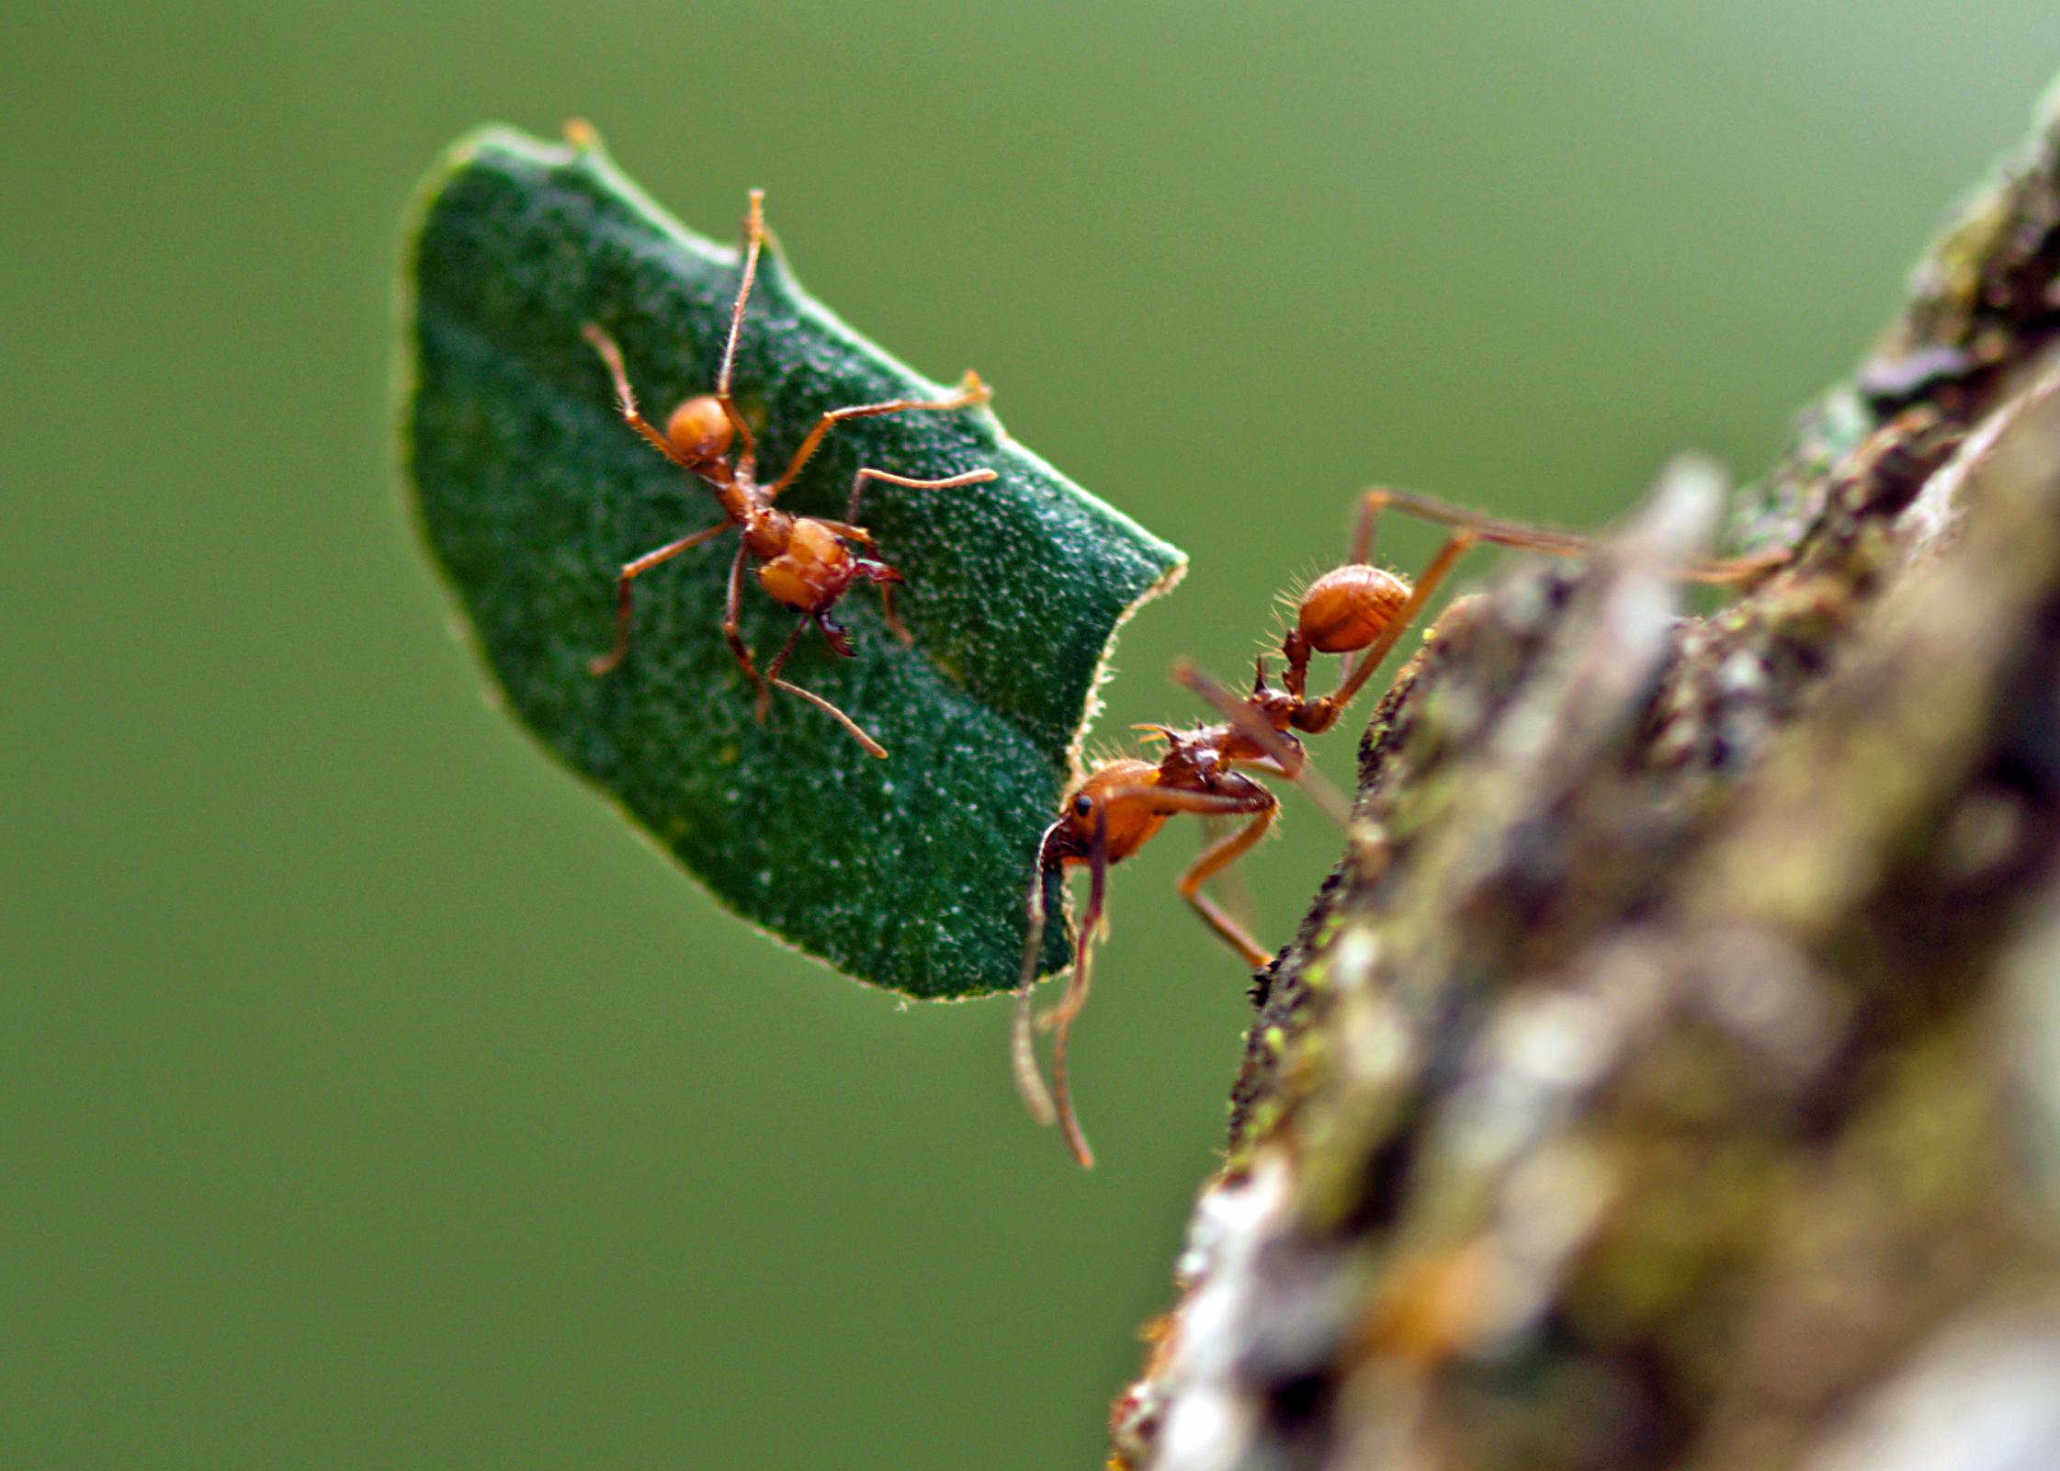
What is an example of parasitism in the Tropical Rainforest?
An example of parasitism in the Tropical Rainforest are leaf-cutter ants.
Notes:
1-Each slide have a different background
1-Each slide have pictures
1-Each slide have transitions (information slides in, rotates, etc.)
The title needs to be larger font than the paragraph.

Slide 12
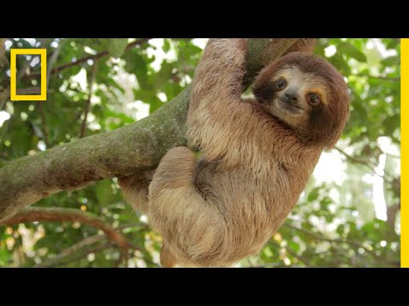
A link of a video about the Tropical Rainforest:
https://www.youtube.com/watch?v=3vijLre760w
Notes:
1-Each slide have a different background
1-Each slide have pictures
1-Each slide have transitions (information slides in, rotates, etc.)

Slide 13
Web Sources
Brandhome.com National Geographic Society lisbdnet.com
Study.com edtechlens.com earthobservatory.nasa.gov
Sciencing.com storymaps.arcgis.com
Notes:
1-Each slide have a different background
1-Each slide have pictures
1-Each slide have transitions (information slides in, rotates, etc.)

