Slide 1
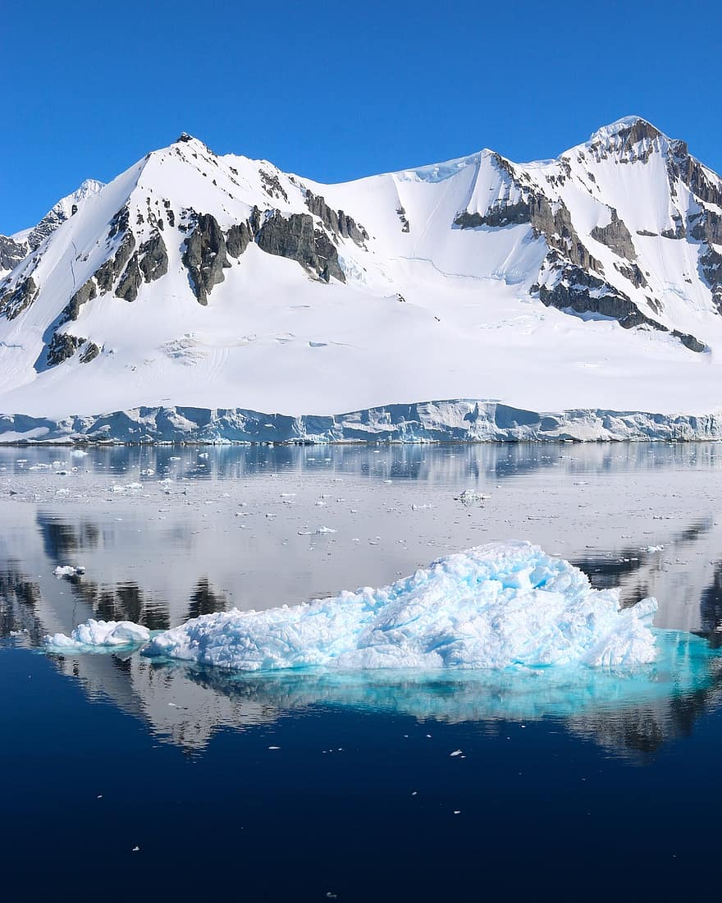
Polar Region
By Jesus Valdez
Notes:
1-Each slide have a different background
1-Each slide have pictures
1-Each slide have transitions (information slides in, rotates, etc.)
This slide needs a transition.

Slide 2
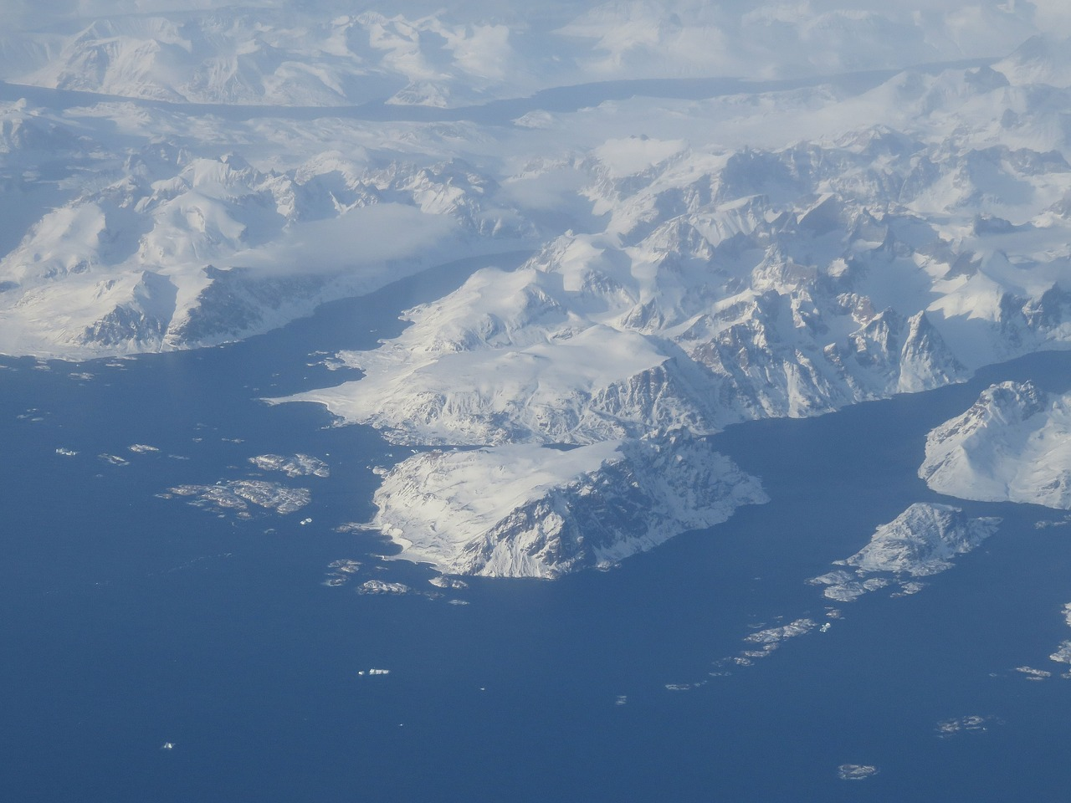
What it is like in the Polar Region
The Polar Region Is Extremely cold with an average temperature of less than 10 °C (50 °F). Also it rains less than 25 cm each year.
Notes:
1-Each slide have a different background
1-Each slide have pictures
1-Each slide have transitions (information slides in, rotates, etc.)
Make sure the title is in larger font than the paragraph. This slide needs a transition.

Slide 3
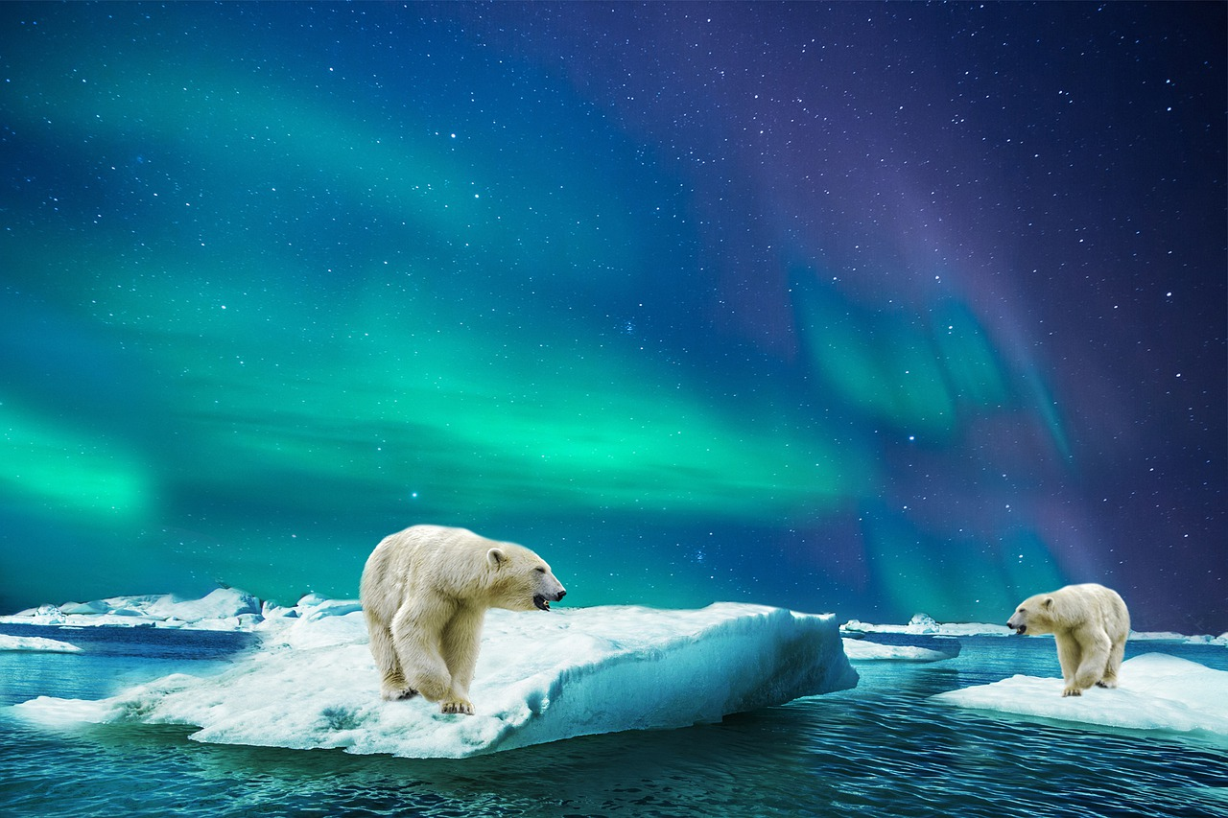
Adaptations in the Polar Region
For Polar Bears they have a thick layer of fur and fat.”For insulation against the cold, a small surface area to volume ratio”.
Notes:
1-Each slide have a different background
1-Each slide have pictures
1-Each slide have transitions (information slides in, rotates, etc.)
Make sure the title is in larger font than the paragraph. This slide needs a transition.

Slide 4
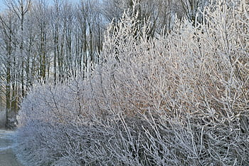
Producers in the Polar region
Lichens, algae, grasses, mosses, and dwarf woody shrubs.
Notes:
1-Each slide have a different background
1-Each slide have pictures
1-Each slide have transitions (information slides in, rotates, etc.)
Make sure the title is in larger font than the paragraph. This slide needs a transition. Either make the title a sentence with proper punctuation, or capitalize all the words. Some to the text is hard to read against the background.

Slide 5
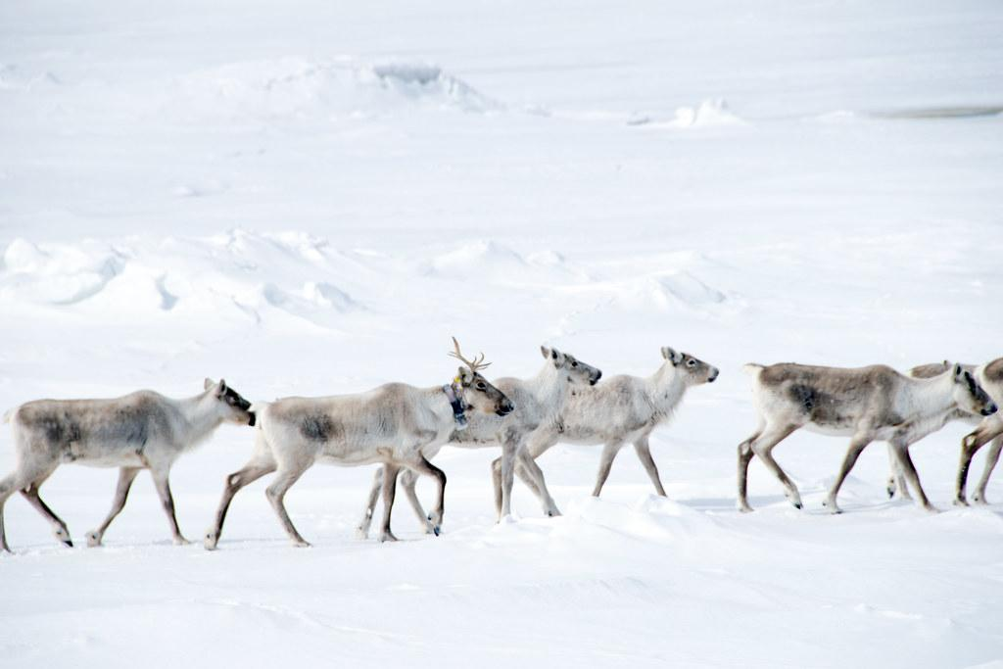
Primary Consumers in the Polar Region
Examples of Primary Consumer are Caribou, rabbits and there are other animals.
Notes:
1-Each slide have a different background
1-Each slide have pictures
1-Each slide have transitions (information slides in, rotates, etc.)
Make sure the title is in larger font than the paragraph. This slide needs a transition.

Slide 6

Secondary consumers in the Polar Region
Here are some examples of secondary consumers in the Polar region: arctic foxes, brown bears, arctic wolves, snowy owls, and penguins.
Notes:
1-Each slide have a different background
1-Each slide have pictures
1-Each slide have transitions (information slides in, rotates, etc.)
Make sure the title is in larger font than the paragraph. This slide needs a transition.

Slide 7
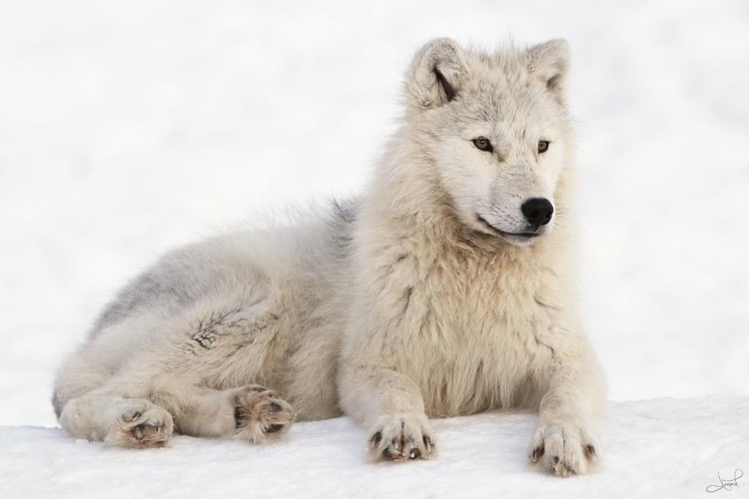
Tertiary Consumers in the Polar Region
Here are some examples of Tertiary consumers in the Polar Region: Polar Bear, wolves, and eagles.
Notes:
1-Each slide have a different background
1-Each slide have pictures
1-Each slide have transitions (information slides in, rotates, etc.)
Make sure the title is in larger font than the paragraph. This slide needs a transition.

Slide 8
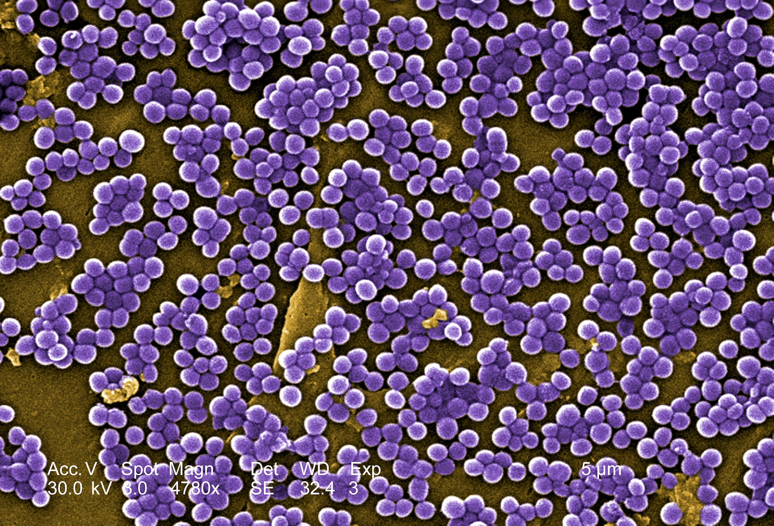
Decomposers in the Polar Region
Examples of decomposers are Staphylococcus, Bacillus, Corynebacterium, Micrococcus, Streptococcus, Neisseria molds, yeasts, the fungi from lichen, and microorganisms.
Notes:
1-Each slide have a different background
1-Each slide have pictures
1-Each slide have transitions (information slides in, rotates, etc.)
Make sure the title is in larger font than the paragraph. This slide needs a transition.

Slide 9
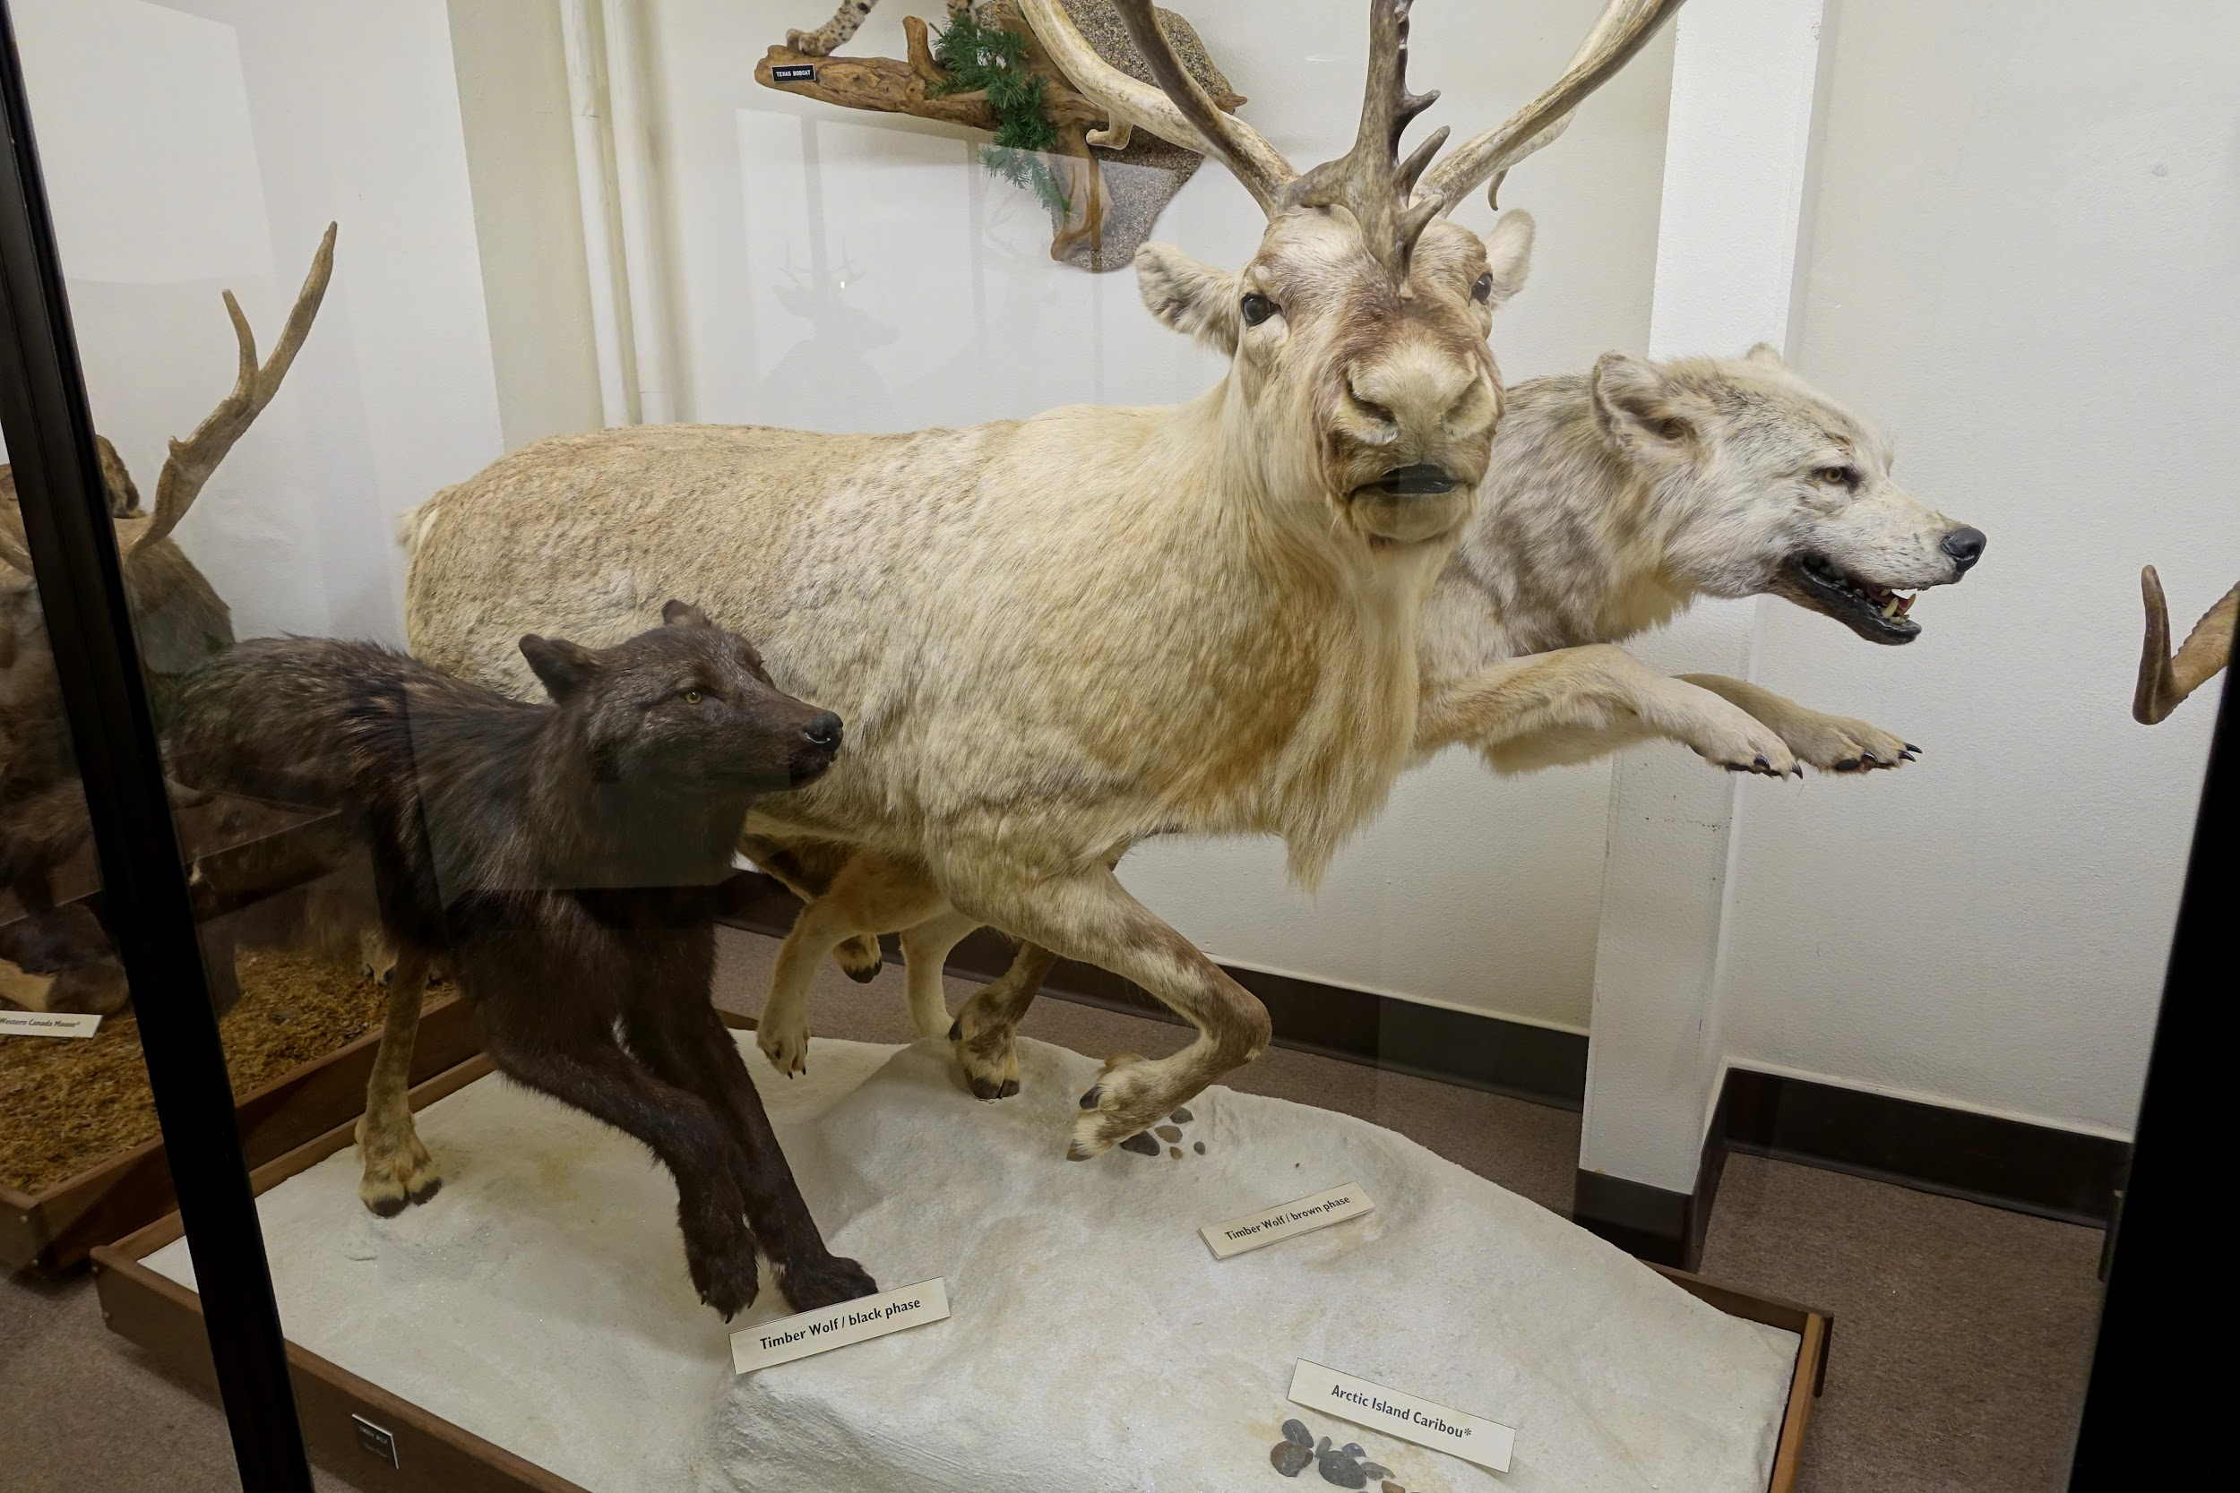
Mutualism in the Polar Region
Caribou and the Arctic Fox, When Caribou are out looking for food, the Arctic fox follows.
Notes:
1-Each slide have a different background
1-Each slide have pictures
1-Each slide have transitions (information slides in, rotates, etc.)
Make sure the title is in larger font than the paragraph. This slide needs a transition. Some of the text is hard to read against the background.

Slide 10
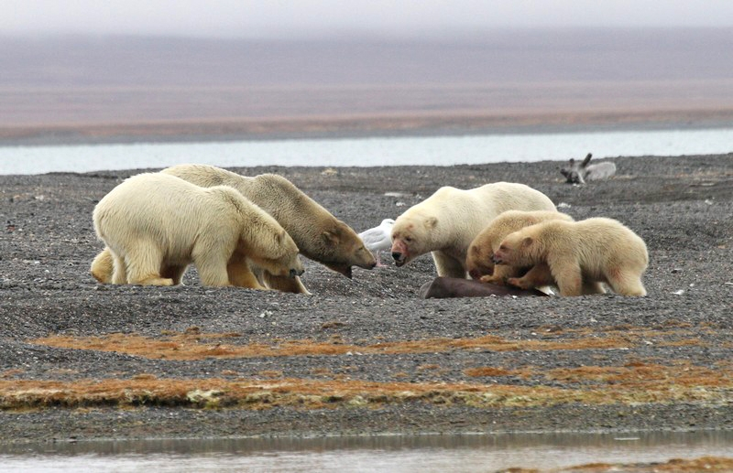
Commensalism in the Polar Region
Arctic foxes travel behind polar bears and scavenge on scraps of food.
Notes:
1-Each slide have a different background
1-Each slide have pictures
1-Each slide have transitions (information slides in, rotates, etc.)
Make sure the title is in larger font than the paragraph. This slide needs a transition.

Slide 11
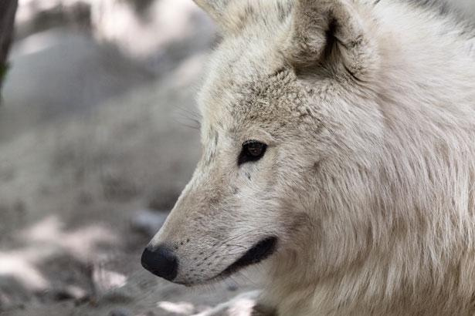
Parasitism in the Polar Region
Typically, it is seen in the case of a liver tapeworm cyst, These organisms are prone to live and thrive in the bodies of various animals including wolves.
Notes:
1-Each slide have a different background
1-Each slide have pictures
1-Each slide have transitions (information slides in, rotates, etc.)
Make sure the title is in larger font than the paragraph. This slide needs a transition.

