Slide 1
Tropical Rainforest
by:Jose Rodriguez
Notes:
Each slide have a different background
Each slide have pictures
Each slide have transitions (information slides in, rotates, etc.)

Slide 2
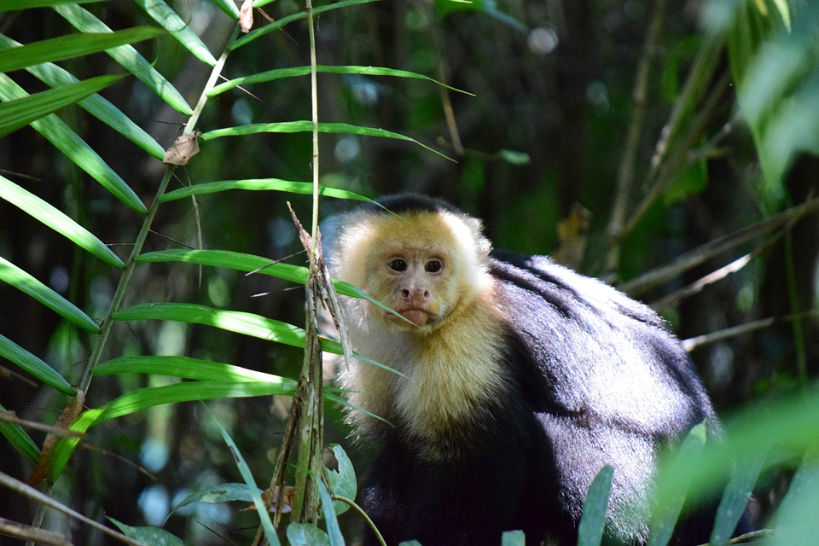
Adaptations animals need to survive rainforest:
Creatures need camouflage,mimicry,having a limited diet,nocturnality.
Notes:
Each slide have a different background
Each slide have pictures
Each slide have transitions (information slides in, rotates, etc.)
Red font is hard on the eye, if your going to use it put a back behind it like above.

Slide 3
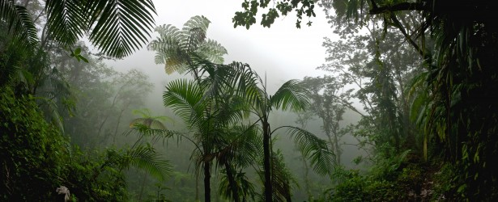
Examples of Producers in your biome:
Trees,vines,grasses, tropical fruit trees, decomposers

Slide 4
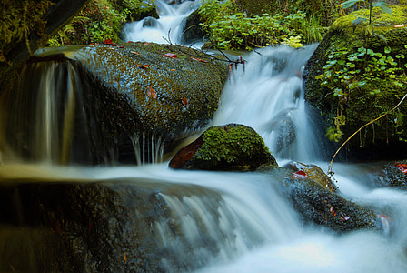
Examples of Primary Consumers in your Biome:
2 primary consumers are monkeys and birds.
Notes:
Each slide have a different background
Each slide have pictures
Each slide have transitions (information slides in, rotates, etc.)
Make sure the title font size is larger than the paragraph size.

Slide 5
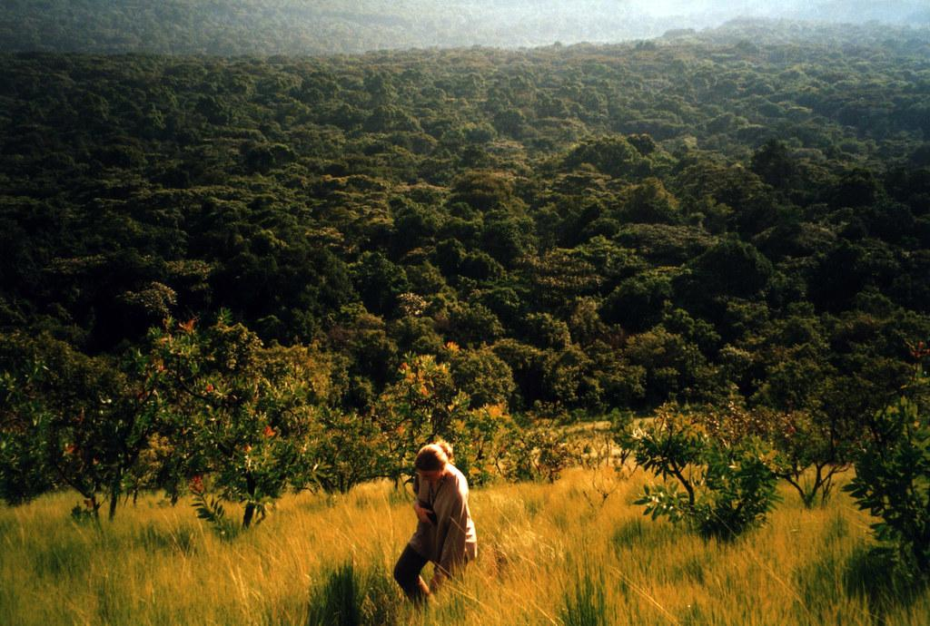
Examples of Secondary Consumers
2 examples of secondary consumers are tree frogs, giant spiders.
Notes:
Each slide have a different background
Each slide have pictures
Each slide have transitions (information slides in, rotates, etc.)

Slide 6
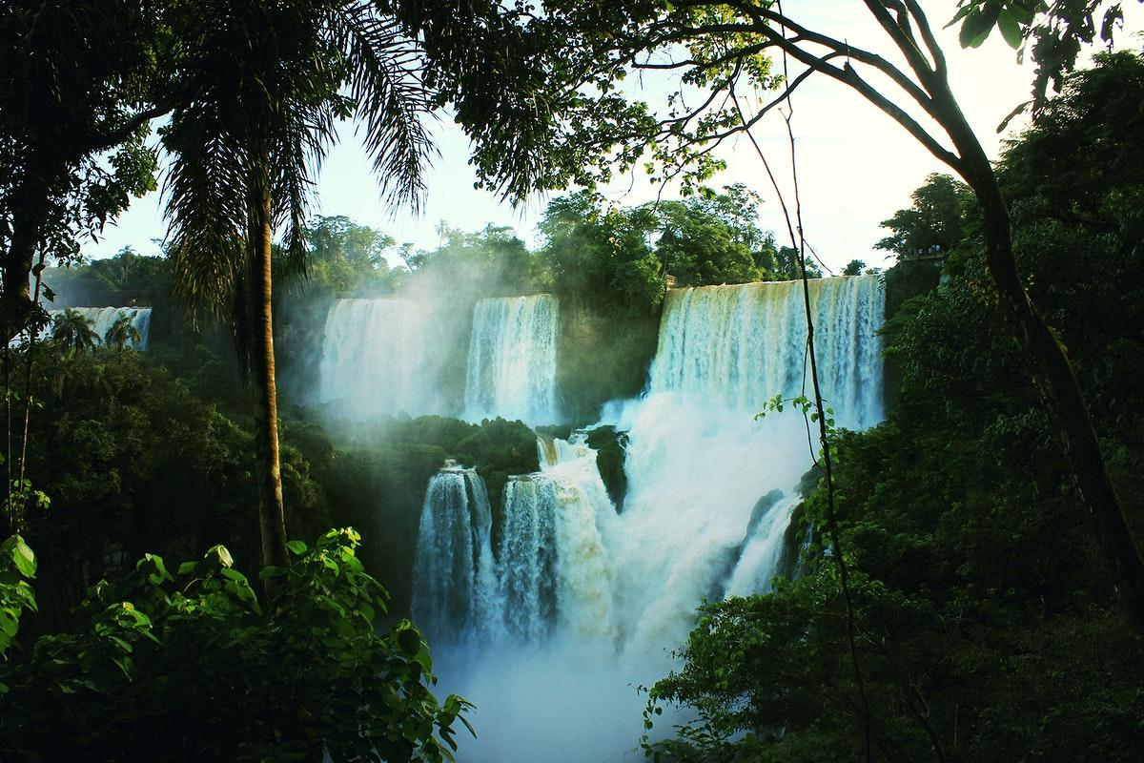
Examples of Tertiary Consumers
Examples of tertiary consumers are pumas,jaguars,crocodiles and poison dart frogs.
Notes:
Each slide have a different background
Each slide have pictures
Each slide have transitions (information slides in, rotates, etc.)

Slide 7
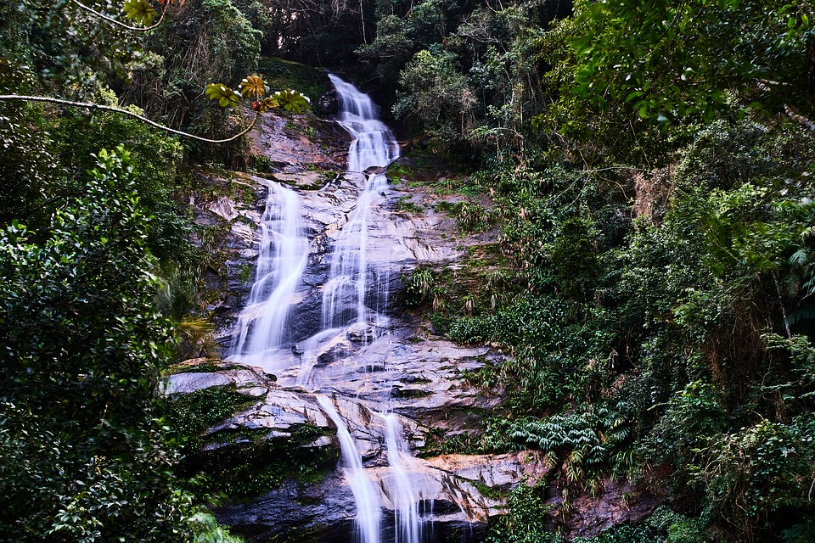
Examples of Decomposers
Examples of decomposers are termites,slugs,scorpions,worms, and fungi
Notes:
Each slide have a different background
Each slide have pictures
Each slide have transitions (information slides in, rotates, etc.)

Slide 8
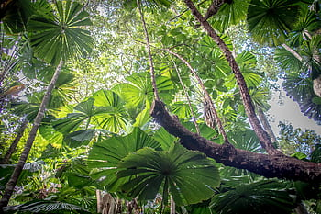
Example of Mutualism
One example of mutualism at work are monarch butterflies travel in large groups to stay safe.
Notes:
Each slide have a different background
Each slide have pictures
Each slide have transitions (information slides in, rotates, etc.)

Slide 9
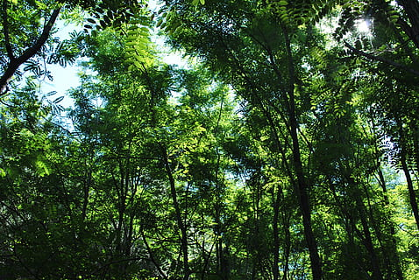
Example of Commensalism
Examples of commensalism are epiphyte plants,such as orchids growing on other trees.
Notes:
Each slide have a different background
Each slide have pictures
Each slide have transitions (information slides in, rotates, etc.)

Slide 10
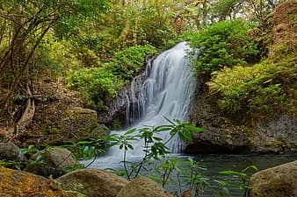
Example of Parasitism
Examples of parasitism are phorid fly and leaf cutter ants

Slide 11
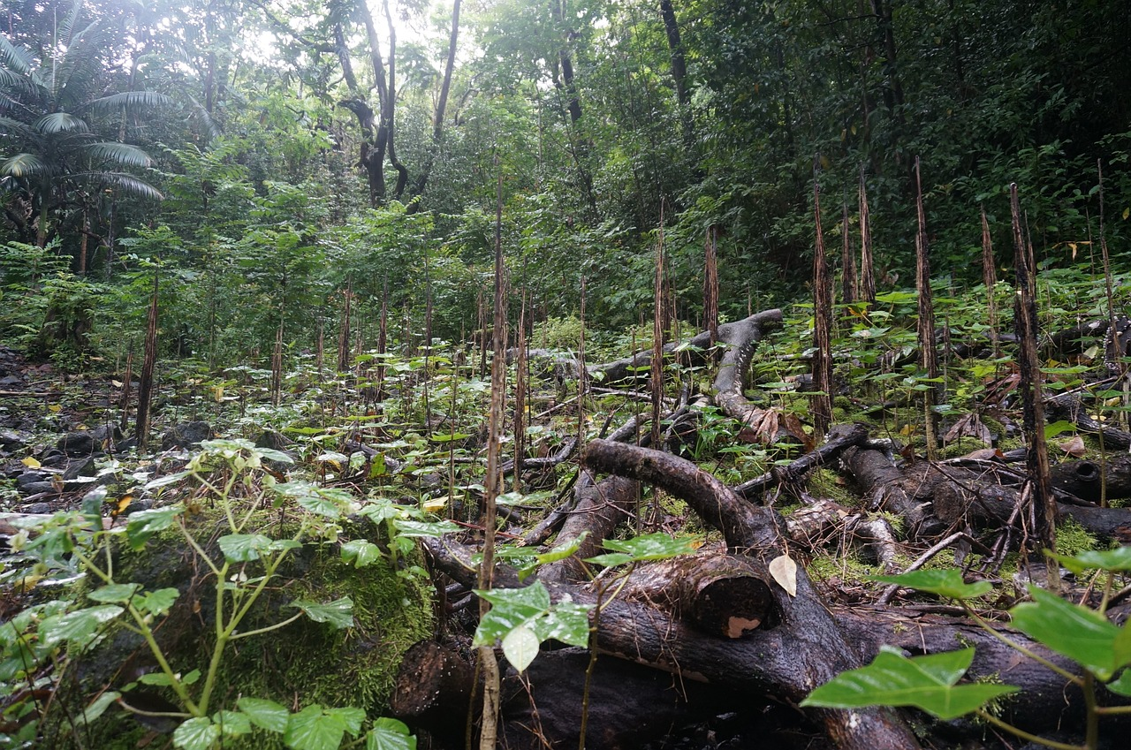
Web addresses
https://rainforests.mongabay.com
Rainforest | National Geographic Society
https://www.nationalgeographic.org › encyclopedia › rain..
Notes:
Each slide have a different background
Each slide have pictures
Each slide have transitions (information slides in, rotates, etc.)

