Slide 1
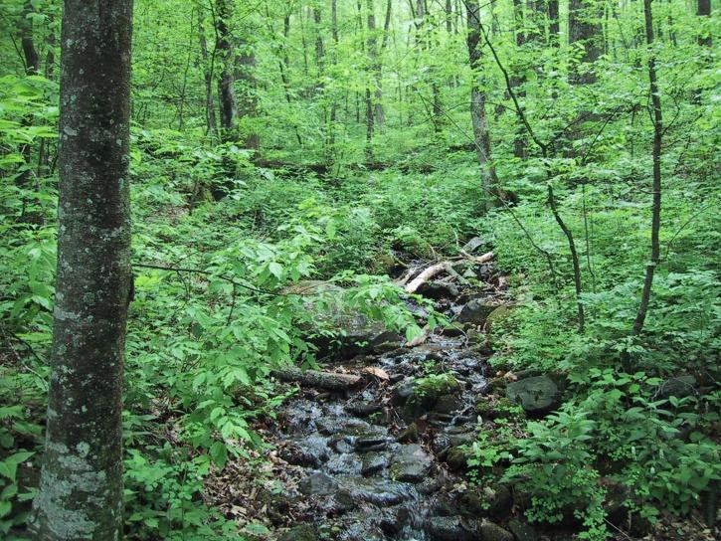
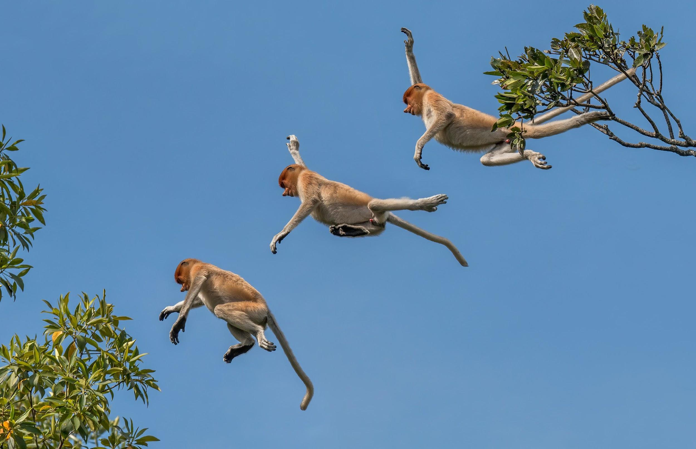
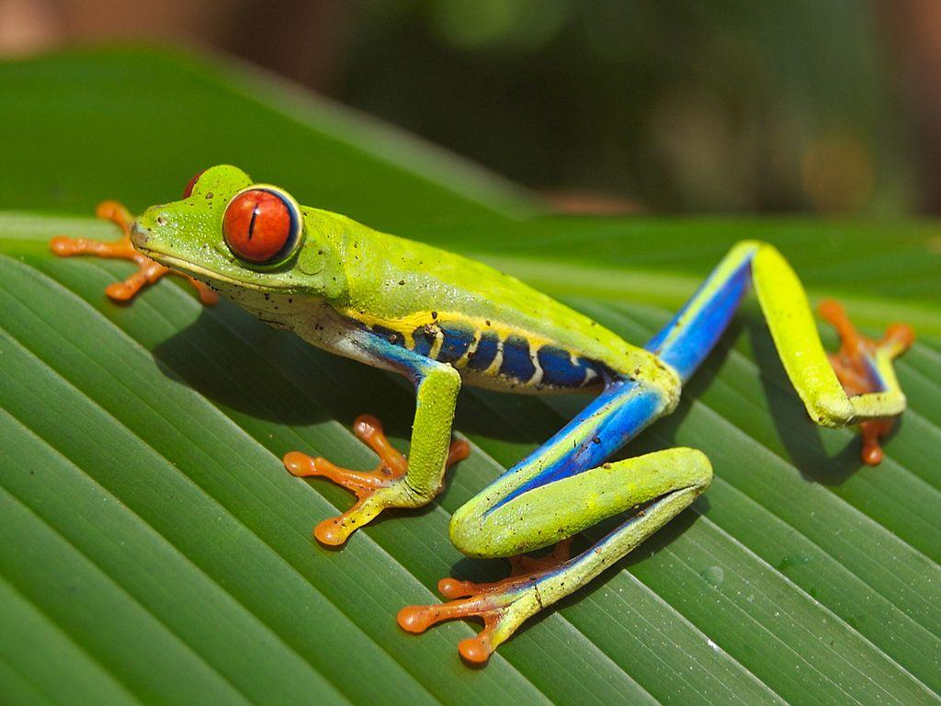
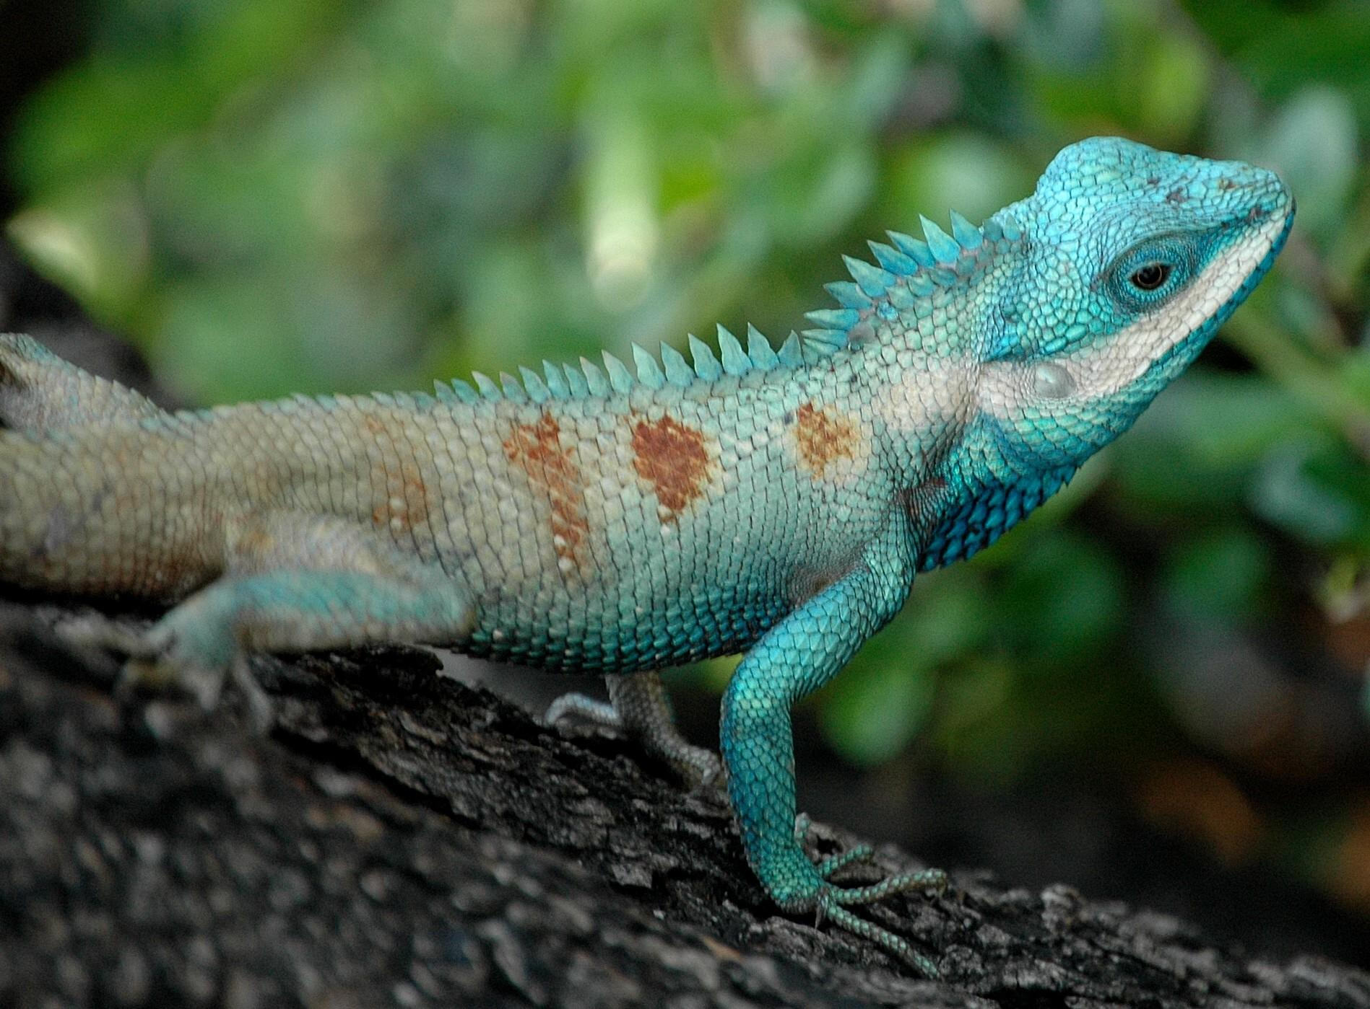
Rainforest
Notes:
1-Each slide have a different background
1-Each slide have pictures
1-Each slide have transitions (information slides in, rotates, etc.)
This slide needs a transition.

Slide 2
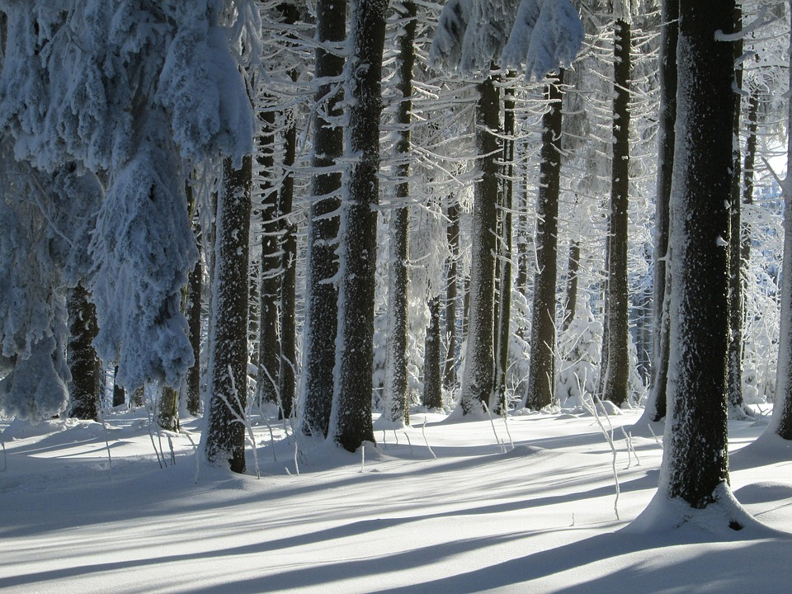
What is you biome like?
The average temperature in a rainforest is from (20 c) (68) to (25 c) (77 F) and one long winter and a short dry summer
Notes:
1-Each slide have a different background
1-Each slide have pictures
1-Each slide have transitions (information slides in, rotates, etc.)
This slide needs a transition.

Slide 3
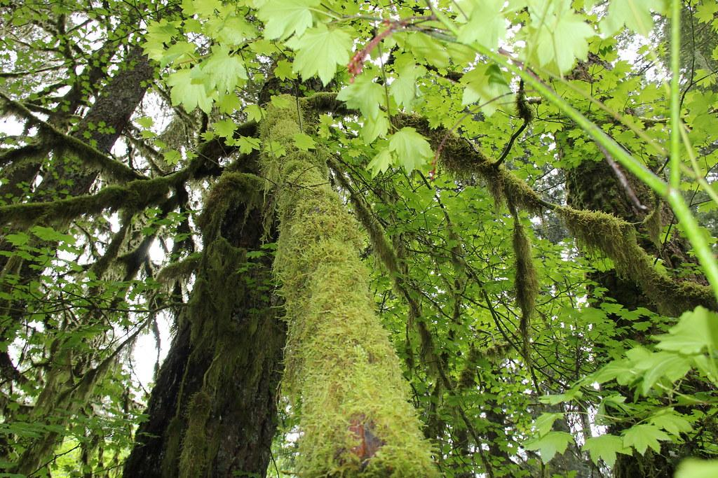
Examples of producers
Some producers of the rainforest are trees,vines,mosses,grasses and tropical tree fruits
Notes:
1-Each slide have a different background
1-Each slide have pictures
1-Each slide have transitions (information slides in, rotates, etc.)
This slide needs a transition.The text of the title is hard to read against the background. Make the paragraph text larger.

Slide 4
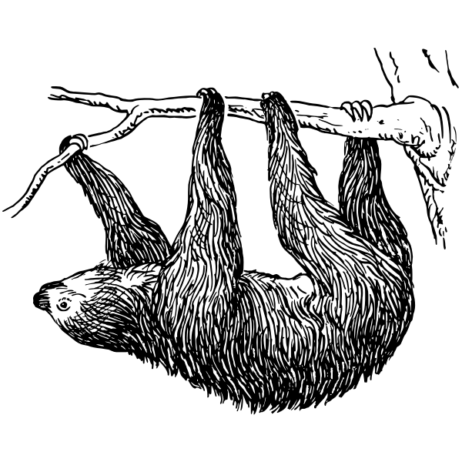
Adaptations
SSloths have camouflage fur and moves slow for t can be difficult for predators to see it, and spider monkey have long, strong limbs to help it navigate through the long and strong trees of the rainforest
Notes:
1-Each slide have a different background
1-Each slide have pictures
1-Each slide have transitions (information slides in, rotates, etc.)
This slide needs a transition. Make the paragraph text larger.

Slide 5
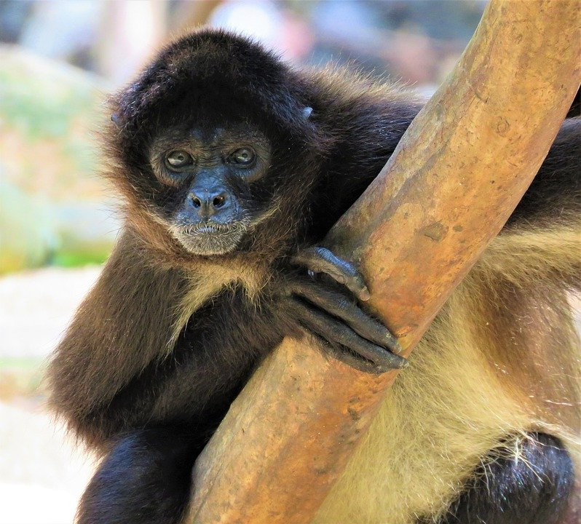
Primary consumers
The primary consumers of the rainforest are macaws ,monkeys,agouti and sloths
Notes:
1-Each slide have a different background
1-Each slide have pictures
1-Each slide have transitions (information slides in, rotates, etc.)
This slide needs a transition. The title text is hard to read against this background. Make the paragraph text bigger.

Slide 6
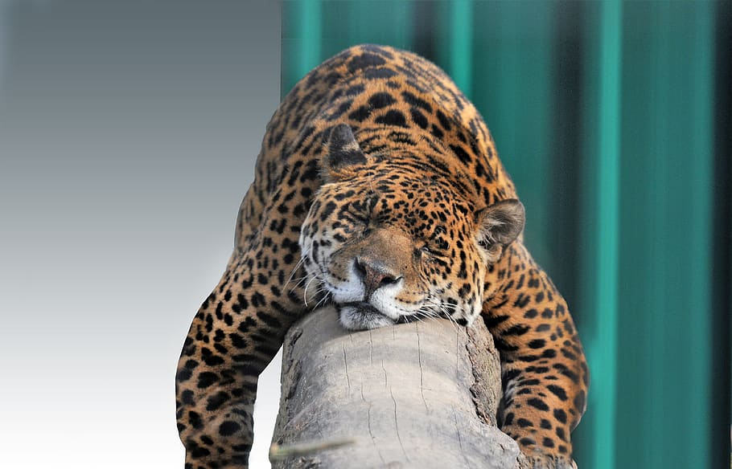
Secondary consumers
The secondary consumers are fierce jaguars and huge boa constrictor and giant spiders.
Notes:
1-Each slide have a different background
1-Each slide have pictures
1-Each slide have transitions (information slides in, rotates, etc.)
This slide needs a transition. In a title either make it a complete sentence with punctuation, or capitalize each word. Make the paragraph text bigger.

Slide 7
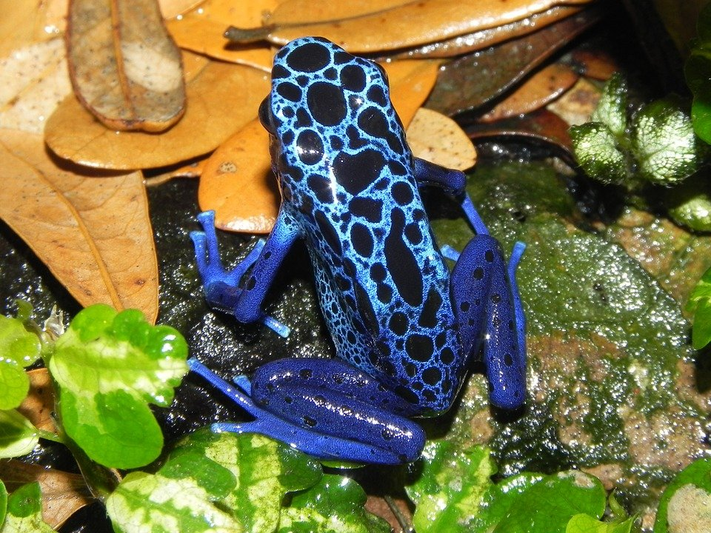
Tertiary consumers
The secondary consumers are fierce jaguars and huge boa constrictor and giant spiders.
Notes:
1-Each slide have a different background
1-Each slide have pictures
1-Each slide have transitions (information slides in, rotates, etc.)
This slide needs a transition. In a title either make it a complete sentence with punctuation, or capitalize each word. Make the paragraph text bigger.

Slide 8
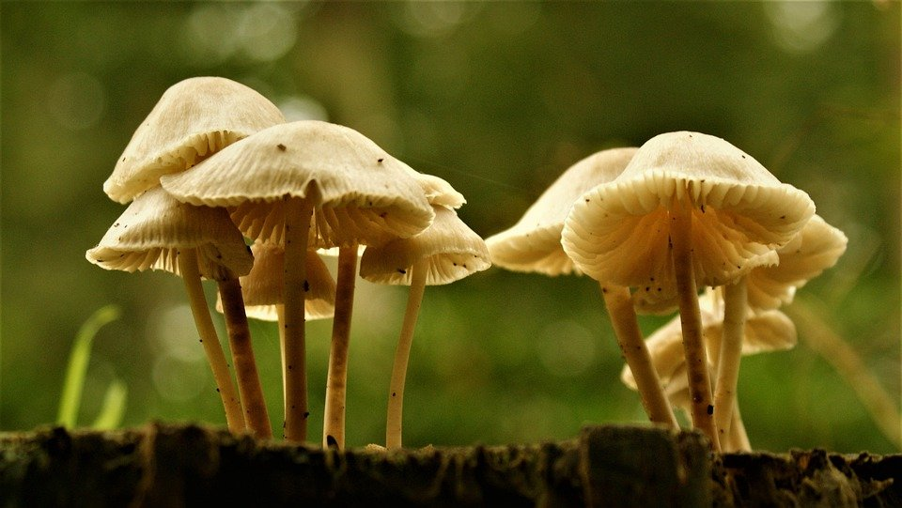
Decomposers
The decomposers that are the most important in the rainforest are,termites,slugs,scorpions,worms, and fungi
Notes:
1-Each slide have a different background
1-Each slide have pictures
1-Each slide have transitions (information slides in, rotates, etc.)
This slide needs a transition.. Make the paragraph text bigger.

Slide 9
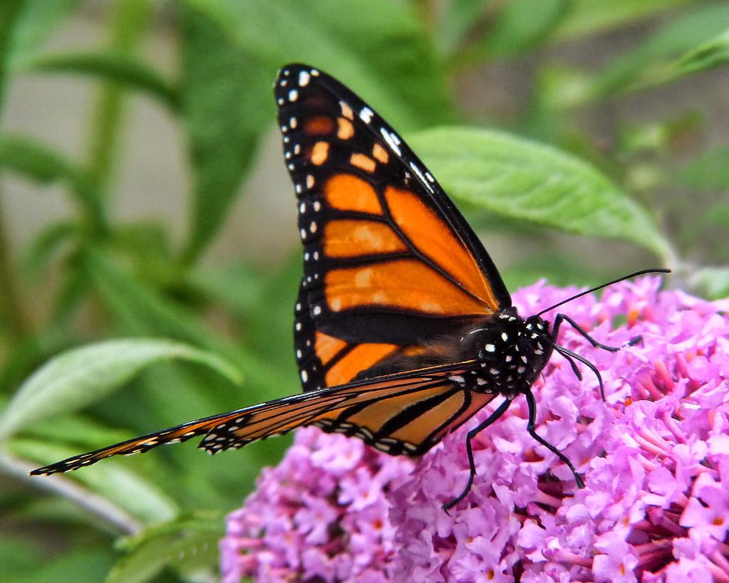
Examples of mutualism
The monarch butterflies always travel in groups and stay together to stay safe from possible predators
Notes:
1-Each slide have a different background
1-Each slide have pictures
1-Each slide have transitions (information slides in, rotates, etc.)
This slide needs a transition. In a title either make it a complete sentence with punctuation, or capitalize each word. Make the paragraph text bigger. Put punctuation.

Slide 10
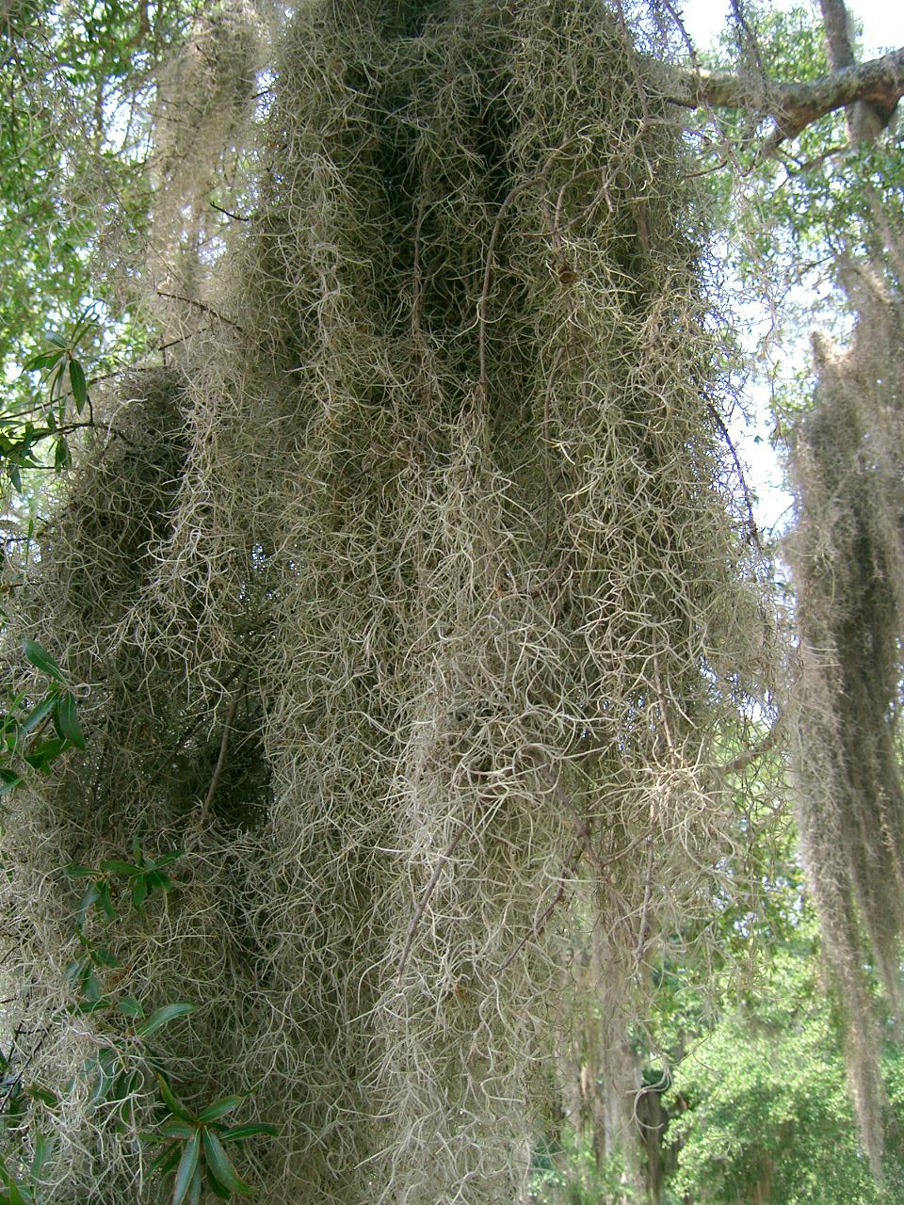
Example of commensalism
Spanish moss growing on the side of a oak tree
Notes:
1-Each slide have a different background
1-Each slide have pictures
1-Each slide have transitions (information slides in, rotates, etc.)
This slide needs a transition. In a title either make it a complete sentence with punctuation, or capitalize each word. Make the paragraph text bigger. Put punctuation.

Slide 11
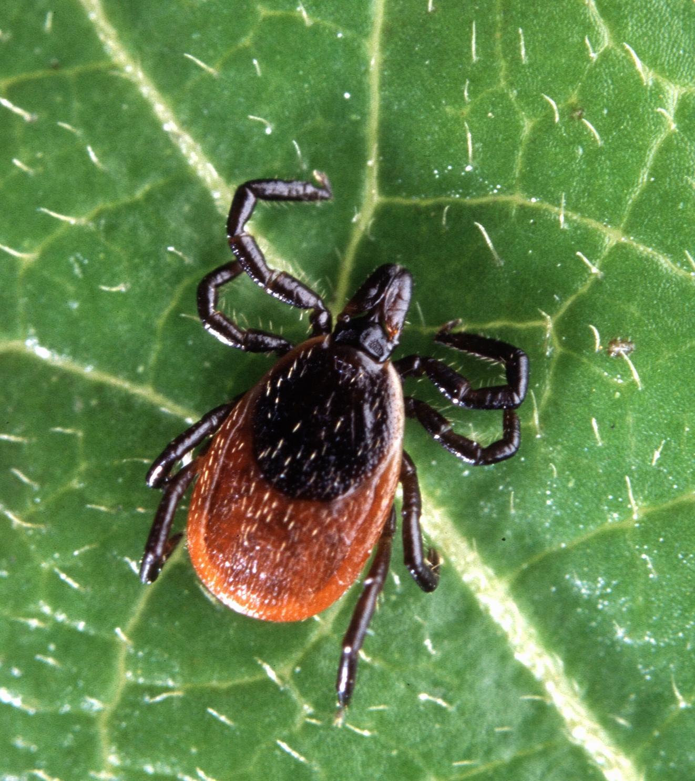
Example of Parasitism in your Biome:
In winter there are ticks that may hop on a animals back.
Notes:
1-Each slide have a different background
1-Each slide have pictures
1-Each slide have transitions (information slides in, rotates, etc.)
This slide needs a transition.

Slide 12
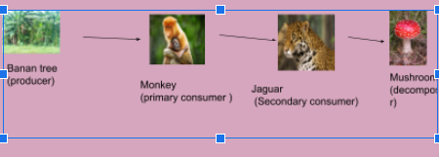
Food Web
Food web in my google doc
Notes:
1-Each slide have a different background
1-Each slide have pictures
1-Each slide have transitions (information slides in, rotates, etc.)
This slide needs a transition. I

