Slide 1
Biome Project:
Polar Region
Notes:
Each slide have a different background
Each slide have pictures
Each slide have transitions (information slides in, rotates, etc.)
This slide needs a transition, This slide needs a picture.

Slide 2
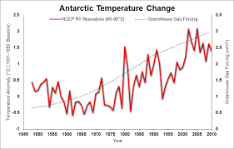
What is it like in the Polar region?
The polar climate regions are characterized by a lack of warm summers. Every month in a polar climate has an average temperature of less than 10 °C (50 °F).
Notes:
Each slide have a different background
Each slide have pictures
Each slide have transitions (information slides in, rotates, etc.)
This slide needs a transition,

Slide 3
Are there any adaptations your creatures need to survive in the polar region?
Animals in polar regions have adapted to survive in these extreme conditions. They have thick fur or feathers, blend in with the white snow, or hibernate during the coldest winter months.
Notes:
Each slide have a different background
Each slide have pictures
Each slide have transitions (information slides in, rotates, etc.)
This slide needs a transition, This slide needs a picture.

Slide 4
Examples of Producers in your biome:
Producers that live in the polar region are sea ice algae, microalgae, phytoplankton.
Notes:
Each slide have a different background
Each slide have pictures
Each slide have transitions (information slides in, rotates, etc.)
This slide needs a transition, This slide needs a picture.

Slide 5
Examples of Primary Consumers the Polar Region
Examples of primary consumers are Arctic rabbit,pikas, musk oxen, caribou, lemmings, and arctic hares.
Notes:
Each slide have a different background
Each slide have pictures
Each slide have transitions (information slides in, rotates, etc.)
This slide needs a transition, This slide needs a picture.

Slide 6
Examples of Secondary Consumers in the Polar Region
Examples of secondary consumers are arctic foxes, brown bears, and arctic wolves.
Notes:
Each slide have a different background
Each slide have pictures
Each slide have transitions (information slides in, rotates, etc.)
This slide needs a transition, This slide needs a picture.

Slide 7
Examples of Tertiary Consumers in the Polar Region
Examples of tertiary consumers are the polar bear, and eagles, which prey on the arctic fox as well as primary consumers
Notes:
Each slide have a different background
Each slide have pictures
Each slide have transitions (information slides in, rotates, etc.)
This slide needs a transition, This slide needs a picture.

Slide 8
Examples of Decomposers in the Polar Region
The decomposers found in the Polar Region are bacteria.
Notes:
Each slide have a different background
Each slide have pictures
Each slide have transitions (information slides in, rotates, etc.)
This slide needs a transition, This slide needs a picture.

Slide 9
Example of Mutualism in the Polar Region
A mutualism relationship between the animals of the Arctic is between the Caribou and the Arctic Fox. When Caribou are out looking for food, the Arctic fox follows. The caribou exposes a small bit of itself, bringing closer other mammals
Notes:
Each slide have a different background
Each slide have pictures
Each slide have transitions (information slides in, rotates, etc.)
This slide needs a transition, This slide needs a picture.

Slide 10
Example of Commensalism in the Polar Region
A commensalism relationship between the animals and the arctic is between the arctic fox and the polar bear. Arctic foxes travel behind polar bears and scavenge on scraps of food. The polar bear is hardly affected and the fox benefits from the food.
Notes:
Each slide have a different background
Each slide have pictures
Each slide have transitions (information slides in, rotates, etc.)
This slide needs a transition, This slide needs a picture.

Slide 11
Example of Parasitism in the Polar Region
Typically, it is seen in the case of a liver tapeworm cyst. These organisms are prone to live and thrive in the bodies of various animals including wolves, caribou, polar bears, and moose. They feed on the food the animal eats, and as a result, the animal develops malnutrition.
Notes:
Each slide have a different background
Each slide have pictures
Each slide have transitions (information slides in, rotates, etc.)
This slide needs a transition, This slide needs a picture.

Slide 12
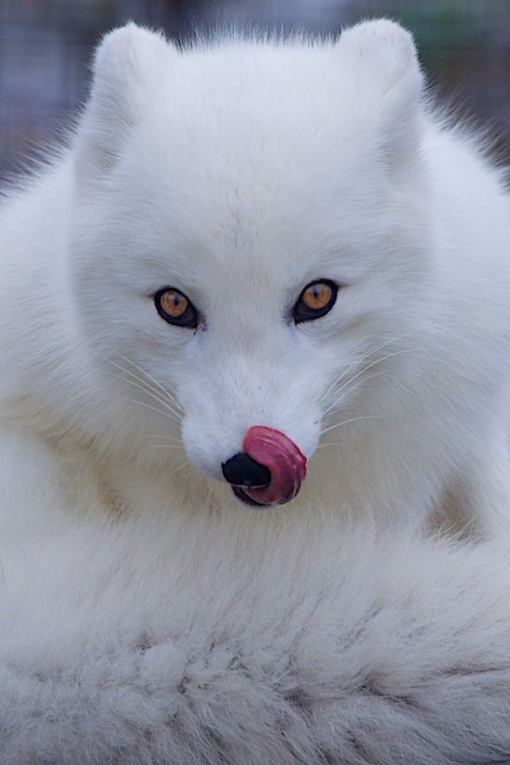
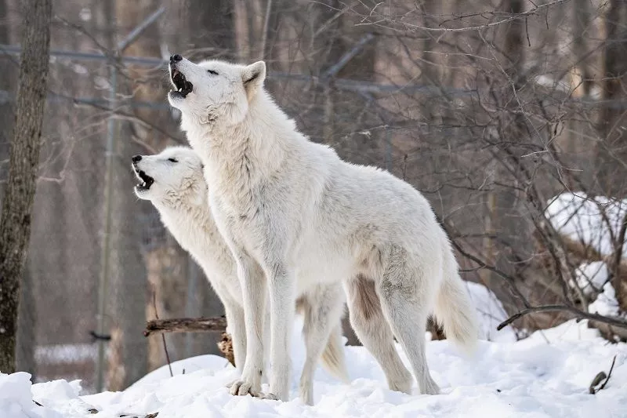
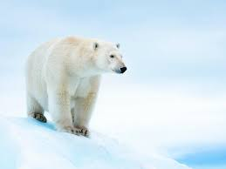
Would I want to live in the polar region.
No
Notes:
Each slide have a different background
Each slide have pictures
Each slide have transitions (information slides in, rotates, etc.)
This slide needs a transition, Please write a sentence explaining.

Slide 13
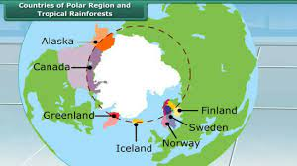
Where would you find the polar region.
The Arctic region covers parts of eight countries: Canada, Greenland, Iceland, Norway, Sweden, Finland, and the United States.
Notes:
Each slide have a different background
Each slide have pictures
Each slide have transitions (information slides in, rotates, etc.)
This slide needs a transition,

