Slide 1
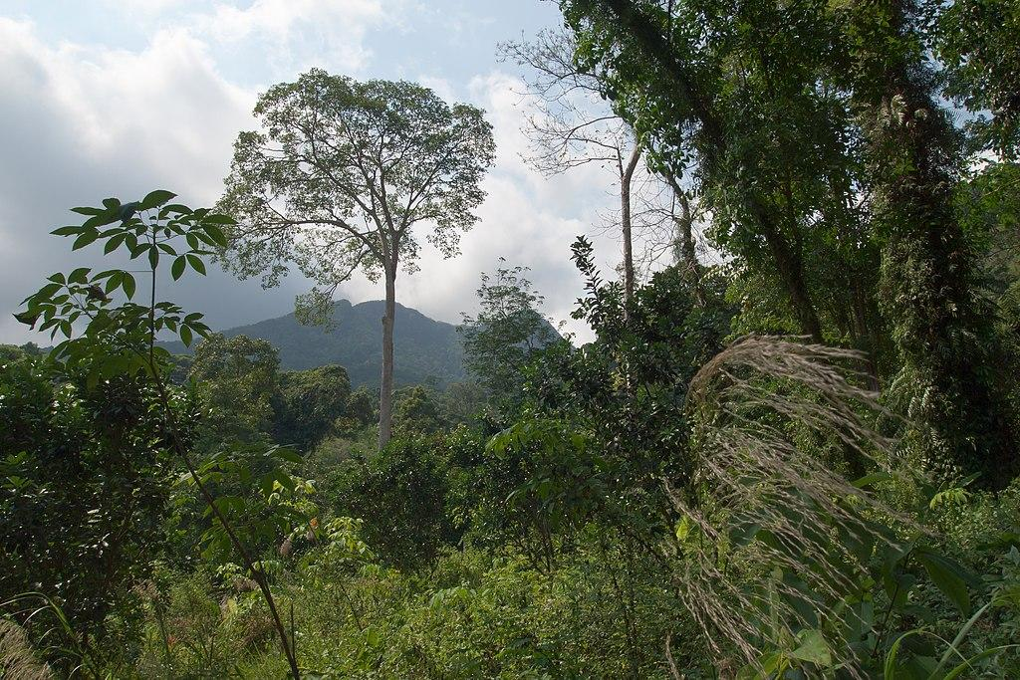
TROPICAL RAINFOREST
Notes:
1-Each slide have a different background
1-Each slide have pictures
1-Each slide have transitions (information slides in, rotates, etc.)
This slide needs a transition.

Slide 2
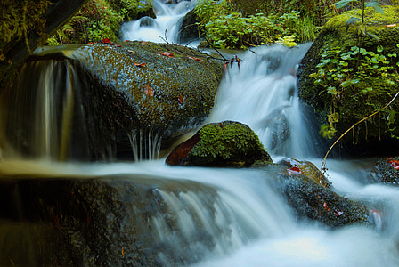
What is your tropical rainforest like?
The tropical rainforest is hot and mostly moist. The temperature is 68 F to 77F. 2,000 to 10,000 millimeters (79 to 394 inches) of rain per year.
Notes:
1-Each slide have a different background
1-Each slide have pictures
1-Each slide have transitions (information slides in, rotates, etc.)
This slide needs a transition.

Slide 3
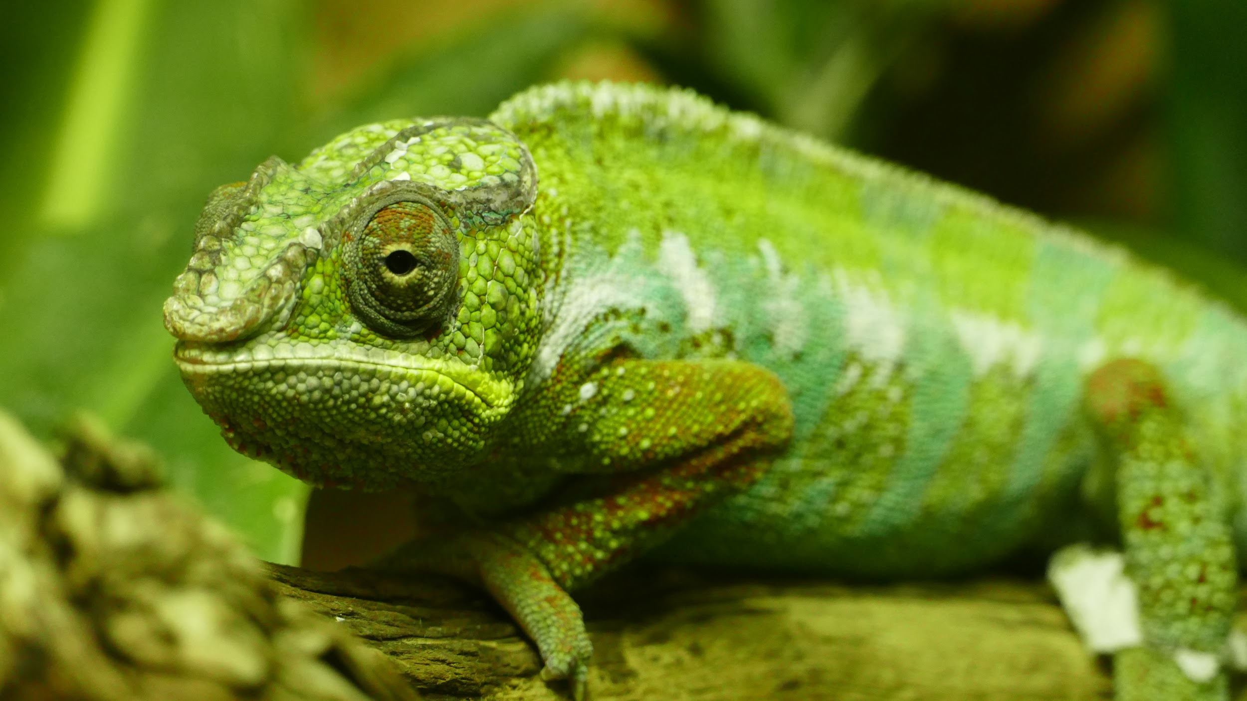
Adaptations creatures need to survive in a tropical rainforest.
Creatures need camouflage and mimicry to survive in a tropical rainforest.
Notes:
1-Each slide have a different background
1-Each slide have pictures
1-Each slide have transitions (information slides in, rotates, etc.)
This slide needs a transition. The text is hard to see against the background.

Slide 4
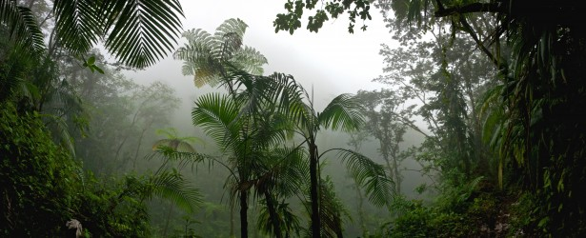
Examples of Producers in tropical rainforest.
Example of producers are trees, vines, mosses, grasses, and tropical fruit trees,
Notes:
1-Each slide have a different background
1-Each slide have pictures
1-Each slide have transitions (information slides in, rotates, etc.)
This slide needs a transition.

Slide 5
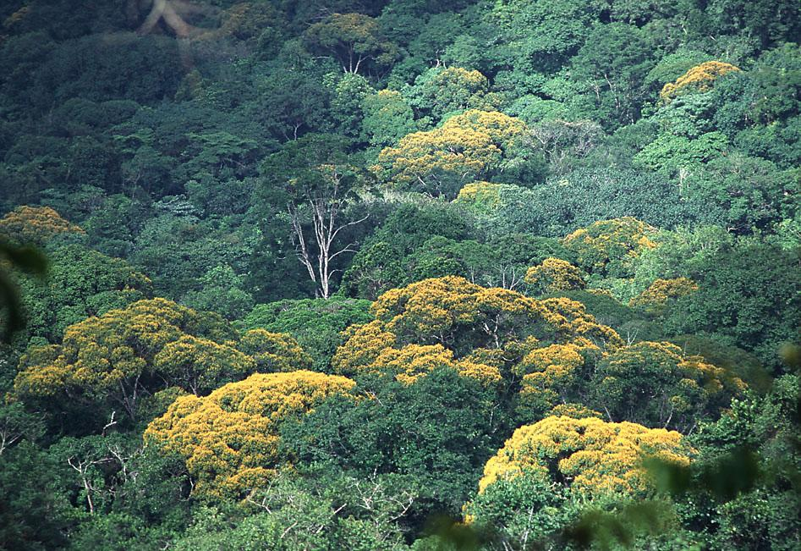
Examples of Primary Consumers in Tropical Rainforest.
Primary consumers in a tropical rainforest are monkeys and birds.
Notes:
1-Each slide have a different background
1-Each slide have pictures
1-Each slide have transitions (information slides in, rotates, etc.)
This slide needs a transition.

Slide 6
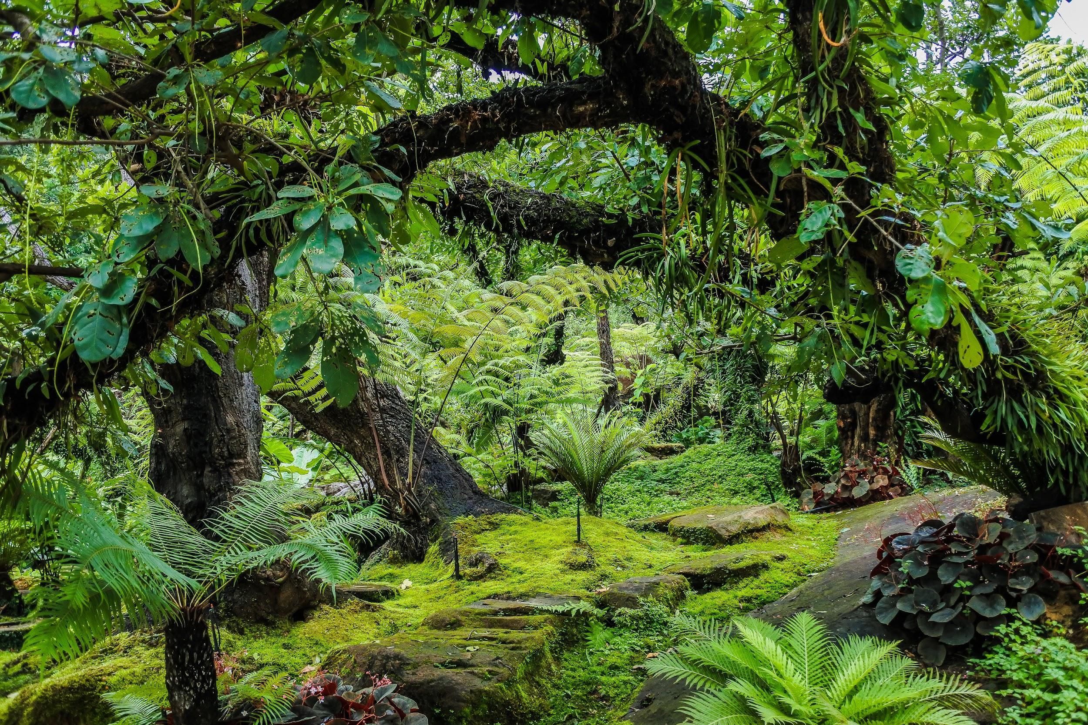
Examples of Secondary Consumers in Tropical Rainforest.
Secondary consumers in a tropical rainforest are tree frogs, and giant spiders.
Notes:
1-Each slide have a different background
1-Each slide have pictures
1-Each slide have transitions (information slides in, rotates, etc.)
This slide needs a transition.

Slide 7
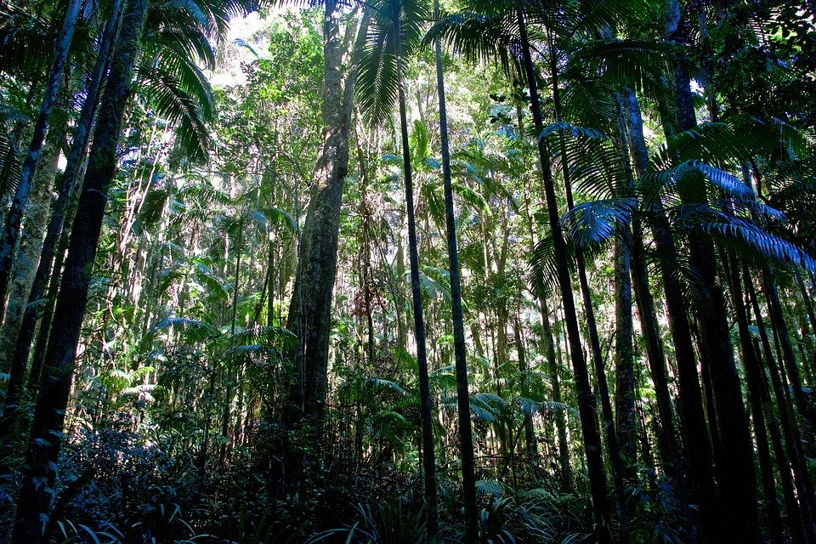
Examples of Tertiary Consumers in tropical rainforest.
Tertiary consumers in a tropical rain forest are jaguar and snakes.
Notes:
1-Each slide have a different background
1-Each slide have pictures
1-Each slide have transitions (information slides in, rotates, etc.)
This slide needs a transition. Titles need to be either a complete sentence with punctuation, or all words capitalized.

Slide 8
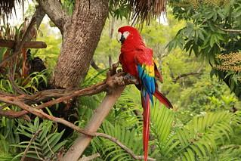
Examples of Decomposers in Tropical rainforest.
Decomposers such as termites, slugs, scorpions, worms, and fungi, live in the rainforest.
Notes:
1-Each slide have a different background
1-Each slide have pictures
1-Each slide have transitions (information slides in, rotates, etc.)
This slide needs a transition., Fix the title

Slide 9
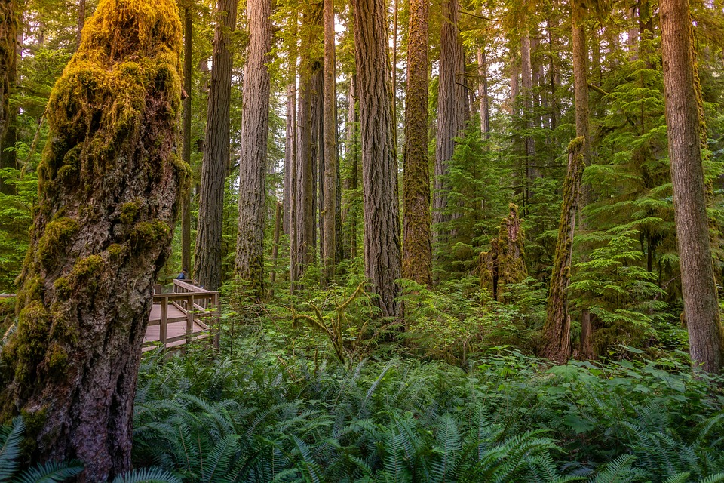
Example of Mutualism in Tropical rainforest.
Examples of mutualism at work are Monarch butterflies traveling in large groups to stay safe. Certain insects such as ants and termites rely on each other and work as a team to build mounds where the group will live, or hunt together to find food.
Notes:
1-Each slide have a different background
1-Each slide have pictures
1-Each slide have transitions (information slides in, rotates, etc.)
This slide needs a transition. Also the title must be larger font than the paragraph.

Slide 10
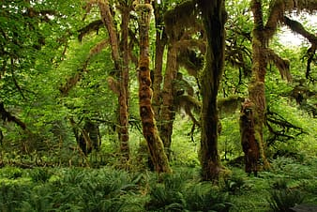
Example of Commensalism in Tropical rainforest.
A tree frog taking shelter under a leaf or seeds falling from plants into the fur or feathers of animals to spread themselves around the forest might be an example of commensalism in the rainforest.
Notes:
1-Each slide have a different background
1-Each slide have pictures
1-Each slide have transitions (information slides in, rotates, etc.)
This slide needs a transition.

Slide 11
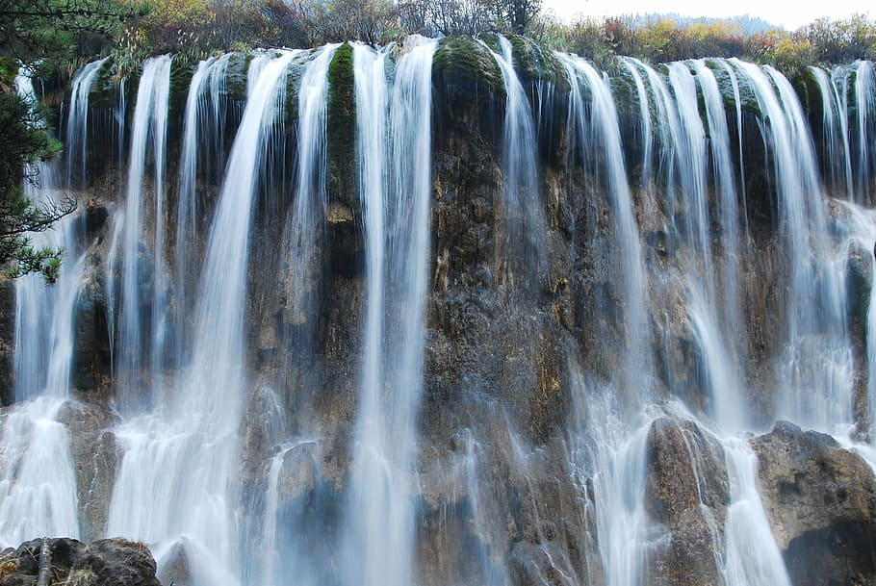
Example of Parasitism in tropical forest.
An example of parasitism in the rainforest is the strangler fig tree and other host trees.
Notes:
1-Each slide have a different background
1-Each slide have pictures
1-Each slide have transitions (information slides in, rotates, etc.)
This slide needs a transition. The highlighted area is off the “t”. Make the title a sentence or capitalize each word.

Slide 12
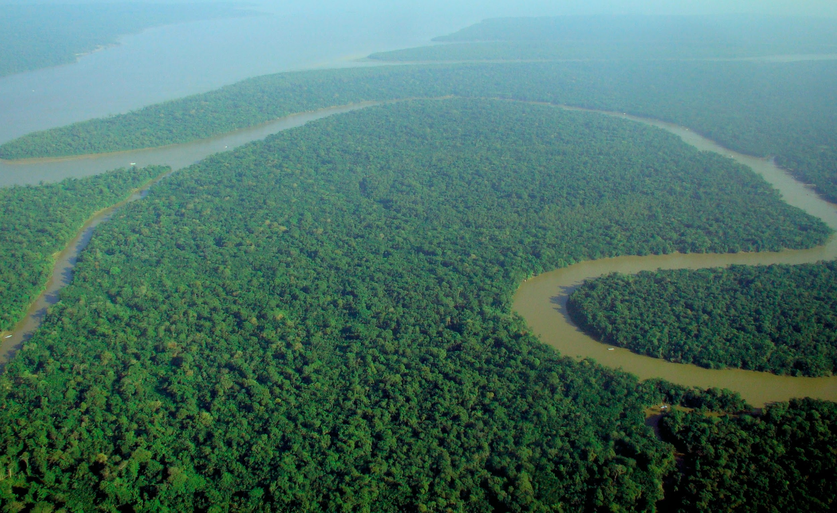
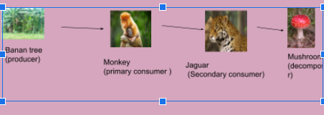
Food web in Tropical rainforest

Slide 13
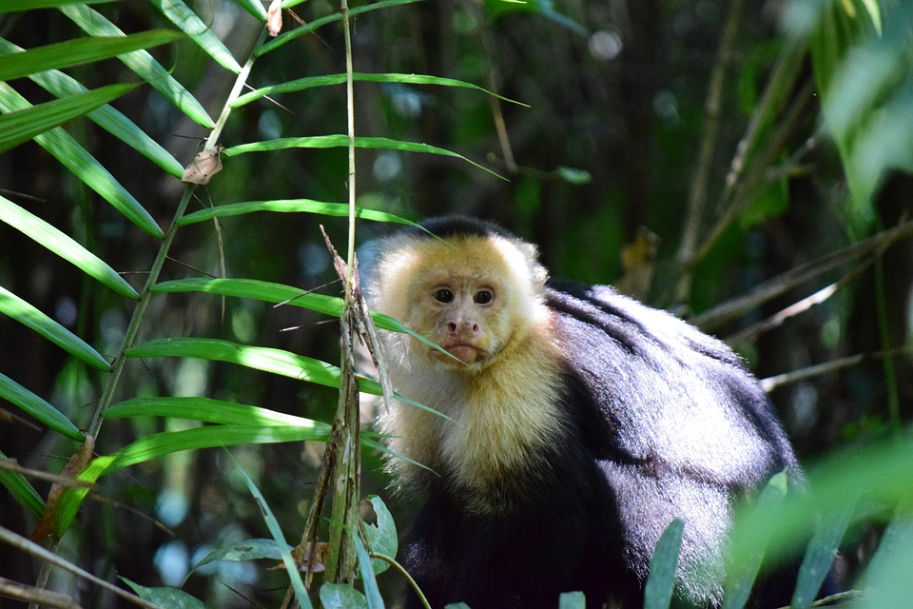
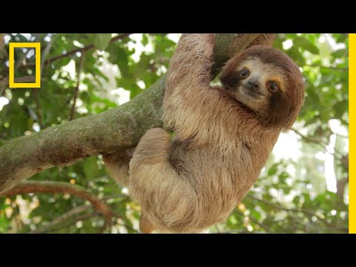
Video about tropical rainforest
https://www.youtube.com/watch?v=3vijLre760w

Slide 14
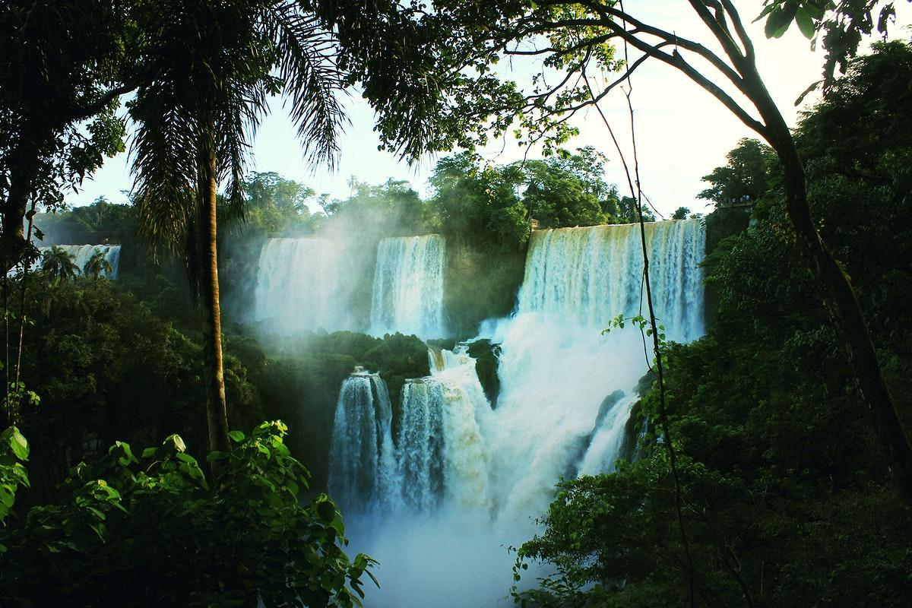
Link i used
https://earthobservatory.nasa.gov/biome/biorainforest.php#:~:text=The%20tropical%20rainforest%20is%20a,it%20rains%20all%20year%20long.&text=Because%20of%20the%20small%20amount,wet%20leaves%20and%20leaf%20litter.
What are examples of commensalism in a tropical rainforest? - Quora
https://www.bioexplorer.net/tropical-rainforest-animal-adaptations.html/#:~:text=In%20this%20article%2C%20let's%20explore,changing%20of%20habitats%20with%20illustrations.
Notes:
1-Each slide have a different background
1-Each slide have pictures
1-Each slide have transitions (information slides in, rotates, etc.)
This slide needs a transition. This slide needs a title.

