Slide 1
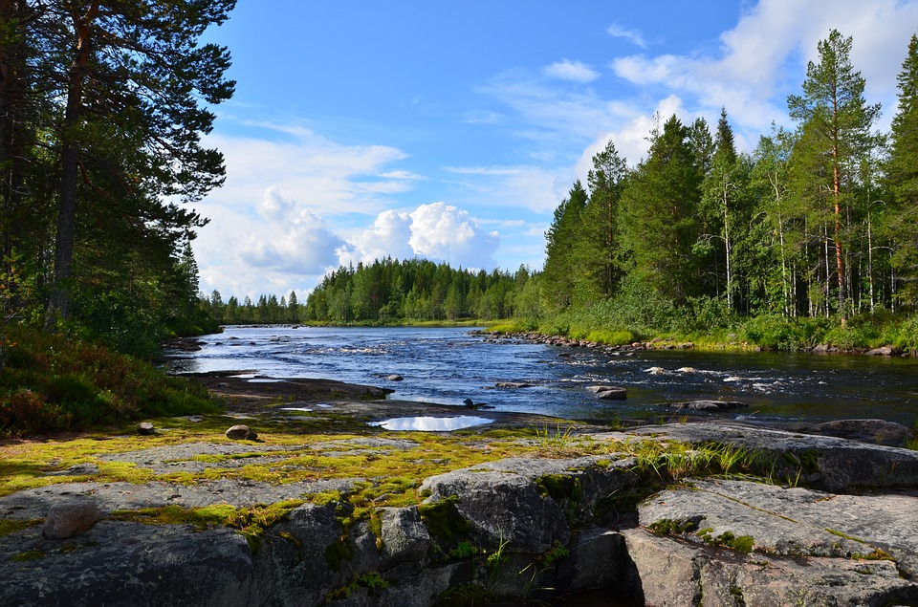
Biome Project
The Taiga
By Nushmia Khan
Notes:
1-Each slide have a different background
1-Each slide have pictures
1-Each slide have transitions (information slides in, rotates, etc.)

Slide 2
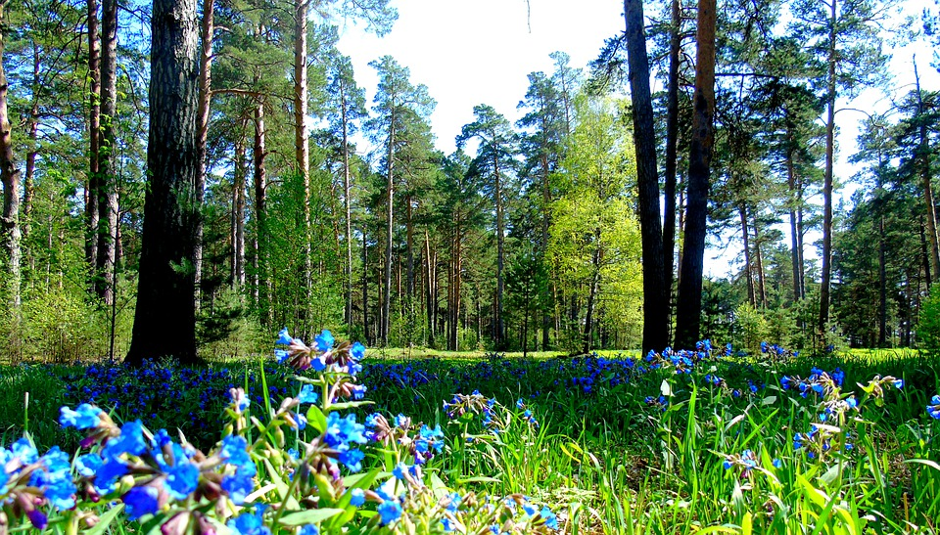
What is the Taiga like?
The Taiga is identified by Cold, Harsh climate. Temperatures in the Taiga range from a few degrees Celsius above freezing to -10 °C (14 °F) or more.The average rain amount is 15-33 inches.The Taiga has 2 major seasons which are Winter and Summer.
Notes:
1-Each slide have a different background
1-Each slide have pictures
1-Each slide have transitions (information slides in, rotates, etc.)

Slide 3
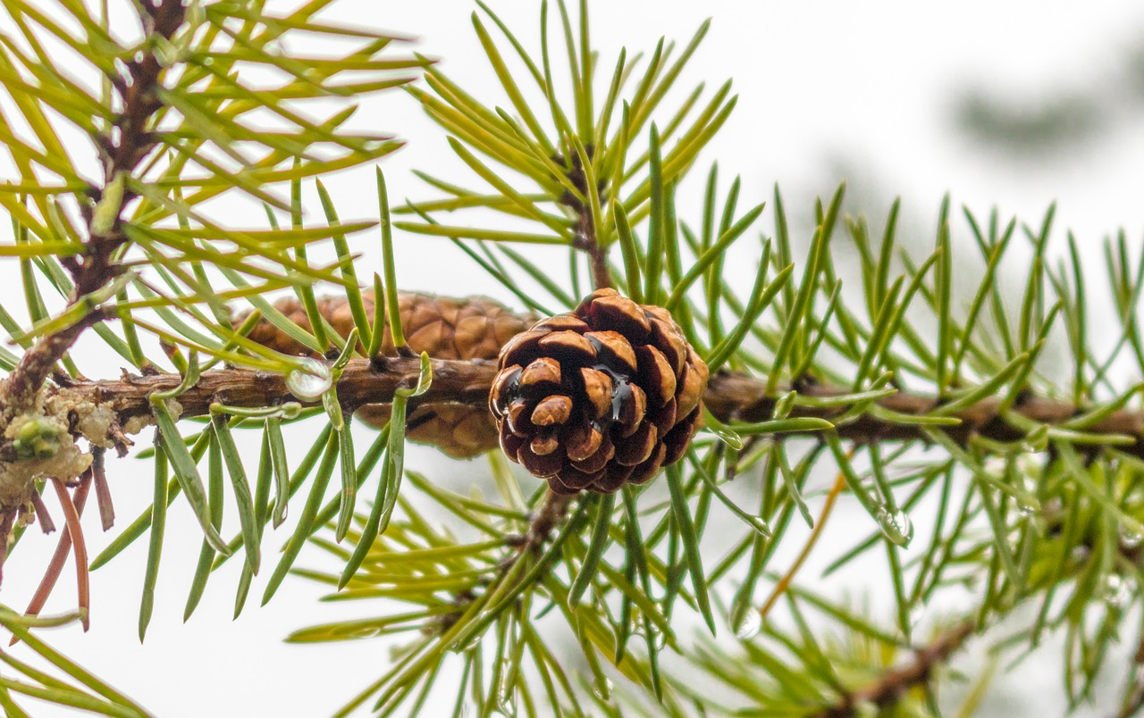
Adaptations in the Taiga
In the Tundra, birds stay warm using their feathers, Some animals hibernate during the winter, Some use their fur to keep warm, and snakes camouflage to hunt prey.
Notes:
1-Each slide have a different background
1-Each slide have pictures
1-Each slide have transitions (information slides in, rotates, etc.)

Slide 4
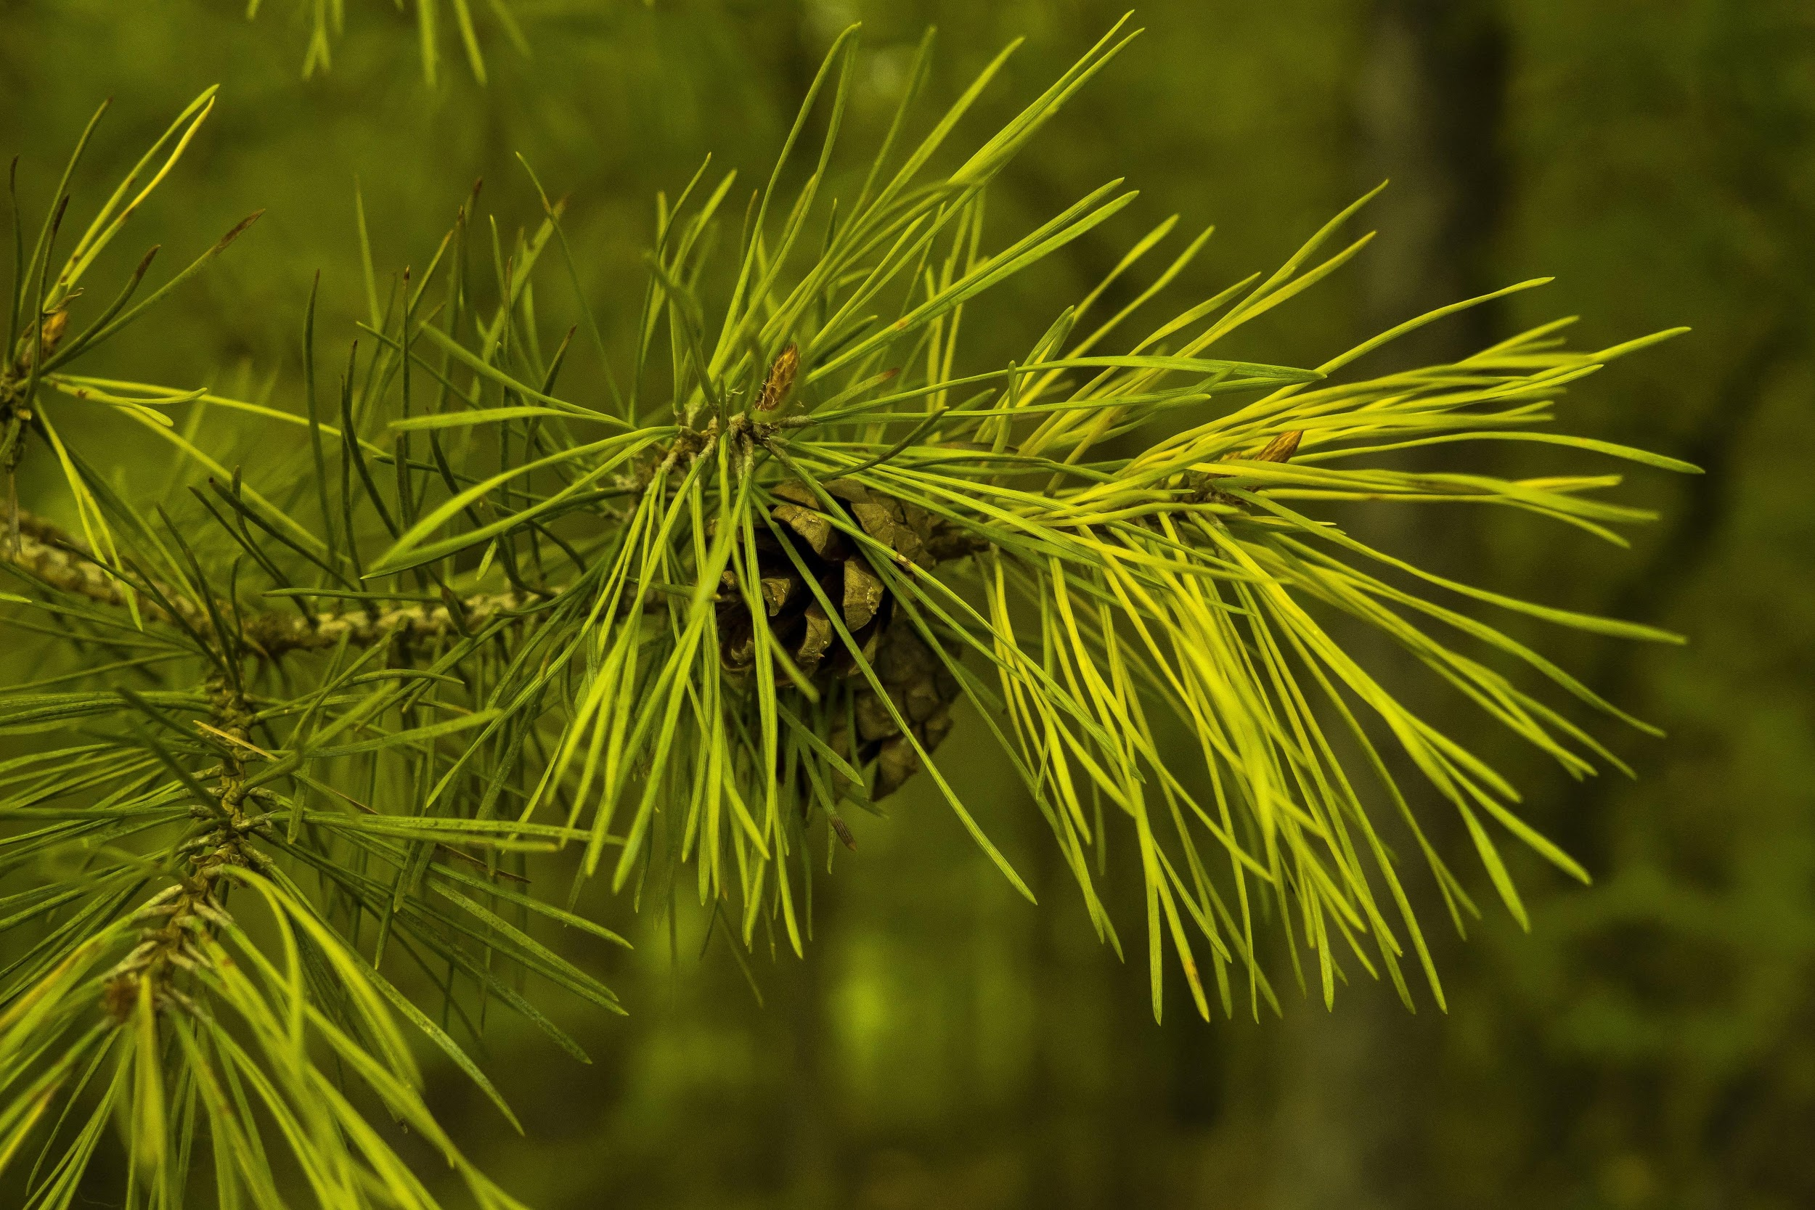
Producers in the Taiga
Needleleaf and Coniferous trees are examples of Producers in the Taiga
Notes:
1-Each slide have a different background
1-Each slide have pictures
1-Each slide have transitions (information slides in, rotates, etc.)

Slide 5
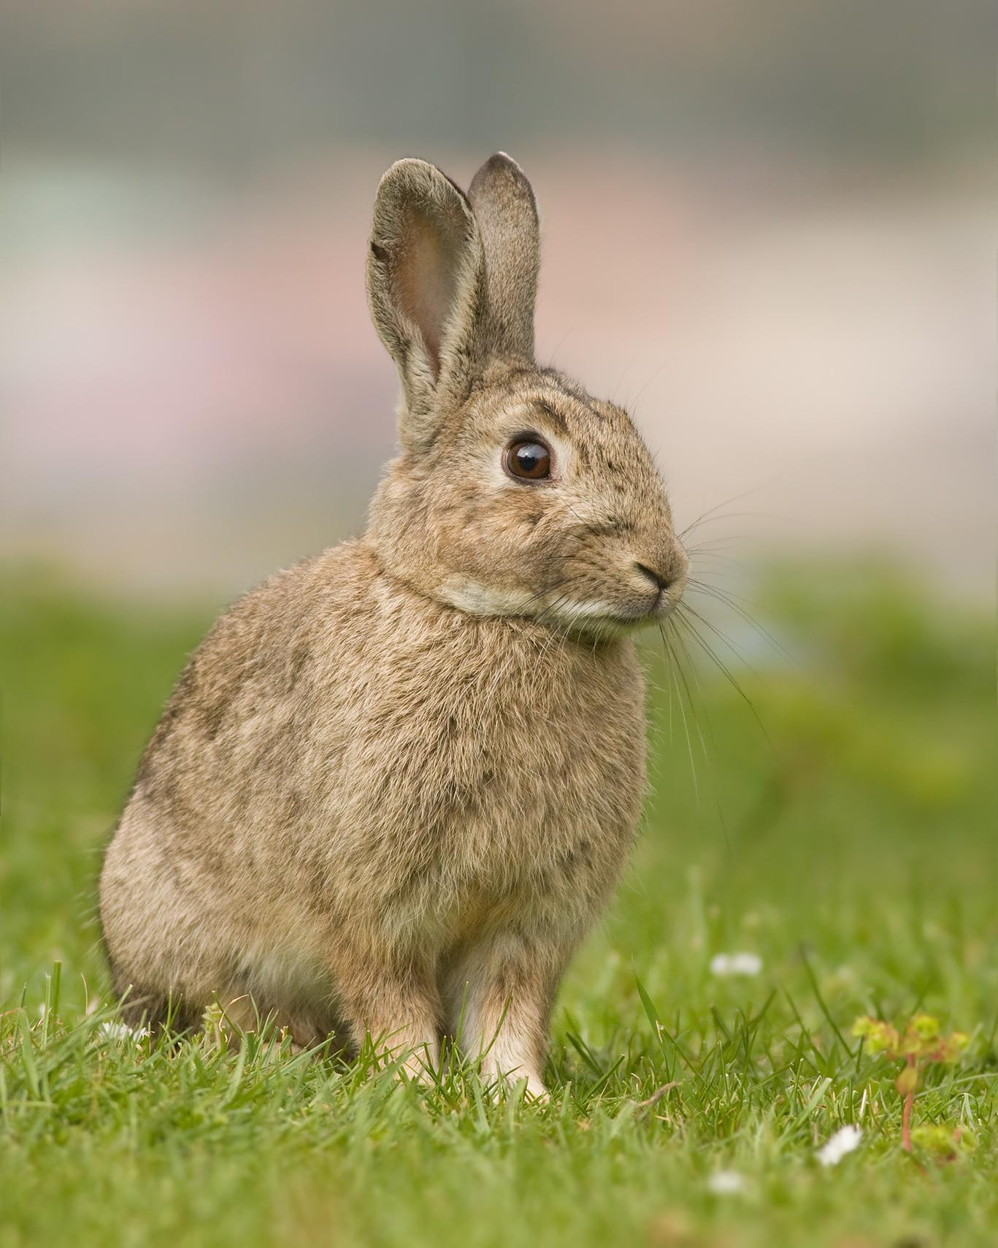
Primary Consumers in the Taiga
Rabbits, Voles, Mice, and Shrews are all examples of Primary consumers in the Taiga.
(my dude lookin like Big Chungus)
Notes:
1-Each slide have a different background
1-Each slide have pictures
1-Each slide have transitions (information slides in, rotates, etc.)

Slide 6
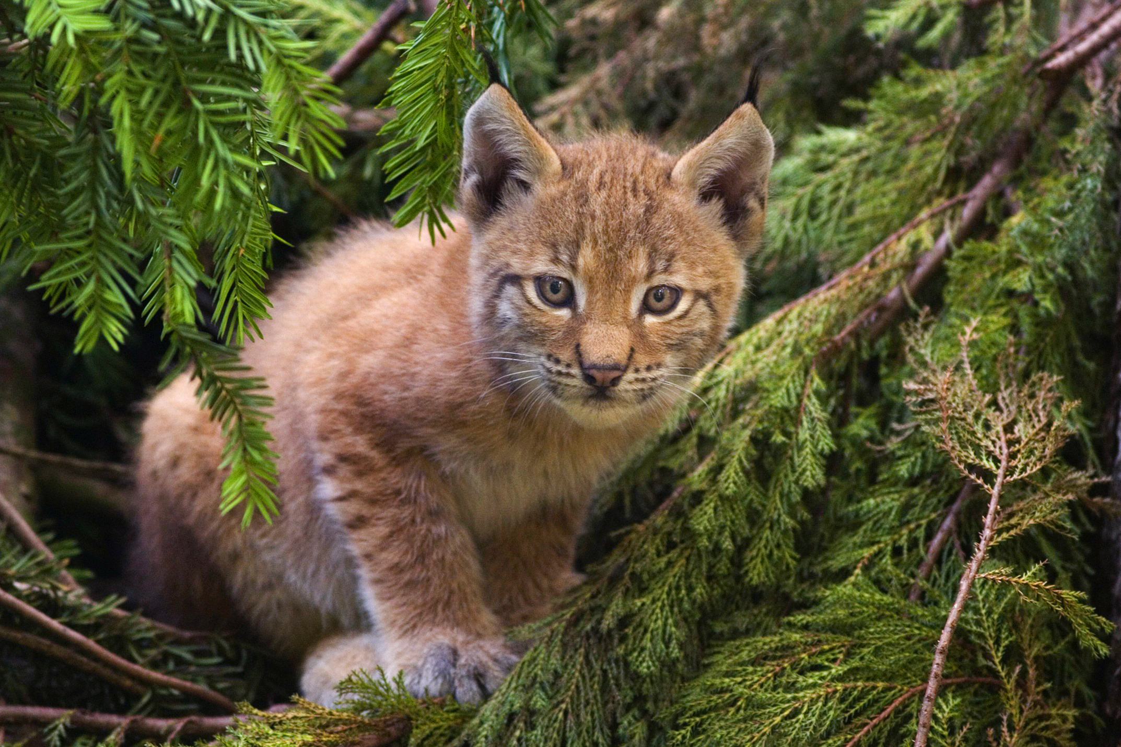
Secondary Consumers in the Taiga
The secondary consumers in the Taiga are, Lynx, Bobcats, and Carnivorous birds.
(why does this lynx look like my cat???).
Notes:
1-Each slide have a different background
1-Each slide have pictures
1-Each slide have transitions (information slides in, rotates, etc.)

Slide 7
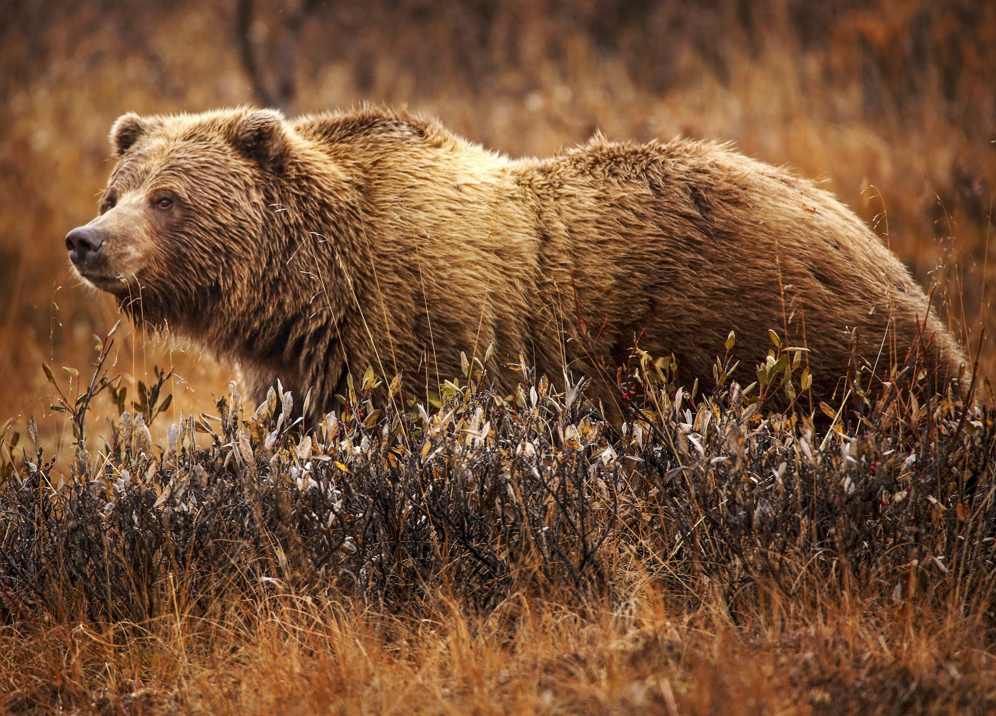
Tertiary Consumers in the Taiga
Bears, Owls, Eagles, and Large Cats are the Tertiary Consumers.
(Ahhhh this picture is so aesthetic! Whoever took this picture, I love you <3.) .
Notes:
1-Each slide have a different background
1-Each slide have pictures
1-Each slide have transitions (information slides in, rotates, etc.)

Slide 8
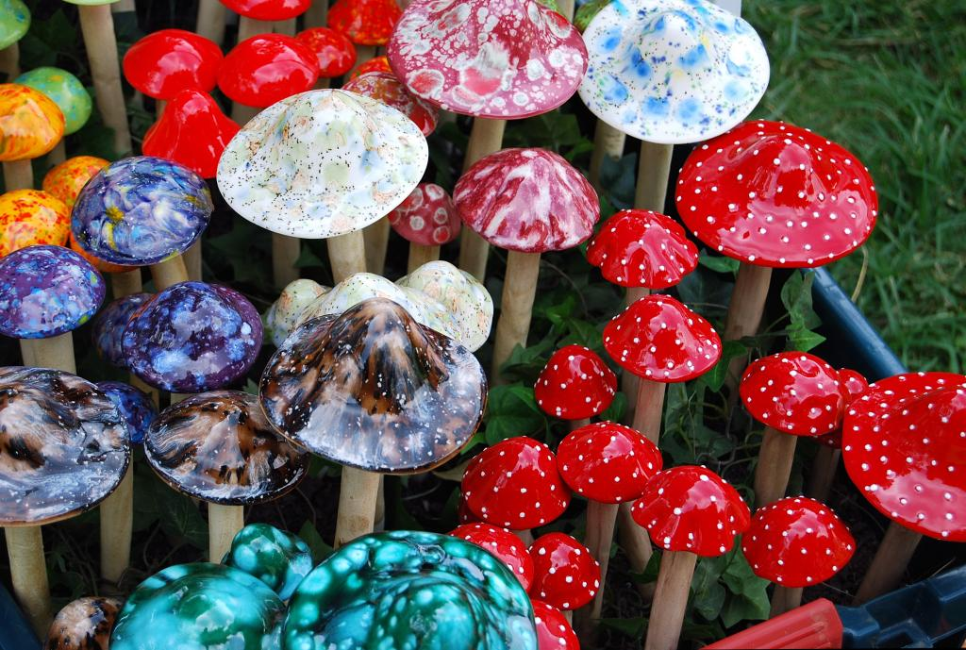
Decomposers in the Taiga
The Decomposers are, Fungi, Slime molds (which one of y’all left your slime at the Taiga???), Bacteria, Slugs, Snails, Woodlice (ey, i know people have lice, but wood??), Springtails, Earthworms, Flies, Maggots, Beetles, and their larvae
Notes:
1-Each slide have a different background
1-Each slide have pictures
1-Each slide have transitions (information slides in, rotates, etc.)

Slide 9
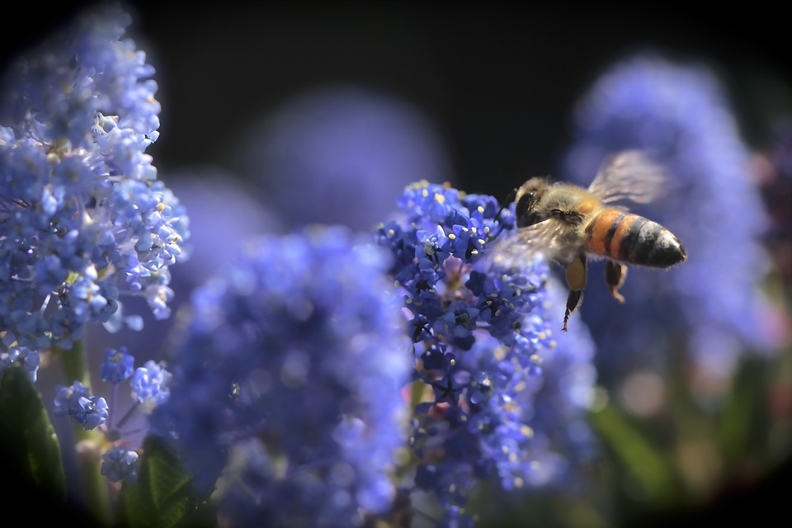
Mutualism in the Taiga .
An example of mutualism is plants and bees. The plants benefit by getting pollinated and the bees benefit by getting food.
Notes:
1-Each slide have a different background
1-Each slide have pictures
1-Each slide have transitions (information slides in, rotates, etc.)

Slide 10
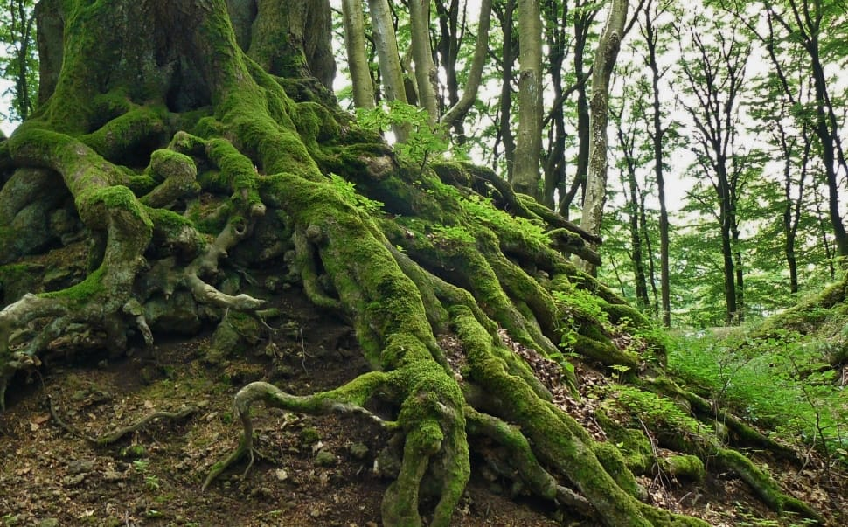
Commensalism in the Taiga
An example of commensalism is Moss and Trees. The Moss benefits because it has a nice and shady place to grow, the tree doesn’t benefit nor does it get harmed. OMG this reminds me of Moana, the mother nature lady or whatever.
Notes:
1-Each slide have a different background
1-Each slide have pictures
1-Each slide have transitions (information slides in, rotates, etc.)

Slide 11
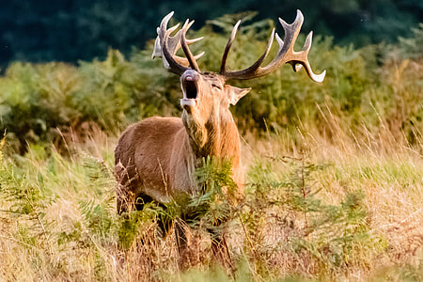
Parasitism in the Taiga
An example of Parasitism is a winter tick and a moose. The winter tick benefits by getting food and blood while the moose on the other hand is getting the opposite, the moose does not benefit and gets harmed.
(The tick is hangin on for dear life)
Notes:
1-Each slide have a different background
1-Each slide have pictures
1-Each slide have transitions (information slides in, rotates, etc.)

Slide 12

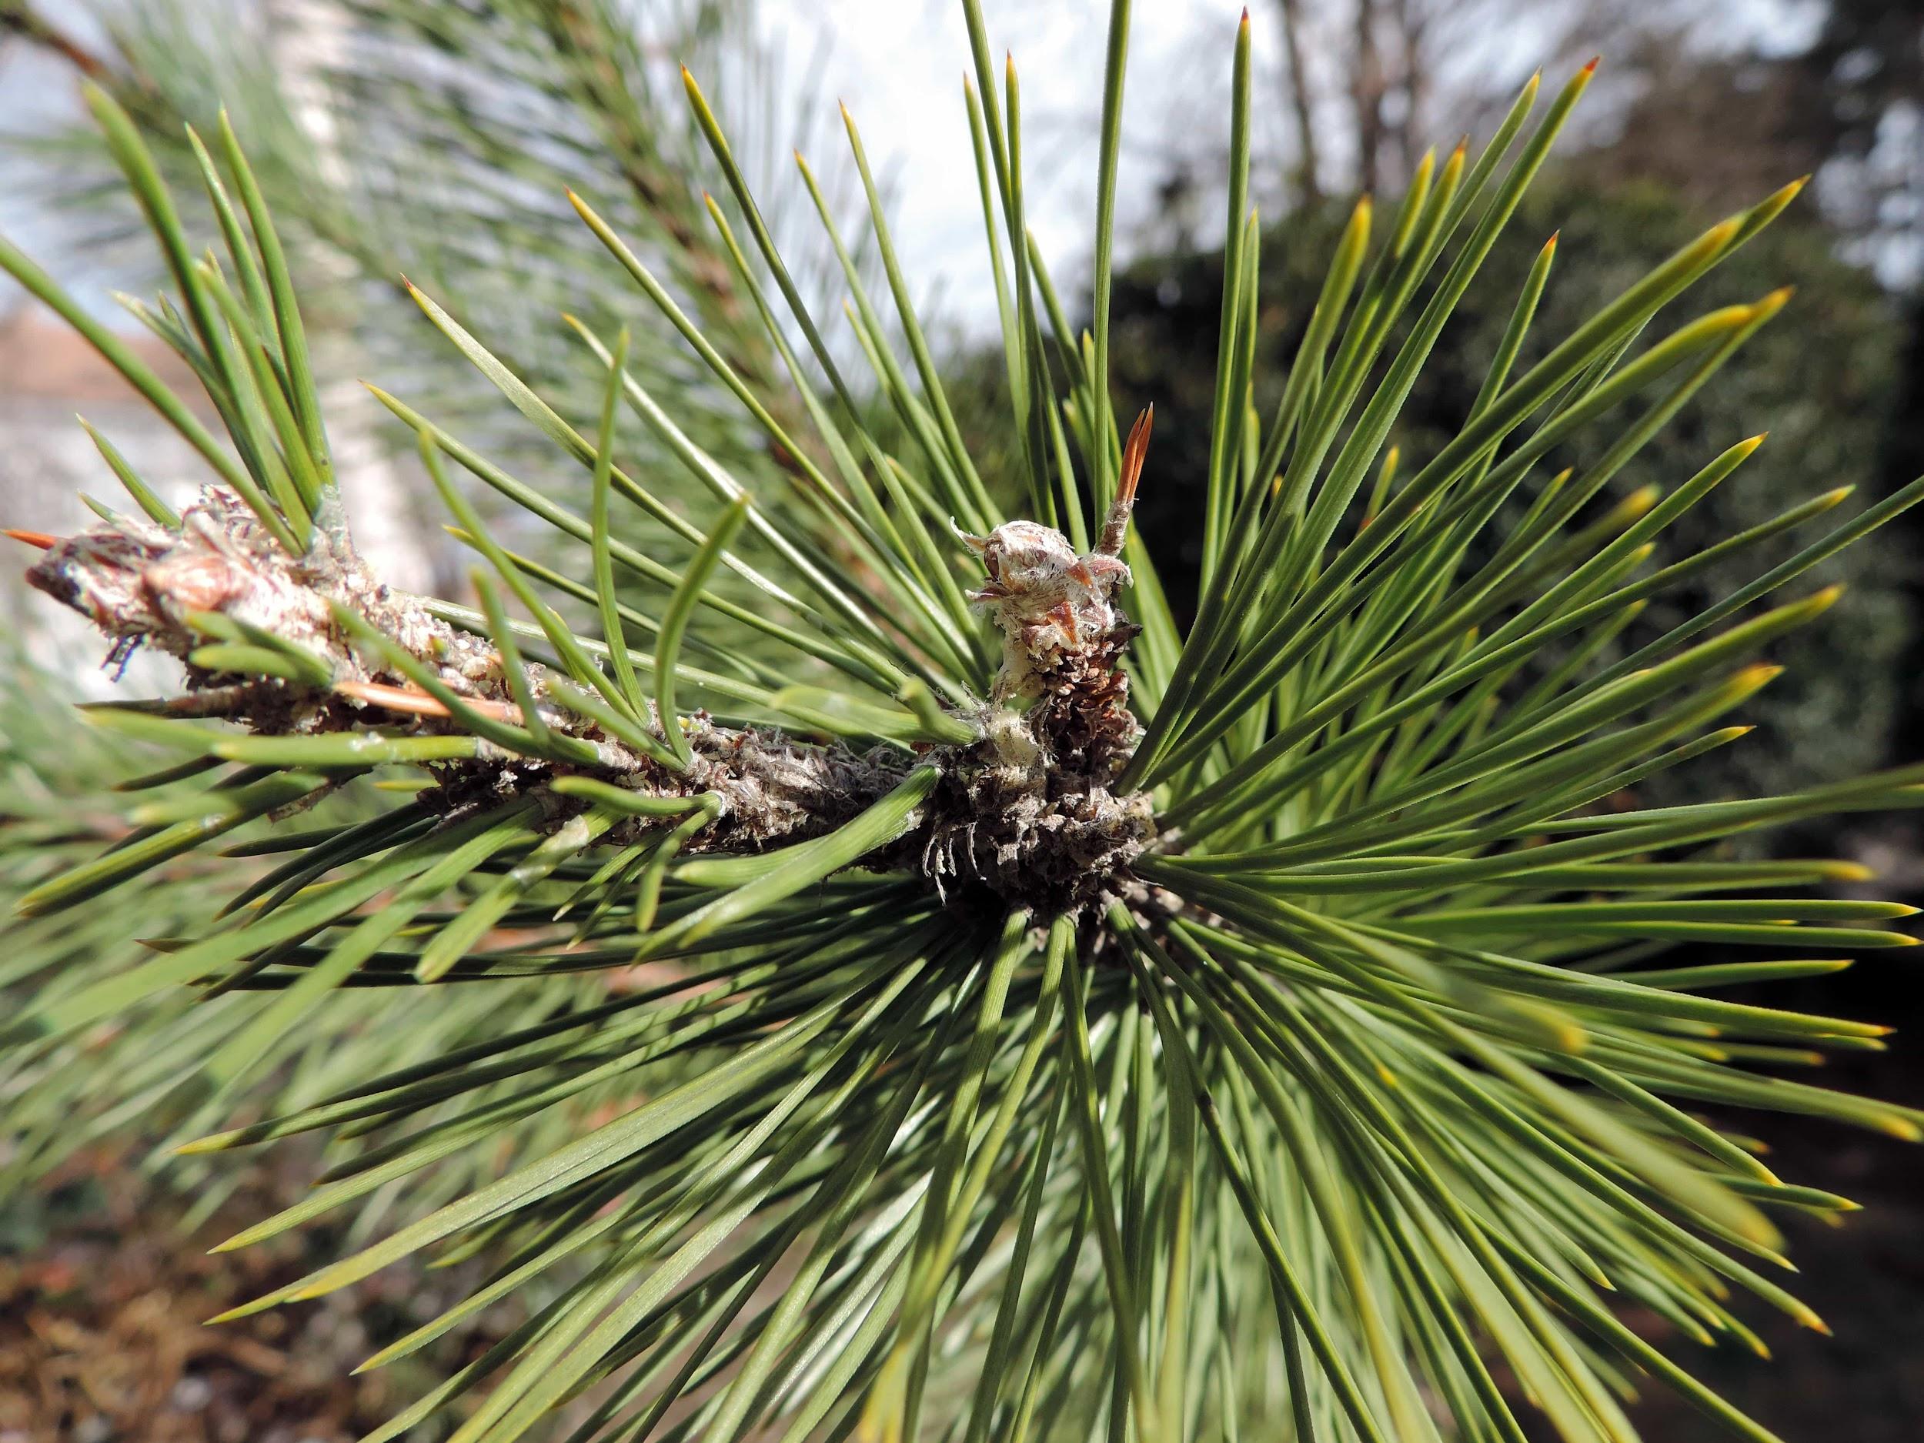
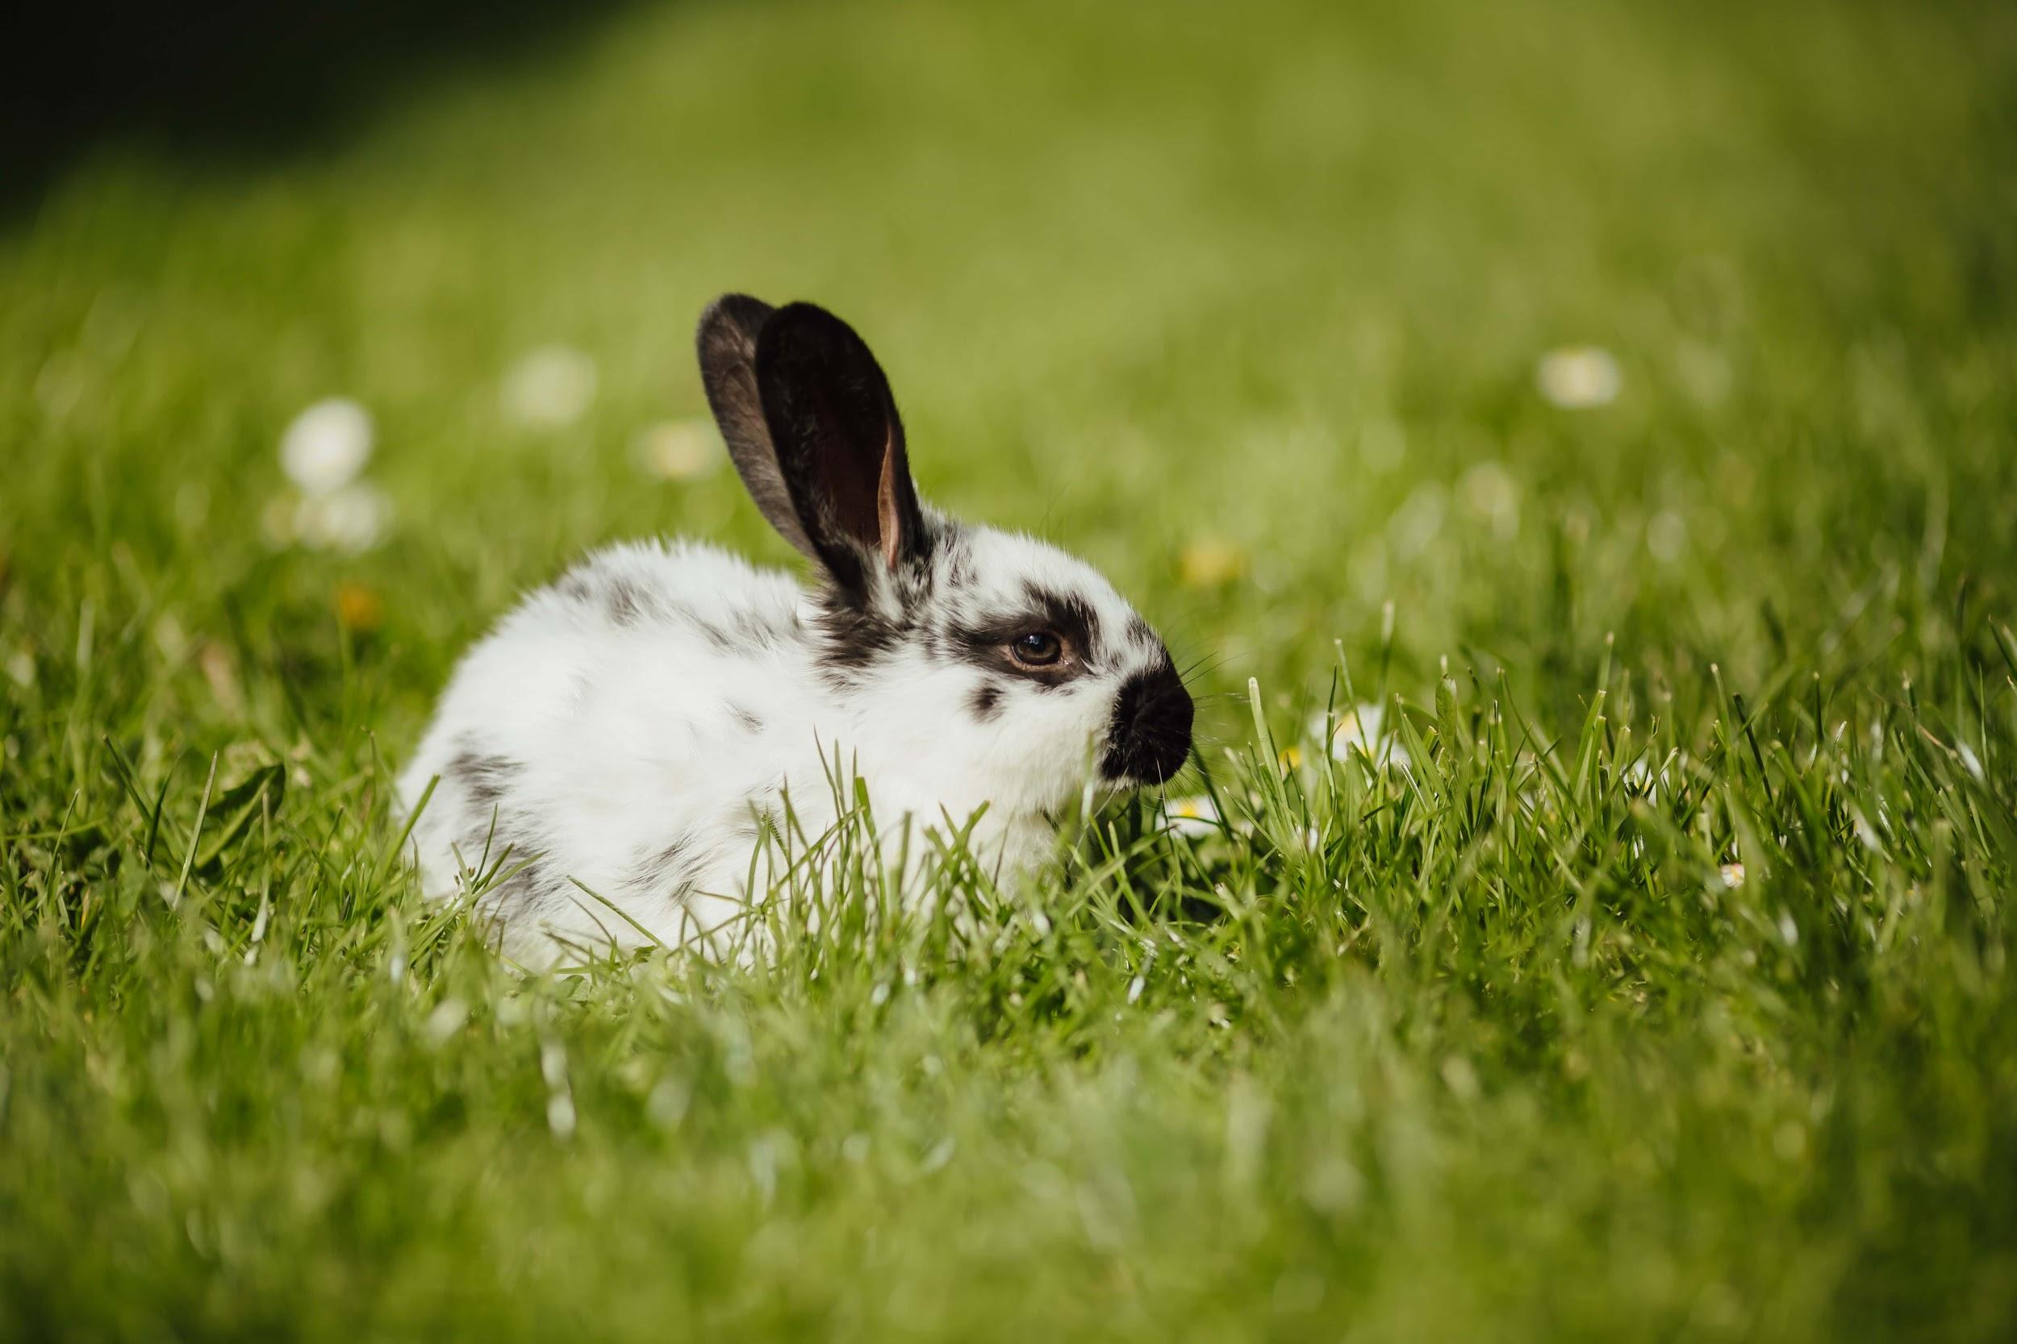
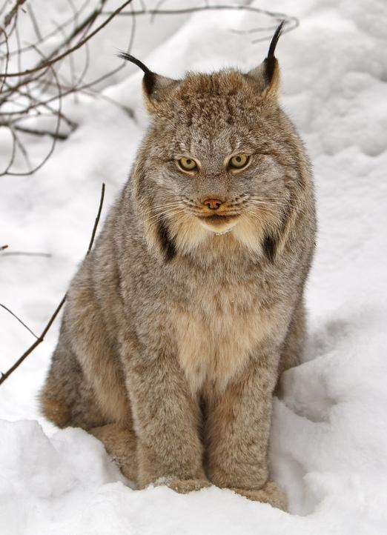
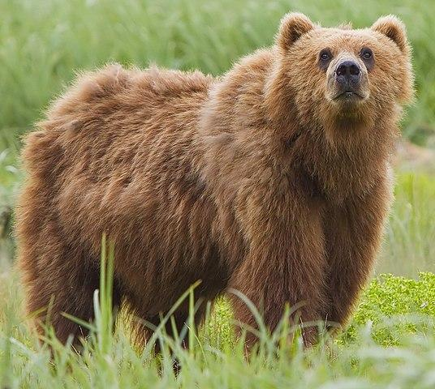
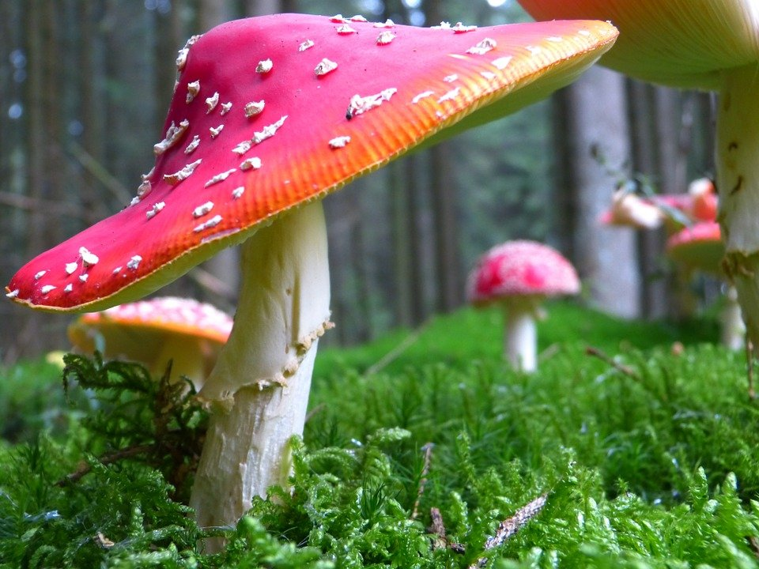
Taiga food chain
Notes:
1-Each slide have a different background
1-Each slide have pictures
1-Each slide have transitions (information slides in, rotates, etc.)

