Slide 1

Biome Project
Notes:
Each slide have a different background
Each slide have pictures
Each slide have transitions (information slides in, rotates, etc.)
This slide needs a transition.

Slide 2
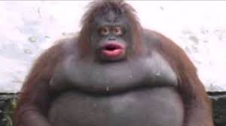
Biome name: Taiga. Temperature?
In the Taiga Biome, there are harsh and very cold winters with extreme rain and snow. The Taiga Biome receives up to 30 to 50 cm of annual precipitation. The Taiga region has only Winter and Summer seasons.
Notes:
Each slide have a different background
Each slide have pictures
Each slide have transitions (information slides in, rotates, etc.)
This slide needs a transition.

Slide 3

Any adaptations creatures need to survive in your biome?
Bears and other animals need to hibernate, some need insulated feet, and some need seasonal coats.

Slide 4

Examples of Producers in your biome:
In the Taiga region, some of the producers there include pine trees, fir trees, evergreen spruce, and the larch or tamarack.

Slide 5
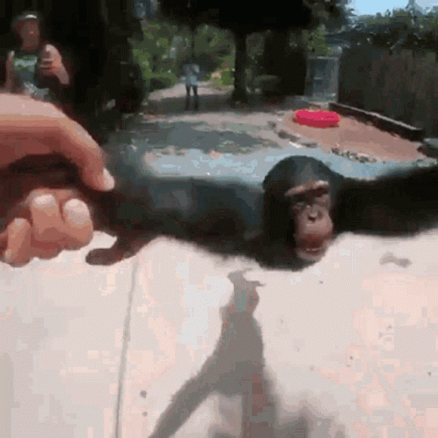
Examples of Primary Consumers in your Biome:
In the Taiga region, the primary consumers there include small mammals such as rabbits, voles, mice, shrews, and other rodents.

Slide 6
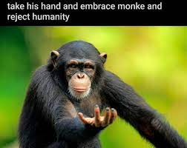
Examples of Secondary Consumers in your Biome:
In the Taiga region, the secondary consumers there include the hawk owl, ermine, marten, red-throated loon and the sable.

Slide 7
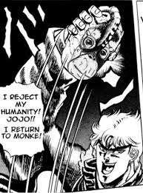
Examples of Tertiary Consumers in your Biome:
In the Taiga region, the tertiary consumers there include Canada Lynx, Peregrine Falcon, Wolverine, Red Fox, and the Black Bear.

Slide 8
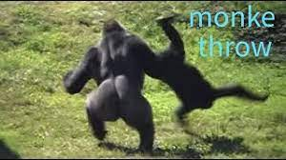
Examples of Decomposers in your Biome:
In the Taiga region, the decomposers there include honey fungus, fungi, moss, worms and soil bacteria.

Slide 9
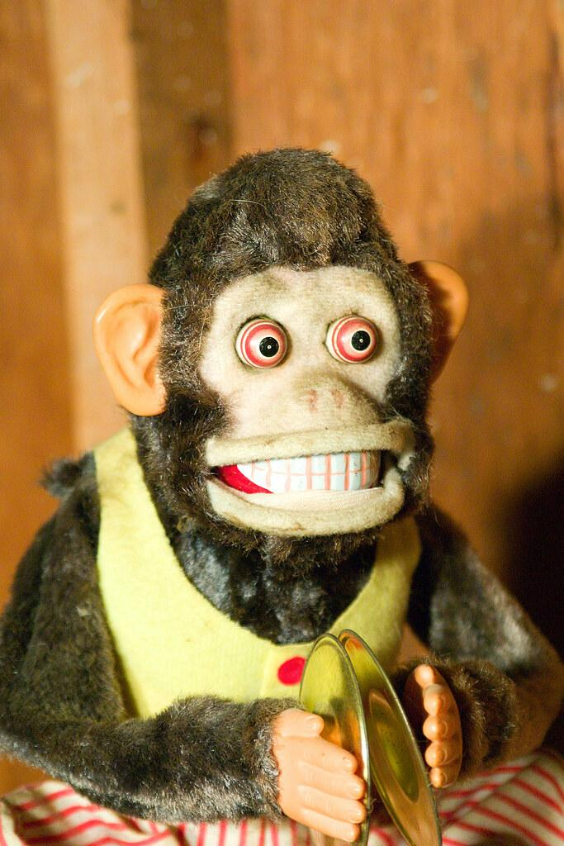
Example of Mutualism in your Biome:
An example of mutualism in the Taiga biome is when bees fly from plant to plant. The flowers are benefiting by getting pollinated and the bees are getting food.

Slide 10
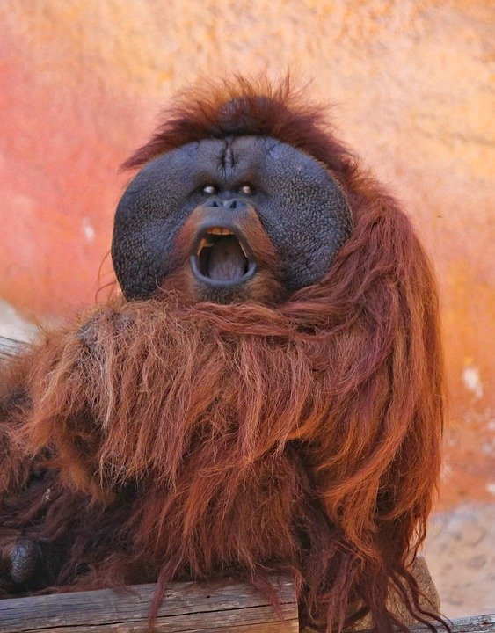
Example of Commensalism in your Biome:
An example of commensalism in the Taiga biome is moss growing on trees because the moss benefits by having a cool place to grow because if it grew in the sun it would dry up, but the tree is neither benefited nor harmed.

Slide 11
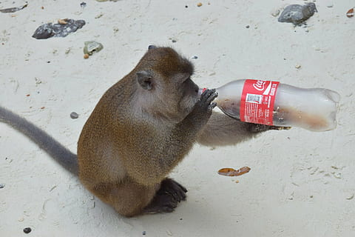
Example of Parasitism in your Biome:
An example of parasitism in the Taiga biome is when a winter tick hitchhikes on a moose's back. The winter tick is receiving food and a place to stay while sucking blood from the moose's body which is beneficial for the tick, but the complete opposite for the moose.

Slide 12
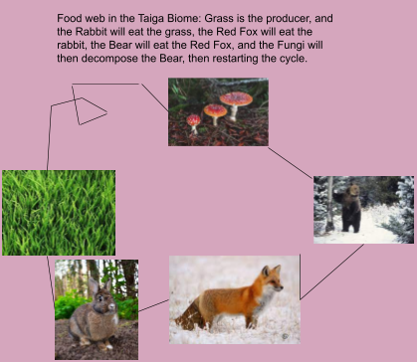
Food Web

