Slide 1
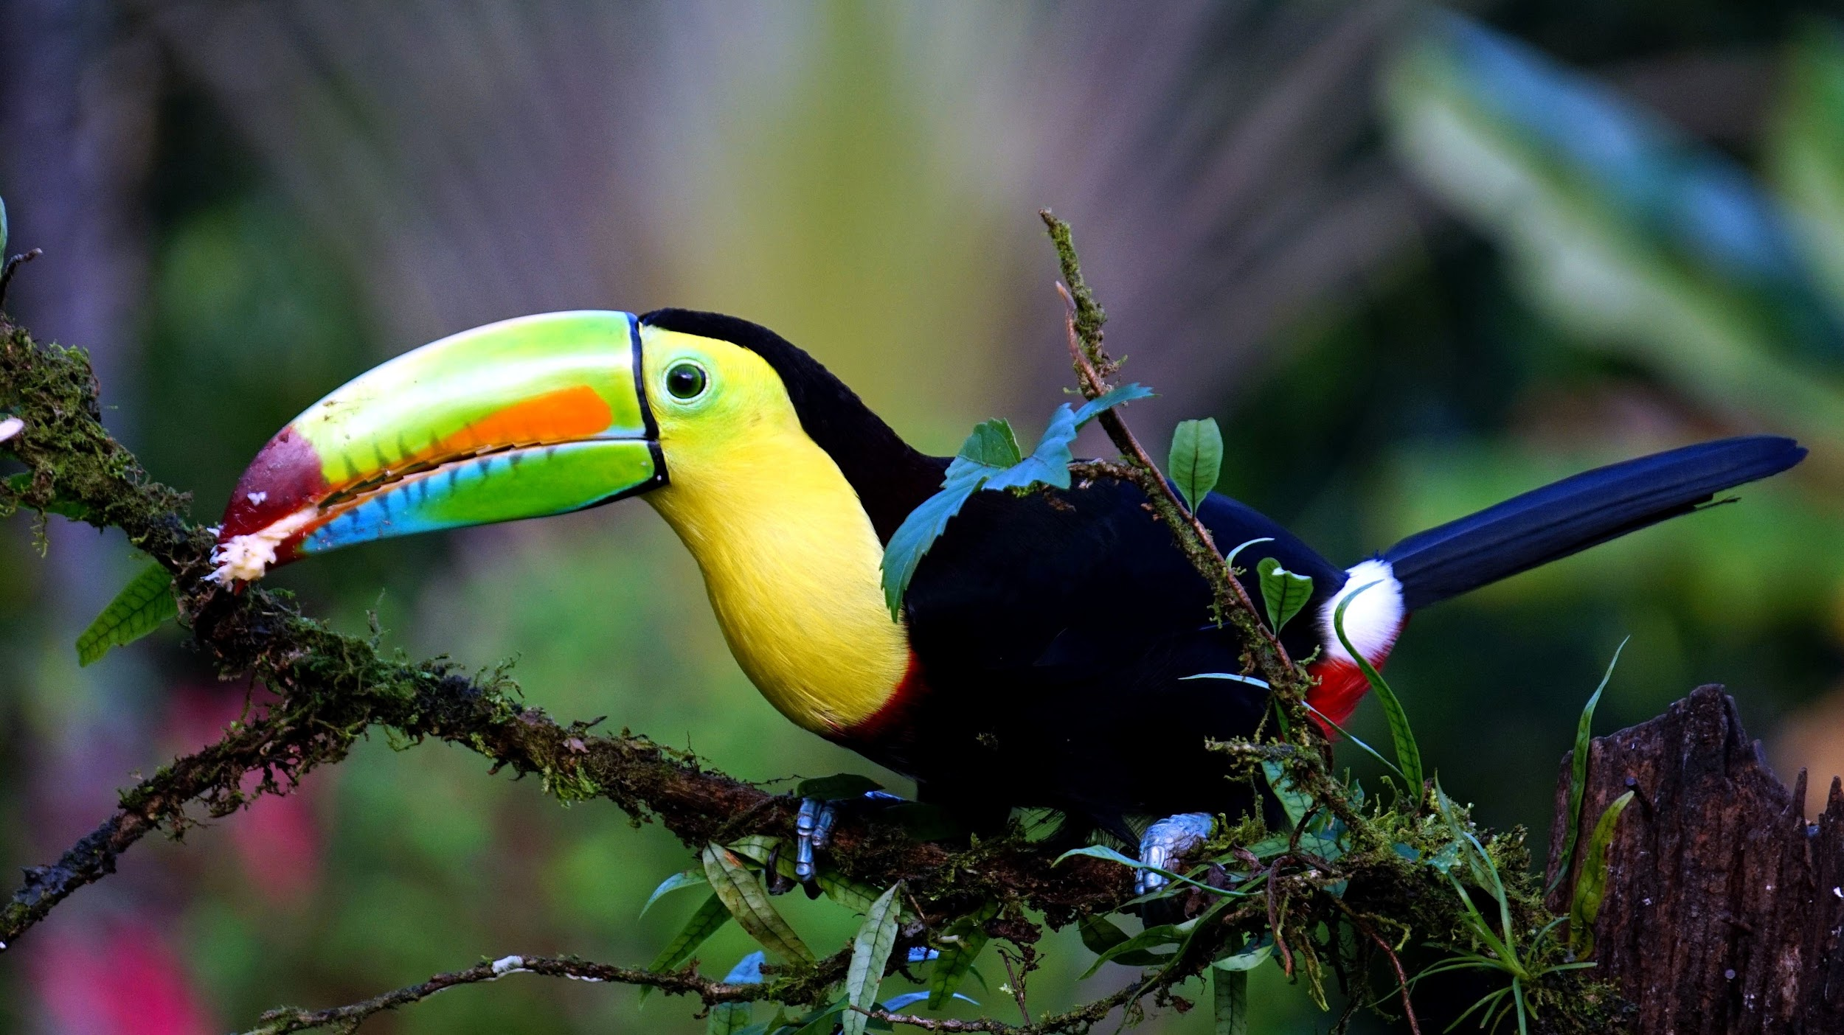
Tropical rainforest
By Yasleen Perez
Notes:
1-Each slide have a different background
1-Each slide have pictures
1-Each slide have transitions (information slides in, rotates, etc.)

Slide 2
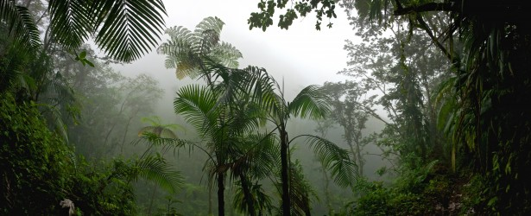
What is the usual temperature of the Tropical rainforest?
The temperature in the rainforest remains warm all year. The average temperature in the rainforest varies from 68 degrees Fahrenheit to 84 degrees Fahrenheit. The average rain amount is 79 to 394 inches of rain per year.
Notes:
1-Each slide have a different background
1-Each slide have pictures
1-Each slide have transitions (information slides in, rotates, etc.)

Slide 3
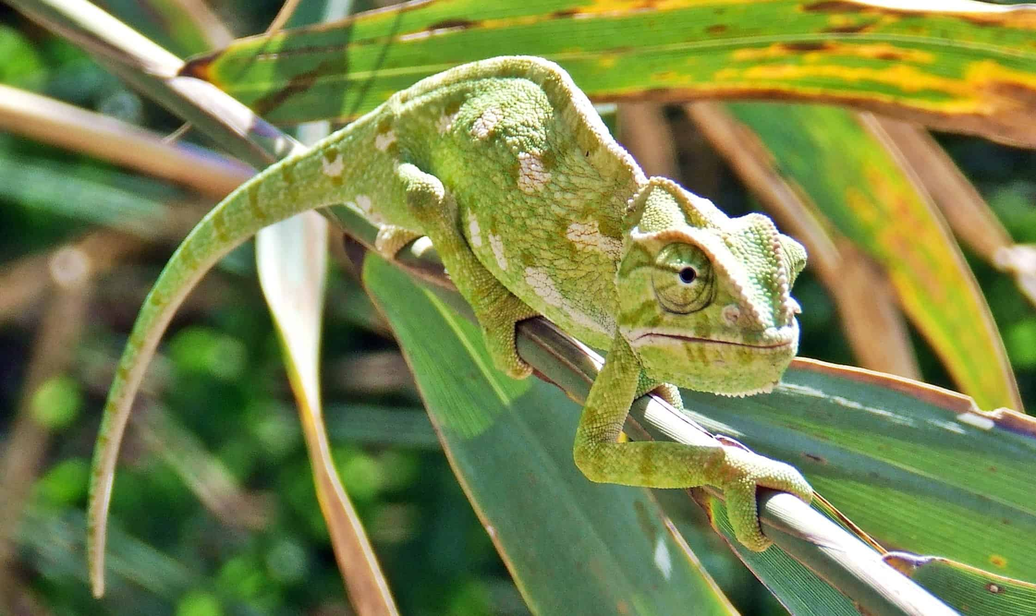
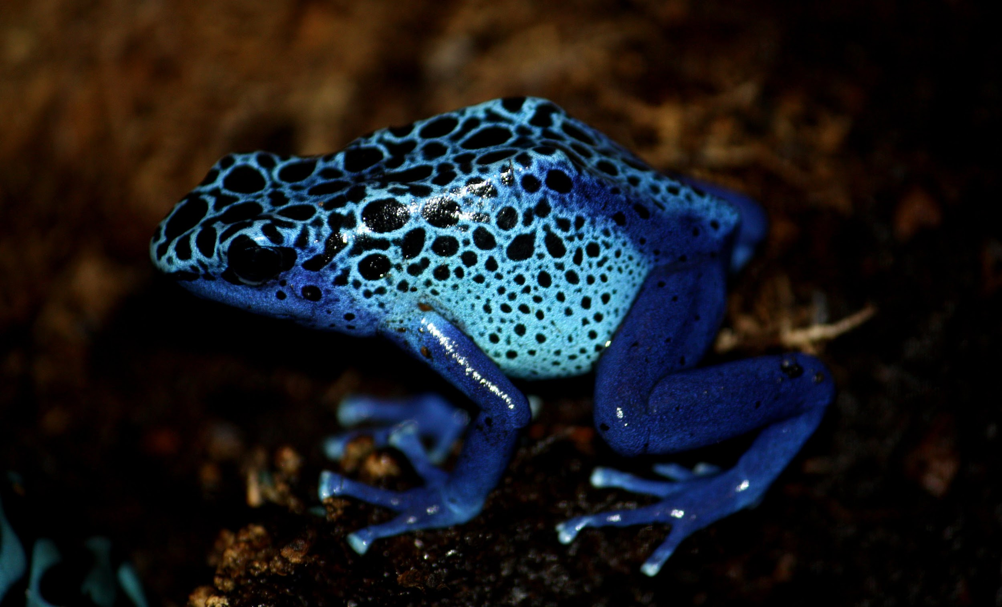
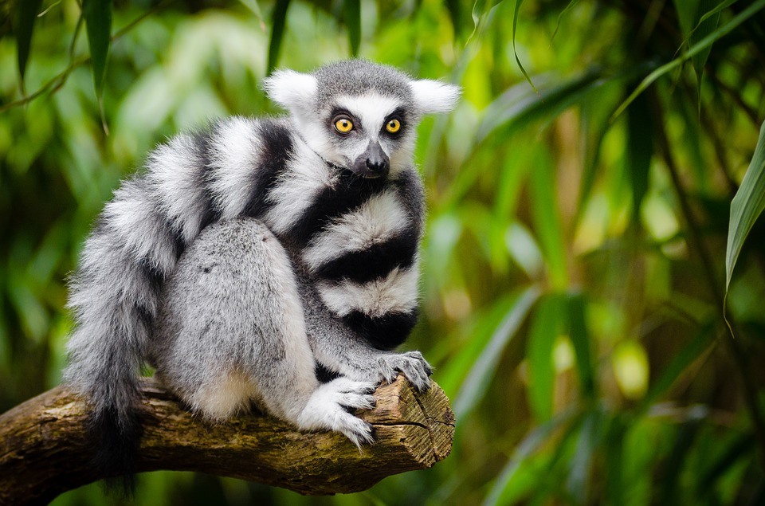
What are some adaptations that the animals in the tropical rainforest have in order to survive?
Some of the adaptations that animals have in the tropical rain forest is camouflage, poison, and reduction of size. Some animals also have bright colored eyes to hunt in the dark.
Has bright eyes for hunting in the dark.
Uses camouflage
Uses Poison
Notes:
1-Each slide have a different background
1-Each slide have pictures
1-Each slide have transitions (information slides in, rotates, etc.)

Slide 4
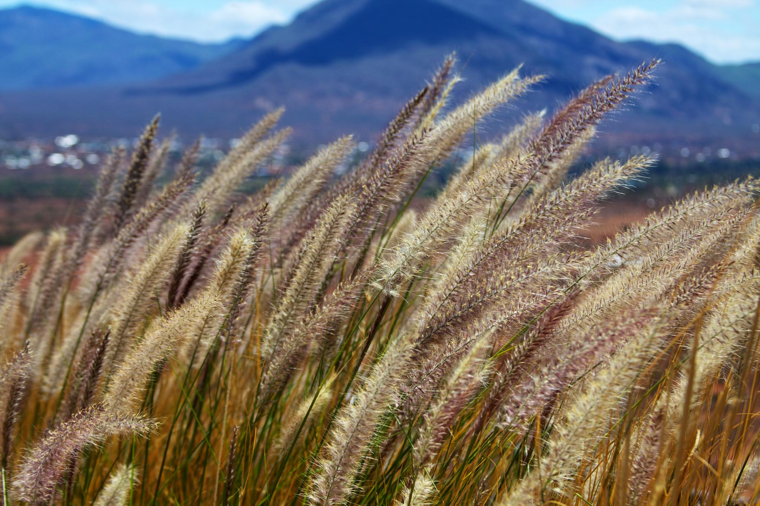
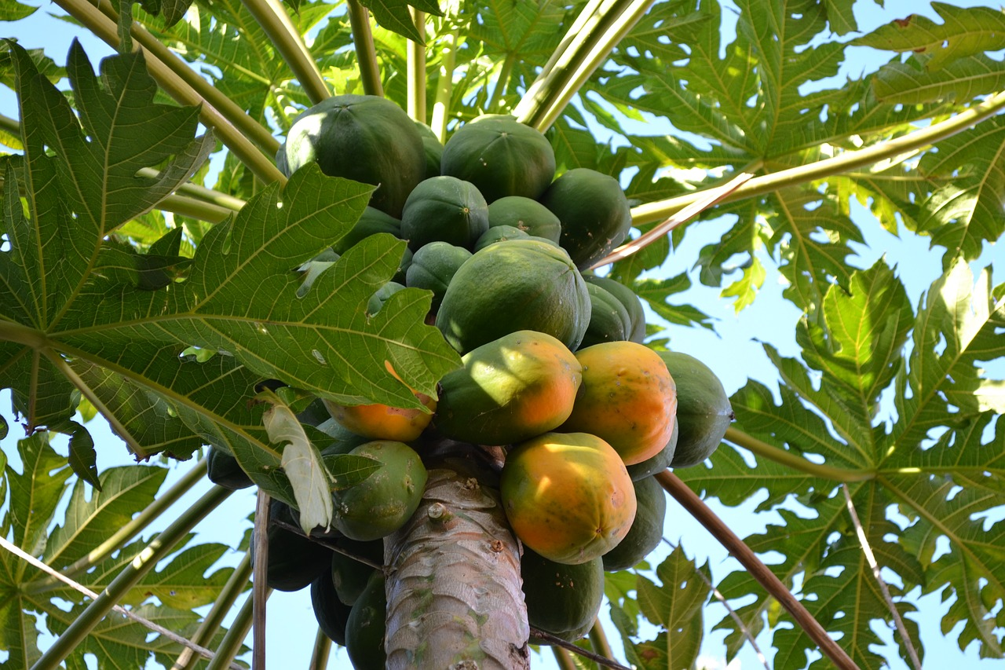
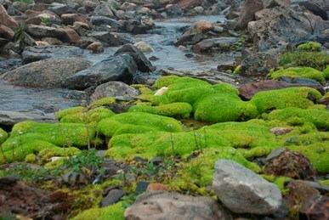
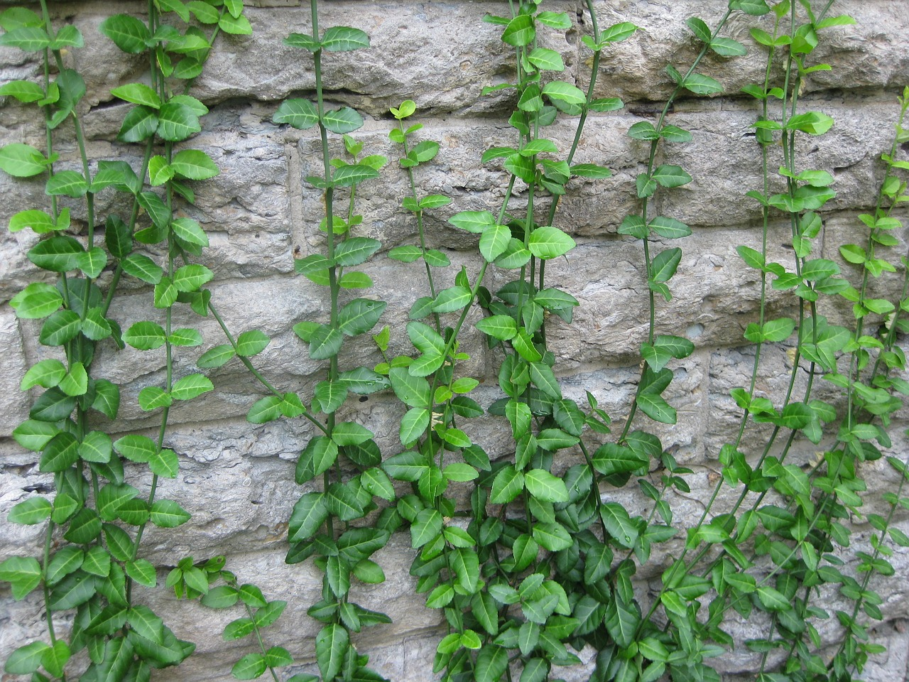
Examples of producers in the tropical rainforest.
Some examples of producers in the Tropical Rain forest are trees, vines, mosses, grasses, tropical fruit trees, and decomposers.
Notes:
1-Each slide have a different background
1-Each slide have pictures
1-Each slide have transitions (information slides in, rotates, etc.)

Slide 5
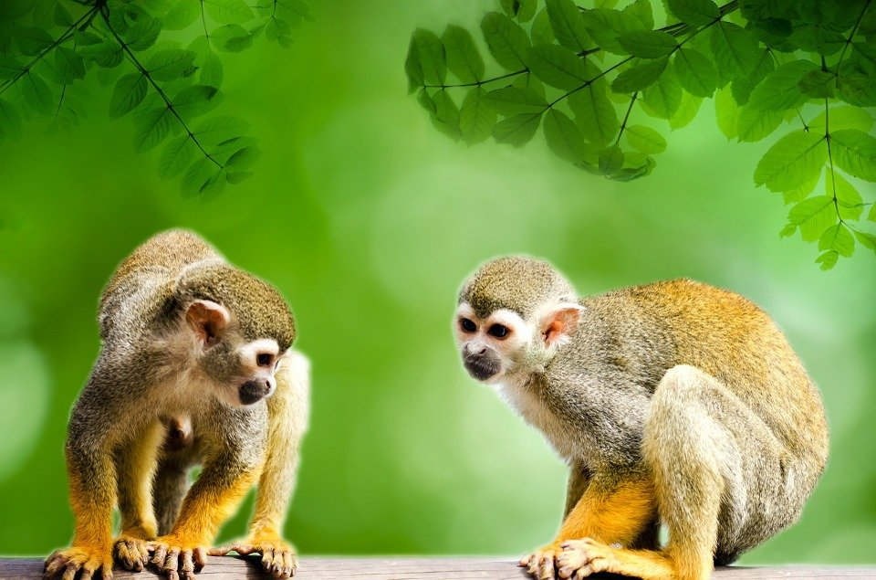
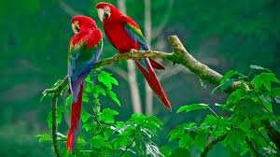
Examples of primary consumers in the tropical rainforest.
Examples for primary consumers in the rain forest are monkeys, and birds.
Notes:
1-Each slide have a different background
1-Each slide have pictures
1-Each slide have transitions (information slides in, rotates, etc.)

Slide 6
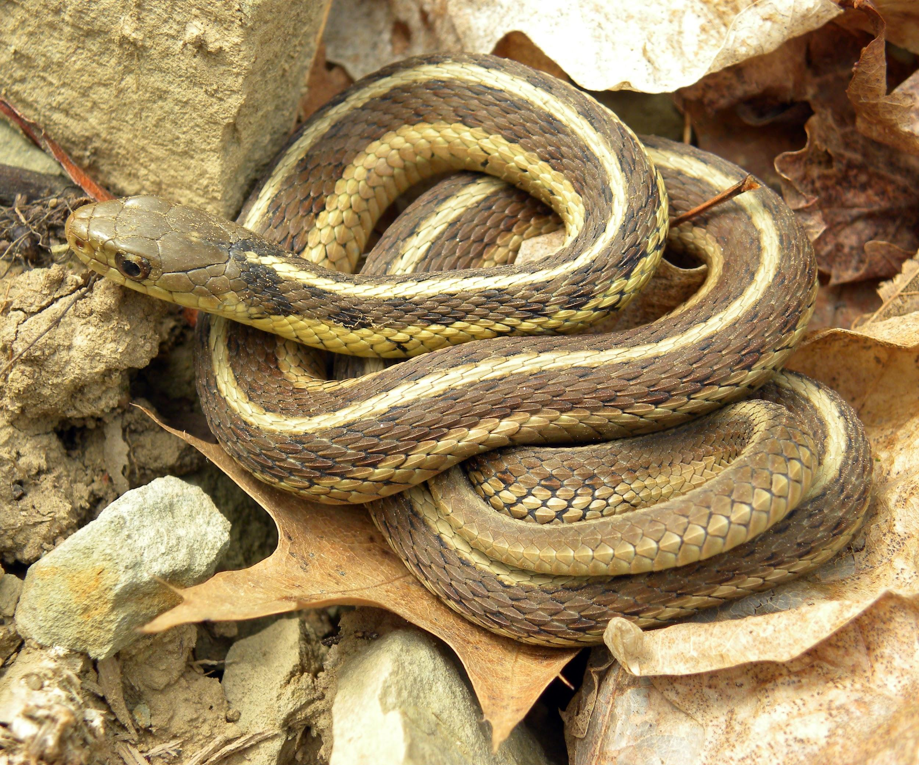
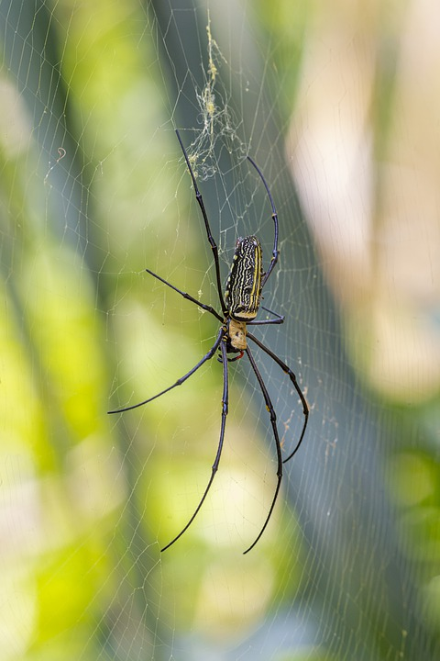
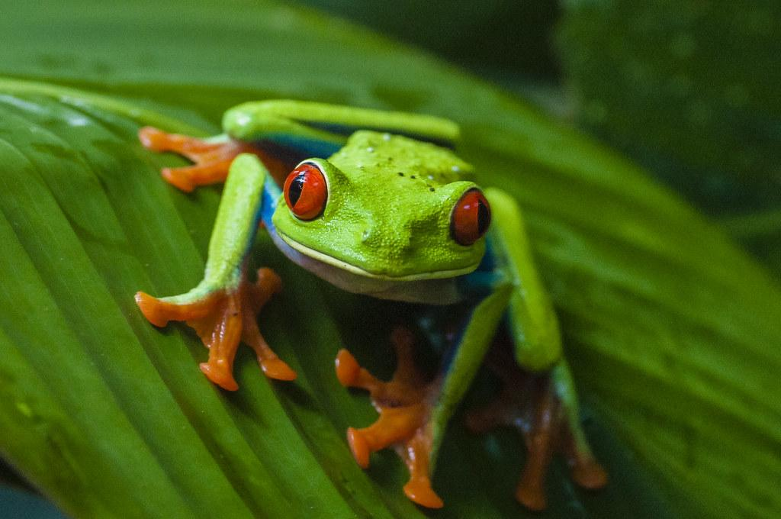
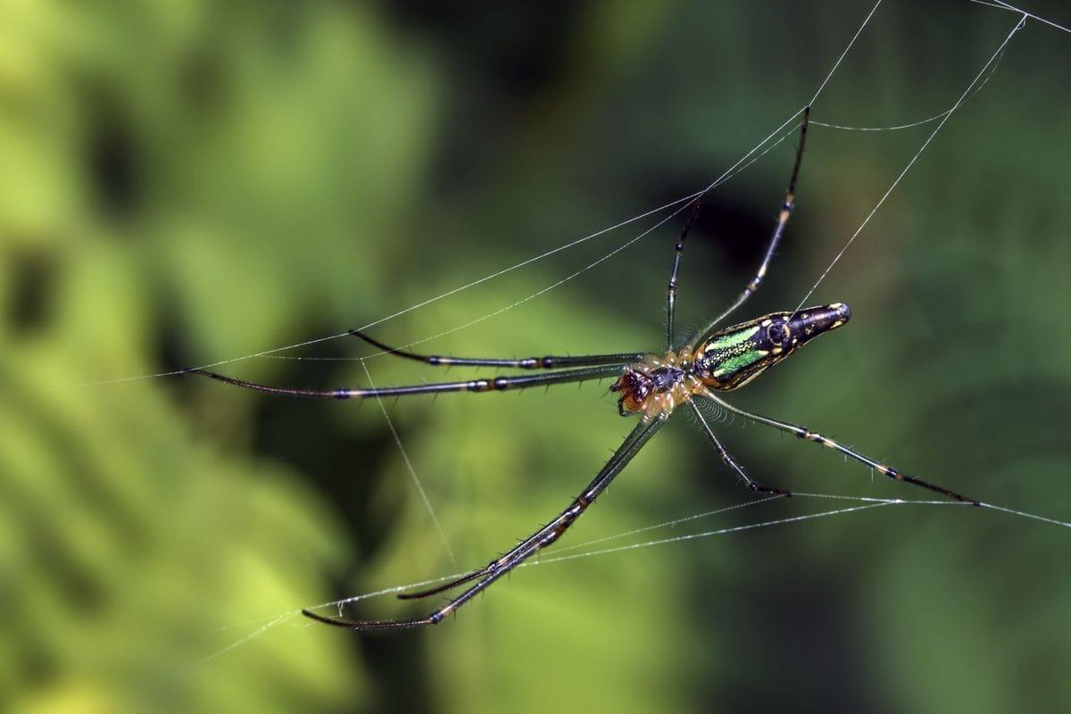
Examples of secondary consumers in the tropical rainforest.
Secondary consumers in the rain forest are tree frogs, snakes, and giant spiders.
Notes:
1-Each slide have a different background
1-Each slide have pictures
1-Each slide have transitions (information slides in, rotates, etc.)

Slide 7
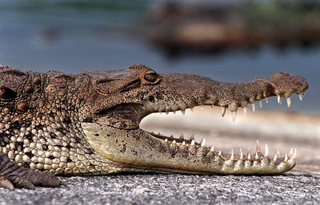
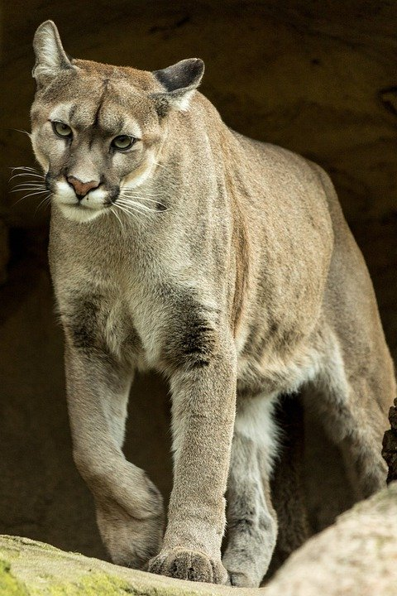
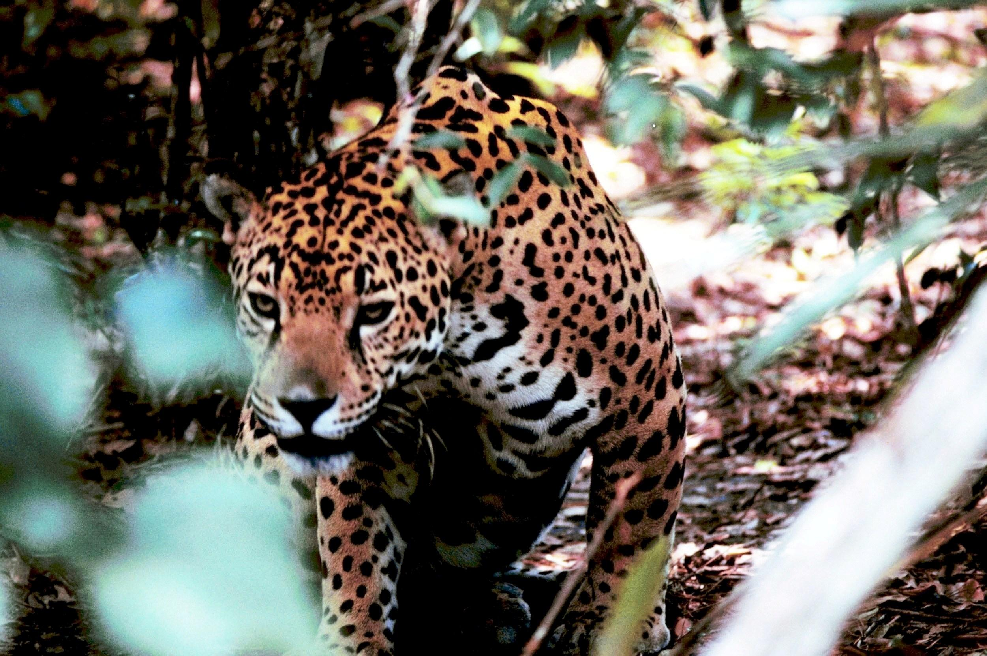
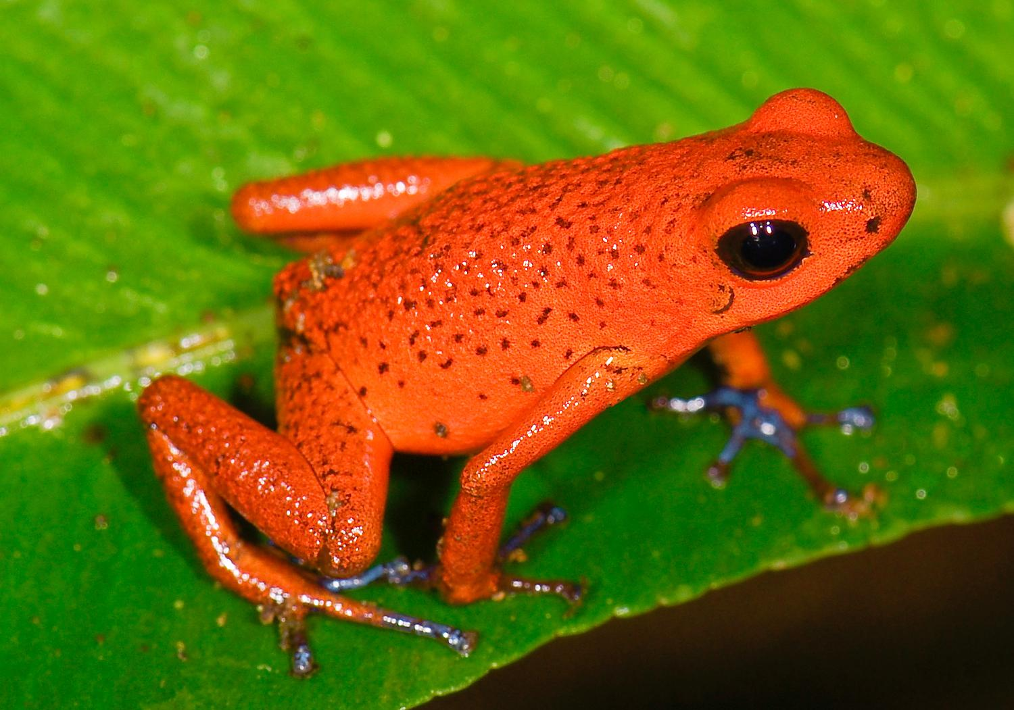
Examples of tertiary consumers in the rainforest.
The rainforests tertiary consumers are pumas, jaguars, crocodiles, and poison dart frogs.
Notes:
1-Each slide have a different background
1-Each slide have pictures
1-Each slide have transitions (information slides in, rotates, etc.)

Slide 8
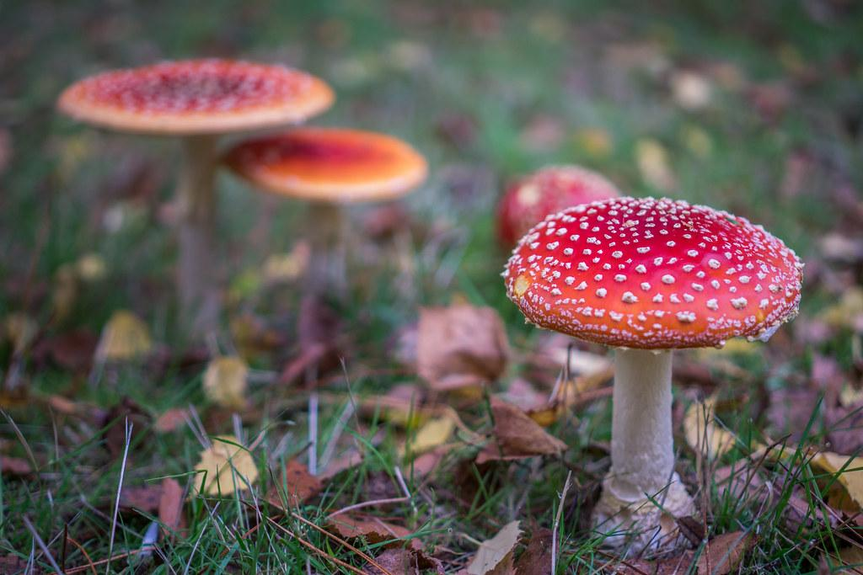
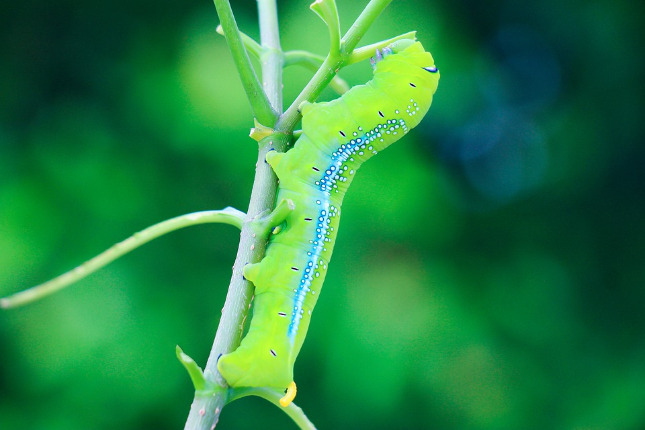
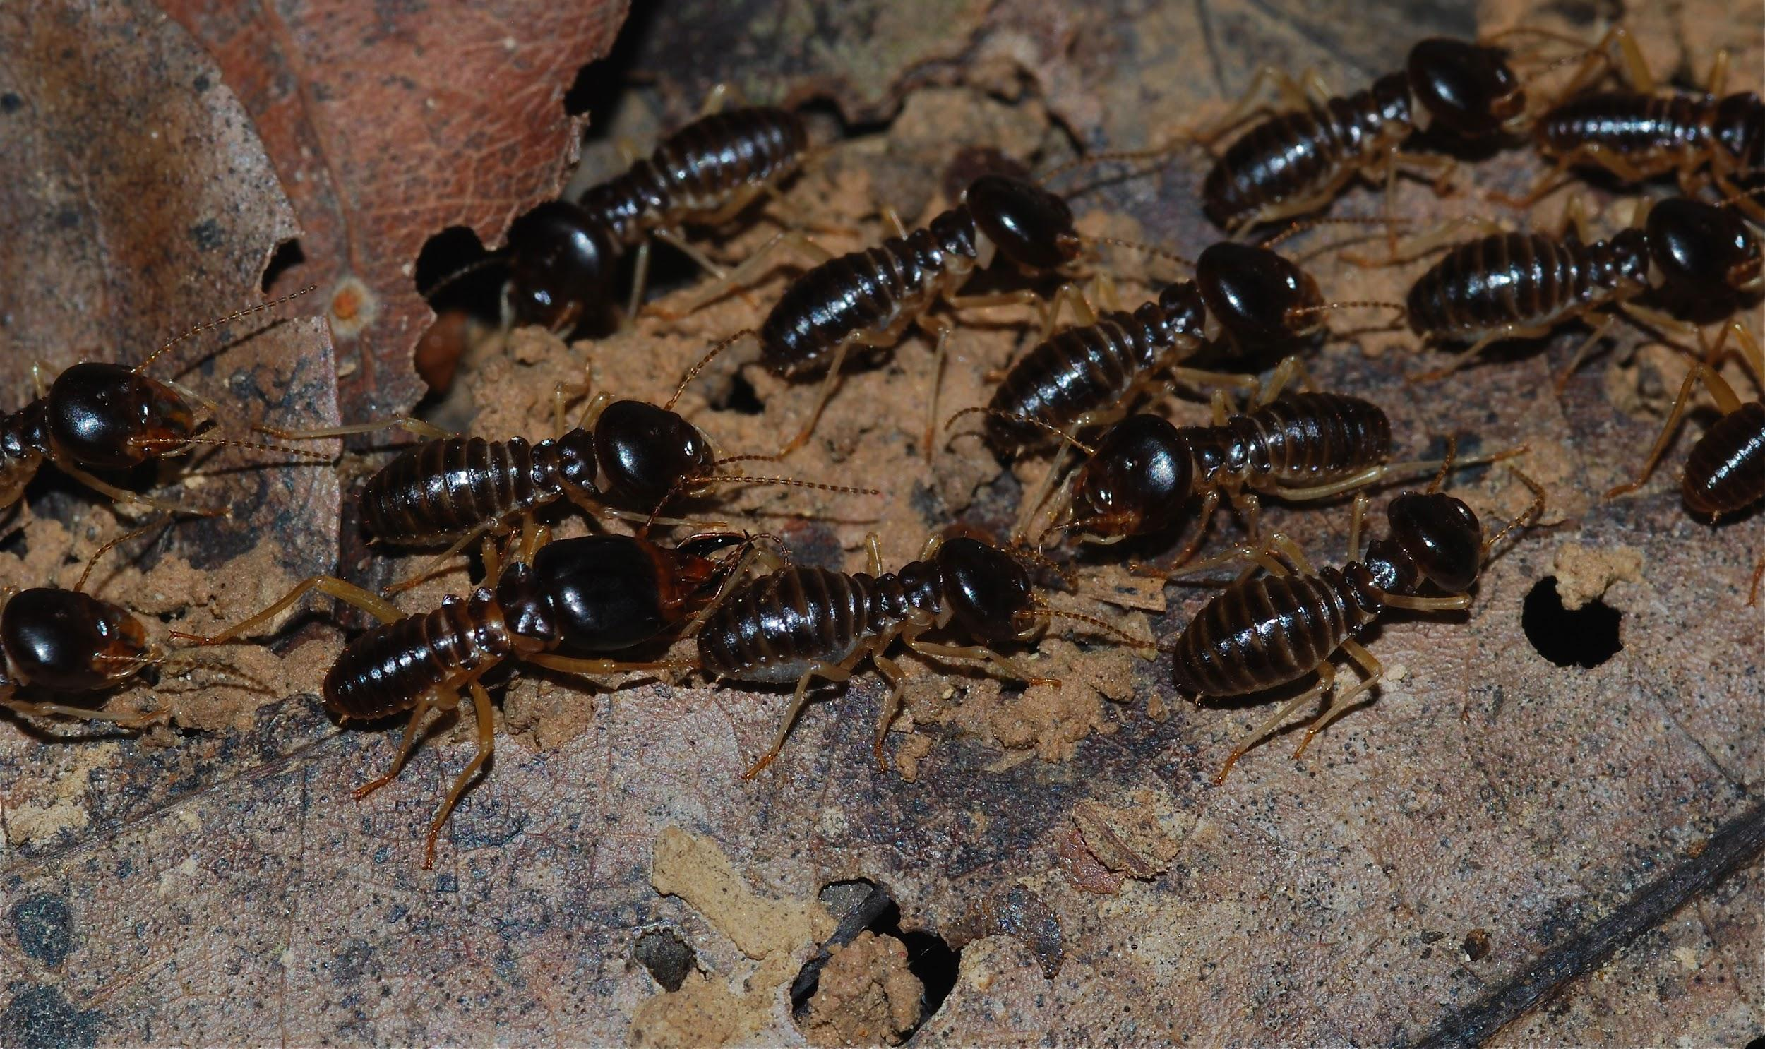
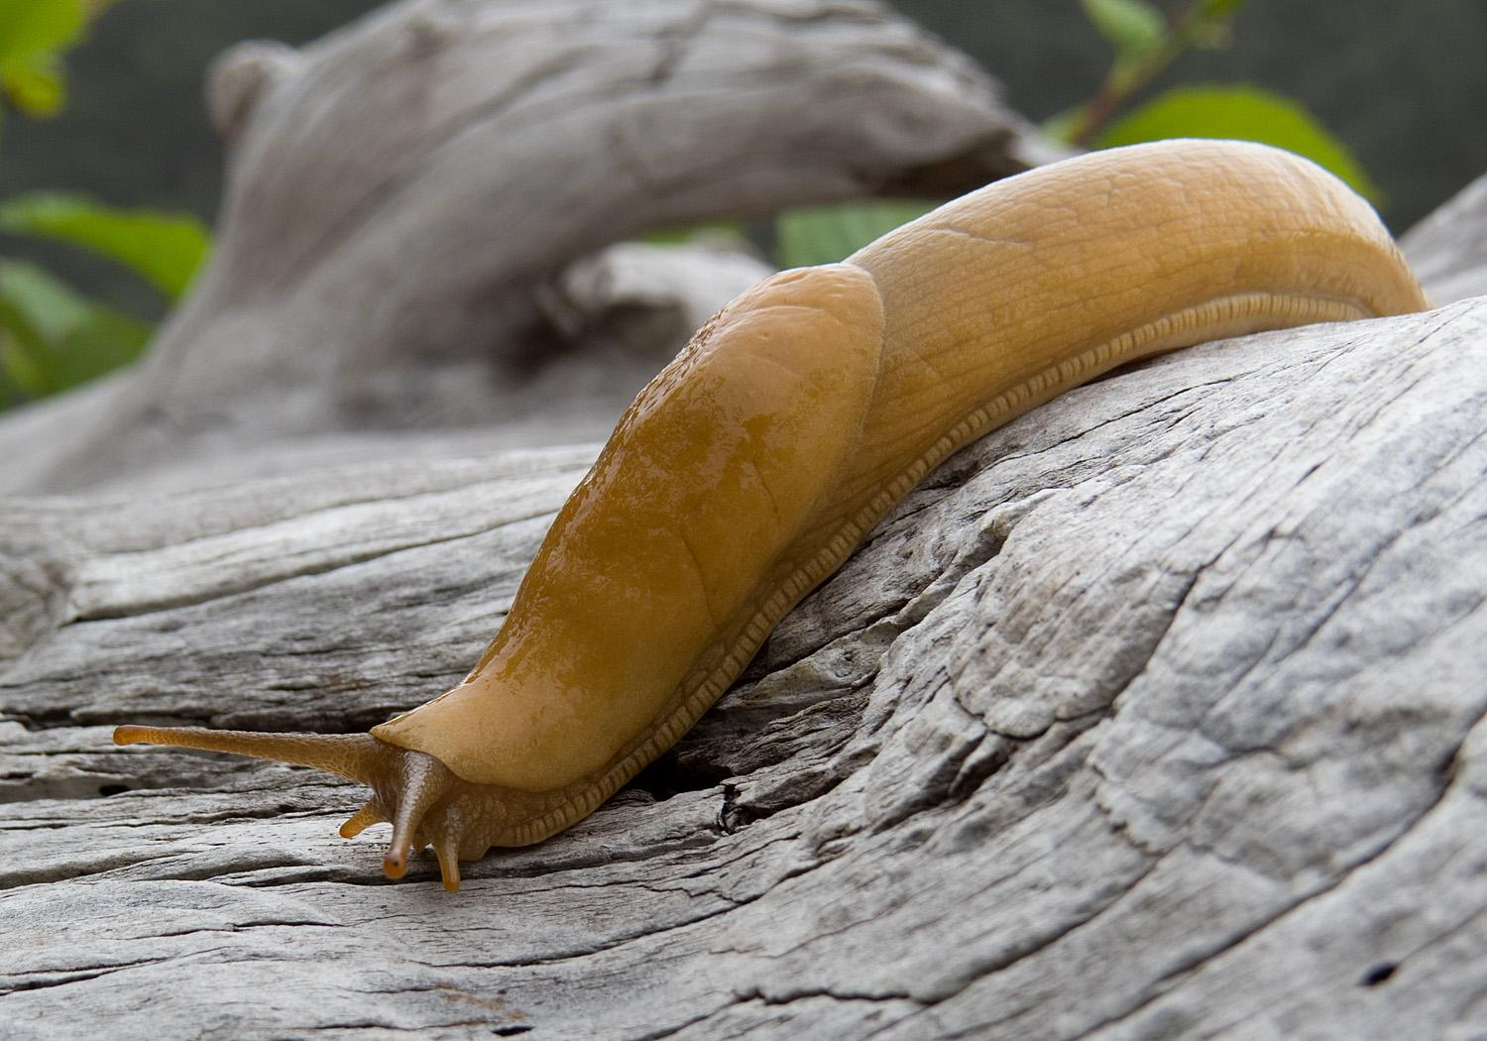
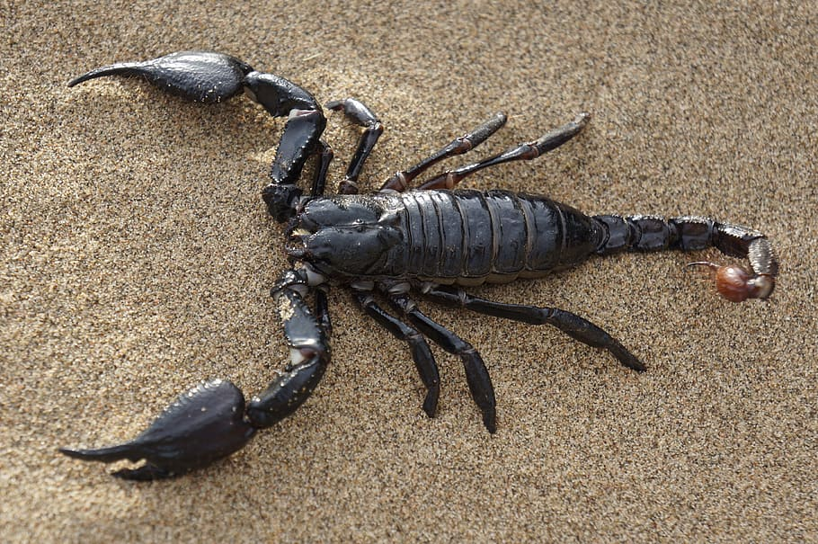
Examples of decomposers in the tropical rainforest.
Decomposers in the tropical rainforests are termites, slugs, scorpions, worms, and fungi.
Notes:
1-Each slide have a different background
1-Each slide have pictures
1-Each slide have transitions (information slides in, rotates, etc.)

Slide 9
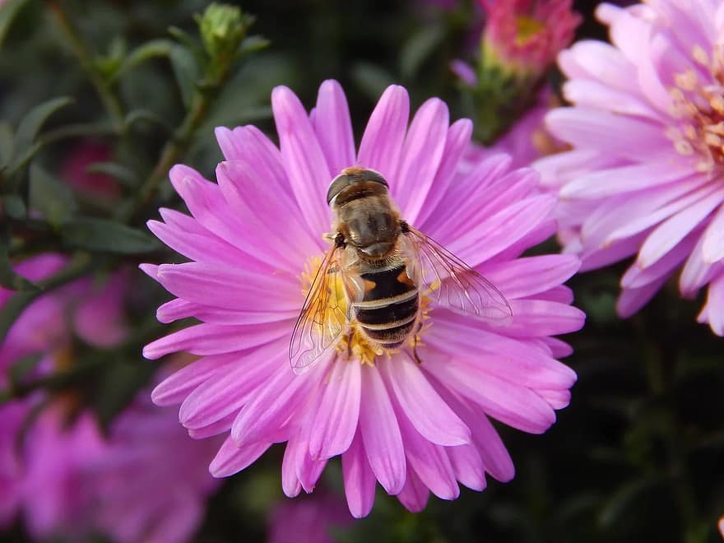
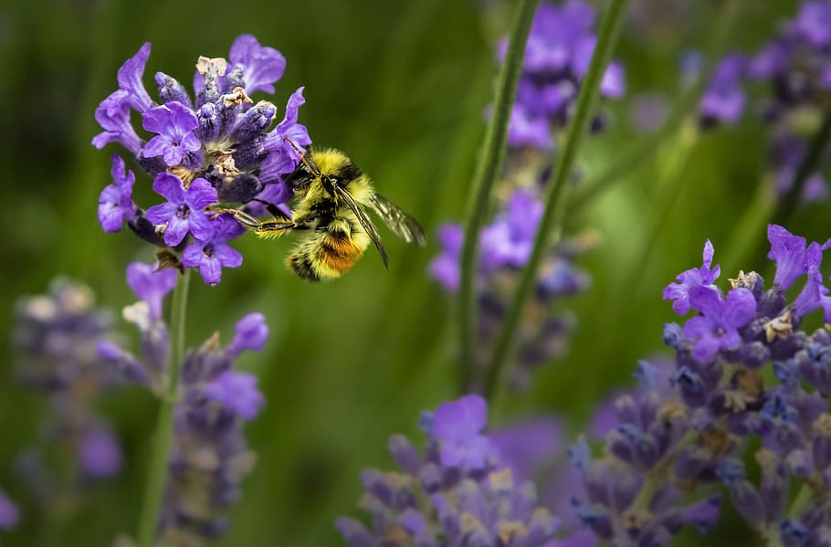
What is an example of mutualism in the rainforest?
An example of mutualism in the rainforest is flowers and bees.
Notes:
1-Each slide have a different background
1-Each slide have pictures
1-Each slide have transitions (information slides in, rotates, etc.)

Slide 10
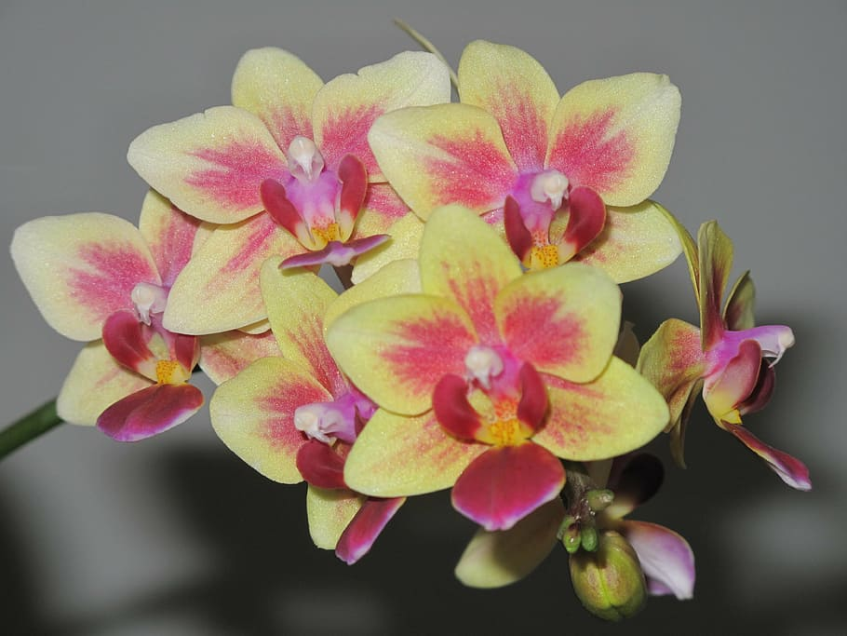
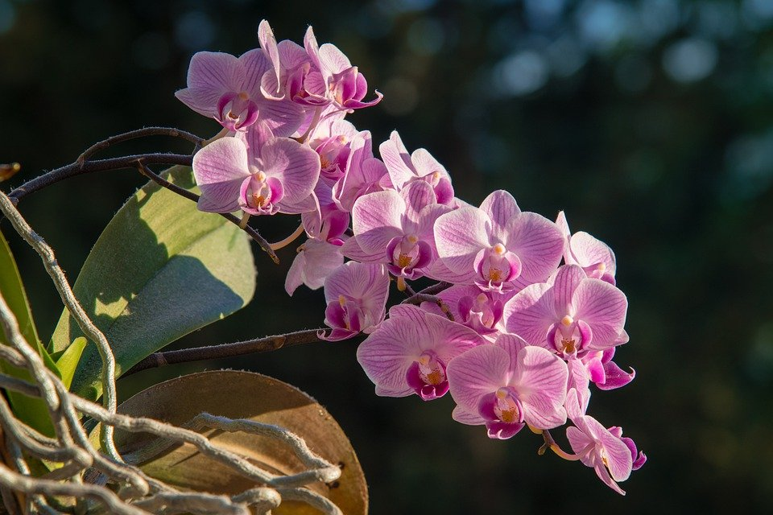

What is an example of commensalism in the tropical rainforest?
In the rainforest an example of commensalism is orchids growing on branches. It is commensal because the orchid has the benefit of having a place to live whereas the branch is not harmed.
Notes:
1-Each slide have a different background
1-Each slide have pictures
1-Each slide have transitions (information slides in, rotates, etc.)

Slide 11
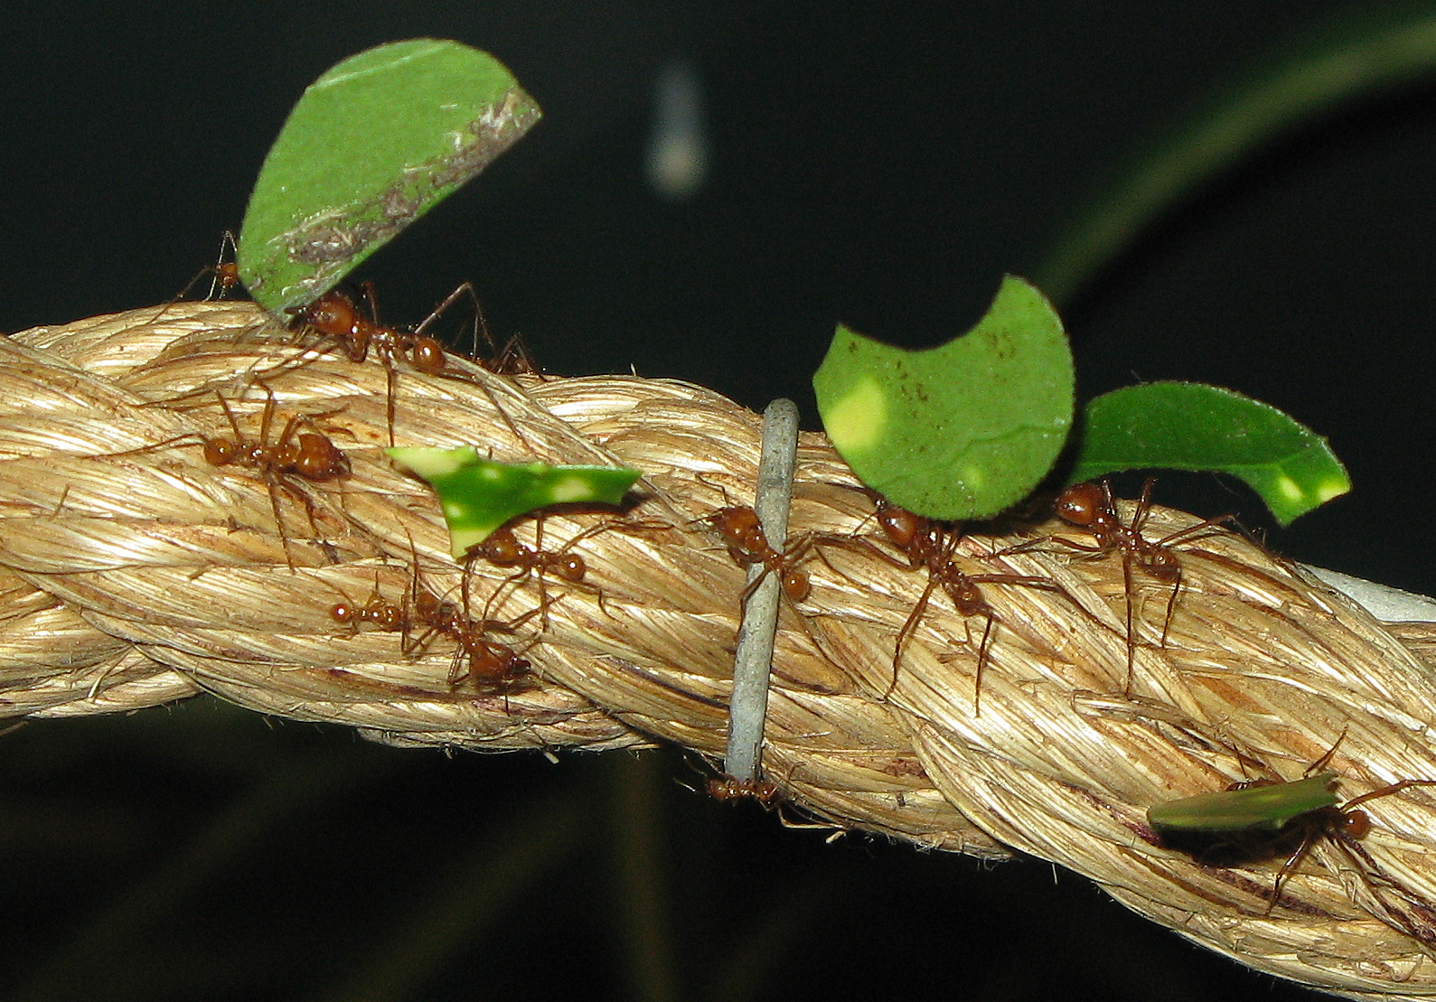
What is an example of parasitism in the tropical rainforest?
An example of parasitism is the phorid fly and leaf-cutter ants in the tropical rainforest. When these leaf-cutter ants are collecting leaves, the phorid flies attack them and lay their eggs in the crevices of the worker ant's head.
Notes:
1-Each slide have a different background
1-Each slide have pictures
1-Each slide have transitions (information slides in, rotates, etc.)

Slide 12
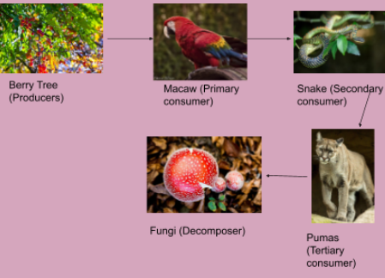
A food chain about the tropical rainforest.
Notes:
1-Each slide have a different background
1-Each slide have pictures
1-Each slide have transitions (information slides in, rotates, etc.)

Slide 13
Here are the resources that I used to find my information
https://study.com/academy/lesson/tropical-rainforest-producers-and-consumers.html
https://birdfact.com/articles/do-birds-eat-frogs
https://www.bioexplorer.net/tropical-rainforest-animal-adaptations.html
https://sciencing.com/food-chain-animals-rain-forest-6733903.html
https://prezi.com/scytixxmykhb/amazon-rainforest-food-web/
https://borealforestandtaiga.weebly.com/mutualism-commensalism-and-parasitism-examples.html
https://www.britannica.com/science/tropical-rainforest
Notes:
1-Each slide have a different background
1-Each slide have pictures
1-Each slide have transitions (information slides in, rotates, etc.)

Slide 14
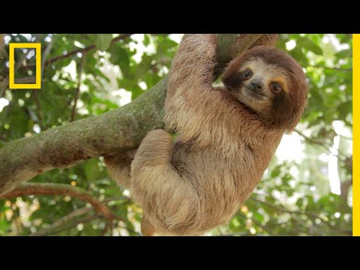
Here is a video about the Tropical rainforest.
https://www.youtube.com/watch?v=3vijLre760w
Notes:
1-Each slide have a different background
1-Each slide have pictures
1-Each slide have transitions (information slides in, rotates, etc.)

Slide 15
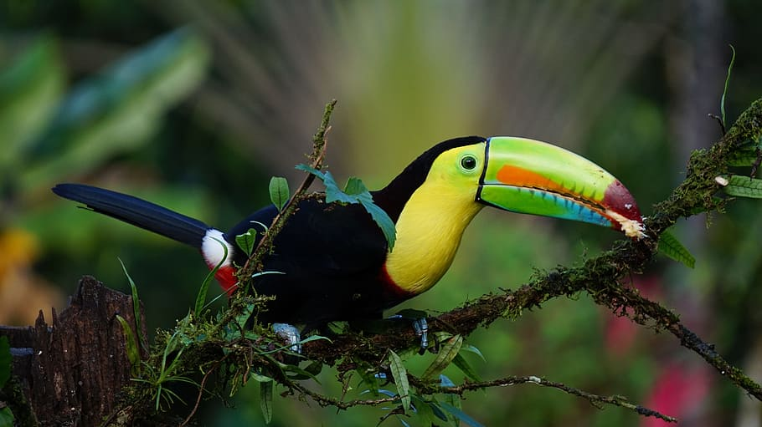
EXTRA CREDIT: Would I like to live in the rainforest?
I don’t think that I would want to live in the tropical rainforest because of all of the creatures that live there. It would probably be pretty to see all of the creatures that live there. Although it would be pretty cool to visit and maybe stay there for a while.
Notes:
1-Each slide have a different background
1-Each slide have pictures
1-Each slide have transitions (information slides in, rotates, etc.)

Slide 16
What countries would I find in the tropical rainforest?
Tropical rainforests grow mainly in three regions: the Malaysian botanical subkingdom, which extends from Myanmar (Burma) to Fiji and includes the whole of Thailand, Malaysia, Indonesia, the Philippines, Papua New Guinea, the Solomon Islands, and Vanuatu and parts of Indochina and tropical Australia; tropical South and Central America.
Notes:
1-Each slide have a different background
1-Each slide have pictures
1-Each slide have transitions (information slides in, rotates, etc.)

Slide 17
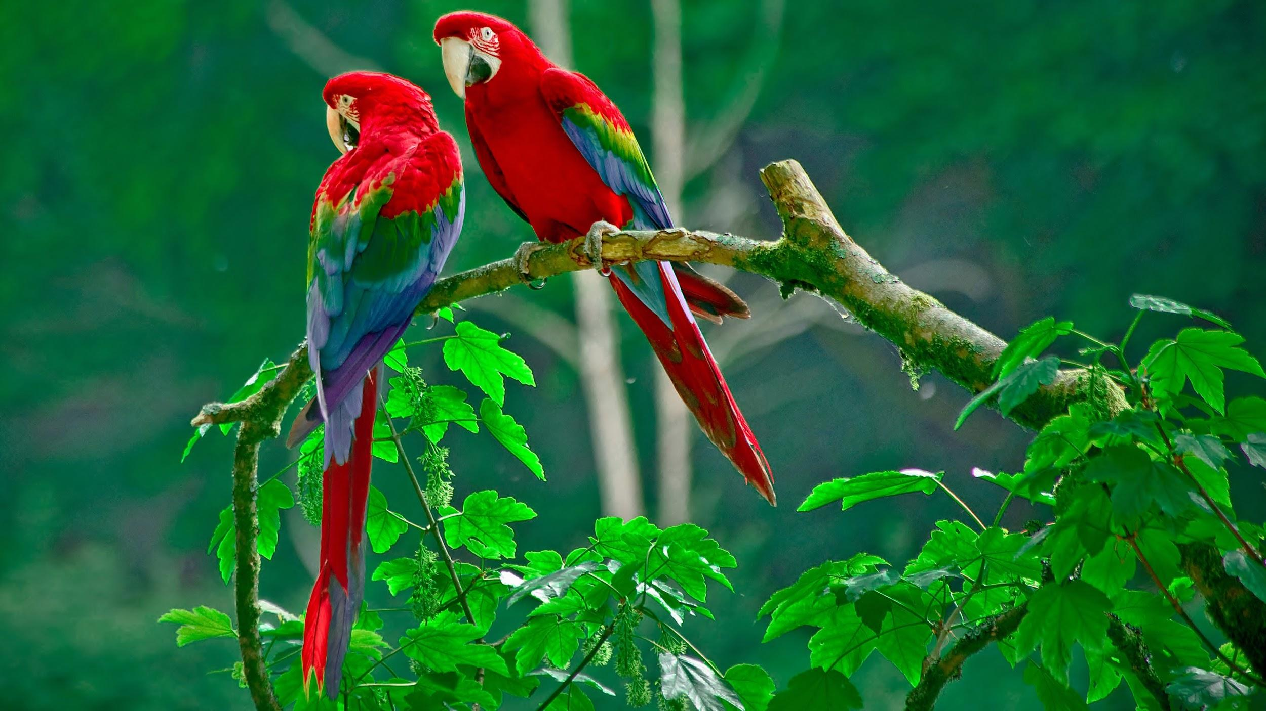
By Yasleen Perez
I hope you enjoyed my slides about the tropical rainforest.
Notes:
1-Each slide have a different background
1-Each slide have pictures
1-Each slide have transitions (information slides in, rotates, etc.)

