Slide 1
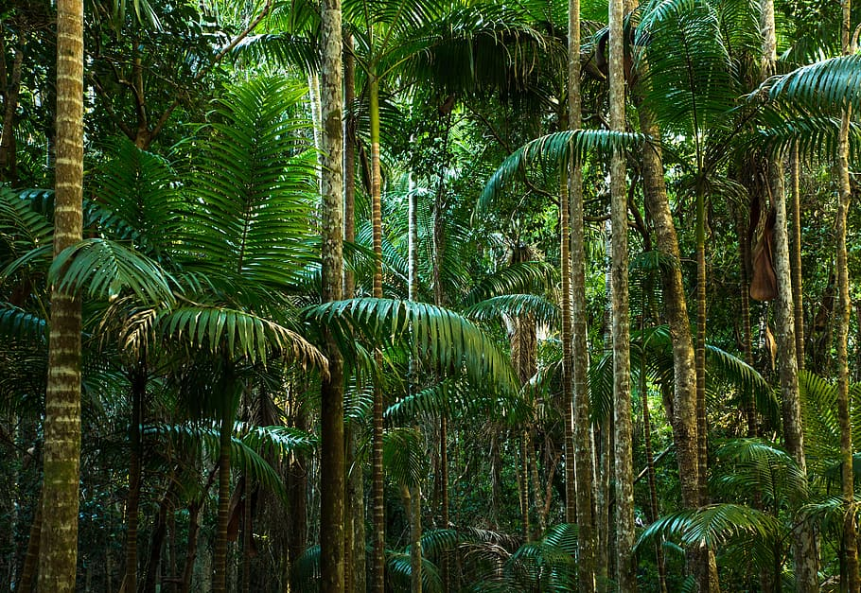
Tropical Rainforest
By:Yuliana Alanis Meza
Notes:
1-Each slide have a different background
1-Each slide have pictures
1-Each slide have transitions (information slides in, rotates, etc.)

Slide 2
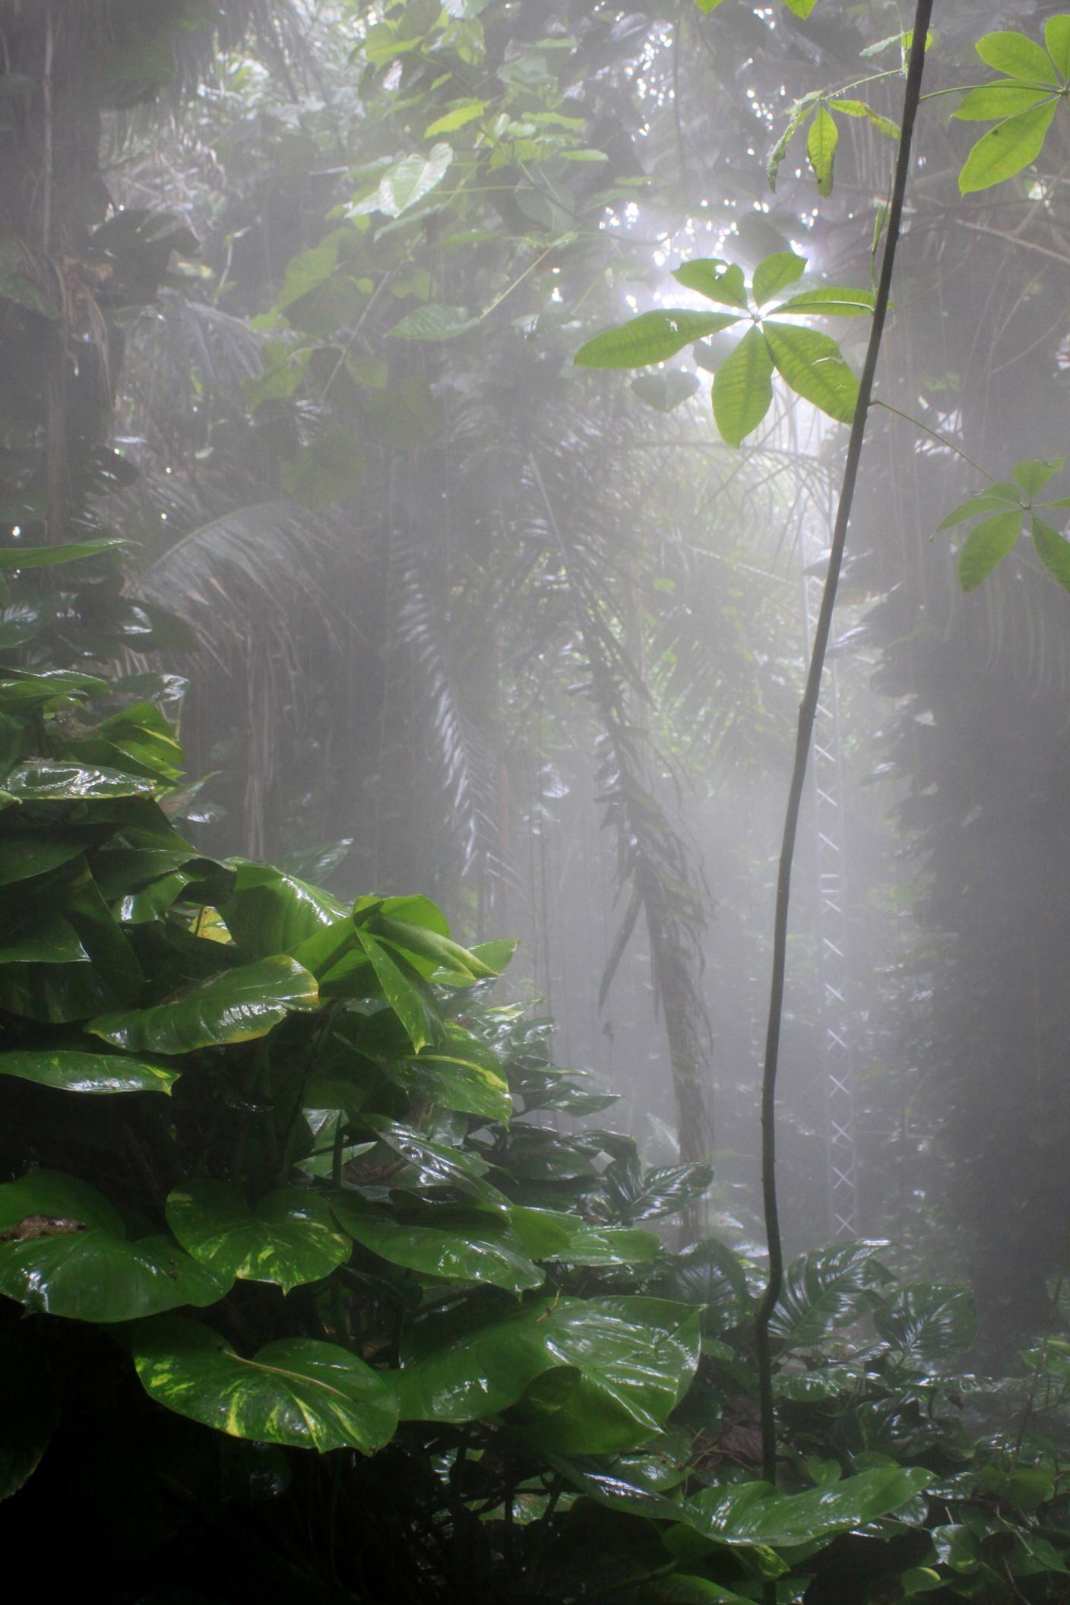
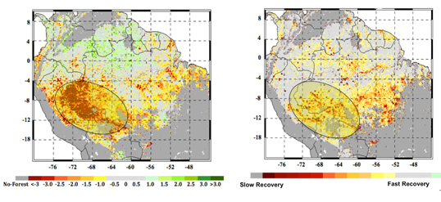
RainForest temperature and climate
The tropical rainforest is hot and something it rains all year.The rainforest biome remains warm all year.The average daily temperatures rane from 20 C (68 F)to 25 C (77).The average rain amount is about 2,000 to 10,000 millimeters(79 to 394 inches) of rain per year.The Season they have is one long wet winter, and a short drier summer.
Notes:
1-Each slide have a different background
1-Each slide have pictures
1-Each slide have transitions (information slides in, rotates, etc.)
Either make the title a sentence with proper punctuation, or capitalize each word.

Slide 3
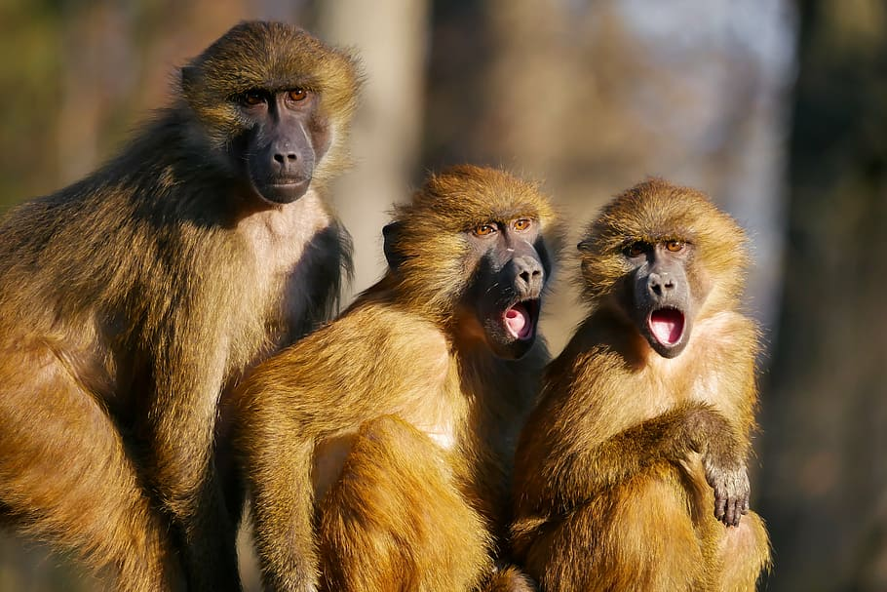
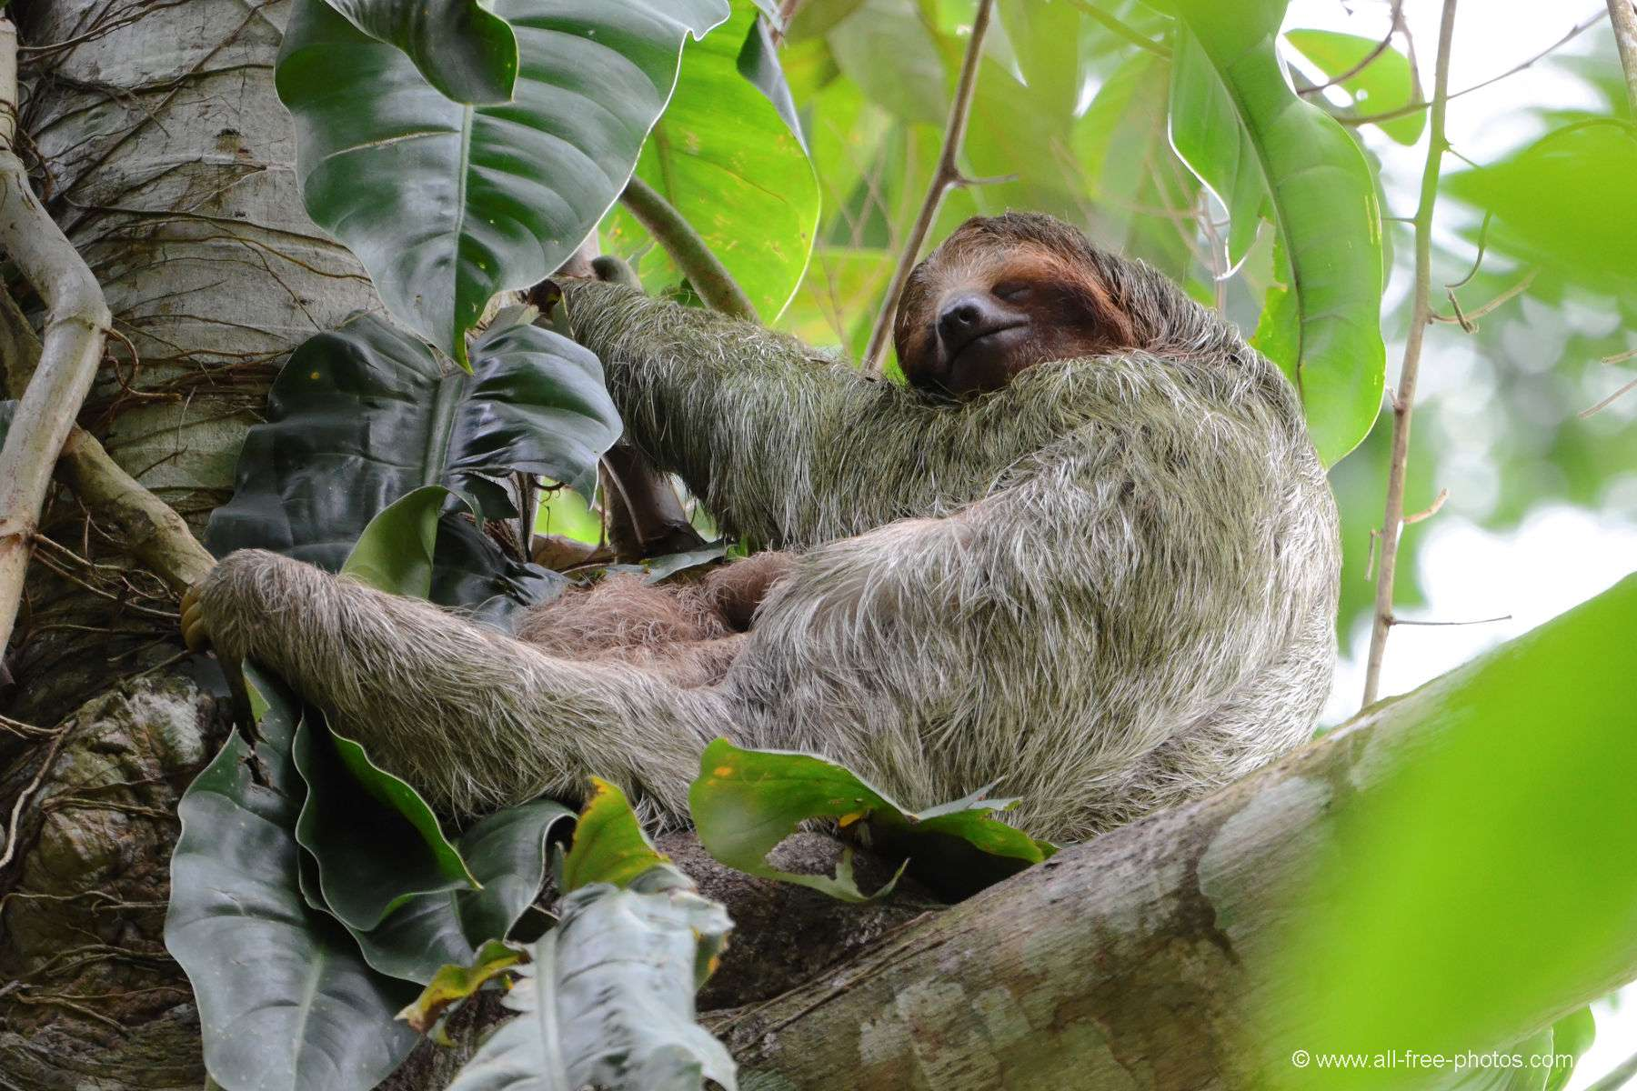
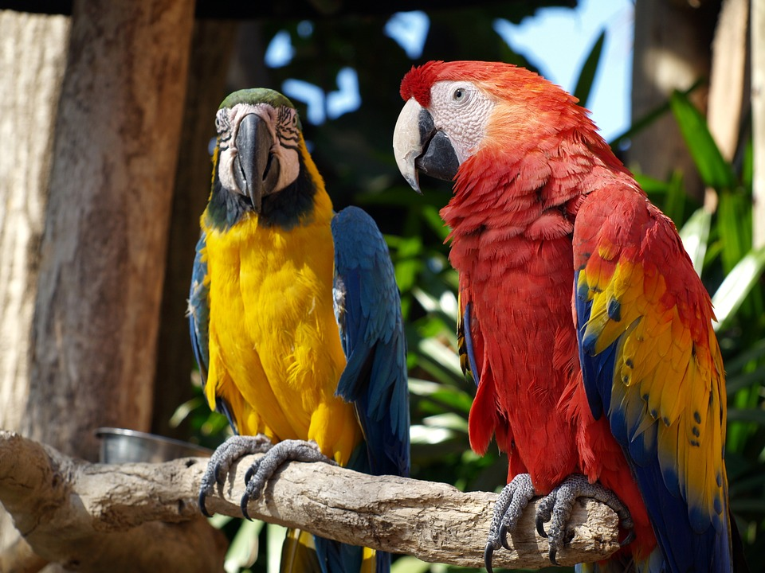
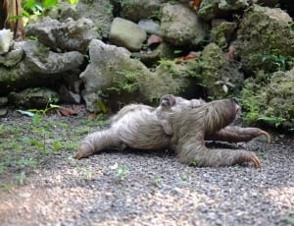
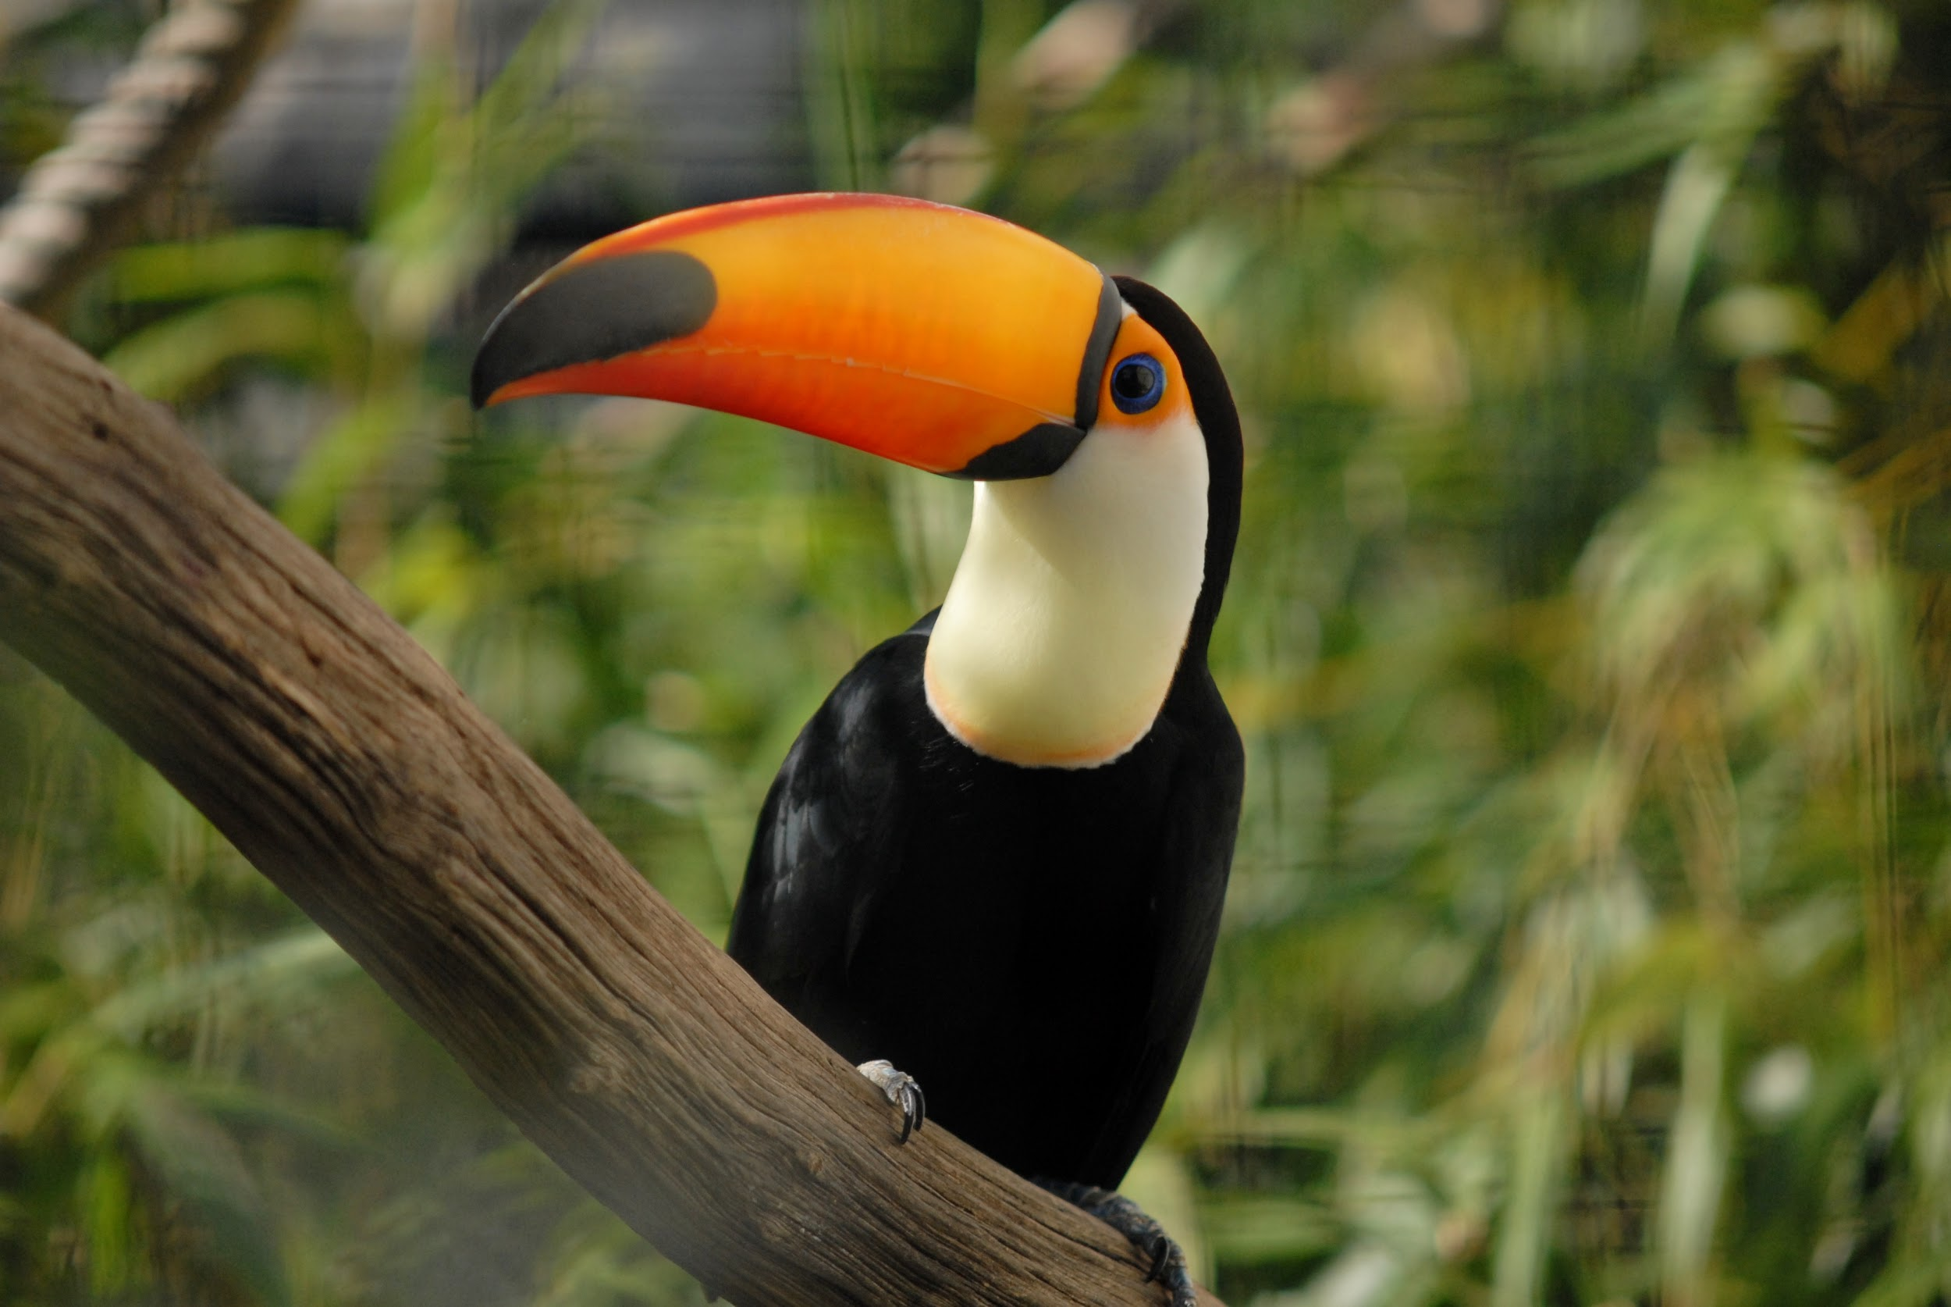
Tropical rainforest creatures survival
Many animals have adapt to the unique condition of the Tropical rainforest.For an example a sloth makes it camouflage and it moves very slowly to make it difficult for predators to see them.The animals from the tropical rainforest is monkeys,birds(parrot,toucans)snakes,rodent,frogs and lizards.
Notes:
1-Each slide have a different background
1-Each slide have pictures
1-Each slide have transitions (information slides in, rotates, etc.)
Either make the title a sentence with proper punctuation, or capitalize each word. There are always 2 spaces after a period and one space after a comma, or bracket.

Slide 4

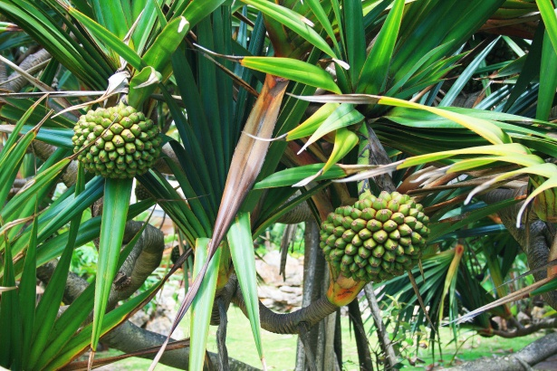
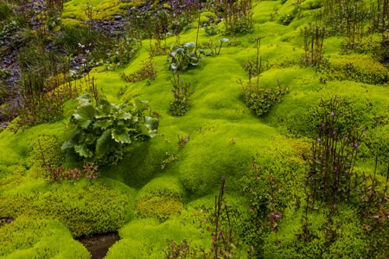
Producers in the tropical rainforest
The producers in the tropical rainforest is trees,vines, mosses, grass and tropical fruit trees.
Notes:
1-Each slide have a different background
1-Each slide have pictures
1-Each slide have transitions (information slides in, rotates, etc.)
Either make the title a sentence with proper punctuation, or capitalize each word. There are always 2 spaces after a period and one space after a comma, or bracket.

Slide 5
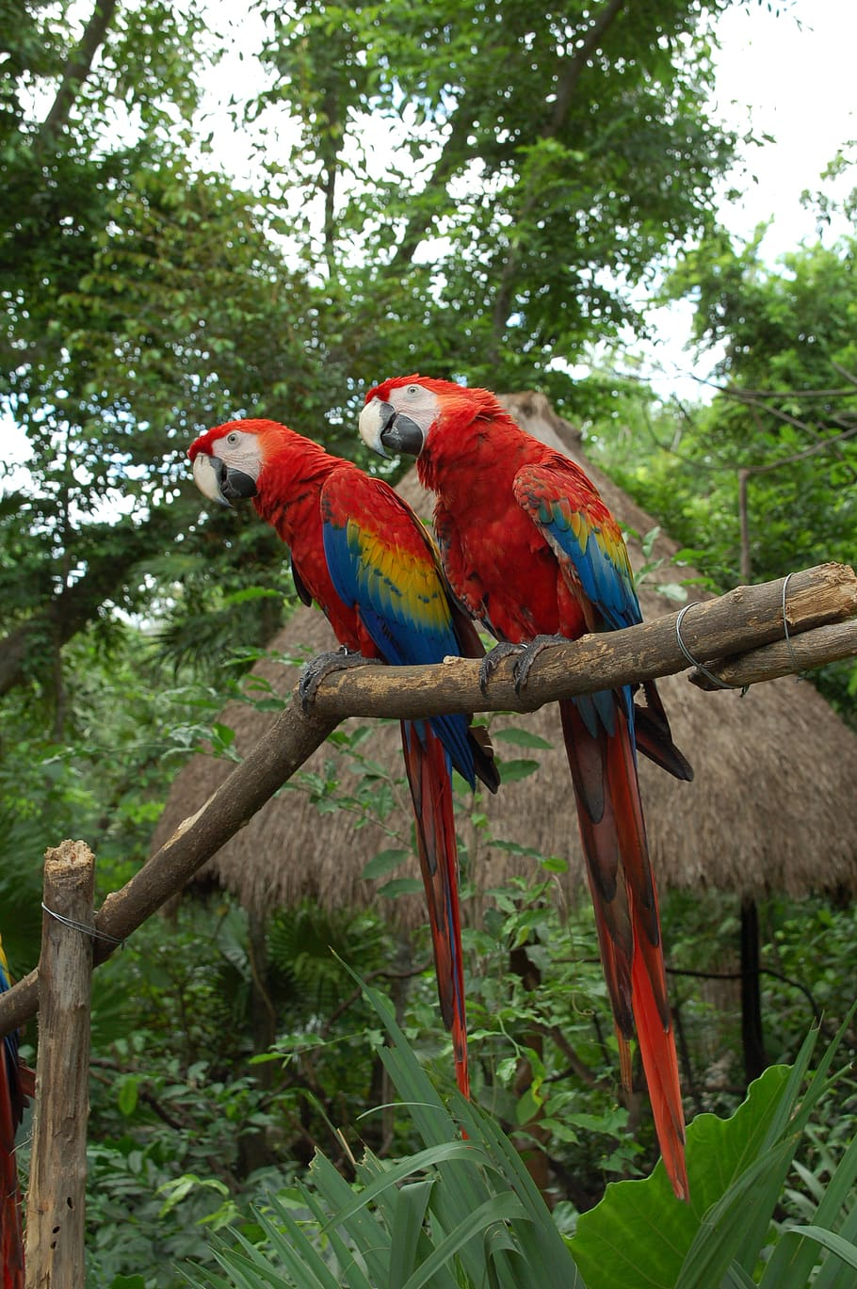
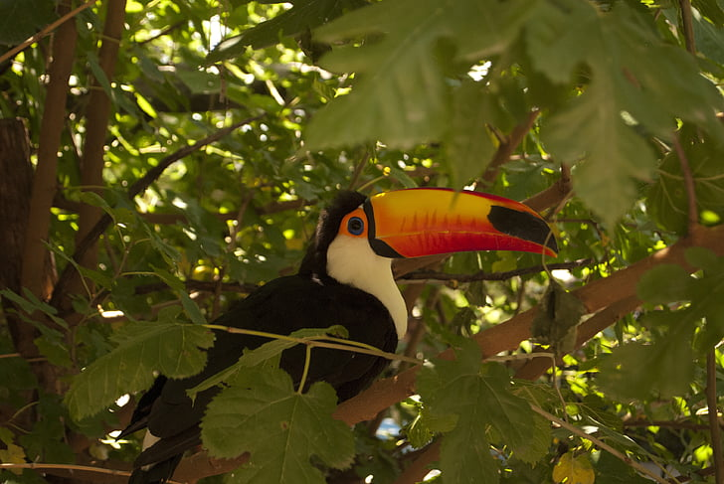
Primary consumer in the tropical rainforest
The primary consumer in the tropical rainforest is Monkeys and birds.
Notes:
1-Each slide have a different background
1-Each slide have pictures
1-Each slide have transitions (information slides in, rotates, etc.)
Either make the title a sentence with proper punctuation, or capitalize each word.

Slide 6
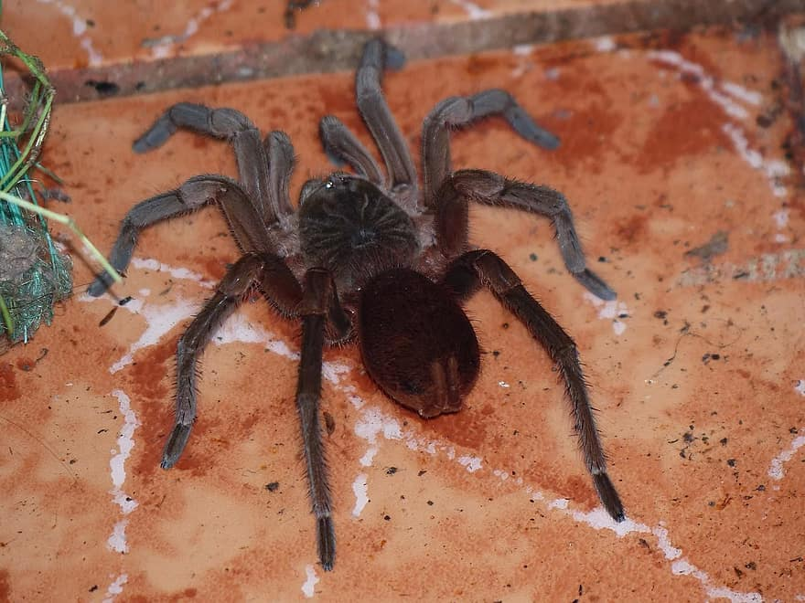
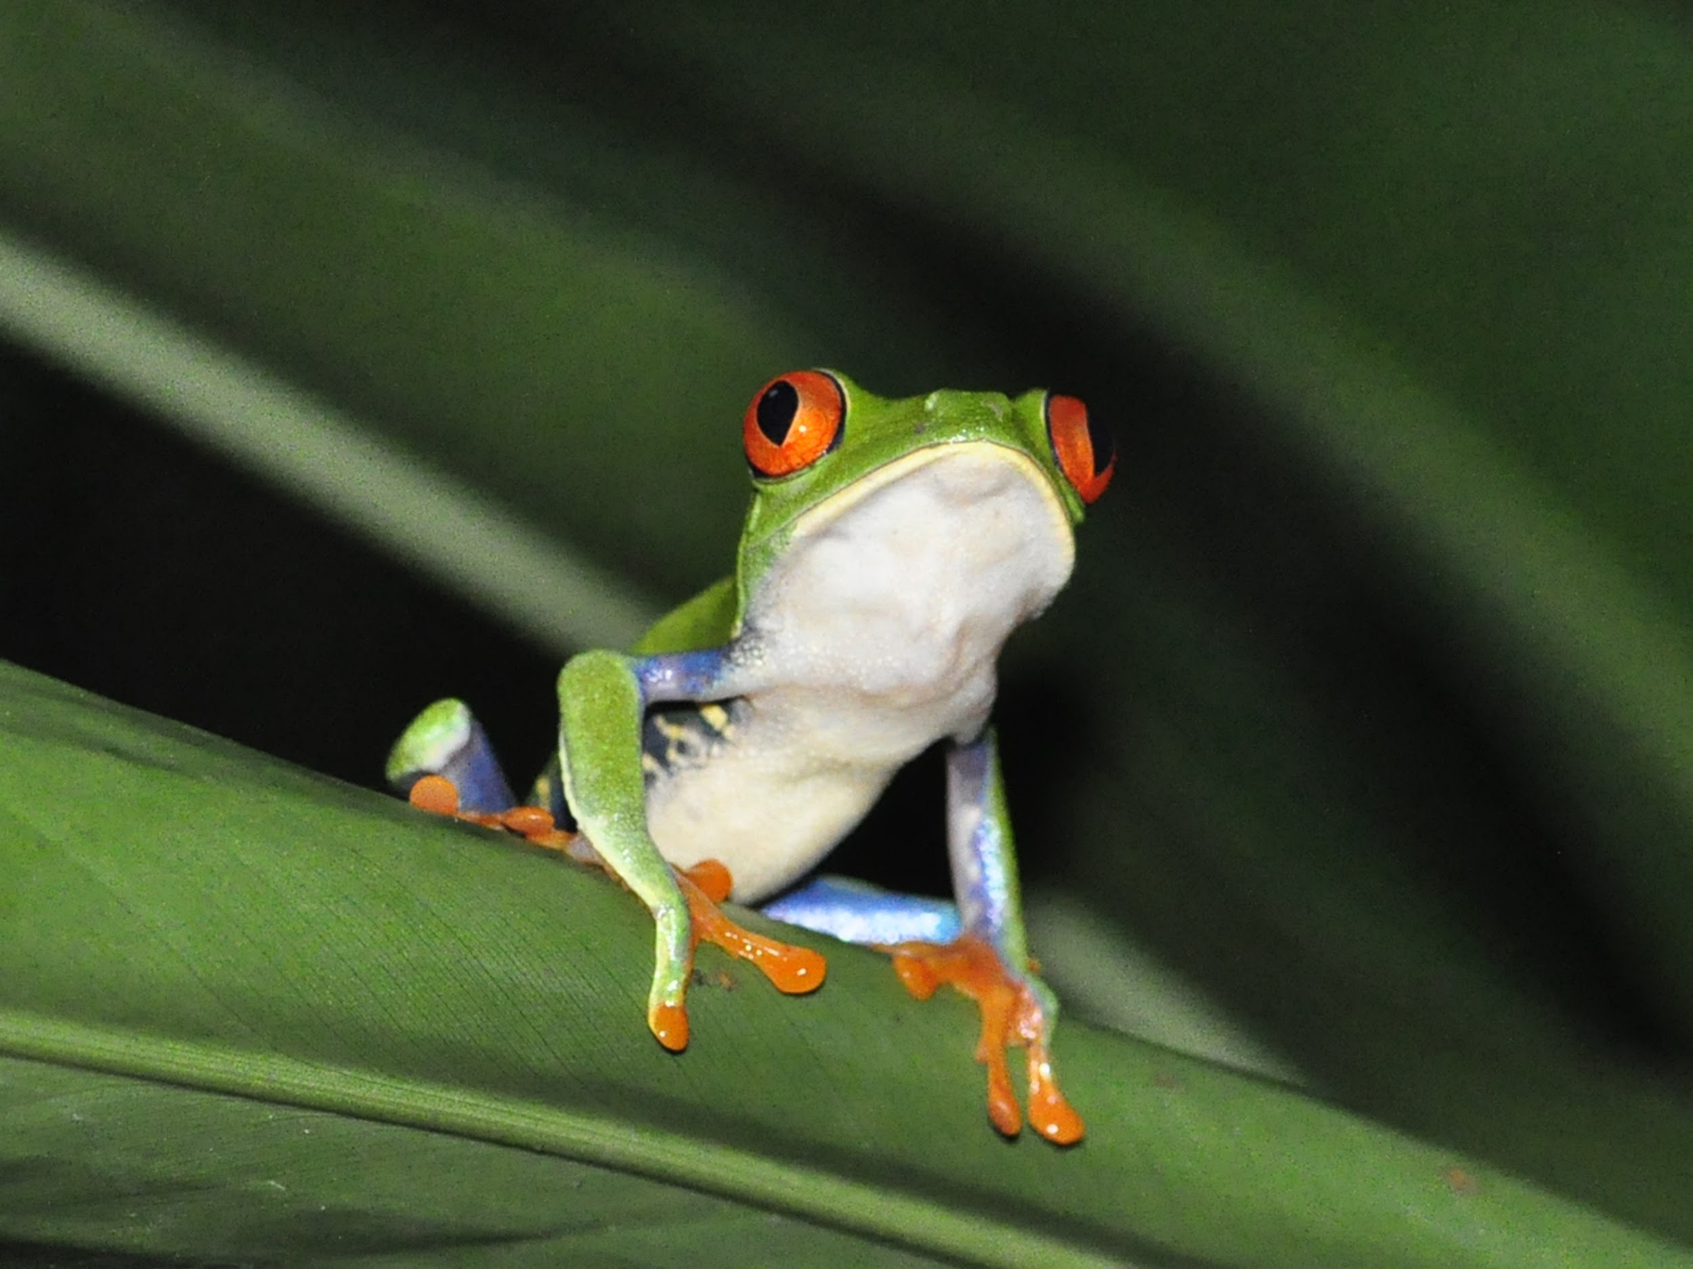
The secondary consumer in the tropical rainforest
The secondary consumer in the tropical rainforest is trees,frogs and giant spider.
Notes:
1-Each slide have a different background
1-Each slide have pictures
1-Each slide have transitions (information slides in, rotates, etc.)
Either make the title a sentence with proper punctuation, or capitalize each word. There are always 2 spaces after a period and one space after a comma, or bracket.

Slide 7
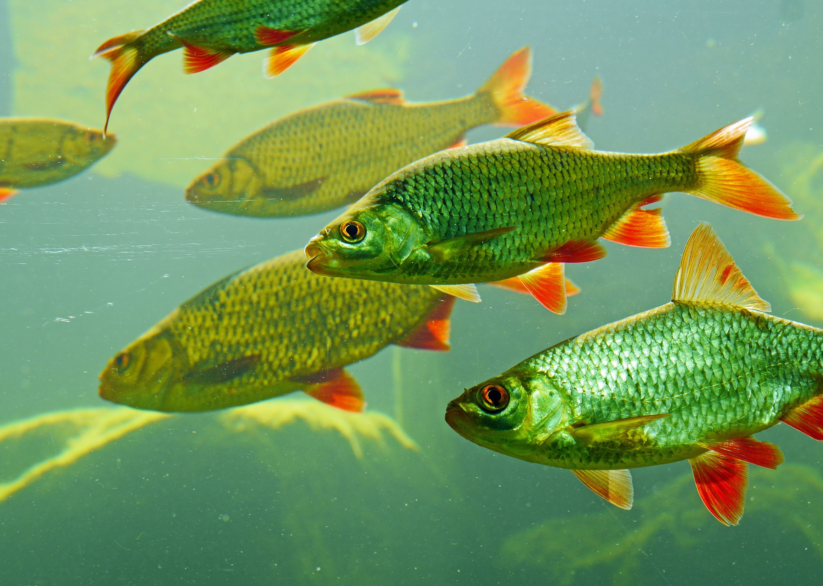
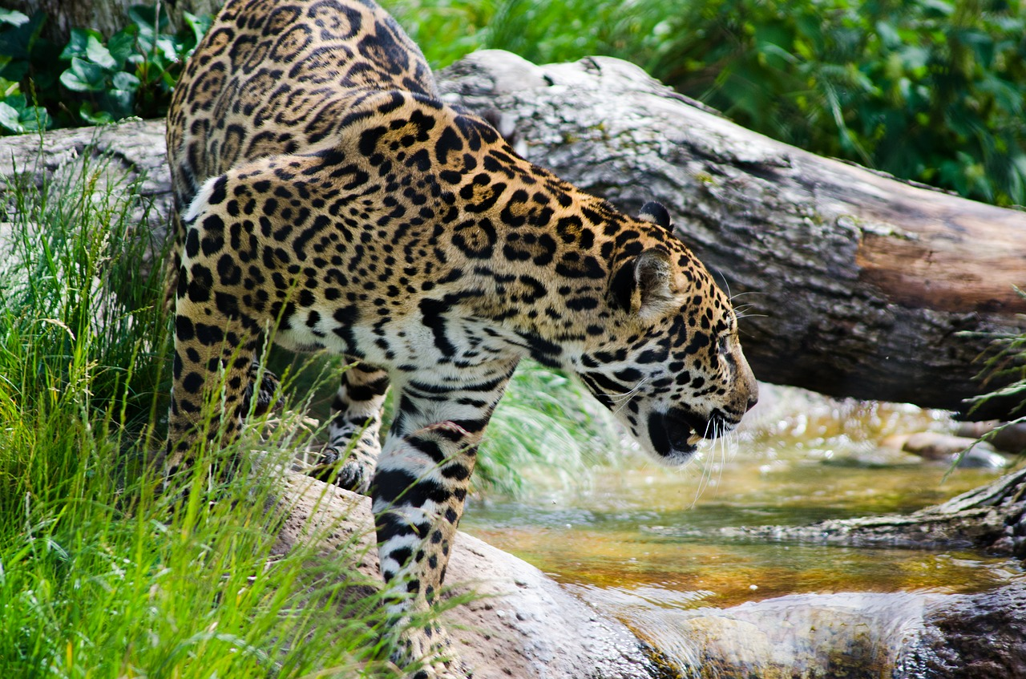
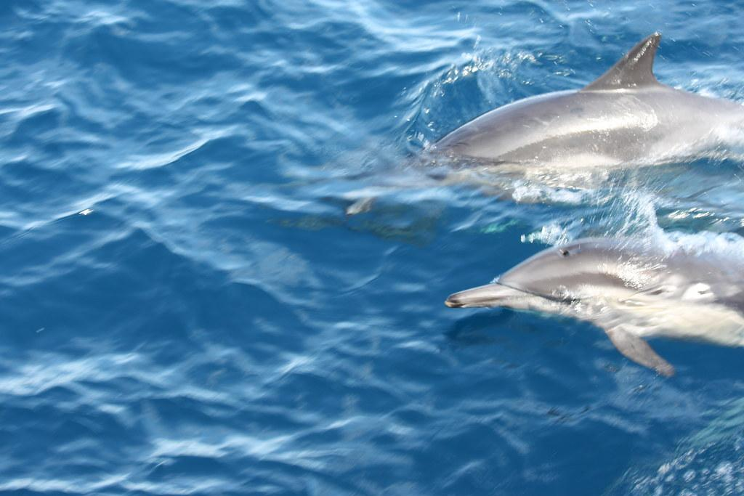
The tertiary consumers in tropical rainforests
The tertiary consumer in the tropical rainforests is most likely jaguars,dolphins and giant fish.
Notes:
1-Each slide have a different background
1-Each slide have pictures
1-Each slide have transitions (information slides in, rotates, etc.)
Either make the title a sentence with proper punctuation, or capitalize each word. There are always 2 spaces after a period and one space after a comma, or bracket.

Slide 8
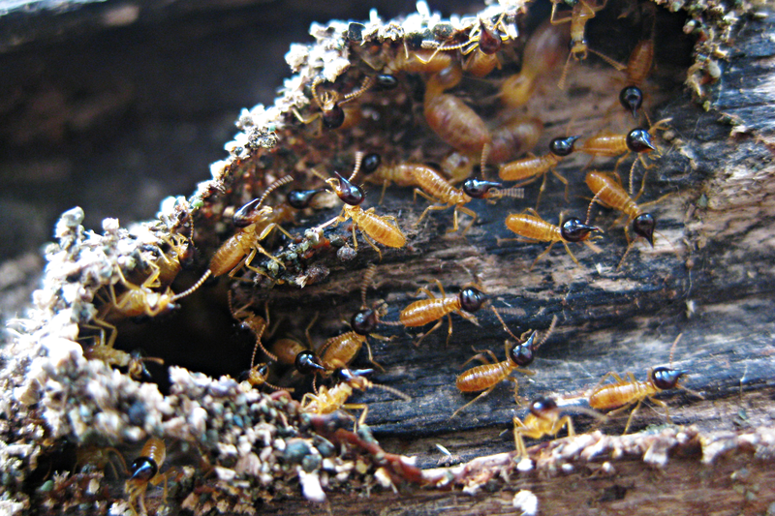
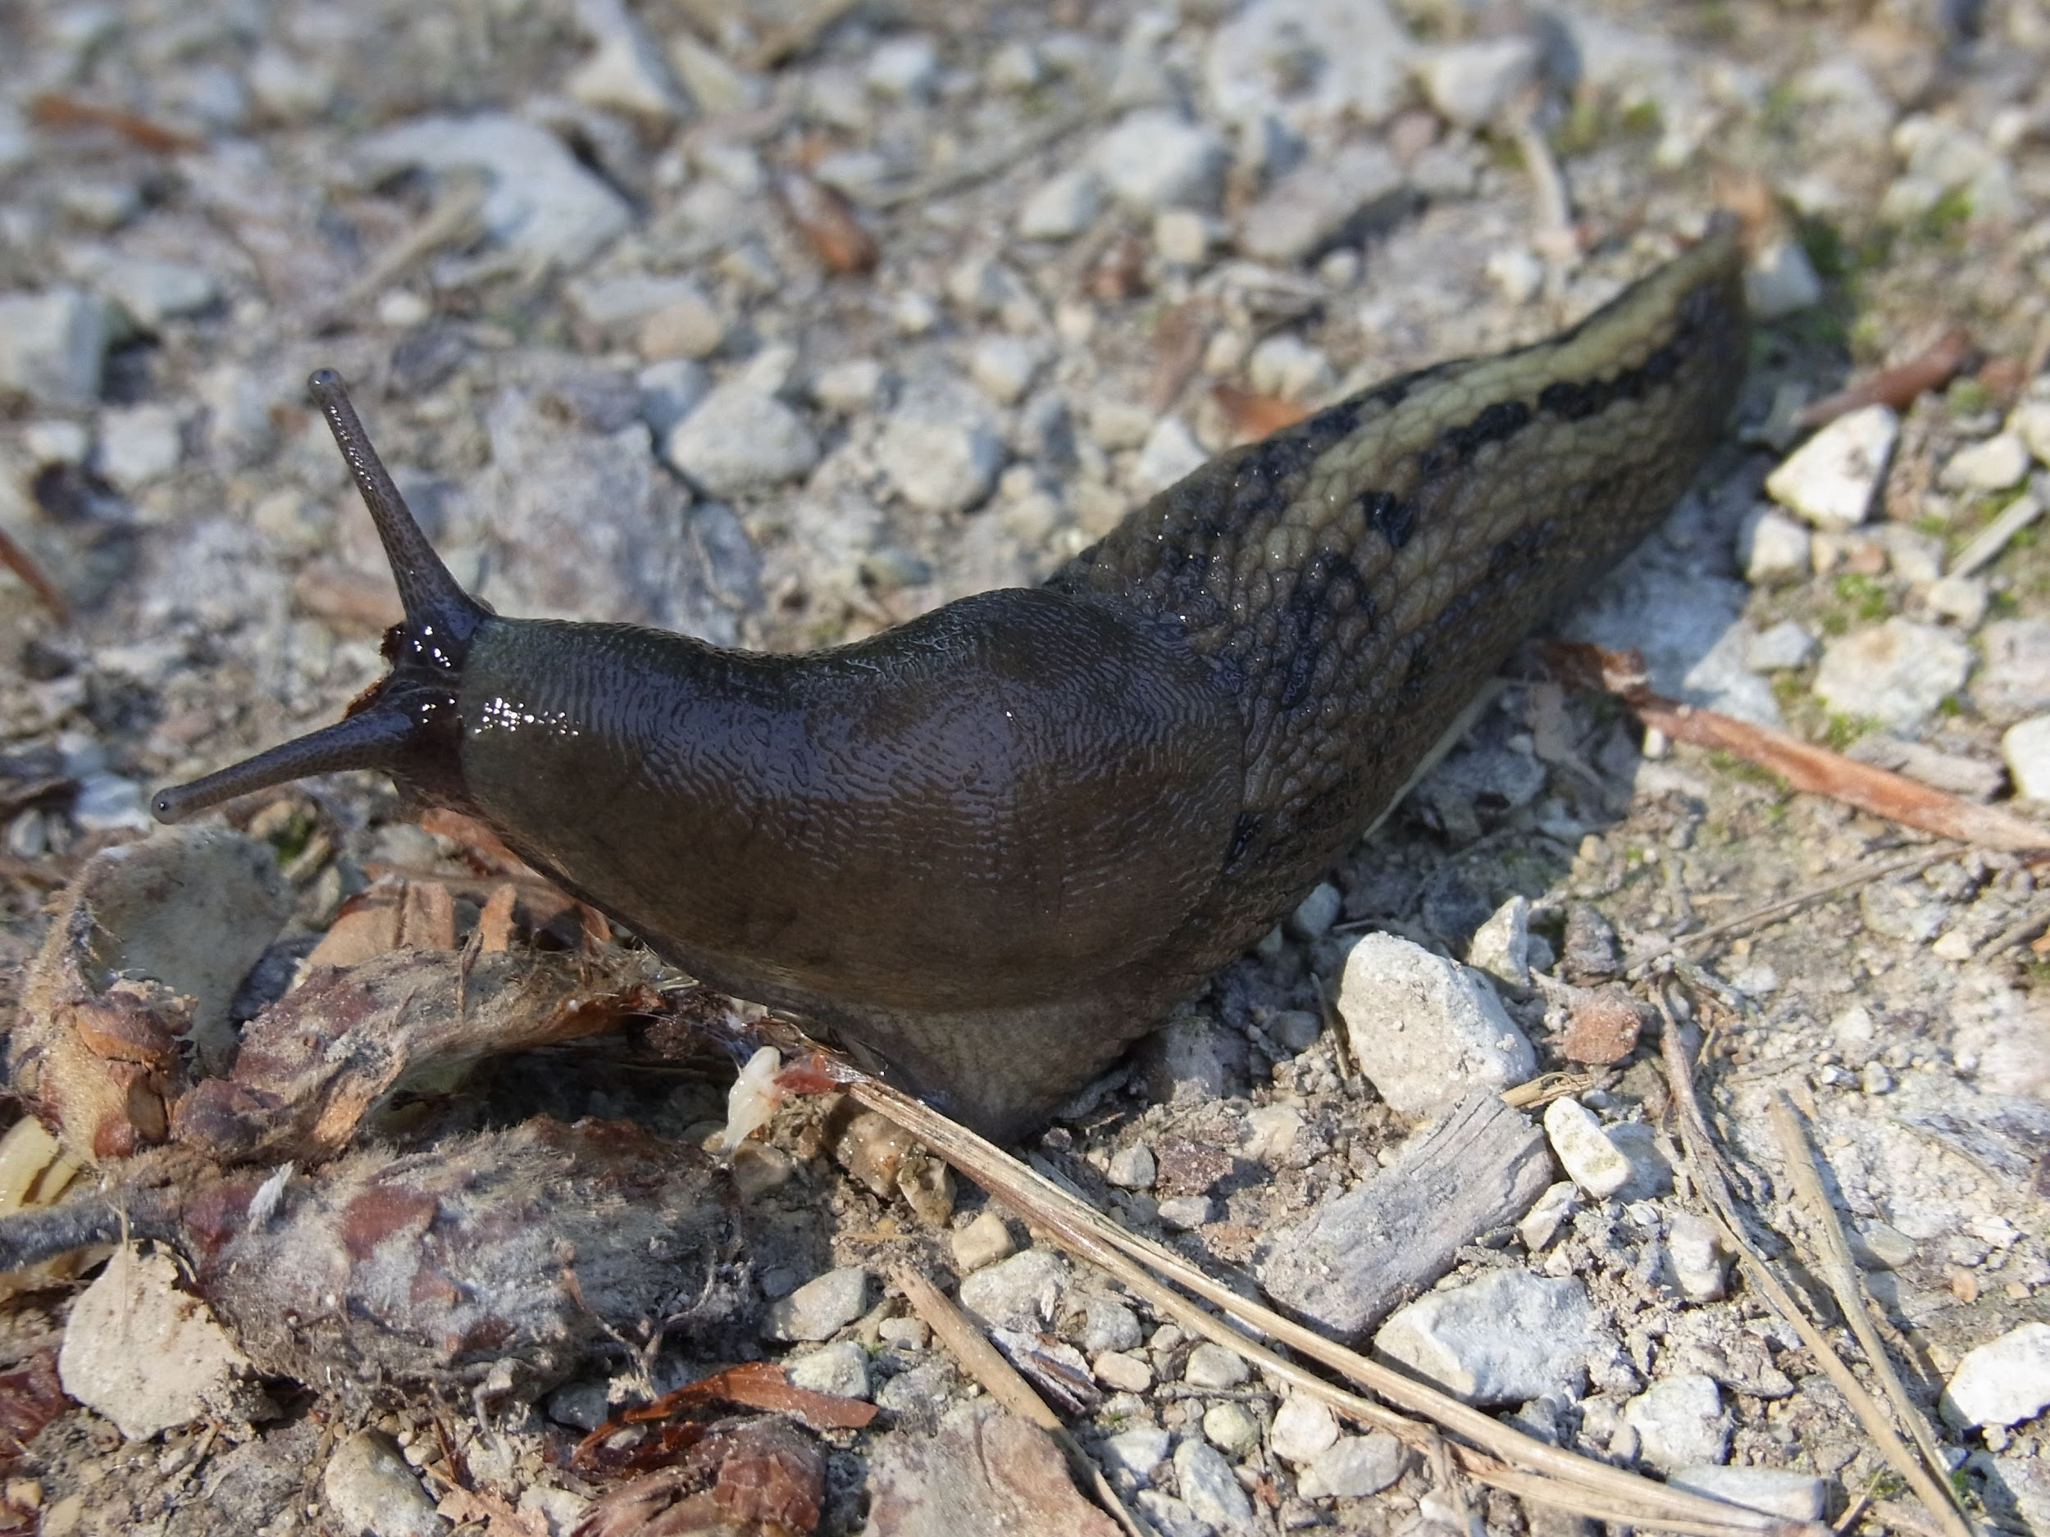
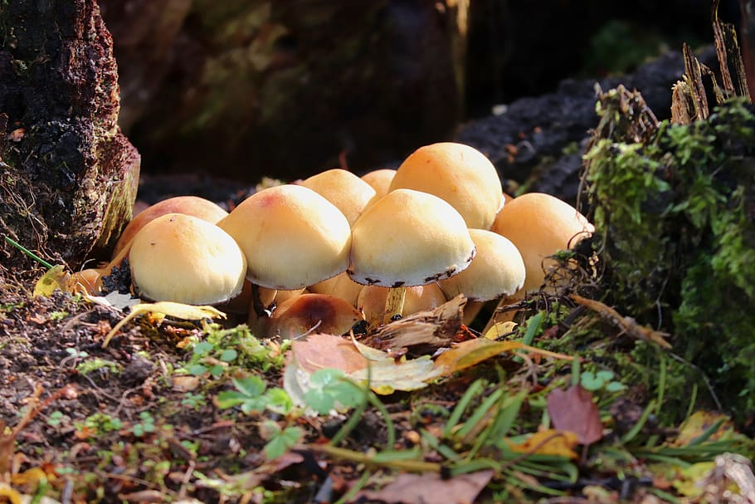
The decomposers in the tropical rain forests
The tropical rain forests decomposers are termites,slugs,scorpions,worms and fungi.
Notes:
1-Each slide have a different background
1-Each slide have pictures
1-Each slide have transitions (information slides in, rotates, etc.)
Either make the title a sentence with proper punctuation, or capitalize each word. There are always 2 spaces after a period and one space after a comma, or bracket.

Slide 9
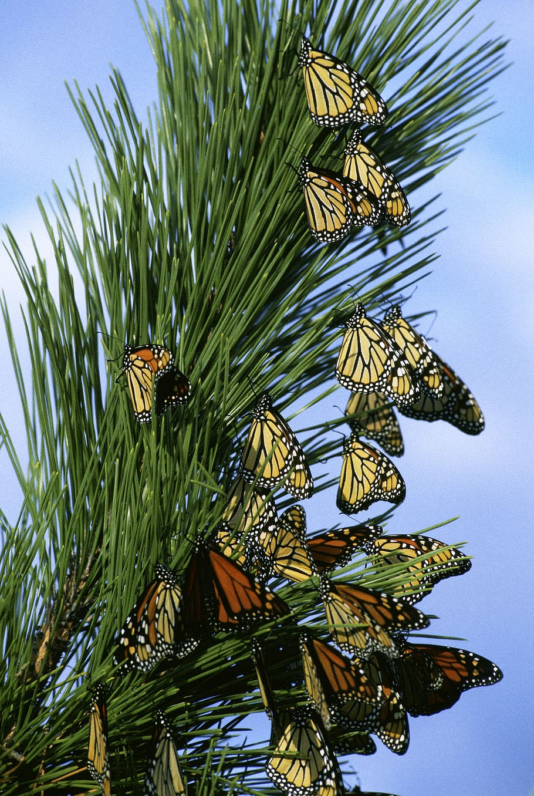
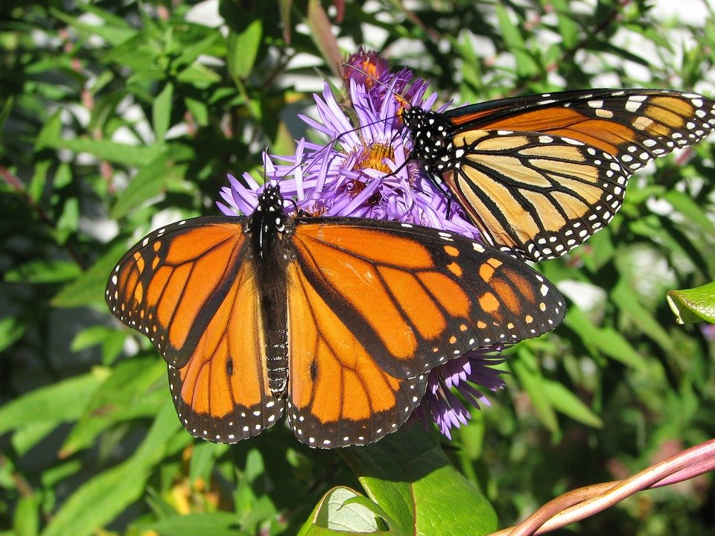
Example of mutualism in rainforests
Example of mutualism in the tropical rainforests is an Monarch butterfly.Monarch butterflies travel in large groups to stay safe and help each other out.
Notes:
1-Each slide have a different background
1-Each slide have pictures
1-Each slide have transitions (information slides in, rotates, etc.)
Either make the title a sentence with proper punctuation, or capitalize each word. There are always 2 spaces after a period and one space after a comma, or bracket.

Slide 10
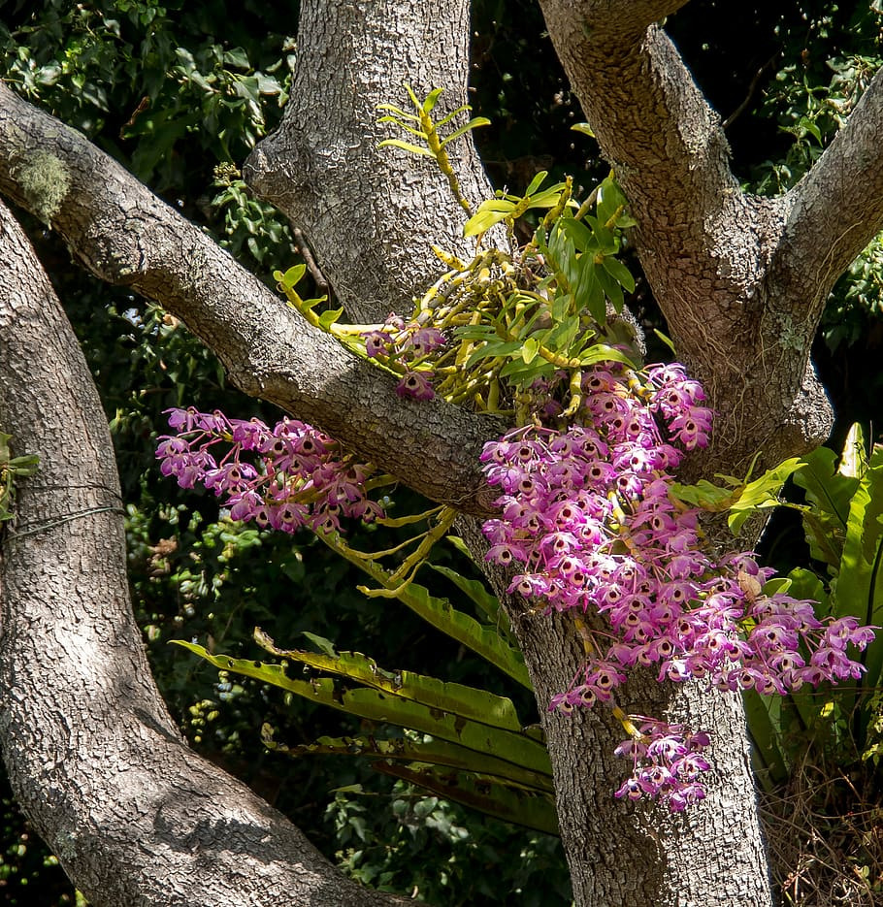
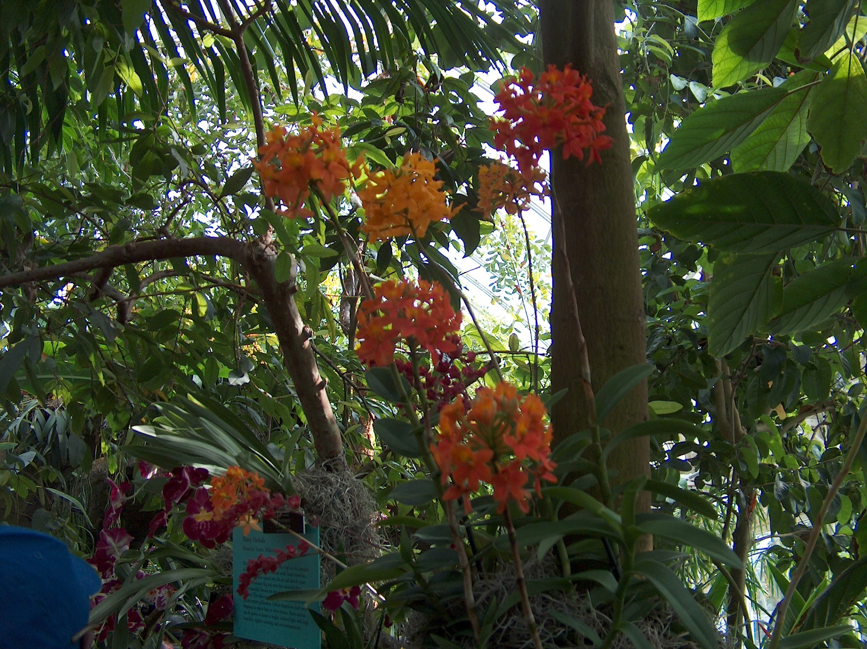
Commensalism example
An example of commensalism is when orchids grown on trees.
Notes:
1-Each slide have a different background
1-Each slide have pictures
1-Each slide have transitions (information slides in, rotates, etc.)
Either make the title a sentence with proper punctuation, or capitalize each word. There are always 2 spaces after a period and one space after a comma, or bracket.

Slide 11
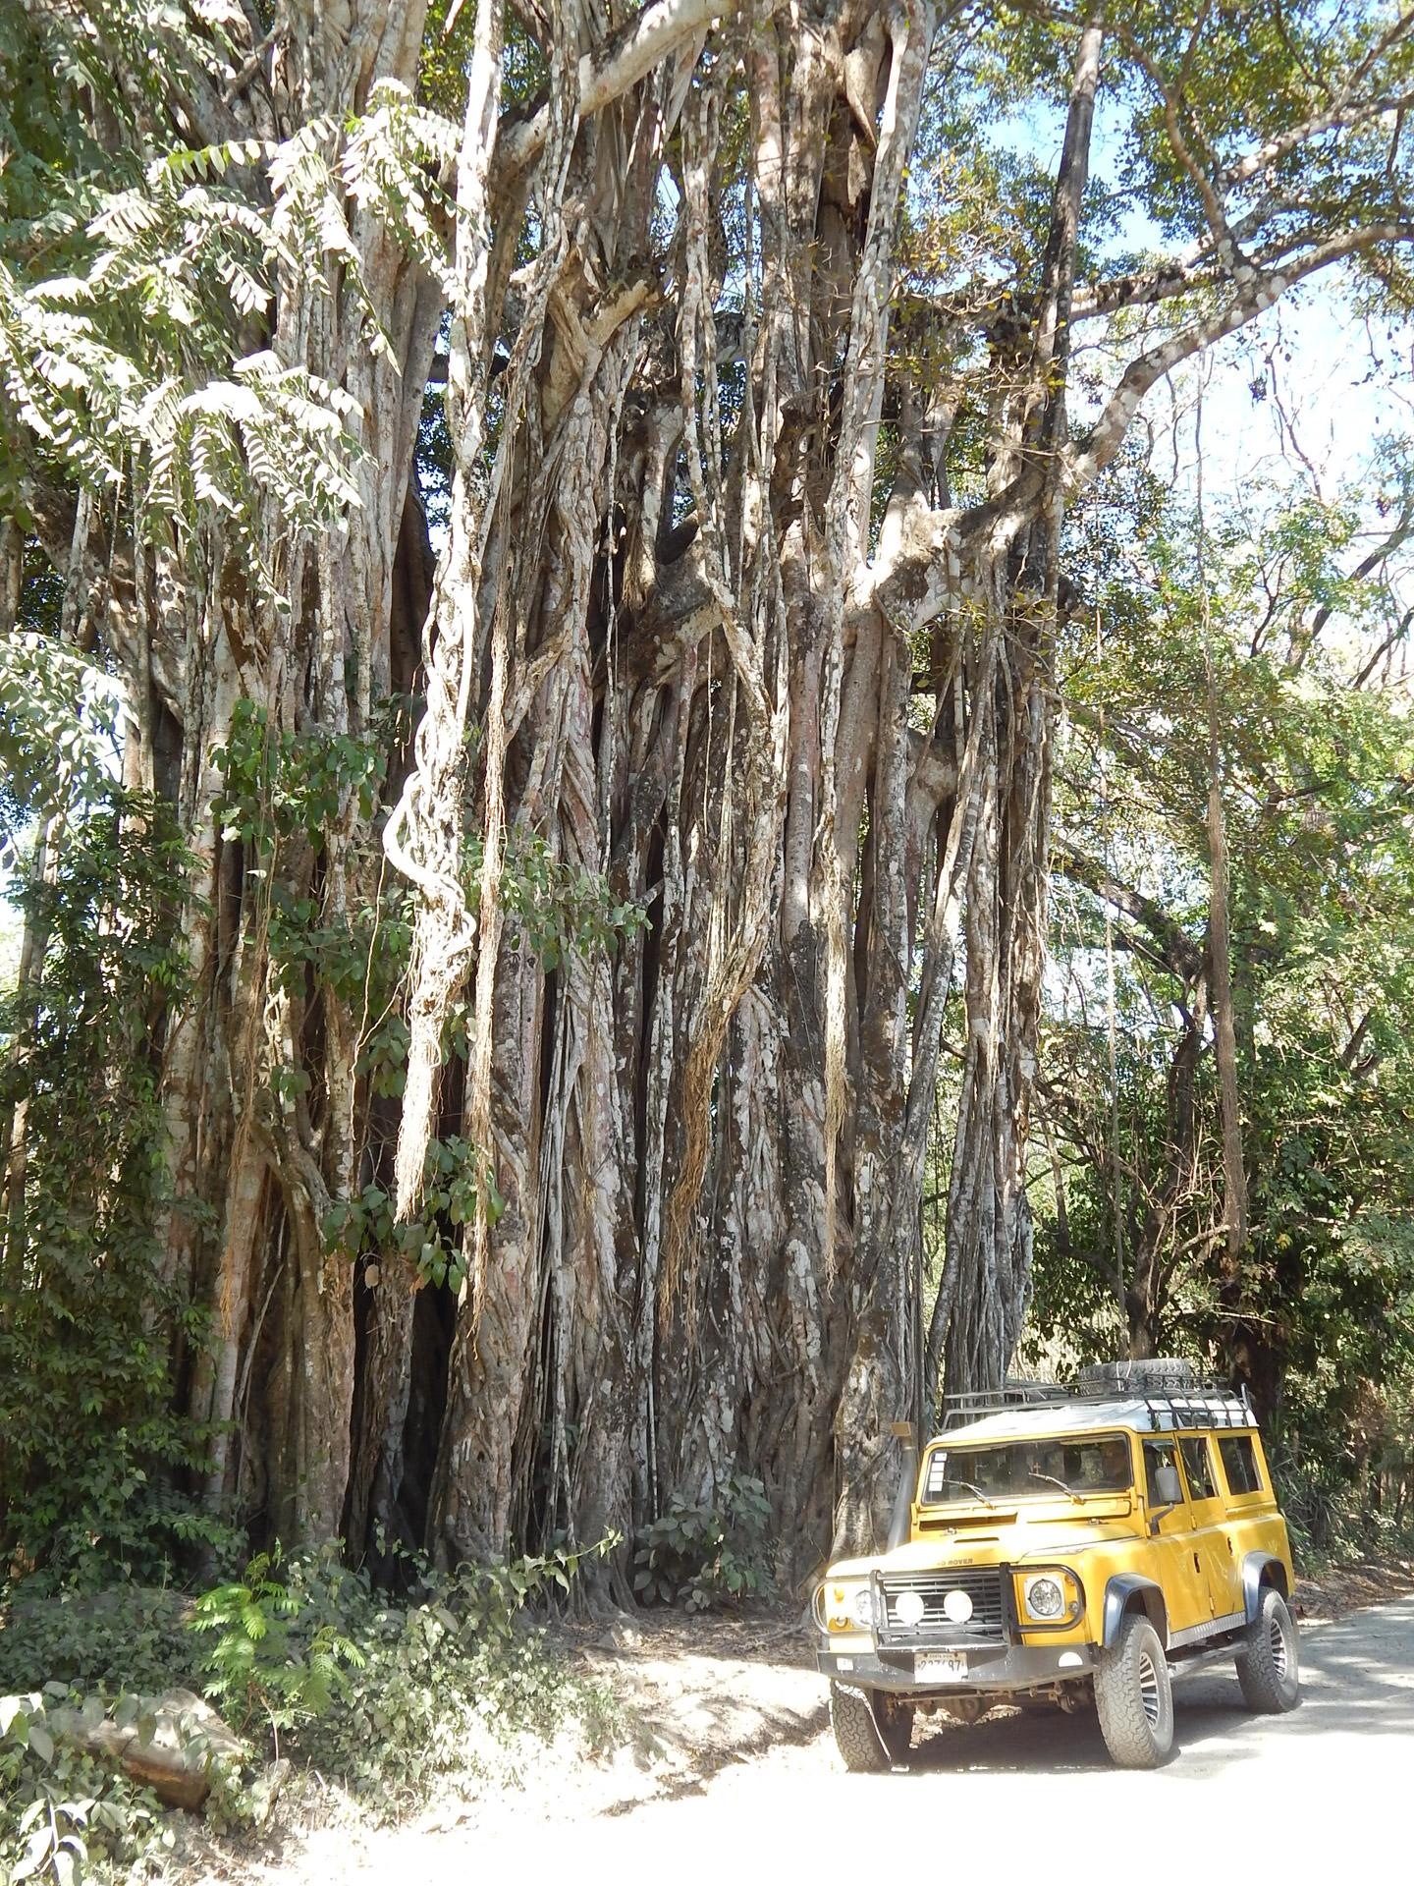
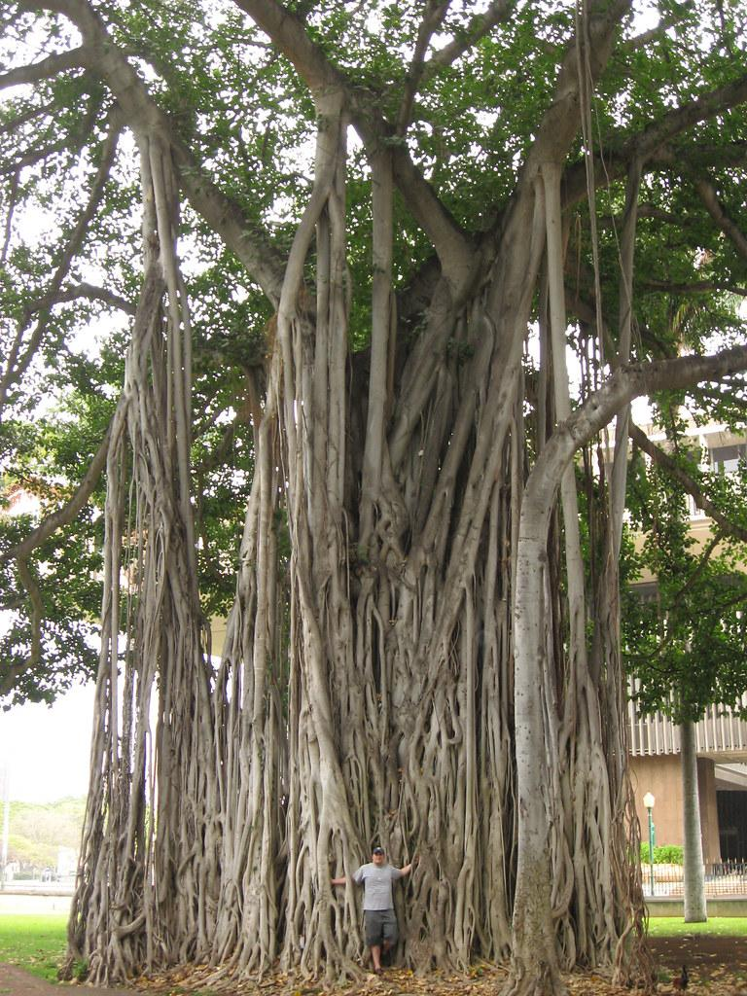
Example of parasitism
An example of parasitism is a strangler fig tree with other host trees.
Notes:
1-Each slide have a different background
1-Each slide have pictures
1-Each slide have transitions (information slides in, rotates, etc.)
Either make the title a sentence with proper punctuation, or capitalize each word.

