Slide 1
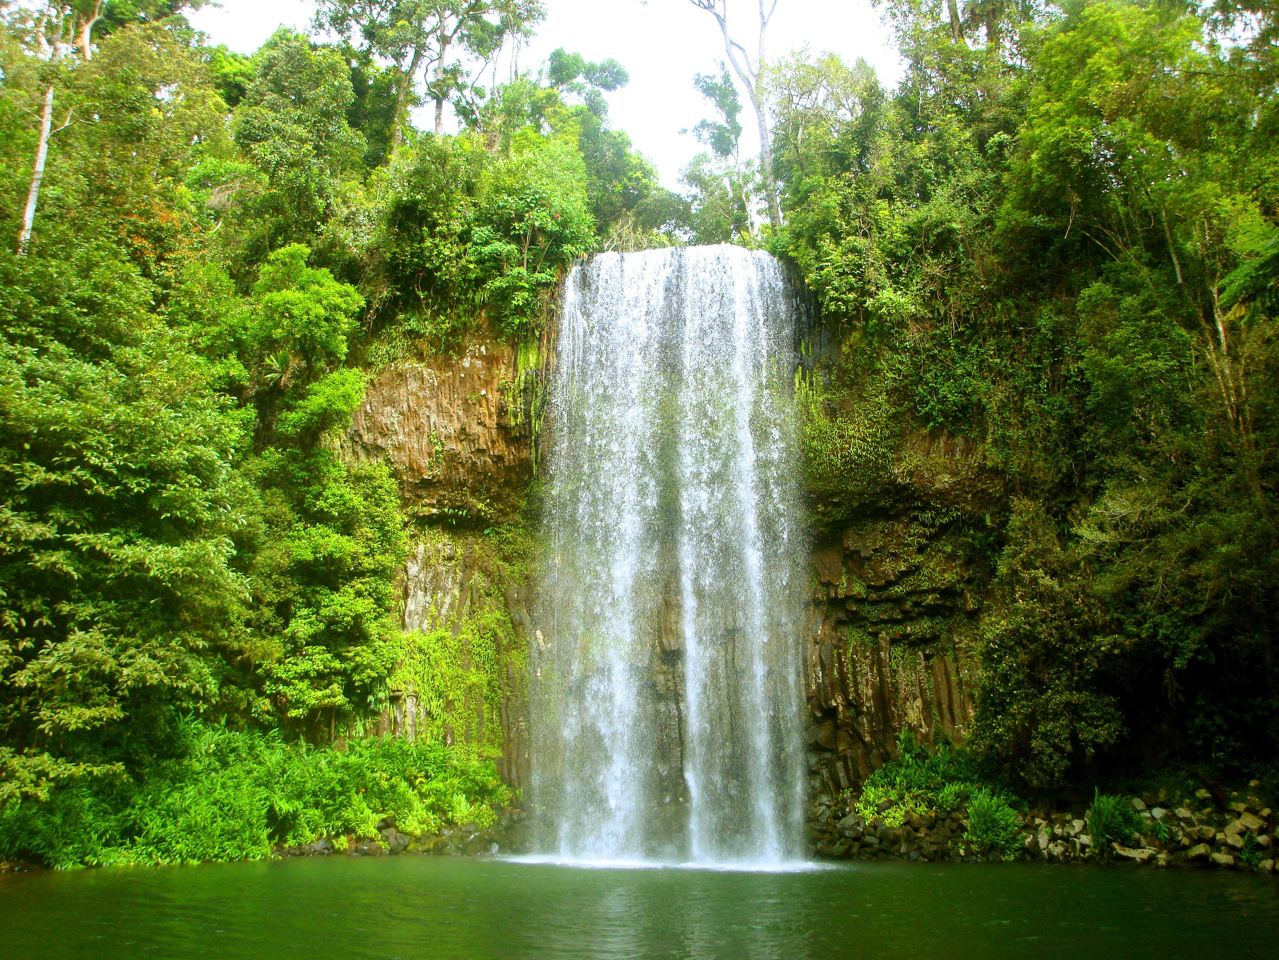
Tropical Rainforest
By: Zaima Bhatti
Notes:
1-Each slide have a different background
1-Each slide have pictures
1-Each slide have transitions (information slides in, rotates, etc.)

Slide 2
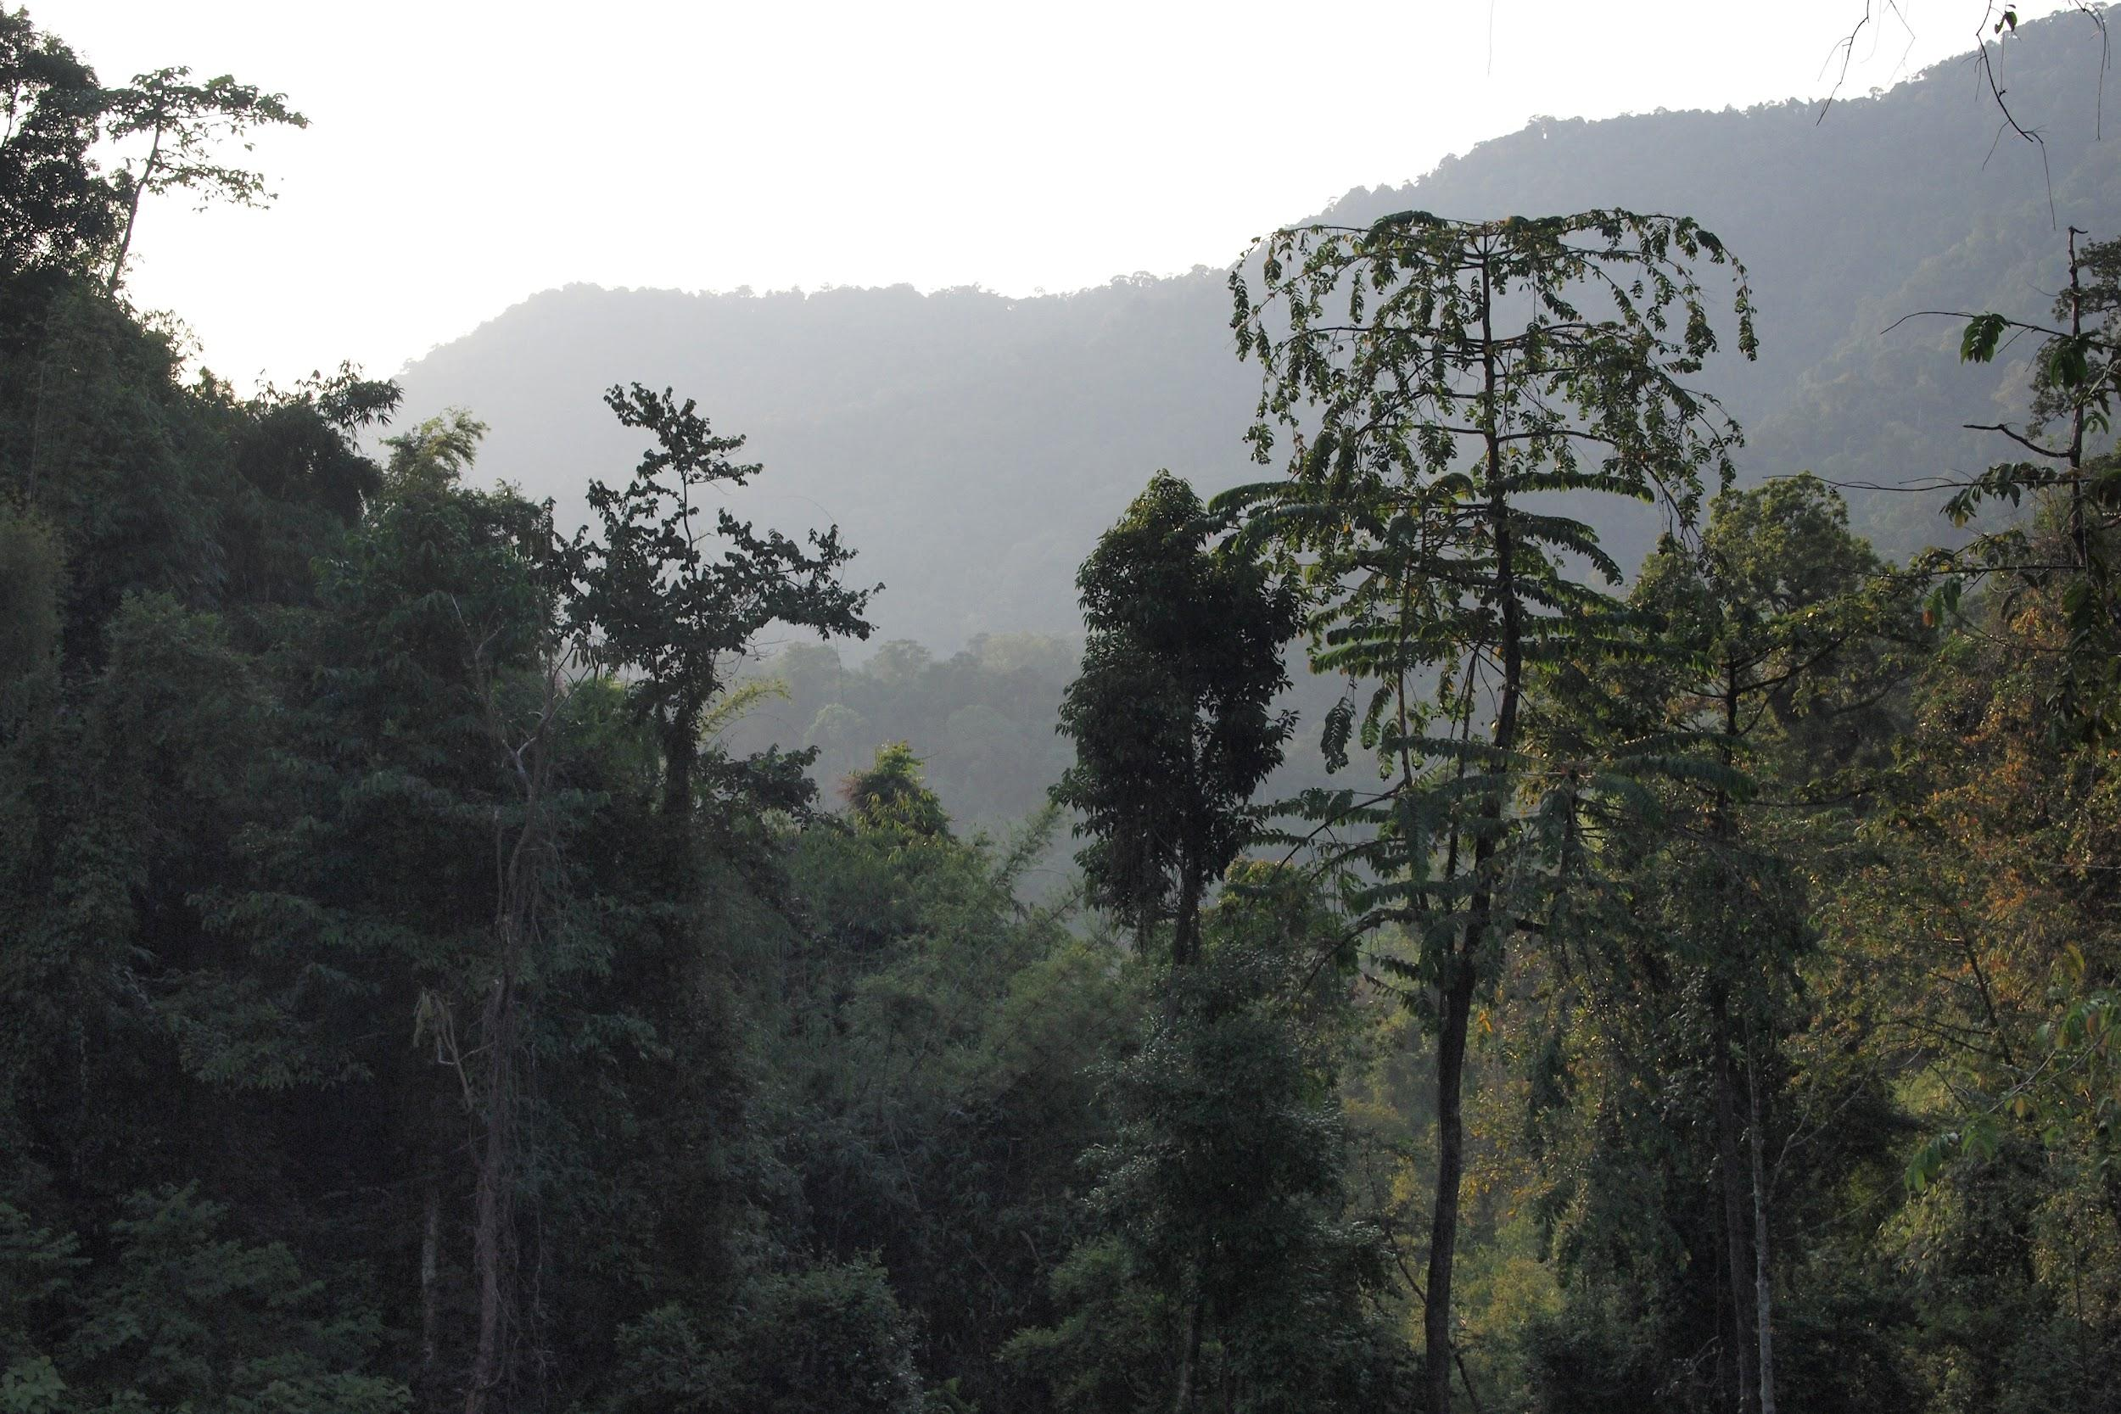
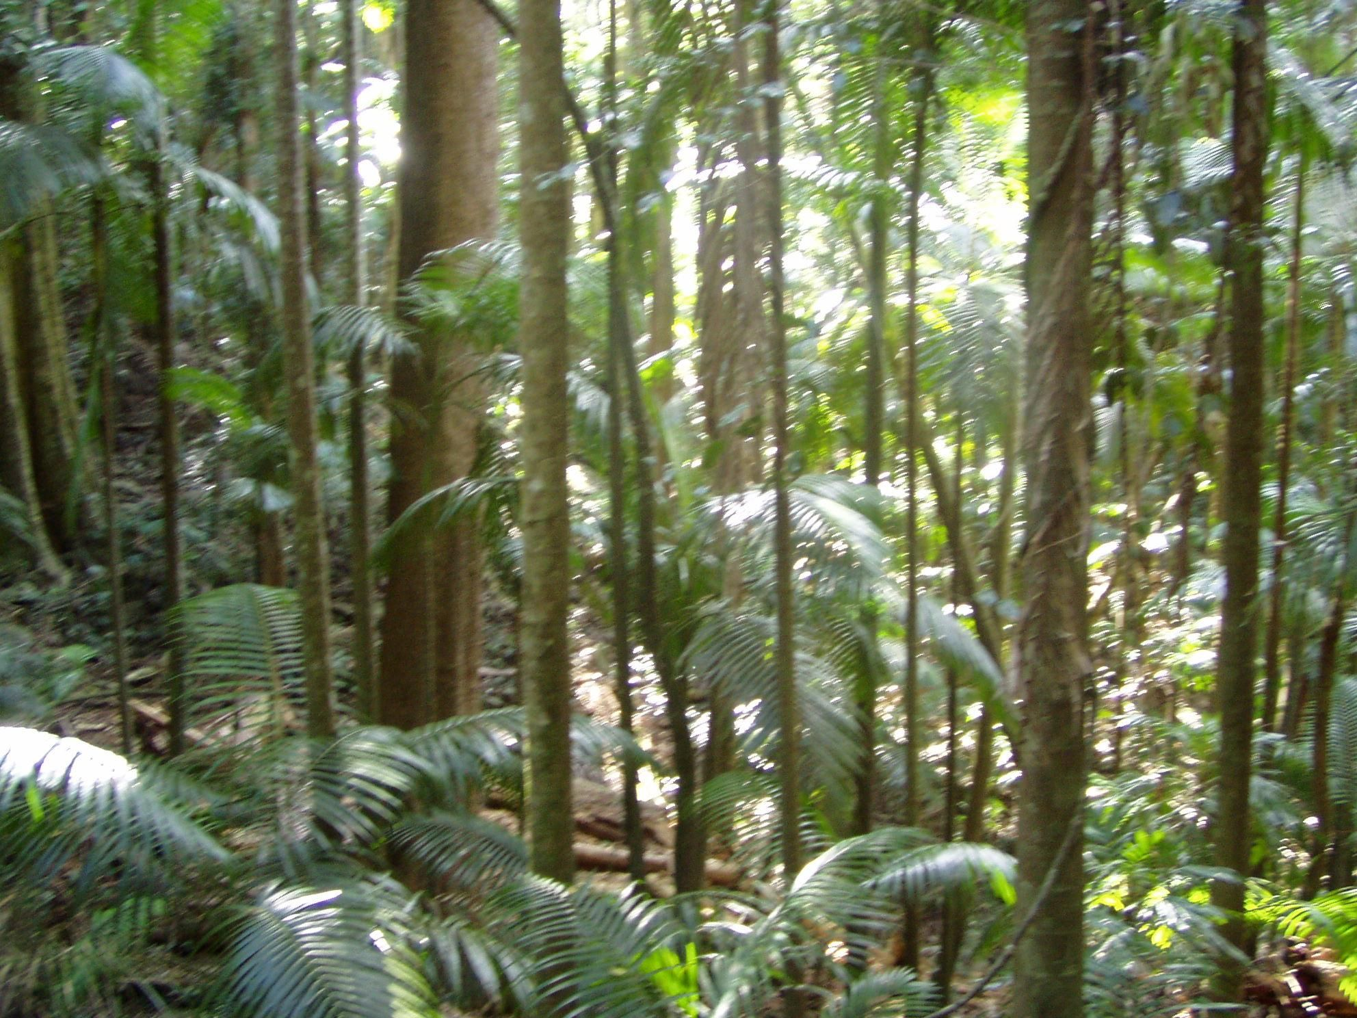
What is your biome like?
The Tropical rainforest is a place where it rains all year long. Average temperatures are from 70-90 degrees. It rains 60-200 inches of rain all year.
Notes:
1-Each slide have a different background
1-Each slide have pictures
1-Each slide have transitions (information slides in, rotates, etc.)

Slide 3
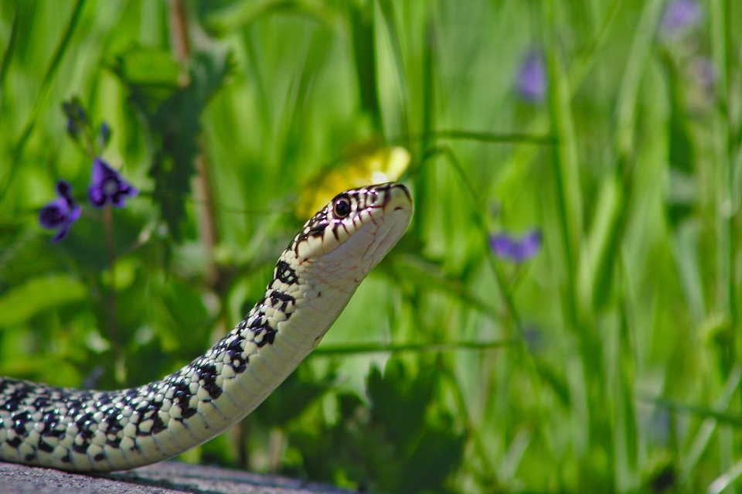
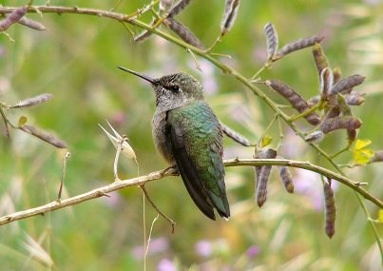
Adaptations in the rainforest:
Snakes adapt by camouflaging and birds adapt by mimicry.
Notes:
1-Each slide have a different background
1-Each slide have pictures
1-Each slide have transitions (information slides in, rotates, etc.)

Slide 4
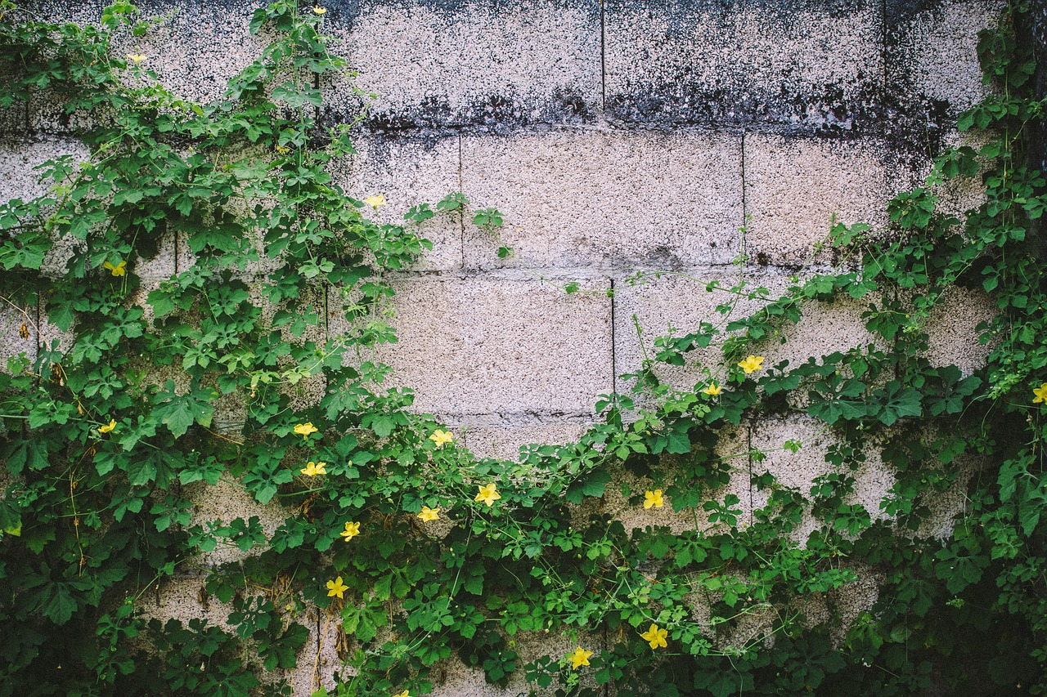
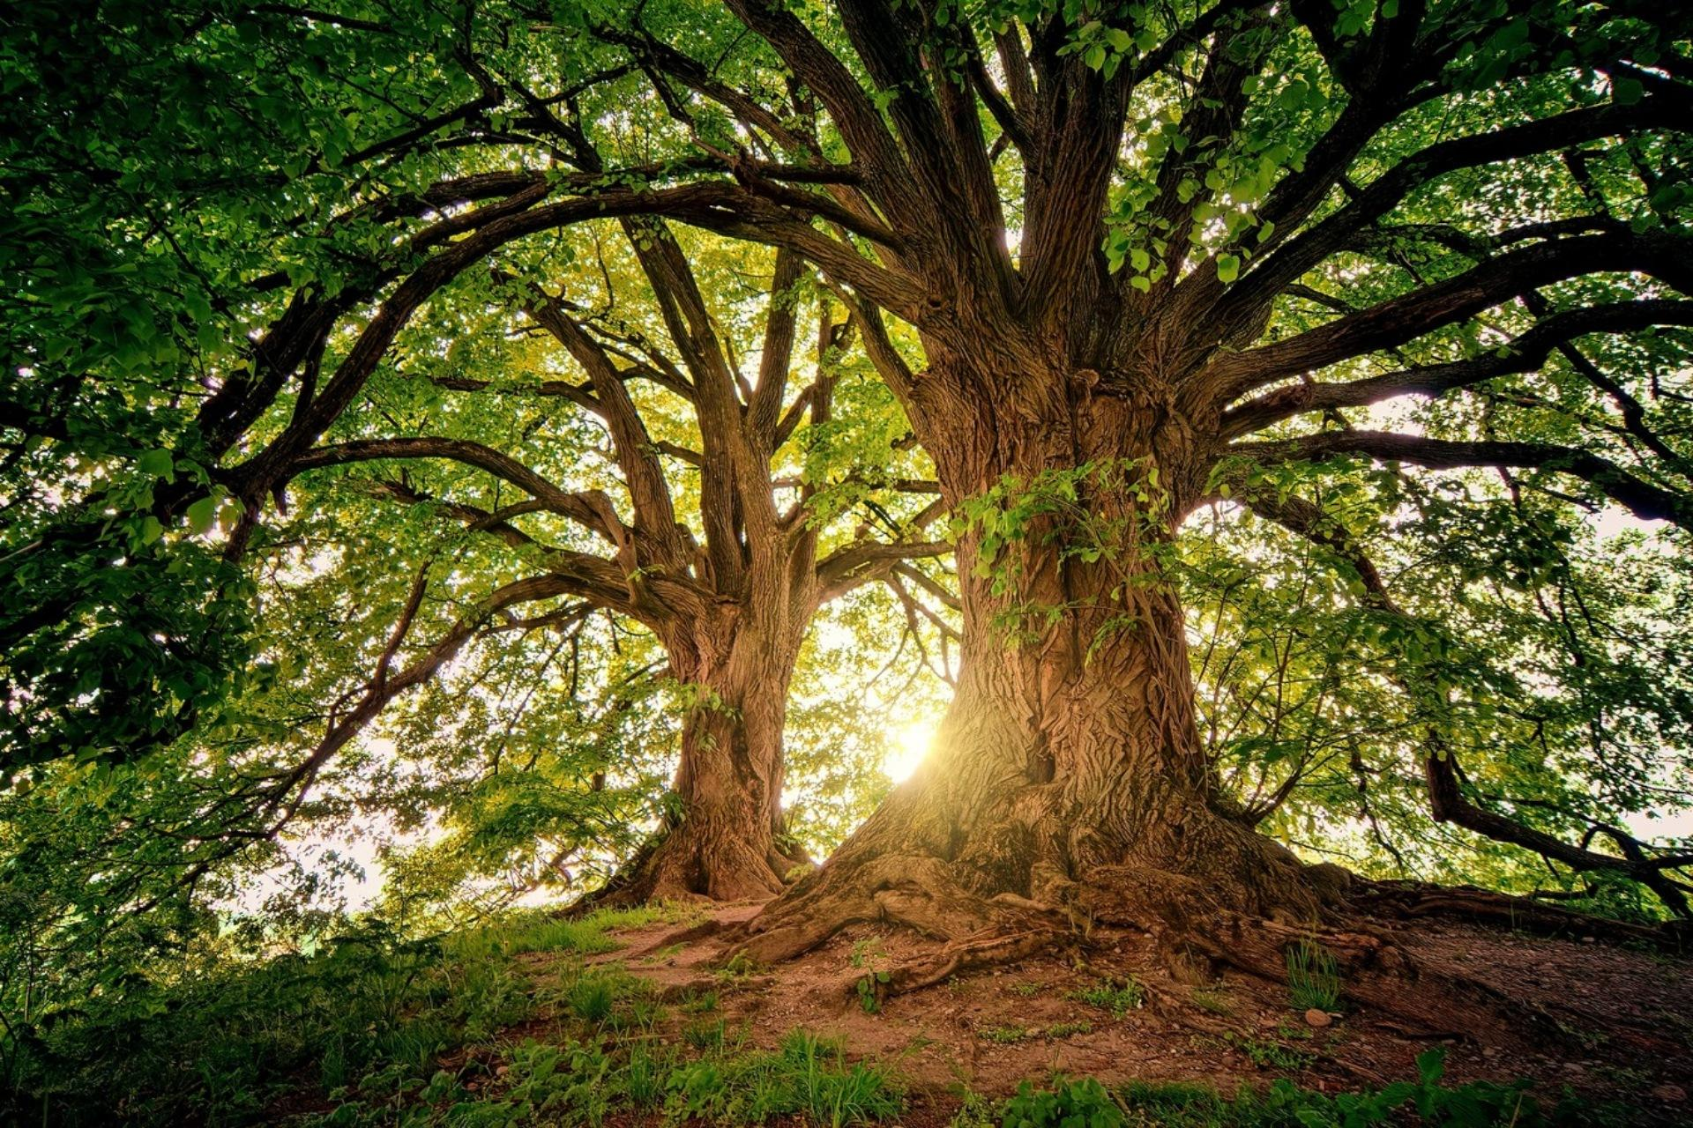
Producers in the rainforest:
Trees, vines, and grass are producers in the tropical rainforest.
Notes:
1-Each slide have a different background
1-Each slide have pictures
1-Each slide have transitions (information slides in, rotates, etc.)

Slide 5
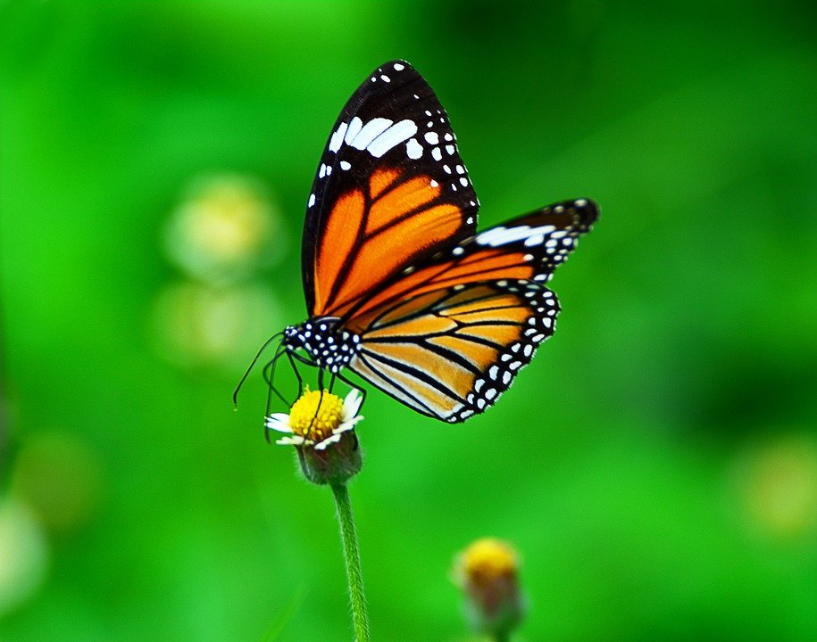
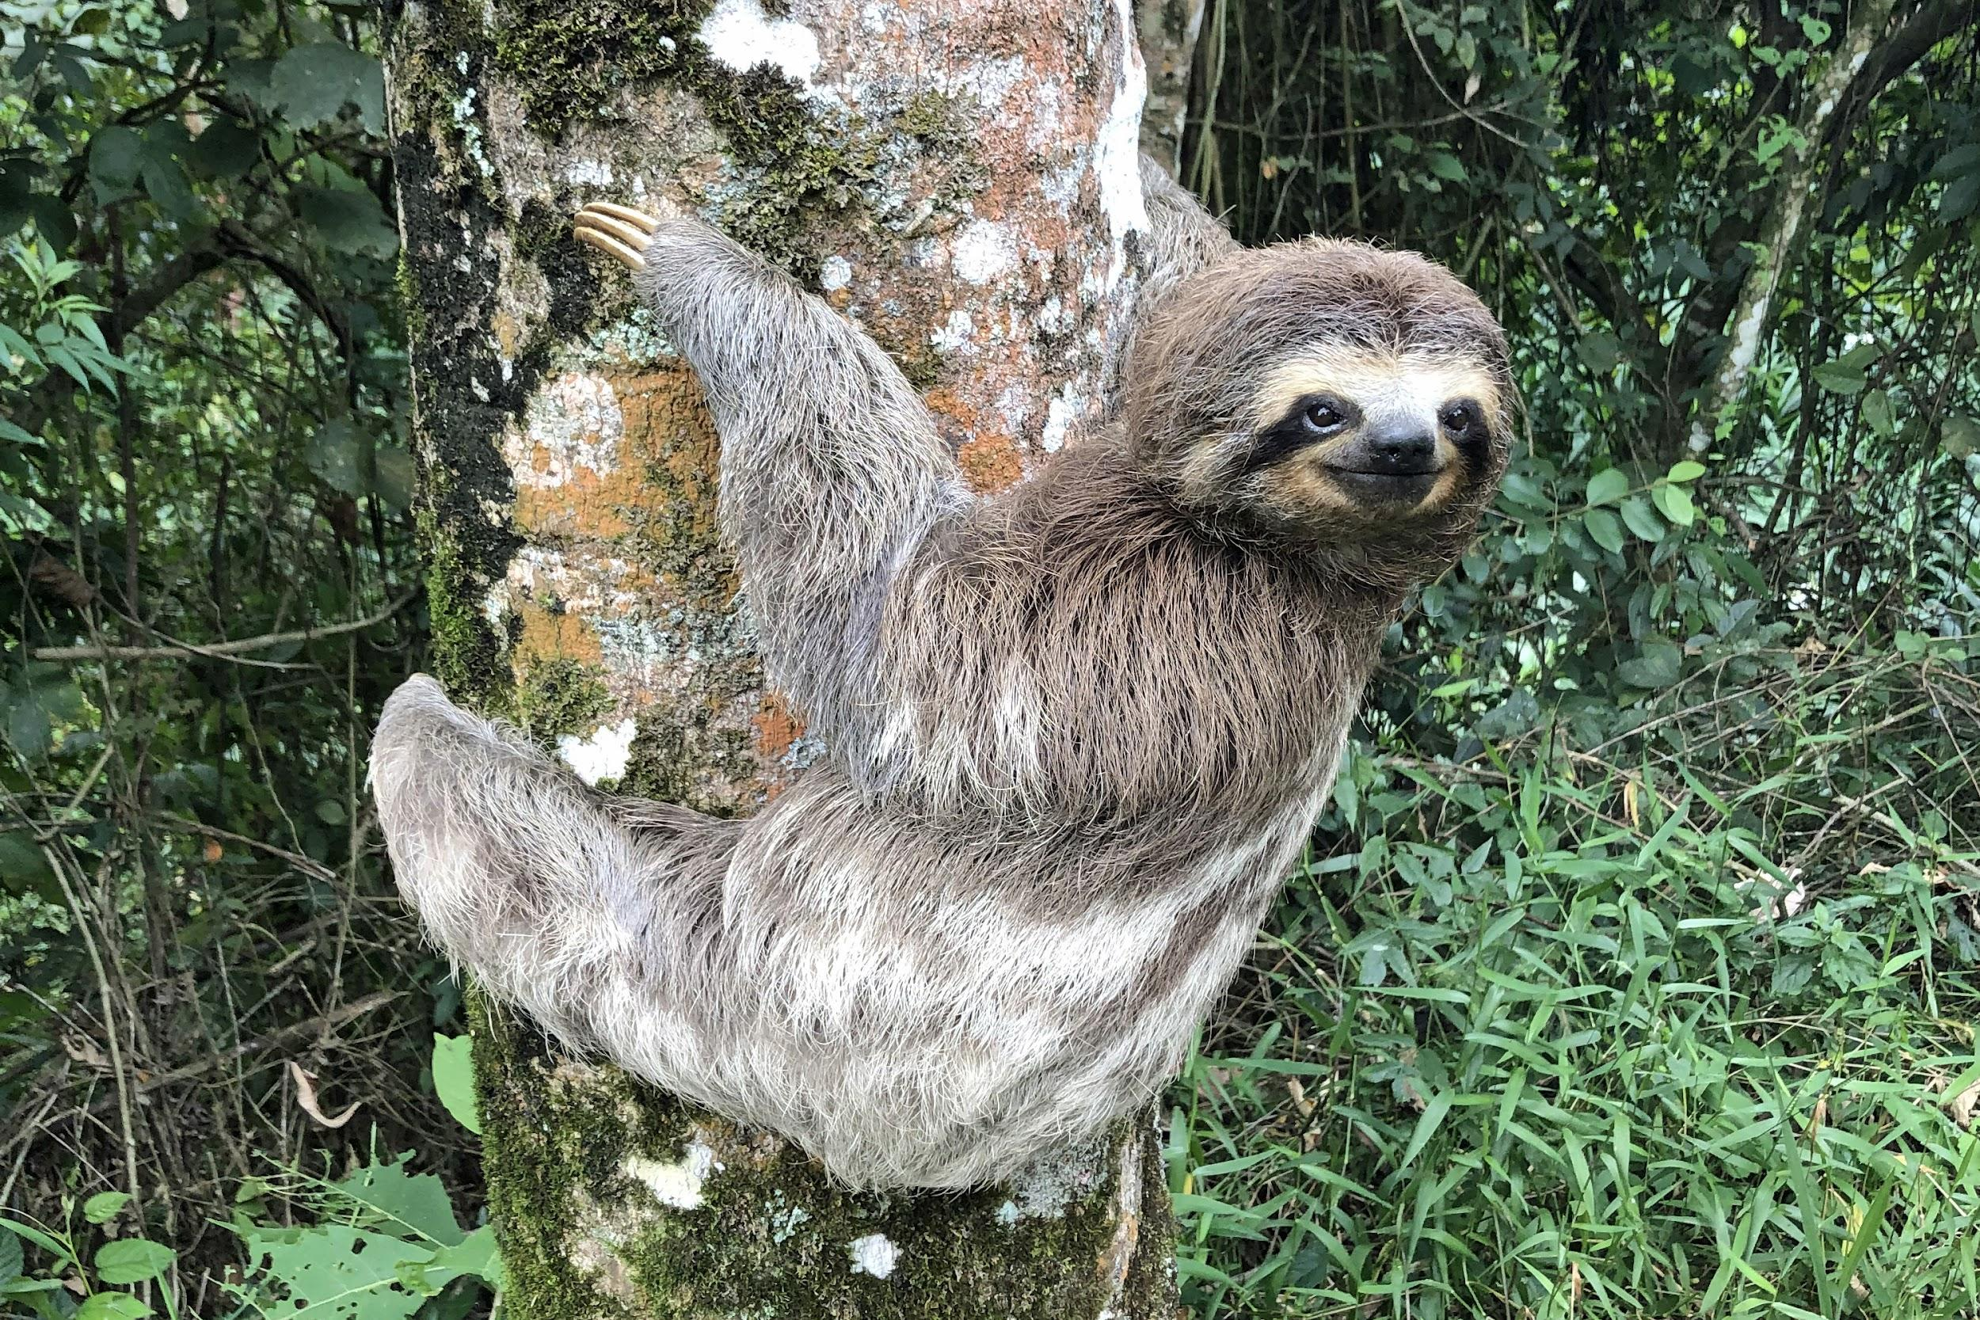
Primary Consumers in the rainforest:
Butterflies, sloths, birds, and monkeys are primary consumers in the tropical rainforest.
Notes:
1-Each slide have a different background
1-Each slide have pictures
1-Each slide have transitions (information slides in, rotates, etc.)

Slide 6
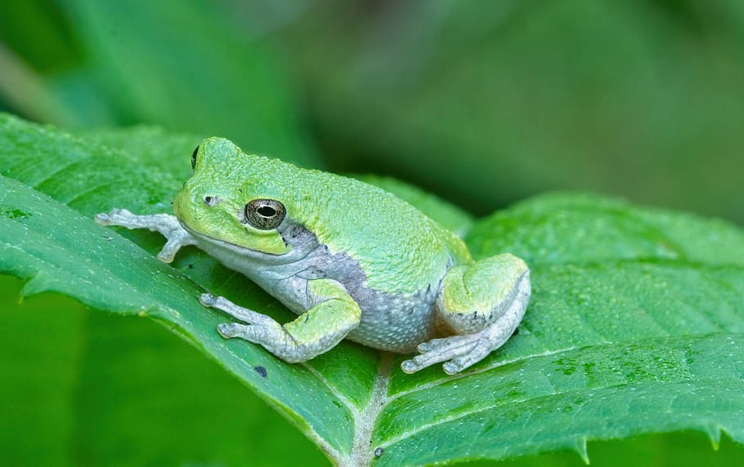
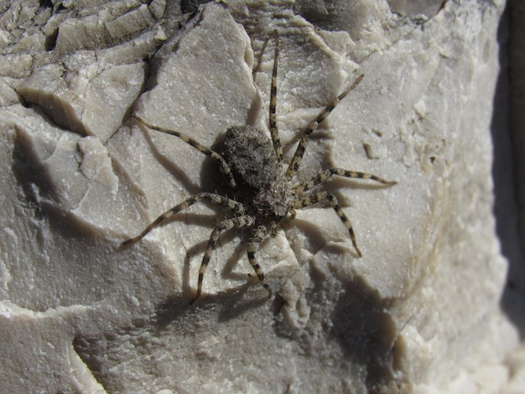
Secondary Consumers in the rainforest:
Tree frogs and giant spiders are the secondary consumers in the tropical rainforest.
Notes:
1-Each slide have a different background
1-Each slide have pictures
1-Each slide have transitions (information slides in, rotates, etc.)

Slide 7
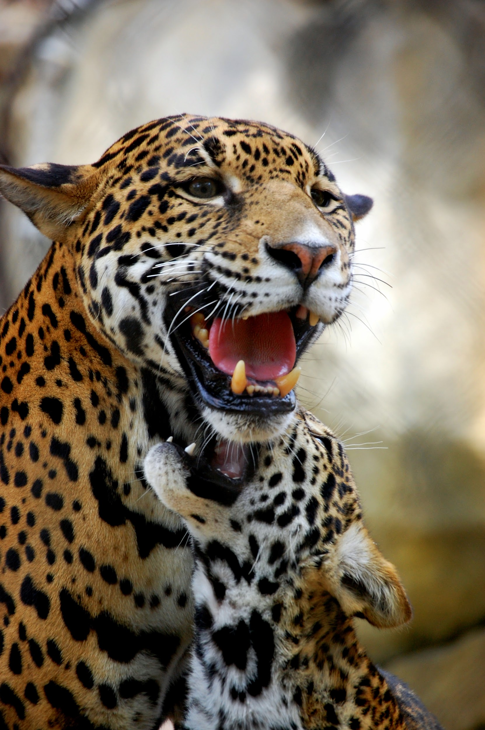
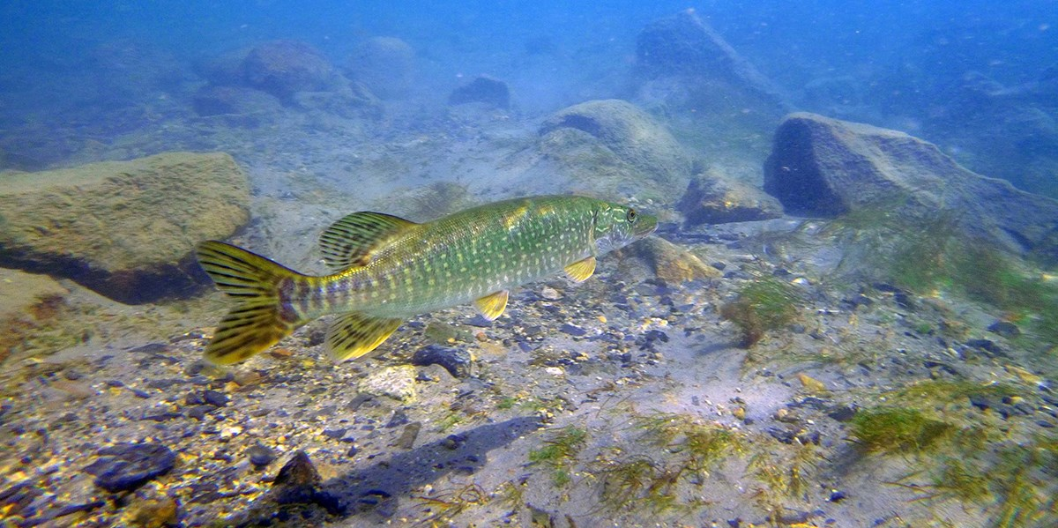
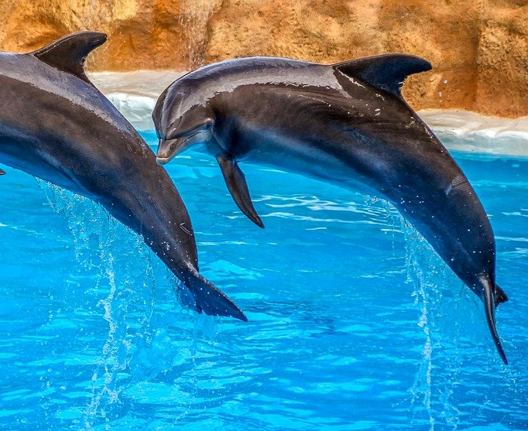
Tertiary Consumers in the rainforest:
Jaguars, dolphins, and giant fish are the tertiary consumers in the tropical rainforest.
Notes:
1-Each slide have a different background
1-Each slide have pictures
1-Each slide have transitions (information slides in, rotates, etc.)

Slide 8
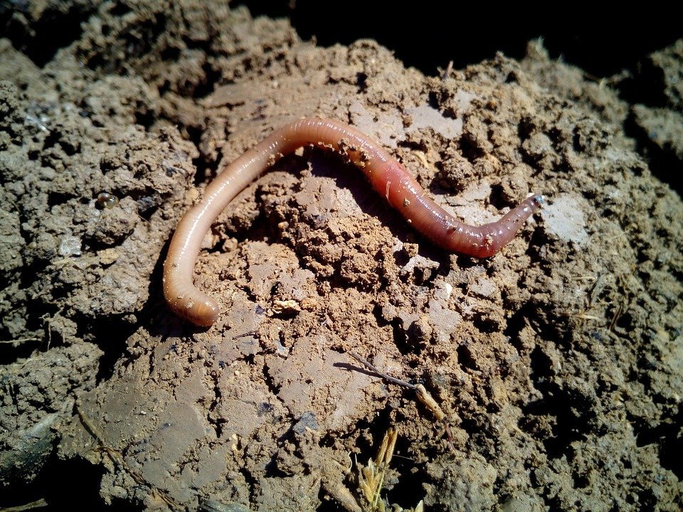
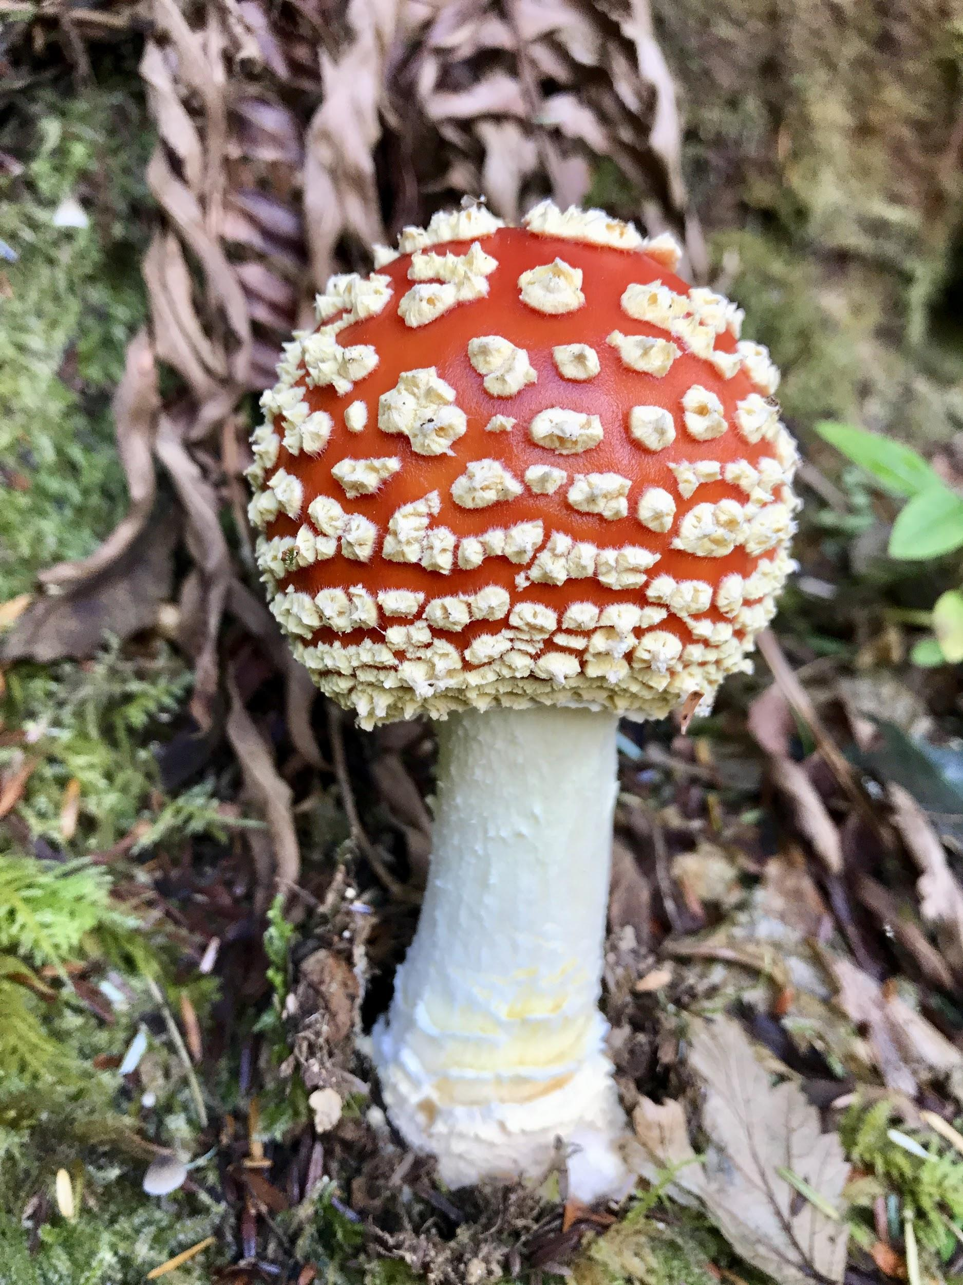
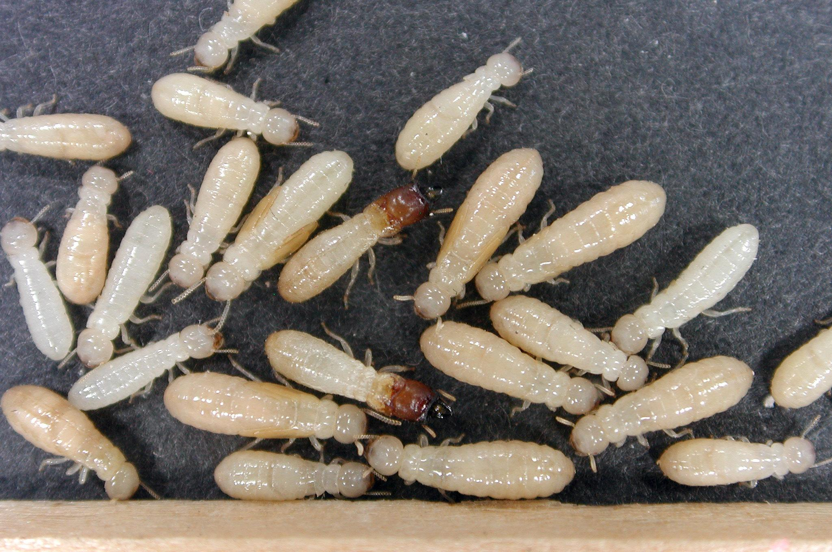
Decomposers in the rainforest:
Termites, slugs, worms, and fungi are the decomposer of the tropical rainforest.
Notes:
1-Each slide have a different background
1-Each slide have pictures
1-Each slide have transitions (information slides in, rotates, etc.)

Slide 9
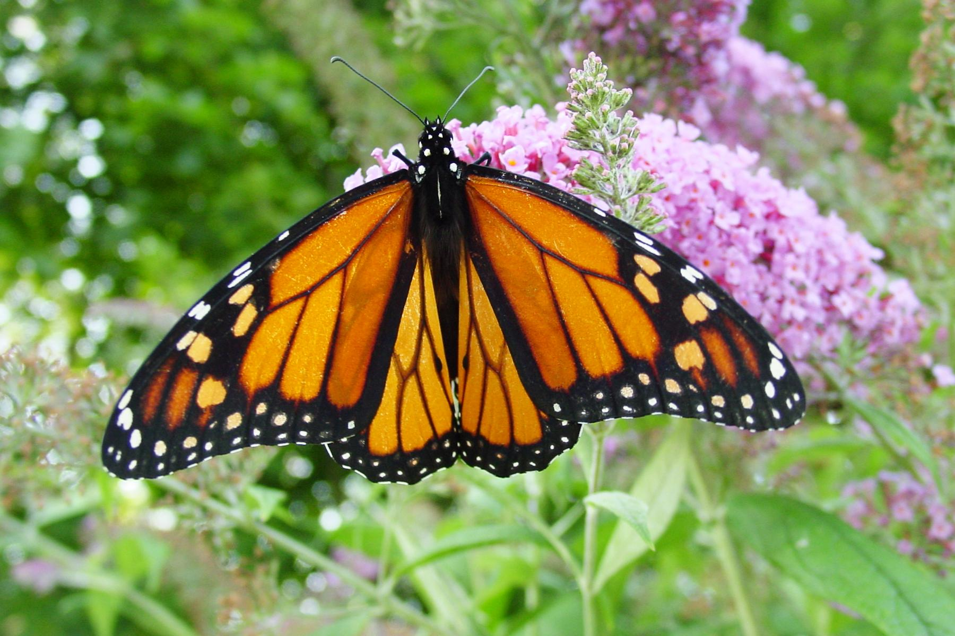
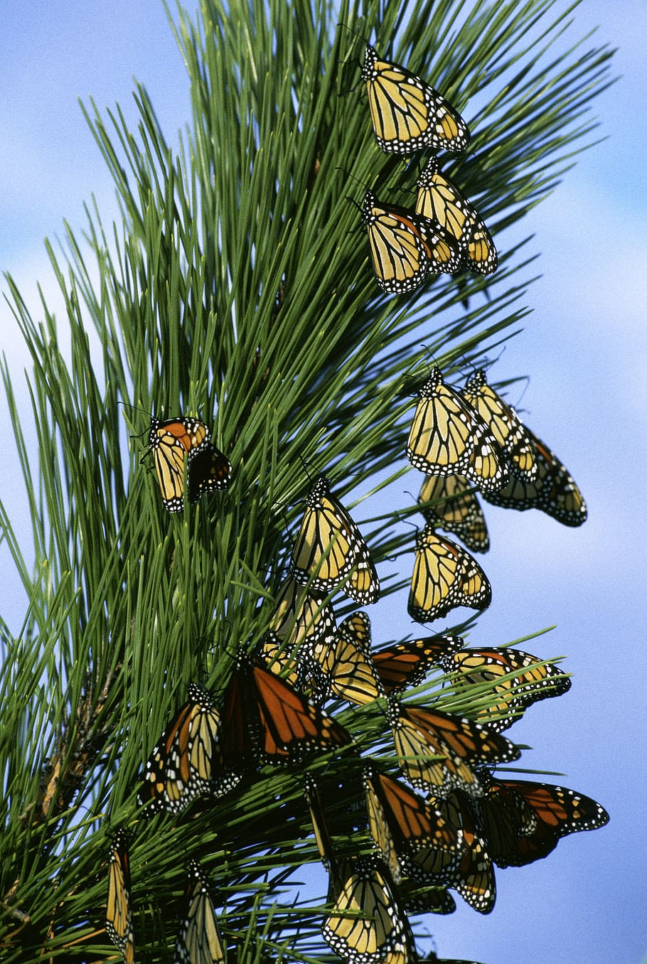
Mutualism in the rainforest:
An example of mutualism in the tropical rainforest is monarch butterflies. They travel together from place to place to stay safe.
Notes:
1-Each slide have a different background
1-Each slide have pictures
1-Each slide have transitions (information slides in, rotates, etc.)

Slide 10
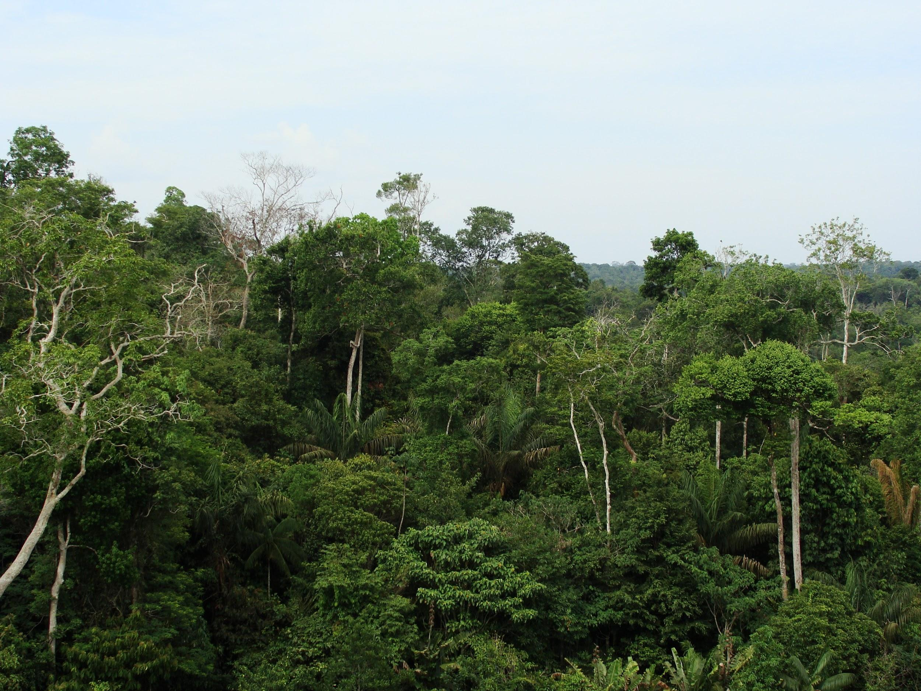
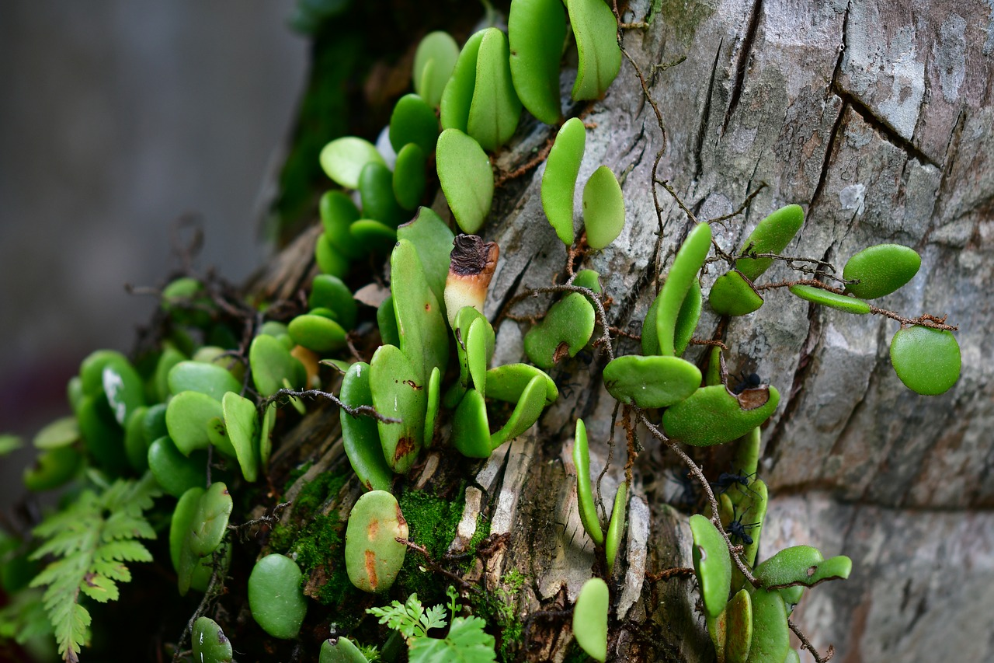
Commensalism in the rainforest:
An example of commensalism in the tropical rainforest epiphyte plants.
Notes:
1-Each slide have a different background
1-Each slide have pictures
1-Each slide have transitions (information slides in, rotates, etc.)

Slide 11
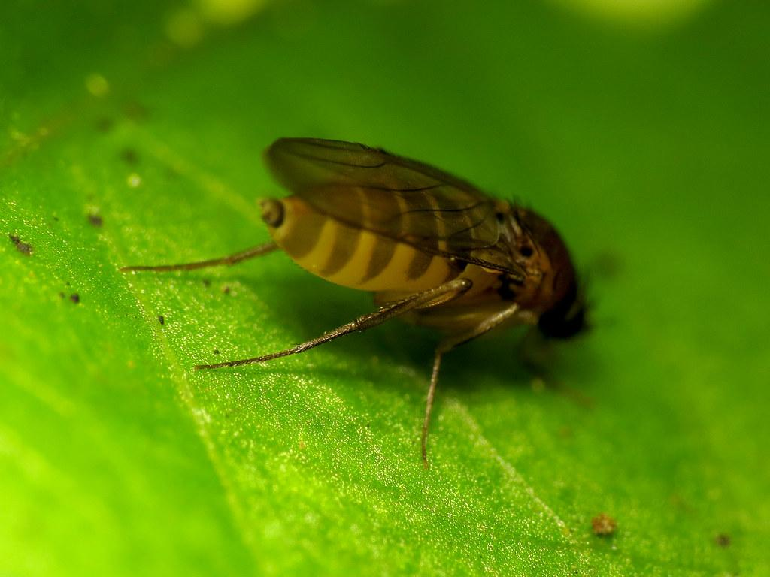
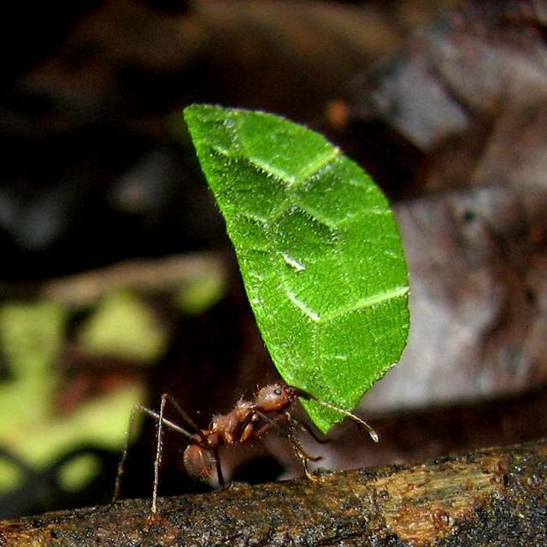
Parasitism in the rainforest:
An example of parasitism in the tropical rainforest is the phorid fly and leaf-cutter ants.
Notes:
1-Each slide have a different background
1-Each slide have pictures
1-Each slide have transitions (information slides in, rotates, etc.)

Slide 12
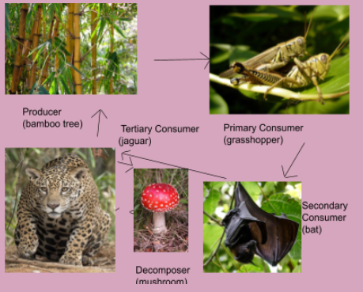
Food Web:
Notes:
1-Each slide have a different background
1-Each slide have pictures
1-Each slide have transitions (information slides in, rotates, etc.)

Slide 13
Resources I used:
-https://rainforests.pwnet.org/4students/index.php#:~:text=of%20Puerto%20Rico.-,Tropical%20Rain%20Forest%20Climate,daytime%20and%2095%25%20at%20night
-https://study.com/academy/lesson/tropical-rainforest-producers-and-consumers.html
-https://www.edtechlens.com/blog/rainforest-kids-science-me-ill-you-working-rainforest#:~:text=In%20the%20rainforest%2C%20there%20are,hunt%20together%20to%20find%20food.
-https://brandhome.com/short-courses-zyvsbb/da2ec5-parasitism-in-the-rainforest#:~:text=gets%20hurt)%201.-,when%20aphids%20eat%20the%20plant%20leaves%20off%20of%20flowers.,the%20bark%20of%20the%20host.
-https://study.com/academy/answer/what-is-an-example-of-commensalism-in-the-tropical-rainforest.html#:~:text=An%20example%20of%20commensalism%20in%20the%20tropical%20rainforest%20are%20epiphyte,orchids%2C%20growing%20on%20other%20trees.
-https://www.edtechlens.com/blog/rainforest-kids-science-me-ill-you-working-rainforest#:~:text=In%20the%20rainforest%2C%20there%20are,hunt%20together%20to%20find%20food.
-https://www.nationalgeographic.org/encyclopedia/rain-forest/#:~:text=Decomposers%2C%20such%20as%20termites%2C%20slugs,of%20predators%20consume%20the%20decomposers!

Slide 14
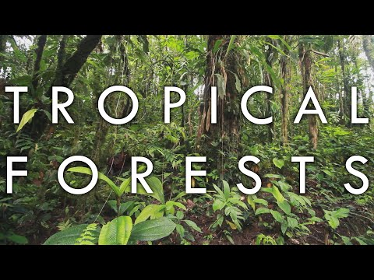
Video about the tropical rainforest:
https://www.youtube.com/watch?v=E6WdEyt93vA&vl=en

Slide 15
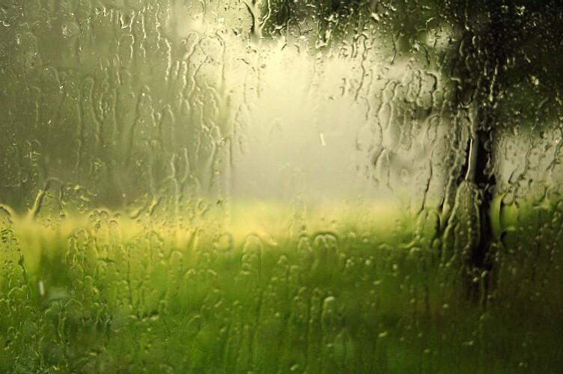
Would I live in my biome?
Yes, I would live in the tropical rainforest. I enjoy the cold, rain, and the animals that live there.
Notes:
Extra Credit

Slide 16
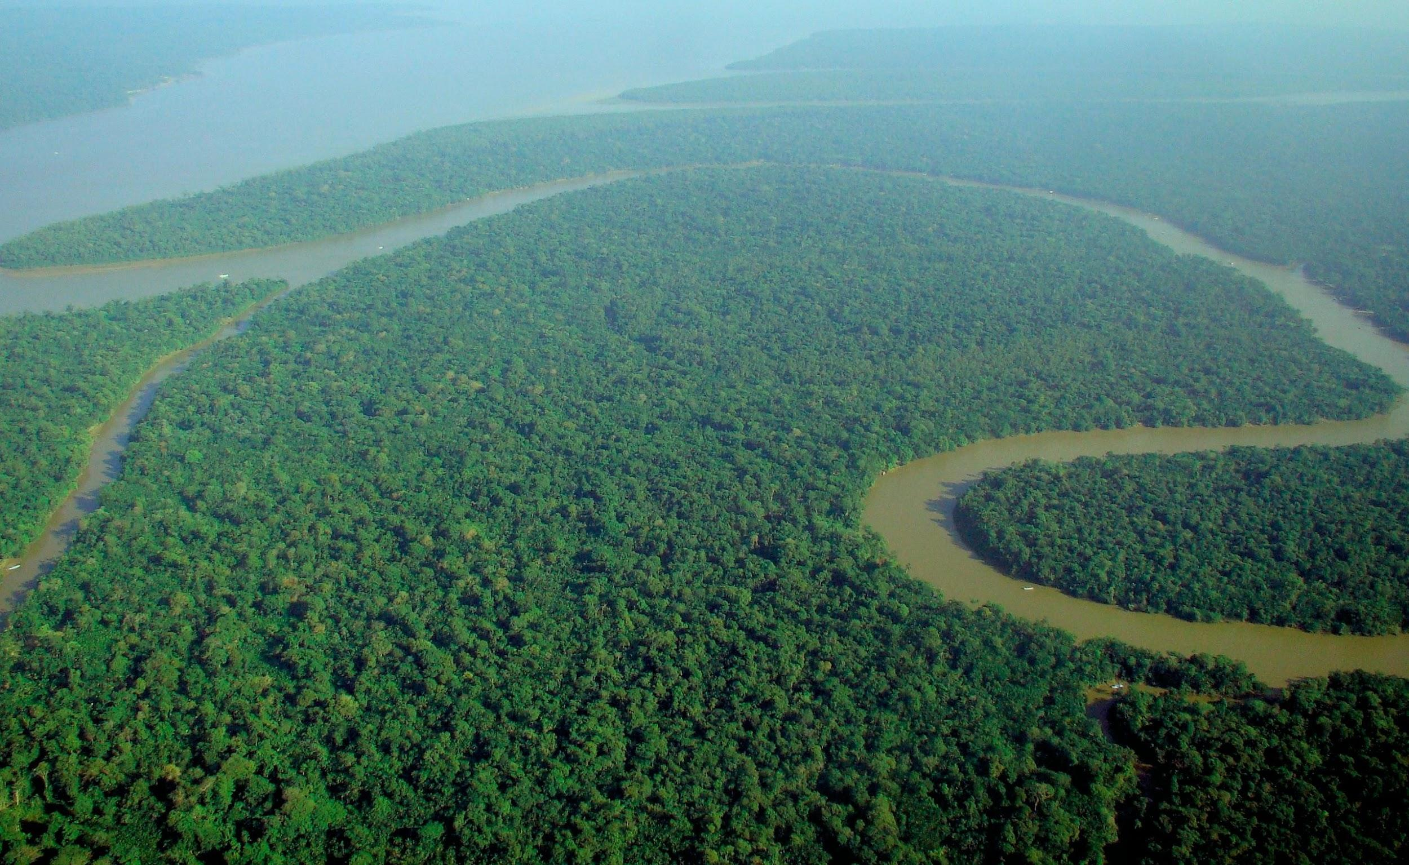
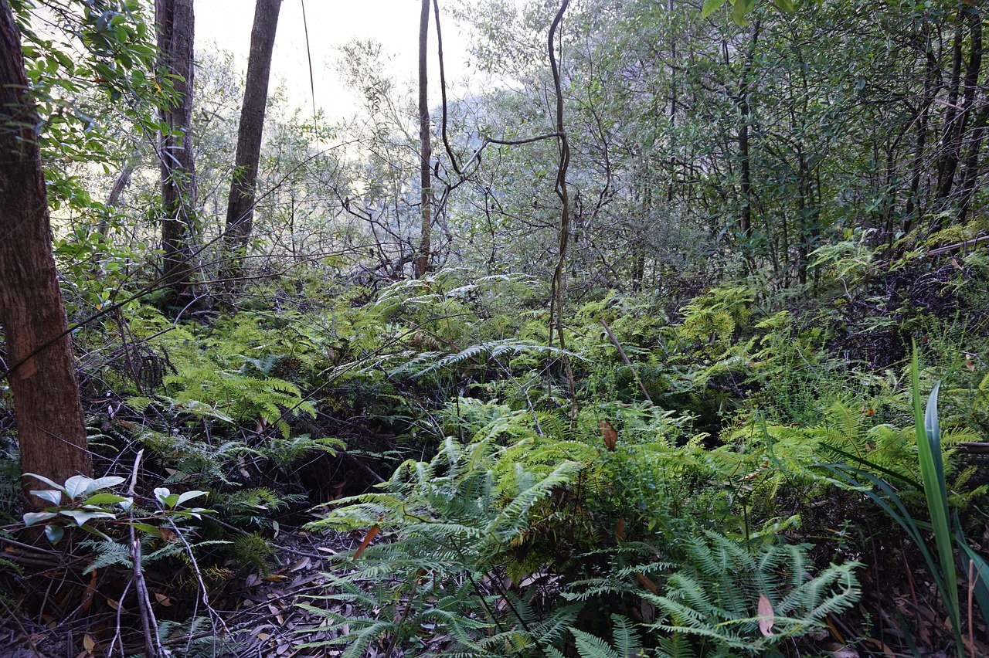
Which countries would I find my biome:
You would find the tropical rainforest in Center and South America, western and central Africa, western India, Southeast Asia, the island of New Guinea, and Australia.
Notes:
Extra credit.

